Slide 1
CS2422 Assembly Language & System Programming
Chapter 1 : Background

Slide 2
1.1 – 1.3’s Topic
1.1 Introduction
1.2 System Software and Machine Architecture
1.3 The Simplified Instructional Computer (SIC)
  SIC Machine Architecture
  SIC/XE Machine Architecture
  SIC Programming Examples

Slide 3
Introduction
Definition of System software
  System software consists of a variety of programs that support the operation of a computer
E.g. of system software
  Text editor, compiler, loader or linker, debugger, macro processors, operating system, database management systems, software engineering tools, ….

Slide 4
System Software and Machine Architecture (1/2)
One characteristic in which most system software differs from application software is machine dependency
System programs are intended to support the operation and use of the computer itself, rather than any particular application.

Slide 5
System Software and Machine Architecture (2/2)
Because most system software is machine-dependent, we must include real machines and real pieces of software in our study.
Simplified Instructional Computer (SIC)
  SIC is a hypothetical computer that has been carefully designed to include the hardware features most often found on real machines, while avoiding unusual or irrelevant complexities

Slide 6
The Simplified Instructional Computer (SIC)
Like many other products, SIC comes in two versions
  The standard model
  An XE version
    “extra equipments”, “extra expensive”
The two versions has been designed to be upward compatible

Slide 7
SIC Machine Architecture (1/7)
Memory
  Memory consists of 8-bit bytes
  Any 3 consecutive bytes form a word (24 bits)
  Total of 32768 (2¹⁵) bytes in the computer memory

Slide 8
SIC Machine Architecture (2/7)
Registers
  Five registers
  Each register is 24 bits in length
Mnemonic | Number | Special use
A | 0 | Accumulator
X | 1 | Index register
L | 2 | Linkage register
PC | 8 | Program counter
SW | 9 | Status word

Slide 9
SIC Machine Architecture (3/7)
Data Formats
  Integers are stored as 24-bit binary number
  2’s complement representation for negative values
  Characters are stored using 8-bit ASCII codes
  No floating-point hardware on the standard version of SIC

Slide 10
SIC Machine Architecture (4/7)
Instruction Formats
  Standard version of SIC
8 | 1 | 15
opcode | x | address
The flag bit x is used to indicate indexed-addressing mode

Slide 11
SIC Machine Architecture (5/7)
Addressing Modes
  There are two addressing modes available
    Indicated by x bit in the instruction
Mode | Indication | Target address calculation
Direct | x=0 | TA=address
Indexed | x=1 | TA=address+(X)
(X): the contents of register X

Slide 12
SIC Machine Architecture (6/7)
Instruction Set
  Load and store registers
    LDA, LDX, STA, STX, etc.
    Integer arithmetic operations
      ADD, SUB, MUL, DIV
      All arithmetic operations involve register A and a word in memory, with the result being left in A
    COMP
    Conditional jump instructions
      JLT, JEQ, JGT
    Subroutine linkage
      JSUB, RSUB
    See appendix A, Page 495

Slide 13
SIC Machine Architecture (7/7)
Input and Output
  Input and output are performed by transferring 1 byte at a time to or from the rightmost 8 bits of register A
    Test Device TD instruction
    Read Data (RD)
    Write Data (WD)

Slide 14
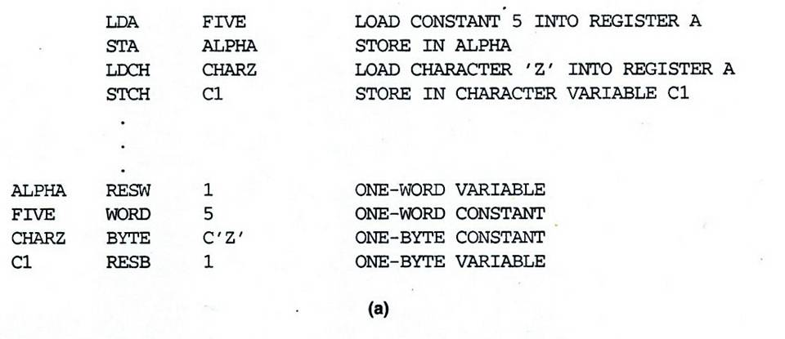
SIC Programming Examples (Fig 1.2a)

Slide 15
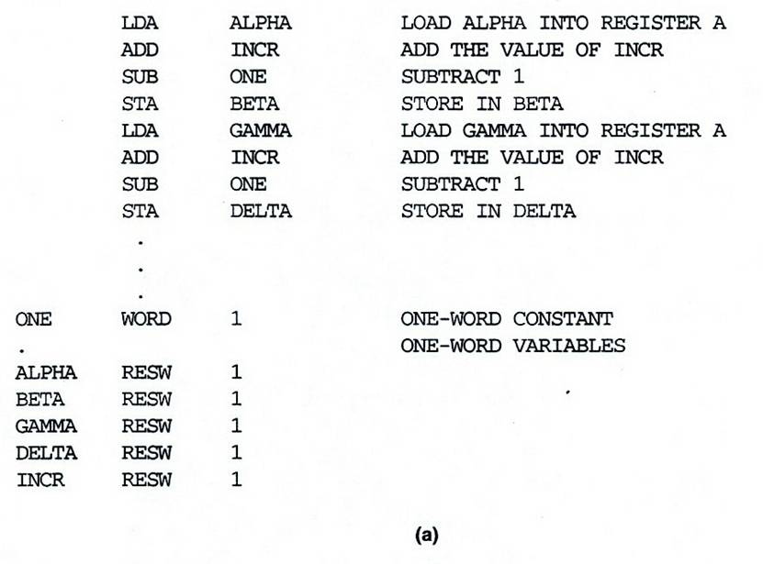
SIC Programming Example (Fig 1.3a)

Slide 16
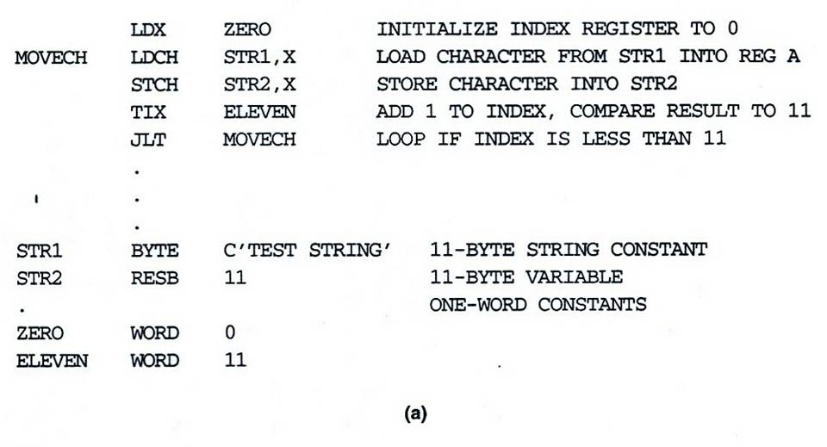
SIC Programming Example (Fig 1.4a)

Slide 17
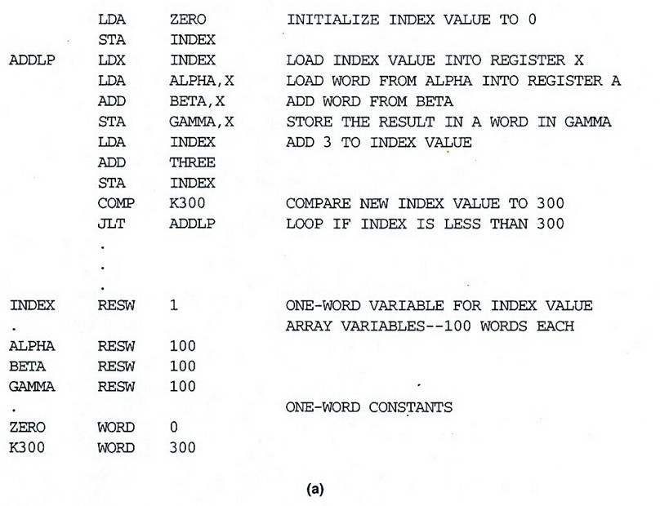
SIC Programming Example (Fig 1.5a)

Slide 18
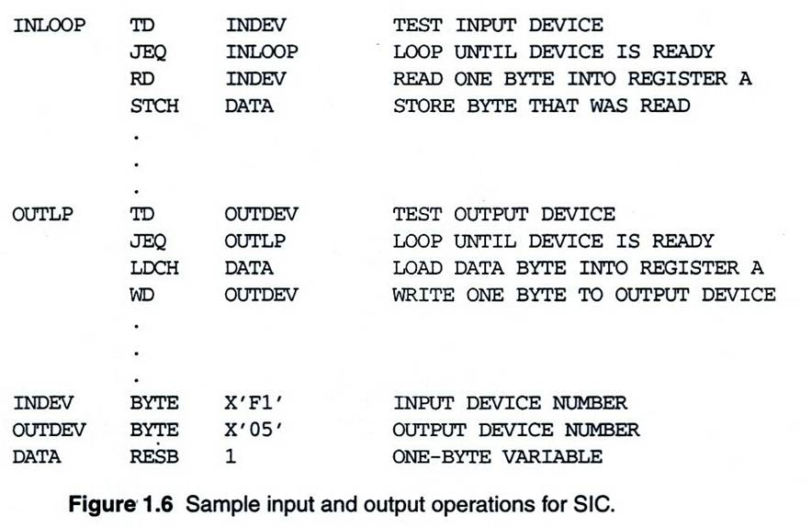
SIC Programming Example (Fig 1.6)

Slide 19
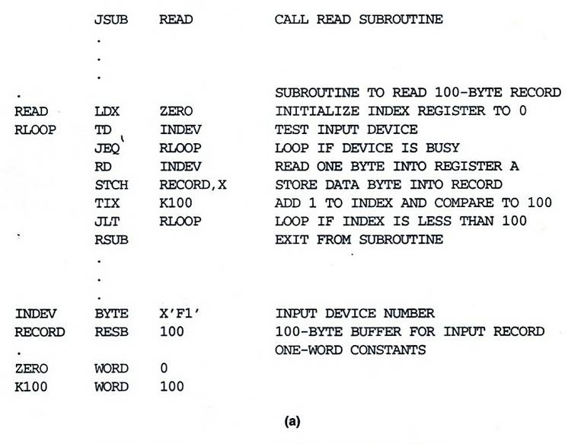
SIC Programming Example (Fig 1.7a)

Slide 20
SIC/XE Machine Architecture (1/13)
Memory
  Maximum memory available on a SIC/XE system is 1 megabyte (2²⁰ bytes)

Slide 21
SIC/XE Machine Architecture (2/13)
Registers
  Additional registers are provided by SIC/XE
Mnemonic | Number | Special use
B | 3 | Base register
S | 4 | General working register
T | 5 | General working register
F | 6 | Floating-point accumulator (48 bits)

Slide 22
SIC/XE Machine Architecture (3/13)
There is a 48-bit floating-point data type
1 | 11 | 36
s | exponent | fraction
F*2^{(e-1024)}

Slide 23
SIC/XE Machine Architecture (4/13)
Instruction Formats
8
op
Format 1 (1 byte)
8 | 4 | 4
op | r1 | r2
Format 2 (2 bytes)
6 | 1 | 1 | 1 | 1 | 1 | 1 | 12
op | n | i | x | b | p | e | disp
Format 3 (3 bytes)
6 | 1 | 1 | 1 | 1 | 1 | 1 | 20
op | n | i | x | b | p | e | address
Format 4 (4 bytes)
Formats 1 and 2 are instructions that do not reference memory at all

Slide 24
SIC/XE Machine Architecture (5/13)
Addressing modes
  Base relative (n=1, i=1, b=1, p=0)
  Program-counter relative (n=1, i=1, b=0, p=1)
  Direct (n=1, i=1, b=0, p=0)
  Immediate (n=0, i=1, x=0)
  Indirect (n=1, i=0, x=0)
  Indexing (both n & i = 0 or 1, x=1)
  Extended (e=1)

Slide 25
SIC/XE Machine Architecture (6/13)
Base Relative Addressing Mode
 | n | i | x | b | p | e
opcode | 1 | 1 |  | 1 | 0 |  | disp
n=1, i=1, b=1, p=0, TA=(B)+disp (0≤disp ≤4095)
Program-Counter Relative Addressing Mode
 | n | i | x | b | p | e
opcode | 1 | 1 |  | 0 | 1 |  | disp
n=1, i=1, b=0, p=1, TA=(PC)+disp (-2048≤disp ≤2047)

Slide 26
SIC/XE Machine Architecture (7/13)
Direct Addressing Mode
 | n | i | x | b | p | e
opcode | 1 | 1 |  | 0 | 0 |  | disp
n=1, i=1, b=0, p=0, TA=disp (0≤disp ≤4095)
 | n | i | x | b | p | e
opcode | 1 | 1 | 1 | 0 | 0 |  | disp
n=1, i=1, b=0, p=0, TA=(X)+disp
(with index addressing mode)

Slide 27
SIC/XE Machine Architecture (8/13)
Immediate Addressing Mode
 | n | i | x | b | p | e
opcode | 0 | 1 | 0 |  |  |  | disp
n=0, i=1, x=0, operand=disp
Indirect Addressing Mode
 | n | i | x | b | p | e
opcode | 1 | 0 | 0 |  |  |  | disp
n=1, i=0, x=0, TA=(disp)

Slide 28
SIC/XE Machine Architecture (9/13)
Simple Addressing Mode
 | n | i | x | b | p | e
opcode | 0 | 0 |  |  |  |  | disp
i=0, n=0, TA=bpe+disp (SIC standard)
 | n | i | x | b | p | e
opcode | 1 | 1 |  |  |  |  | disp
i=1, n=1, TA=disp (SIC/XE standard)

Slide 29
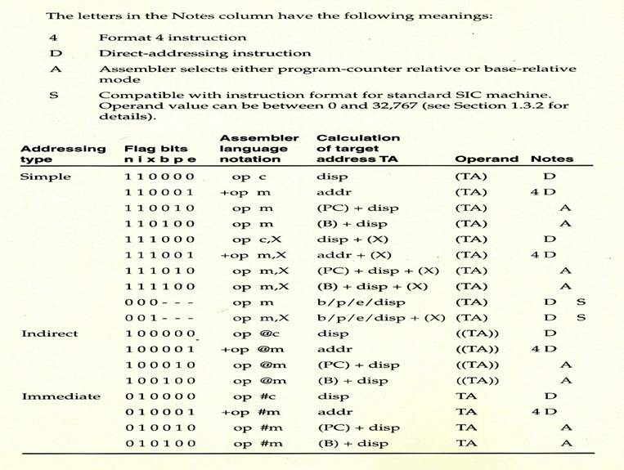
SIC/XE Machine Architecture (10/13)
Addressing Modes Summary

Slide 30
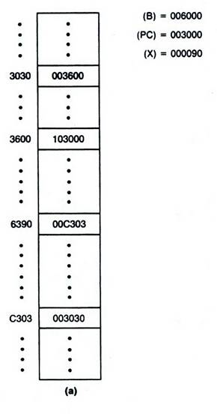
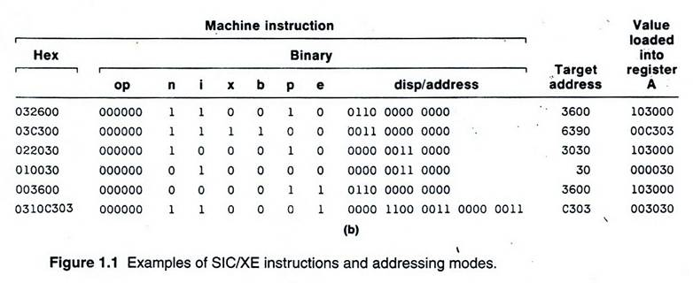
SIC/XE Machine Architecture (11/13)
Instruction Format

Slide 31
SIC/XE Machine Architecture (12/13)
Instruction Set
  Instructions to load and store the new registers
    LDB, STB, etc.
  Floating-point arithmetic operations
    ADDF, SUBF, MULF, DIVF
  Register move instruction
    RMO
  Register-to-register arithmetic operations
    ADDR, SUBR, MULR, DIVR
  Supervisor call instruction
    SVC

Slide 32
SIC/XE Machine Architecture (13/13)
Input and Output
  There are I/O channels that can be used to perform input and output while the CPU is executing other instructions

Slide 33
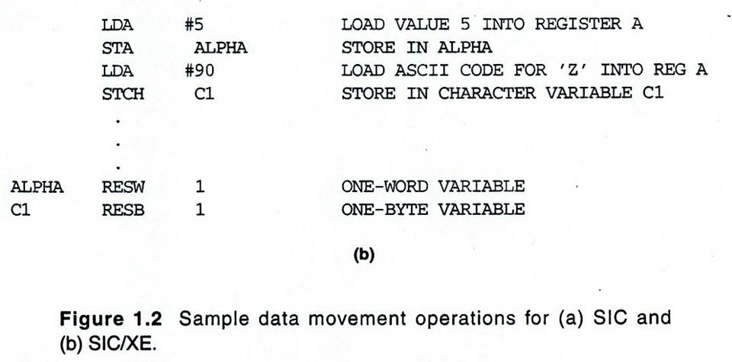
SIC/XE Programming Examples (Fig 1.2b)

Slide 34
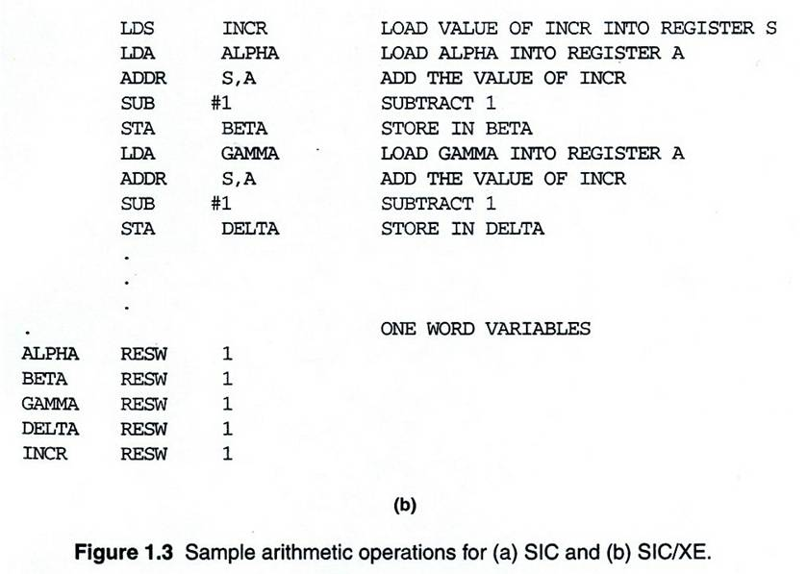
SIC/XE Programming Example (Fig 1.3b)

Slide 35
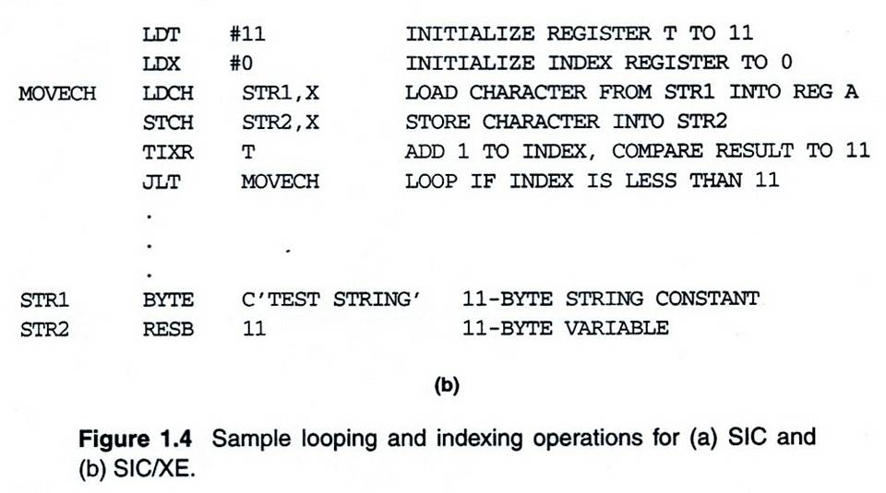
SIC/XE Programming Example (Fig 1.4b)

Slide 36
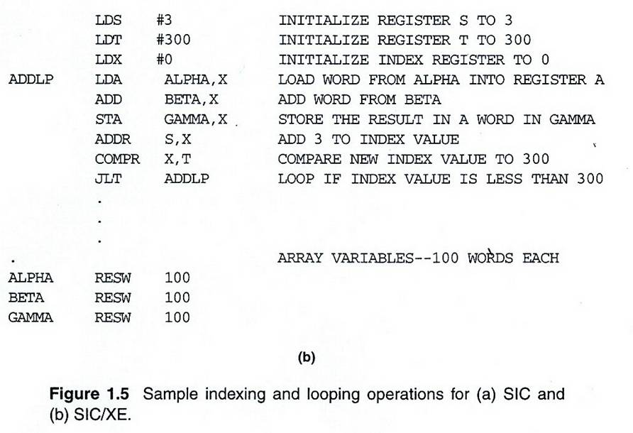
SIC/XE Programming Example (Fig 1.5b)

Slide 37
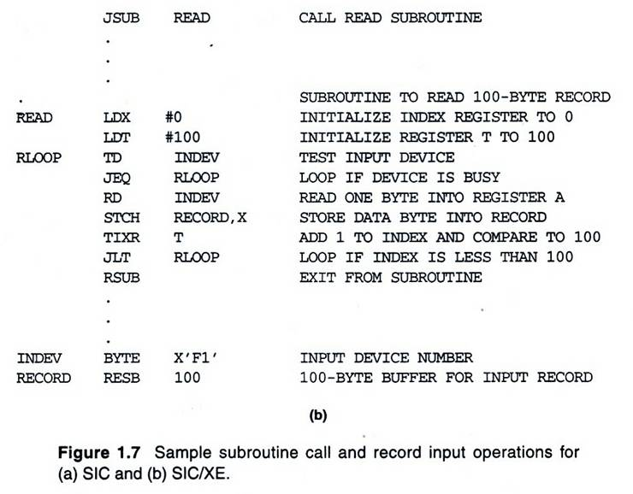
SIC/XE Programming Example (Fig 1.7b)

Slide 38
1.4 – 1.5’s Topic
CISC & RISC Machines
  Chapters 1.4 & 1.5 of Leland Beck’s “System Software” book.

Slide 39
Traditional (CISC) Machines
Complex Instruction Set Computers (CISC)
  Complicated instruction set
  Different instruction formats and lengths
  Many different addressing modes
  e.g. VAX or PDP-11 from DEC
  e.g. Intel x86 family

Slide 40
Pentium Pro Architecture (1/5)
Memory
  Physical level: byte addresses, word, doubleword
  Logical level: segments and offsets
  In some cases, a segment can also be divided into pages
  The segment/offset address specified by the programmer is translated into a physical address by the x86 MMU (Memory Management Unit)

Slide 41
Pentium Pro Architecture (2/5)
Registers
  General-purpose registers:
    EAX, EBX, ECX, EDX: data manipulation
    ESI, EDI, EBP, ESP: address
  Special-purpose registers:
    EIP: next instruction
    FLAGS: status word
    CS: code segment register
    SS: stack segment register
    DS, ES, FS, and GS: data segments
  Floating-point unit (FPU)
  Registers reserved for system programs
16-bit segment registers

Slide 42
Pentium Pro Architecture (3/5)
Data Formats
  Integers:
    8-, 16-, 32-bit binary numbers
    Negative values: 2’s complement
    FPU can also handle 64-bit signed integers
    The least significant part of a numeric value is stored at the lowest-numbered address (little-endian)
    Binary coded decimal (BCD)
      unpacked: 0000____0000____0000____…...0000____
      packed: |____|____|____|____|____|____|…..|____|____|
  Floating-point data formats
    Single-precision: 32 bits=24+7-bit exponent+sign bit
    Double-precision: 64 bits=53+10-bit exponent+sign bit
    Extended-precision: 80 bits=64+15-bit exponent+sign bit

Slide 43
Pentium Pro Architecture (4/5)
Instruction Formats
  Prefix (optional) containing flags that modify the operation of instruction
    specify repetition count, segment register, etc.
  Opcode (1 or 2 bytes)
  Operands and addressing modes
Addressing Modes
  TA=(base register)+(index register)*(scale factor)+displacement
  Base register: any general-purpose registers
  Index register: any general-purpose registers except ESP
  Scale factor: 1, 2, 4, 8
  Displacement: 8-, 16-, 32- bit value
  Eight addressing modes

Slide 44
Pentium Pro Architecture (5/5)
Instruction Set
  400 different machine instructions
    R-to-R instructions, R-to-M instructions, M-to-M instructions
    immediate values,
  Special purpose instructions for high-level programming language
    entering and leaving procedures,
    checking subscript values against the bounds of an array
Input and Output
  Input is performed by instructions that transfer one byte, word, or doubleword from an I/O register EAX
  Repetition prefixes allow these instructions to transfer an entire string in a single operation

Slide 45
RISC Machines
RISC system
  Instruction
    Standard, fixed instruction format
    Single-cycle execution of most instructions
    Memory access is available only for load and store instruction
    Other instructions are register-to-register operations
    A small number of machine instructions, and instruction format
  A large number of general-purpose registers
  A small number of addressing modes

Slide 46
RISC Machines
Three RISC machines
  SPARC family
  PowerPC family
  Cray T3E

Slide 47
UltraSPARC (1/8)
Sun Microsystems (1995)
SPARC stands for scalable processor architecture
SPARC, SuperSPARC, UltraSPARC
  Memory
  Registers
  Data formats
  Instruction Formats
  Addressing Modes

Slide 48
UltraSPARC (2/8)
Byte addresses
  Two consecutive bytes form halfword
  Four bytes form a word
  Eight bytes form doubleword
Alignment
  Halfword are stored in memory beginning at byte address that are multiples of 2
  Words begin at addresses that are multiples of 4
  Doublewords at addresses that are multiples of 8
Virtual address space
  UltraSPARC programs can be written using 2⁶⁴ bytes
  Memory Management Unit

Slide 49
UltraSPARC (3/8)
Registers
  ~100 general-purpose registers
  Any procedure can access only 32 registers (r0~r31)
    First 8 registers (r0~r8) are global, i.e. they can be access by all procedures on the system (r0 is zero)
    Other 24 registers can be visualized as a window through which part of the register file can be seen
  Program counter (PC)
    The address of the next instruction to be executed
  Condition code registers
  Other control registers

Slide 50
UltraSPARC (4/8)
Data Formats
  Integers are 8-, 16-, 32-, 64-bit binary numbers
  2’s complement is used for negative values
  Support both big-endian and little-endian byte orderings
    (big-endian means the most significant part of a numeric value is stored at the lowest-numbered address)
  Three different floating-point data formats
    Single-precision, 32 bits long (23 + 8 + 1)
    Double-precision, 64 bits long (52 + 11 + 1)
    Quad-precision, 78 bits long (63 + 16 + 1)

Slide 51
UltraSPARC (5/8)
Three Instruction Formats
  32 bits long
  The first 2 bits identify which format is being used
  Format 1: call instruction
  Format 2: branch instructions
  Format 3: remaining instructions

Slide 52
UltraSPARC (6/8)
Addressing Modes
  Immediate mode
  Register direct mode
  Memory addressing
  Mode Target address calculation
  PC-relative* TA= (PC)+displacement {30 bits, signed}
  Register indirect TA= (register)+displacement {13 bits, signed}
  with displacement
  Register indirect indexed TA= (register-1)+(register-2)
  *PC-relative is used only for branch instructions

Slide 53
UltraSPARC (7/8)
Instruction Set
  <100 instructions
  Pipelined execution
    While one instruction is being executed, the next one is fetched from memory and decoded
  Delayed branches
    The instruction immediately following the branch instruction is actually executed before the branch is taken
  Special-purpose instructions
    High-bandwidth block load and store operations
    Special “atomic” instructions to support multi-processor system

Slide 54
UltraSPARC (8/8)
Input and Output
  A range of memory locations is logically replaced by device registers
  Each I/O device has a unique address, or set of addresses
  No special I/O instructions are needed

Slide 55
PowerPC Architecture (1/8)
POWER stands for Performance Optimization with Enhanced RISC
History
  IBM (1990) introduced POWER in 1990 with RS/6000
  IBM, Apple, and Motorola formed an alliance to develop PowerPC in 1991
  The first products were delivered near the end of 1993
  Recent implementations include PowerPC 601, 603, 604

Slide 56
PowerPC Architecture (2/8)
Memory
  Halfword, word, doubleword, quadword
  May instructions may execute more efficiently if operands are aligned at a starting address that is a multiple of their length
  Virtual space 2⁶⁴ bytes
  Fixed-length segments, 256 MB
  Fixed-length pages, 4KB
  MMU: virtual address -> physical address

Slide 57
PowerPC Architecture (3/8)
Registers
  32 general-purpose registers, GPR0~GPR31
  FPU
  Condition code register reflects the result of certain operations, and can be used as a mechanism for testing and branching
  Link Register (LR) and Count Register (CR) are used by some branch instructions
  Machine Status Register (MSR)

Slide 58
PowerPC Architecture (4/8)
Data Formats
  Integers are 8-, 16-, 32-, 64-bit binary numbers
  2’s complement is used for negative values
  Support both big-endian (default) and little-endian byte orderings
  Three different floating-point data formats
    single-precision, 32 bits long (23 + 8 + 1)
    double-precision, 64 bits long (52 + 11 + 1)
  Characters are stored using 8-bit ASCII codes

Slide 59
PowerPC Architecture (5/8)
Seven Instruction Formats
  32 bits long
  The first 6 bits identify specify the opcode
  Some instruction have an additional extended opcode
  The complexity is greater than SPARC
  Fixed-length makes decoding faster and simple than VAX and x86

Slide 60
PowerPC Architecture (6/8)
Addressing Modes
  Immediate mode, register direct mode
  Memory addressing
  Mode Target address calculation
  Register indirect TA=(register)
  Register indirect with indexed TA=(register-1)+(register-2)
  Register indirect with TA=(register)+displacement {16 bits, signed}
  immediate indexed
  Branch instruction
  Mode Target address calculation
  Absolute TA= actual address
  Relative TA= current instruction address + displacement {25 bits, signed}
  Link Register TA= (LR)
  Count Register TA= (CR)

Slide 61
PowerPC Architecture (7/8)
Instruction Set
  200 machine instructions
    More complex than most RISC machines
    e.g. floating-point “multiply and add” instructions that take three input operands
    e.g. load and store instructions may automatically update the index register to contain the just-computed target address
  Pipelined execution
    More sophisticated than SPARC
  Branch prediction

Slide 62
PowerPC Architecture (8/8)
Input and Output
  Two different modes
    Direct-store segment: map virtual address space to an external address space
    Normal virtual memory access

