Slide 1
Assembly Language for Intel-Based Computers, 4th Edition
Kip R. Irvine
Chapter 1: Basic Concepts

Slide 2
Chapter Overview
Welcome to Assembly Language
Virtual Machine Concept
Data Representation
Boolean Operations

Slide 3
Welcome to Assembly Language
Some Good Questions to Ask
Assembly Language Applications

Slide 4
Some Good Questions to Ask
Why am I taking this course (reading this book)?
What background should I have?
What is an assembler?
What hardware/software do I need?
What types of programs will I create?
What do I get with this book?
What will I learn?

Slide 5
Welcome to Assembly Language (cont)
How does assembly language (AL) relate to machine language?
How do C++ and Java relate to AL?
Is AL portable?
Why learn AL?

Slide 6
Assembly Language Applications
Some representative types of applications:
  Business application for single platform
  Hardware device driver
  Business application for multiple platforms
  Embedded systems & computer games
(see next panel)
* HL = high-level

Slide 7
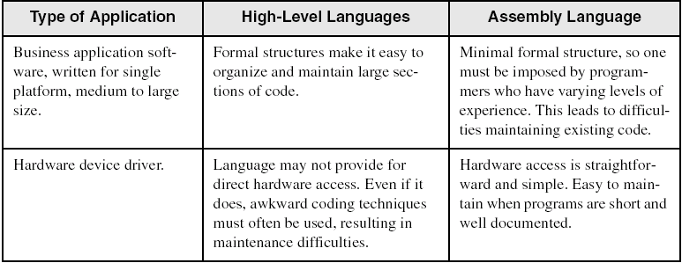
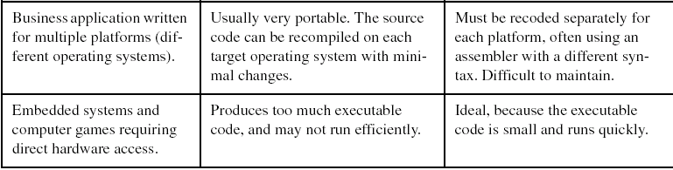
Comparing ASM to High-Level Languages

Slide 8
Virtual Machine Concept
Virtual Machines
Specific Machine Levels

Slide 9
Virtual Machines
Tanenbaum: Virtual machine concept
Programming Language analogy:
  Each computer has a native machine language (language L0) that runs directly on its hardware
  A more human-friendly language is usually constructed above machine language, called Language L1
Programs written in L1 can run two different ways:
  Interpretetation – L0 program interprets and executes L1 instructions one by one
  Translation – L1 program is completely translated into an L0 program, which then runs on the computer hardware

Slide 10
Specific Machine Levels

Slide 11
High-Level Language
Level 5
Application-oriented languages
Programs compile into assembly language (Level 4)

Slide 12
Assembly Language
Level 4
Instruction mnemonics that have a one-to-one correspondence to machine language
Calls functions written at the operating system level (Level 3)
Programs are translated into machine language (Level 2)

Slide 13
Operating System
Level 3
Provides services to Level 4 programs
Programs translated and run at the instruction set architecture level (Level 2)

Slide 14
Instruction Set Architecture
Level 2
Also known as conventional machine language
Executed by Level 1 program (microarchitecture, Level 1)

Slide 15
Microarchitecture
Level 1
Interprets conventional machine instructions (Level 2)
Executed by digital hardware (Level 0)

Slide 16
Digital Logic
Level 0
CPU, constructed from digital logic gates
System bus
Memory

Slide 17
Data Representation
Binary Numbers
  Translating between binary and decimal
Binary Addition
Integer Storage Sizes
Hexadecimal Integers
  Translating between decimal and hexadecimal
  Hexadecimal subtraction
Signed Integers
  Binary subtraction
Character Storage

Slide 18
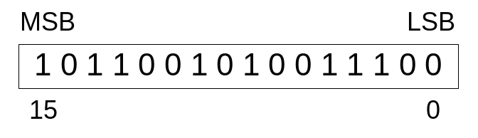
Binary Numbers
Digits are 1 and 0
  1 = true
  0 = false
MSB – most significant bit
LSB – least significant bit
Bit numbering:

Slide 19

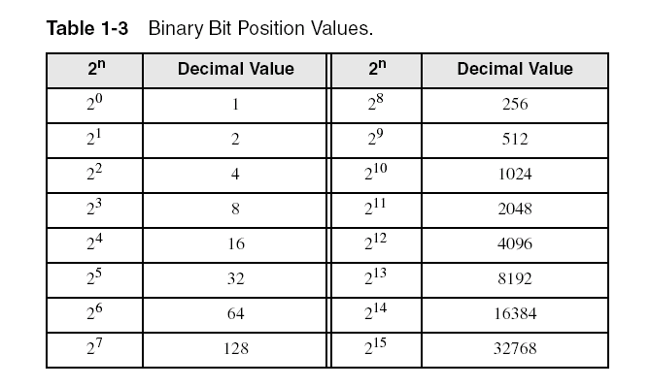
Binary Numbers
Each digit (bit) is either 1 or 0
Each bit represents a power of 2:
Every binary number is a sum of powers of 2

Slide 20
Translating Binary to Decimal
Weighted positional notation shows how to calculate the decimal value of each binary bit:
dec = (D_{n-1} × 2^{n-1}) + (D_{n-2} × 2^{n-2}) + ... + (D₁ × 2¹) + (D₀ × 2⁰)
D = binary digit
binary 00001001 = decimal 9:
(1 × 2³) + (1 × 2⁰) = 9

Slide 21
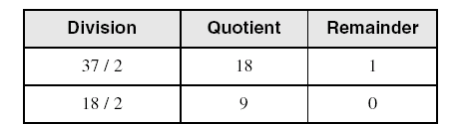
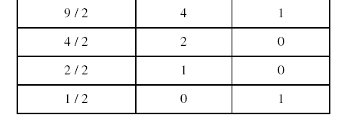
Translating Unsigned Decimal to Binary
Repeatedly divide the decimal integer by 2. Each remainder is a binary digit in the translated value:
37 = 100101

Slide 22
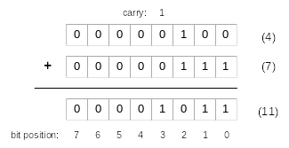
Binary Addition
Starting with the LSB, add each pair of digits, include the carry if present.

Slide 23

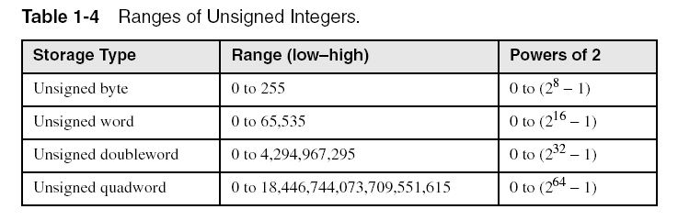
Integer Storage Sizes
Standard sizes:
Practice: What is the largest unsigned integer that may be stored in 20 bits?

Slide 24
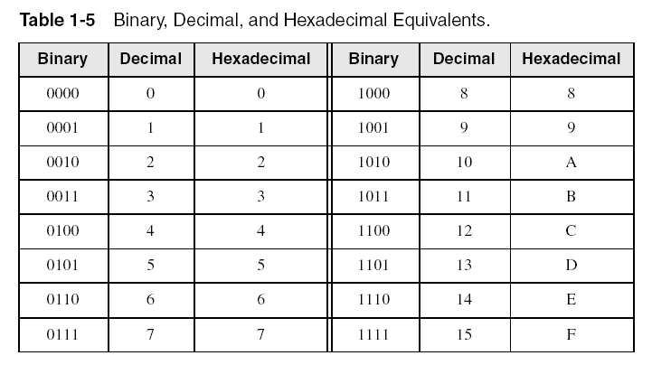
Hexadecimal Integers
All values in memory are stored in binary. Because long binary numbers are hard to read, we use hexadecimal representation.

Slide 25

Translating Binary to Hexadecimal
Each hexadecimal digit corresponds to 4 binary bits.
Example: Translate the binary integer 000101101010011110010100 to hexadecimal:

Slide 26
Converting Hexadecimal to Decimal
Multiply each digit by its corresponding power of 16:
  dec = (D₃ × 16³) + (D₂ × 16²) + (D₁ × 16¹) + (D₀ × 16⁰)
Hex 1234 equals (1 × 16³) + (2 × 16²) + (3 × 16¹) + (4 × 16⁰), or decimal 4,660.
Hex 3BA4 equals (3 × 16³) + (11 * 16²) + (10 × 16¹) + (4 × 16⁰), or decimal 15,268.

Slide 27
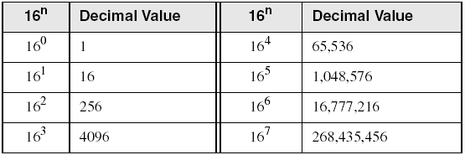
Powers of 16
Used when calculating hexadecimal values up to 8 digits long:

Slide 28
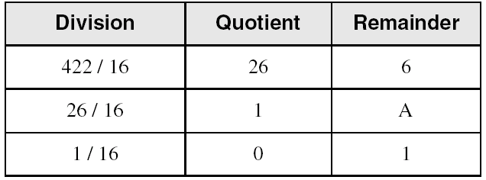
Converting Decimal to Hexadecimal
decimal 422 = 1A6 hexadecimal

Slide 29
Hexadecimal Addition
Divide the sum of two digits by the number base (16). The quotient becomes the carry value, and the remainder is the sum digit.
1
1
36 28 28 6A
42 45 58 4B
78 6D 80 B5
21 / 16 = 1, rem 5
Important skill: Programmers frequently add and subtract the addresses of variables and instructions.

Slide 30
Hexadecimal Subtraction
When a borrow is required from the digit to the left, add 10h to the current digit's value:
10h + 5 = 15h
−1
C6 75
A2 47
24 2E
Practice: The address of var1 is 00400020. The address of the next variable after var1 is 0040006A. How many bytes are used by var1?

Slide 31
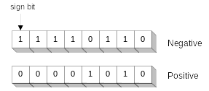
Signed Integers
The highest bit indicates the sign. 1 = negative,
0 = positive
If the highest digit of a hexadecmal integer is > 7, the value is negative. Examples: 8A, C5, A2, 9D

Slide 32
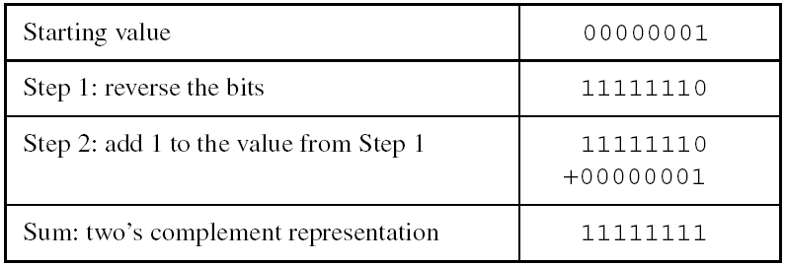
Forming the Two's Complement
Negative numbers are stored in two's complement notation
Additive Inverse of any binary integer
Steps:
  Complement (reverse) each bit
  Add 1
Note that 00000001 + 11111111 = 00000000

Slide 33
Binary Subtraction
When subtracting A – B, convert B to its two's complement
Add A to (–B)
1 1 0 0 1 1 0 0
– 0 0 1 1 1 1 0 1
1 0 0 1
Practice: Subtract 0101 from 1001.

Slide 34
Learn How To Do the Following:
Form the two's complement of a hexadecimal integer
Convert signed binary to decimal
Convert signed decimal to binary
Convert signed decimal to hexadecimal
Convert signed hexadecimal to decimal

Slide 35
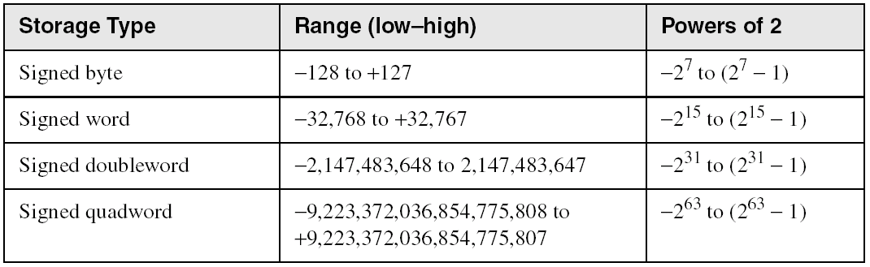
Ranges of Signed Integers
The highest bit is reserved for the sign. This limits the range:
Practice: What is the largest positive value that may be stored in 20 bits?

Slide 36
Character Storage
Character sets
  Standard ASCII (0 – 127)
  Extended ASCII (0 – 255)
  ANSI (0 – 255)
  Unicode (0 – 65,535)
Null-terminated String
  Array of characters followed by a null byte
Using the ASCII table
  back inside cover of book

Slide 37
Numeric Data Representation
pure binary
  can be calculated directly
ASCII binary
  string of digits: "01010101"
ASCII decimal
  string of digits: "65"
ASCII hexadecimal
  string of digits: "9C"

Slide 38
Boolean Operations
NOT
AND
OR
Operator Precedence
Truth Tables

Slide 39
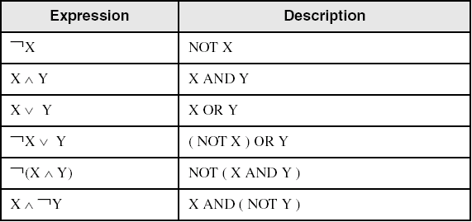
Boolean Algebra
Based on symbolic logic, designed by George Boole
Boolean expressions created from:
  NOT, AND, OR

Slide 40
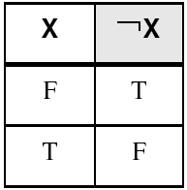
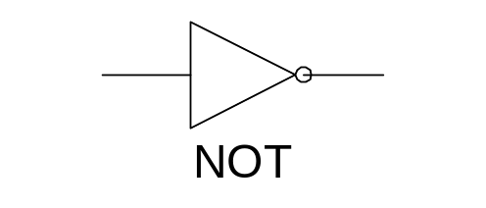
NOT
Inverts (reverses) a boolean value
Truth table for Boolean NOT operator:
Digital gate diagram for NOT:

Slide 41
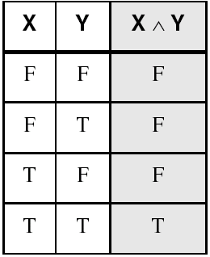
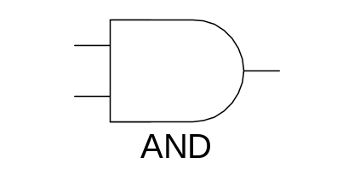
AND
Truth table for Boolean AND operator:
Digital gate diagram for AND:

Slide 42
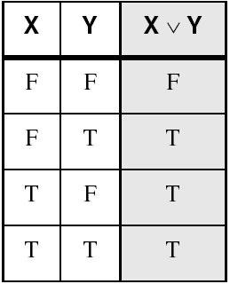
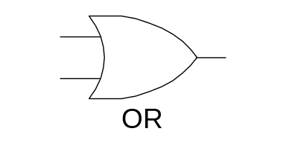
OR
Truth table for Boolean OR operator:
Digital gate diagram for OR:

Slide 43
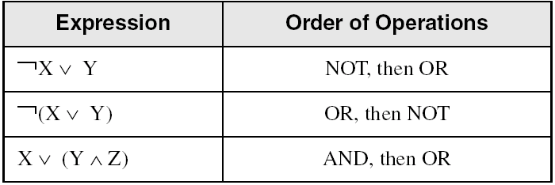
Operator Precedence
Examples showing the order of operations:

Slide 44
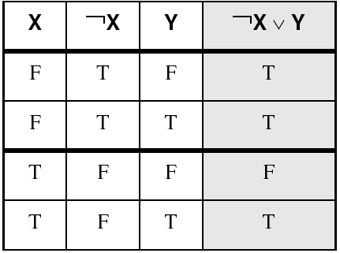
Truth Tables (1 of 3)
A Boolean function has one or more Boolean inputs, and returns a single Boolean output.
A truth table shows all the inputs and outputs of a Boolean function
Example: ¬X ∨ Y

Slide 45
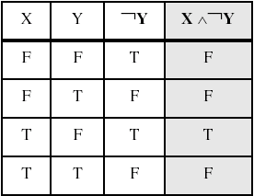
Truth Tables (2 of 3)
Example: X ∧ ¬Y

Slide 46
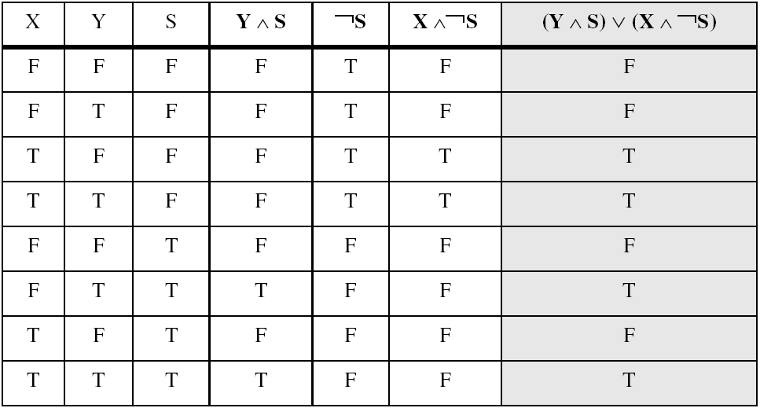
Truth Tables (3 of 3)
Example: (Y ∧ S) ∨ (X ∧ ¬S)
Two-input multiplexer

Slide 47

54 68 65 20 45 6E 64
What do these numbers represent?

Slide 48
Printing this Slide Show
To print this slide show with black characters on a white background, do the following:
Select Print... from the File menu.
Select Handouts in the Print what drop-down box.
Select 2 or 3 in the Slides per page drop-down box.
Select the Pure black and white check box (optional)
Click on OK to begin printing.
Back to the title page

