Slide 1
Data Structures
內容：Basic Concepts, Arrays and Structures, Stacks and Queues, Lists, Trees, Graphs, Sorting, Hashing, Heap Structures, and Search Structures
成績評定：程式60% ， 期中20% ， 期末20%
教科書：Ellis Horowitz, Sartaj Sahni and Susan Anderson-Freed, Fundamentals of Data Structures in C, Freeman and Company.
授課老師：鍾葉青

Slide 2
作業格式：
  1.封面 -- 作業題目、班級、座號、姓名
  2.目錄 -- 編頁碼
  3.題目定義 -- 作法及說明
  4.程式碼
  5.執行結果 -- 測試資料及結果
  6.討論 -- 遭遇困難及解決過程
  7.心得 -- 自由發揮

Slide 3
Chapter 1 Basic Concepts
Overview: System Life Cycle
Algorithm Specification
Data Abstraction
Performance Analysis

Slide 4
System Life Cycle
Requirements
Analysis
Design
Refinement and coding
Verification
  Correctness proofs
  Testing
  Error removal

Slide 5
Algorithm Specification
Introduction
  An algorithm is a finite set of instructions that accomplishes a particular task.
  criteria:
    Input
    Output
    Definiteness
    Finiteness
    Effectiveness
  A program does not have to satisfy the finiteness criteria.

Slide 6
  Representation
    A natural language, like English or Chinese.
    A graphic, like flowcharts.
    A computer language, like C.
  Algorithms + Data structures = Programs [Niklus Wirth]
  Sequential search v.s. binary search

Slide 7
  Example 1.1 [Selection sort]
  i [0] [1] [2] [3] [4]
    - 30 10 50 40 20
    0 10 30 50 40 20
    1 10 20 50 40 30
    2 10 20 30 40 50
    3 10 20 30 40 50
    From those integers that are currently unsorted, find the smallest and place it next in the sorted list.
    For (i = 0; i < n; i ++) {
    Examine list[i] to list[n-1] and suppose that the smallest integer is at list[min]
    Interchange list[i] and list[min]
    }

Slide 8
  Example 1.2 [Binary search]
    [0] [1] [2] [3] [4] [5] [6]
    8 14 26 30 43 50 52
    left right middle list[middle] : searchnum
    0 6 3 30 < 43
    4 6 5 50 > 43
    4 4 4 43 == 43
    0 6 3 30 > 18
    0 2 1 14 < 18
    2 2 2 26 > 18
    2 1 -

Slide 9
  Searching a sorted list
    while (there are more integers to check) {
    middle = (left + right) / 2;
    if (searchnum < list[middle])
    right = middle - 1;
    else if (searchnum == list[middle])
    return middle;
    else left = middle + 1;
    }

Slide 10
Recursive Algorithms
  Functions can call themselves(direct recursion) or they may call other functions that invoke the calling function again (indirect recursion).
  We should express a recursive algorithm when the problem itself is defined recursively.

Slide 11
  The factorial function n!
    Definition:
      if n <= 1 then n! = 1;
      else n! = n * (n - 1) * (n - 2) * … * 3 * 2 * 1;
    Recursive definition:
      if n <= 1 then n! = 1;
      else n! = n * (n - 1) !;
    The recursive C function
      int Factorial(int n)
{
if (n <= 1)
return 1;
else
return n * Factorial(n - 1);
}

Slide 12
  The Fabonacci numbers are defined as f₀ = 0, f₁ = 1, and f_{i} = f_{i-1} + f_{i-2} for i > 1. Such as 0, 1, 1, 2, 3, 5, 8, 13, …
    The recursive C function to compute f_{i}
    int Fib(int n)
    {
    if (n <= 0)
    return 0;
    else if (n == 1)
    return 1;
    else
    return Fib(n - 1) + Fib(n - 2);
    }

Slide 13
  Towers of Hanoi(漢諾塔問題)
    定義
      有A,B,C三根柱子，n個不同直徑的套環置於柱子A上，小套環依序置於大套環之上，藉由柱子B，將所有套環移到柱子C上。
    移動規則
        每次只能移動一個套環。
        任何一個大套環都不能置於小套環之上。
A
B
C

Slide 14
    n = 1, A -> C
    n = 2, A -> B
    A -> C
    B -> C
    n = 3, A -> C
    A -> B
    C -> B
    A -> C
    B -> A
    B -> C
    A -> C
A
B
C
A
B
C
A
B
C

Slide 15
    移動過程(recursive)
      1. 將n-1個套環由A柱子移到B柱子(藉由C柱子)。
      2. 移動第n個套環由A柱子移到C柱子。
      3.再將n-1個套環由B柱子移到C柱子(藉由A柱子)。
    The recursive C function
    void tower(int n, char frompg, char topg, char auxpg)
    {
    if (n == 1)
    printf(“Move disc %c --> %c\n”,frompg, topg);
    else
    { tower(n-1, frompg, auxpg, topg);
    printf((“Move disc %c --> %c\n”,frompg, topg);
    tower(n-1, auxpg, topg, frompg);
    }
    }

Slide 16
Data Abstraction
The data types of C
  The basic data types
    char, int, float, and double.
  The group data types
    array and struct.
  The pointer data type
  The user-defined types

Slide 17
Definition
  A data type is a collection of objects and a set of operations that act on those objects.
  For example, the data type int consists of the objects {0, +1, -1, +2, -2, …, INT_MAX, INT_MIN} and the operations +, -, *, /, and %.
  An abstract data type(ADT) is a data type that is organized in such a way that the specification of the objects and the operations on the objects is separated from the representation of the objects and the implementation of the operations.
  We know what is does, but not necessarily how it will do it.

Slide 18
  The functions of a data type are classified into several categories:
    Creator/constructor
    Transformers
    Observers/reporters
  For example, ADT Natural_Number.

Slide 19
structure Natural_Number is
objects: an ordered subrange of the integers starting at zero and ending
at the maximum integer (INT_MAX) on the computer
functions:
for all x, y ∈ Nat_Number; TRUE, FALSE ∈ Boolean
and where +, -, <, and == are the usual integer operations.
Nat_No Zero ( ) ::= 0
Boolean Is_Zero(x) ::= if (x) return FALSE
else return TRUE
Nat_No Add(x, y) ::= if ((x+y) <= INT_MAX) return x+y
else return INT_MAX
Boolean Equal(x,y) ::= if (x== y) return TRUE
else return FALSE
Nat_No Successor(x) ::= if (x == INT_MAX) return x
else return x+1
Nat_No Subtract(x,y) ::= if (x<y) return 0
else return x-y
end Natural_Number

Slide 20
Performance Analysis
Space Complexity
  Fixed space requirements
    independent of the characteristics of the inputs and outputs
    instruction codes
    space for variables, fixed-size structured variables, and constants
  Variable space requirements
    depend on the instance characteristics
    number, size, values of inputs and output
    recursive stack space, return address, formal parameters and local variables

Slide 21
/* Simple arithmetic function */ float abc(float a, float b, float c)
{ return a + b + b * c + (a + b - c) / (a + b) + 4.00;
}
/*Iterative summing of a list of numbers float */ sum(float list[ ], int n)
{ float tempsum = 0; int i; for (i = 0; i<n; i++) tempsum += list [i]; return tempsum;
}

Slide 22
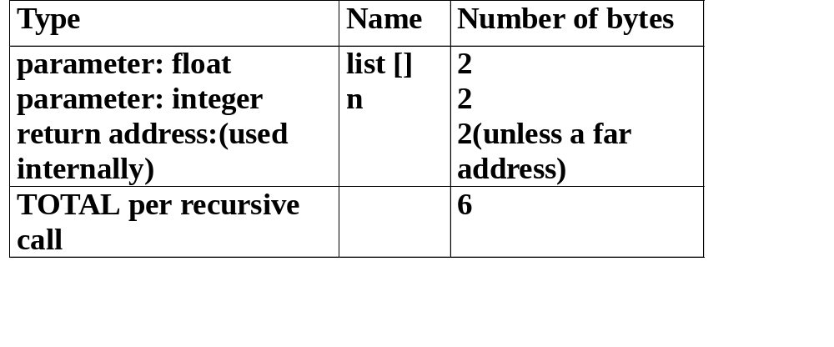
/* Recursive summing of a list of numbers */ float rsum(float list[ ], int n)
{ if (n) return rsum(list, n-1) + list[n-1]; return 0;
}

Slide 23
Time Complexity
  Fixed time requirements
    compile time
  Variable time requirements
    execution(run) time
  A program step is a syntactically or semantically meaningful program segment whose execution time is independent of the instance characteristics.
  For example
    a = 2
    a = 2 * b + 3 * c / d

Slide 24
/* with count statements */ float sum(float list[ ], int n)
{ float tempsum = 0; count++; /* for assignment */ int i; for (i = 0; i < n; i++) { count++; /*for the for loop */ tempsum += list[i]; count++; /* for assignment */
} count++; /* last execution of for */ return tempsum; count++; /* for return */
}
=> (2n + 3) steps

Slide 25
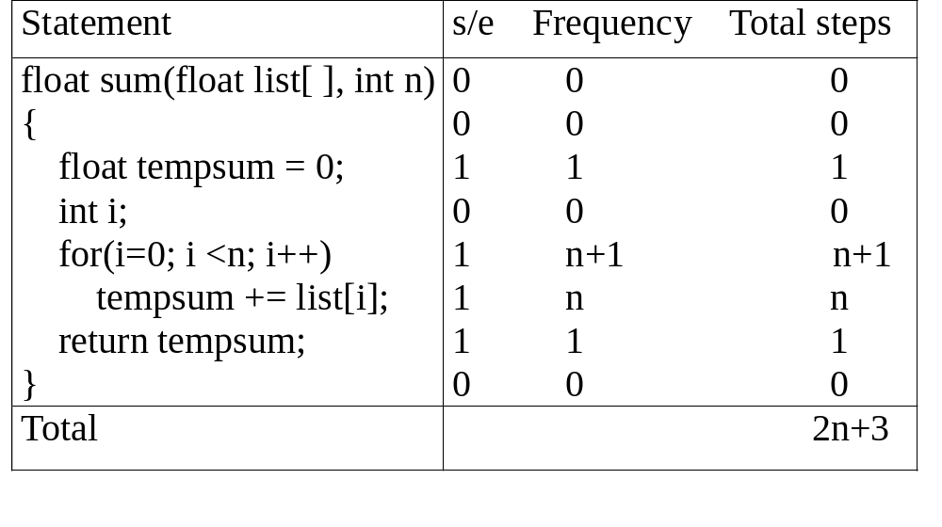
Iterative summing of a list of numbers

Slide 26
float rsum(float list[ ], int n)
{
count++; /*for if conditional */
if (n) {
count++; /* for return and rsum invocation */
return rsum(list, n-1) + list[n-1];
}
count++;
return list[0];
}
=>(2n + 2) steps

Slide 27
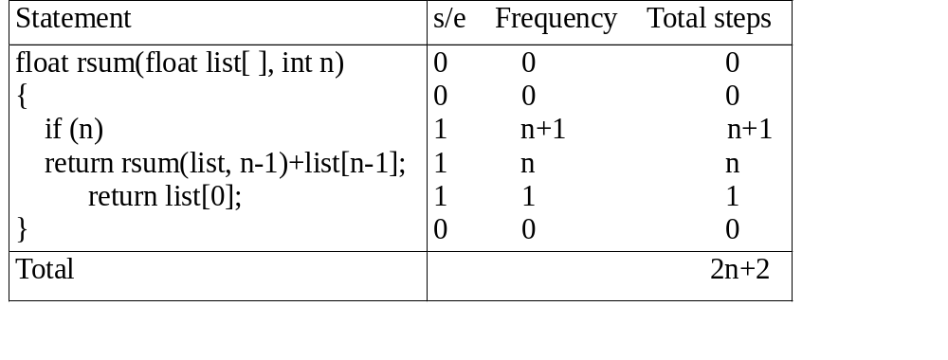
Recursive summing of a list of numbers

Slide 28
/* Matrix addition with count statements */
void add(int a[ ][MAX_SIZE], int b[ ][MAX_SIZE],
int c[ ][MAX_SIZE], int row, int cols )
{
int i, j;
for (i = 0; i < rows; i++) {
count++; /* for i for loop */
for (j = 0; j < cols; j++) {
count++; /* for j for loop */
c[i][j] = a[i][j] + b[i][j];
count++; /* for assignment statement */
}
count++; /* last time of j for loop */
}
count++; /* last time of i for loop */
}
=>(2rows * cols + 2rows + 1) steps

Slide 29
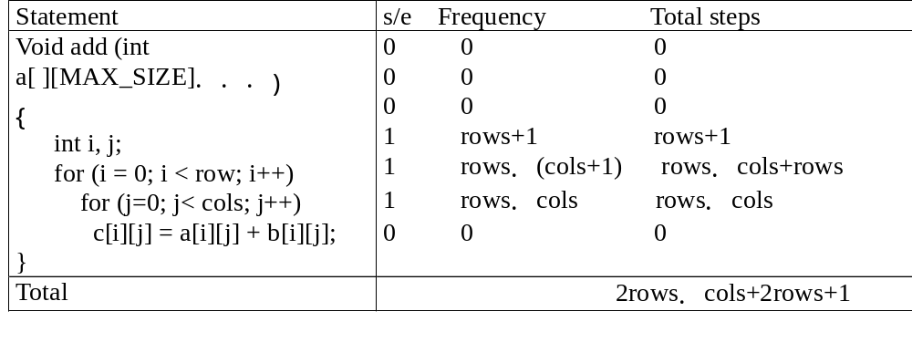
Matrix addition

Slide 30
Asymptotic Notation(Ο, Ω, Θ)
  Definition: [Big “oh”]
    f(n) = Ο(g(n)) iff there exist positive constants c and n₀ such that f(n) <= cg(n) for all n, n >=n₀.
    g(n) is an upper bound on f(n), that is the worst case.
  Definition: [Omega]
    f(n) = Ω(g(n)) iff there exist positive constants c and n₀ such that f(n) >= cg(n) for all n, n >=n₀.
    g(n) is a lower bound on f(n), that is the best case.

Slide 31
  Definition: [Theta]
    f(n) = Θ(g(n)) iff there exist positive constants c₁,c₂ and n₀ such that c₁g(n) <= f(n) <= c₂g(n) for all n, n >=n₀.
    g(n) is both an upper and lower bound on f(n), that is the average case.

Slide 32
  Examples
    1. f(n) = 3n+2
      3n + 2 <= 4n, for all n >= 2, ∴3n + 2 = Ο (n)
      3n + 2 >= 3n, for all n >= 1, ∴3n + 2 = Ω (n)
      3n <= 3n + 2 <= 4n, for all n >= 2, ∴ 3n + 2 = Θ (n)
    2. f(n) = 10n²+4n+2
      10n²+4n+2 <= 11n², for all n >= 5, ∴ 10n²+4n+2 = Ο (n²)
      10n²+4n+2 >= n², for all n >= 1, ∴ 10n²+4n+2 = Ω (n²)
      n² <= 10n²+4n+2 <= 11n², for all n >= 5, ∴ 10n²+4n+2 = Θ (n²)
  If f(n) = a_{m}n^{m} + … + a₁n + a₀ and a_{m} > 0,
    then f(n) = Ο(n^{m}), f(n) = Ω(n^{m}), and f(n) = Θ(n^{m}),

Slide 33
    Ο (1) : constant
    Ο (log n) : logarithmic
    Ο (n) : linear
    Ο (n log n) : log linear
    Ο (n²) : quadratic
    Ο (n³) : cubic
    Ο (2^{n}) : exponential
    Ο (n!) : factorial

