Slide 1
Chapter 2
Arrays and Structures
Arrays
Structures and Unions
Ordered Lists
Sparse Matrix
Representation of Multi-D Arrays
Strings

Slide 2
Arrays
Definition
  An array is a set of <index, value>, for each index, there is a value associated with that index.
Representation
  Implemented as a consecutive memory.

Slide 3
Arrays in C
int list[5], *plist[5];
implementation of array list[5]
Variable Memory Address
list[0] base address = α
list[1] α + sizeof(int)
list[2] α + 2*sizeof(int)
list[3] α + 3*sizeof(int)
list[4] α + 4*size(int)

Slide 4
Compare int *list1 and int list2[5] in C.
Same: list1 and list2 are pointers.
Difference: list2 reserves five locations.
Notations:
list2 : a pointer to list2[0]
(list2 + i) : a pointer to list2[i], i.e. &list2[i])
*(list2 + i) : list2[i]

Slide 5
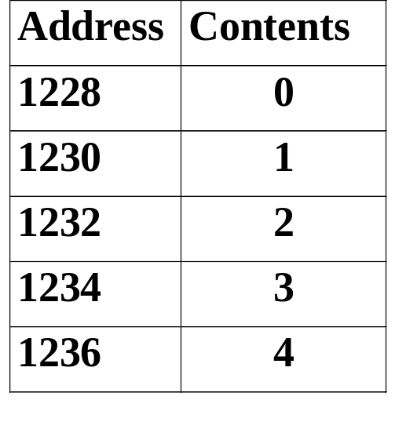
Example: 1-D array addressing
int one[] = {0,1,2,3,4};
print1(one,5);
void print1(int *ptr, int rows)
{
/* print out a one-dimensional array using a pointer */
int i;
printf(“Address Contents\n”);
for (i=0; i < rows; i++)
printf(“%8u%5d\n”, ptr+i, *(ptr+i));
printf(“\n”);
}

Slide 6
Structures and Unions
Structures in C
struct {
char name[10];
int age;
float salary;
} person;
strcpy(person.name, “james”);
person.age=10;
person.salary=35000;

Slide 7
Create structure data type
typedef struct human_being {
char name[10];
int age;
float salary;
};
or
typedef struct {
char name[10];
int age;
float salary
} human_being;
human_being person1, person2;

Slide 8
Unions in C
Similar to struct, but the fields of union must share their memory space, and only one field is active.
Example: Add fields for male and female.
typedef struct sex_type {
enum tag_field {female, male} sex;
union {
int children;
int beard;
} u;
};
typedef struct human_being {
char name[10];
int age;
float salary;
date dob;
sex_type sex_info;
}
human_being person1, person2;
person1.sex_info.sex=male;
person1.sex_info.u.beard=FALSE;

Slide 9
Self-Referential Structures
One or more of its components is a pointer to itself.
typedef struct list {
char data;
list *link;
}
list item1, item2, item3;
item1.data=‘a’;
item2.data=‘b’;
item3.data=‘c’;
item1.link=item2.link=item3.link=NULL;
/* Construct a list with three nodes */
item1.link=&item2;
item2.link=&item3;
a
b
c

Slide 10
Ordered or Linear Lists
  (item1, item2, item3, …, itemn)
  Examples
    (Sunday, Monday,Tuesday, Wednesday, Thursday, Friday, Saturday)
    (甲, 乙, 丙, 丁)
  Operations
    Finding the length
    Reading the items
    Retrieving the ith element
    Replacing the ith element
    Inserting a new element
    Deleting the element
  Implementation
    sequential mapping
    nonsequential mapping

Slide 11
Polynomial Addition
A(x) = 3x²⁰ + 2x⁵ + 4
A(x) = a_{i}x^{i}, where x is the variable, a_{i} is the coefficient, and i is the exponent
A(x) + B(x) = (a_{i} + b_{i})x^{i}
- Representation I
#define MAX_DEGREE 101
typedef struct {
int degree;
float coef[MAX_DEGREE];
} polynomial;

Slide 12
/* d =a + b, where a, b, and d are polynomials */
d = Zero( )
while (! IsZero(a) && ! IsZero(b)) do {
switch COMPARE (Lead_Exp(a), Lead_Exp(b)) {
case -1: d =
Attach(d, Coef (b, Lead_Exp(b)), Lead_Exp(b));
b = Remove(b, Lead_Exp(b));
break;
case 0: sum = Coef (a, Lead_Exp (a)) + Coef ( b, Lead_Exp(b));
if (sum) {
Attach (d, sum, Lead_Exp(a));
a = Remove(a , Lead_Exp(a));
b = Remove(b , Lead_Exp(b));
}
break;
case 1: d =
Attach(d, Coef (a, Lead_Exp(a)), Lead_Exp(a));
a = Remove(a, Lead_Exp(a));
}
}
insert any remaining terms of a or b into d

Slide 13
- Representation II
MAX_TERMS 100 /* size of terms array */
typedef struct {
float coef;
int expon;
} polynomial;
polynomial terms[MAX_TERMS];
int avail = 0;

Slide 14
A(X)=2X¹⁰⁰⁰+1
B(X)=X⁴+10X³+3X²+1
starta finisha startb finishb avail
2
1
1
10
3
1
coef
exp
1000
0
4
3
2
0

Slide 15
void padd (int starta, int finisha, int startb, int finishb,
int * startd, int *finishd)
{
/* add A(x) and B(x) to obtain D(x) */
float coefficient;
*startd = avail;
while (starta <= finisha && startb <= finishb)
switch (COMPARE(terms[starta].expon,
terms[startb].expon)) {
case -1: /* a expon < b expon */
attach(terms[startb].coef, terms[startb].expon);
startb++
break;

Slide 16
case 0: /* equal exponents */
coefficient = terms[starta].coef +
terms[startb].coef;
if (coefficient)
attach (coefficient, terms[starta].expon);
starta++;
startb++;
break;
case 1: /* a expon > b expon */
attach(terms[starta].coef, terms[starta].expon);
starta++;
}

Slide 17
/* add in remaining terms of A(x) */
for( ; starta <= finisha; starta++)
attach(terms[starta].coef, terms[starta].expon);
/* add in remaining terms of B(x) */
for( ; startb <= finishb; startb++)
attach(terms[startb].coef, terms[startb].expon);
*finishd =avail -1;
}
=> O(m+n), where m and n be the number of nonzero terms in A and B, respectively.

Slide 18
void attach(float coefficient, int exponent)
{
/* add a new term to the polynomial */
if (avail >= MAX_TERMS) {
fprintf(stderr, “Too many terms in the polynomial\n”);
exit(1);
}
terms[avail].coef = coefficient;
terms[avail++].expon = exponent;
}

Slide 19
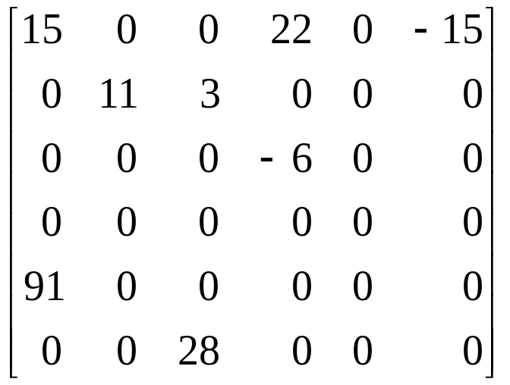
Sparse Matrix
0 1 2 3 4 5
0
1
2
3
4
5
6*6
1.Represented by a two-dimensional array.
Sparse matrix wastes space.
2. Each element is characterized by <row, col, value>.

Slide 20
Sparse_matrix Create(max_row, max_col) ::=
#define MAX_TERMS 101 /* maximum number of terms +1*/
typedef struct {
int col;
int row;
int value;
} term;
term a[MAX_TERMS]

Slide 21
row col value row col value
a[0] 6 6 8 b[0] 6 6 8
[1] 0 0 15 [1] 0 0 15
[2] 0 3 22 [2] 0 4 91
[3] 0 5 -15 [3] 1 1 11
[4] 1 1 11 [4] 2 1 3
[5] 1 2 3 [5] 2 5 28
[6] 2 3 -6 [6] 3 0 22
[7] 4 0 91 [7] 3 2 -6
[8] 5 2 28 [8] 5 0 -15
Row, column in ascending order
a[0].row: the number of rows
a[0].col: the number of cols
a[0].value: the total number of nonzero terms

Slide 22
Transposing a Matrix
(1) for each row i
take element <i, j, value> and store it
in element <j, i, value> of the transpose.
(0, 0, 15) => (0, 0, 15)
(0, 3, 22) => (3, 0, 22)
(0, 5, -15) => (5, 0, -15)
difficulty: where to put <j, i, value>
(2) For all elements in column j,
place element <i, j, value> in element <j, i, value>
=>O(cols * elements)

Slide 23
-Discussion: compared with 2-D array representation
O(cols * elements) v.s. O(cols * rows)
elements => cols * rows when nonsparse
O(cols * elements) => O(cols² * rows)
-Problem: Scan the array cols times.
-Solution:
Step1: Determine the number of elements in each column of the original matrix.
Step2: Determine the starting positions of each row in the transpose matrix.

Slide 24
row col value row col value
a[0] 6 6 8 b[0] 6 6 8
[1] 0 0 15 [1] 0 0 15
[2] 0 3 22 [2] 0 4 91
[3] 0 5 -15 [3] 1 1 11
[4] 1 1 11 ➔ [4] 2 1 3
[5] 1 2 3 [5] 2 5 28
[6] 2 3 -6 [6] 3 0 22
[7] 4 0 91 [7] 3 2 -6
[8] 5 2 28 [8] 5 0 -15
[0] [1] [2] [3] [4] [5]
row_terms = 2 1 2 2 0 1
starting_pos = 1 3 4 6 8 8

Slide 25
void fast_transpose(term a[ ], term b[ ])
{
/* the transpose of a is placed in b */
int row_terms[MAX_COL], starting_pos[MAX_COL];
int i, j, num_cols = a[0].col, num_terms = a[0].value;
b[0].row = num_cols; b[0].col = a[0].row;
b[0].value = num_terms;
if (num_terms > 0){ /*nonzero matrix*/
for (i = 0; i < num_cols; i++)
row_terms[i] = 0;
for (i = 1; i <= num_terms; i++)
row_term [a[i].col]++
starting_pos[0] = 1;
for (i =1; i < num_cols; i++)
starting_pos[i]=starting_pos[i-1] +row_terms [i-1];

Slide 26
for (i=1; i <= num_terms, i++) {
j = starting_pos[a[i].col]++;
b[j].row = a[i].col;
b[j].col = a[i].row;
b[j].value = a[i].value;
}
}
}
-Compared with 2-D array representation
O(cols + elements) v.s. O(cols * rows)
-elements => cols * rows when nonsparse
O(cols + elements) => O(cols * rows)

Slide 27
Representation of Multidimensional Arrays
row major order and column major order
  A[u₀][u₁] -- u₀ rows, row₀, row₁, …, row_{u0-1}, each row contains u₁ elements.
  col₀ col₁ col_{u1}-1
  row₀ A[0][0] A[0][1] . . . A[0][u₁-1]
  row₁ A[1][0] A[1][1] . . . A[1][u₁-1]
  . . .
  row_{u0-1} A[u₀₋₁ ][0] A[u₀₋₁][1] . . . A[u₀₋₁][u₁-1]
α α + u₀ α+(u₁-1)* u₀
α + u₁
α+(u₀-1)*u1

Slide 28
Row major order A[i][j] : α + i*u₁ + j
Row # 1st element Address
row₀ A[0][0] α
row₁ A[1][0] α + u₁
row₂ A[2][0] α + 2u₁
row_{i} A[i][0] α + i*u₁
row_{u0-1} A[u₀-1][0] α + (u₀-1)*u₁
Column major order A[i][j] : α + j*u₀ + i

Slide 29
Strings
S = s₀, s₁, …, s_{n-1}, where s_{i} are characters. If n = 0, then S is an empty or null string.
Operations:
  creating a new empty string
  reading a string or printing it out
  concatenation: appending two strings together
  copying a string
  comparing strings
  inserting a substring into a string
  removing a substring from a string
  finding a pattern in a string

Slide 30
#include <string.h>
#define MAX_SIZE 100 /*size of largest string*/
char string1[MAX_SIZE], *s = string1;
char string2[MAX_SIZE], *t = string2;
s a m o b i l e \0
t u t o \0
temp \0
temp a \0
temp a u t o \0
temp a u t o m b i l e \0
insert t into s[1]
initially
after strncpy(temp,s,i)
after strcat(temp,t)
after strcat(temp, (s+ i ))

Slide 31
Pattern Matching
Sequential algorithm examines each character in string until it either finds the pattern or it reaches the end of the string.
KMP algorithm developed by Knuth, Morris and Pratt.
s = “ … a b c a b c a b c a c a b … “
pat = “a b c a b c a c a b”

Slide 32
Def: if p=p₀p₁…p_{n-1} is a pattern, then its failure function, f, is defined as
largest i < j such that p₀p₁…p_{i}= p_{j-i}p_{j-i+1}…p_{j}
f(j) if such an i >=0 exists
-1 otherwise
j 0 1 2 3 4 5 6 7 8 9
pat “a b c a b c a c a b”
f -1 -1 -1 0 1 2 3 -1 0 1

Slide 33
Pattern matching rule
if a partial match is found such that s_{i-j}s_{i-j+1} …s_{i-1} = p₀p₁…p_{j-1} and s_{i} ≠ p_{j} then matching may be resumed by comparing s_{i} and p_{f(j-1)+1} if j ≠ 0. If j = 0, then we may continue by comparing s_{i+1} and p₀.
s = “ … a b c a b c a b c a c a b … “
pat = “a b c a b c a c a b”
f= -1 -1 -1 0 1 2 3 -1 0 1
Compared with sequential algorithm
O(strlen(pat)+strlen(s)) v.s. O(strlen(pat)*strlen(s))

