Slide 1
CHAPTER 3
STACKS AND QUEUES
Stacks
Queues
A Mazing Problem
Evaluation of Expression
Multiple Stacks and Queues

Slide 2
Stacks
A stack is an ordered list in which insertions and deletions are made at one end called the top.
a Last-In-First-Out (LIFO) list
Inserting and deleting elements in a stack
B
A
C
B
A
D
C
B
A
E
D
C
B
A
top
D
C
B
A
top
top
top
top
A
top

Slide 3
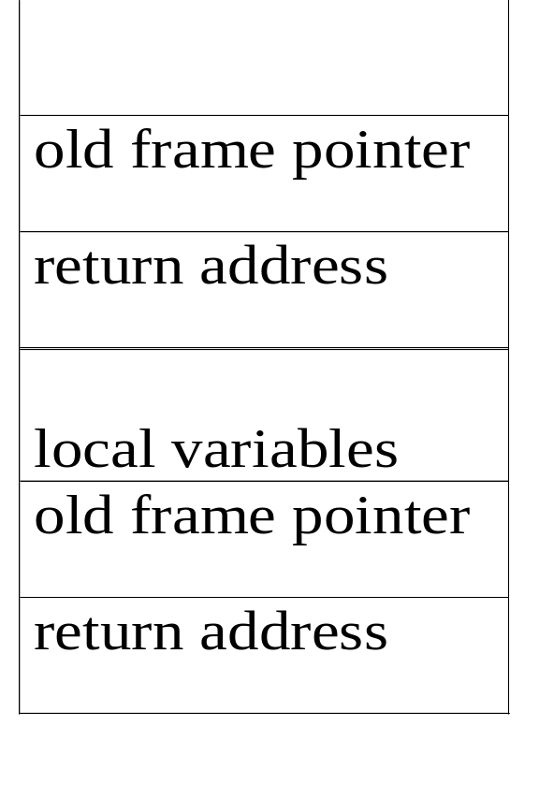
Application: system stack
fp
al
old frame pointer
fp
main
return address
system stack before a1 is invoked
system stack after a1 is invoked
fp: a pointer to current stack frame

Slide 4
structure Stack is objects: a finite ordered list with zero or more elements. functions: for all stack ∈ Stack, item ∈ element, max_stack_size
∈ positive integer
Stack CreateS(max_stack_size) ::= create an empty stack whose maximum size is max_stack_size
Boolean IsFull(stack, max_stack_size) ::= if (number of elements in stack == max_stack_size) return TRUE else return FALSE
Stack Add(stack, item) ::= if (IsFull(stack)) stack_full else insert item into top of stack and return
Abstract data type for stack

Slide 5
Boolean IsEmpty(stack) ::= if(stack == CreateS(max_stack_size)) return TRUE else return FALSE
Element Delete(stack) ::= if(IsEmpty(stack)) return else remove and return the item on the top of the stack. end Stack

Slide 6
Stack CreateS(max_stack_size) ::=
#define MAX_STACK_SIZE 100 /* maximum stack size */ typedef struct { int key;
/* other fields */
} element; element stack[MAX_STACK_SIZE]; int top = -1; /* denote an empty stack */
Boolean IsEmpty(Stack) ::= top< 0;
Boolean IsFull(Stack) ::= top >= MAX_STACK_SIZE-1;
Implementation: using array

Slide 7
void add(int *top, element item)
{
/* add an item to the global stack */ if (*top >= MAX_STACK_SIZE-1) { stack_full( ); return;
} /* the stack is overflow */ stack[++*top] = item;
}
Invoking function : add(&top, item);
Add to a stack

Slide 8
element delete(int *top)
{
/* return the top element from the stack */ if (*top == -1) /* the stack is underflow */ return stack_empty( ); /* returns an error key */ return stack[(*top)--];
}
Invoking function : item = delete(&top);
Delete from a stack

Slide 9
Queue
A queue is an ordered list in which all insertion take place one end, called the rear and all deletions take place at the opposite end, called the front.
a First-In-First-Out (FIFO) list
Inserting and deleting elements in a queue
A
B
A
C
B
A
D
C
B
A
rear
front
D
C
B
rear
front
rear
front
rear
front
rear
front

Slide 10
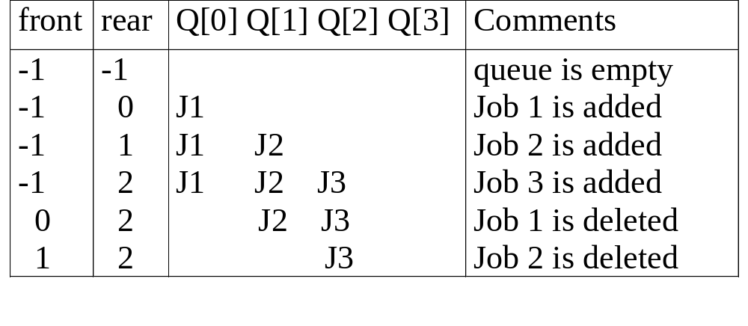
Application: Job scheduling
Insertion and deletion from a sequential queue

Slide 11
structure Queue is objects: a finite ordered list with zero or more elements. functions: for all queue ∈ Queue, item ∈ element, max_ queue_ size ∈ positive integer
Queue CreateQ(max_queue_size) ::= create an empty queue whose maximum size is max_queue_size
Boolean IsFullQ(queue, max_queue_size) ::= if(number of elements in queue == max_queue_size) return TRUE else return FALSE
Queue AddQ(queue, item) ::= if (IsFullQ(queue)) queue_full else insert item at rear of queue and return queue
Abstract data type for queue

Slide 12
Boolean IsEmptyQ(queue) ::= if (queue ==CreateQ(max_queue_size)) return TRUE else return FALSE
Element DeleteQ(queue) ::= if (IsEmptyQ(queue)) return else remove and return the item at front of queue. end Queue

Slide 13
Queue CreateQ(max_queue_size) ::=
# define MAX_QUEUE_SIZE 100/* Maximum queue size */ typedef struct { int key;
/* other fields */
} element; element queue[MAX_QUEUE_SIZE]; int rear = -1; int front = -1;
Boolean IsEmpty(queue) ::= front == rear
Boolean IsFullQ(queue) ::= rear == MAX_QUEUE_SIZE-1
Implementation 1: using array

Slide 14
void addq(int *rear, element item)
{
/* add an item to the queue */ if (*rear == MAX_QUEUE_SIZE_1) { queue_full( ); return;
} /* the queue is overflow */ queue [++*rear] = item;
}
Invoking function : addq(&rear, item); problem: there may be available space when IsFullQ is true i.e. movement is required.
Add to a queue

Slide 15
element deleteq(int *front, int rear)
{
/* remove element at the front of the queue */ if ( *front == rear) /* the queue is underflow */ return queue_empty( ); /* return an error key */ return queue [++ *front];
}
Invoking function item = deleteq(&rear, rear);
Delete from a queue

Slide 16
Implementation 2: regard an array as a circular queue
EMPTY QUEUE
[2]
[3] [2] [3]
J2
J3
[1] [4] [1] [4]
J1
[0] [5] [0] [5]
front = 0 front = 0
rear = 0 rear = 3

Slide 17
Problem: one space is left when queue is full.
Full circular queues
[2]
[3] [2] [3]
J8
J9
J2
J3
J4
J7
[1] [4] [1] [4]
J1
J5
J6
J5
[0] [5] [0] [5]
front = 0 front = 4
rear = 5 rear = 3

Slide 18
void addq(int front, int *rear, element item)
{
/* add an item to the queue */
*rear = (*rear +1) % MAX_QUEUE_SIZE; if (front == *rear) /* reset rear and print error */ return;
} queue[*rear] = item;
}
Invoking function: addq(front, &rear, item);
Add to a circular queue

Slide 19
element deleteq(int* front, int rear)
{ element item;
/* remove front element from the queue and put it in item */ if (*front == rear) return queue_empty( );
/* queue_empty returns an error key */
*front = (*front+1) % MAX_QUEUE_SIZE; return queue[*front];
}
Invoking function: item=deleteq(&rear, rear);
Delete from a circular queue

Slide 20
A Mazing Problem
1 1 1 1 1 1 1 1 1 1 1 1 1 1 1 1 1
entrance
0 1 0 0 0 1 1 0 0 0 1 1 1 1 1
1 0 0 0 1 1 0 1 1 1 0 0 1 1 1
0 1 1 0 0 0 0 1 1 1 1 0 0 1 1
1 1 0 1 1 1 1 0 1 1 0 1 1 0 0
1 1 0 1 0 0 1 0 1 1 1 1 1 1 1
0 0 1 1 0 1 1 1 0 1 0 0 1 0 1
0 1 1 1 1 0 0 1 1 1 1 1 1 1 1
0 0 1 1 0 1 1 0 1 1 1 1 1 0 1
1 1 0 0 0 1 1 0 1 1 0 0 0 0 0
0 0 1 1 1 1 1 0 0 0 1 1 1 1 0
0 1 0 0 1 1 1 1 1 0 1 1 1 1 0
1
1
1
1
1
1
1
1
1
1
1
1
1
1
1
1
1
1
1
1
1
1
exit
1 1 1 1 1 1 1 1 1 1 1 1 1 1 1 1 1
1: blocked path 0: through path

Slide 21
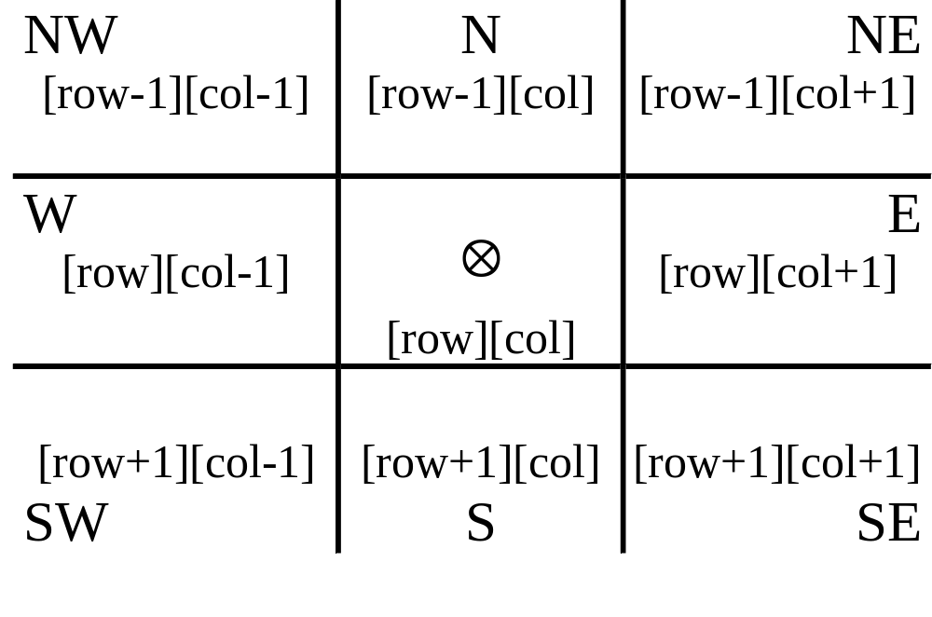
Allowable moves

Slide 22
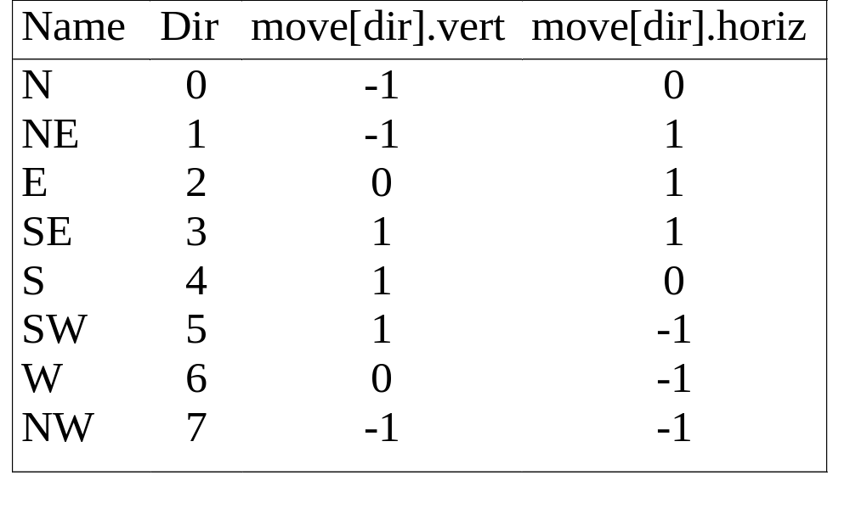
typedef struct { short int vert; short int horiz;
} offsets; offsets move[8]; /*array of moves for each direction*/
A possible implementation
next_row = row + move[dir].vert;
next_col = col + move[dir].horiz;

Slide 23
#define MAX_STACK_SIZE 100
/*maximum stack size*/ typedef struct { short int row; short int col; short int dir;
} element; element stack[MAX_STACK_SIZE];
Use stack to keep pass history

Slide 24
Initialize a stack to the maze’s entrance coordinates and direction to north; while (stack is not empty){
/* move to position at top of stack */
<row, col, dir> = delete from top of stack; while (there are more moves from current position) {
<next_row, next_col > = coordinates of next move; dir = direction of move; if ((next_row == EXIT_ROW)&& (next_col == EXIT_COL)) success; if (maze[next_row][next_col] == 0 && mark[next_row][next_col] == 0) {
Initial maze algorithm

Slide 25
/* legal move and haven’t been there */ mark[next_row][next_col] = 1;
/* save current position and direction */ add <row, col, dir> to the top of the stack; row = next_row; col = next_col; dir = north;
}
}
} printf(“No path found\n”);

Slide 26
The size of a stack
000001
111110
100001
011111
100001
111110
100001
011111
100000
m*p

Slide 27
Evaluation of Expressions
An Expression is made up of operators and operands.
(front == rear)
a + b * 5
((rear + 1 == front) || (!front))
x = a / b - c + d * e - a * c
How to generate the machine instructions corresponding to a given expression?
precedence rule and associative rule

Slide 28
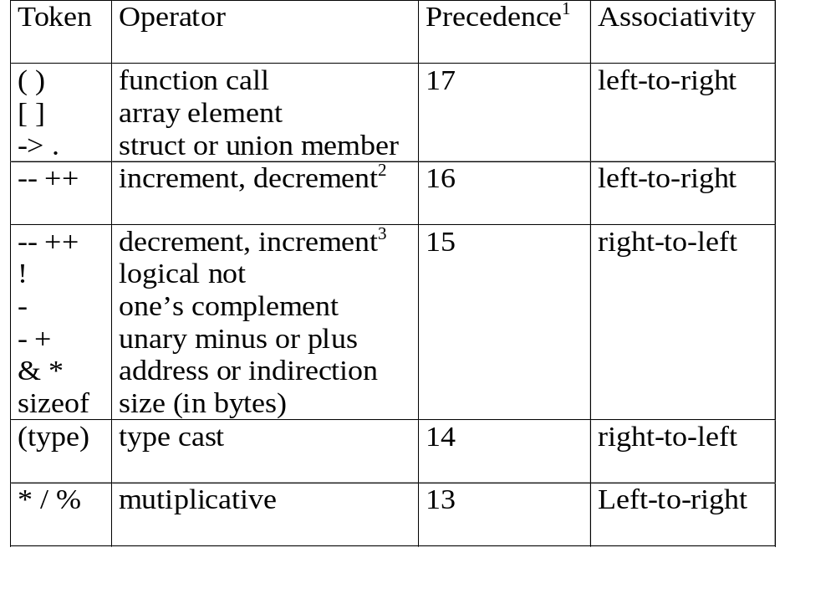
Precedence hierarchy and associative for C

Slide 29
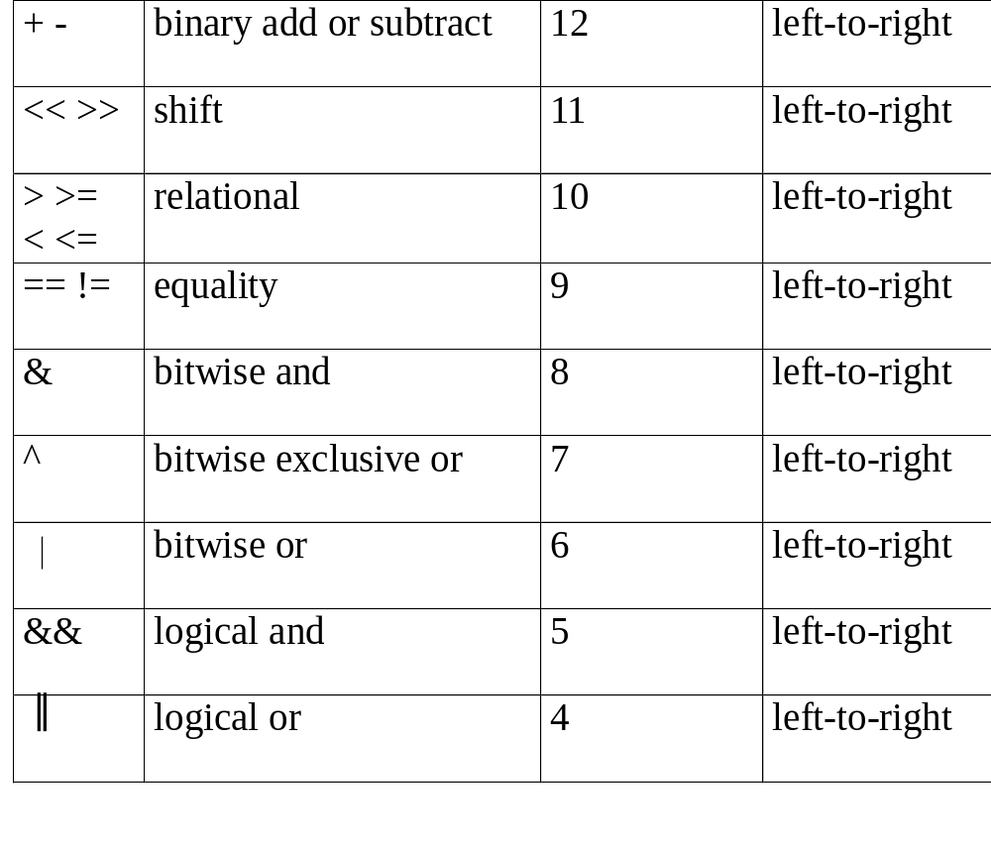

Slide 30
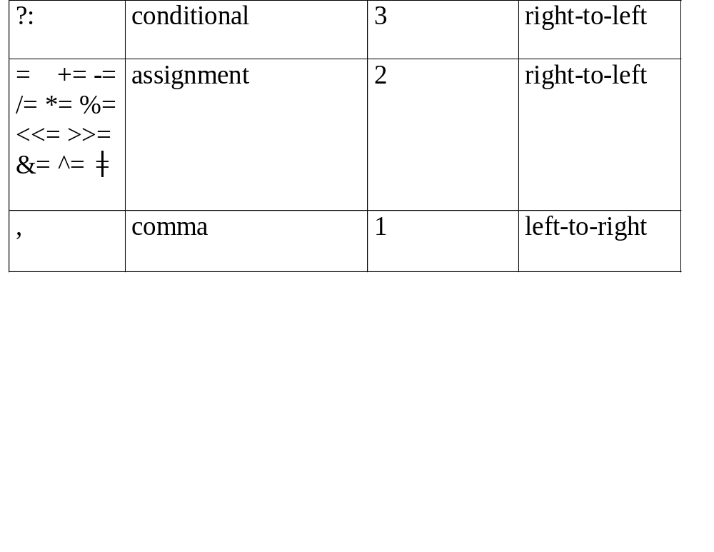
1.The precedence column is taken from Harbison and Steele.
2.Postfix form
3.prefix form

Slide 31
Infix to Postfix Conversion
(1) Fully parenthesize expression
a / b - c + d * e - a * c
 ((((a / b) - c) + (d * e)) - (a * c))
(2) All operators replace their corresponding right
parentheses.
((((a / b) - c) + (d * e)) - (a * c))
(3) Delete all parentheses.
a b / c - d e * + a c * -
 The order of operands is the same in infix and postfix
-
*
*
/
+
-

Slide 32
Infix and postfix notation
Infix
Postfix
2+3*4
2 3 4 * +
a*b+5
a b * 5 +
(1+2)*7
1 2 + 7 *
a*b/c
a b * c /
(a/(b-
c+d))*(e-a)*c
a b c - d + / e a - * c *
a/b-
c+d*e-
a*c
a b / c - d e * a c * -
Postfix: no parentheses, no precedence

Slide 33
Algorithm to convert from infix to postfix
Assumptions:
operators: (, ), +, -, *, /, %
operands: single digit integer or
variable of one character
1. Operands are taken out immediately.
2. Operators are taken out of the stack as long as their
in-stack precedence (isp) is higher than or equal to
the incoming precedence (icp) of the new operator.
3. ‘ (‘ has low isp, and high icp.
op ( ) + - * / % eos
isp 0 19 12 12 13 13 13 0
icp 20 19 12 12 13 13 13 0

Slide 34
precedence stack[MAX_STACK_SIZE];
/* isp and icp arrays -- index is value of precedence lparen, rparen, plus, minus, times, divide, mod, eos */ static int isp [ ] = {0, 19, 12, 12, 13, 13, 13, 0}; static int icp [ ] = {20, 19, 12, 12, 13, 13, 13, 0};
/* isp: in-stack precedence
icp: incoming precedence */

Slide 35
void postfix(void)
{
/* output the postfix of the expression. The expression string, the stack, and top are global */ char symbol; precedence token; int n = 0; int top = 0; /* place eos on stack */ stack[0] = eos; for (token = get _token(&symbol, &n); token != eos; token = get_token(&symbol, &n)) { if (token == operand) printf (“%c”, symbol); else if (token == rparen ){

Slide 36
/*unstack tokens until left parenthesis */ while (stack[top] != lparen) print_token(delete(&top)); delete(&top); /*discard the left parenthesis */
} else{
/* remove and print symbols whose isp is greater than or equal to the current token’s icp */ while(isp[stack[top]] >= icp[token] ) print_token(delete(&top)); add(&top, token);
}
} while ((token = delete(&top)) != eos) print_token(token); print(“\n”);
}

Slide 37
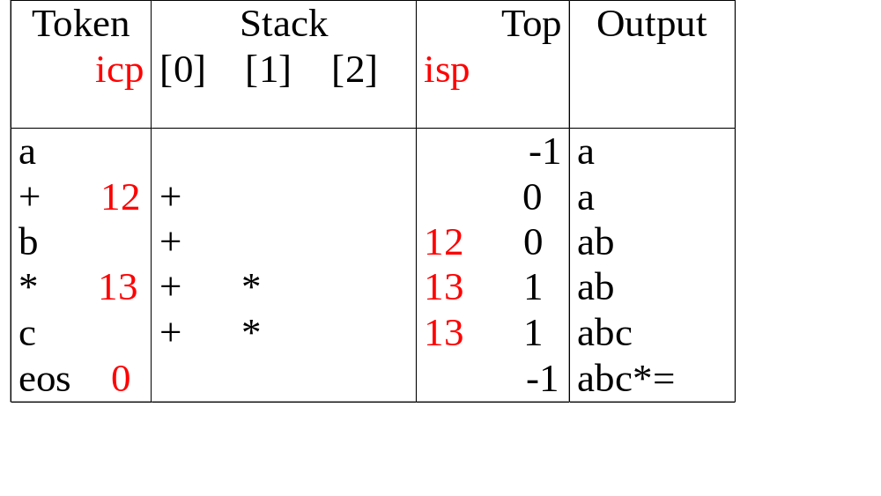
Translation of a+b*c to postfix

Slide 38
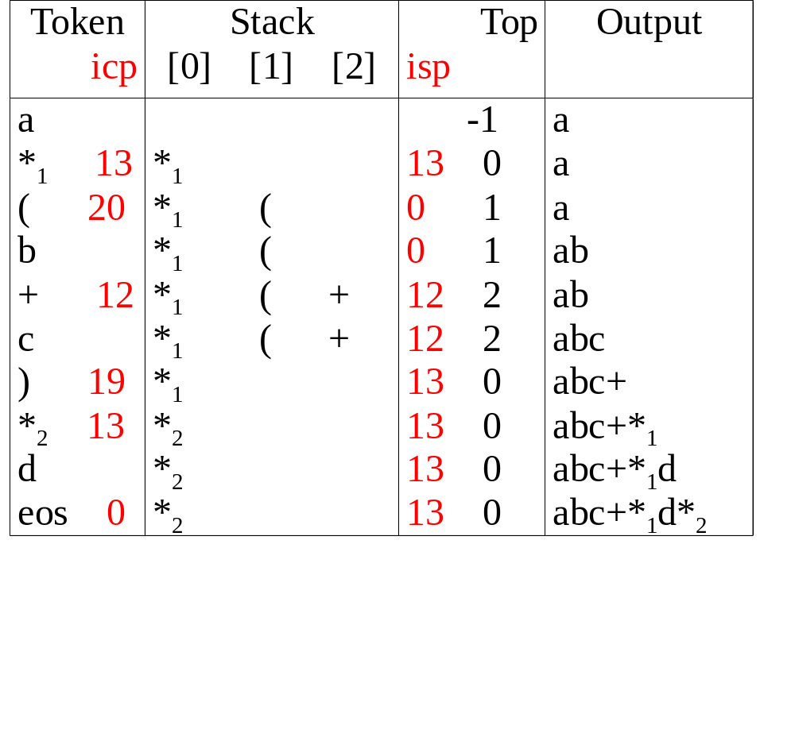
Translation of a *₁ (b +c) *₂ d to postfix
match )
*₁ = *₂

Slide 39
#define MAX_STACK_SIZE 100 /* maximum stack size */
#define MAX_EXPR_SIZE 100 /* max size of expression */ typedef enum{1paran, rparen, plus, minus, times, divide, mod, eos, operand} precedence; int stack[MAX_STACK_SIZE]; /* global stack */ char expr[MAX_EXPR_SIZE]; /* input string */
Algorithm to evaluate a postfix expression
Assumptions:
operators: +, -, *, /, %
operands: single digit integer

Slide 40
int eval(void)
{
/* evaluate a postfix expression, expr, maintained as a global variable, ‘\0’ is the the end of the expression.
The stack and top of the stack are global variables. get_token is used to return the token type and the character symbol. Operands are assumed to be single character digits */ precedence token; char symbol; int op1, op2; int n = 0; /* counter for the expression string */ int top = -1; token = get_token(&symbol, &n); while (token != eos) { if (token == operand) add(&top, symbol-’0’); /* stack insert */
exp: character array

Slide 41
else {
/* remove two operands, perform operation, and return result to the stack */ op2 = delete(&top); /* stack delete */ op1 = delete(&top); switch(token) { case plus: add(&top, op1+op2); break; case minus: add(&top, op1-op2); break; case times: add(&top, op1*op2); break; case divide: add(&top, op1/op2); break; case mod: add(&top, op1%op2);
}
} token = get_token (&symbol, &n);
} return delete(&top); /* return result */
}

Slide 42
precedence get_token(char *symbol, int *n)
{
/* get the next token, symbol is the character representation, which is returned, the token is represented by its enumerated value, which is returned in the function name */
*symbol =expr[(*n)++]; switch (*symbol) { case ‘(‘ : return lparen; case ’)’ : return rparen; case ‘+’: return plus; case ‘-’ : return minus;
case ‘/’ : return divide;
case ‘*’ : return times;
case ‘%’ : return mod;
case ‘\0‘ : return eos;
default : return operand;
/* no error checking, default is operand */
}
}

Slide 43
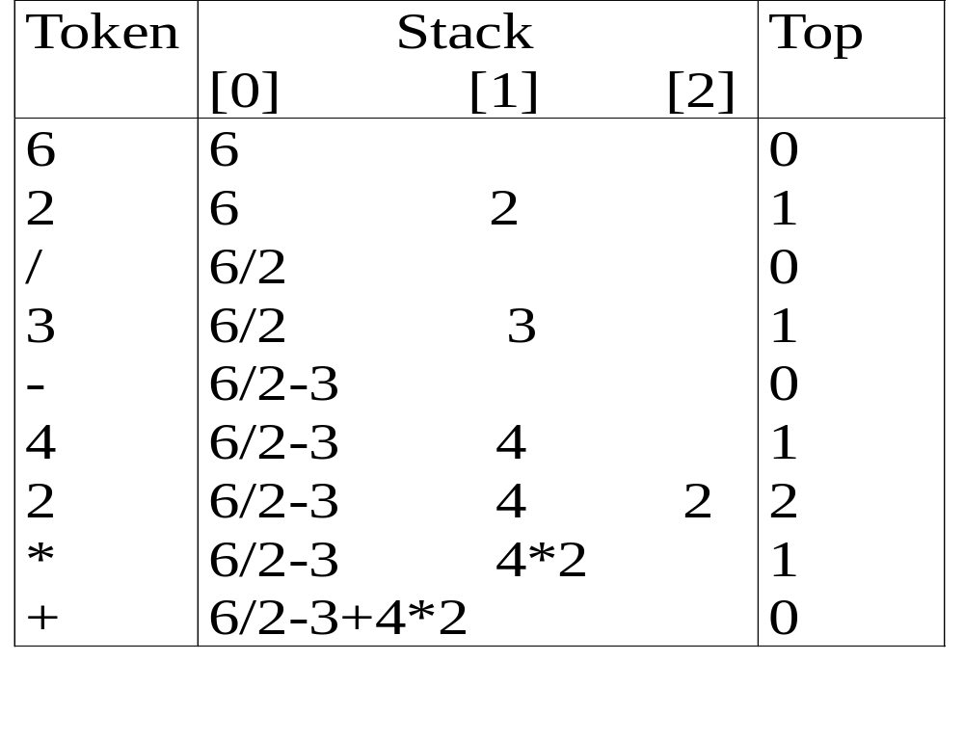
Postfix evaluation : 6 2 / 3 - 4 2 * +

Slide 44
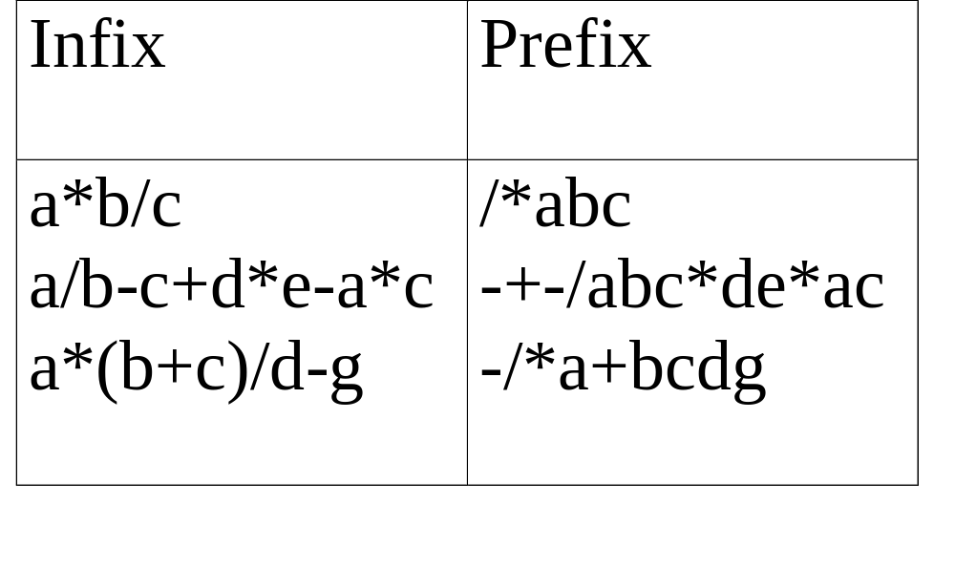
Infix and prefix expressions
The order of operands is the same in infix and prefix.
Prefix: no parentheses, no precedence

Slide 45
Multiple stacks and queues
(1) Two stacks
m[0], m[1], …, m[n-2], m[n-1]
bottommost bottommost
stack 1 stack 2
(2) More than two stacks (n)
memory is divided into n equal segments
boundary[stack_no]
0 ≤ stack_no < MAX_STACKS
top[stack_no]
0 ≤ stack_no < MAX_STACKS

Slide 46
Initial configuration for n stacks in memory [m], boundary[i]=top[i],
All stacks are empty and divided into roughly equal segments.
0 1 ... [ m/n ] ... 2[ m/n ] … m-1
boundary[ 0] boundary[1] boundary[ 2] boundary[n]
top[ 0] top[ 1] top[ 2]

Slide 47
#define MEMORY_SIZE 100 /* size of memory */
#define MAX_STACK_SIZE 100
/* max number of stacks plus 1 */
/* global memory declaration */ element memory[MEMORY_SIZE]; int top[MAX_STACKS]; int boundary[MAX_STACKS]; int n; /* number of stacks entered by the user */ top[0] = boundary[0] = -1; for (i = 1; i < n; i++) top[i] =boundary[i] =(MEMORY_SIZE/n)*i; boundary[n] = MEMORY_SIZE-1;

Slide 48
void add(int i, element item)
{
/* add an item to the ith stack */ if (top[i] == boundary [i+1]) stack_full(i); /* may have unused storage*/ memory[++top[i]] = item;
}
Add to the stack[i]

Slide 49
Delete from the stack[i]
element delete(int i)
{
/* remove top element from the ith stack */
if (top[i] == boundary[i])
return stack_empty(i);
return memory[top[i]--];
}

Slide 50
Configuration when stack i meets stack i+1,
but the memory is not full
(往右)
Find j, stack_no < j < n
such that top[j] < boundary[j+1]
or, 0 ≤ j < stack_no
(往左)
b[0] t[0] b[1] t[1] b[i] t[i] t[i+1] t[j] b[j+1] b[n]
b[i+1] b[i+2]
b=boundary, t=top
meet
往左或右找一個空間

