Slide 1

Chapter 6
Graphs

Slide 2
Outline
The Graph Abstract Data Type
Elementary Graph Operations
Minimum Cost Spanning Trees
Shortest Paths And Transitive Closure
Activity Network

Slide 3
The Bridges of Koenigsbers
C
c
g
d
C
g
c
d
e
A
A
D
e
D
Kneiphof
a
b
f
B
a
f
b
B

Slide 4
Definitions
A graph G = (V,E) consists of two sets
  a finite, nonempty set of vertices V
  a finite, possible empty set of edges E
0
1
2
V(G1)={0,1,2,3} E(G1)={(0,1),(0,2),(0,3),(1,2),(1,3),(2,3)}
3
G1

Slide 5
Undirected Graph
An undirected graph is one in which the pair of vertices in a edge is unordered, i.e.(v0, v1) = (v1,v0)
0
0
1
3
2
1
2
3

Slide 6
Directed Graph
A directed graph is one in which each edge is a directed pair of vertices, <v0, v1> != <v1,v0>
0
0
2
1
1
2
G3

Slide 7
Complete Graph
A complete graph is a graph that has the
maximum number of edges
  For undirected graph with n vertices, the maximum number of edges is n(n-1)/2
  For directed graph with n vertices, the maximum number of edges is n(n-1)

Slide 8
Complete Graph (cont’d)
0
0
0
1
2
1
2
1
2
3
3
3
4
5
6
complete graph
incomplete graph
complete undirected graph: n(n-1)/2 edges
complete directed graph: n(n-1) edges

Slide 9
Adjacent and Incident
If (v0, v1) is an edge in an undirected graph,
  v0 and v1 are adjacent
  The edge (v0, v1) is incident on vertices v0 and v1
If <v0, v1> is an edge in a directed graph
  v0 is adjacent to v1, and v1 is adjacent from v0
  The edge <v0, v1> is incident on v0 and v1
V₀
V₁
V₀
V₁

Slide 10
A Graph with Feedback and a Multigraph
0
0
2
1
3
1
2
self edge
multigraph:
multiple occurrences
of the same edge
(a)
(b)

Slide 11
Subgraph
A subgraph of G is a graph G’ such that V(G’) ⊆ V(G) and E(G’) ⊆ E(G).
0
0
0
1
2
1
2
0
1
2
3
3
1
2
3
(i) (ii) (iii) (iv)
(a) Some of the subgraph of G₁
G1

Slide 12
Subgraph (cont’d)
0
0
0
0
0
1
1
1
1
2
2
2
G3
(i) (ii) (iii) (iv)
(b) Some of the subgraph of G₃

Slide 13
Path
A path from vertex vp to vertex vq in a graph G, is a sequence of vertices, vp, vi1, vi2, ..., vin, vq, such that (vp, vi1), (vi1, vi2), ..., (vin, vq) are edges in an undirected graph.
The length of a path is the number of edges on it.
0
0
0
1
2
1
2
1
2
3
3
3

Slide 14
Simple Path and Cycle
A simple path is a path in which all vertices,
except possibly the first and the last, are distinct.
A cycle is a simple path in which the first and the last vertices are the same.
0
1
2
3

Slide 15
Simple Path and Cycle (cont’d)
In an undirected graph G, two vertices, v₀ and v₁, are connected if there is a path in G from v₀ to v₁
An undirected graph is connected if, for every pair of distinct vertices v_{i}, v_{j}, there is a path from v_{i} to v_{j}
0
4
5
0
4
5
1
2
3
1
2
3

Slide 16
Connected Component
A connected component of an undirected graph is a maximal connected subgraph.
A tree is a graph that is connected and acyclic.
4
0
H₂
H₁
5
2
1
6
3
7
A graph with two connected components

Slide 17
Strongly Connected Component
A directed graph is strongly connected if there is a directed path from vi to vj and also from vj to vi.
A strongly connected component is a maximal subgraph that is strongly connected.
0
0
1
2
2
1
G3
Strongly connected components of G₃

Slide 18
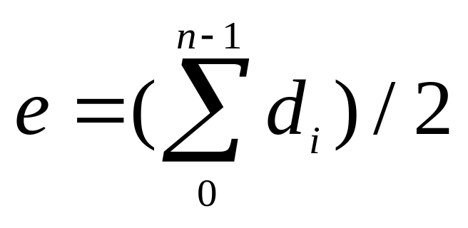
Degree
The degree of a vertex is the number of edges incident to that vertex.
For directed graph,
  in-degree (v) : the number of edges that have v as the head
  out-degree (v) : the number of edges that have v as the tail.
if di is the degree of a vertex i in a graph G with n vertices and e edges, the number of edges is

Slide 19
Degree (cont’d)
undirected graph
directed graph
3
in-degree
out-degree
degree
2
0
0
3
3
3
1
2
0
in:1, out: 1
3
1
2
3
1
1
1
1
3
1
in: 1, out: 2
3
4
5
6
G1
G2
2
in: 1, out: 0
G3

Slide 20
Abstract Data Type Graph
structure Graph is
objects : a nonempty set of vertices and a set of undirected edges, where each edge is a pair of vertices
functions : for all graph ∈ Graph, v, v₁ and v₂ ∈ Vertices
Graph Create() ::= return an empty graph
Graph InsertVertex(graph, v) ::= return a graph with v inserted. v has no
incident edge.
Graph InsertEdge(graph, v1,v2) ::= return a graph with new edge
between v1 and v2
Graph DeleteVertex(graph, v) ::= return a graph in which v and all edges
incident to it are removed
Graph DeleteEdge(graph, v1, v2) ::= return a graph in which the edge (v1, v2)
is removed
Boolean IsEmpty(graph) ::= if (graph==empty graph) return TRUE
else return FALSE
List Adjacent(graph,v) ::= return a list of all vertices that are adjacent to v

Slide 21
Graph Representations
Adjacency Matrix
Adjacency Lists
Adjacency Multilists

Slide 22
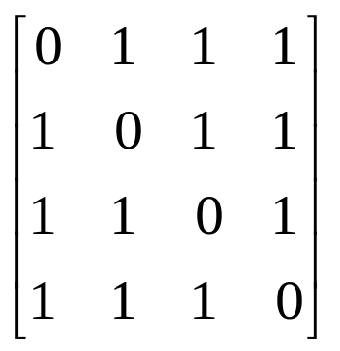
Adjacency Matrix
Let G=(V,E) be a graph with n vertices.
The adjacency matrix of G is a two-dimensional
n x n array, say adj_mat
If the edge (vi, vj) is in E(G), adj_mat[i][j]=1
If there is no such edge in E(G), adj_mat[i][j]=0
The adjacency matrix for an undirected graph is symmetric; the adjacency matrix for a digraph
need not be symmetric
0
1
2
G1
3

Slide 23
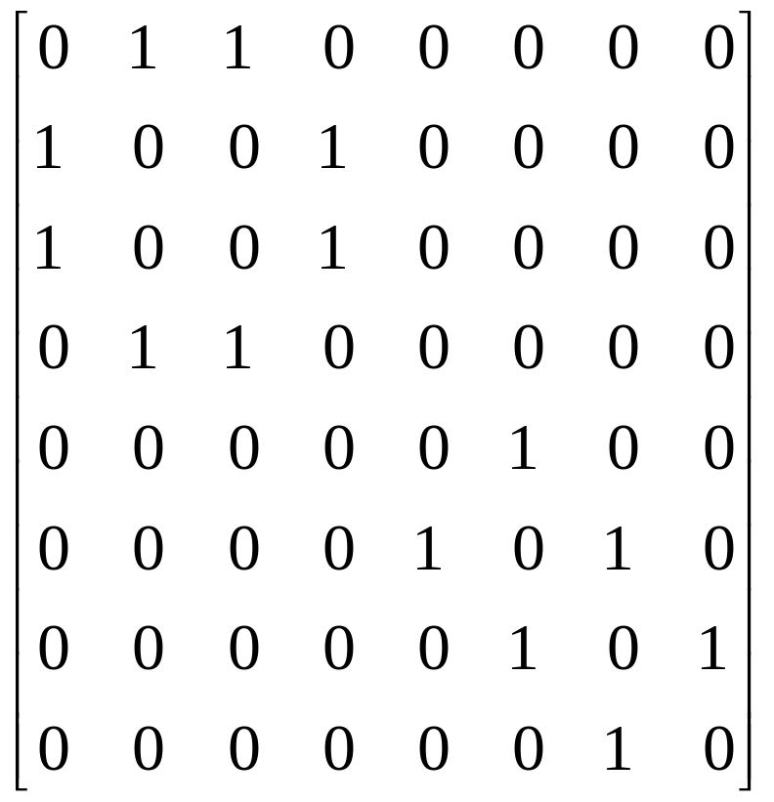
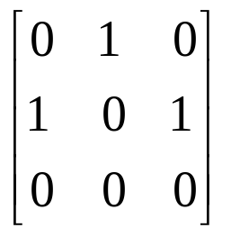
Adjacency Matrix (Cont’d)
0
4
2
1
5
3
6
0
G4
7
1
2
G3

Slide 24
C Declarations for Adjacency Lists
#define MAX_VERTICES 50
typedef struct node *node_pointer;
typedef struct node {
int vertex;
struct node *link;
};
node_pointer graph[MAX_VERTICES];
int n=0;
/* vertices currently in use */

Slide 25
Adjacency lists for G₁ and G₃
0
G1
0
G3
1
1
2
3
2
0
1
2
3
1
2
3
0
2
3
0
1
2
1
0
1
3
0
2
0
1
2

Slide 26
Adjacency lists for G₄
0
1
2
3
4
5
6
7
1
2
0
3
0
4
0
3
2
1
5
1
2
3
6
5
7
4
6
G4
5
7
6

Slide 27
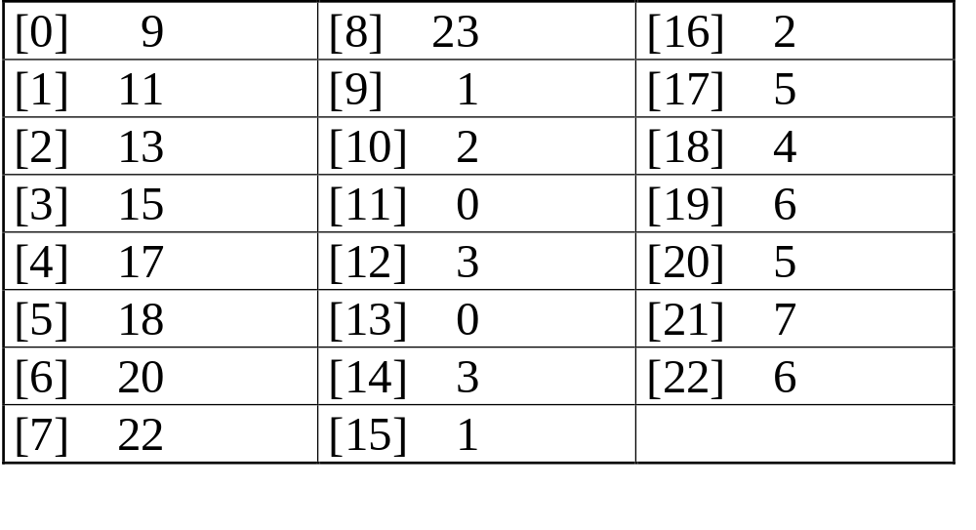
Sequential Representation of Graph G₄
0
4
node[0] … node[n-1]: starting point for vertices
node[n]: n+2e+1
node[n+1] … node[n+2e]: head node of edge
2
1
5
3
6
7
0
4
5
1
6
2
7
3

Slide 28
Finding In-degree of Vertices
0
0
1
2
•
•
•
1 NULL
0 NULL
1
1 NULL
2
Inverse adjacency list of G₃
tail head column link for head row link for tail
Alternate node structure of adjacency lists

Slide 29
Example of Changing Node Structure
0
1
2
0
0 1 NULL NULL
1
1 0 NULL
1 2 NULL NULL
0
2 NULL
1
Orthogonal representation of G₃
2

Slide 30
Vertices in Any Order
Head nodes vertex links
0
•
3 •
1 •
2 NULL
0
1
•
2 •
0 •
3 NULL
1
2
2
•
3 •
0 •
1 NULL
3
3
•
2 •
1 •
0 NULL

Slide 31
Adjacency Multilists
Lists in which nodes may be shared among several lists.
There is exactly one node for each edge.
This node is on the adjacency list for each of the two vertices it is incident to.

Slide 32
C Declarations for Adjacency Multilists
typedef struct edge *edge_pointer;
typedef struct edge {
short int marked;
int vertex1, vertex2;
edge_pointer path1, path2;
};
edge_pointer graph[MAX_VERTICES];
marked vertex1 vertex2 path1 path2
Node structure for adjacency multilists

Slide 33
Adjacency multilist for G₁
marked vertex1 vertex2 path1 path2
Lists: vertex 0: N1->N2->N3, vertex 1: N1->N4->N5
vertex 2: N2->N4->N6, vertex 3: N3->N5->N6
0
1
2
3
N1
N2
N3
N4
N5
N6
0 1 N2 N4
edge (0,1)
edge (0,2)
edge (0,3)
edge (1,2)
edge (1,3)
edge (2,3)
0 2 N3 N4
0 3 N5
1 2 N5 N6
0
1 3 N6
1
2
2 3
3

Slide 34
Elementary Graph Operations
Traversal
Given G=(V,E) and vertex v, find all w∈V,
such that w connects v.
  Depth First Search (DFS): preorder traversal
  Breadth First Search (BFS):level order traversal
Spanning Trees
Biconnected Components

Slide 35
Examples of DFS and BFS
0
1
2
3
4
5
6
7
depth first search: v0, v1, v3, v7, v4, v5, v2, v6
breadth first search: v0, v1, v2, v3, v4, v5, v6, v7

Slide 36
Depth First Search
#define FALSE 0
#define TRUE 1
short int visited[MAX_VERTICES];
void dfs(int v)
{
node_pointer w;
visited[v]= TRUE;
printf(“%5d”, v);
for (w=graph[v]; w; w=w->link)
if (!visited[w->vertex])
dfs(w->vertex);
}

Slide 37
Breadth First Search
typedef struct queue *queue_pointer;
typedef struct queue {
int vertex;
queue_pointer link;
};
void addq(queue_pointer *,
queue_pointer *, int);
int deleteq(queue_pointer *);

Slide 38
Breadth First Search (cont’d)
void bfs(int v)
{
node_pointer w;
queue_pointer front, rear;
front = rear = NULL;
printf(“%5d”, v);
visited[v] = TRUE;
addq(&front, &rear, v);

Slide 39
Breadth First Search (cont’d)
while (front) {
v= deleteq(&front);
for (w=graph[v]; w; w=w->link)
if (!visited[w->vertex]) {
printf(“%5d”, w->vertex);
addq(&front,&rear,w-vertex);
visited[w->vertex] = TRUE;
}
}
}

Slide 40
Connected Components
void connected(void)
{
for (i=0; i<n; i++) {
if (!visited[i]) {
dfs(i);
printf(“\n”);
}
}
}

Slide 41
Spanning Trees
When graph G is connected, a depth first or breadth first search starting at any vertex will visit all vertices in G
A spanning tree is any tree that consists solely of edges in G and that includes all the vertices
0
0
0
0
1
2
1
2
1
2
1
2
3
3
3
3
G1
Three of its spanning trees

Slide 42
Spanning Trees (cont’d)
We may use either DFS or BFS to create a
spanning tree
  When DFS is used, the resulting spanning tree is known as a depth first spanning tree
  When BFS is used, the resulting spanning tree is known as a breadth first spanning tree
If we add a non-tree edge into any spanning tree, a cycle will be created.

Slide 43
DFS & BFS Spanning Tree
0
0
0
1
2
1
2
1
2
3
4
5
6
3
4
5
6
3
4
5
6
7
7
7
DFS spanning tree
BFS spanning tree
depth first search: v0, v1, v3, v7, v4, v5, v2, v6
breadth first search: v0, v1, v2, v3, v4, v5, v6, v7

Slide 44
Spanning Trees (cont’d)
A spanning tree is a minimal subgraph, G', of G such that V(G')=V(G) and G' is connected.
Any connected graph with n vertices must have at least n-1 edges.

Slide 45
Biconnected Graph & Articulation Points
An articulation points is a vertex v of G such that the deletion of v, together with all edges incident on v,produces a graph, G’, that at least two connected components.
A biconnected graph is a connected graph that has no articulation points.
0
1
2
3
4
5
6
7

Slide 46
Articulation Points (e.g. Node 3)
0
8 9
0
8 9
2
7
2
7
1
1
3
5
3
5
4
6
4
6
Connected graphe
two connected components

Slide 47
Non-articulation Points (e.g. Node 2)
0
8 9
0
8 9
2
7
2
7
1
1
3
5
3
5
4
6
4
6
Connected graph
one connected graph

Slide 48
Biconnected Component
0
8
9
0
8 9
1
7
7
2
7
1
2
7
1
3
5
3
3
5
5
4
6
4
6
Connected graph
Biconnected components

Slide 49
Find biconnected component by using depth first spanning tree
0
3
4 0
9 8 9 8
1 5
4
5
7 7
3
1
0 5
3 5
2
4
2
6
7
6
2 2
3
1
7
8 9
4 6
1 6
0
9
8
(a) depth first spanning tree (b)

Slide 50
0
The root is an articulation point if it has at least two children.
3
1 5
4
5
2
4
2
6
7
6
Any other vertex u is an articulation point if it has at least one child w such that low(w) ≥ dfn(u)
3
1
7
8 9
0
9
8
low(u) = min{dfn(u), min{low(w)|w is a child of
u}, min{dfn(w) | (u,w) is a back edge}}

Slide 51
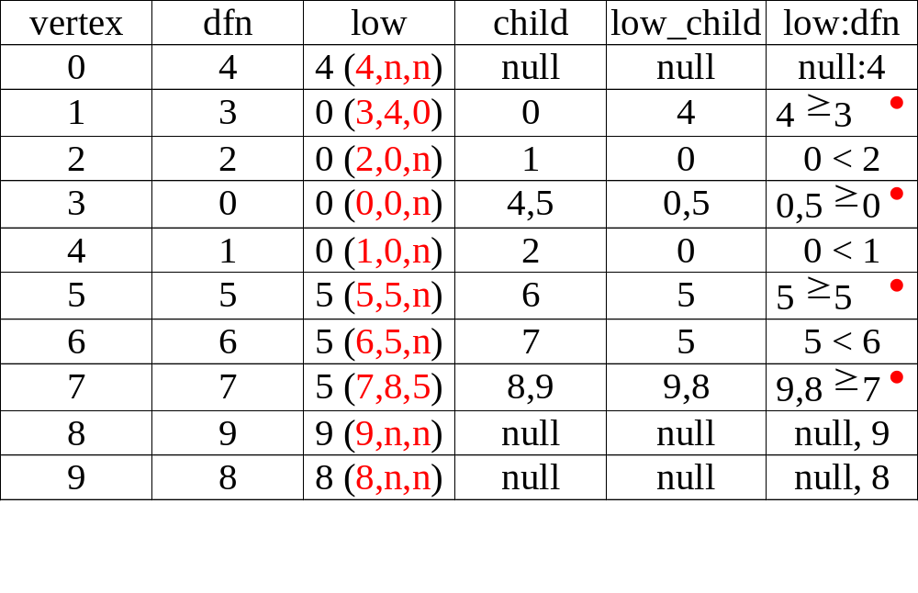
3
1 5
4
5
2
4
2
6
7
6
3
1
7
0
9
8
8 9

Slide 52
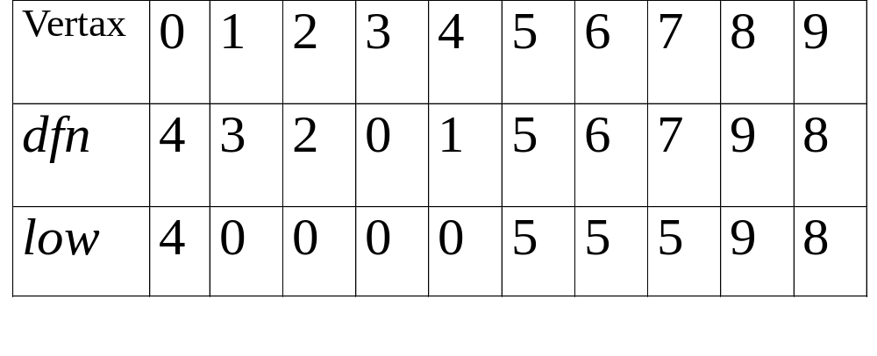
Figure 6.24
dfn and low values for dfs spanning tree with root =3

Slide 53
Initialization of dfn and low
(Program 6.5)
void init(void)
{
int i;
for (i = 0; i < n; i++) {
visited[i] = FALSE;
dfn[i] = low[i] = -1;
}
num = 0;
}

Slide 54
Determining dfn and low (Program 6.4)
void dfnlow(int u, int v)
{
/* compute dfn and low while performing a dfs search
beginning at vertex u, v is the parent of u (if any) */
node_pointer ptr;
int w;
dfn[u] = low[u] = num++;
for (ptr = graph[u]; ptr; ptr = ptr ->link) {
w = ptr ->vertex;
if (dfn[w] < 0) { /*w is an unvisited vertex */
dfnlow(w, u);
low[u] = MIN2(low[u], low[w]);
}
else if (w != v)
low[u] =MIN2(low[u], dfn[w] );
}
}

Slide 55
Biconnected components (Program 6.6)
void bicon(int u, int v)
{
/* compute dfn and low, and output the edges of G by their
biconnected components , v is the parent ( if any) of the u
(if any) in the resulting spanning tree. It is assumed that all
entries of dfn[ ] have been initialized to -1, num has been
initialized to 0, and the stack has been set to empty */
node_pointer ptr;
int w, x, y;
dfn[u] = low[u] = num ++;
for (ptr = graph[u]; ptr; ptr = ptr->link) {
w = ptr ->vertex;
if ( v != w && dfn[w] < dfn[u] )
add(&top, u, w); /* add edge to stack */

Slide 56
Program 6.6 (cont’d)
if(dfn[w] < 0) {/* w has not been visited */
bicon(w, u);
low[u] = MIN2(low[u], low[w]);
if (low[w] >= dfn[u] ){
printf(“New biconnected component: “);
do { /* delete edge from stack */
delete(&top, &x, &y);
printf(“ <%d, %d>” , x, y);
} while (!(( x = = u) && (y = = w)));
printf(“\n”);
}
}
else if (w != v) low[u] = MIN2(low[u], dfn[w]);
}
}

Slide 57
Minimum Cost Spanning Trees
The cost of a spanning tree of a weighted undirected graph is the sum of the costs of the edges in the spanning tree
A minimum cost spanning tree is a spanning
tree of least cost.
Three different algorithms can be used to obtain a minimum cost spanning tree.
  Kruskal’s algorithm
  Prim’s algorithm
  Sollin’s algorithm

Slide 58
Greedy Strategy
Construct an optimal solution in stages.
At each stage, make the best decision at this time.
Make sure that the decision will result in a feasible solution
The selection of an item is based on a least cost or a highest profit criterion.
A feasible solution works within the constraints specified by the problem.

Slide 59
Kruskal’s Algorithm
Build a minimum cost spanning tree T by
adding edges to T one at a time.
Select the edges for inclusion in T in non-decreasing order of the cost.
An edge is added to T if it does not form a
cycle.

Slide 60
10
0
0 5
2 3
1 6
1 2
3 6
3 4
4 6
4 5
0 1
28
10
1
12
14
16
14
5
6
2
24
25
16
18
12
4
18
22
3
0
0
22
1
1
10
24
5
6
2
5
6
2
25
4
4
28
3
3

Slide 61
Kruskal’s Algorithm
T= {};
while (T contains less than n-1 edges
&& E is not empty) {
choose a least cost edge (v,w) from E;
delete (v,w) from E;
if ((v,w) does not create a cycle in T)
add (v,w) to T
else
discard (v,w);
}
if (T contains fewer than n-1 edges)
printf(“No spanning tree\n”);

Slide 62
Prim’s Algorithm
Build a minimum cost spanning tree T by
adding edges to T one at a time.
At each stage, add a least cost edge to T such that the set of selected edges is still a tree.
Repeat the edge addition step until T contains n-1 edges.

Slide 63
Examples for Prim’s Algorithm
0
0
0
28
1
1
1
10
10
10
14
16
5
6
2
5
6
2
5
6
2
24
25
25
18
12
4
4
4
22
3
3
3

Slide 64
Prim’s Algorithm
T={};
TV={0};
while (T contains fewer than n-1 edges)
{
let (u,v) be a least cost edge such
that u ∈ TV and v ∉ TV
if (there is no such edge ) break;
add v to TV;
add (u,v) to T;
}
if (T contains fewer than n-1 edges)
printf(“No spanning tree\n”);

Slide 65
Sollin’s Algorithm
Selects several edges for inclusion in T at each stage.
At the start of a stage, the selected edges forms a spanning forest.
During a stage we select a minimum cost edge that has exactly one vertex in the tree edge for each tree in the forest.
Repeat until only one tree at the end of a stage or no edges remain for selection.

Slide 66
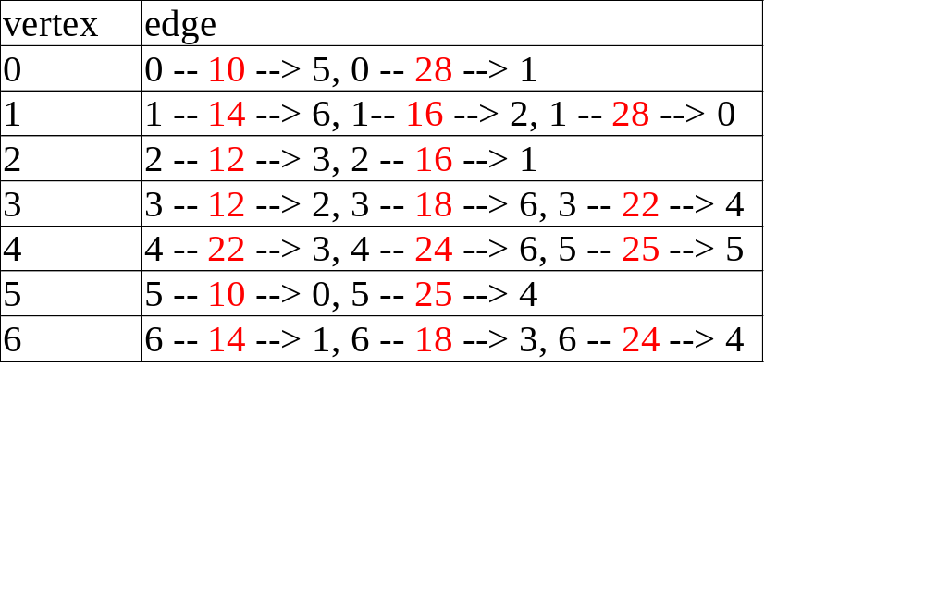
Example of Sollin’s Algorithm
0
28
10
1
14
16
5
6
2
24
25
18
12
4
22
3
0
0
1
10
1
10
14
14
16
5
6
2
5
6
2
12
4
12
4
22
3
22
3

Slide 67

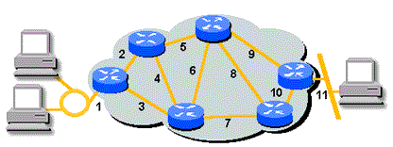
Shortest Paths

Slide 68
Single Source All Destinations
Determine the shortest paths from v₀ to all the remaining vertices.
45
50 10
path length
1) v0 v2 10
2) v0 v2 v3 25
3) v0 v2 v3 v1 45
4) v0 v4 45
(b)
V₀
V₁
V₄
20 10 15 20 35 30
V₂
15 3
V₃
V₅
(a)

Slide 69
Example of the Shortest Path
Boston
San
Francisco
Chicago
4
Denver
1200
3
250
1500
800
2
1000
1
5
New
York
300
1000
1400
1700
New Orleans
900
0
7
1000
Los Angeles
6
Miami
0 1 2 3 4 5 6 7
0 0
1 300 0
2 1000 800 0
3 1200 0
4 1500 0 250
5 1000 0 900 1400
6 0 1000
7 1700 0

Slide 70
Boston
San
Francisco
Chicago
4
Denver
1200
3
250
1500
800
2
1000
1
5
New
York
300
1000
1400
1700
New Orleans
900
0
7
1000
Los Angeles
6
Miami
(a)
(b)
(c)
4
1500
4
1500
4
250
3
3
5
250
250
5
1000
5
900
6

Slide 71
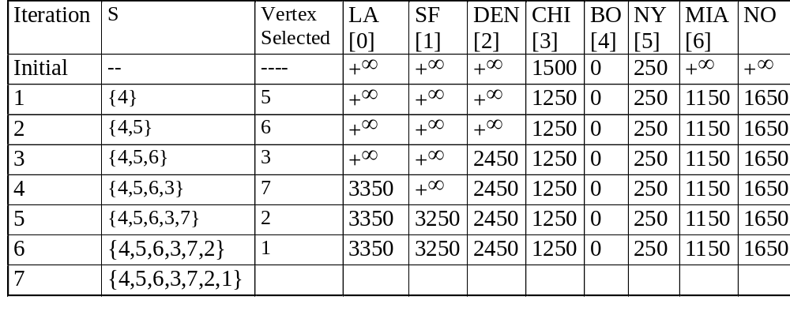
Action of shortestpath

Slide 72
Declarations for the Shortest Path Algorithm
#define MAX_VERTICES 6
int cost[][MAX_VERTICES]=
{{ 0, 50, 10, 1000, 45, 1000},
{1000, 0, 15, 1000, 10, 1000},
{ 20, 1000, 0, 15, 1000, 1000},
{1000, 20, 1000, 0, 35, 1000},
{1000, 1000, 30, 1000, 0, 1000},
{1000, 1000, 1000, 3, 1000, 0}};
int distance[MAX_VERTICES];
short int found{MAX_VERTICES];
int n = MAX_VERTICES;

Slide 73
Single Source Shortest Paths (Program 6.10)
void shortestpath(int v, int cost[][MAX_ERXTICES], int distance[], int n, short int found[])
{
int i, u, w;
for (i=0; i<n; i++) {
found[i] = FALSE;
distance[i] = cost[v][i];
}
found[v] = TRUE;
distance[v] = 0;

Slide 74
Single Source Shortest Paths (Program 6.10)
for (i=0; i<n-2; i++) {
u = choose(distance, n, found);
found[u] = TRUE;
for (w=0; w<n; w++)
if (!found[w])
if(distance[u]+cost[u][w]<distance[w])
distance[w] = distance[u]+cost[u][w];
}
}

Slide 75
All Pairs Shortest Paths
Find the shortest paths between all pairs of vertices.
One Solution:
  Apply shortest path n times with each vertex as source.
  Computing time : O(n³)

Slide 76
All Pairs Shortest Paths (cont’d)
Another Solution
  Represent the graph G by its cost adjacency matrix with cost[i][j]
  If the edge <i,j> is not in G, the cost[i][j] is set to some sufficiently large number
  A[i][j] is the cost of the shortest path form i to j, using only those intermediate vertices with an index <= k

Slide 77
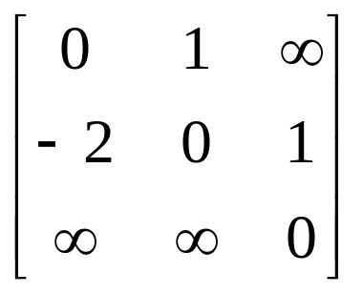
Graph with Negative Cycle
-2
0
1
2
1
1
(a) Directed graph (b) A⁻¹

Slide 78
All pairs, shortest paths function (Program 6.12)
void allcosts(int cost[][MAX_VERTICES],
int distance[][MAX_VERTICES], int n)
{
int i, j, k;
for (i=0; i<n; i++)
for (j=0; j<n; j++)
distance[i][j] = cost[i][j];
for (k=0; k<n; k++)
for (i=0; i<n; i++)
for (j=0; j<n; j++)
if (distance[i][k]+distance[k][j]
< distance[i][j])
distance[i][j]=
distance[i][k]+distance[k][j];
}

Slide 79
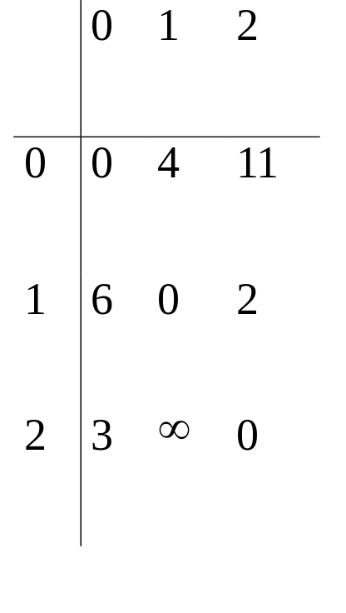
Directed graph and its cost matrix
6
4
V₀
V1
3 11 2
V₂
(a) Digraph G (b) Cost adjacency matrix for G

Slide 80
Transitive Closure
given a graph with unweighted edges, determine if there is a path from i to j for all i and j.
  Require positive path (> 0) lengths
  Require nonnegative path (≥0) lengths.

Slide 81
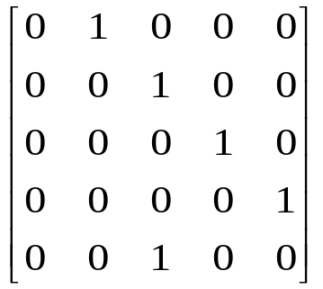
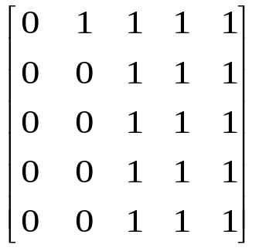
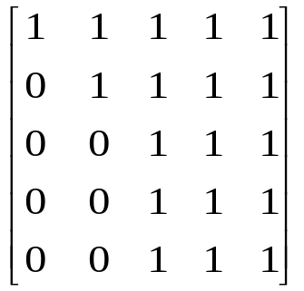
Transitive Closure (cont’d)
0
1
2
3
4
0
1
2
3
4
(a) Digraph G (b) Adjacency matrix A for G
0
1
2
3
4
0
1
2
3
4
(c) transitive closure matrix A⁺ (d) reflexive transitive closure matrix A*

Slide 82
Activity on Vertex (AOV) Network
Definition: A directed graph in which the vertices represent tasks or activities and the edges represent precedence relations between tasks.
predecessor (successor): vertex i is a predecessor of vertex j if there is a directed path from i to j. j is a successor of i.
partial order: a precedence relation which is both transitive (∀i, j, k, i • j & j • k => i • k ) and irreflexive (∀x, x • x is false).

Slide 83
An AOV Network (Figure 6.38)
Topological order: linear ordering of vertices of a graph
∀i, j if i is a predecessor of j, then i precedes j in the linear ordering
C1, C2, C4, C5, C3, C6, C8,
C7, C10, C13, C12, C14, C15,
C11, C9
C4, C5, C2, C1, C6, C3, C8,
C15, C7, C9, C10, C11, C13,
C12, C14
C8
C9
C1
C3
C10
C11
C2
C7
C12
C4
C5
C6
C13
C14
C15

Slide 84
Topological sort (Program 6.13)
for (i = 0; i <n; i++) {
if every vertex has a predecessor {
fprintf (stderr, “Network has a cycle. \n “ );
exit(1);
}
pick a vertex v that has no predecessors;
output v;
delete v and all edges leading out of v
from the network;
}

Slide 85
Similation of Program 6.13
V₁
V₁
V₁
V₀
V₂
V₄
V₂
V₄
V₂
V₄
V₃
V₅
V₃
V₅
V₅
(a) initial
(b) V₀
(c) V₃
V₁
V₁
V₄
V₄
V₄
V₅
(d) V₂
(e) V₅
(f) V₀₁
(g) V₄

Slide 86
Declarations used in topsort
typedef struct node *node_pointer;
typedef struct node {
int vertex;
node_pointer link;
};
typedef struct {
int count;
node_pointer link;
} hdnodes;
hdnodes graph[MAX_VERTICES];

Slide 87
Adjacency list representation of Figure 6.39(a)
count
link
vertex
link
V₀
V₁
V₂
0 •
1 •
2 •
3 NULL
1 •
4 NULL
1 •
4 •
5 NULL
V₃
V₄
V₅
1 •
5 •
4 NULL
3 NULL
v1
2 NULL
v0
v2
v4
v3
v5

Slide 88
Topological sort (Program 6.14)
void topsort (hdnodes graph [] , int n)
{
int i, j, k, top;
node_pointer ptr;
/* create a stack of vertices with no predecessors */
top = -1;
for (i = 0; i < n; i++)
if (!graph[i].count) {
graph[i].count = top;
top = i;
}
for (i = 0; i < n; i++)
if (top == -1) {
fprintf(stderr, “\n Network has a cycle. Sort terminated. \n”);
exit(1);
}

Slide 89
Topological sort (cont’d)
else {
j = top; /* unstack a vertex */
top = graph[top].count;
printf(“v%d, “, j);
for (ptr = graph [j]. link; ptr ;ptr = ptr ->link ){
/* decrease the count of the successor vertices of j */
k = ptr ->vertex;
graph[k].count --;
if (!graph[k].count) {
/* add vertex k to the stack*/
graph[k].count = top;
top = k;
}
}
}
}

Slide 90
Activity on Edge (AOE) Networks
AOE is related to the AOV network.
directed edge: tasks or activities to be performed
vertex: events which signal the completion of certain activities
number: associated with each edge (activity) is the time required to perform the activity

Slide 91
An AOE Network
v1
v6
a3=1
a9=2
a0=6
a6=9
v0
v4
v8
a1=4
a4=1
a7=7
a10=4
v2
v7
a2=5
Event interpretation
V0 start of project
V1 completion of activity a0
V4 completion of activity a3 and a4
V7 completion of activity a7 and a8
V8 completion of project
a8=4
v3
v5
a5=2

Slide 92
AOE Networks (cont’d)
Evaluate performance
  minimum amount of time to complete a project
  activity whose duration time should be shortened
  Critical path: a path that has the longest length
    v0, v1, v4, v7, v8 or
    v0, v1, v4, v6, v8 (18)

Slide 93
Critical Path
16
6
v1
v6
16
6
0
a3=1
7
a9=2
a0=6
16
0
6
7
a6=9
18
0
6
10
v4
7
v8
v0
0
14
a1=4
4
7
7
0
14
18
4
a4=1
a7=7
2
a10=4
v2
6
v7
14
0
6
14
a2=5
7
3
a8=4
7
5
14
v3
5
v5
a5=2
8
10
8

Slide 94
Various Factors
Earliest time that v_{i} can occur
  the length of the longest path from v₀ to v_{i}
  the earliest start time for all activities leaving vi
  early(6) = early(7) = 7
Latest time of activity
  the latest time the activity may start without increasing the project duration
  late(5)=8, late(7)=7

Slide 95
Various Factors (cont’d)
Critical activity
  an activity for which early(i)=late(i)
  early(7)=late(7)
late(i)-early(i)
  a measure of how critical an activity is
  late(5)-early(5)=8-5=3

