Slide 1

Chapter 7 SORTING
Why efficient sorting methods are so important ?
e.g. searching and list verification
No single sorting technique is the “best” for all initial orderings and sizes of the list being sorted.
We examine several techniques, indicating when one is superior to the others.

Slide 2
Contents
Sequential and Binary Search
List Verification
Selection Sort
Insertion Sort
Quit Sort
Merge Sort
Heap Sort
Radix Sort
List Sort
Table Sort
External Sorting

Slide 3
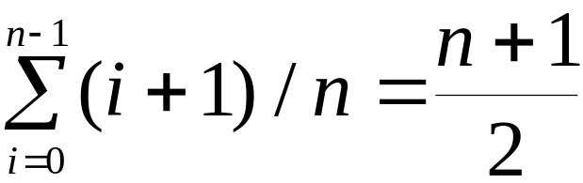
Sequential Search (1/3)
Example: List has n records.
4, 15, 17, 26, 30, 46, 48, 56, 58, 82, 90, 95
unsuccessful search
  n+1 ⇒ O(n)
average successful search
⇒ O(n)

Slide 4
# define MAX-SIZE 1000/* maximum size of list plus one */ typedef struct { int key;
/* other fields */
} element; element list[MAX_SIZE];
Sequential Search (2/3)

Slide 5
Program 7.1 Sequential search int seqsearch( int list[ ], int searchnum, int n )
{
/*search an array, list, that has n numbers. Return i, if list[i]=searchnum. Return -1, if searchnum is not in the list */ int i; list[n]=searchnum; for (i=0; list[i] != searchnum; i++)
; return (( i<n) ? i : -1);
}
Sequential Search (3/3)

Slide 6
Figure 7.1 Decision tree for binary search
Binary Search (1/3)
4, 15, 17, 26, 30, 46, 48, 56, 58, 82, 90, 95
[5]
46
[2]
[8]
17
58
[0]
[3]
[6]
[10]
4
26
48
90
[1]
[4]
[7]
[9]
[11]
15
30
56
82
95

Slide 7
Program 7.2 Binary search int binsearch(element list[ ], int searchnum, int n)
{
/* search list [0], ..., list[n-1]*/ int left = 0, right = n-1, middle; while (left <= right) { middle = (left+ right)/2; switch (COMPARE(list[middle].key, searchnum)) { case -1: left = middle +1; break; case 0: return middle; case 1:right = middle - 1;
}
} return -1;
}
(2/3)

Slide 8
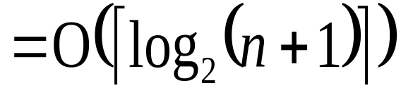
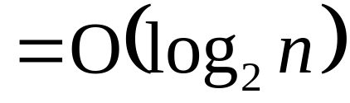
Binary Search(3/3)
Definition:
A full binary tree of depth k is a binary tree of depth k having 2^{k}-1 nodes, k >= 0.
Let n ∈[2^{k-1}, 2^{k}-1]
complexity

Slide 9
List Verification (1/6)
Compare lists to verify that they are identical or identify the discrepancies.
example
  International Revenue Service (e.g., employee vs. employer)
Reports three types of errors:
(1) all records found in list1 but not in list2
(2) all records found in list2 but not in list1
(3) all records that are in list1 and list2 with
the same key but have different values
for different fields.

Slide 10
Program 7.3 Verifying using a sequential search void verify1(element list1[], element list2[ ], int n, int m)
/* compare two unordered lists list1 and list2 */
{ int i, j; int marked[MAX_SIZE]; for(i = 0; i<m; i++) marked[i] = FALSE; for (i=0; i<n; i++) if ((j = seqsearch(list2, m, list1[i].key)) < 0) printf(“%d is not in list 2\n “, list1[i].key); else
/* check each of the other fields from list1[i] and list2[j], and print out any discrepancies */
(2/6)

Slide 11
marked[j] = TRUE; for ( i=0; i<m; i++) if (!marked[i]) printf(“%d is not in list1\n”, list2[i]key);
}
List Verification (3/6)

Slide 12
Program 7.4 Fast verification of two lists void verify2(element list1[ ], element list2 [ ], int n, int m)
/* Same task as verify1, but list1 and list2 are sorted */
{ int i, j; sort(list1, n); sort(list2, m); i = j = 0; while (i < n && j < m) if (list1[i].key < list2[j].key) { printf (“%d is not in list 2 \n”, list1[i].key); i++;
} else if (list1[i].key == list2[j].key) {
/* compare list1[i] and list2[j] on each of the other field and report any discrepancies */ i++; j++;
}
(4/6)

Slide 13
else { printf(“%d is not in list 1\n”, list2[j].key); j++;
} for(; i < n; i++) printf (“%d is not in list 2\n”, list1[i].key); for(; j < m; j++) printf(“%d is not in list 1\n”, list2[j].key);
}
List Verification (5/6)

Slide 14
List Verification (6/6)
complexities
  random order: O(mn)
  ordered list:
  O(tsort(n)+tsort(m)+m+n)
  =O(max[nlogn, mlogm])

Slide 15
  Selection Sort
  i [0] [1] [2] [3] [4]
    - 30 10 50 40 20
    0 10 30 50 40 20
    1 10 20 50 40 30
    2 10 20 30 40 50
    3 10 20 30 40 50
From those integers that are currently unsorted, find the smallest and place it next in the sorted list.
    For (i = 0; i < n; i ++) {
    Examine list[i] to list[n-1] and suppose that the smallest integer is at list[min]
    Interchange list[i] and list[min]
    }

Slide 16
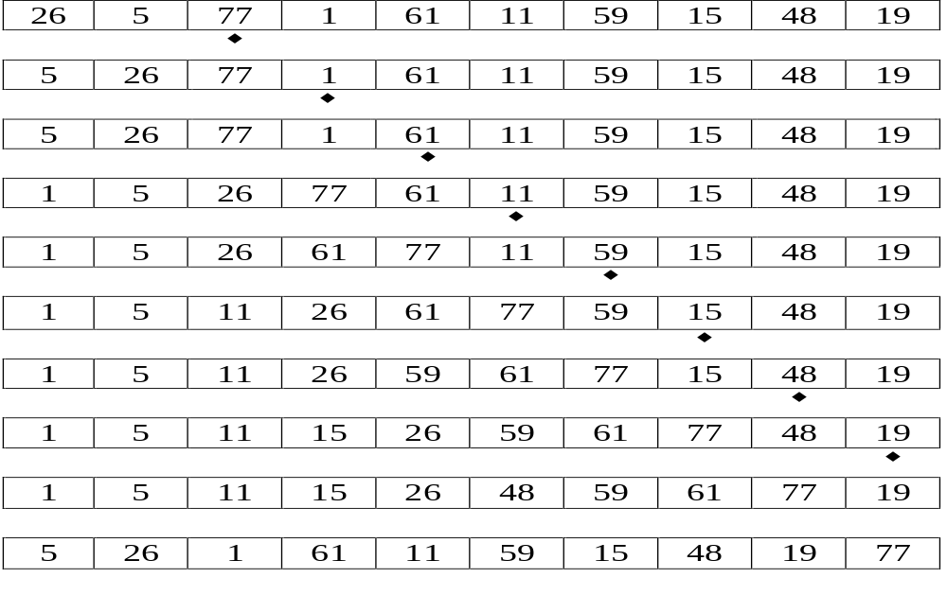
Insertion Sort (1/5)
Find an element smaller than K.

Slide 17
Insertion Sort (2/5)
Program 7.5: insertion-sort
void insertion_sort(element list[], int n)
{
int i, j;
element next;
for (i=1; i<n; i++) {
next= list[i];
for (j=i-1; j>=0&&next.key<list[j].key;
j--)
list[j+1] = list[j];
list[j+1] = next;
}
}

Slide 18
Insertion Sort (3/5)
worst case
i 0 1 2 3 4
- 5 4 3 2 1
1 4 5 3 2 1
2 3 4 5 2 1
3 2 3 4 5 1
4 1 2 3 4 5
best case
i 0 1 2 3 4
- 2 3 4 5 1
1 2 3 4 5 1
2 2 3 4 5 1
3 2 3 4 5 1
4 1 2 3 4 5

Slide 19
Insertion Sort (4/5)
R_{i} is LOO iff R_{i} < max{R_{j}}
0≤j<i
2 3 4 5 1
*
k: no. of LOO records
Computing time: O((k+1)n)
Stable
best case : o(n)
worst case : O(n²)
average case : O(n²)

Slide 20
Insertion Sort (5/5)
Variation
Binary insertion sort
  sequential search --> binary search
  reduce no of comparisons,
  no of moves unchanged
List insertion sort
  array --> linked list
  sequential search
  no. of moves = 0

Slide 21
Quick Sort (1/7)
Given (R₀, R₁, …, R_{n-1})
K_{i}: pivot key
if K_{i} is placed in S(i),
then K_{j} ≤ K_{s(i)} for j < S(i),
K_{j} ≥ K_{s(i)} for j > S(i).
R₀, …, R_{S(i)-1}, R_{S(i)}, R_{S(i)+1}, …, R_{S(n-1)}

Slide 22
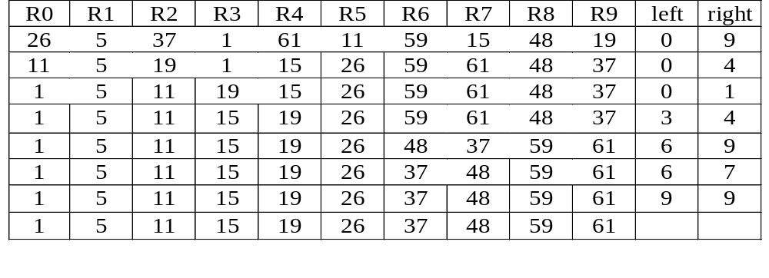
Example for Quick Sort (2/7)
[
]
[
]
[
]
[
]
[
]
[
]
[
]
[
]
[
]
[
]

Slide 23
Program for Quick Sort (3/7)
Program7.6: quicksort function
void quicksort(element list[], int left,
int right)
{
int pivot, i, j;
element temp;
if (left < right) {
i = left; j = right+1;
pivot = list[left].key;
do {
do i++; while (list[i].key < pivot);
do j--; while (list[j].key > pivot);
if (i < j) SWAP(list[i], list[j], temp);
} while (i < j);
SWAP(list[left], list[j], temp);
quicksort(list, left, j-1);
quicksort(list, j+1, right);
}
}

Slide 24
Analysis for Quick Sort (4/7)
Assume that each time a record is positioned, the list is divided into the rough same size of two parts.
Positioning a list with n elements needs O(n)
T(n) is the time taken to sort n elements
T(n)<=cn+2T(n/2) for some constant c
<=cn+2(cn/2+2T(n/4))
<=2cn+4T(n/4)
...
<=cnlog₂ n+nT(1)=O(nlog n)

Slide 25
Space for Quick Sort (5/7)
Stack space complexity:
  Average case and best case: O(log n)
  Worst case: O(n)
The smaller of the two subarrays is always stored first, the maximum stack space is less than 2logn.

Slide 26
Time for Quick Sort (6/7)
Time complexity:
  Average case and best case: O(n log n)
  Worst case: O(n2 )
Best internal sorting method considering the average case.
Insertion can be used to speed up whenever size < 16
unstable

Slide 27
Quick Sort (7/7)
Variation:
Quicksorting using a median of three
pivot = median{K_{left}, K_{(left+right)/2}, K_{right}}
e.g. median {10, 5, 7}=7
and {10, 7, 7}=7

Slide 28
Merge Sort (1/9)
Given two sorted lists
(list[i], …, list[m])
(list[m+1], …, list[n])
generate a single sorted list
(sorted[i], …, sorted[n])
O(n) space vs. O(1) space

Slide 29
Program for Merge Sort (2/9)
Program 7.7: Merging two sorted lists
void merge(element list[], element sorted[],
int i, int m, int n)
{
int j, k, t;
j = m+1;
k = i;
while (i<=m && j<=n) {
if (list[i].key<=list[j].key)
sorted[k++]= list[i++];
else sorted[k++]= list[j++];
}
if (i>m) for (t=j; t<=n; t++)
sorted[k+t-j]= list[t];
else for (t=i; t<=m; t++)
sorted[k+t-i] = list[t];
}

Slide 30
Analysis for Merge Sort (3/9)
addition space: n-i+1
no of data movements: M(n-i+1)
array vs. linked list representation
  array: O(M(n-i+1)) where M: record length
  for copy
  linked list representation: O(n-i+1)
  (n-i+1) linked fields

Slide 31
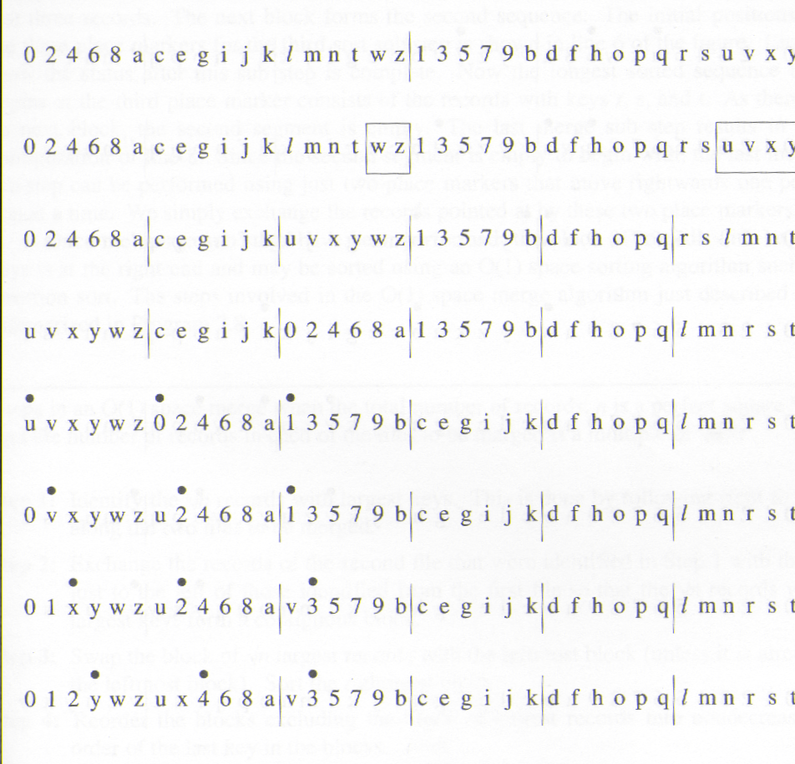
Fig. 7.5: First eight lines for O(1) space merge example
(4/9)

Slide 32
Merge Sort (5/9)
•
•
•
0 1 2 y w z u x 4 6 8 a v 3 5 7 9 b c e g i j k d f h o p q l m n r s t
•
•
•
0 1 2 3 w z u x 4 6 8 a v y 5 7 9 b c e g i j k d f h o p q l m n r s t
•
•
•
0 1 2 3 4 z u x w 6 8 a v y 5 7 9 b c e g i j k d f h o p q l m n r s t
•
•
•
0 1 2 3 4 5 u x w 6 8 a v y z 7 9 b c e g i j k d f h o p q l m n r s t

Slide 33
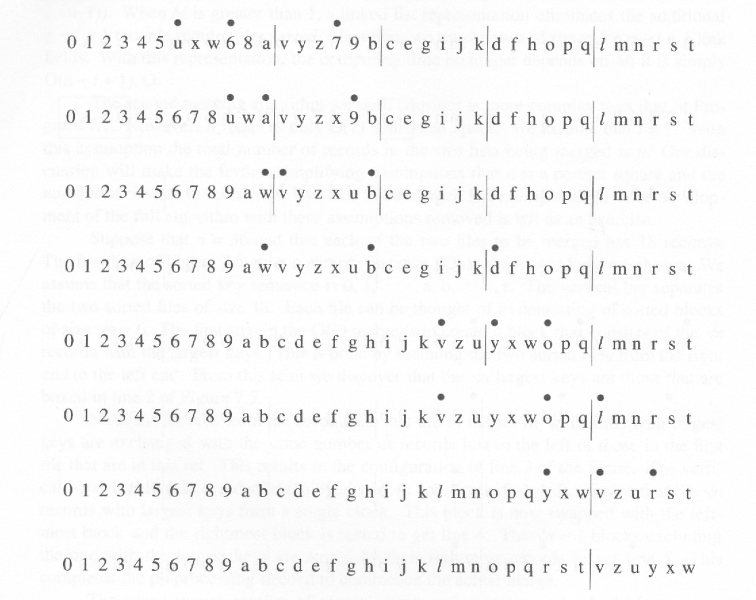
Fig. 7.6: Last eight lines for O(1) space merge example
(6/9)

Slide 34
Program 7.8: O(1) space merge
Steps in an O(1) space merge when the total number of records, n is a perfect square */ and the number of records in each of the files to be merged is a multiple of √n */
Step1:Identify the √n records with largest key. This is done by following right to left along the two files to be merged.
Step2:Exchange the records of the second file that were identified in Step1 with those just to the left of those identified from the first file so that the √n record with largest keys form a contiguous block.
Step3:Swap the block of √n largest records with the leftmost block (unless it is already the leftmost block). Sort the rightmost block.
(7/9)

Slide 35
Step4:Reorder the blocks excluding the block of largest records into nondecreasing order of the last key in the blocks.
Step5:Perform as many merge sub steps as needed to merge the √n-1 blocks other than the block with the largest keys.
Step6:Sort the block with the largest keys.
Merge Sort (8/9)

Slide 36
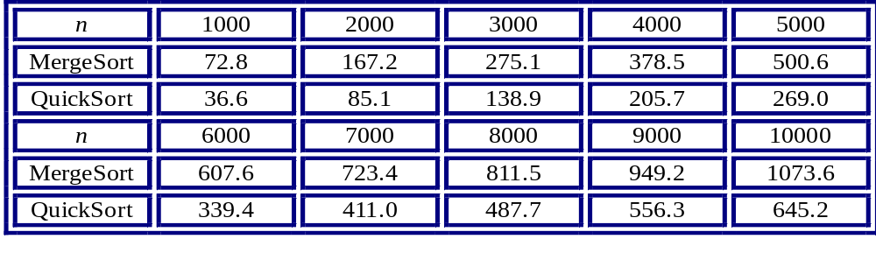
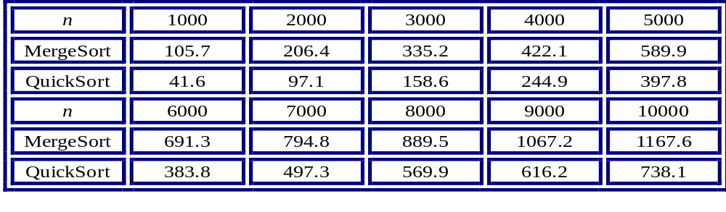
Merge Sort (9/9)
Average computing times for two sorting algorithms on random inputs
Worst-case computing times for two sorting algorithms on random inputs

Slide 37
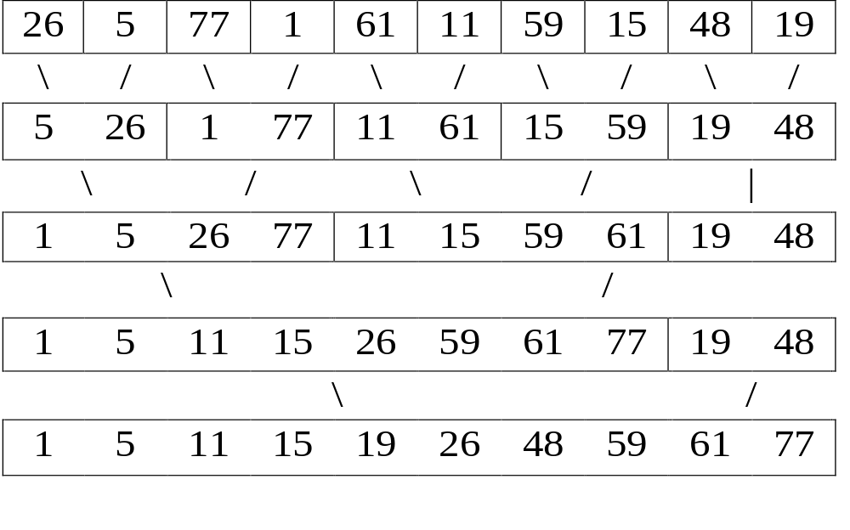
Interactive Merge Sort(1/3)
Sort 26, 5, 77, 1, 61, 11, 59, 15, 48, 19
O(nlog₂n): ⎡log₂n⎤ passes, O(n) for each pass

Slide 38
Interactive Merge Sort (2/3)
Program 7.10: Merge₋sort.
void merge_sort(element list[], int n)
{
int length=1;
element extra[MAX_SIZE];
while (length<n) {
merge_pass(list, extra, n, length);
length *= 2;
merge_pass(extra, list, n, length);
length *= 2;
}
}

Slide 39
Interactive Merge Sort (3/3)
Program 7.9: Merge_pass.
void merge_pass(element list[], element
sorted[],int n, int length)
{
int i, j;
for (i=0; i<n-2*length; i+=2*length)
merge(list,sorted,i,i+length-1,
i+2*lenght-1);
if (i+length<n)
merge(list, sorted, i, i+lenght-1, n-1);
else
for (j=i; j<n; j++) sorted[j]= list[j];
}

Slide 40
Recursive Merge Sort (1/5)
Fig. 7.8: Sublist partitioning for a recursive merge sort.
26 5 77 1 61 11 59 15 48 19
5 26 11 59
5 26 77 1 61 11 15 59 19 48
1 5 26 61 77 11 15 19 48 59
1 5 11 15 19 26 48 59 61 77

Slide 41
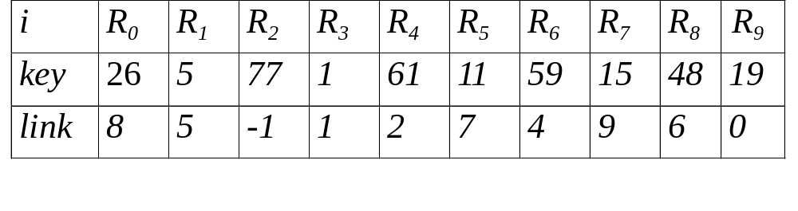
Fig. 7.9: Simulation of merge_sort.
Recursive Merge Sort (2/5)
start=3

Slide 42
Recursive Merge Sort (3/5)
Program 7.11: Recursive merge sort.
int rmerge(element list[], int lower,
int upper)
{
int middle;
if (lower >= upper) return lower;
else {
middle = (lower+upper)/2;
return listmerge(list,
rmerge(list,lower,middle),
rmerge(list,middle, upper));
}
}

Slide 43
Recursive Merge Sort (4/5)
Program 7.12: Merging linked lists.
int listmerge(element list[], int first, int
second)
{
int start=n;
while (first!=-1 && second!=-1) {
if (list[first].key<=list[second].key) {
/* key in first list is lower, link this
element to start and change start to
point to first */
list[start].link= first;
start = first;
first = list[first].link;
}

Slide 44
Recursive Merge Sort (5/5)
else {
/* key in second list is lower, link this
element into the partially sorted list */
list[start].link = second;
start = second;
second = list[second].link;
}
}
if (first==-1)
list[start].link = second;
else
list[start].link = first;
return list[n].link;
}

Slide 45
Nature Merge Sort
Fig. 7.10: Merge sort starting with sorted sublists.
26 5 77 1 61 11 59 15 48 19
5 26 77
1 11 59 61
15 19 48
1 5 11 26 59 61 77
15 19 48
1 5 11 15 19 26 48 59 61 77

Slide 46
Fig. 7.1: Array interpreted as a binary tree
Heap Sort (1/7)
[
[
]
[
]
]
]
1 2 3 4 5 6 7 8 9 10
[
]
[
]
[
]
[
]
[
]
[
]
[
26 5 77 1 61 11 59 15 48 19
[1]
26
input file
[2]
5
[3]
77
[4]
1
[5]
61
[6]
11
[7]
59
[8]
15
[9]
48
[10]
19

Slide 47
Fig. 7.12: Max heap following first for loop of heapsort.
Heap Sort (2/7)
initial heap
[1]
77
[2]
61
[3]
59
[4]
48
[5]
19
[6]
11
[7]
26
[8]
15
[9]
1
[10]
5

Slide 48
Fig. 7.13: Heap sort example.
Heap Sort (3/7)
[1]
61
[2]
48
[3]
59
15
19
11
[7]
26
[4]
[5]
[6]
[8]
5
[9]
1
[10]
77
(a)
[1]
59
[2]
48
[3]
26
15
19
11
[7]
1
[4]
[5]
[6]
[8]
5
[9]
61
[10]
77
(b)

Slide 49
(continued) Heap sort example
(4/7)
[1]
48
[2]
19
[3]
26
15
5
11
[7]
1
[4]
[5]
[6]
59
59
61
[8]
[9]
61
[10]
77
(c)
[1]
26
[2]
19
[3]
11
48
15
5
1
[7]
48
[4]
[5]
[6]
59
[8]
59
[9]
61
[10]
77
(d)

Slide 50
Heap Sort (5/7)
Program 7.13: Adjusting a max heap.
void adjust(element list[], int root, int n)
{
int child, rootkey; element temp;
temp=list[root]; rootkey=list[root].key;
child=2*root;
while (child <= n) {
if ((child < n) &&
(list[child].key < list[child+1].key))
child++;
if (rootkey > list[child].key) break;
else {
list[child/2] = list[child];
child *= 2;
}
}
list[child/2] = temp;
}

Slide 51
Heap Sort (6/7)
Program 7.14: Heap sort.
void heapsort(element list[], int n)
{
int i, j;
element temp;
for (i=n/2; i>0; i--) adjust(list, i, n);
for (i=n-1; i>0; i--) {
SWAP(list[1], list[i+1], temp);
adjust(list, 1, i);
}
}

Slide 52
Heap Sort (7/7)
Heap sort is unstable (Exercise)
Time complexity:
Best case : O(nlogn)
Average case : O(logn)
Worst case : O(nlogn)

Slide 53
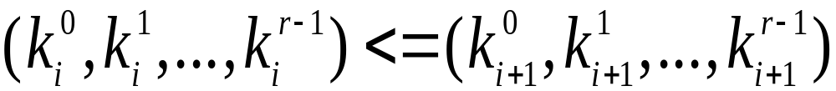
Radix Sort (1/10)
Sorted by various keys
K⁰, K¹, …, K^{r-1}
K⁰, K¹, …, K^{r-1}
Most significant
Least significant
R₀, R₁, …, R_{n-1} are said to be sorted w.r.t. K₀, K₁, …, K_{r-1} iff
0≤i<n-1
Most significant digit (MSD) first: sort on K⁰, then K¹, ...
Least significant digit (LSD) first: sort on K^{r-1}, then K^{r-2}, ...

Slide 54
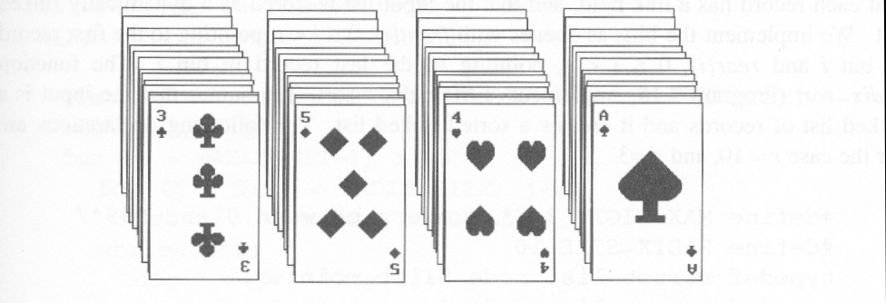
Fig. 7.14: Arrangement of cards after first pass of an MSD sort.
Radix Sort (2/10)
Suits: ♣ < ♦ < ♥ < ♠
Face values: 2 < 3 < 4 < … < J < Q < K < A
(1) MSD sort first, e.g., bin sort, four bins ♣ ♦ ♥ ♠
LSD sort second, e.g., insertion sort

Slide 55
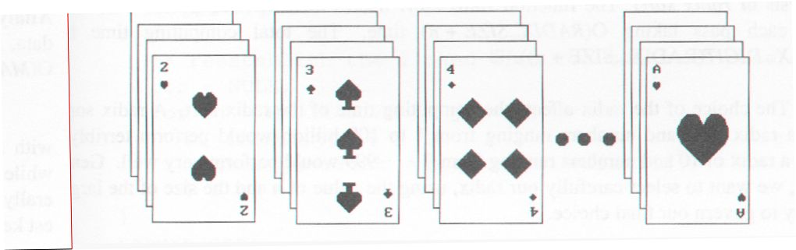
Fig. 7.15: Arrangement of cards after first pass of LSD sort .
Radix Sort (3/10)
Suits: ♣ < ♦ < ♥ < ♠
Face values: 2 < 3 < 4 < … < J < Q < K < A
(2) LSD sort first, e.g., bin sort, 13 bins
2, 3, 4, …, 10, J, Q, K, A
MSD sort, e.g., bin sort four bins ♣ ♦ ♥ ♠

Slide 56
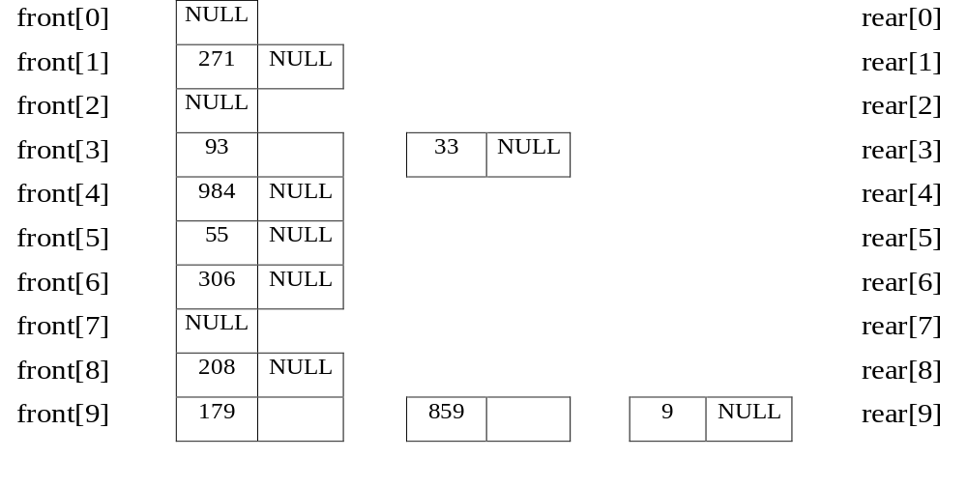
Example for LSD Radix Sort
(4/10)
179, 208, 306, 93, 859, 984, 55, 9, 271, 33
271, 93, 33, 984, 55, 306, 208, 179, 859, 9 After the first pass

Slide 57
front[0]
306
208
9
null
(5/10)
rear[0]
front[1]
null
rear[1]
front[2]
null
rear[2]
front[3]
33
null
rear[3]
front[4]
null
rear[4]
front[5]
55
859
null
rear[5]
front[6]
null
rear[6]
front[7]
271
179
null
rear[7]
front[8]
984
null
rear[8]
front[9]
93
null
306, 208, 9, 33, 55, 859, 271, 179, 984, 93 (second pass)
rear[9]

Slide 58
front[0]
9
33
55
93
null
(6/10)
rear[0]
front[1]
179
null
rear[1]
front[2]
208
271
null
rear[2]
front[3]
306
null
rear[3]
front[4]
null
rear[4]
front[5]
null
rear[5]
front[6]
null
rear[6]
front[7]
null
rear[7]
front[8]
859
null
rear[8]
front[9]
984
null
9, 33, 55, 93, 179, 208, 271, 306, 859, 984 (third pass)
rear[9]

Slide 59
Data Structures for LSD Radix Sort (7/10)
Develop an LSD radix r sort,
R0, R1, ..., Rn-1 have the keys that are d-tuples
(x0, x1, ..., xd-1), and that 0<=x_{i}<r.
#define MAX_DIGIT 3
#define RADIX_SIZE 10
typedef struct list_node *list_pointer;
typedef struct list_node {
int key[MAX_DIGIT];
list_pointer link;
}

Slide 60
LSD Radix Sort (8/10)
Program 7.15: LSD radix sort.
list_pointer radix_sort(list_pointer ptr)
{
list_pointer front[RADIX_SIZE],
rear[RADIX_SIZE];
int i, j, digit;
for (i=MAX_DIGIT-1; i>=0; i--) {
for (j=0; j<RADIX_SIZE; j++)
front[j]=read[j]=NULL;
while (ptr) {
digit=ptr->key[I];
if (!front[digit]) front[digit]=ptr;
else rear[digit]->link=ptr;

Slide 61
Radix Sort (9/10)
rear[digit]=ptr;
ptr=ptr->link;
}
/* reestablish the linked list for the next pass */
ptr= NULL;
for (j=RADIX_SIZE-1; j>=0; j++)
if (front[j]) {
rear[j]->link=ptr;
ptr=front[j];
}
}
return ptr;
}

Slide 62
Analysis of Radix Sort (10/10)
radix-sort makes MAX_DIGIT passes
each pass taking O(RADIX_SIZE+n) time
Time complexity
O(MAX_DIGIT(RADIX_SIZE+n)

Slide 63
List Sort (1/9)
Many sorting algorithms require excessive
data movement since we must physically
move records following some comparisons
If the records are large, this slows down the
sorting process
We can reduce data movement by using a
linked list representation

Slide 64
List Sort (2/9)
However, in some applications we must
physically rearrange the records so that they
are in the required order
We can achieve considerable savings by first performing a linked list sort and then physically rearranging the records according to the order specified in the list.

Slide 65
List Sort (3/9)
Practical Considerations for Internal Sorting
Data movement
  slow down sorting process
  insertion sort and merge sort --> linked file
perform a linked list sort + rearrange records

Slide 66
List Sorts (4/9)
Start = 3
i
key
link
R0 R1 R2 R3 R4 R5 R6 R7 R8 R9
26 5 77 1 61 11 59 15 48 19
8 5 -1 1 2 7 4 9 6 0
R0 <--> R3
i
key
link
R0 R1 R2 R3 R4 R5 R6 R7 R8 R9
1 5 77 26 61 11 59 15 48 19
1 5 -1 8 2 7 4 9 6 3

Slide 67
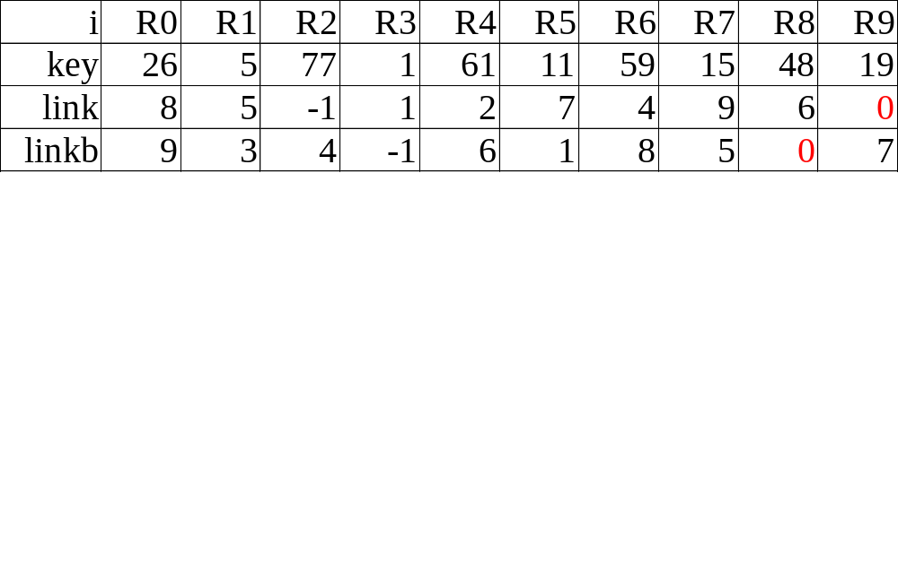
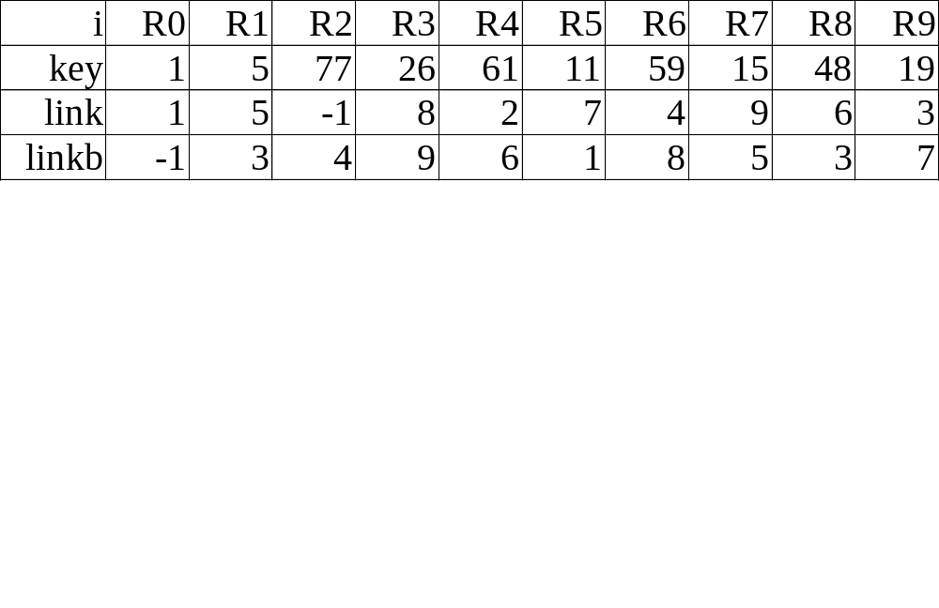
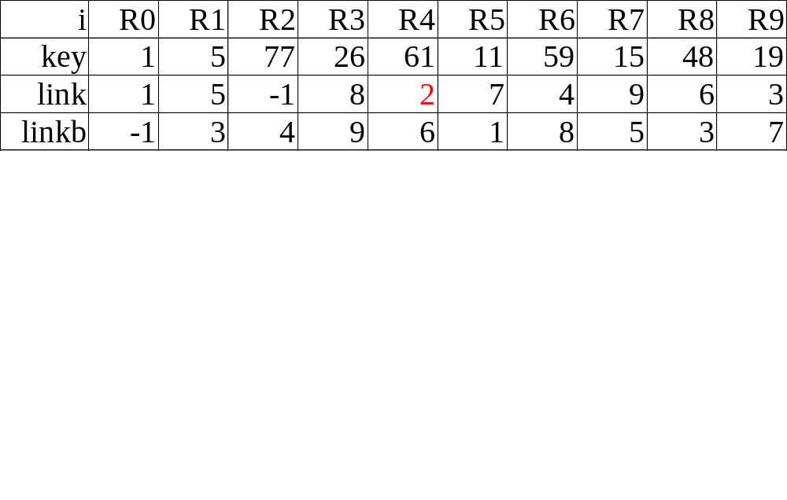
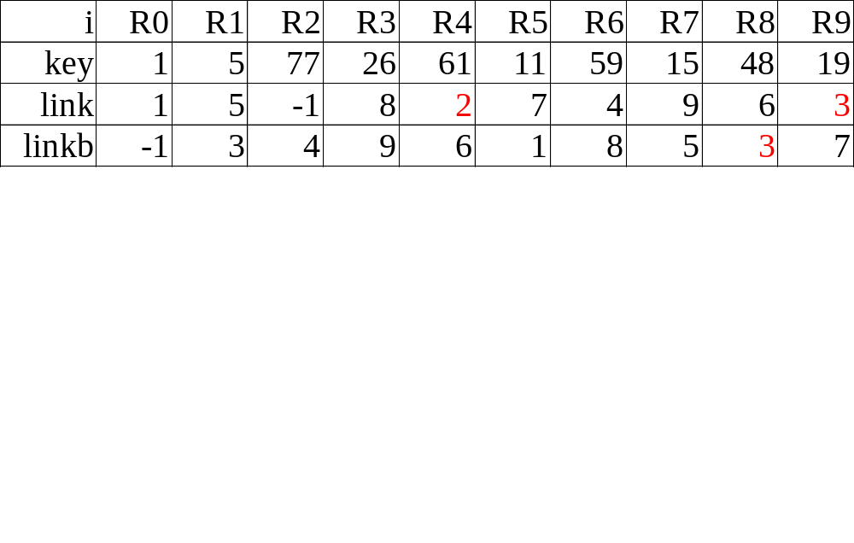
Doubly Linked List
(5/9)

Slide 68
Algorithm for List Sort (6/9)
Program 7.16: list_sort1.
void list_sort1(element list[], int n,
int start)
{
int i, last, current;
element temp;
last = -1;
for (current=start; current!=-1;
current=list[current].link) {
list[current].linkb = last;
last = current;
}

Slide 69
Algorithm for List Sort (7/9)
for (i=0; i<n-1; i++) {
if (start!=i) {
if (list[i].link+1)
list[list[i].link].linkb= start;
list[list[i].linkb].link= start;
SWAP(list[start], list[i].temp);
}
start = list[i].link;
}
}

Slide 70
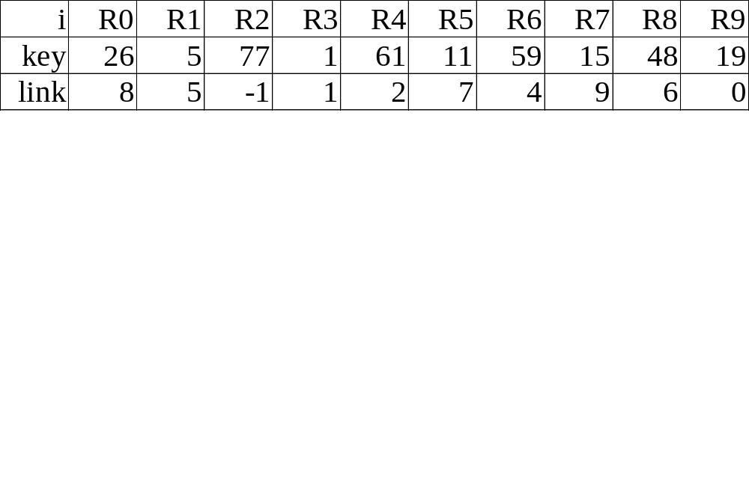
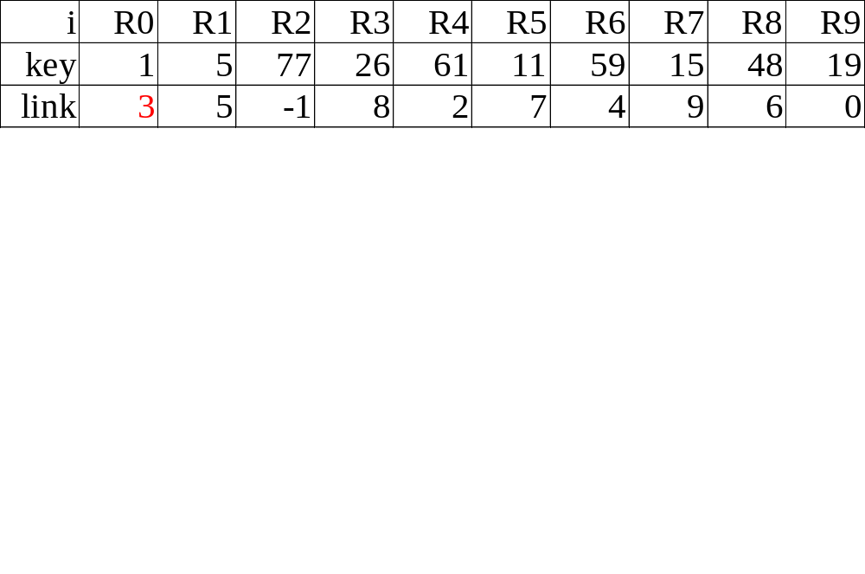
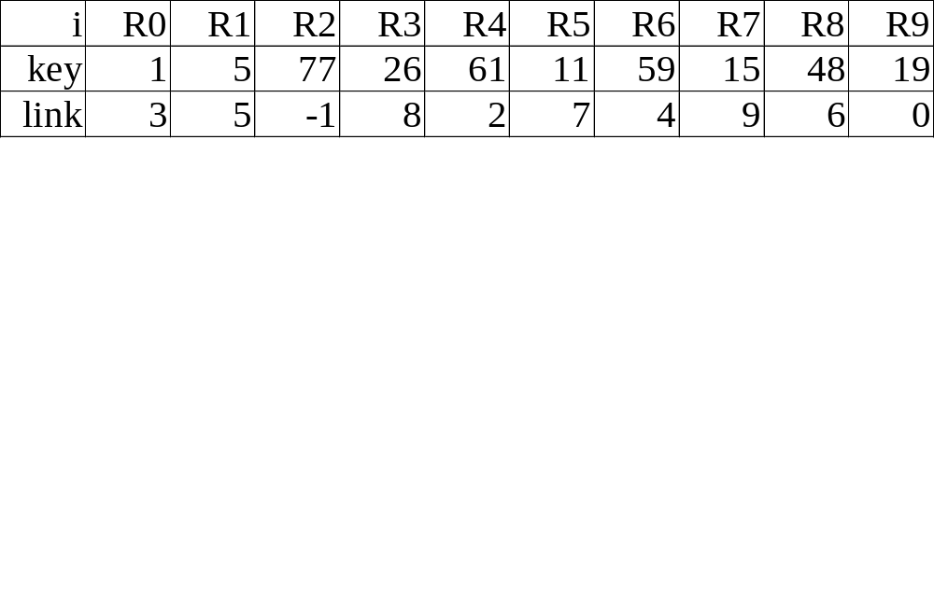
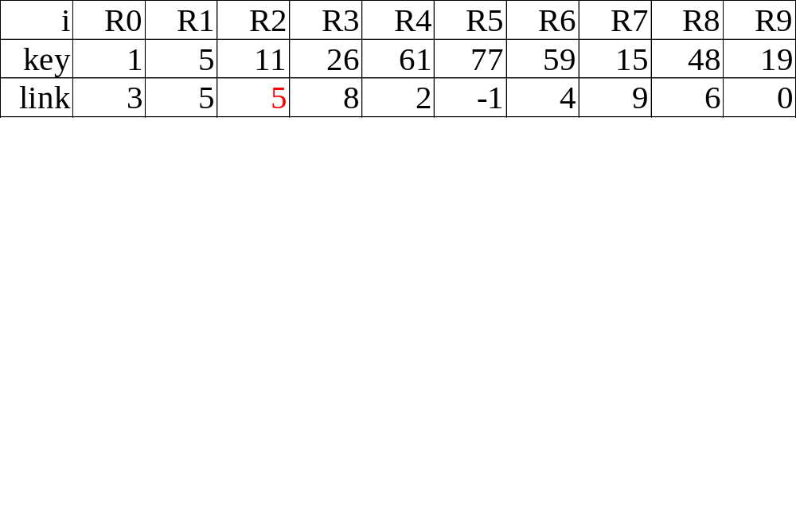
(2)
(8/9)
(1)
i=0
start=1
i=1
start=5
i=2
start=7

Slide 71
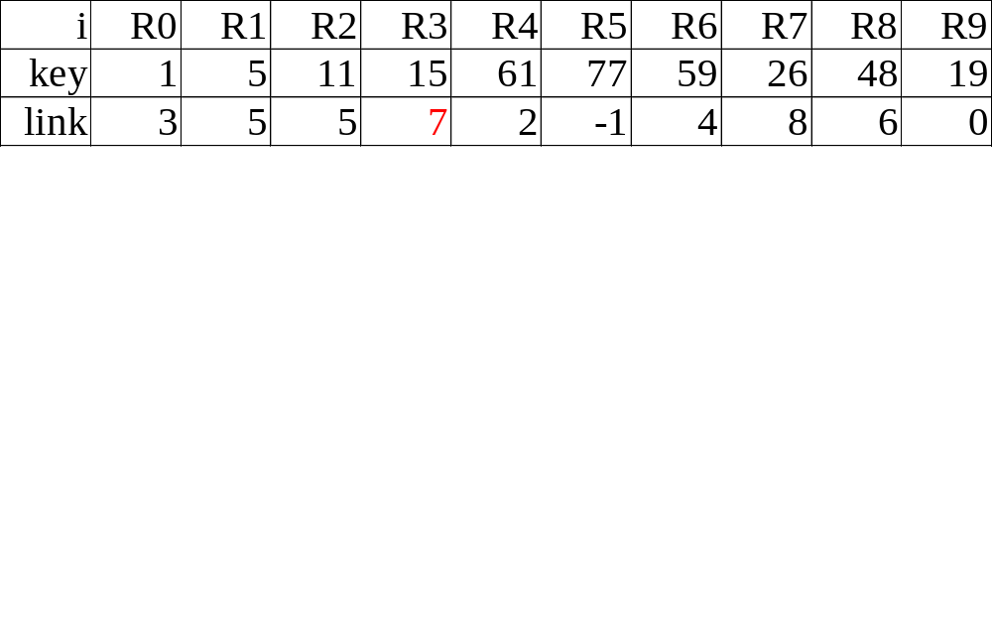
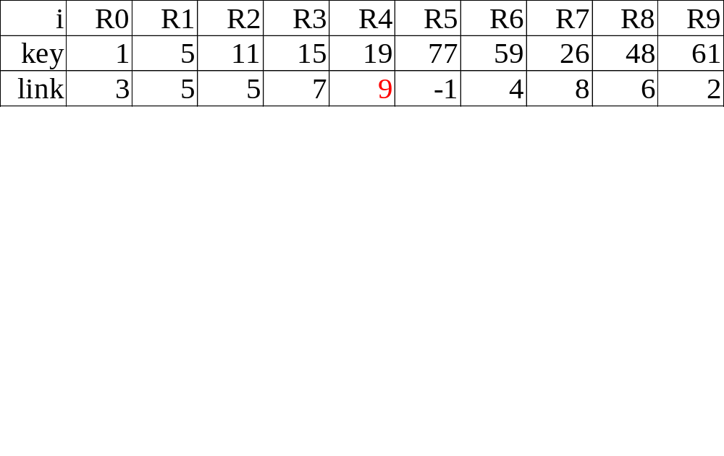
(9/9)
i=3
start=9
i=4
start=0
i=5
start=8

Slide 72
Table Sort (1/5)
Before
sort
0 • 1 • 2 • 3 • 4 •
Auxiliary
table
T
R₀
50
R₁
9
R₂
11
R₃
8
R₄
3
Key
After
sort
Auxiliary
table
T
4 • 3 • 2 • 1 • 0 •

Slide 73
Example for Table Sort (2/5)
R0 R1 R2 R3 R4 R5 R6 R7
35 14 12 42 26 50 31 18
2 1 7 4 6 0 3 5
key
table

Slide 74
Table Sort (3/5)
(1) R0 R2 R7 R5 R0
0 2 7 5
12 18 50 35
35 0
(2) i=1,2 t[i]=i
(3) R3 R4 R6 R3
3 4 6
26 31 42
42 3

Slide 75
Algorithm for Table Sort (4/5)
Program 7.18: table_sort.
void table_sort(element list[], int n,
int table[])
{
int i, current, next;
element temp;
for (i=0; i<n-1; i++)
if (table[i]!=i) {
temp= list[i];
current= i;

Slide 76
Algorithm for Table Sort (5/5)
do {
next = table[current];
list[current] = list[next];
table[current]= current;
current = next;
} while (table[current]!=i);
list[current] = temp;
table[current] = current;
}
}

Slide 77
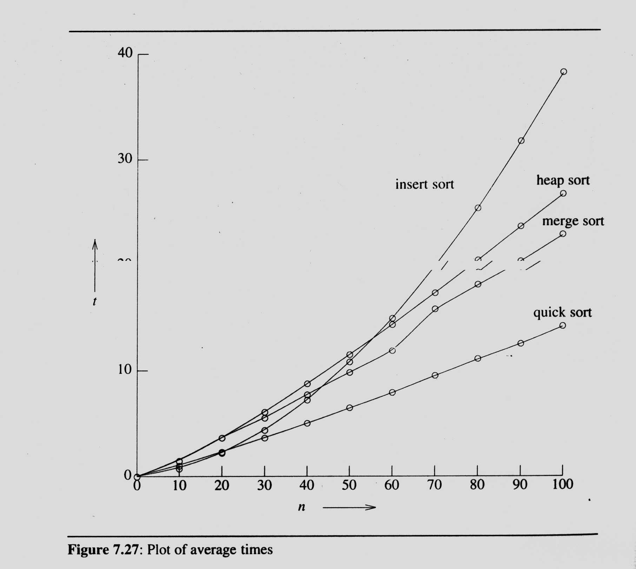
Summary of Internal Sorting (1/2)

Slide 78
Summary of Internal Sorting (2/2)
n < 20: insertion sort
20 ≤ n < 45: quick sort
n ≥ 45: merge sort
hybrid method: merge sort + quick sort
merge sort + insertion sort

Slide 79
External Sorting(1/9)
Very large files (overheads in disk access)
  seek time: time take to position the read/write head to the correct track of the disk.
  latency time:time until the right sector of the track is under the read/write head.
  transmission time: time to transmit the data to/from the disk.
merge sort
  phase 1
  Segment the input file & sort the segments (runs)
  phase 2
  Merge the runs

Slide 80
Example for External Sorting(2/9)
File: 4500 records, A1, …, A4500
internal memory: 750 records (3 blocks)
block length: 250 records
input disk vs. scratch pad (disk)
(1) sort three blocks at a time and write them out
onto scratch pad
(2) three blocks: two input buffers & one output
buffer

Slide 81
Example for External Sorting(3/9)
750 Records
750 Records
750 Records
750 Records
750 Records
750 Records
1500 Records
1500 Records
1500 Records
3000 Records
4500 Records

Slide 82
Time Complexity of External Sorting (4/9)
input/output time
ts = maximum seek time
tl = maximum latency time
trw = time to read/write one block of 250 records
tIO = ts + tl + trw
cpu processing time
tIS = time to internally sort 750 records
ntm = time to merge n records from input buffers to the output buffer

Slide 83
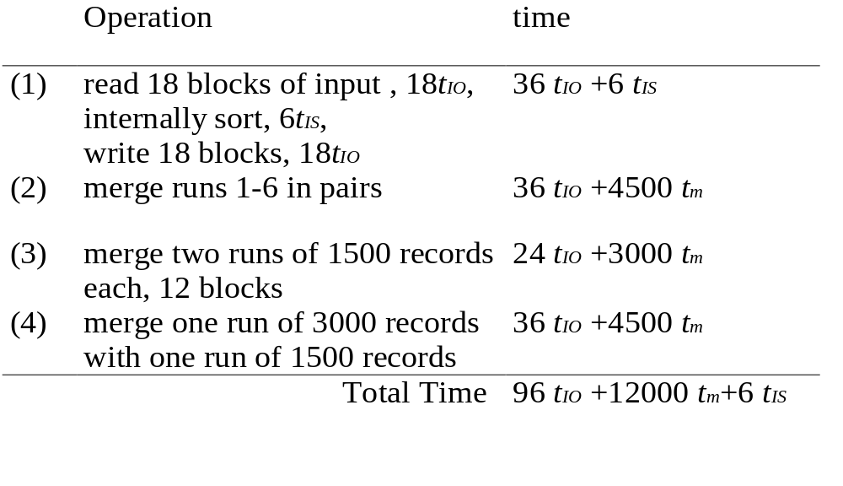
Time Complexity of External Sorting (5/9)

Slide 84
Parallelism Consideration (6/9)
Carry out the CPU operation and I/O operation
in parallel
132 tIO = 12000 tm + 6 tIS
Two disks: 132 tIO is reduced to 66 tIO

Slide 85
K-Way Merging (7/9)
Fig. 7.31: A 4_way merge on 16 runs.
1 2 3 4
1 2 3 4
1 2 3 4
1 2 3 4
A 4-way merge on 16 runs
2 passes (4-way) vs. 4 passes (2-way)

Slide 86

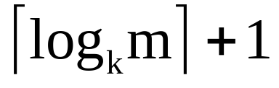
K-Way Merging (8/9)
Fig. 7.32: A k-way merge.
1 2 … k
K+1 … 2k
…( -1)k+1…m
...
k
levels

Slide 87
Analysis (9/9)
⎡log_{k} m⎤ passes
1 pass: ⎡nlog₂ k⎤
O(nlog₂ k*log_{k} m)
I/O time vs. CPU time
  reduction of the number of passes being made over the data
  efficient utilization of program buffers so that input, output and CPU processing is overlapped as much as possible
  run generation
  run merging

Slide 88
作業六:多種排序方法的實作與分析(1/2)
題目:給予測試資料檔test.txt,內容有以亂數產生的N=2¹²個正整數[0,999]。
(1)請以下列排序法分別對測試檔的前n個數排序, n=2¹,2²,…,2¹²,計算其所花時間:
(a)Bubble sort (b)Selection sort (c)Insertion sort
(d)Quick sort (e)Merge sort (f)Heap sort
(g)Radix sort (h)List sort (i)Table sort
將排序所花時間以Time(t) vs. Size(n)以Excel畫出。

Slide 89
作業六:多種排序方法的實作與分析(2/2)
(2)採用各種最佳化技巧(含選用排序法、程式語言、程式寫作技巧、記憶體、CPU…… 等)排序N個整數以獲得最快時間。說明選用理由與結果。
(3)列表整理各排序法在穩定性(stability)、所用空間(space)和時間(Time complexity)(含最佳(best)、平均(average)及最差情況(worst))的比較。
(4)討論各種排序法所的適用時機(含資料原先順序與資料檔大小。
(5)自己實作External sorting, 並討論和Internal sorting的特性差異。(本小題為加分題)
繳交作業日期:元月十二日

