Slide 1

Chapter 8
HASHING

Slide 2
Outline
The Symbol Table Abstract Data Type
Hashing Tables
Hashing Functions
Overflow Handling

Slide 3
Symbol Table
A set of name-attribute pairs
Also called Dictionary
Operations on a symbol table
  Determine if a particular name is in the table
  Retrieve the attributes of the name
  Modify the attributes of that name
  Insert a new name and its attributes
  Delete a name and its attributes
Three basic operations: search, insert, delete

Slide 4
The ADT of a Symbol Table
Objects
  A set of name-attribute pairs, where the names are unique.
Functions
  SymTab Create(max_size)
  Boolean IsIn(symtab,name)
  Attribute Find(symtab,name)
  SymTab Insert(symtab, name,attr)
  SymTab Delete(symtab,name)

Slide 5
Search Techniques
Search tree methods
  Identifier comparisons
hashing methods
  Hash functions
Types of hashing
  static hashing
  dynamic hashing

Slide 6
Static Hashing
Hash table
  Store the identifiers in a fixed table
Arithmetic function, f
  To determine the address of an identifier, x, in the table
The hash table ht is stored in sequential memory locations that are partitioned into b buckets, ht[0], …, ht[b-1].

Slide 7
Synonyms
Two identifiers, i₁ and i₂ are synonyms with respect to f if f(i₁) = f(i₂)
We enter distinct synonyms into the same bucket as long as the bucket has slots available.

Slide 8
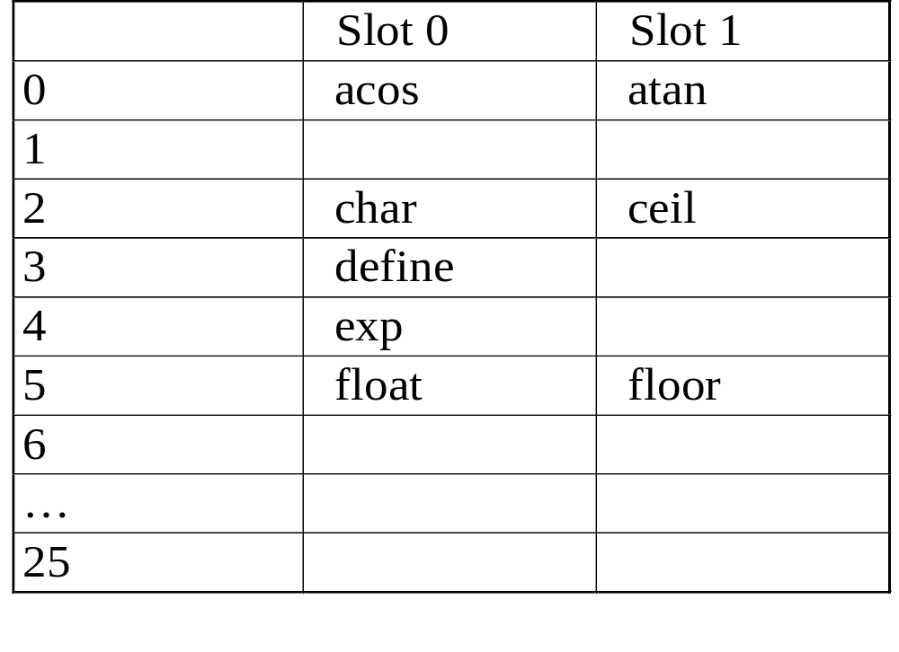
Synonyms (cont’d)
Synonyms
Synonyms
Synonyms

Slide 9
Overflow and Collision
An overflow occurs when we hash a new
identifier into a full bucket
A collision occurs when we hash two
non-identical identifiers into the same bucket.
When the bucket size is 1, collisions and overflows occur simultaneously.

Slide 10
Overflow and Collision (cont’d)
clock
overflow
Collision

Slide 11


Hashing Functions
Mid-square
Division
Folding
Digit Analysis

Slide 12
Folding
Partition the identifier x into several parts
All parts except for the last one have the same length
Add the parts together to obtain the hash address
Two possibilities
  Shift folding
    x1=123, x2=203, x3=241, x4=112, x5=20, address=699
  Folding at the boundaries
    x1=123, x2=203, x3=241, x4=112, x5=20, address=897

Slide 13
Data Structure for Hash Table
#define MAX_CHAR 10
#define TABLE_SIZE 13
typedef struct {
char key[MAX_CHAR];
/* other fields */
} element;
element hash_table[TABLE_SIZE];

Slide 14
Creation of a Hash Function
void init_table(element ht[])
{
int i;
for (i=0; i<TABLE_SIZE; i++)
ht[i].key[0]=NULL;
}
int transform(char *key)
{
int number=0;
while (*key) number += *key++;
return number;
}
int hash(char *key)
{
return (transform(key) % TABLE_SIZE);
}
#define MAX_CHAR 10
#define TABLE_SIZE 13
typedef struct {
char key[MAX_CHAR];
/* other fields */
} element;
element hash_table[TABLE_SIZE];

Slide 15
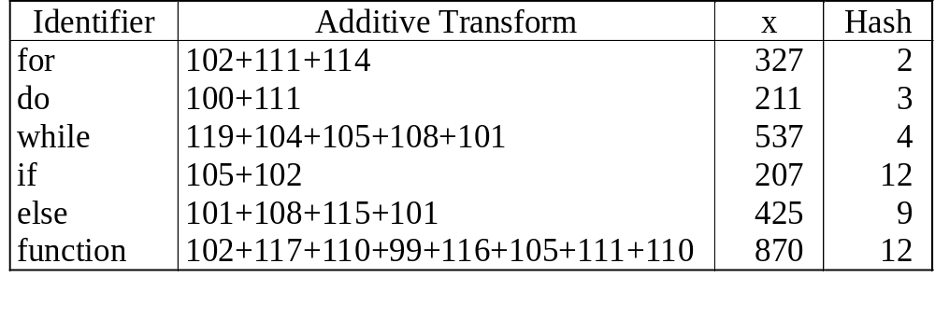
Additive transformation and Division

Slide 16
Overflow Handling
Linear probing (Linear open addressing)
Rehashing
Chaining

Slide 17
Linear Probing
[0] | function
[1]
[2] | for
[3] | do
[4] | while
[5]
[6]
[7]
[8]
[9] | else
[10]
[11]
[12] | if
Identifier | Hash
for | 2
do | 3
while | 4
if | 12
else | 9
function | 12

Slide 18
Rehashing
Reduce the clustering that occurs with linear probing
Try f₁, f₂, …, f_{m} in sequence if collision occurs
disadvantage
  comparison of identifiers with different hash values
  use chain to resolve collisions

Slide 19
Chaining
Maintained a list of synonyms for each bucket
To insert a new element
  Computer the hash address f(x)
  Examine the identifiers in the list for f(x)

Slide 20
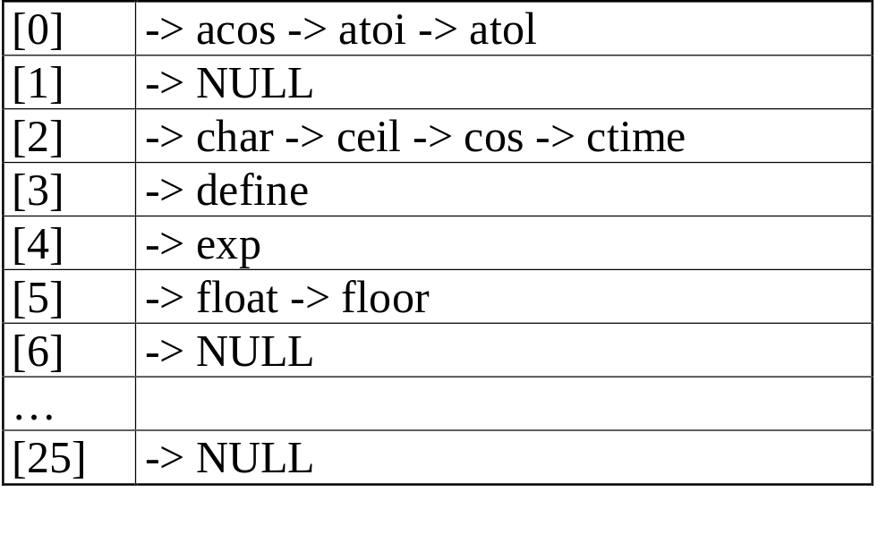
An Example of Hash Chaining
acos, atoi, char, define, exp, ceil, cos, float, atol, floor, ctime
f(x)=first character of x

