Slide 1
Efficient Partitioning and Load-Balancing Method for Finite Element Graphs on Distributed Memory Multicomputers
Yeh-Ching Chung
Department of Information Engineering
Feng-Chia University
Email:ychung@fcu.edu.tw
April 27, 1999

Slide 2
Outline of Presentation
Introduction
Related Work
The Dynamic Diffusion Optimization Method
The Prefix Code Matching Parallel Load-Balancing Method
Performance Evaluation and Experimental Results
Conclusions

Slide 3
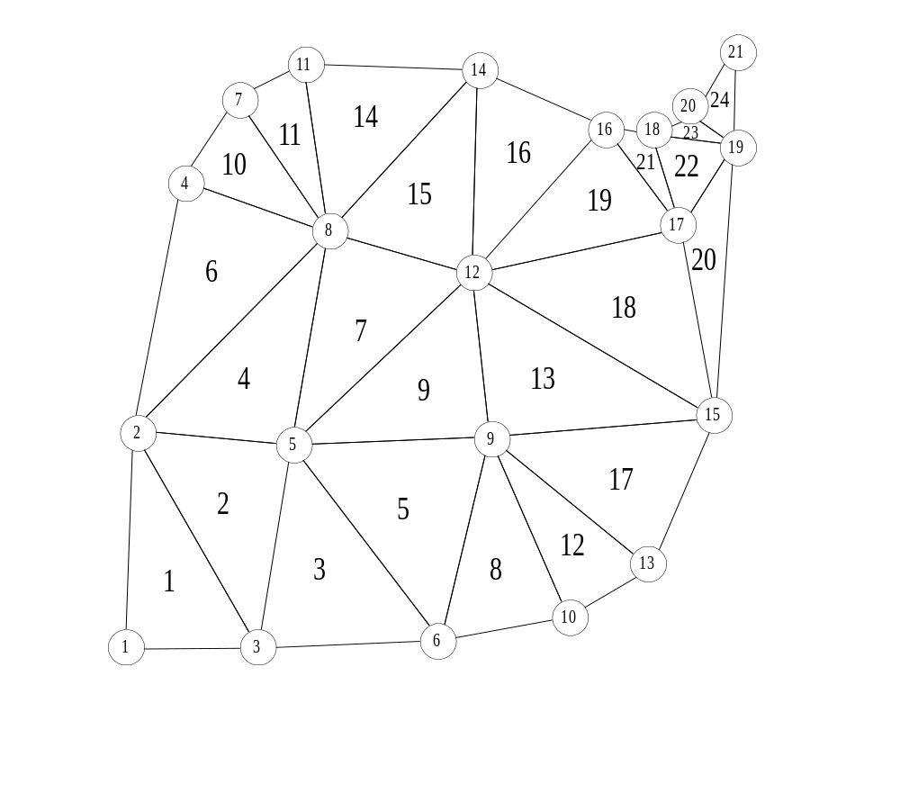
Introduction
Finite Element Graph
– Computation Independent
– Neighboring Communication
AX = B

Slide 4
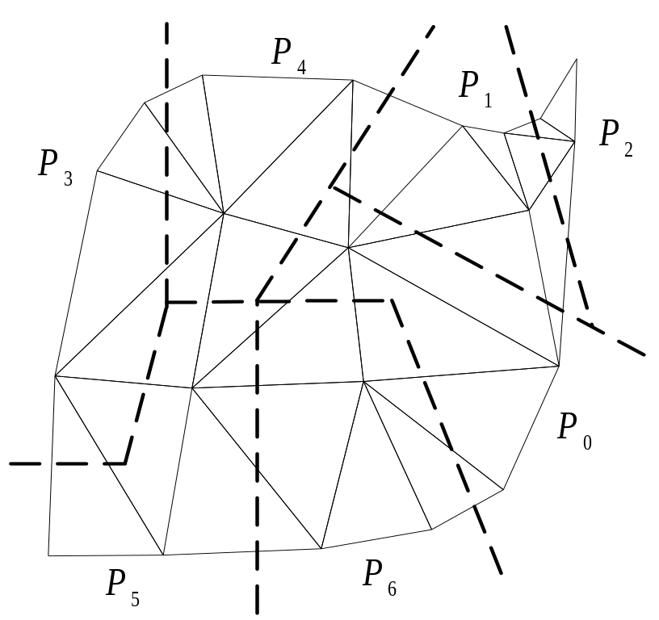
Introduction (continued)
The Partition/Mapping Issues
– Load Balancing
– Minimize the communication overheads

Slide 5
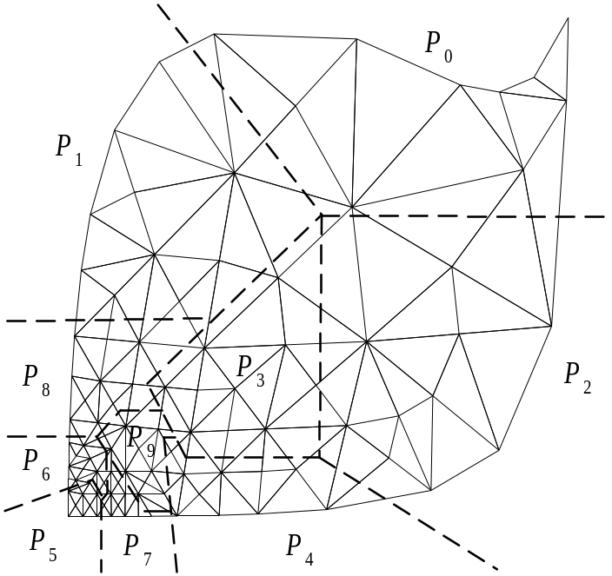
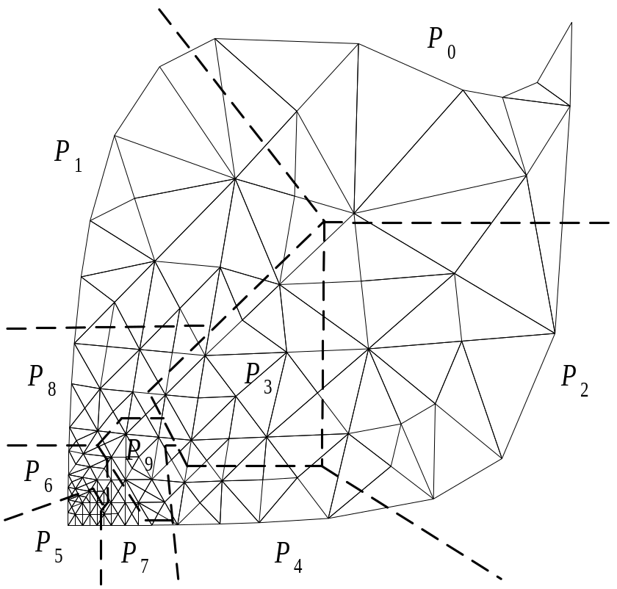
Introduction (Continued)
The Load Balancing Issues
– Load Balancing
– Minimize the communication overheads

Slide 6
Related Work
Partition and Mapping Methods
  Orthogonal Section Approach
  Min-Cut Approach
  Spectral Approach
  Multilevel Approach
  Others

Slide 7
Related Work (continued)
Graph Partition Libraries
  Chaco (Multilevel Recursive Spectral Bisection, MRSB)
  DIME (ORB, Simulated Annealing)
  JOSTLE (Direct Diffusion and Multilevel Diffusion)
  METIS (Multilevel k-way partition, MLkP)
  ParMetis (Parallel Multilevel Diffusion)
  PARTY (Helpful Sets)
  TOP/DOMDEC (RCB, RGB, RSB)

Slide 8
Related Work (continued)
Load-Balancing Methods
  Dimension Exchange Method (DEM, proposed by Ranka 1988, and Cybenko, 1989)
  Direct Diffusion (Hu and Blake, 1995)
  Multilevel Diffusion (Horton, 1993)
  Parallel Multilevel Diffusion (Schloegel et al., 1997)
  Parallel partitioner and a direct diffusion repartitioner (Walshaw et al., 1995)
  Linear programming-based method (Ou and Ranka, 1996)
  TWA, MWA, CWA (M.Y. Wu, 1997)

Slide 9
The Dynamic Diffusion Optimization Method (DDM)
Jostle, Metis, and Party allow 3-5% load imbalance
DDM can optimize the 3-5% load imbalance allowed by Jostle, Metis, and Party

Slide 10
The Dynamic Diffusion Optimization Method (DDM)
The DDM method can be divided into the following four phases.
  Phase 1: Obtain a processor graph G from the initial partition.
  Phase 2: Calculate the under-load and over-load weights of processors in G.
  Phase 3: Determine the load transfer sequence by using dynamic diffusion heuristic.
  Phase 4: Perform the load transfer and use the KL heuristic to reduce the cut-edges of boundary nodes.

Slide 11

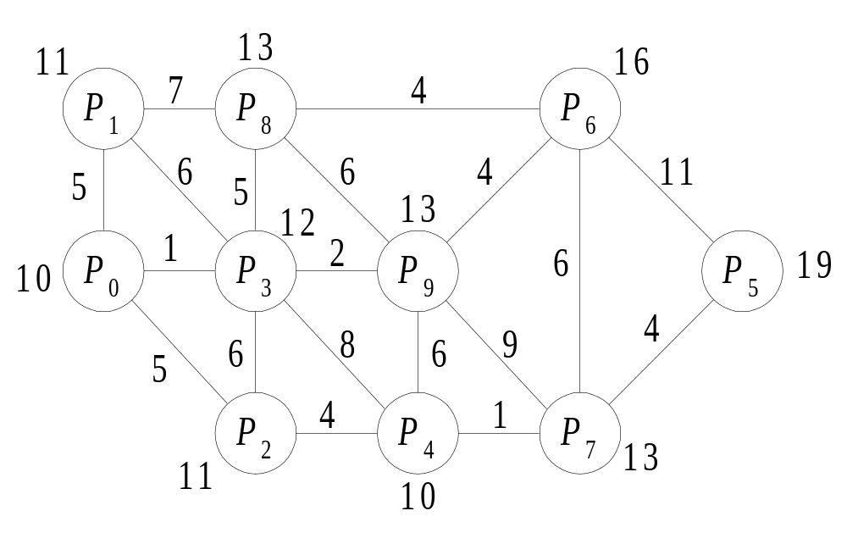
The DDM Method (Cont’d)
Phase 1: Obtain a processor graph G from the initial partition.

Slide 12
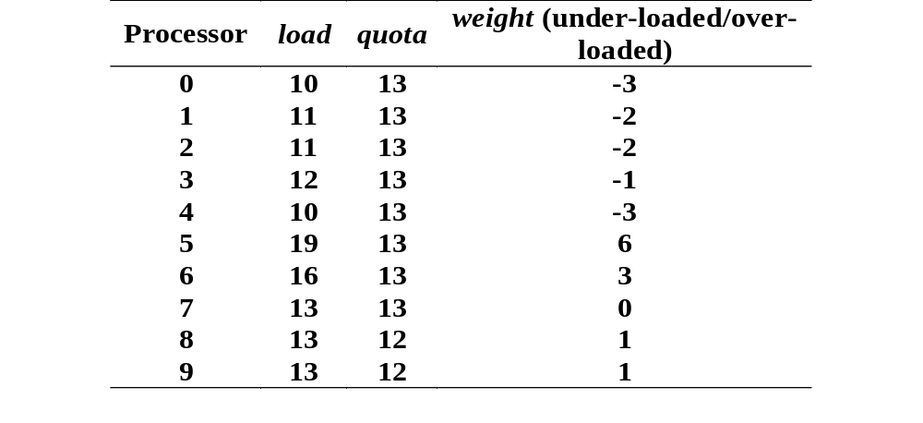
The DDM Method (Cont’d)
Phase 2: Calculate the under-load and over-load weights of processors in G.

Slide 13
The Dynamic Diffusion Heuristic
Step 1: Sort processors in G according to their degrees in ascending order.
Step 2: Starting from the processor with the smallest degree, find processor P_{v} that satisfies the following conditions. If there are two or more candidate processors, select the processor that has the smallest under-loaded/over-loaded weight of candidate processors.
  (a) The removal of P_{v} from G will not break G into two or more components.
  (b) P_{v} is an over-loaded/balanced processor or if P_{v} is an under-loaded processor, the load of one of its neighboring processors is greater than its under-loaded weight.

Slide 14
The Dynamic Diffusion Heuristic (Cont’d)
Step 3: If no processor satisfies the conditions listed in Step 2, then select processor P_{v} that has the largest load in G. Mark processor P_{v}.
Step 4: If P_{v} is an under-loaded processor, then P_{v} needs to receive |load(P_{v}) − quota(P_{v})| nodes from its neighbor processor P_{u}, where P_{u} is one of the neighbor processors of P_{v} with the largest load. Record the send/receive relation and update the values of load(P_{v}) and load(P_{u}).
Step 5: If P_{v} is an over-loaded processor, then P_{v} needs to send load(P_{v}) − quota(P_{v}) nodes to its neighbor processor P_{w}, where P_{w} is one of its neighbor processors with the smallest load and P_{w} has not been marked. Record the send/receive relation and update the values of load(P_{v}) and load(P_{w}).

Slide 15
The Dynamic Diffusion Heuristic (Cont’d)
Step 6: If the removal of processor P_{v} from G will not break G into two or more components, then remove P_{v} from G and clear all marks of processors.
Step 7: Perform Step 1 to Step 6 until the load of processors is balanced.

Slide 16
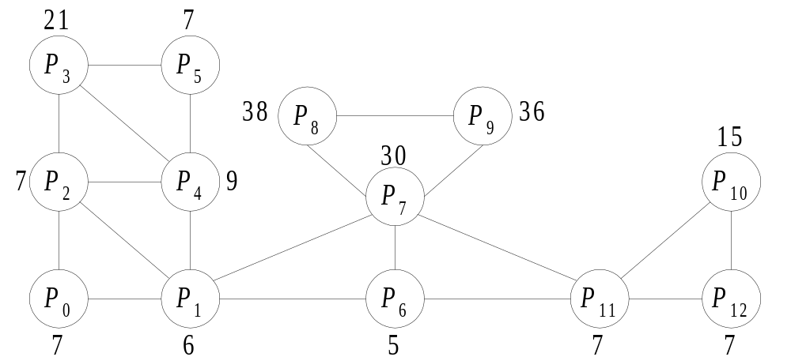
The DDM Method (Cont’d)
Phase 3:Determine the load transfer sequence by using dynamic diffusion heuristic.

Slide 17
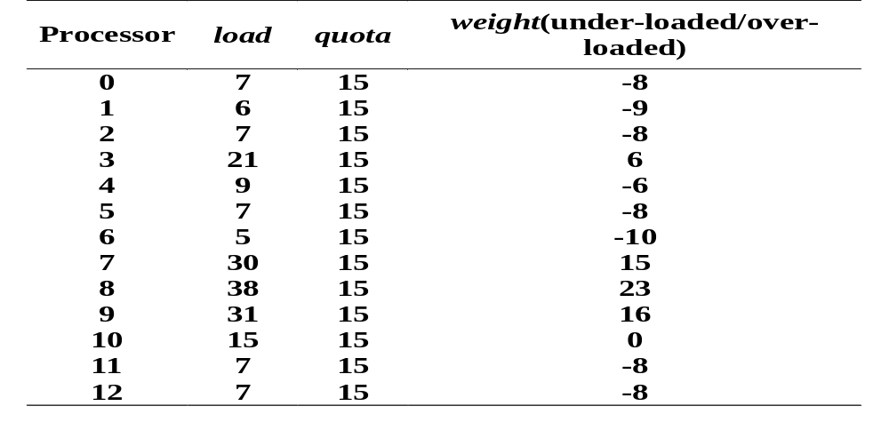
The DDM Method (Cont’d)
Phase 3:Determine the load transfer sequence by using dynamic diffusion heuristic.

Slide 18
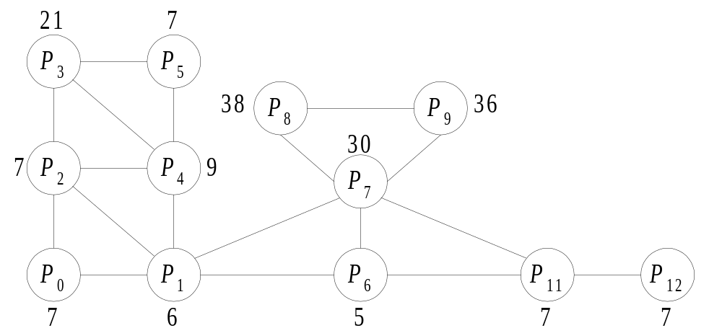
The DDM Method (Cont’d)
Phase 3:Determine the load transfer sequence by using dynamic diffusion heuristic.

Slide 19
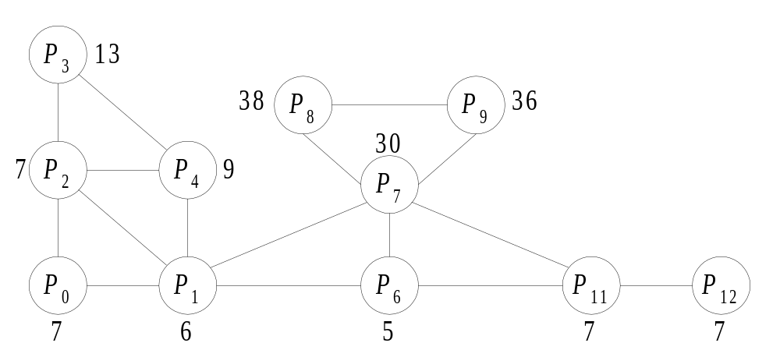
The DDM Method (Cont’d)
Phase 3:Determine the load transfer sequence by using dynamic diffusion heuristic.

Slide 20
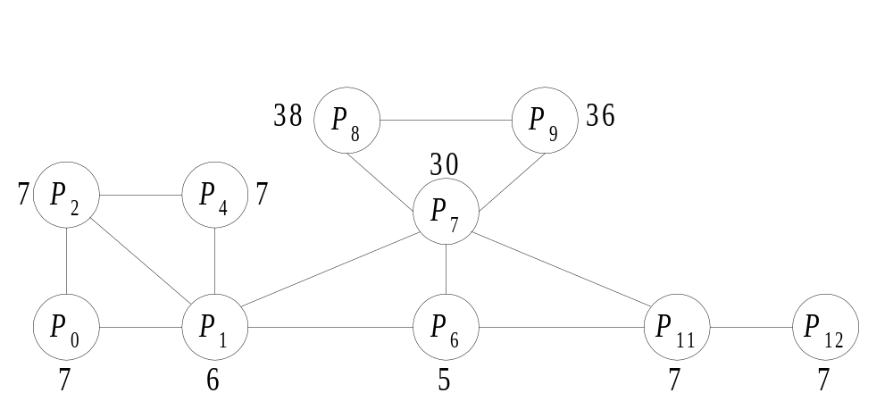
The DDM Method (Cont’d)
Phase 3:Determine the load transfer sequence by using dynamic diffusion heuristic.

Slide 21
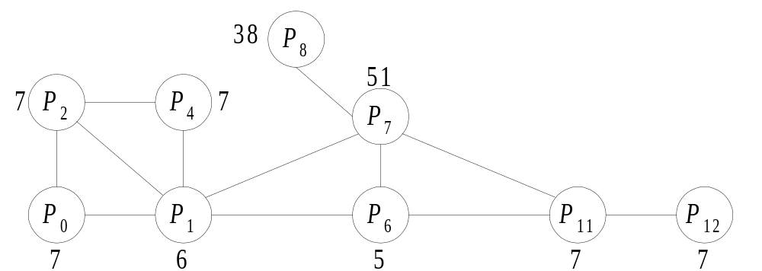
The DDM Method (Cont’d)
Phase 3:Determine the load transfer sequence by using dynamic diffusion heuristic.

Slide 22
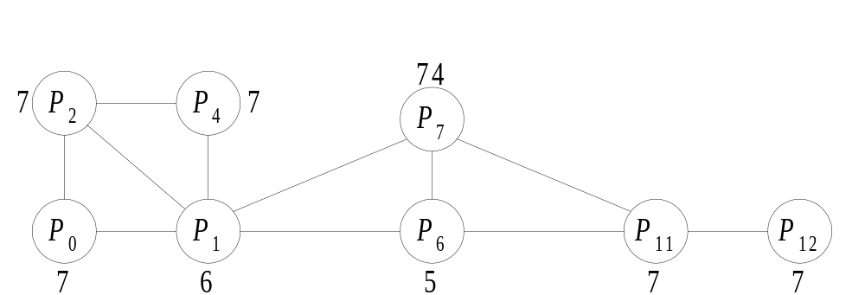
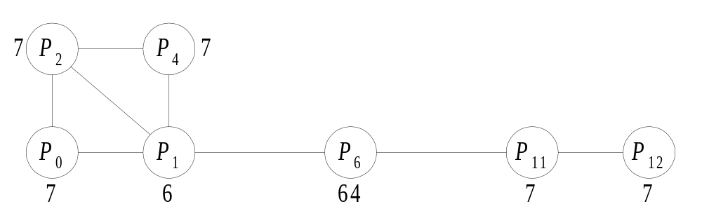
The DDM Method (Cont’d)
Phase 3:Determine the load transfer sequence by using dynamic diffusion heuristic.

Slide 23
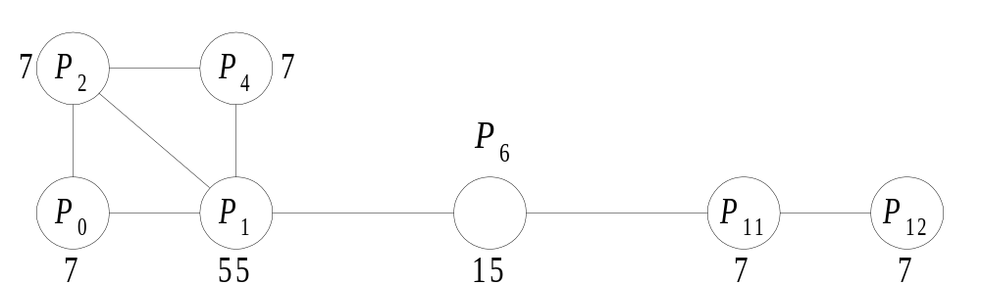
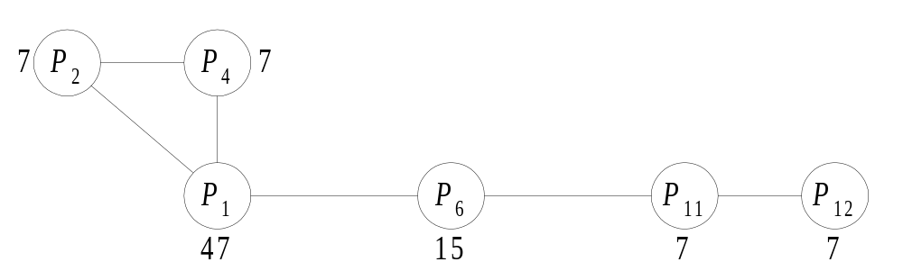
The DDM Method (Cont’d)
Phase 3:Determine the load transfer sequence by using dynamic diffusion heuristic.

Slide 24
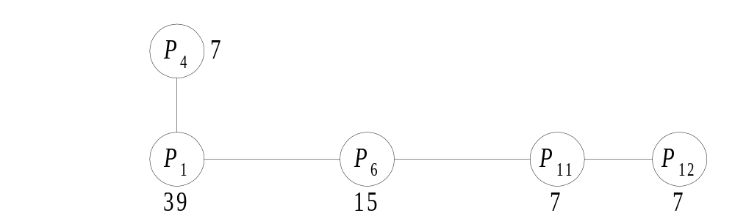
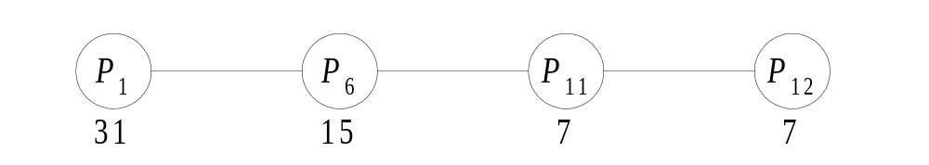
The DDM Method (Cont’d)
Phase 3:Determine the load transfer sequence by using dynamic diffusion heuristic.

Slide 25
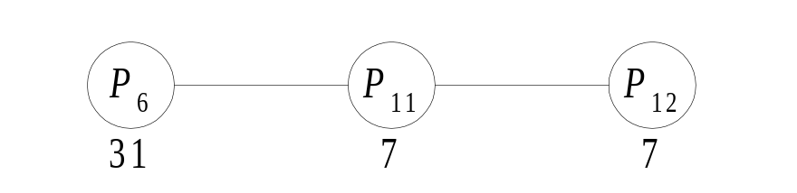
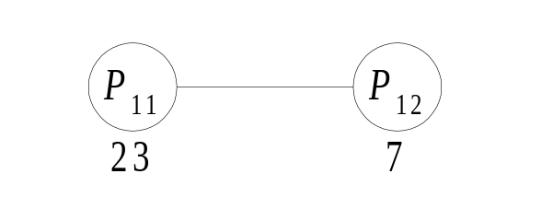

The DDM Method (Cont’d)
Phase 3:Determine the load transfer sequence by using dynamic diffusion heuristic.

Slide 26
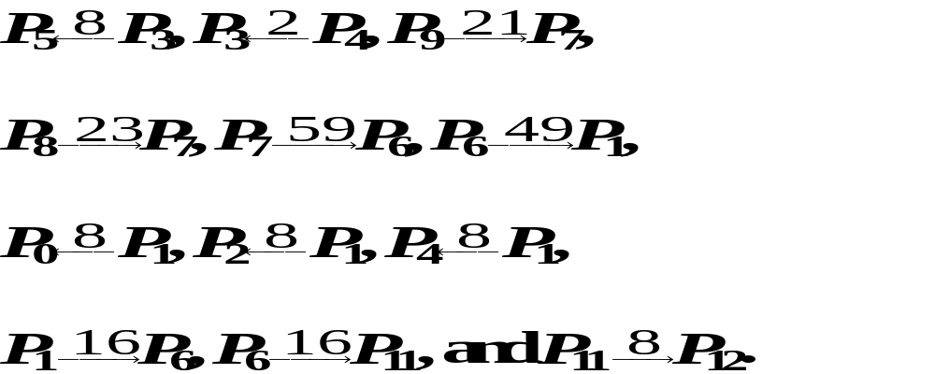
The DDM Method (Cont’d)
Phase 3:Determine the load transfer sequence by using dynamic diffusion heuristic.

Slide 27
The DDM Method (Cont’d)
Phase 4: Perform the load transfer and use the KL heuristic to reduce the cut-edges of boundary nodes.
  Goal: balance the load of processors and to minimize the communication cost among processors.
  Perform in parallel
  Move the boundary nodes with smaller degrees.

Slide 28
Performance Evaluation and Experimental Results
Three Mapping Methods: JOSTLE, Metis, and Party.
Two Load-Balancing Methods: Direct Diffusion and Multilevel Diffusion.

Slide 29
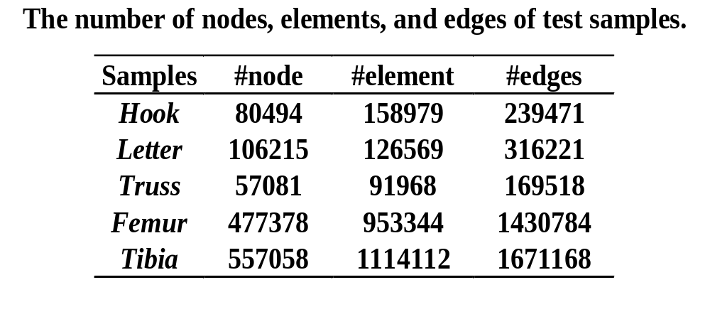
Performance Evaluation and Experimental Results (Cont’d)

Slide 30
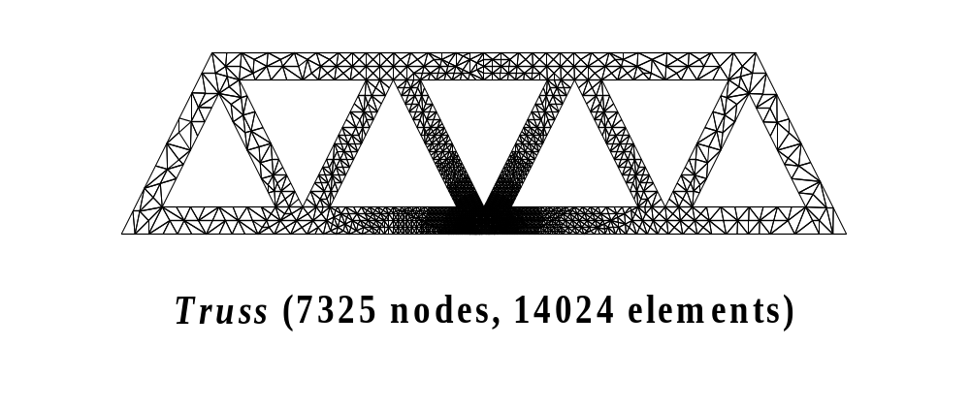
Performance Evaluation and Experimental Results
Test sample Truss

Slide 31
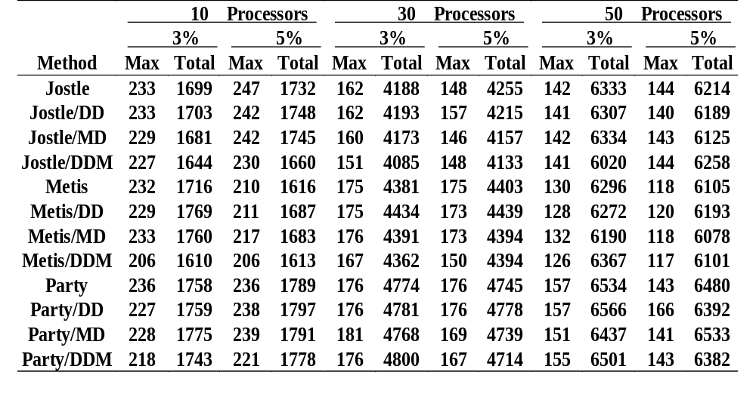
The Cut-Edges for Hook

Slide 32
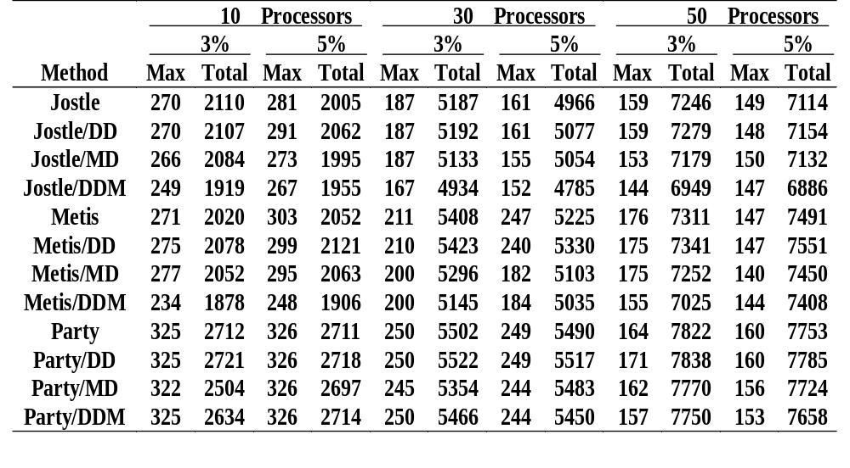
The Cut-Edges for Simple

Slide 33
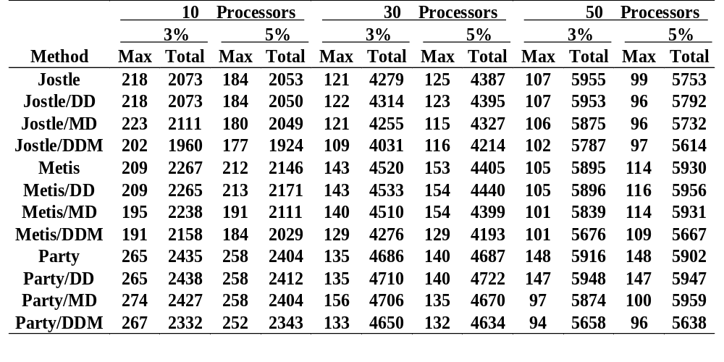
The Cut-Edges for Truss

Slide 34
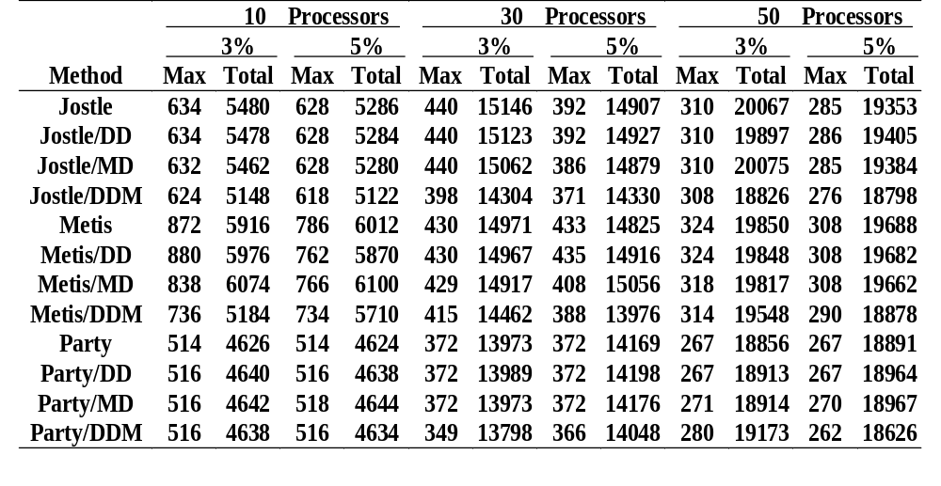
The Cut-Edges for Femur

Slide 35
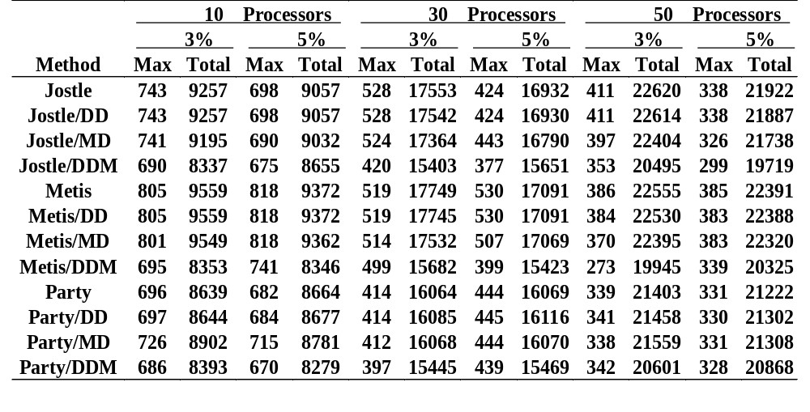
The Cut-Edges for Tibia

Slide 36
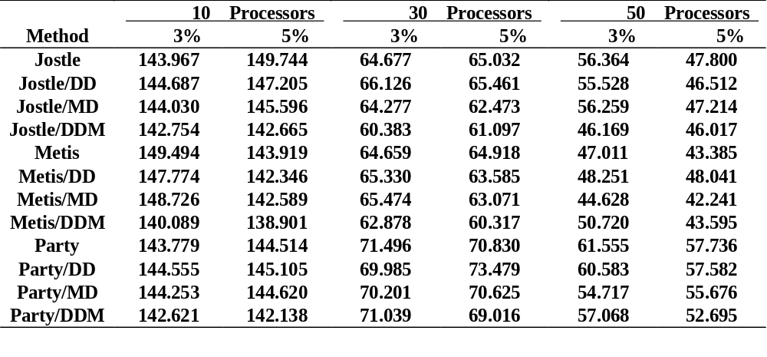
The Execution Time of a Laplace for Hook

Slide 37
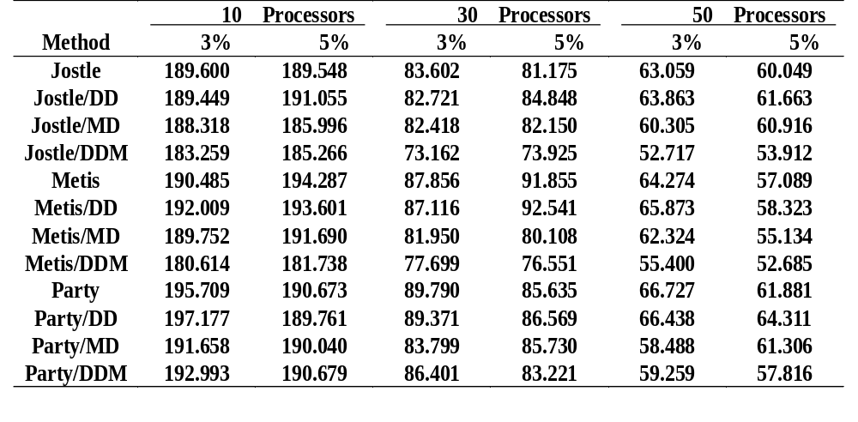
The Execution Time of a Laplace for Simple

Slide 38
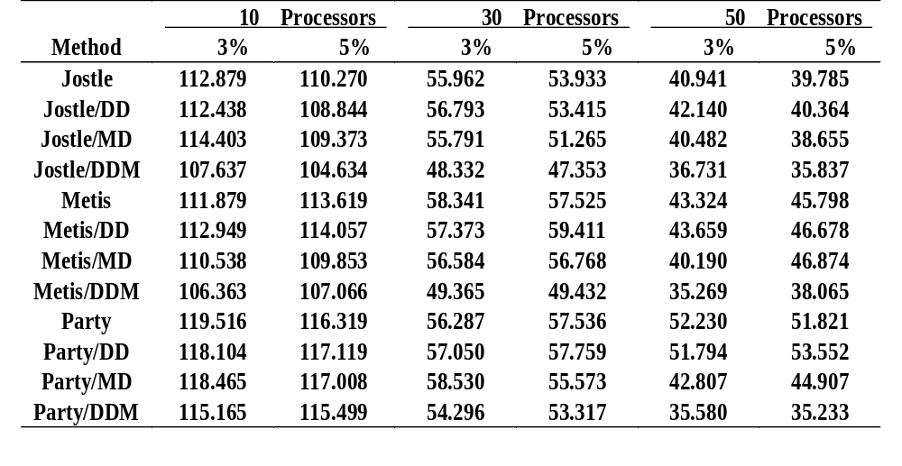
The Execution Time of a Laplace for Truss

Slide 39
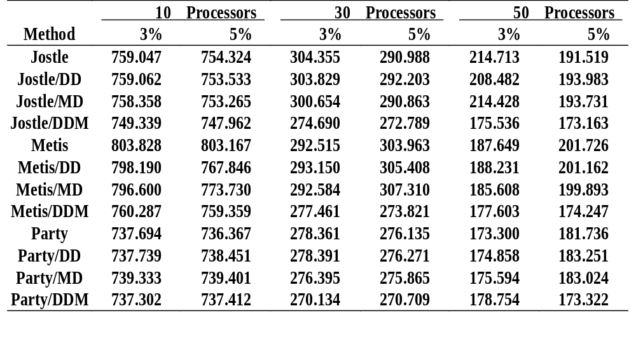
The Execution Time of a Laplace for Femur

Slide 40
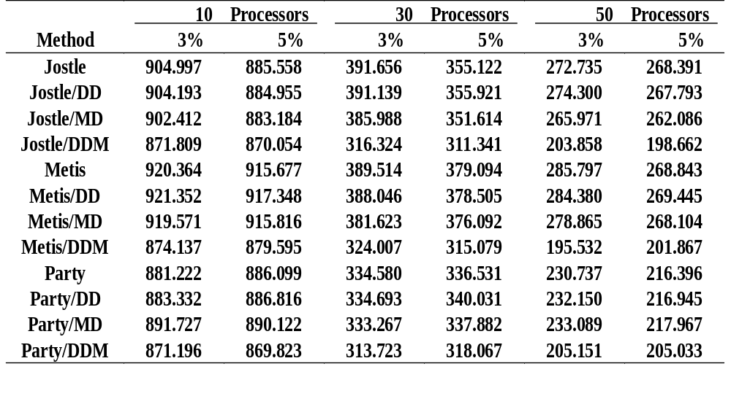
The Execution Time of a Laplace for Tibia

Slide 41
The Prefix Code Matching Parallel Load-Balancing Method (PCMPLB)
The PCMPLB method can be divided into the following four phases.
  Phase 1: Obtain a processor graph G from the initial partition.
  Phase 2: Construct a prefix code tree for processors in G.
  Phase 3: Determine the load transfer sequence by using matching theorem.
  Phase 4: Perform the load transfer.

Slide 42
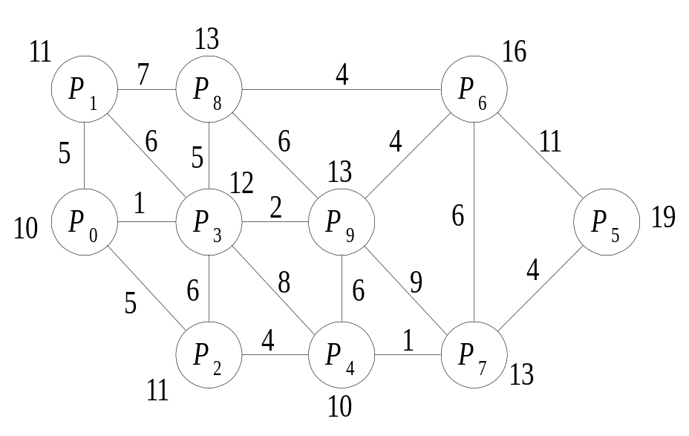
The Processor Graph (PCMPLB)

Slide 43
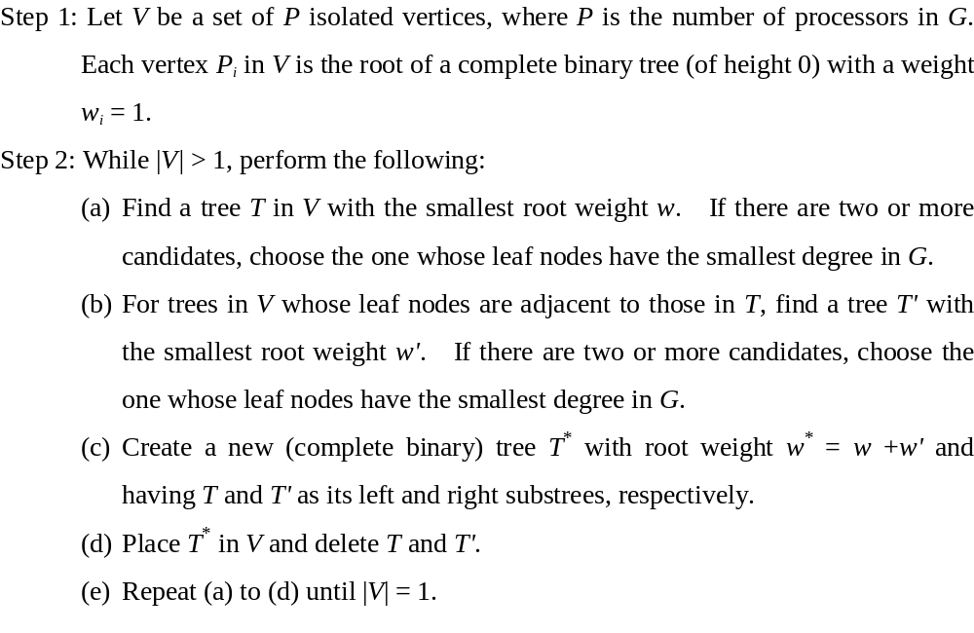
The Construction of a Prefix Code Tree

Slide 44
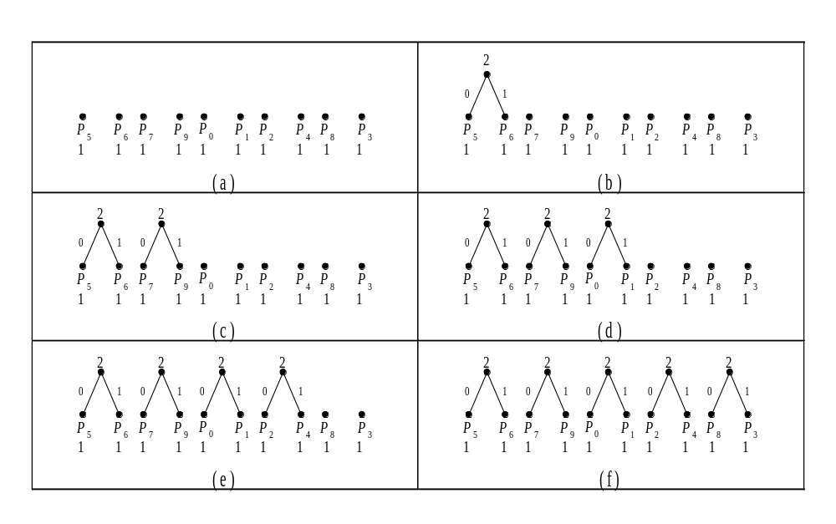
The Construction of a Prefix Code Tree (continued)

Slide 45
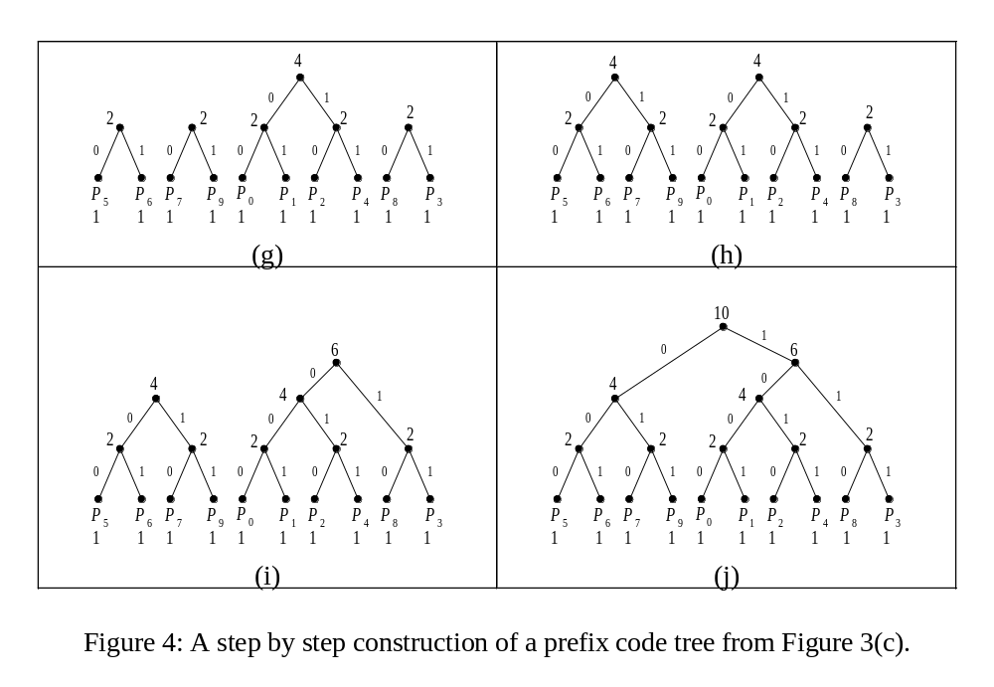
The Construction of a Prefix Code Tree (continued)

Slide 46
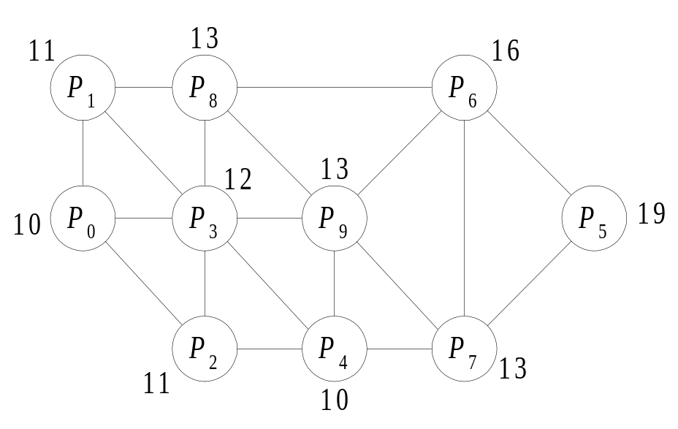
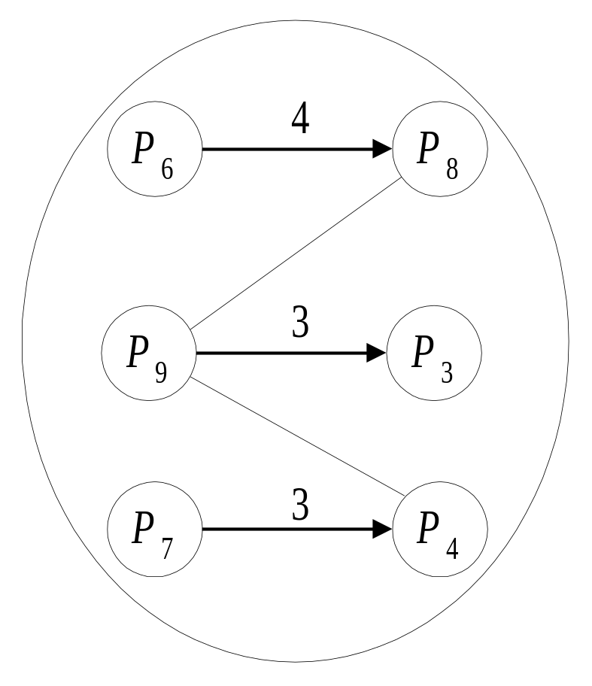
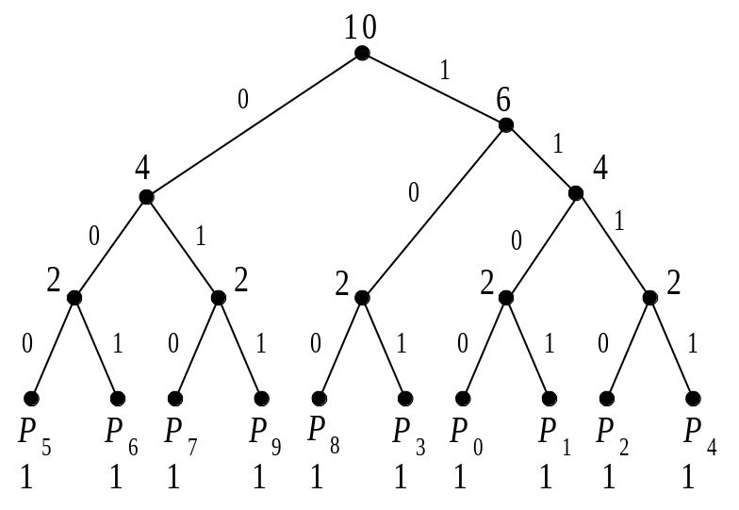
Determine a Load Transfer Sequence by Using Matching Theorem

Slide 47
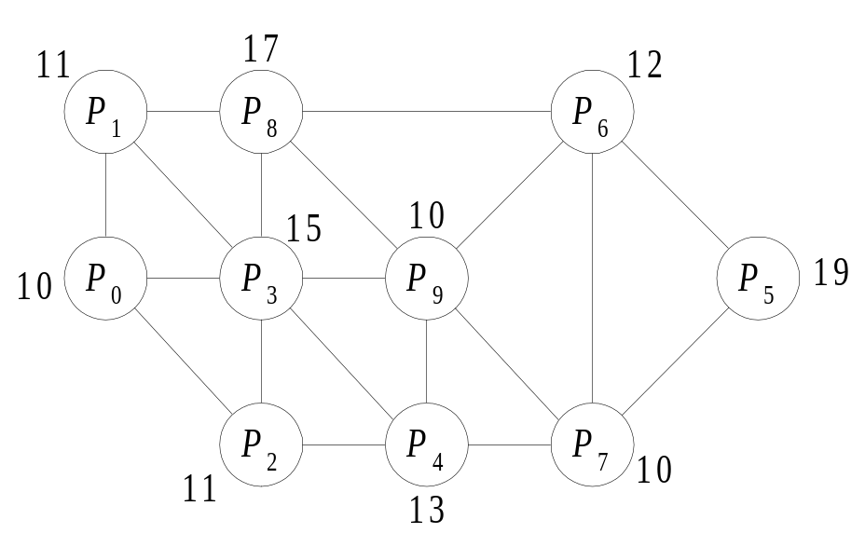
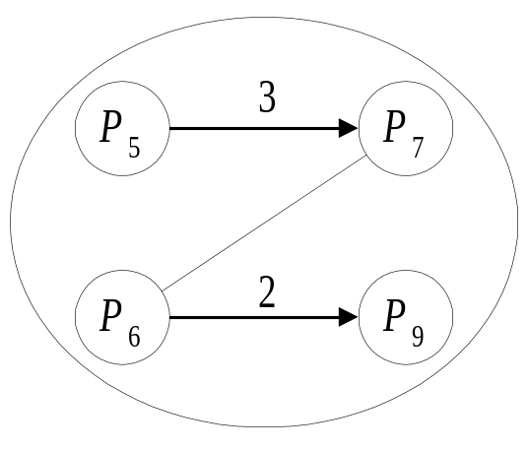
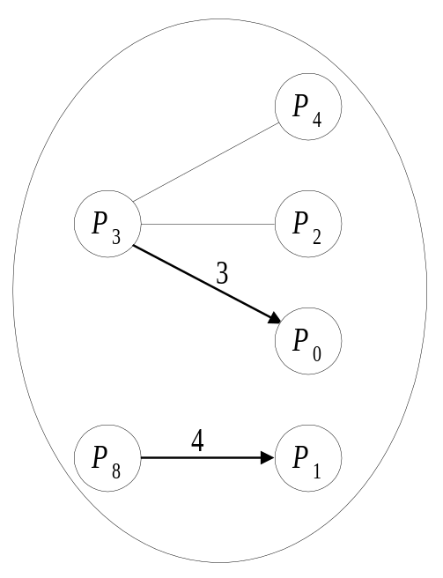
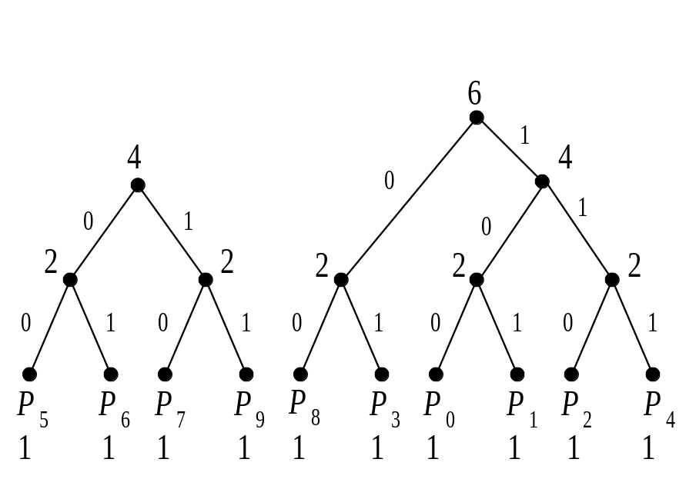
Determine a Load Transfer Sequence by Using Matching Theorem (Cont’d)

Slide 48

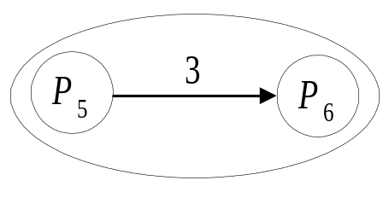
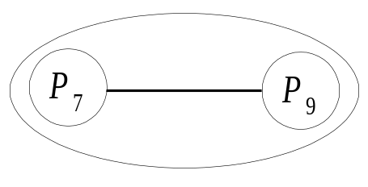
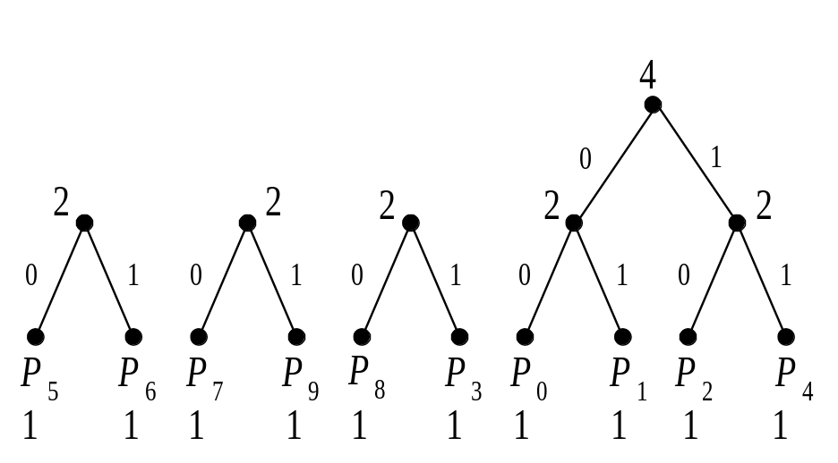
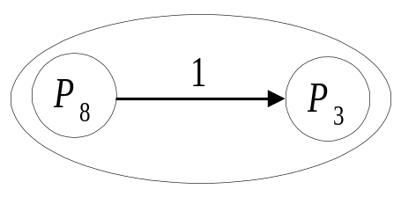
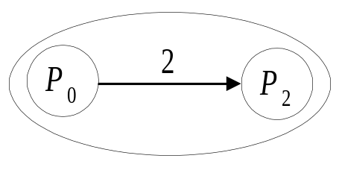
Determine a Load Transfer Sequence by Using Matching Theorem (Cont’d)

Slide 49
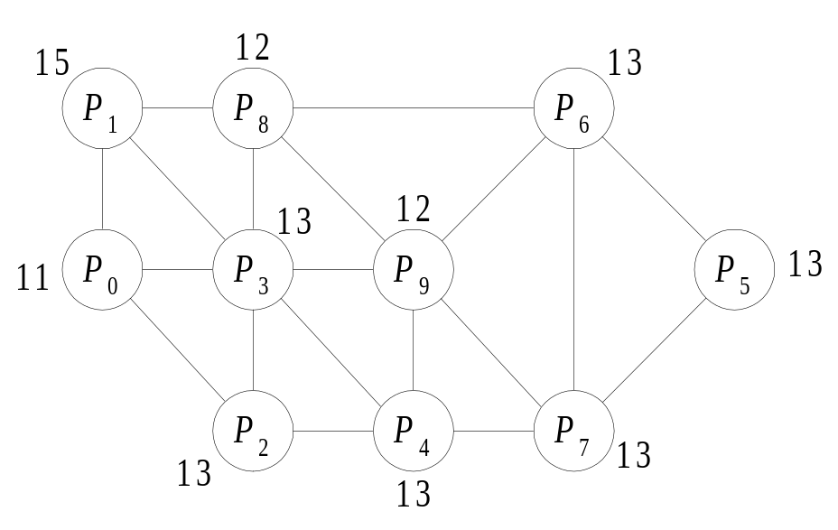




Determine a Load Transfer Sequence by Using Matching Theorem

Slide 50

Determine a Load Transfer Sequence by Using Matching Theorem (continued)
Load Transfer Sequence

Slide 51
Perform The Load Transfer
Goal: balance the load of processors and to minimize the communication cost among processors.
Perform in parallel
Move the boundary nodes with smaller degrees.

Slide 52

The Prefix Code Matching Parallel Load-Balancing Method (continued)

Slide 53


Performance Evaluation and Experimental Results
Test sample:

Slide 54

Performance Evaluation and Experimental Results (continued)
Five Mapping Methods: AE/ORB, AE/MC, JOSTLE-MS, MLkP, and PARTY Library
Three Load-Balancing Methods: Direct Diffusion, Multilevel Diffusion, and PCMPLB

Slide 55

Comparison of the Execution Time of Mapping/Load-Balancing Methods

Slide 56

Comparison of the Execution Time of the Test Sample under Different Mapping/Load-Balancing Methods

Slide 57

Comparison of the Execution Time of the Test Sample under Different Mapping/Load-Balancing Methods (continued)

Slide 58

Comparison of the Execution Time of the Test Sample under Different Mapping/Load-Balancing Methods (continued)

Slide 59

Comparison of the Speedups under Mapping/Load-Balancing Methods for the Test Sample

Slide 60

Comparison of the Speedups under Mapping/ Load-Balancing Methods for the Test Sample (continued)

Slide 61
Conclusions
The dynamic diffusion optimization method can optimize the partitioning results of Jostle, Metis, and Party
The prefix code matching parallel load-balancing (PCMPLB) method outperforms DD, MD, and other remapping methods.

