Slide 1
Techniques for Array Redistribution
Basic Cycle Calculation &
krr Techniques
Speaker : Yeh-Ching Chung
Date : December 10, 1999

Slide 2
Outline of Presentation
Introduction to Array Redistribution
Array Redistribution Issues
Related Work
Basic Cycle Calculation (BCC)
Performance of BCC
krr Techniques
Performance of krr
Conclusions & Future Work

Slide 3
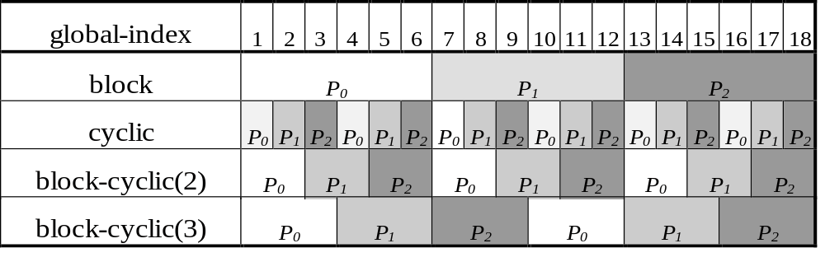
Introduction to Array Redistribution
Array distribution
  BLOCK, CYCLIC, BLOCK-CYCLIC(c)
  Example :
  REAL A(18)
  !HPF$ DISTRIBUTE A(BLOCK), A(CYCLIC),.....

Slide 4
Introduction to Array Redistribution (Cont’d)
Array redistribution
REAL DIM(18, 24) :: A
  !HPF$ PROCESSORS P(2, 3)
  !HPF$ DISTRIBUTE A(BLOCK, BLOCK) ONTO P
  : (computation)
  !HPF$ REDISTRIBUTE A(CYCLIC, CYCLIC(2))
  ONTO P
  : (computation)

Slide 5
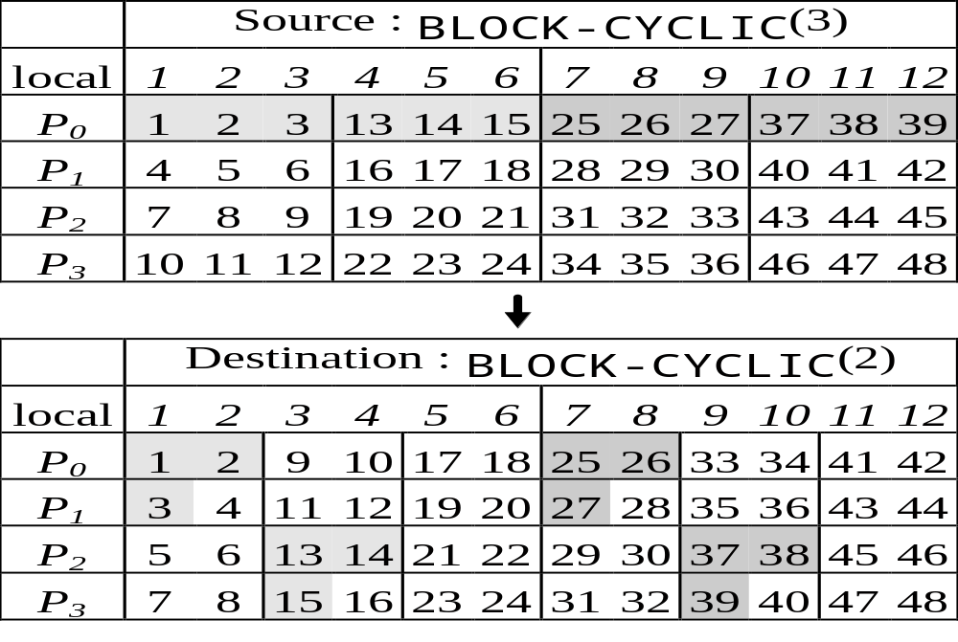
Introduction to Array Redistribution (Cont’d)
Example of one dimension array redistribution

Slide 6
Introduction to Array Redistribution (Cont’d)
Why redistribution?
  Required in many parallel application programs
    FFT, ADI ...
  Code optimization for parallel compiler

Slide 7
Array Redistribution Issues
Types
  BLOCK to CYCLIC (or vice versa)
  BLOCK-CYCLIC(c₁) to BLOCK-CYCLIC(c₂)
    Type 1 : c₁= k c₂ or c₂= k c₁
    Type 2 : Not type 1 & gcd(c₁, c₂) = m (m > 1)
    Type 3 : gcd(c₁, c₂) = 1
  Irregular

Slide 8
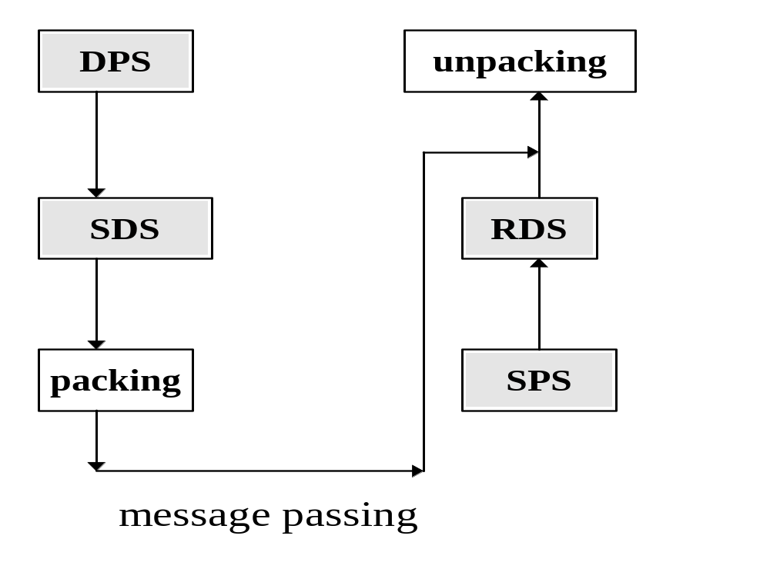
Array Redistribution Issues (Cont’d)
The basic process of array redistribution
Send phase Receive Phase

Slide 9
Array Redistribution Issues (Cont’d)
Redistribution Overheads
  Computation
    Send phase
      Destination Processor Set (DPS)
      Send Data Sets (SDS)
      Packing
    Receive phase
      Source Processor Set (SPS)
      Receive Data Sets (RDS)
      Unpacking
  Communication
    Message passing

Slide 10
Array Redistribution Issues (Cont’d)
Factors of Performance
  Computation Overheads
    Efficient ways to perform send/receive phases
  Communication Overheads
    Communication scheduling (Avoid node contention)
    Asynchronous mode
    (Overlap communication & computation)

Slide 11
Related Work
Computation Methods
  Single-Phase Redistribution
    BLOCK-CYCLIC(60) to BLOCK- CYCLIC(2)
  Multi-Phase Redistribution (Kaushik et al.)
    BLOCK- CYCLIC(60) to BLOCK- CYCLIC(30)
    BLOCK- CYCLIC(30) to BLOCK- CYCLIC(10)
    BLOCK- CYCLIC(10) to BLOCK- CYCLIC(2)
Communication Methods
  Processor Mapping (Ni et al.)
  Communication Scheduling (Lim et al.)

Slide 12
BCC & krr
Basic-Cycle Calculation VS. Multi-Phase redistribution
krr Techniques are good for kr → r & r → kr redistribution

Slide 13
Basic Cycle Calculation
Overview
  A Single-Phase redistribution technique
  Block-Cyclic(S) to Block-Cyclic(t) redistribution
  Types 1, 2, 3

Slide 14
Basic Cycle Calculation (Cont’d)
BLOCK-CYCLIC(s) to BLOCK-CYCLIC(t) redistribution
  Basic-Cycle : lcm(s, t)/gcd(s, t)
Observation 1
  Each Basic-Cyclic has the same communication patterns

Slide 15
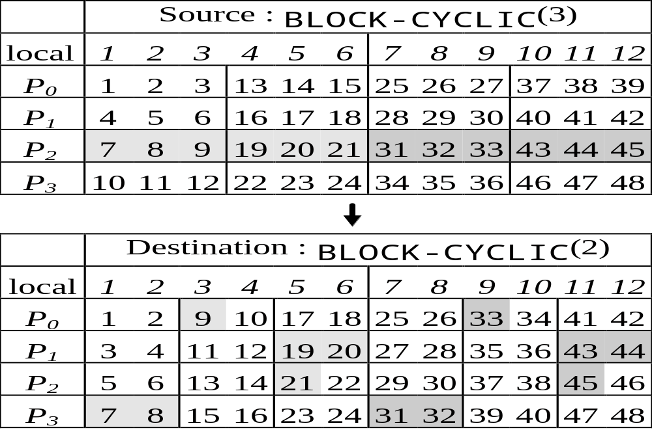
Basic Cycle Calculation (Cont’d)
Basic-Cycle = 6

Slide 16
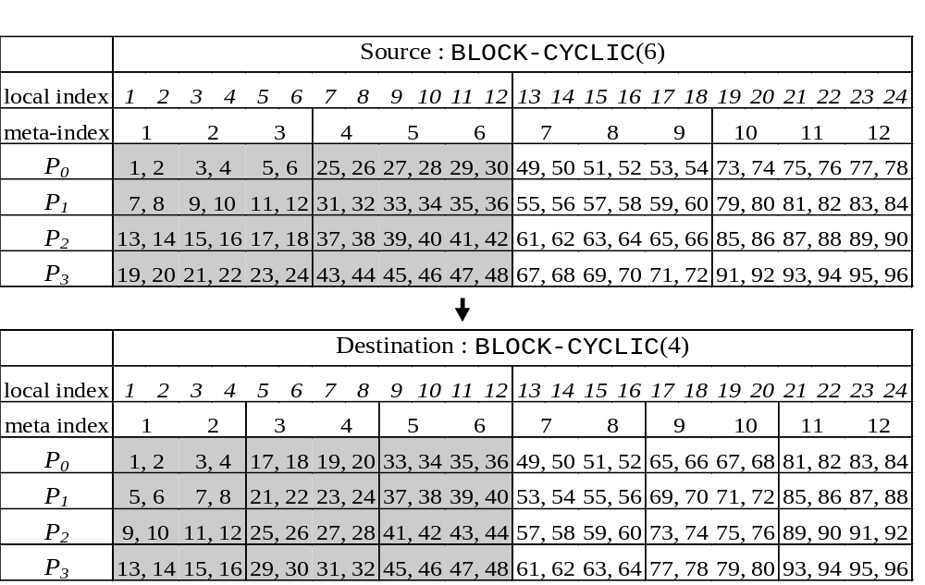
Basic Cycle Calculation (Cont’d)
Basic-Cycle = 6

Slide 17
Basic Cycle Calculation (Cont’d)
BLOCK-CYCLIC(s) to BLOCK-CYCLIC(t) redistribution
  Section in a Basic-Cycle
    Source Section : s
    Destination Section : t
Observation 2
  Each Section is independent

Slide 18
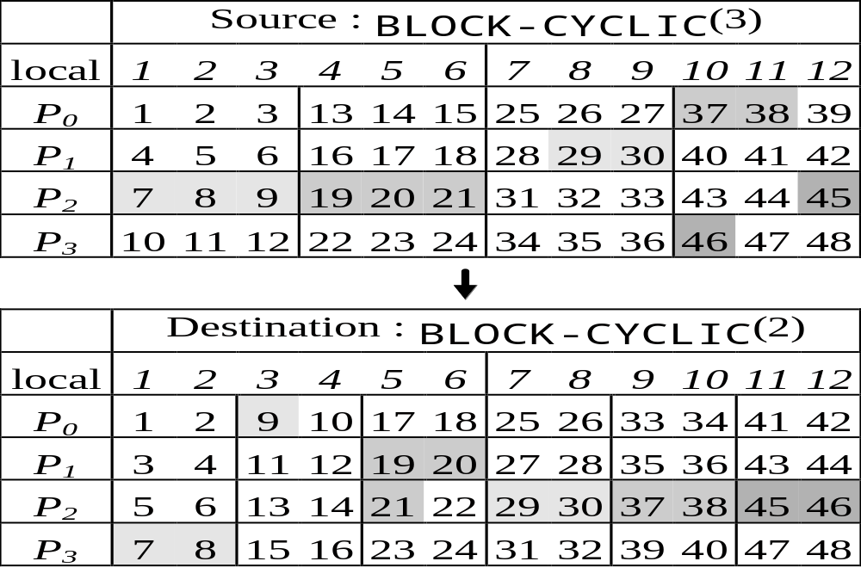
Basic Cycle Calculation (Cont’d)
Source Section = 3, Destination Section = 2

Slide 19
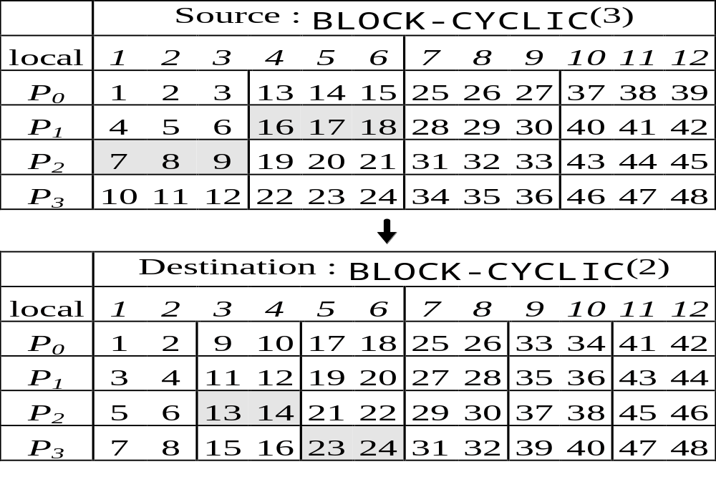
Basic Cycle Calculation (Cont’d)
Observation 3
  Elements in a section have consecutive global array indices

Slide 20
Basic Cycle Calculation (Cont’d)
Observation 1
  Only construct the send/receive processor/data sets of the first Basic-Cycle
Observation 2
  Need to Deal each section separately
Observation 3
  Only need to calculate the first element’s pattern position in each section

Slide 21

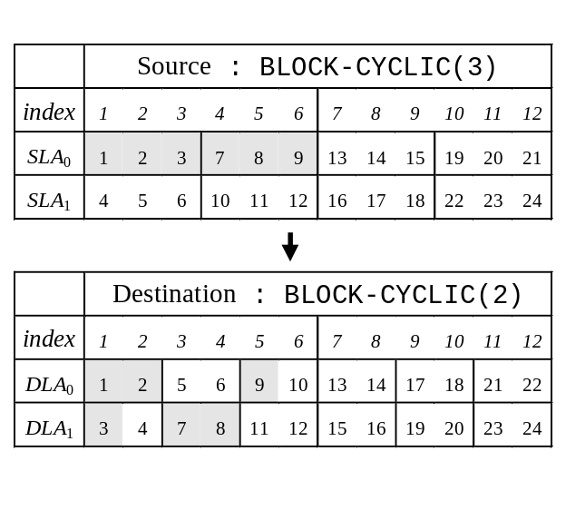
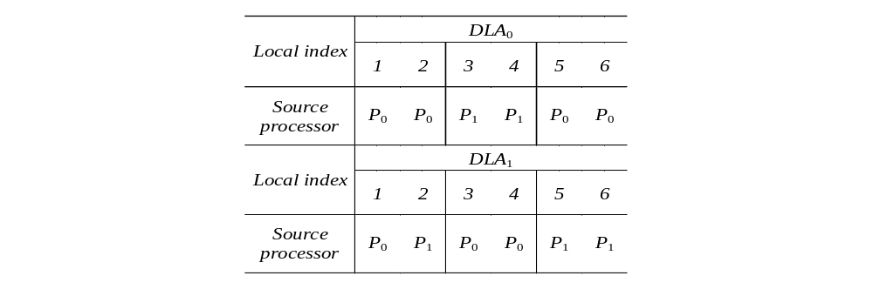
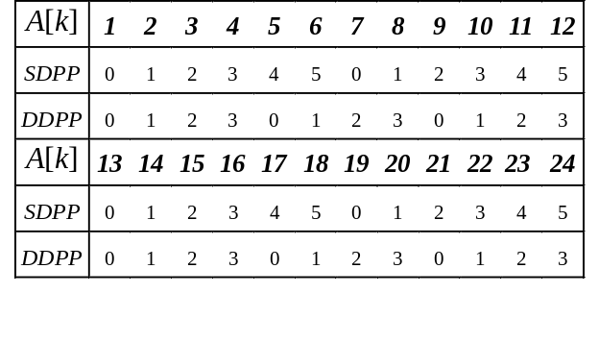
Basic Cycle Calculation (Cont’d)
  An Example of calculating the first element’s pattern position in each section

Slide 22
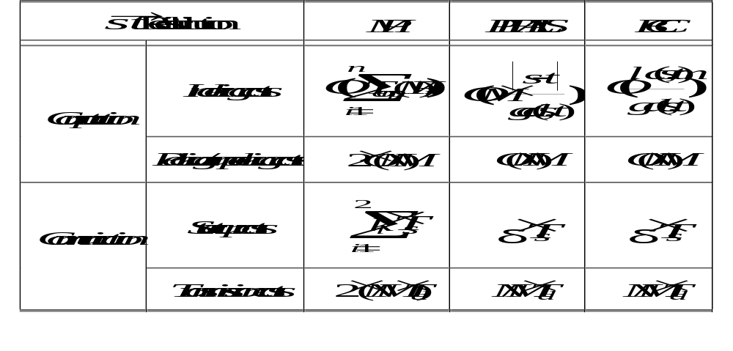
Basic Cycle Calculation (Cont’d)

Slide 23
Basic Cycle Calculation (Cont’d)
Performance Analysis
  Three Types
    gcd(s, t) = 1 (Type 3)
    gcd(s, t) = k, s, t are not divisible to each other (Type 2)
    gcd(s, t) = k, s = kt or t = ks (Type 1)
  T_{comm}(2-P) larger than or equal to T_{comm}(BCC)
    Lemma 1, 2, 3

Slide 24
Basic Cycle Calculation (Cont’d)
Lemma 1
  Given a BLOCK-CYCLIC(s) to BLOCK-CYCLIC(t) redistribution on an array A(1:N) over M processors, where s is not divisible by t, t is not divisible by s, and the value of gcd(s, t) is equal to 1, the communication time for the two-stage multi-phase method to perform this redistribution is always greater than that of the basic-cycle calculation.

Slide 25
Basic Cycle Calculation (Cont’d)
Lemma 2
  Given a BLOCK-CYCLIC(s) to BLOCK-CYCLIC(t) redistribution on an array A(1:N) over M processors, where s is not divisible by t, t is not divisible by s, and the value of gcd(s, t) is not equal to 1, the communication time for the two-stage multi-phase method to perform this redistribution is always greater than that of the basic-cycle calculation.

Slide 26
Basic Cycle Calculation (Cont’d)
Lemma 3
  Given a BLOCK-CYCLIC(s) to BLOCK-CYCLIC(t) redistribution on an array A(1:N) over M processors, where s is divisibly by t or t is divisibly by s, the communication time for the one-stage multi-phase method to perform this redistribution is the same as that of the basic-cycle calculation.

Slide 27
Performance of BCC
IBM-SP2 parallel machine
72 processors
Different size in each case were tested
Mean time of 10 tests were reported
Single-precision array was used for the test

Slide 28
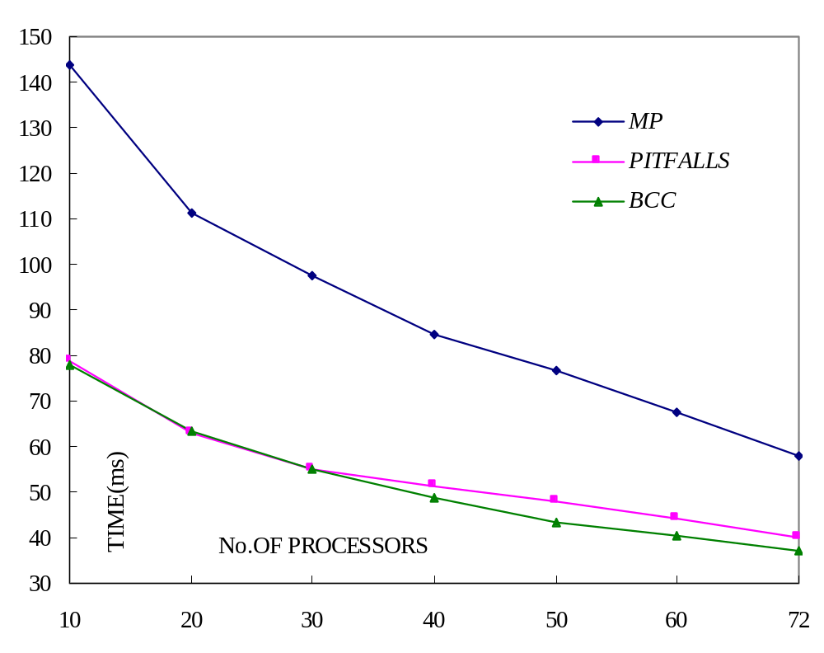
Performance of BCC (Cont’d)
Type 3: BC(5) to BC(8) Redistribution

Slide 29
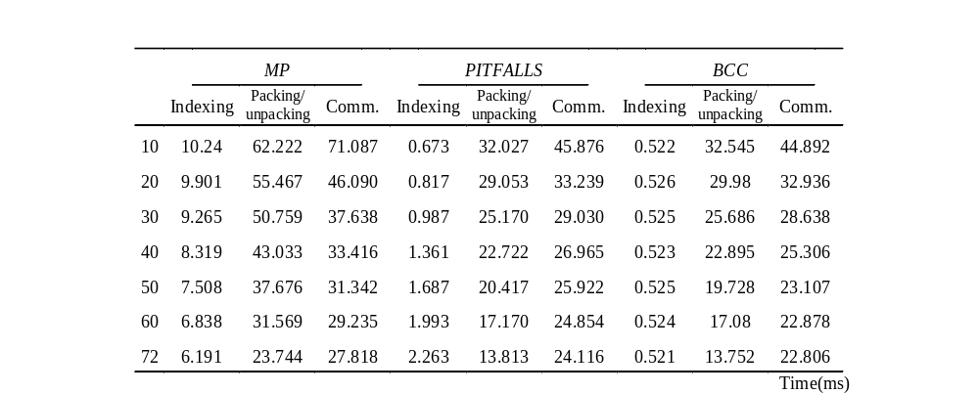
Performance of BCC (Cont’d)
Type 3: B-C(5) to B-C(8) Redistribution

Slide 30
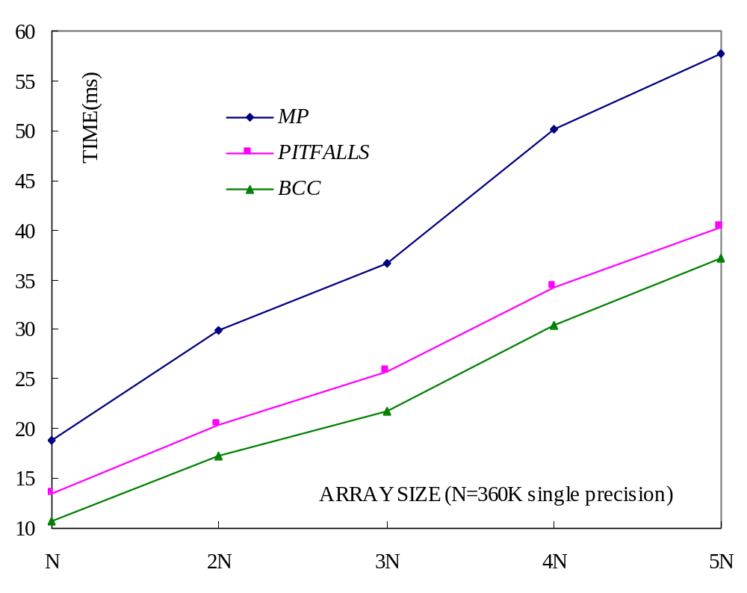
Performance of BCC (Cont’d)
Type 3: BC(5) to BC(8) Redistribution

Slide 31
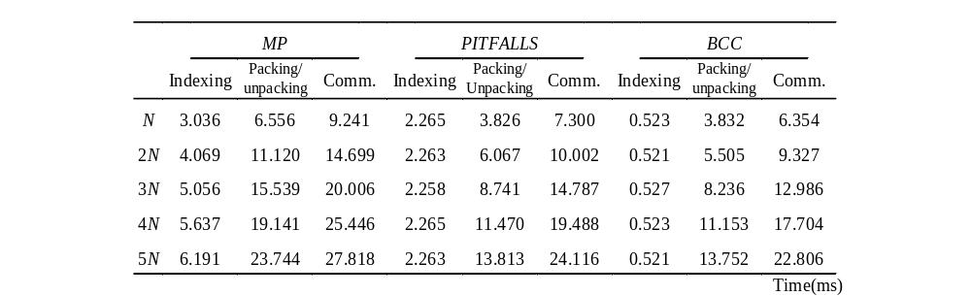
Performance of BCC (Cont’d)
Type 3: B-C(5) to B-C(8) Redistribution

Slide 32
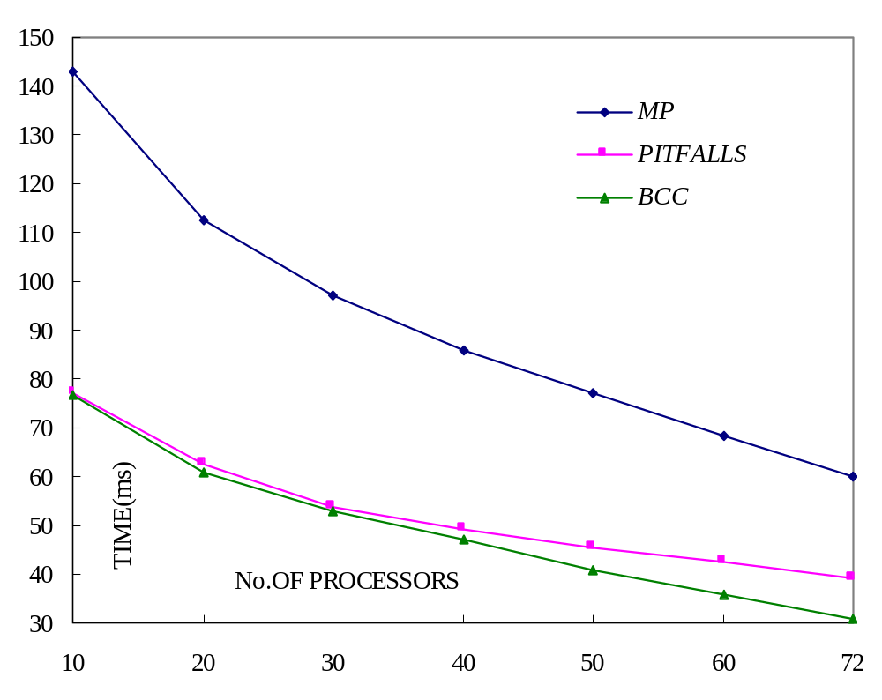
Performance of BCC (Cont’d)
Type 2: BC(40) to BC(300) Redistribution

Slide 33
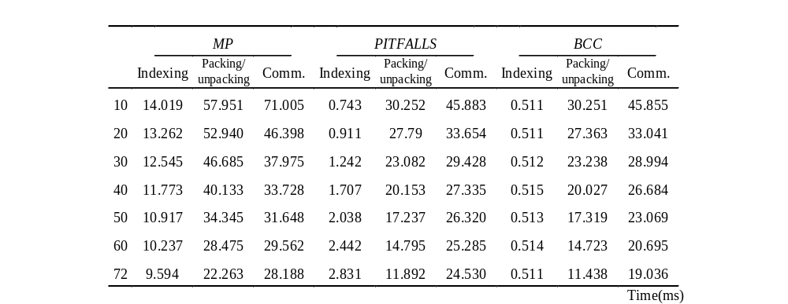
Performance of BCC (Cont’d)
Type 2: BC(40) to B-C(300) Redistribution

Slide 34
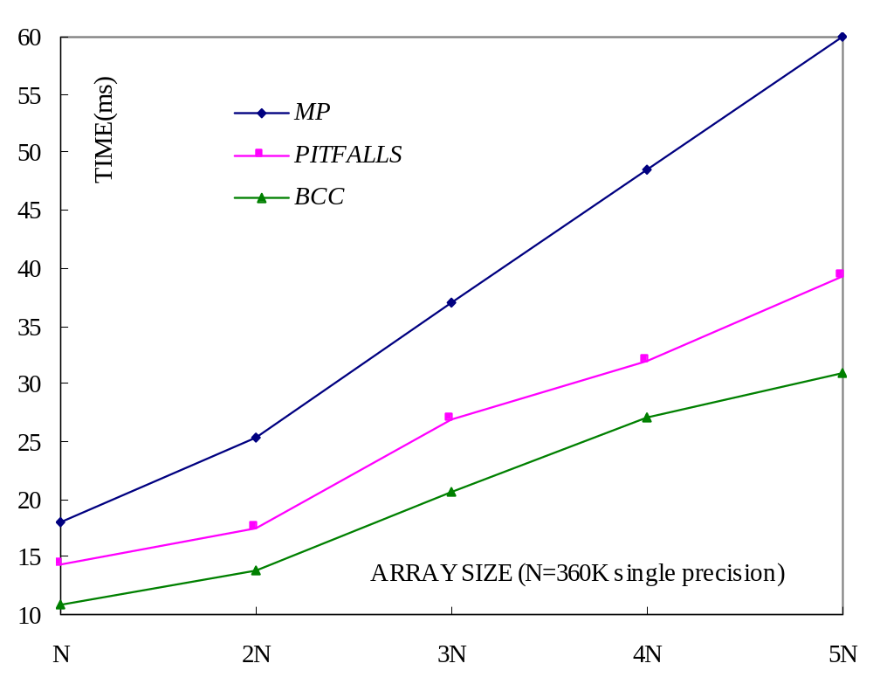
Performance of BCC (Cont’d)
Type 2: BC(40) to BC(300) Redistribution

Slide 35
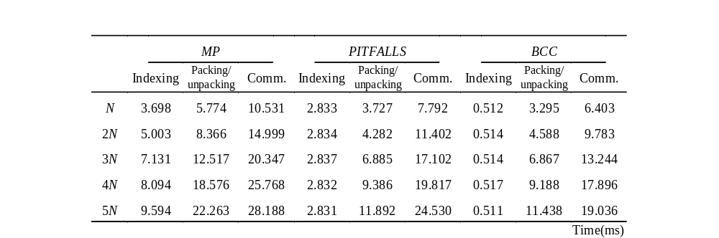
Performance of BCC (Cont’d)
Type 2: BC(40) to BC(300) Redistribution

Slide 36
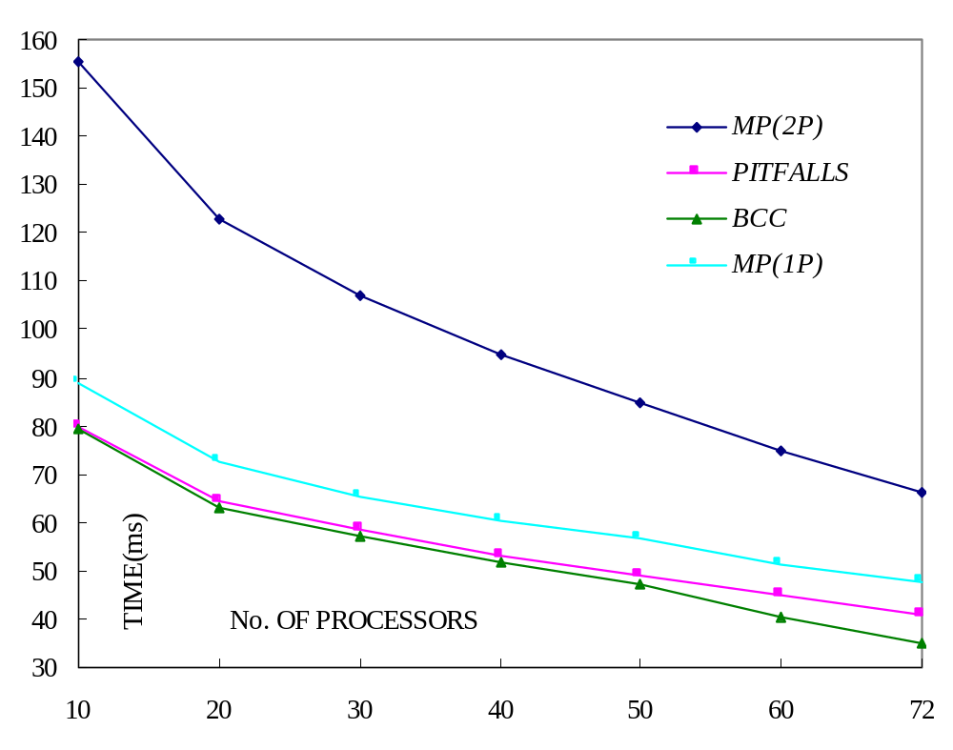
Performance of BCC (Cont’d)
Type 1 : BC(10) to BC(500) Redistribution

Slide 37
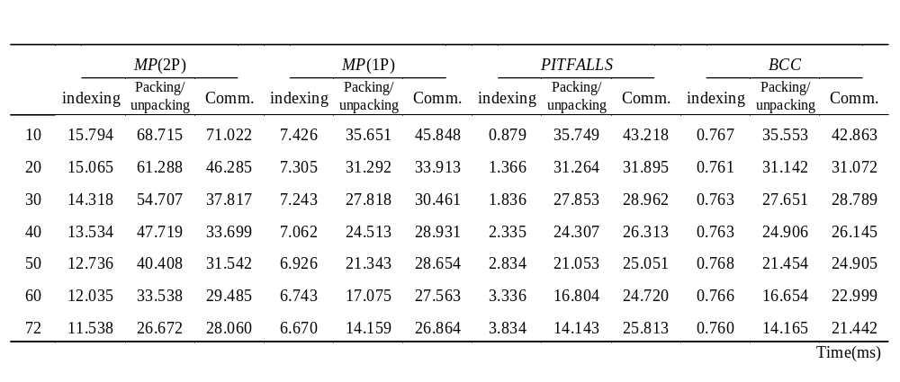
Performance of BCC (Cont’d)
Type 1 : BC(10) to BC(500) Redistribution

Slide 38
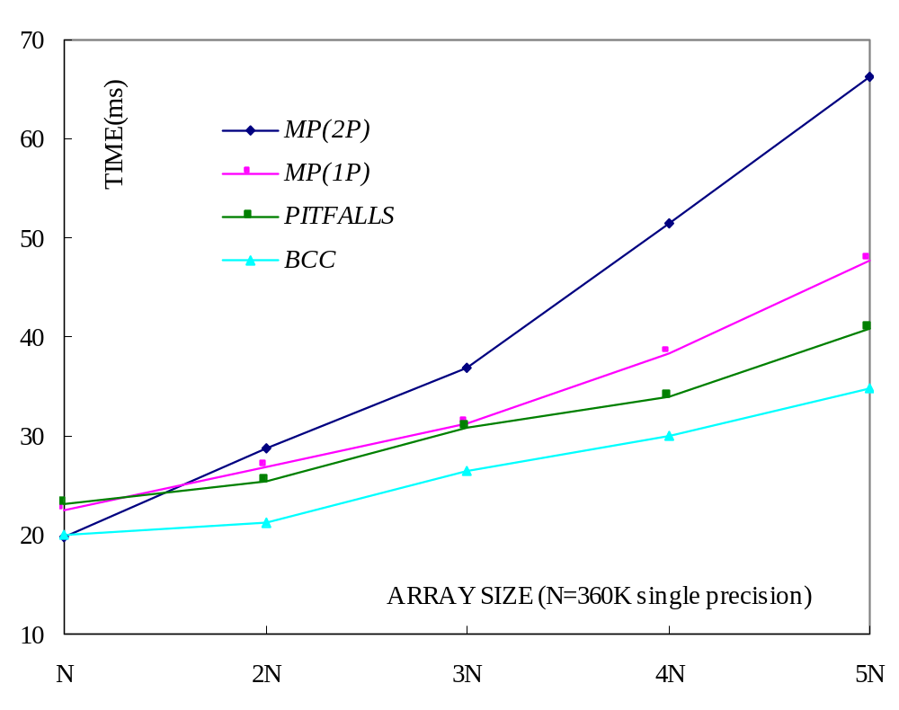
Performance of BCC (Cont’d)
Type 1 : BC(10) to BC(500) Redistribution

Slide 39
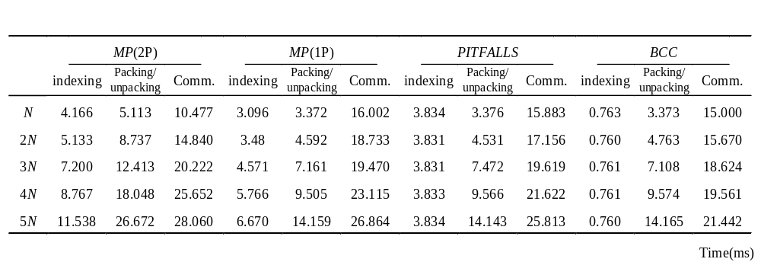
Performance of BCC (Cont’d)
Type 1 : BC(10) to BC(500) Redistribution

Slide 40
Summary
Type 1 :
  Small size : PITFALLS > 1P > 2P > BCC
  Large size : 2P > 1P > PITFALLS > BCC
Type 2, 3 :
  2P > PITFALLS > BCC

Slide 41
Summary (Cont’d)
Basic-Cycle Calculation
  Computation efficiency
  Avoid node contention mostly
  Without extra transmission cost

Slide 42
Krr Techniques
Overview
  Efficient redistribution algorithms for Type 1
Type 1 : BLOCK-CYCLIC(c₁) to BLOCK-CYCLIC(c₂)
  Case 1 : c₁= k c₂
    BLOCK-CYCLIC(kr) TO BLOCK-CYCLIC(r)
  Case 2 : c₂= k c₁
    BLOCK-CYCLIC(r) TO BLOCK-CYCLIC(kr)

Slide 43
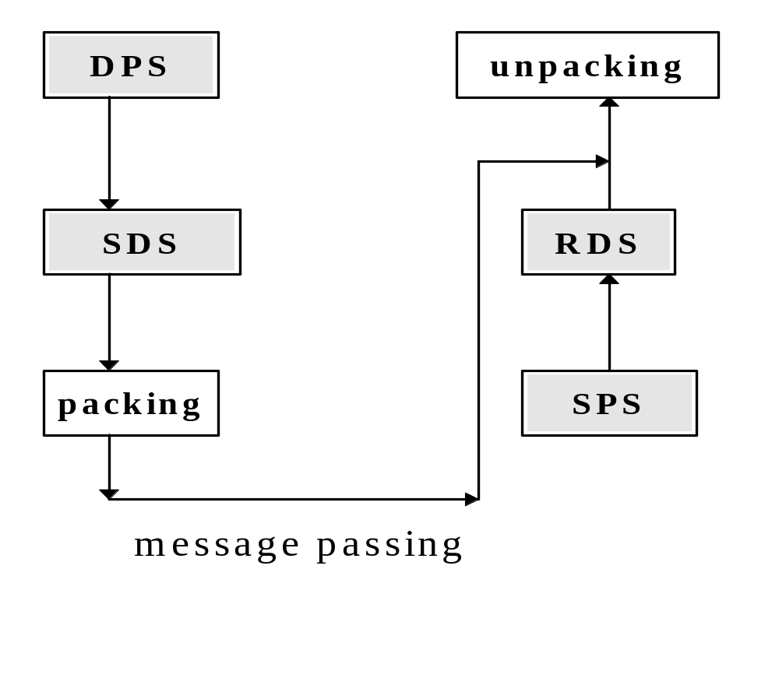
krr Techniques (Cont’d)
Send phase Receive Phase

Slide 44
krr Techniques (Cont’d)
Overheads
  Computation : Four Sets, packing, unpacking
  Communication : Message passing
Observations
  To minimize comm. overheads is more difficult
  Minimize comp. overheads

Slide 45
kr→r Redistribution
Send Phase
  Lemma 1: Given an s→t redistribution on A[1:N] over M processors, SLA_{i}[m], SLA_{i}[m+LCC], SLA_{i}[m+2×LCC], …, and SLA_{i}[m+(⎣N/GCC⎦−1)×LCC] have the same destination processor, where 0 ≤ i ≤ M−1 and 0 ≤ m ≤ LCC−1.

Slide 46
kr→r Redistribution (Cont’d)
Send Phase
  Lemma 2: Given a kr→r redistribution on A[1:N] over M processors, for a source processor P_{i} and array elements in SLA_{i}[x×LCC:(x+1)×LCC−1], if the destination processor of SLA_{i}[x×LCC] is P_{j}, then the destination processors of SLA_{i}[x×LCC:x×LCC+r−1], SLA_{i}[x×LCC+r:x×LCC+2r−1],…, SLA_{i}[x×LCC+(k-1)×r: x×LCC+kr−1] are P_{j}, P_{mod(j+1, M)}, …, P_{mod(j+k−1, M)}, respectively, where 0 ≤ x ≤ N/GCC−1 and 0 ≤ i, j ≤ M−1.

Slide 47
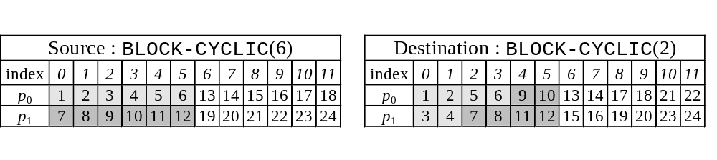
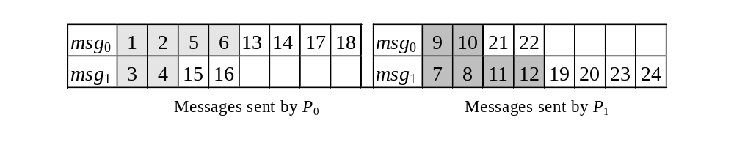
kr→r Redistribution (Cont’d)
Example

Slide 48
kr→r Redistribution(Cont’d)
Receive Phase
  Lemma 3: Given a kr→r redistribution on A[1:N] over M processors, for a source processor P_{i} and array elements in SLA_{i}[x×LCC:(x+1)×LCC−1], if the destination processor of SG(SLA_{i}[a₀]), SG(SLA_{i}[a₁]), ..., SG(SLA_{i}[a_{γ-1}]) is P_{j}, then SG(SLA_{i}[a₀]), SG(SLA_{i}[a₁]), ..., SG(SLA_{i}[a_{γ-1}]) are in the consecutive local array positions of DLA_{j}[0:N/M−1], where 0 ≤ i, j ≤ M−1, 0 ≤ x ≤ N/GCC−1, and x×LCC ≤ a₀ < a₁ < a₂ < ... < a_{γ-1} < (x+1)×LCC.

Slide 49
kr→r Redistribution (Cont’d)
Receive Phase
  Lemma 4: Given a kr→r redistribution on A[1:N] over M processors, for a source processor P_{i}, if SLA_{i}[a] and SLA_{i}[b] are the first array element of SLA_{i}[x×LCC:(x+1)×LCC−1] and SLA_{i}[(x+1)×LCC:(x+2)×LCC−1], respectively, with the same destination processor P_{j} and SG(SLA_{i}[a]) = DG(DLA_{j}[α]), then SG(SLA_{i}[b]) = DG(DLA_{j}[α+kr]), where 0 ≤ i, j ≤ M−1, 0 ≤ x ≤ N/GCC−2, and 0 ≤ α ≤ N/M−1.

Slide 50
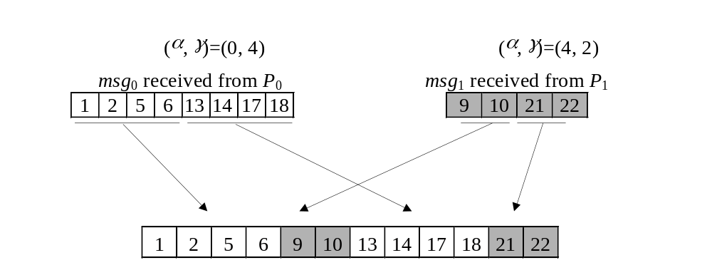
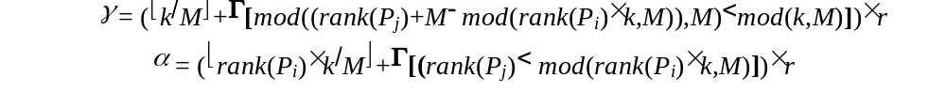
kr→r Redistribution (Cont’d)
Example

Slide 51
r→kr Redistribution
Send Phase
  Lemma 5: Given an r→kr redistribution on A[1:N] over M processors, for a source processor P_{i} and array elements in SLA_{i}[x×LCC:(x+1)×LCC−1], if the destination processor of SG(SLA_{i}[a₀]), SG(SLA_{i}[a₁]), ..., SG(SLA_{i}[a_{n-1}]) is P_{j}, then SG(SLA_{i}[a₀]), SG(SLA_{i}[a₁]), ..., SG(SLA_{i}[a_{n-1}]) are in the consecutive local array positions of SLA_{i}[0:N/M−1], where 0 ≤ i, j ≤ M−1, 0 ≤ x ≤ N/GCC−1, and x×LCC ≤ a₀ < a₁ < a₂ < ... < a_{n-1} < (x+1)×LCC.

Slide 52
r→kr Redistribution(Cont’d)
Send Phase
Given an r→kr redistribution on A[1:N] over M processors, for a source processor P_{i}, if the destination processor for the first array element of SLA_{i} is P_{j} and there are u classes, C₁, C₂, C₃,…, and C_{u} in SLA_{i}[0:LCC-1] (assume that the indices of local array elements in these classes have the order C₁ < C₂ < C₃ < …< C_{u} and the destination processors of C₁, C₂, C₃,…, and C_{u} are P_{j1}, P_{j2}, P_{j3},…, and P_{ju}, respectively), according to Lemma 5, we know that
j₁ = j,
j₂ = mod( (|C₁|×M) / kr + j₁, M),
j₃ = mod( (|C₂|×M) / kr + j₂, M),
:
j_{u} = mod( (|C_{u-1}|×M) / kr + j_{u−1}, M),
where 1 ≤ u ≤ min(k, M) and |C₁|, …, |C_{u-1}| are class size of C₁, …, C_{u−1}, respectively.

Slide 53
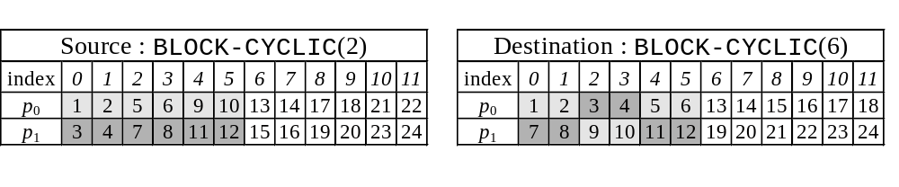
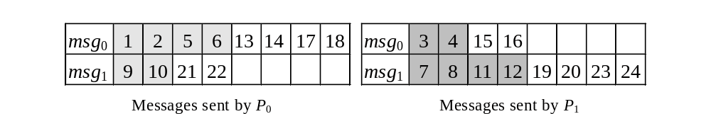
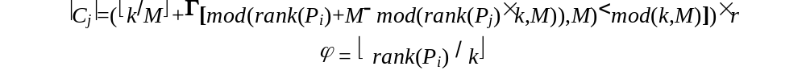
r→kr Redistribution (Cont’d)
Example

Slide 54
r→kr Redistribution(Cont’d)
Receive Phase
Lemma 6: Given an r→kr redistribution on A[1:N] over M processors, for a source processor P_{i} and array elements in SLA_{i}[x×LCC:(x+1)×LCC−1], if the destination processor of SG(SLA_{i}[a₀]), SG(SLA_{i}[a₁]), ..., SG(SLA_{i}[a_{n-1}]) is P_{j}, then array elements of SG(SLA_{i}[a₀]), ..., SG(SLA_{i}[a_{r-1}]); SG(SLA_{i}[a_{r}]), ..., SG(SLA_{i}[a_{2r-1}]); ... ; and SG(SLA_{i}[a_{n-r}]), ..., SG(SLA_{i}[a_{n-1}]) are in the consecutive local array positions of DLA_{j}[0:N/M−1], where 0 ≤ i, j ≤ M−1, 0 ≤ x ≤ N/GCC−1 and x×LCC ≤ a₀ < a₁ < a₂ < ... < a_{n-1} < (x+1)×LCC. Furthermore, if SG(SLA_{i}[a₀]) = DG(DLA_{j}[v]), then SG(SLA_{i}[a_{r}]) = DG(DLA_{j}[v+Mr]), SG(SLA_{i}[a_{2r}]) = DG(DLA_{j}[v+2Mr]), ..., and SG(SLA_{i}[a_{n-r}]) = DG(DLA_{j}[v+(n/r−1)×Mr]), where 0 ≤ v ≤ N/M−1.

Slide 55
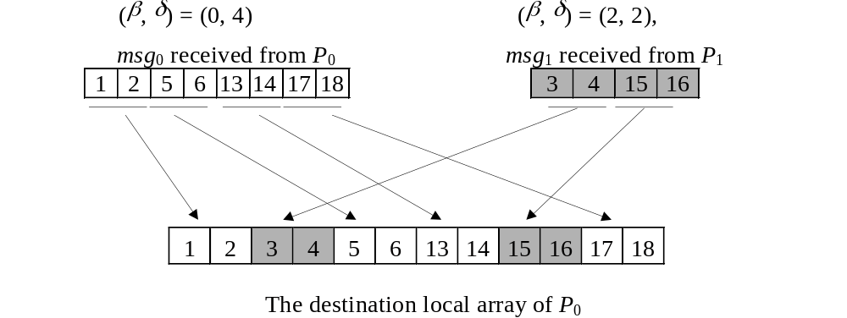
r→kr Redistribution (Cont’d)
Example

Slide 56
Performance of krr
IBM-SP2 parallel machine
64 processors
N ∈ {1.28Mbytes, 2.56Mbytes, 3.84Mbytes, 5.12Mbytes, 6.4Mbytes}
k ∈ {5, 25, 50, 100, N/64}
Mean time of 10 tests were reported
Single-precision array was used for the test

Slide 57
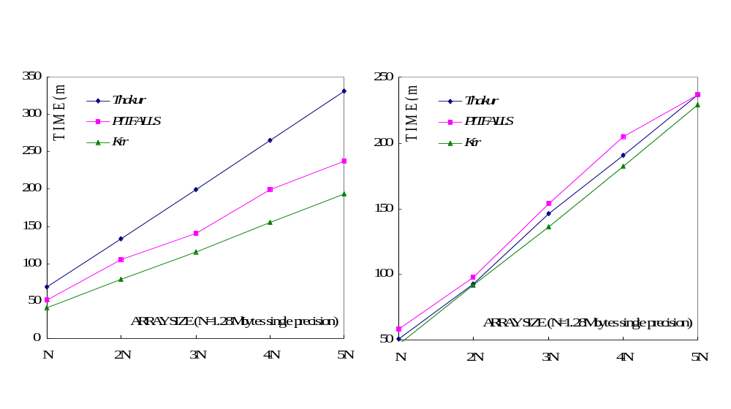
Performance of krr (Cont’d)
BC(10) to BC(2) & BC(2) to BC(10)

Slide 58
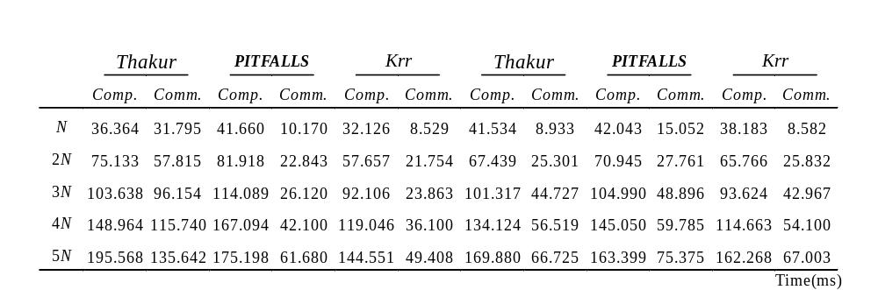
Performance of krr (Cont’d)
BC(10) to BC(2) & BC(2) to BC(10)

Slide 59
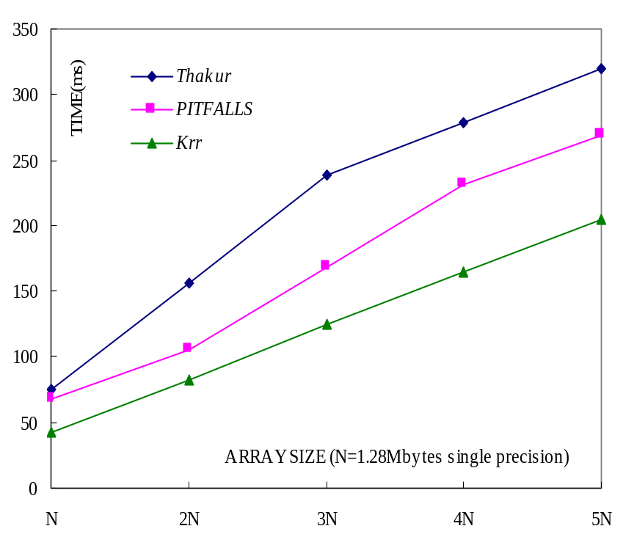
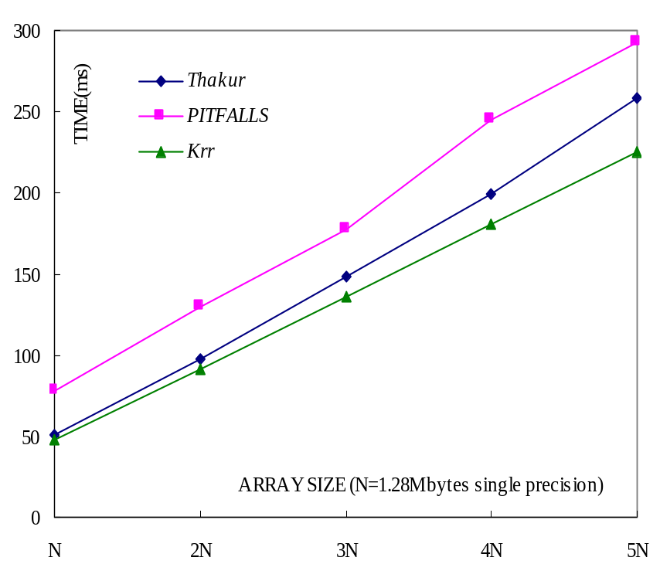
Performance of krr (Cont’d)
BC(50) to BC(2) & BC(2) to BC(50)

Slide 60
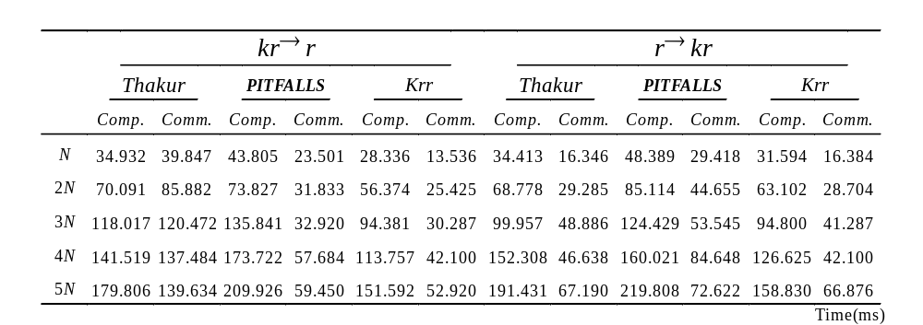
Performance of krr (Cont’d)
BC(50) to BC(2) & BC(2) to BC(50)

Slide 61
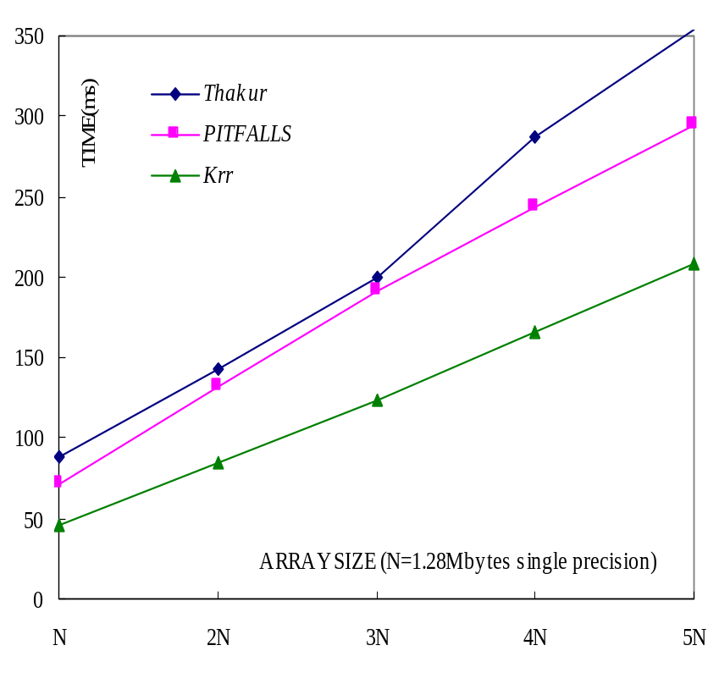
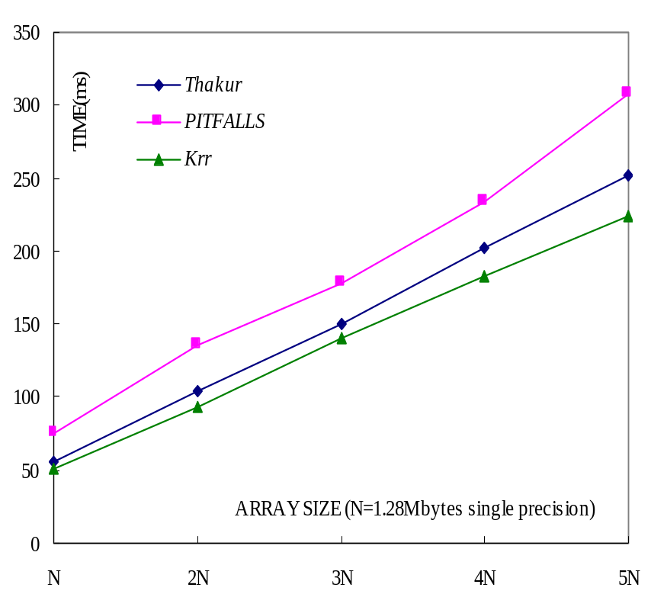
Performance of krr (Cont’d)
BC(100) to BC(2) & BC(2) to BC(100)

Slide 62
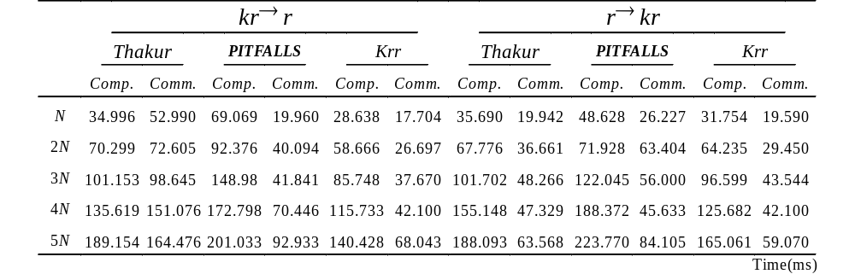
Performance of krr (Cont’d)
BC(100) to BC(2) & BC(2) to BC(100)

Slide 63
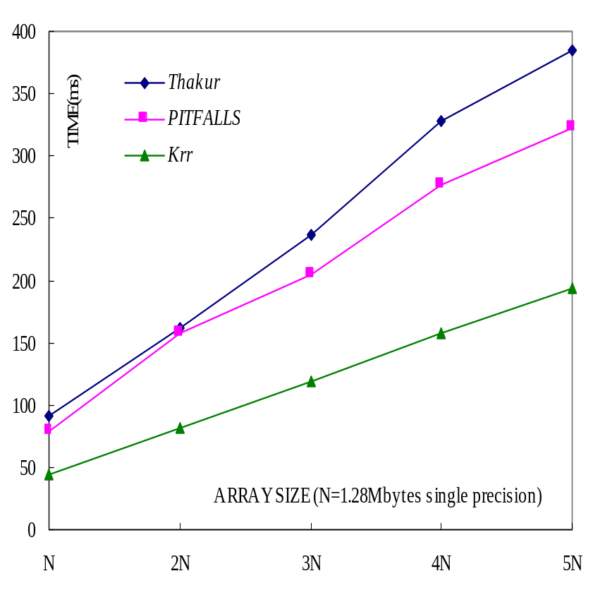
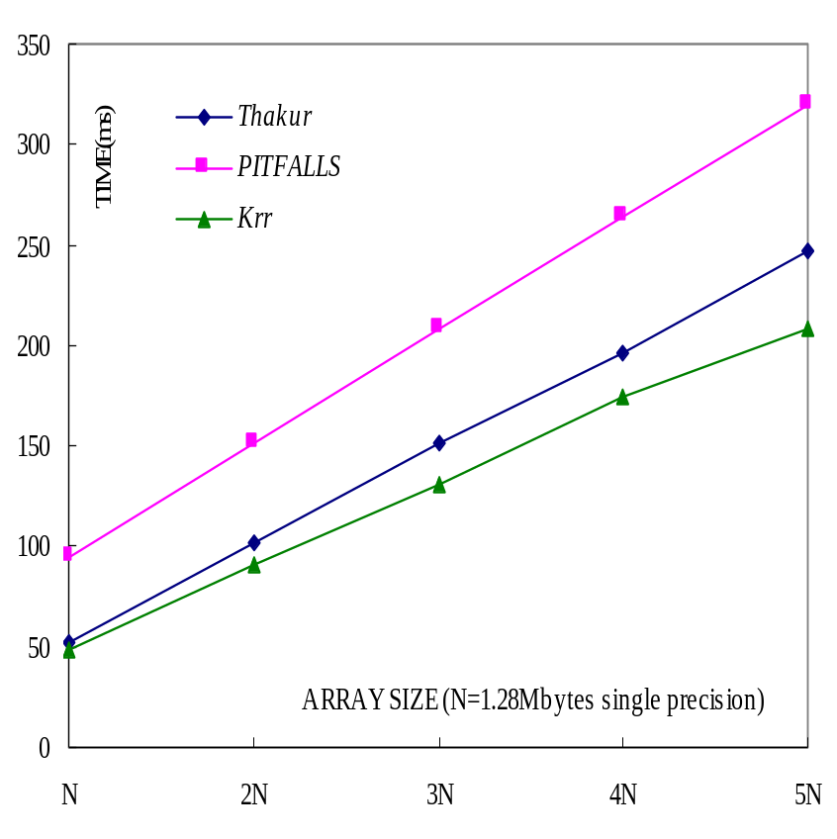
Performance of krr (Cont’d)
BC(200) to BC(2) & BC(2) to BC(200)

Slide 64
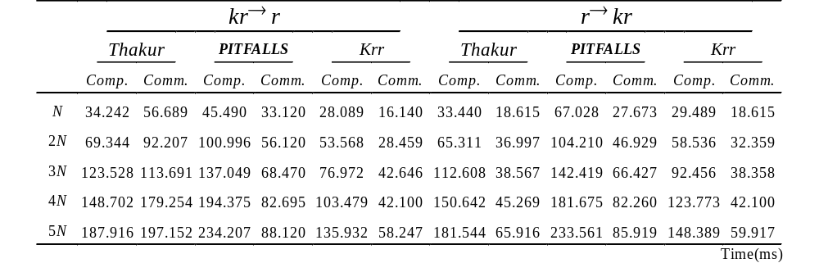
Performance of krr (Cont’d)
BC(200) to BC(2) & BC(2) to BC(200)

Slide 65
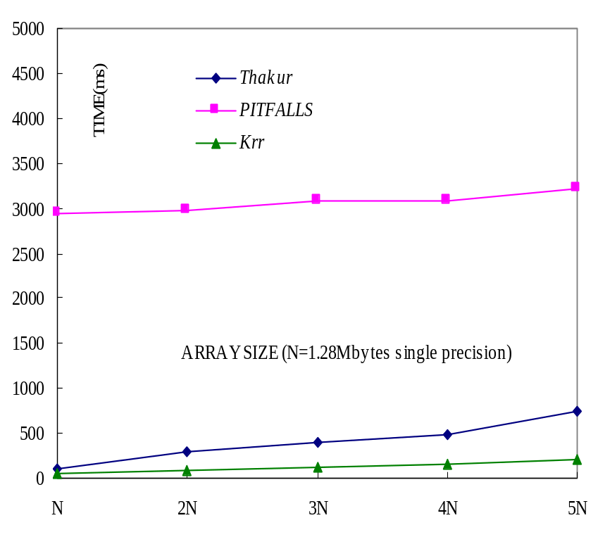
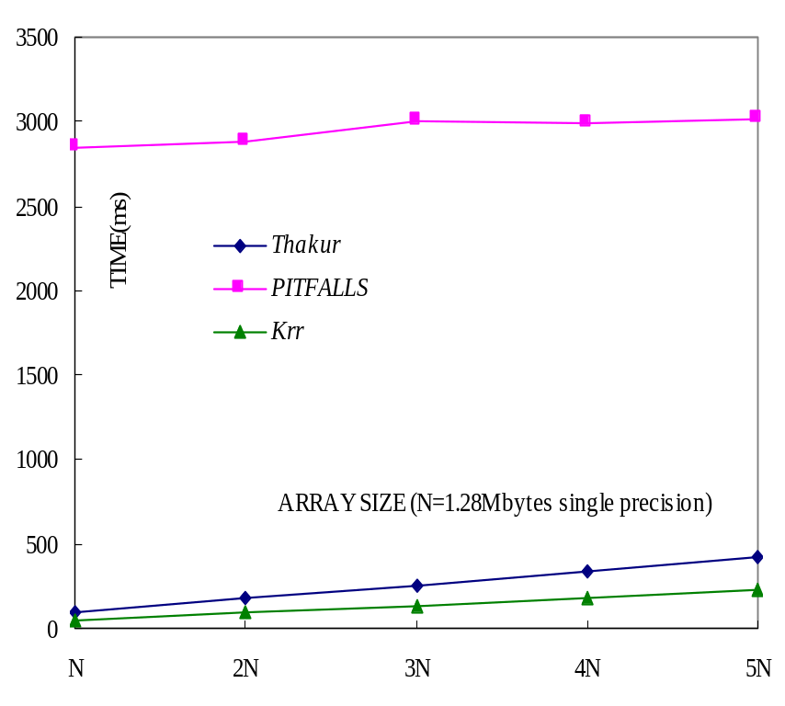
Performance of krr (Cont’d)
BLOCK to CYCLIC & CYCLIC to BLOCK

Slide 66
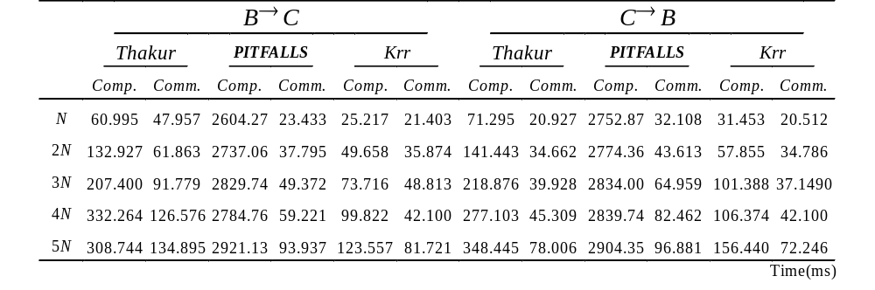
Performance of krr (Cont’d)
BLOCK to CYCLIC & CYCLIC to BLOCK

Slide 67
Conclusions & Future Work
Run-time array redistribution must be efficiently
BCC is an efficient redistribution method
krr is good for kr → r & r → kr
Study methods to minimize the communication overheads
Methods for different size of processors

