Slide 1
Embedding Network with Ring Connection in Hypercube Machines
C.Y. Roger Chen & Yeh-Ching Chung
Speaker : Yeh-Ching Chung
Date: December 24, 1999

Slide 2
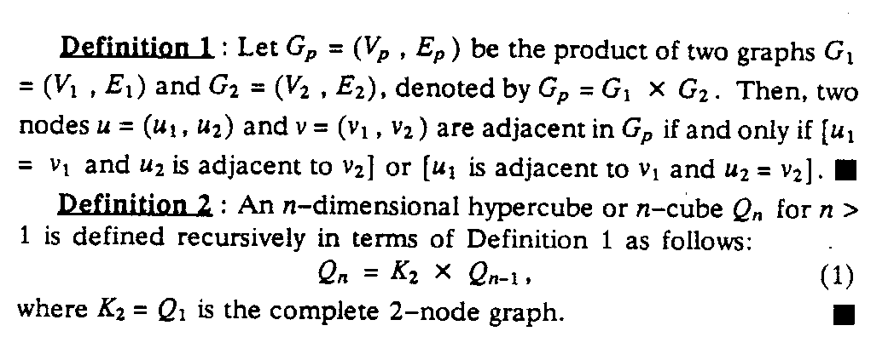
Preliminaries
A. Hypercubes

Slide 3
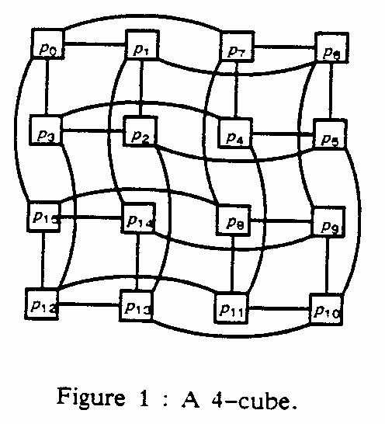
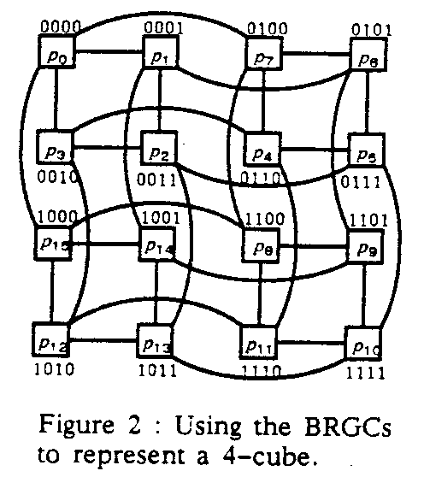
Preliminaries(cont’d.)

Slide 4
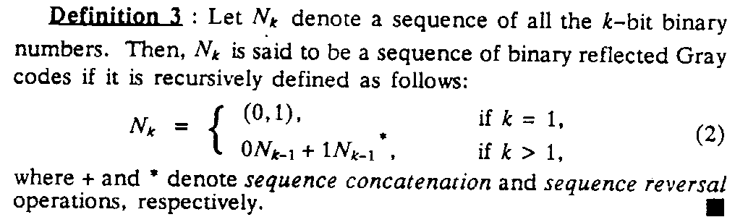
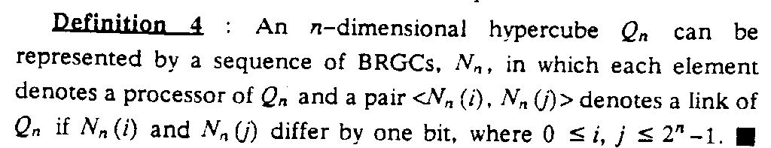
Preliminaries(cont’d.)

Slide 5
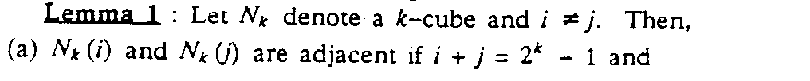
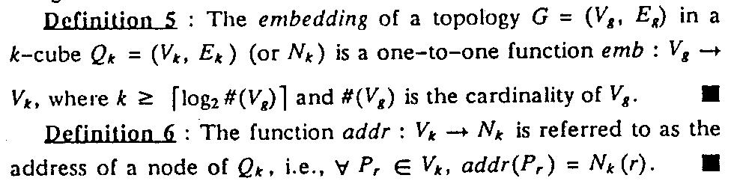
Preliminaries(cont’d.)
(b) N_{k}(i) and N_{K}(j) differ by an even (odd) number of bits if | i - j | is even (odd).
B. Embedding

Slide 6
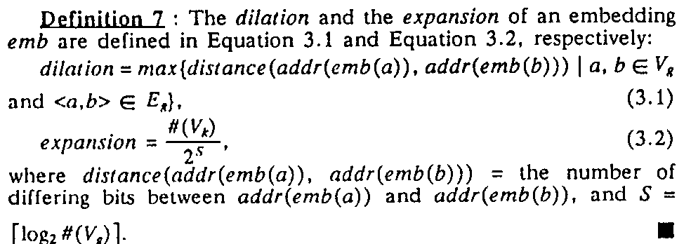
Preliminaries(cont’d.)

Slide 7
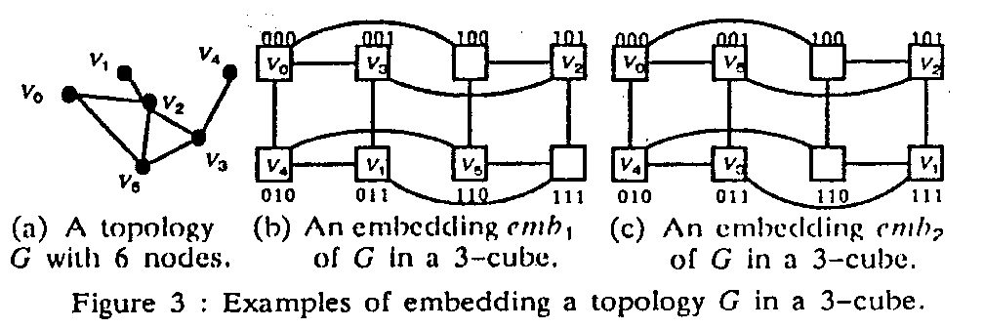
Preliminaries(cont’d.)

Slide 8
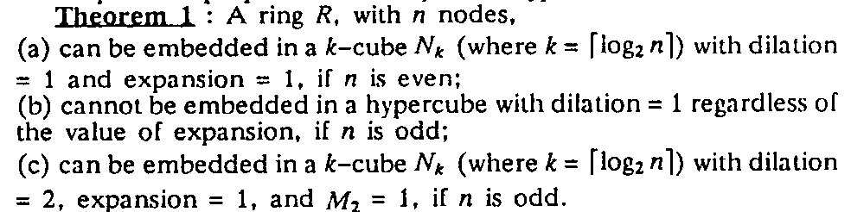
Embedding Rings and Chordal Rings
In Hypercubes
A. Embedding Rings in Hypercubes

Slide 9
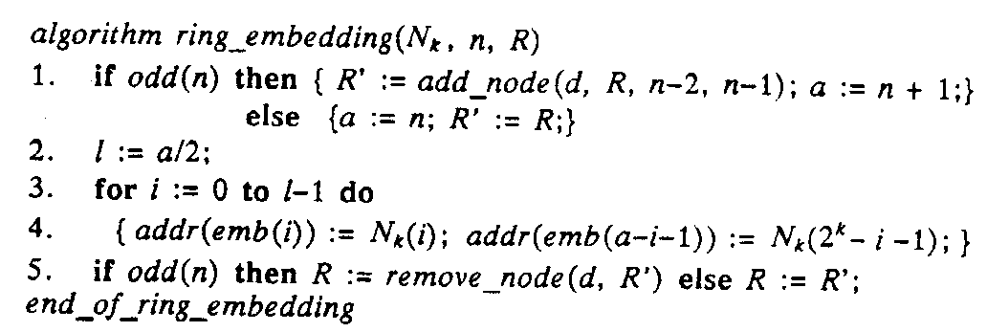
Embedding Rings and Chordal Rings
In Hypercubes(cont’d.)
B.Embedding Chordal Rings in Hypercube

Slide 10
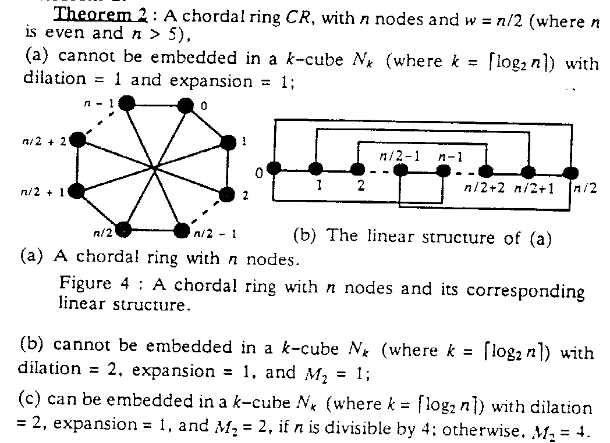
Embedding Rings and Chordal Rings
In Hypercubes(cont’d.)

Slide 11
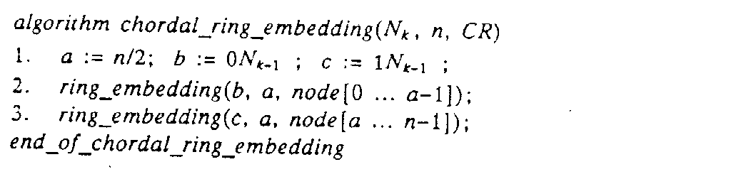
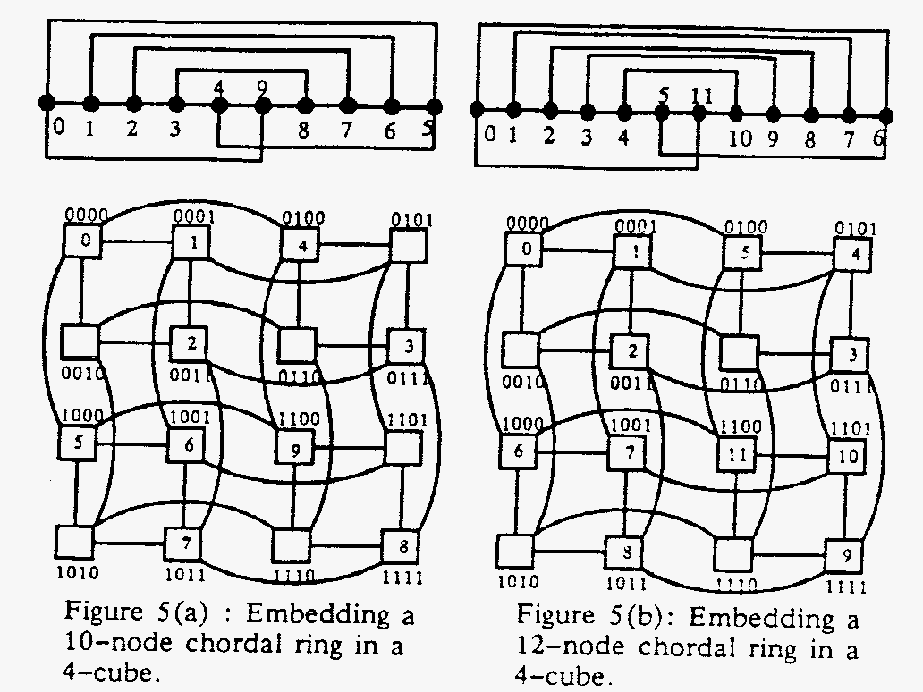
Embedding Rings and Chordal Rings
In Hypercubes(cont’d.)

Slide 12
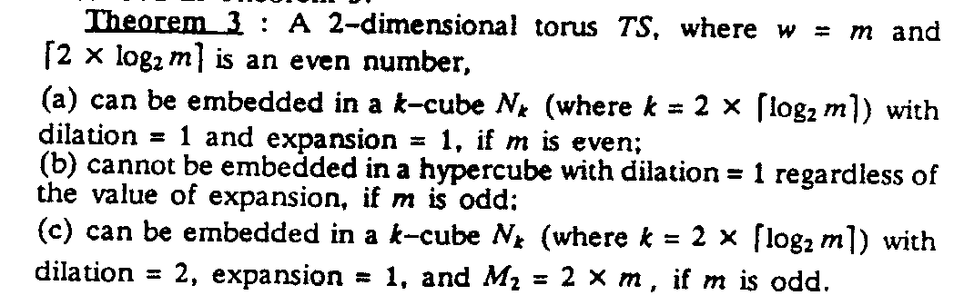
Embedding Tori and Illiac Networks
In Hypercubes
A. Embedding Tori in Hypercubes

Slide 13
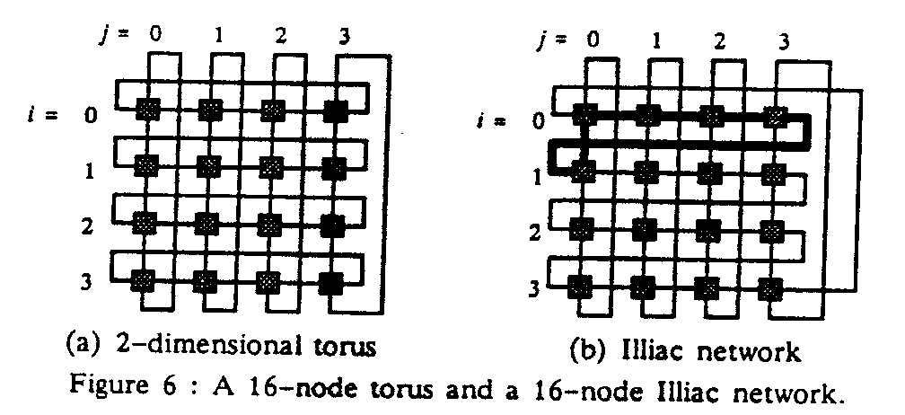
Embedding Tori and Illiac Networks
In Hypercubes(cont’d.)

Slide 14
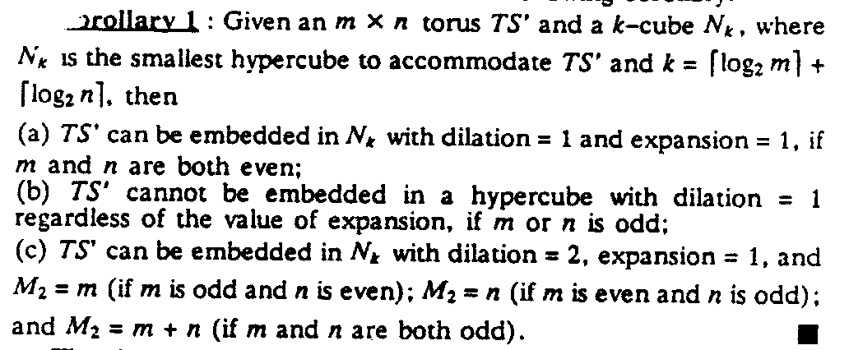
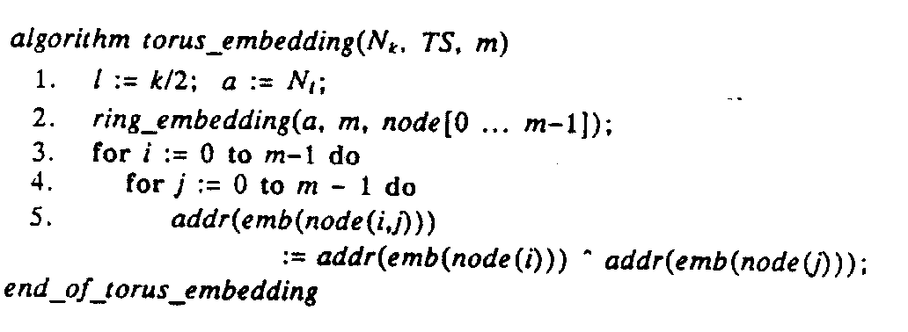
Embedding Tori and Illiac Networks
In Hypercubes(cont’d.)

Slide 15
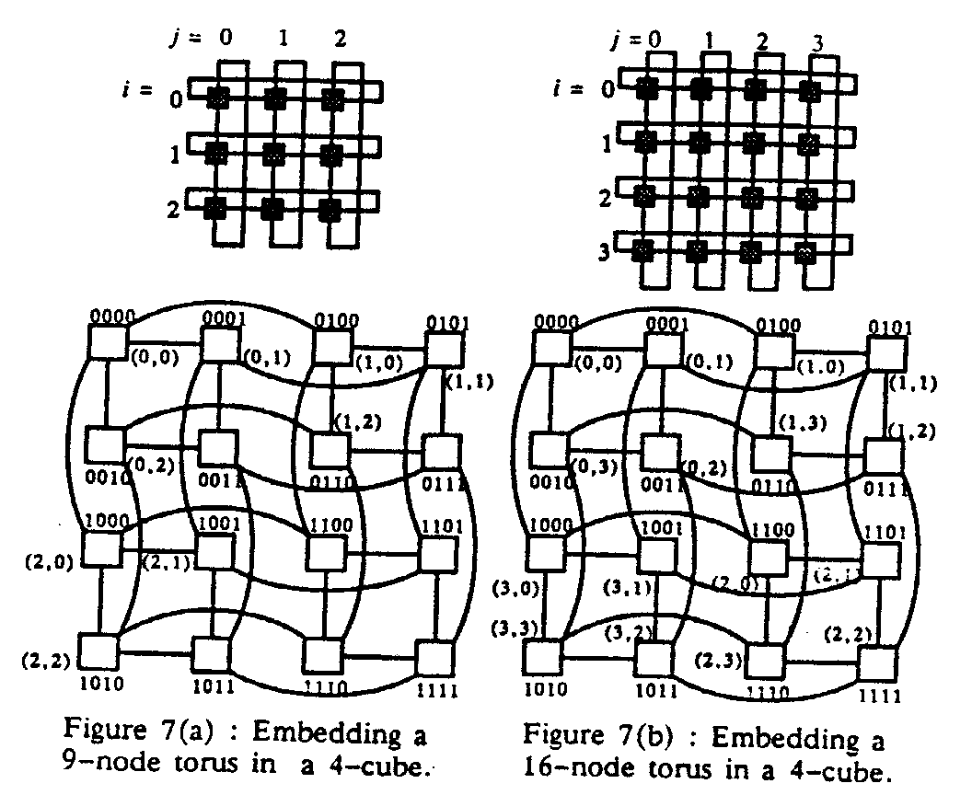
Embedding Tori and Illiac Networks
In Hypercubes(cont’d.)

Slide 16
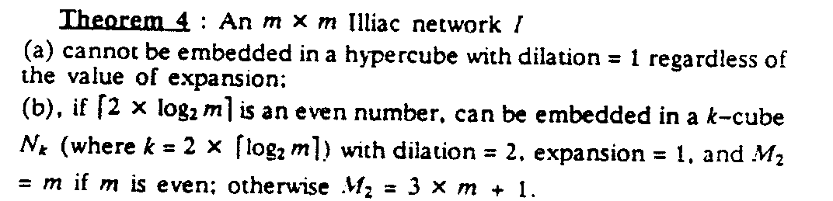
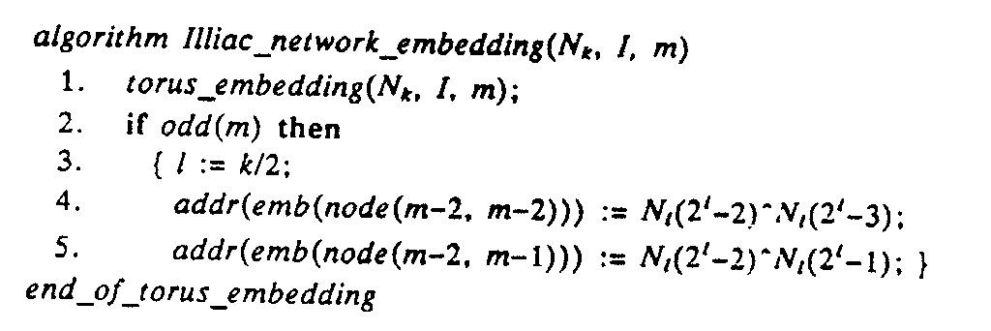
Embedding Tori and Illiac Networks
In Hypercubes(cont’d.)
B.Embedding Illiac Networks in Hypercubes

Slide 17
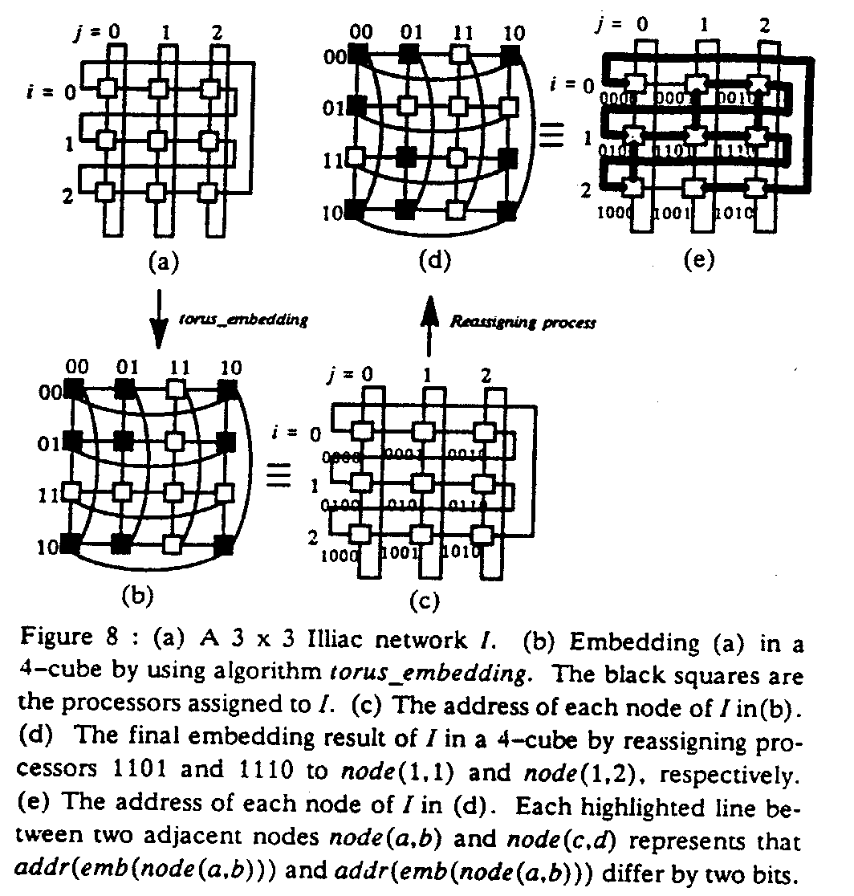
Embedding Tori and Illiac Networks
In Hypercubes(cont’d.)

Slide 18
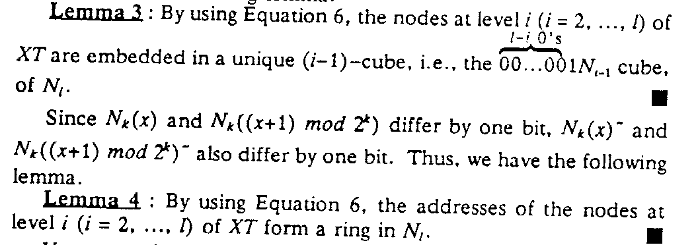
Embedding X-trees And Hypertrees in Hypercubes
A. Embedding X-trees in Hypercubes
Lemma 2: An l-level (l >1) X-tree cannot be embedded in a hypercube with dilation = 1 regardless of the value of expansion.

Slide 19
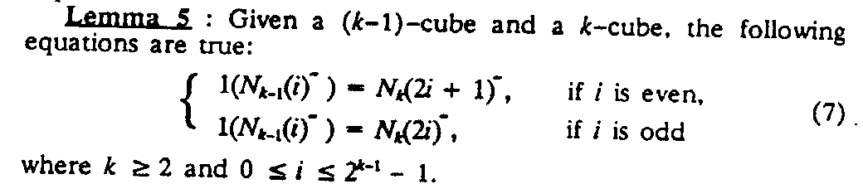
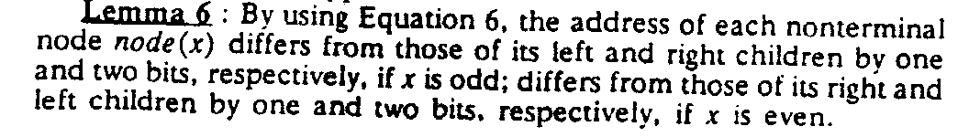
Embedding X-trees And Hypertrees in Hypercubes(cont’d.)

Slide 20
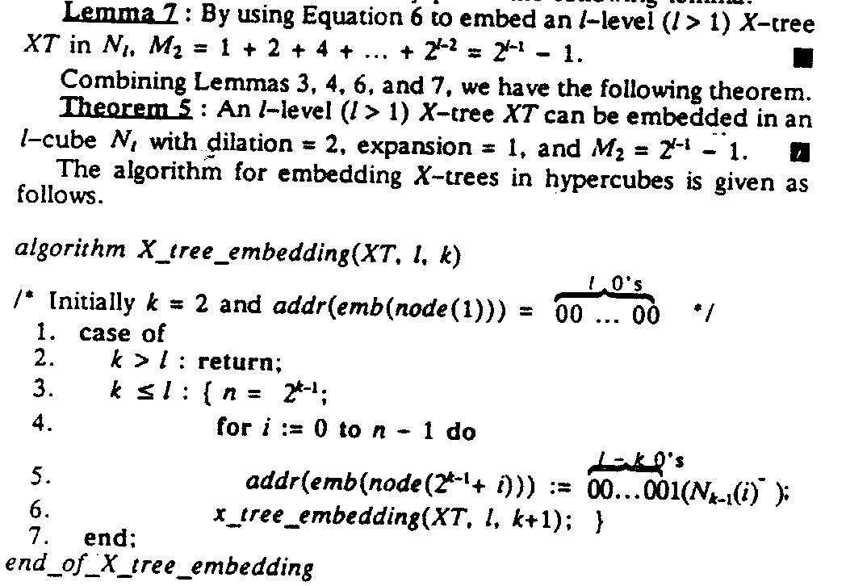
Embedding X-trees And Hypertrees in Hypercubes(cont’d.)

Slide 21
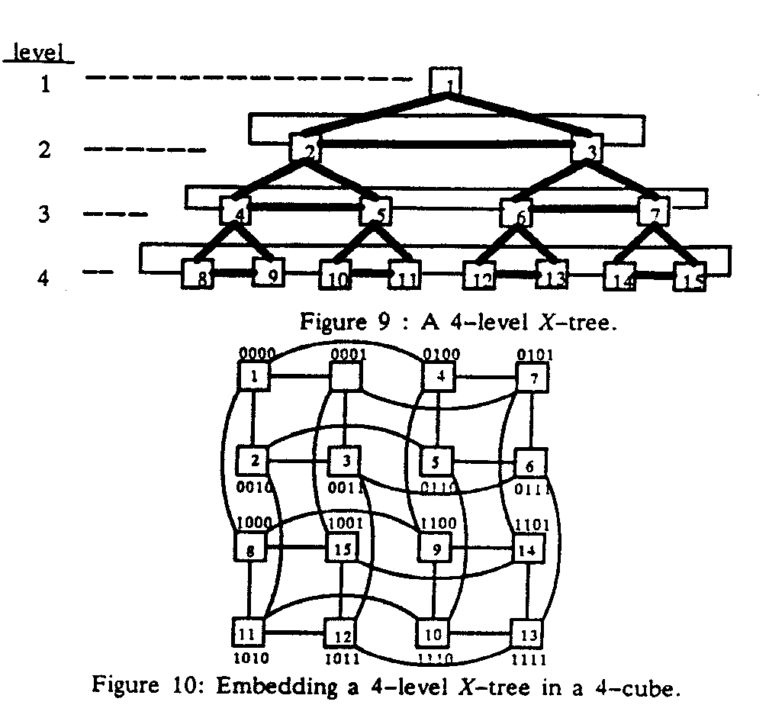
Embedding X-trees And Hypertrees in Hypercubes(cont’d.)

Slide 22
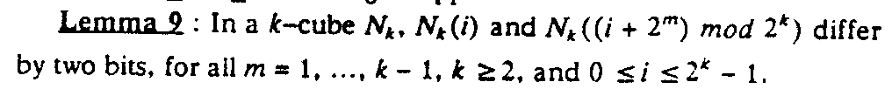
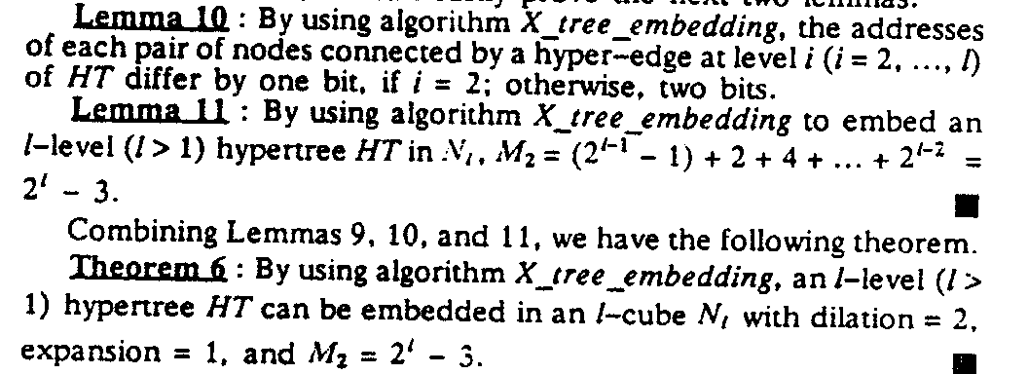
Embedding X-trees And Hypertrees in Hypercubes(cont’d.)
B. Embedding Hypertrees in Hypercubes by Using algorithm X_tree_embedding

Slide 23
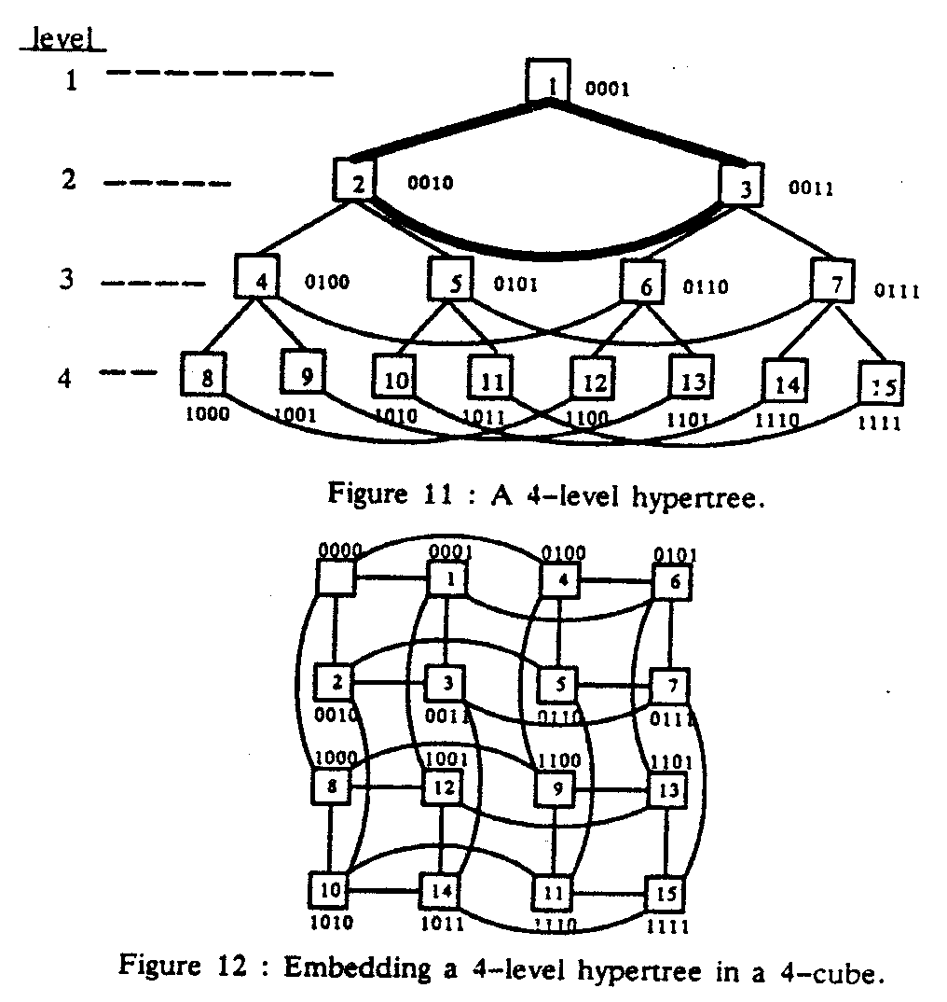
Embedding X-trees And Hypertrees in Hypercubes(cont’d.)

Slide 24
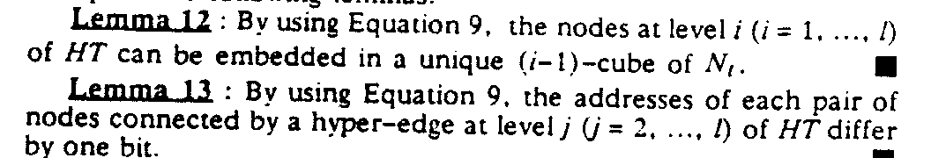
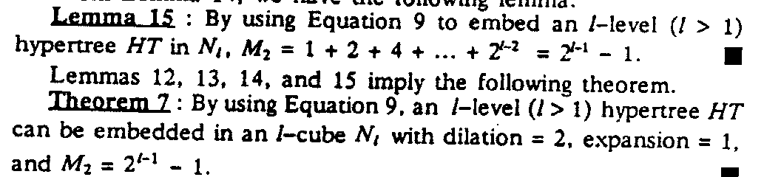
Embedding X-trees And Hypertrees in Hypercubes(cont’d.)
C. Embedding Hypertrees in Hypercubes by Using Algorithm hypertree_embedding.

Slide 25
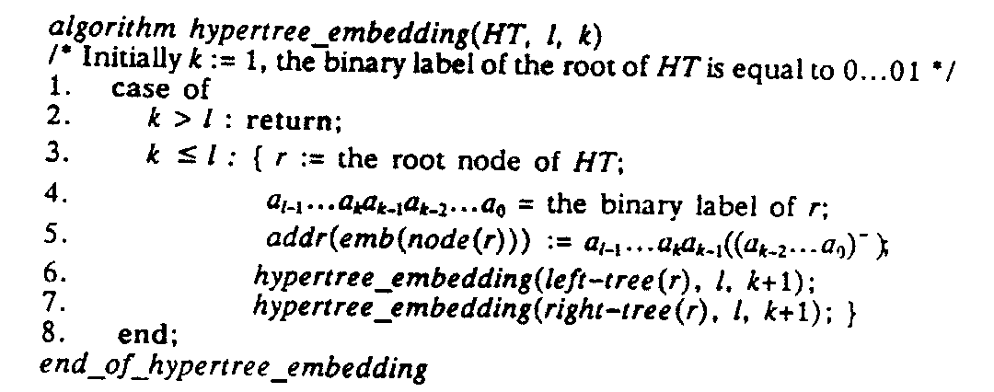
Embedding X-trees And Hypertrees in Hypercubes(cont’d.)

