Slide 1
CS 194
Unified Parallel C (UPC)
Kathy Yelick
http://upc.lbl.gov

Slide 2
UPC Outline
Background
UPC Execution Model
Basic Memory Model: Shared vs. Private Scalars
Synchronization
Collectives
Data and Pointers
Dynamic Memory Management
Programming Examples
8. Performance Tuning and Early Results
9. Concluding Remarks

Slide 3
Context
Most parallel programs are written using either:
  Message passing with a SPMD model
    Usually for scientific applications with C++/Fortran
    Scales easily
  Shared memory with threads in OpenMP, Threads+C/C++/F or Java
    Usually for non-scientific applications
    Easier to program, but less scalable performance
Global Address Space (GAS) Languages take the best of both
  global address space like threads (programmability)
  SPMD parallelism like MPI (performance)
  local/global distinction, i.e., layout matters (performance)

Slide 4
Partitioned Global Address Space Languages
Explicitly-parallel programming model with SPMD parallelism
  Fixed at program start-up, typically 1 thread per processor
Global address space model of memory
  Allows programmer to directly represent distributed data structures
Address space is logically partitioned
  Local vs. remote memory (two-level hierarchy)
Programmer control over performance critical decisions
  Data layout and communication
Performance transparency and tunability are goals
  Initial implementation can use fine-grained shared memory
Multiple PGAS languages: UPC (C), CAF (Fortran), Titanium (Java)

Slide 5
Global Address Space Eases Programming
Thread₀ Thread₁ Thread_{n}
X[0]
X[1]
X[P]
Shared
Global address space
ptr:
ptr:
ptr:
Private
The languages share the global address space abstraction
  Shared memory is logically partitioned by processors
  Remote memory may stay remote: no automatic caching implied
  One-sided communication: reads/writes of shared variables
  Both individual and bulk memory copies
Languages differ on details
  Some models have a separate private memory area
  Distributed array generality and how they are constructed

Slide 6
Current Implementations of PGAS Languages
A successful language/library must run everywhere
UPC
  Commercial compilers available on Cray, SGI, HP machines
  Open source compiler from LBNL/UCB (source-to-source)
  Open source gcc-based compiler from Intrepid
CAF
  Commercial compiler available on Cray machines
  Open source compiler available from Rice
Titanium
  Open source compiler from UCB runs on most machines
Common tools
  Open64 open source research compiler infrastructure
  ARMCI, GASNet for distributed memory implementations
  Pthreads, System V shared memory

Slide 7
UPC Overview and Design Philosophy
Unified Parallel C (UPC) is:
  An explicit parallel extension of ANSI C
  A partitioned global address space language
  Sometimes called a GAS language
Similar to the C language philosophy
  Programmers are clever and careful, and may need to get close to hardware
    to get performance, but
    can get in trouble
  Concise and efficient syntax
Common and familiar syntax and semantics for parallel C with simple extensions to ANSI C
Based on ideas in Split-C, AC, and PCP

Slide 8
UPC Execution Model

Slide 9
UPC Execution Model
A number of threads working independently in a SPMD fashion
  Number of threads specified at compile-time or run-time; available as program variable THREADS
  MYTHREAD specifies thread index (0..THREADS-1)
  upc_barrier is a global synchronization: all wait
  There is a form of parallel loop that we will see later
There are two compilation modes
  Static Threads mode:
    THREADS is specified at compile time by the user
    The program may use THREADS as a compile-time constant
  Dynamic threads mode:
    Compiled code may be run with varying numbers of threads

Slide 10
Hello World in UPC
Any legal C program is also a legal UPC program
If you compile and run it as UPC with P threads, it will run P copies of the program.
Using this fact, plus the identifiers from the previous slides, we can parallel hello world:
#include <upc.h> /* needed for UPC extensions */
#include <stdio.h>
main() {
printf("Thread %d of %d: hello UPC world\n",
MYTHREAD, THREADS);
}

Slide 11
Example: Monte Carlo Pi Calculation
Estimate Pi by throwing darts at a unit square
Calculate percentage that fall in the unit circle
  Area of square = r² = 1
  Area of circle quadrant = ¼ * π r² = π/4
Randomly throw darts at x,y positions
If x² + y² < 1, then point is inside circle
Compute ratio:
  # points inside / # points total
  π = 4*ratio
r =1

Slide 12
Pi in UPC
Independent estimates of pi:
main(int argc, char **argv) {
int i, hits, trials = 0;
double pi;
if (argc != 2)trials = 1000000;
else trials = atoi(argv[1]);
srand(MYTHREAD*17);
for (i=0; i < trials; i++) hits += hit();
pi = 4.0*hits/trials;
printf("PI estimated to %f.", pi);
}
Each thread gets its own copy of these variables
Each thread can use input arguments
Initialize random in math library
Each thread calls “hit” separately

Slide 13
Helper Code for Pi in UPC
Required includes:
#include <stdio.h>
#include <math.h>
#include <upc.h>
Function to throw dart and calculate where it hits:
int hit(){
int const rand_max = 0xFFFFFF;
double x = ((double) rand()) / RAND_MAX;
double y = ((double) rand()) / RAND_MAX;
if ((x*x + y*y) <= 1.0) {
return(1);
} else {
return(0);
}
}

Slide 14
Shared vs. Private Variables

Slide 15
Private vs. Shared Variables in UPC
Normal C variables and objects are allocated in the private memory space for each thread.
Shared variables are allocated only once, with thread 0
shared int ours; // use sparingly: performance
int mine;
Shared variables may not have dynamic lifetime: may not occur in a in a function definition, except as static. Why?
Thread₀ Thread₁ Thread_{n}
ours:
Shared
Global address space
mine:
mine:
mine:
Private
Notes:
Thread 0 owns all shared scalar variables. Performance implications are clear, but if you don’t understand this, it’s easy to write slow UPC programs.
Why not allow shared scalar variables as automatic (non-static) variables within a function? Imagine what could happen if a shared variable were declared in a function. All threads calling that function could access the variable, but it might not exist at a given point in time.

Slide 16
Pi in UPC: Shared Memory Style
Parallel computing of pi, but with a bug
shared int hits;
main(int argc, char **argv) {
int i, my_trials = 0;
int trials = atoi(argv[1]);
my_trials = (trials + THREADS - 1)/THREADS;
srand(MYTHREAD*17);
for (i=0; i < my_trials; i++)
hits += hit();
upc_barrier;
if (MYTHREAD == 0) {
printf("PI estimated to %f.", 4.0*hits/trials);
}
}
shared variable to record hits
divide work up evenly
accumulate hits
What is the problem with this program?

Slide 17
Shared Arrays Are Cyclic By Default
Shared scalars always live in thread 0
Shared arrays are spread over the threads
Shared array elements are spread across the threads
  shared int x[THREADS] /* 1 element per thread */
  shared int y[3][THREADS] /* 3 elements per thread */
  shared int z[3][3] /* 2 or 3 elements per thread */
In the pictures below, assume THREADS = 4
  Red elts have affinity to thread 0
Think of linearized C array, then map in round-robin
x
As a 2D array, y is logically blocked by columns
y
z
z is not

Slide 18
Pi in UPC: Shared Array Version
Alternative fix to the race condition
Have each thread update a separate counter:
  But do it in a shared array
  Have one thread compute sum
shared int all_hits [THREADS];
main(int argc, char **argv) {
… declarations an initialization code omitted
for (i=0; i < my_trials; i++)
all_hits[MYTHREAD] += hit();
upc_barrier;
if (MYTHREAD == 0) {
for (i=0; i < THREADS; i++) hits += all_hits[i];
printf("PI estimated to %f.", 4.0*hits/trials);
}
}
all_hits is shared by all processors, just as hits was
update element with local affinity

Slide 19
UPC Synchronization

Slide 20
UPC Global Synchronization
UPC has two basic forms of barriers:
  Barrier: block until all other threads arrive
    upc_barrier
  Split-phase barriers
  upc_notify; this thread is ready for barrier
  do computation unrelated to barrier
  upc_wait; wait for others to be ready
Optional labels allow for debugging
  #define MERGE_BARRIER 12
  if (MYTHREAD%2 == 0) {
  ...
  upc_barrier MERGE_BARRIER;
  } else {
  ...
  upc_barrier MERGE_BARRIER;
  }

Slide 21
Synchronization - Locks
Locks in UPC are represented by an opaque type:
  upc_lock_t
Locks must be allocated before use:
  upc_lock_t *upc_all_lock_alloc(void);
  allocates 1 lock, pointer to all threads
  upc_lock_t *upc_global_lock_alloc(void);
  allocates 1 lock, pointer to one thread
To use a lock:
  void upc_lock(upc_lock_t *l)
  void upc_unlock(upc_lock_t *l)
  use at start and end of critical region
Locks can be freed when not in use
  void upc_lock_free(upc_lock_t *ptr);

Slide 22
Pi in UPC: Shared Memory Style
Parallel computing of pi, without the bug
shared int hits;
main(int argc, char **argv) {
int i, my_hits, my_trials = 0;
upc_lock_t *hit_lock = upc_all_lock_alloc();
int trials = atoi(argv[1]);
my_trials = (trials + THREADS - 1)/THREADS;
srand(MYTHREAD*17);
for (i=0; i < my_trials; i++)
my_hits += hit();
upc_lock(hit_lock);
hits += my_hits;
upc_unlock(hit_lock);
upc_barrier;
if (MYTHREAD == 0)
printf("PI: %f", 4.0*hits/trials);
}
create a lock
accumulate hits locally
accumulate across threads

Slide 23
Recap: Private vs. Shared Variables in UPC
We saw several kinds of variables in the pi example
  Private scalars (my_hits)
  Shared scalars (hits)
  Shared arrays (all_hits)
  Shared locks (hit_lock)
Thread₀ Thread₁ Thread_{n}
where:
n=Threads-1
hits:
hit_lock:
all_hits[0]:
all_hits[1]:
all_hits[n]:
Shared
Global address space
my_hits:
my_hits:
my_hits:
Private
Notes:
Thread 0 owns all shared scalar variables. Performance implications are clear, but if you don’t understand this, it’s easy to write slow UPC programs.
Why not allow shared scalar variables as automatic (non-static) variables within a function? Imagine what could happen if a shared variable were declared in a function. All threads calling that function could access the variable, but it might not exist at a given point in time.

Slide 24
UPC Collectives

Slide 25
UPC Collectives in General
The UPC collectives interface is in the language spec:
  http://upc.lbl.gov/docs/user/upc_spec_1.2.pdf
It contains typical functions:
  Data movement: broadcast, scatter, gather, …
  Computational: reduce, prefix, …
Interface has synchronization modes:
  Avoid over-synchronizing (barrier before/after is simplest semantics, but may be unnecessary)
  Data being collected may be read/written by any thread simultaneously
Simple interface for collecting scalar values (int, double,…)
  Berkeley UPC value-based collectives
  Works with any compiler
  http://upc.lbl.gov/docs/user/README-collectivev.txt

Slide 26
Pi in UPC: Data Parallel Style
The previous version of Pi works, but is not scalable:
  On a large # of threads, the locked region will be a bottleneck
Use a reduction for better scalability
#include <bupc_collectivev.h>
// shared int hits;
main(int argc, char **argv) {
...
for (i=0; i < my_trials; i++)
my_hits += hit();
my_hits = // type, input, thread, op
bupc_allv_reduce(int, my_hits, 0, UPC_ADD);
// upc_barrier;
if (MYTHREAD == 0)
printf("PI: %f", 4.0*my_hits/trials);
}
Berkeley collectives
no shared variables
barrier implied by collective

Slide 27
UPC (Value-Based) Collectives in General
General arguments:
  rootthread is the thread ID for the root (e.g., the source of a broadcast)
  All 'value' arguments indicate an l-value (i.e., a variable or array element, not a literal or an arbitrary expression)
  All 'TYPE' arguments should the scalar type of collective operation
  upc_op_t is one of: UPC_ADD, UPC_MULT, UPC_AND, UPC_OR, UPC_XOR, UPC_LOGAND, UPC_LOGOR, UPC_MIN, UPC_MAX
Computational Collectives
  TYPE bupc_allv_reduce(TYPE, TYPE value, int rootthread, upc_op_t reductionop)
  TYPE bupc_allv_reduce_all(TYPE, TYPE value, upc_op_t reductionop)
  TYPE bupc_allv_prefix_reduce(TYPE, TYPE value, upc_op_t reductionop)
Data movement collectives
  TYPE bupc_allv_broadcast(TYPE, TYPE value, int rootthread)
  TYPE bupc_allv_scatter(TYPE, int rootthread, TYPE *rootsrcarray)
  TYPE *bupc_allv_gather(TYPE, TYPE value, int rootthread, TYPE *rootdestarray)
    Gather a 'value' (which has type TYPE) from each thread to 'rootthread', and place them (in order by source thread) into the local array 'rootdestarray' on 'rootthread'.
  TYPE *bupc_allv_gather_all(TYPE, TYPE value, TYPE *destarray)
  TYPE bupc_allv_permute(TYPE, TYPE value, int tothreadid)
    Perform a permutation of 'value's across all threads. Each thread passes a value and a unique thread identifier to receive it - each thread returns the value it receives.

Slide 28
Full UPC Collectives: Synchronization
  When can a collective argument begin executing?
    Arguments with affinity to thread i are ready when thread i calls the function; results with affinity to thread i are ready when thread i returns.
    This is appealing but it is incorrect: In a broadcast, thread 1 does not know when thread 0 is ready.
shared
0
1
2
local
dst
dst
dst
src
src
src
Slide source: Steve Seidel, MTU

Slide 29
UPC Collective: Sync Flags
In full UPC Collectives, blocks of data may be collected
A extra argument of each collective function is the sync mode of type upc_flag_t.
Values of sync mode are formed by or-ing together a constant of the form UPC_IN_XSYNC and a constant of the form UPC_OUT_YSYNC, where X and Y may be NO, MY, or ALL.
If sync_mode is (UPC IN_XSYNC | UPC OUT YSYNC), then if X is:
  NO the collective function may begin to read or write data when the first thread has entered the collective function call,
  MY the collective function may begin to read or write only data which has affinity to threads that have entered the collective function call, and
  ALL the collective function may begin to read or write data only after all threads have entered the collective function call
and if Y is
  NO the collective function may read and write data until the last thread has returned from the collective function call,
  MY the collective function call may return in a thread only after all reads and writes of data with affinity to the thread are complete3, and
  ALL the collective function call may return only after all reads and writes of data are complete.

Slide 30
Work Distribution Using upc_forall

Slide 31
Example: Vector Addition
Questions about parallel vector additions:
  How to layout data (here it is cyclic)
  Which processor does what (here it is “owner computes”)
/* vadd.c */
#include <upc_relaxed.h>
#define N 100*THREADS
shared int v1[N], v2[N], sum[N];
void main() {
int i;
for(i=0; i<N; i++)
if (MYTHREAD == i%THREADS) sum[i]=v1[i]+v2[i];
}
cyclic layout
owner computes

Slide 32
Work Sharing with upc_forall()
The idiom in the previous slide is very common
  Loop over all; work on those owned by this proc
UPC adds a special type of loop
  upc_forall(init; test; loop; affinity)
  statement;
Programmer indicates the iterations are independent
  Undefined if there are dependencies across threads
Affinity expression indicates which iterations to run on each thread. It may have one of two types:
  Integer: affinity%THREADS is MYTHREAD
  Pointer: upc_threadof(affinity) is MYTHREAD
Syntactic sugar for loop on previous slide
  Some compilers may do better than this, e.g.,
for(i=MYTHREAD; i<N; i+=THREADS)
  Rather than having all threads iterate N times:
for(i=0; i<N; i++) if (MYTHREAD == i%THREADS)

Slide 33
Vector Addition with upc_forall
The vadd example can be rewritten as follows
  Equivalent code could use “&sum[i]” for affinity
  The code would be correct but slow if the affinity expression were i+1 rather than i.
#define N 100*THREADS
shared int v1[N], v2[N], sum[N];
void main() {
int i;
upc_forall(i=0; i<N; i++; i)
sum[i]=v1[i]+v2[i];
}
The cyclic data distribution may perform poorly on some machines

Slide 34
Distributed Arrays in UPC

Slide 35
Blocked Layouts in UPC
If this code were doing nearest neighbor averaging (3pt stencil) the cyclic layout would be the worst possible layout.
Instead, want a blocked layout
Vector addition example can be rewritten as follows using a blocked layout
#define N 100*THREADS
shared int [*] v1[N], v2[N], sum[N];
void main() {
int i;
upc_forall(i=0; i<N; i++; &sum[i])
sum[i]=v1[i]+v2[i];
}
blocked layout

Slide 36
Layouts in General
All non-array objects have affinity with thread zero.
Array layouts are controlled by layout specifiers:
  Empty (cyclic layout)
  [*] (blocked layout)
  [0] or [] (indefinite layout, all on 1 thread)
  [b] or [b1][b2]…[bn] = [b1*b2*…bn] (fixed block size)
The affinity of an array element is defined in terms of:
  block size, a compile-time constant
  and THREADS.
Element i has affinity with thread
  (i / block_size) % THREADS
In 2D and higher, linearize the elements as in a C representation, and then use above mapping

Slide 37
2D Array Layouts in UPC
Array a1 has a row layout and array a2 has a block row layout.
shared [m] int a1 [n][m];
shared [k*m] int a2 [n][m];
If (k + m) % THREADS = = 0 them a3 has a row layout
shared int a3 [n][m+k];
To get more general HPF and ScaLAPACK style 2D blocked layouts, one needs to add dimensions.
Assume r*c = THREADS;
shared [b1][b2] int a5 [m][n][r][c][b1][b2];
or equivalently
shared [b1*b2] int a5 [m][n][r][c][b1][b2];

Slide 38
UPC Matrix Vector Multiplication Code
Matrix-vector multiplication with matrix stored by rows
(Contrived example: problems size is PxP)
shared [THREADS] int a[THREADS][THREADS];
shared int b[THREADS], c[THREADS];
void main (void) {
int i, j , l;
upc_forall( i = 0 ; i < THREADS ; i++; i) {
c[i] = 0;
for ( l= 0 ; l< THREADS ; l++)
c[i] += a[i][l]*b[l];
}
}

Slide 39
UPC Matrix Multiplication Code
/* mat_mult_1.c */
#include <upc_relaxed.h>
#define N 4
#define P 4
#define M 4
shared [N*P /THREADS] int a[N][P], c[N][M];
// a and c are row-wise blocked shared matrices
shared[M/THREADS] int b[P][M]; //column-wise blocking
void main (void) {
int i, j , l; // private variables
upc_forall(i = 0 ; i<N ; i++; &c[i][0]) {
for (j=0 ; j<M ;j++) {
c[i][j] = 0;
for (l= 0 ; l<P ; l++) c[i][j] += a[i][l]*b[l][j];
}
}
}

Slide 40
Notes on the Matrix Multiplication Example
The UPC code for the matrix multiplication is almost the same size as the sequential code
Shared variable declarations include the keyword shared
Making a private copy of matrix B in each thread might result in better performance since many remote memory operations can be avoided
Can be done with the help of upc_memget

Slide 41
Domain Decomposition for UPC
Exploits locality in matrix multiplication
A (N × P) is decomposed row-wise into blocks of size (N × P) / THREADS as shown below:
B(P × M) is decomposed column wise into M/ THREADS blocks as shown below:
Thread 0
Thread THREADS-1
P
M
0 .. (N*P / THREADS) -1
Thread 0
(N*P / THREADS)..(2*N*P / THREADS)-1
Thread 1
N
P
((THREADS-1)×N*P) / THREADS .. (THREADS*N*P / THREADS)-1
Thread THREADS-1
Note: N and M are assumed to be multiples of THREADS
Columns 0: (M/THREADS)-1
Columns ((THREAD-1) × M)/THREADS:(M-1)

Slide 42
Pointers to Shared vs. Arrays
In the C tradition, array can be access through pointers
Here is the vector addition example using pointers
#define N 100*THREADS
shared int v1[N], v2[N], sum[N];
void main() {
int i;
shared int *p1, *p2;
p1=v1; p2=v2;
for (i=0; i<N; i++, p1++, p2++ )
if (i %THREADS= = MYTHREAD)
sum[i]= *p1 + *p2;
}
v1
p1

Slide 43
UPC Pointers
Where does the pointer point?
 | Local | Shared
Private | PP (p1) | PS (p3)
Shared | SP (p2) | SS (p4)
Where does the pointer reside?
int *p1; /* private pointer to local memory */
shared int *p2; /* private pointer to shared space */
int *shared p3; /* shared pointer to local memory */
shared int *shared p4; /* shared pointer to
shared space */
Shared to private is not recommended.

Slide 44
UPC Pointers
Thread₀ Thread₁ Thread_{n}
p3:
p3:
p3:
p4:
p4:
p4:
Shared
Global address space
p1:
p1:
p1:
p2:
p2:
p2:
Private
int *p1; /* private pointer to local memory */
shared int *p2; /* private pointer to shared space */
int *shared p3; /* shared pointer to local memory */
shared int *shared p4; /* shared pointer to
shared space */
Pointers to shared often require more storage and are more costly to dereference; they may refer to local or remote memory.

Slide 45
Common Uses for UPC Pointer Types
int *p1;
These pointers are fast (just like C pointers)
Use to access local data in part of code performing local work
Often cast a pointer-to-shared to one of these to get faster access to shared data that is local
shared int *p2;
Use to refer to remote data
Larger and slower due to test-for-local + possible communication
int *shared p3;
Not recommended
shared int *shared p4;
Use to build shared linked structures, e.g., a linked list

Slide 46
UPC Pointers
In UPC pointers to shared objects have three fields:
  thread number
  local address of block
  phase (specifies position in the block)
Example: Cray T3E implementation
Virtual Address | Thread | Phase
Phase | Thread | Virtual Address
63
49
48
38
37
0

Slide 47
UPC Pointers
Pointer arithmetic supports blocked and non-blocked array distributions
Casting of shared to private pointers is allowed but not vice versa !
When casting a pointer-to-shared to a pointer-to-local, the thread number of the pointer to shared may be lost
Casting of shared to local is well defined only if the object pointed to by the pointer to shared has affinity with the thread performing the cast

Slide 48
Special Functions
size_t upc_threadof(shared void *ptr);
returns the thread number that has affinity to the pointer to shared
size_t upc_phaseof(shared void *ptr);
returns the index (position within the block)field of the pointer to shared
shared void *upc_resetphase(shared void *ptr); resets the phase to zero

Slide 49
Dynamic Memory Allocation in UPC
Dynamic memory allocation of shared memory is available in UPC
Functions can be collective or not
  A collective function has to be called by every thread and will return the same value to all of them

Slide 50
Global Memory Allocation
shared void *upc_global_alloc(size_t nblocks, size_t nbytes);
nblocks : number of blocks
nbytes : block size
Non-collective: called by one thread
The calling thread allocates a contiguous memory space in the shared space
If called by more than one thread, multiple regions are allocated and each thread which makes the call gets a different pointer
Space allocated per calling thread is equivalent to :
shared [nbytes] char[nblocks * nbytes]

Slide 51
Collective Global Memory Allocation
shared void *upc_all_alloc(size_t nblocks, size_t nbytes);
nblocks: number of blocks
nbytes: block size
This function has the same result as upc_global_alloc. But this is a collective function, which is expected to be called by all threads
All the threads will get the same pointer
Equivalent to :
shared [nbytes] char[nblocks * nbytes]

Slide 52
Memory Freeing
void upc_free(shared void *ptr);
The upc_free function frees the dynamically allocated shared memory pointed to by ptr
upc_free is not collective

Slide 53
Distributed Arrays Directory Style
Some high performance UPC programmers avoid the UPC style arrays
  Instead, build directories of distributed objects
  Also more general
typedef shared [] double *sdblptr;
shared sdblptr directory[THREADS];
directory[i]=upc_alloc(local_size*sizeof(double));
upc_barrier;

Slide 54
Memory Consistency in UPC
The consistency model defines the order in which one thread may see another threads accesses to memory
  If you write a program with unsychronized accesses, what happens?
  Does this work?
    data = … while (!flag) { };
    flag = 1; … = data; // use the data
UPC has two types of accesses:
  Strict: will always appear in order
  Relaxed: May appear out of order to other threads
There are several ways of designating the type, commonly:
  Use the include file:
    #include <upc_relaxed.h>
  Which makes all accesses in the file relaxed by default
  Use strict on variables that are used as synchronization (flag)

Slide 55
Synchronization- Fence
Upc provides a fence construct
  Equivalent to a null strict reference, and has the syntax
    upc_fence;
  UPC ensures that all shared references issued before the upc_fence are complete

Slide 56
Performance of UPC

Slide 57
PGAS Languages have Performance Advantages
Strategy for acceptance of a new language
Make it run faster than anything else
Keys to high performance
Parallelism:
  Scaling the number of processors
Maximize single node performance
  Generate friendly code or use tuned libraries (BLAS, FFTW, etc.)
Avoid (unnecessary) communication cost
  Latency, bandwidth, overhead
  Berkeley UPC and Titanium use GASNet communication layer
Avoid unnecessary delays due to dependencies
  Load balance; Pipeline algorithmic dependencies

Slide 58
One-Sided vs Two-Sided
one-sided put message
host
CPU
address
data payload
network
interface
two-sided message
memory
message id
data payload
A one-sided put/get message can be handled directly by a network interface with RDMA support
  Avoid interrupting the CPU or storing data from CPU (preposts)
A two-sided messages needs to be matched with a receive to identify memory address to put data
  Offloaded to Network Interface in networks like Quadrics
  Need to download match tables to interface (from host)
  Ordering requirements on messages can also hinder bandwidth

Slide 59
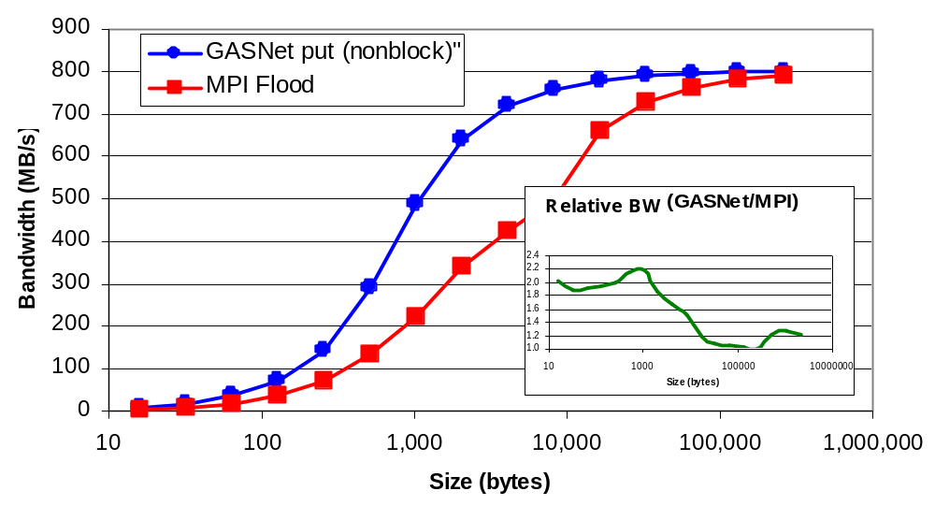
One-Sided vs. Two-Sided: Practice
NERSC Jacquard machine with Opteron processors
(up is good)
InfiniBand: GASNet vapi-conduit and OSU MVAPICH 0.9.5
Half power point (N ½ ) differs by one order of magnitude
This is not a criticism of the implementation!
Joint work with Paul Hargrove and Dan Bonachea
Notes:
Reduce text at bottom of slides and improve claris
Make nested graph more readable
Use “MVAPICH” not just OSU MPI
AMRCI allows ordering; GASnet is at HW RDMA BW
Define RDMA

Slide 60
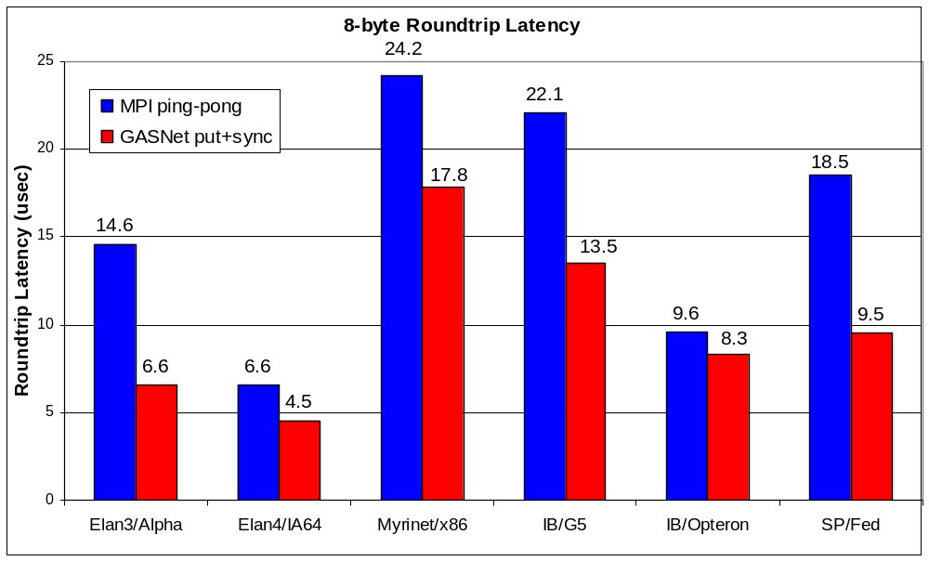
GASNet: Portability and High-Performance
(down is good)
GASNet better for latency across machines
Joint work with UPC Group; GASNet design by Dan Bonachea
Notes:
Remove Altix data or explain better
explain axes
significant benefit to targetting the lower-level API - MPI is not always the best choice

Slide 61
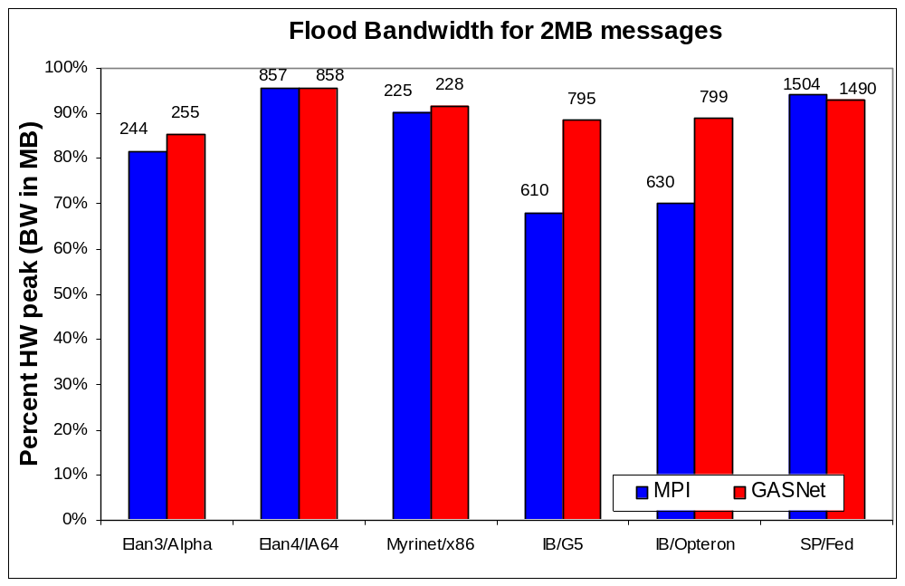
GASNet: Portability and High-Performance
(up is good)
GASNet at least as high (comparable) for large messages
Joint work with UPC Group; GASNet design by Dan Bonachea
Notes:
Generally meet or exceed what MPI can provide
vapi deviation - firmware perf bug
altix - single vs two copy?

Slide 62
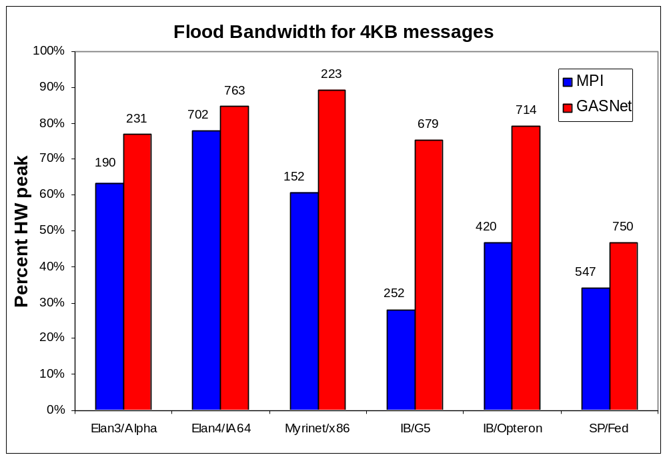
GASNet: Portability and High-Performance
(up is good)
GASNet excels at mid-range sizes: important for overlap
Joint work with UPC Group; GASNet design by Dan Bonachea
Notes:
LAPI and VAPI increase B/W relative to MPI
Generally meet or exceed what MPI can provide

Slide 63
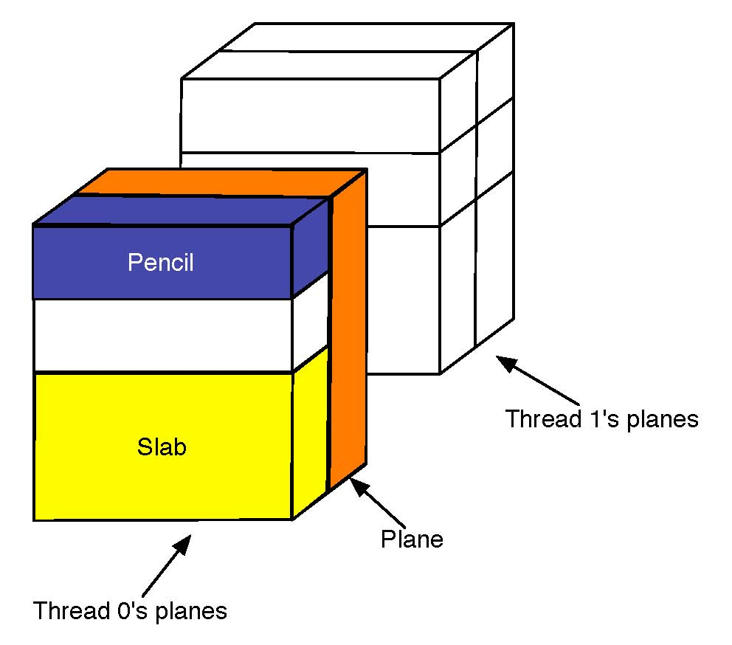
Case Study: NAS FT
Performance of Exchange (Alltoall) is critical
  1D FFTs in each dimension, 3 phases
  Transpose after first 2 for locality
  Bisection bandwidth-limited
    Problem as #procs grows
Three approaches:
  Exchange:
    wait for 2nd dim FFTs to finish, send 1 message per processor pair
  Slab:
    wait for chunk of rows destined for 1 proc, send when ready
  Pencil:
    send each row as it completes
Joint work with Chris Bell, Rajesh Nishtala, Dan Bonachea
Notes:
Rearrange this slide; need a picture

Slide 64
Overlapping Communication
Goal: make use of “all the wires all the time”
  Schedule communication to avoid network backup
Trade-off: overhead vs. overlap
  Exchange has fewest messages, less message overhead
  Slabs and pencils have more overlap; pencils the most
Example: Class D problem on 256 Processors
Exchange (all data at once) | 512 Kbytes
Slabs (contiguous rows that go to 1 processor) | 64 Kbytes
Pencils (single row) | 16 Kbytes
Joint work with Chris Bell, Rajesh Nishtala, Dan Bonachea
Notes:
Merge with earlier slide
Make clear that nonblocking availabe in MPI too

Slide 65
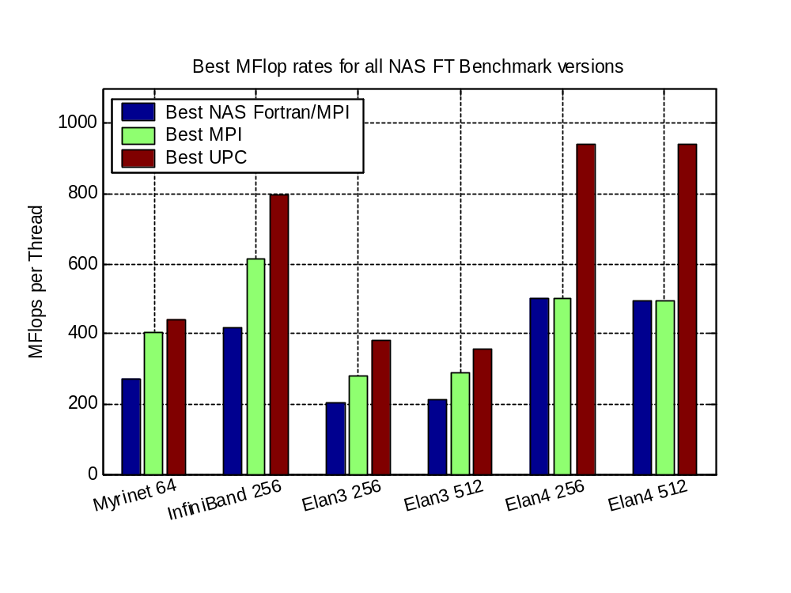
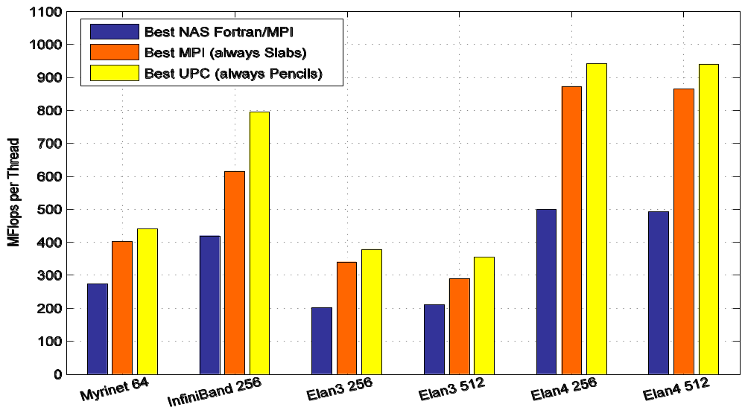
NAS FT Variants Performance Summary
.5 Tflops
Slab is always best for MPI; small message cost too high
Pencil is always best for UPC; more overlap
Joint work with Chris Bell, Rajesh Nishtala, Dan Bonachea
Notes:
Remote “long message matching queue depths”
MPI point less negative

Slide 66
Case Study: LU Factorization
Direct methods have complicated dependencies
  Especially with pivoting (unpredictable communication)
  Especially for sparse matrices (dependence graph with holes)
LU Factorization in UPC
  Use overlap ideas and multithreading to mask latency
  Multithreaded: UPC threads + user threads + threaded BLAS
    Panel factorization: Including pivoting
    Update to a block of U
    Trailing submatrix updates
Status:
  Dense LU done: HPL-compliant
  Sparse version underway
Joint work with Parry Husbands
Notes:
Slide was not helpful: reorganize

Slide 67
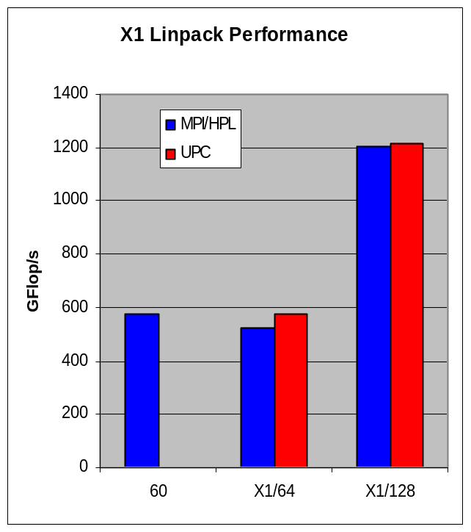
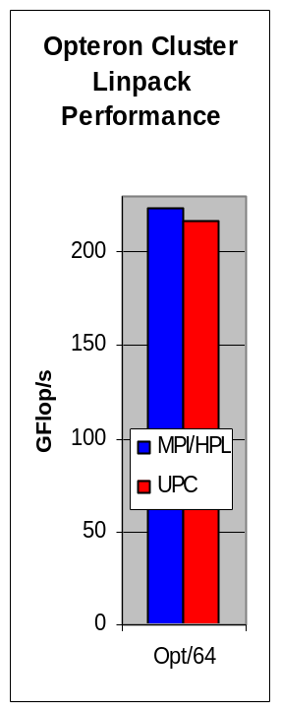
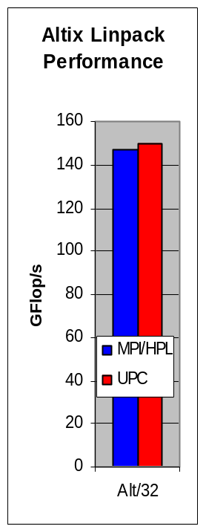
UPC HPL Performance
MPI HPL numbers from HPCC database
Large scaling:
  2.2 TFlops on 512p,
  4.4 TFlops on 1024p (Thunder)
Comparison to ScaLAPACK on an Altix, a 2 x 4 process grid
  ScaLAPACK (block size 64) 25.25 GFlop/s (tried several block sizes)
  UPC LU (block size 256) - 33.60 GFlop/s, (block size 64) - 26.47 GFlop/s
n = 32000 on a 4x4 process grid
  ScaLAPACK - 43.34 GFlop/s (block size = 64)
  UPC - 70.26 Gflop/s (block size = 200)
Joint work with Parry Husbands

Slide 68
Summary
UPC designed to be consistent with C
  Some low level details, such as memory layout are exposed
  Ability to use pointers and arrays interchangeably
Designed for high performance
  Memory consistency explicit
  Small implementation
Berkeley compiler (used for next homework)
  http://upc.lbl.gov
Language specification and other documents
  http://upc.gwu.edu

