Slide 1
Introduction to
Taiwan UniGrid
Yeh-Ching Chung
Department of Computer Science
National Tsing Hua University

Slide 2
Outline
Introduction
Portal and SSO
Global Queue
Resource Broker
Job Scheduler
Information Service
Storage Service
Applications

Slide 3
Introduction (1)
The purpose of grid computing is to integrate various resources within a large network environment.
The purpose of the UniGrid project is to build a platform for academic research using grid-related technologies in Taiwan.

Slide 4
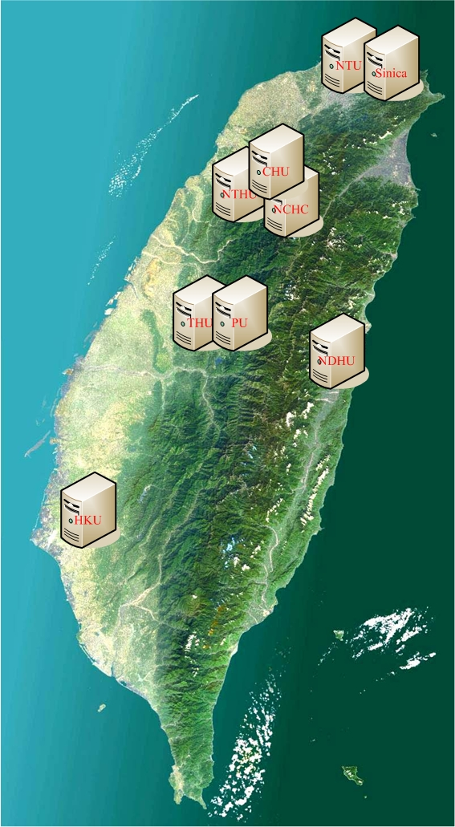
Introduction (2)
8 institutes join to develop the system
  國網中心
  清華大學資工系
  中研院資科所
  東華大學資工系
  東海大學資科系
  中華大學資工系
  興國管理學院電子商務學系
  靜宜大學資訊管理系

Slide 5
Introduction (3)
Over 20 institutes join Taiwan UniGrid platform
台灣大學電機系
台灣大學資工系
台灣師大資工系
台北大學資工系
淡江大學資工系
德明技術學院資科系
交通大學資工系
新竹教育大學資工所
中興大學資科系
逢甲大學資工系
台中教育大學資科系
國家高速網路與計算中心中群
修平技術學院資管系
彰化師大資工系
中正大學資工系
成功大學電機系
成功大學資工系
台南大學數位學習科技系
長榮大學資管系
立德管理學院資管系
中山大學電機系
義守大學資工系
高雄大學資工系
台東大學資訊管理學系

Slide 6
Introduction (4)
All institutes that participate in the UniGrid project contribute some resources.
These resources can be used in collaboration for large scale applications.

Slide 7
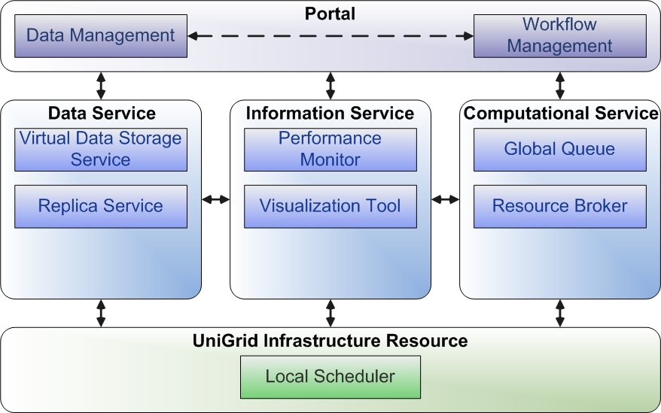
Introduction (5)
System Architecture

Slide 8
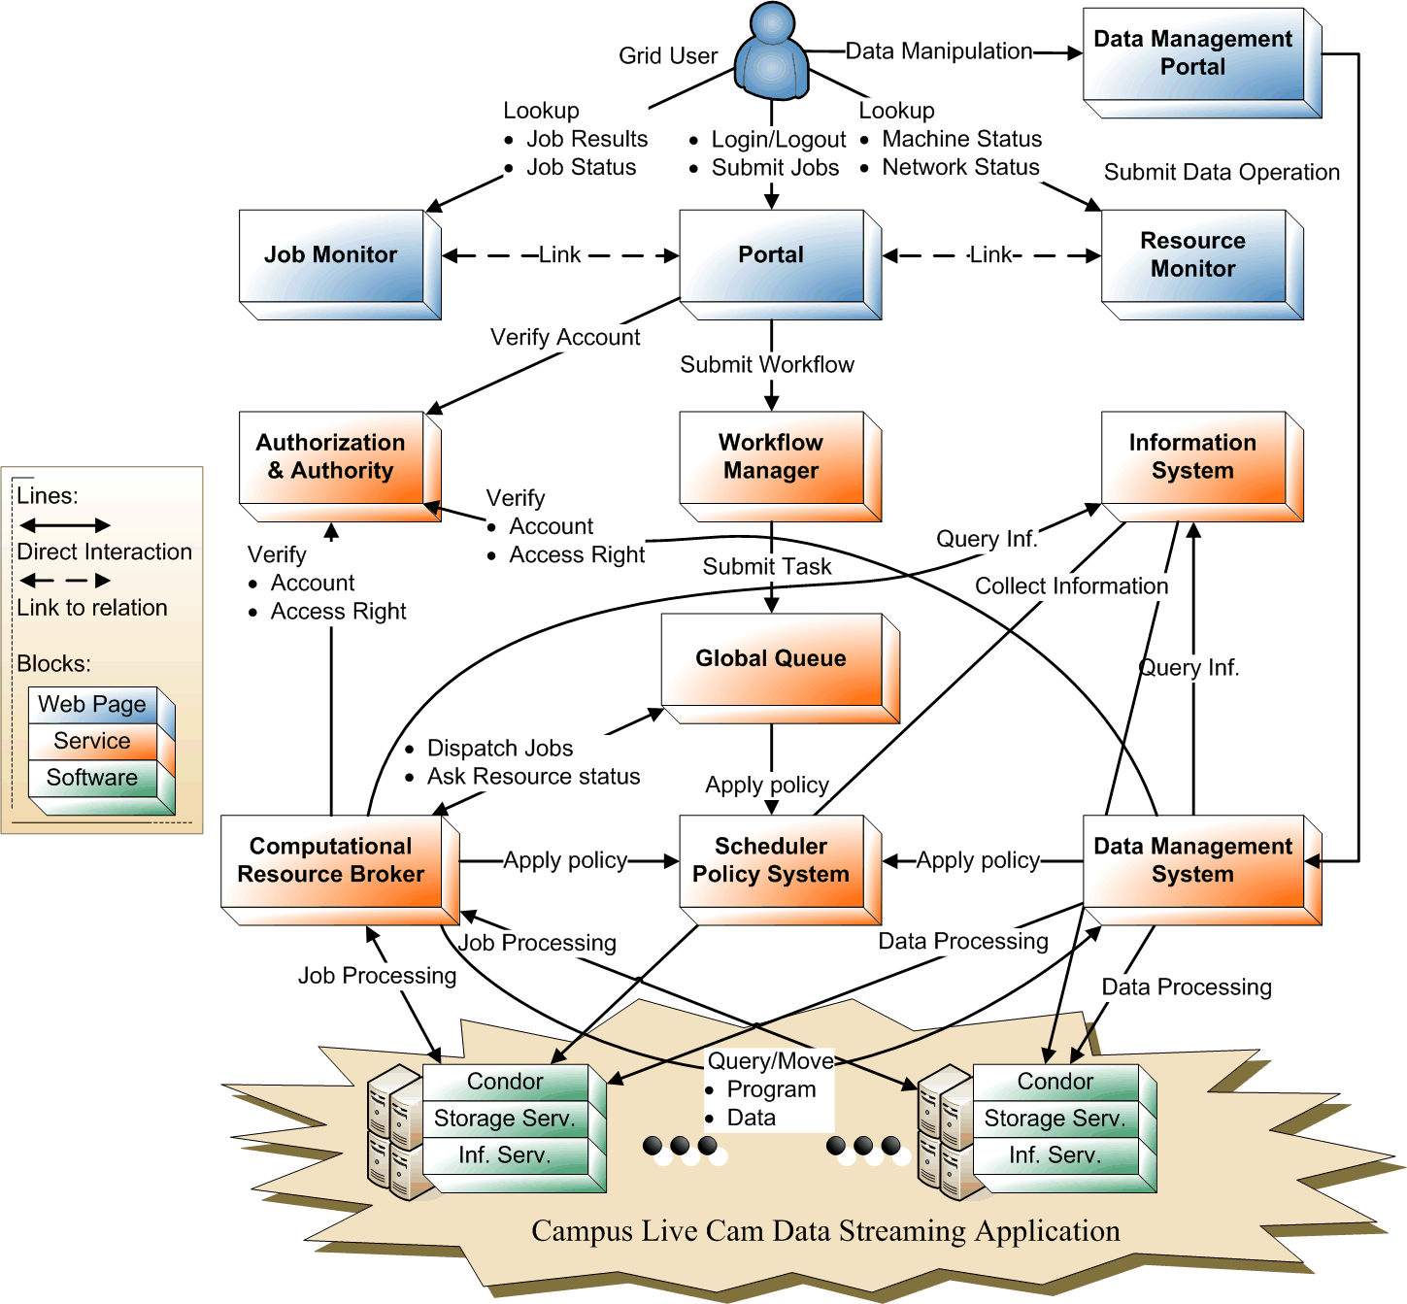

Slide 9
Outline
Introduction
Portal and SSO
Global Queue
Resource Broker
Job Scheduler
Information Service
Storage Service
Applications

Slide 10
Portal and SSO (1)
The UniGrid portal provides an interface for UniGrid users to use the resources available in the UniGrid system.
Functionalities of the portal
  Project information
  Single sign-on
  Resource Monitoring
  User workflow management

Slide 11
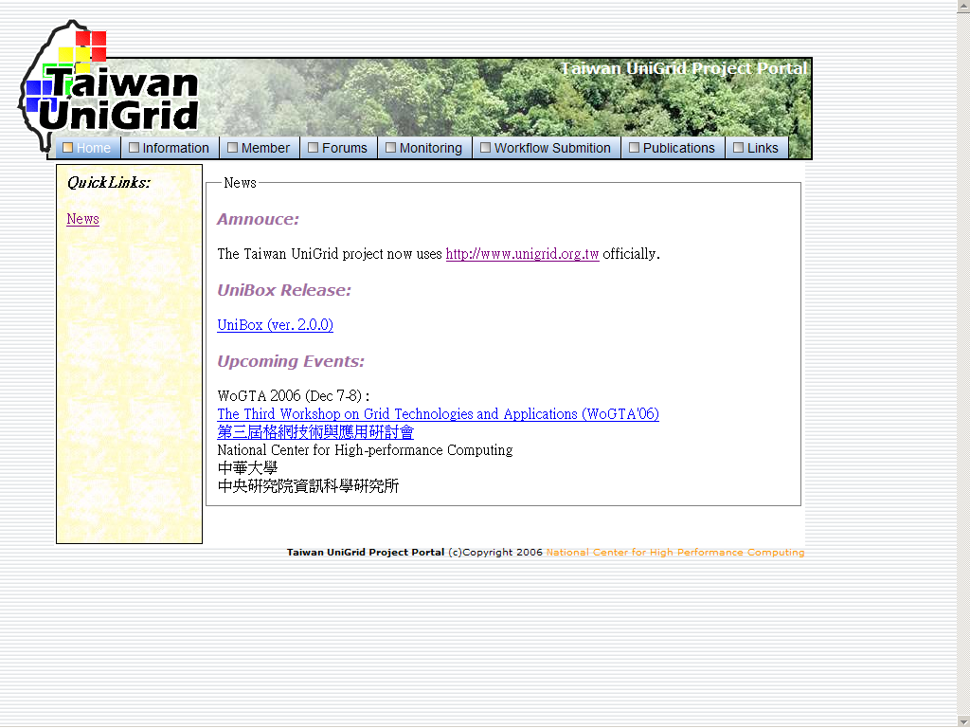
Portal and SSO (2)

Slide 12
Single Sign-On (1)
Single sign-on is a mechanism whereby a single authentication can permit a user to access all resources where he has access permission, without the need to enter multiple passwords.
  All user account information are kept in a database at the portal site.
  When a user requests a service, his/her verification data is passed to that service.
  The request will be granted only if the identity is verified by the verification service

Slide 13
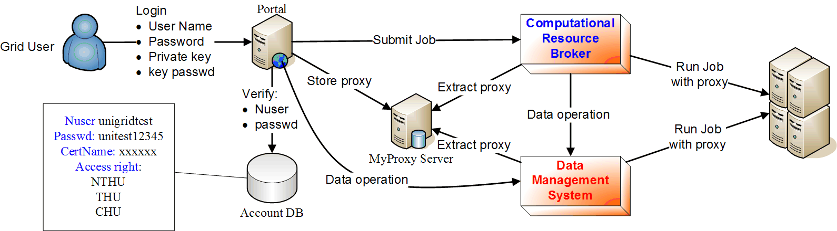
Single Sign-On (2)
Using MyProxy server
The proxy could provide
  User’s limitations or not overdue proxy (for user)
  Password (for RB or other components)

Slide 14
Resource Monitor (1)
UniGrid users can examine the status of system resources through the portal.
The portal gathers the current system information from the information service and present these information to the users.

Slide 15
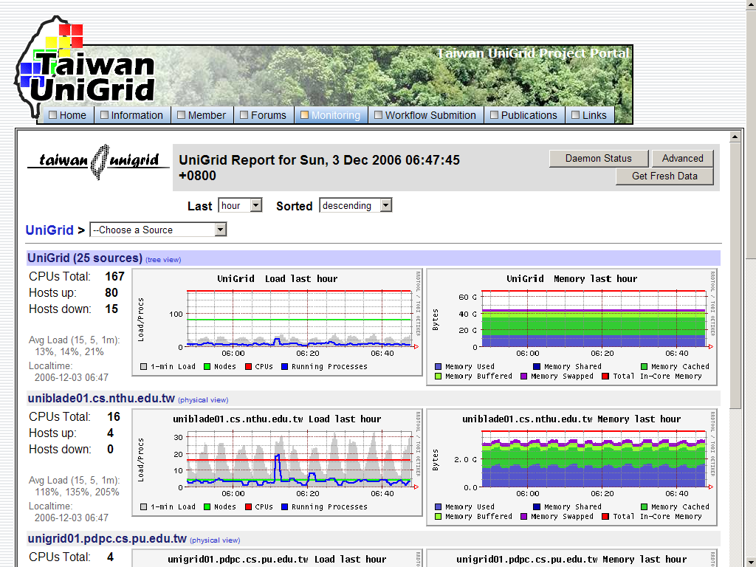
Resource Monitor (2)
Screenshot of the system status monitoring

Slide 16
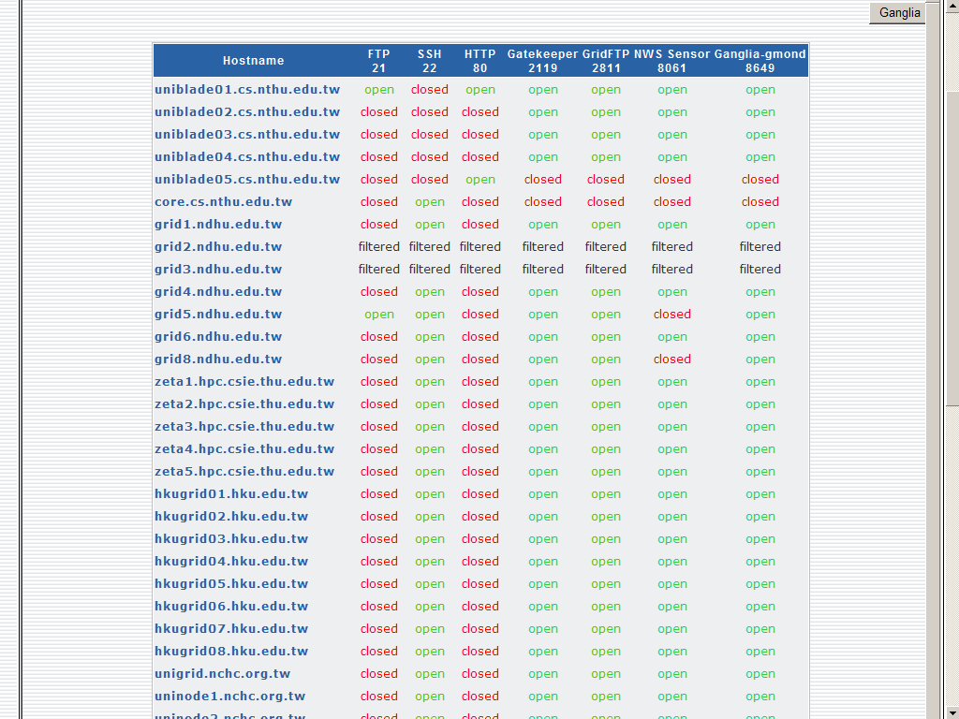
Resource Monitor (3)
Screenshot of open service monitor

Slide 17
User Workflow Management (1)
A user can design and execute the workflow through the UniGrid portal.
Workflow Management can handle job dependency and pass independent task to resource broker
A user can also monitor the status of his workflow through the UniGrid portal.

Slide 18
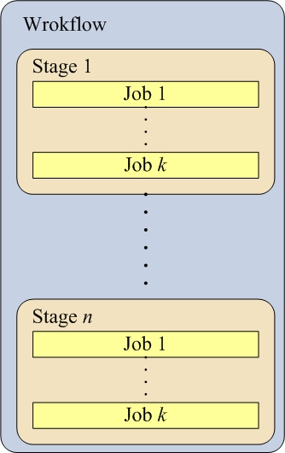
User Workflow Management (2)
Structure of a workflow
Workflow
parallel
execution
sequential
execution

Slide 19
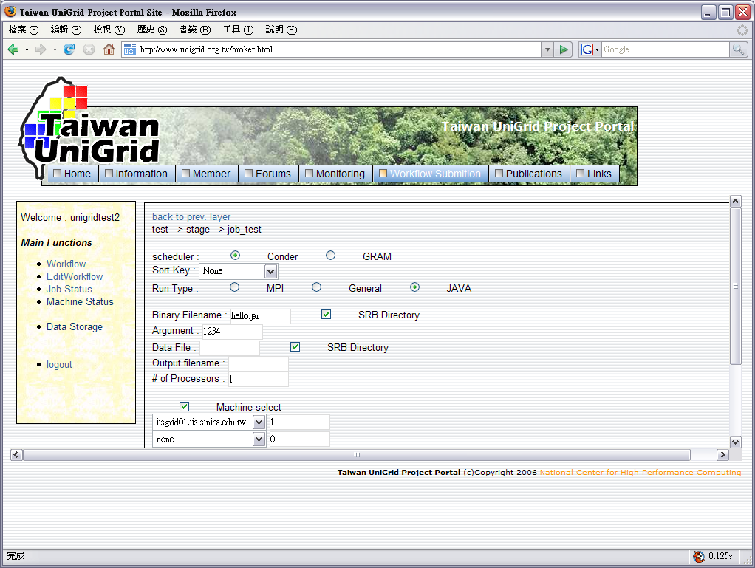
User Workflow Management (3)
Screenshot of the workflow editing web page

Slide 20
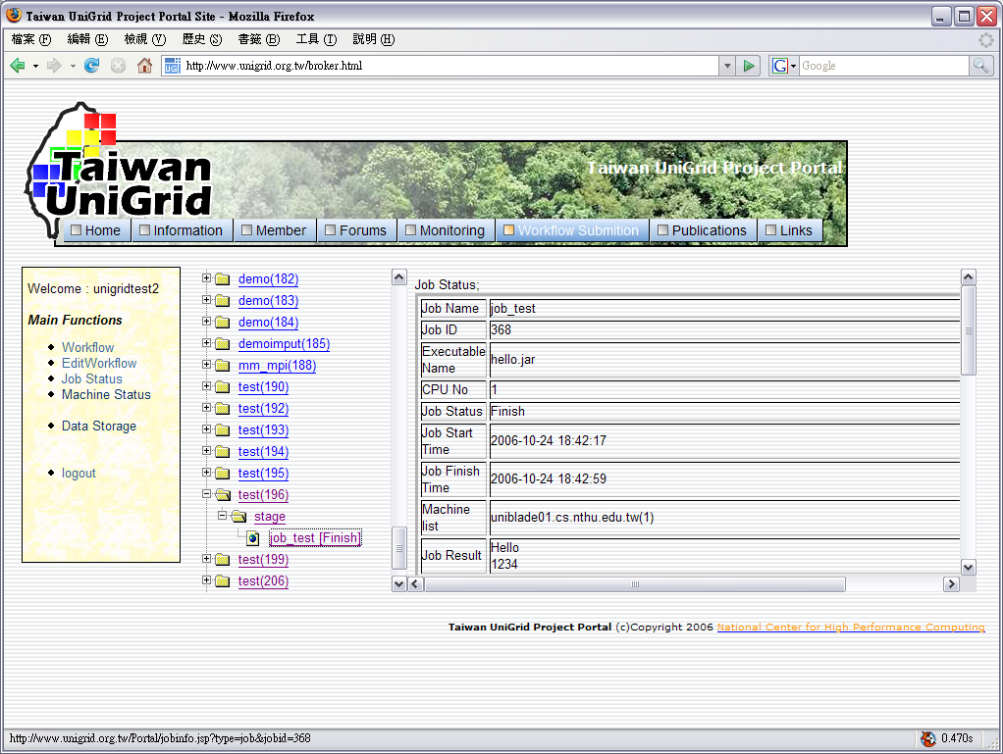
User Workflow Management (4)
Screenshot of the workflow monitoring web page

Slide 21
Outline
Introduction
Portal and SSO
Global Queue
Resource Broker
Job Scheduler
Information Service
Storage Service
Applications

Slide 22
Global Queue (1)
All independent jobs from workflow manager is stored in global queue and waiting for scheduling
Global queue uses database to store all job requirements and provides failure recover capability when program failures

Slide 23
Global Queue (2)
Three queues with configurable capacity in UniGrid
  Waiting queue (DB)
    Store all job information from G.Q. into database
  Ready queue (Memory)
    Periodically grab DB for new jobs into ready queue
    When job in ready queue, perform scheduling
  Running queue (Memory)
    Store running jobs (thread)
    Control parallel degree

Slide 24
Global Queue (3)
Develop queue scheduler to control the queue behavior
  JobDBCrawler
    Crawling DB for new jobs
  SPSController
    Control when to call Scheduler

Slide 25
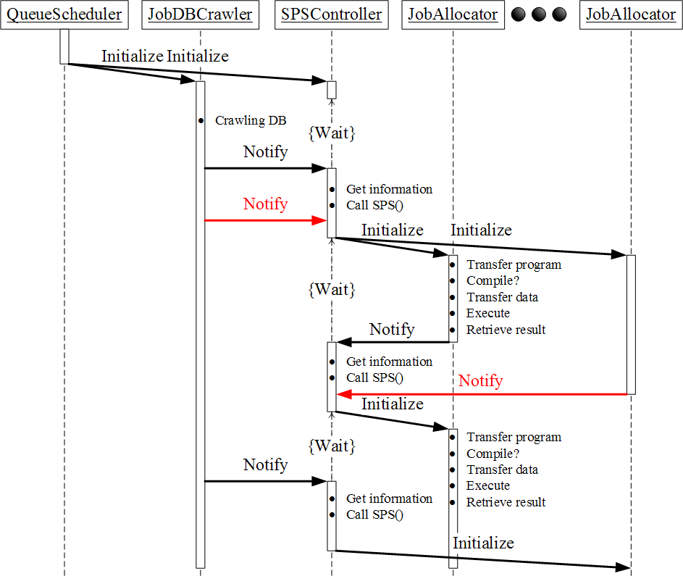
Global Queue
Resource Broker

Slide 26
Outline
Introduction
Portal and SSO
Global Queue
Resource Broker
Job Scheduler
Information Service
Storage Service
Applications

Slide 27
Resource Broker (1)
Resource broker is designed to help users to perform job execution process automatically
Main steps of resource broker
  Query resource information
  Resource matchmaking (job scheduler)
  Submit jobs for execution
  Retrieve and store results

Slide 28
Resource Broker (2)
Each participating organization has a local scheduler (Condor) installed to schedule the jobs assigned to that organization.
Condor
  A scheduler for large collections of distributively owned computing resources
  Developed by the researchers at University of Wisconsin
  Specialized for compute-intensive jobs

Slide 29
Query resource information
Obtain system information from information service
  Static and dynamic resource
  Dynamic network information
Obtain local condor information from each condor master
  Total/Available CPUs
total, owner, free
uniblade01.cs.nthu.edu.tw,16,4,12
zeta1.hpc.csie.thu.edu.tw,10,0,10
hkugrid01.hku.edu.tw,32,0,26
iisgrid01.iis.sinica.edu.tw,14,0,14
srbn01.csie.chu.edu.tw,4,0,3
grid1.ndhu.edu.tw,5,0,5

Slide 30
Submit jobs to local scheduler
Use multi-thread to submit and execute jobs to each sites
Job execution flow
  Obtain user proxy
  Transfer program and data
  Generate AP specific file (rsl, machinefile)
  Execute

Slide 31
Retrieve and store results
Retrieve result from job execution site when job finish or failure
  Execution result (screen output)
  Execution log (for debug)
  Output file

Slide 32
Outline
Introduction
Portal and SSO
Global Queue
Resource Broker
Job Scheduler
Information Service
Storage Service
Applications

Slide 33
Job Scheduler (1)
Job scheduler is used to control the scheduling and allocation policy of each jobs in queue.
  Scheduler
    Control the job order in queue (ready queue)
  Allocation
    Control which resource to submit

Slide 34
Job Scheduler (2)
Implemented algorithms
  Scheduling
    First come first serve (FCFS)
    Smallest job first (SJF)
  Allocation
    Single Pool
      Only can submit to one site
    Multi Pool
      Can submit cross multi-site
    Single Pool Job Preference
      Take user defined job preference such as CPU-bound or communication-bound into consider

Slide 35
Outline
Introduction
Portal and SSO
Global Queue
Resource Broker
Job Scheduler
Information Service
Storage Service
Applications

Slide 36
Information System (1)
Information service include monitoring resource and network status
Resource
  Static
    CPU frequency, total memory, etc…
  Dynamic
    CPU loading, free memory, etc…
Network
  Bandwidth
  Latency

Slide 37
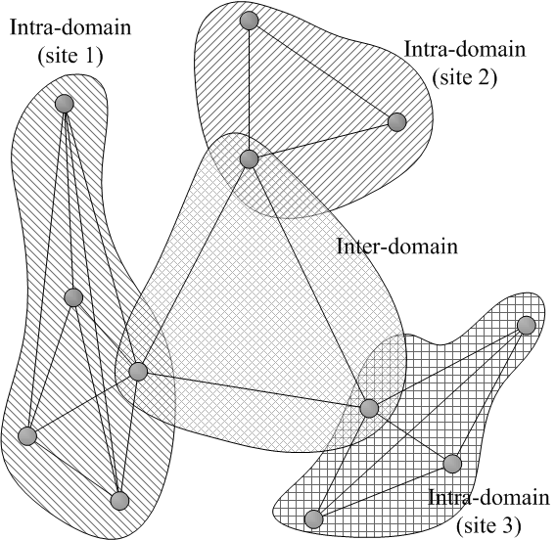
Information System (2)
Network information model

Slide 38
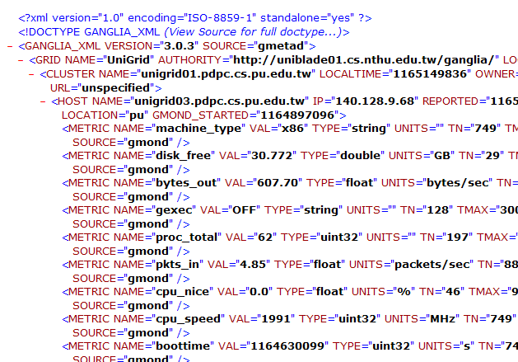
Information System (3)
All resource information are collected by Ganglia and presented in XML format

Slide 39
Outline
Introduction
Portal and SSO
Global Queue
Resource Broker
Job Scheduler
Information Service
Storage Service
Applications

Slide 40
Storage Service (1)
The goal of storage service is to provide a collaborative space where UniGrid users can share their data and resources with others.
Components of the storage service
  Virtual storage system
  Data management system

Slide 41
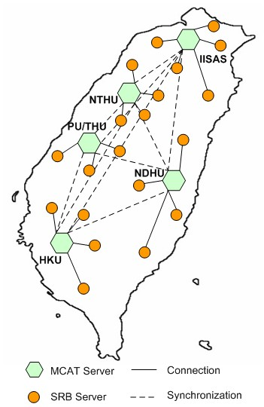
Storage Service (2)
Five SRB Zone for different geographic distributed locations
  Each Zone contain one MCAT server
Each site provides at least one server to join different Zone to form SRB data grid

Slide 42
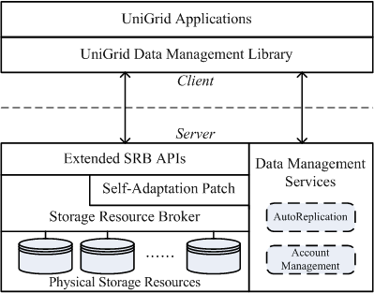
Storage Service (3)
System architecture

Slide 43
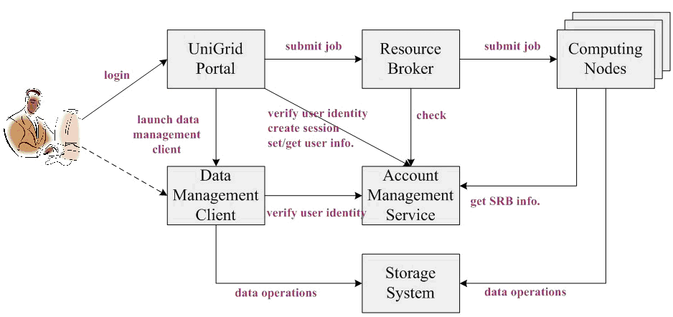
Virtual Storage System (1)
Virtual storage component diagram

Slide 44
Virtual Storage System (2)
The virtual storage system is implemented with Java as a web service
UniGrid services access the virtual storage system when they need to access user data
A client program is available for users to manage his own storage space
The files are stored in a master file server and replicas of the files are distributed to other SRB server

Slide 45
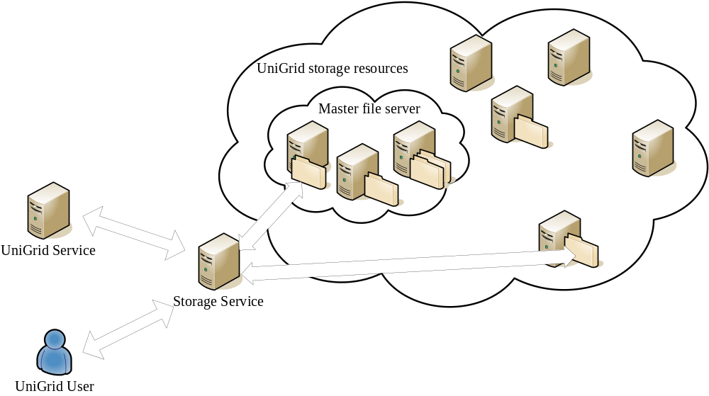
Virtual Storage System (3)

Slide 46
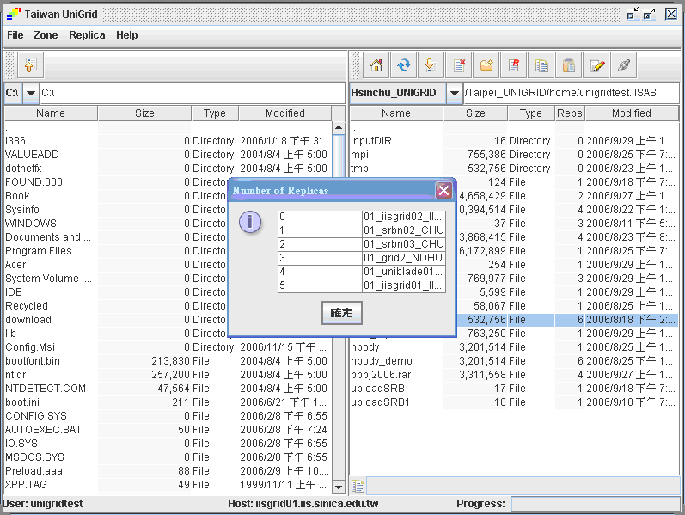
Virtual Storage System (4)
Screenshot of the storage service client program

Slide 47
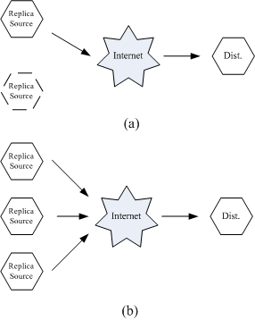
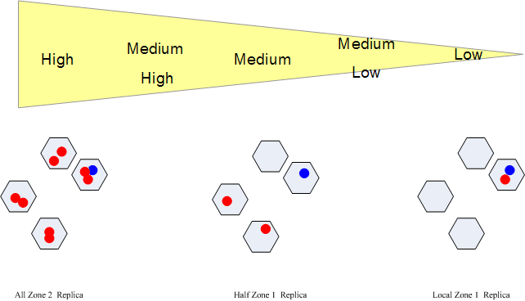
Data management system (1)
Efficient file transfer
Automatic replication
Replica level

Slide 48
Data management system (2)
Multi-source data transfer
Resc_1
Resc_2
Resc_3
Resc_4
replica_1
replica_2
replica_3
replica_4
getData()
Client

Slide 49
Outline
Introduction
Portal and SSO
Global Queue
Resource Broker
Job Scheduler
Information Service
Storage Service
Applications

Slide 50
UbiStream
Streaming data are abundant in our surroundings:
  Length of queue at cafeteria
  If the stadium is crowded or not
  Live streaming of concerts or games
  Course video/audio for e-learning
Great demands to access these streaming data at any time, any place

Slide 51
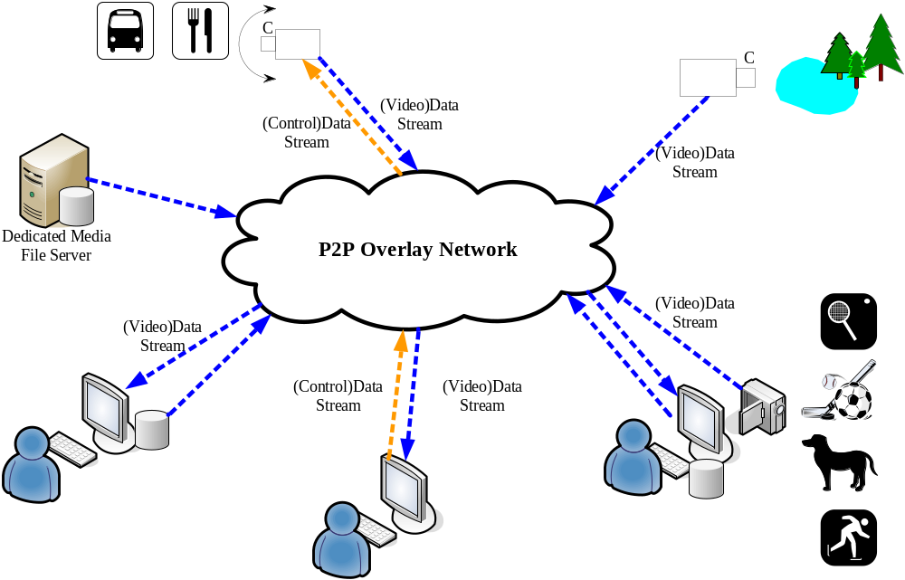

Slide 52
System components
Streaming source
  Turn information in the surroundings into streaming data
  Ex. Camera, sensor, counter
Indexing mechanism
  Make those data available to be searched
Processing units
  Further processing on raw data to provide better usage of them
User interface
  Display different kinds of streaming data

Slide 53
Scenario
We want to show streaming data from tens or even hundreds of sources on our monitor screen simultaneously
Machines on UniGrid are recruited to help shrinking the original screens to smaller size, and aggregate them in a single screen

Slide 54
Workflows
Three main workflows involve:
  Service discovery
    User queries, indexing server replies:
      HTML layout
      Addresses of decoders
      Addresses of services
  Interpreting the service
    Download decoders
  Streaming data delivery
    Decoder fetches media streams

Slide 55
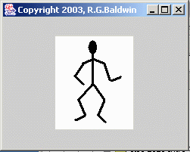
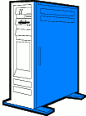




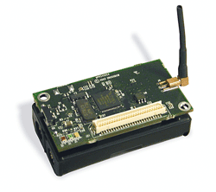
User tier
Processing tier
Source tier
1
Indexing server
2
3
Decoder server
Processing units
Camera
Sensor
Video-on-demand

Slide 56
Workflow 1
User tier
Processing tier
Source tier
Server translates XML metadata to HTML layout
Query strings
HTML
Indexing server

Slide 57
Workflow 2
User tier
Processing tier
Source tier
Browser downloads decoders (ActiveX)
URL
ActiveX
Decoder server
(Optional:)
Browser executes control logic (JavaScript)
Logic interacts with decoders

Slide 58
Workflow 3
User tier
Processing tier
Source tier
UniGrid
Tree root
ActiveX
Request
Grid portal recruits machines
……
Transcoding tree
UniGrid portal

Slide 59
Workflow 3
User tier
Processing tier
Source tier
UniGrid
Decoder fetches streaming data
Customized query
ActiveX
Media stream
Tree root
……
Transcoding tree

Slide 60
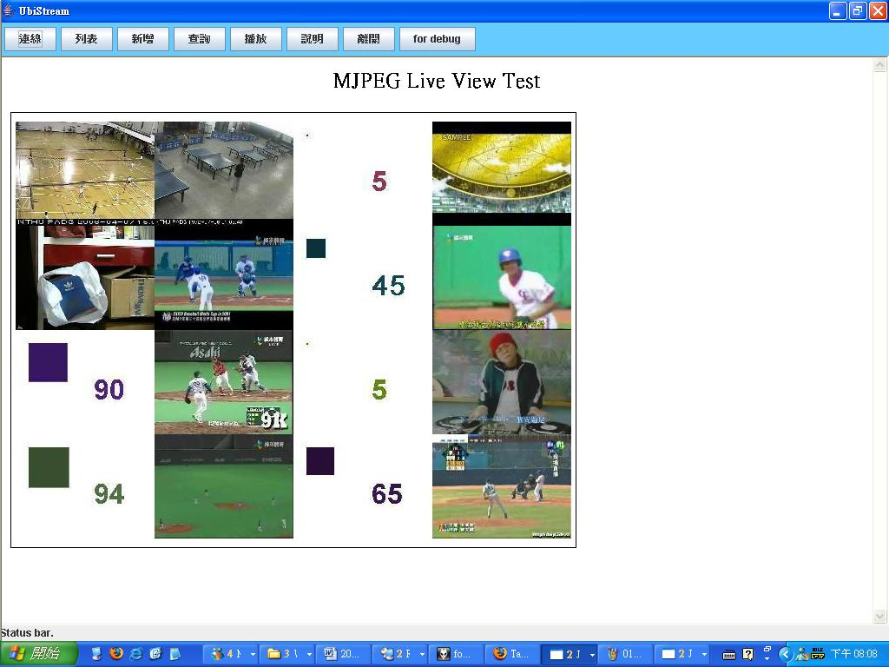
Results

Slide 61
Conclusions and Future Work
A prototype of Grid platform for researchers in Taiwan is established
Invite more researchers join Taiwan UniGrid
Participate in the Grid operation of NCHC
Establish a Grid Computing Association
Establish a Grid research office under NSC to promote Grid research in Taiwan

