Slide 1
X Programming with Xlib

Slide 2
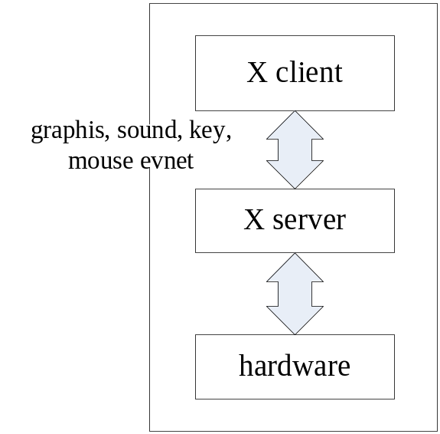
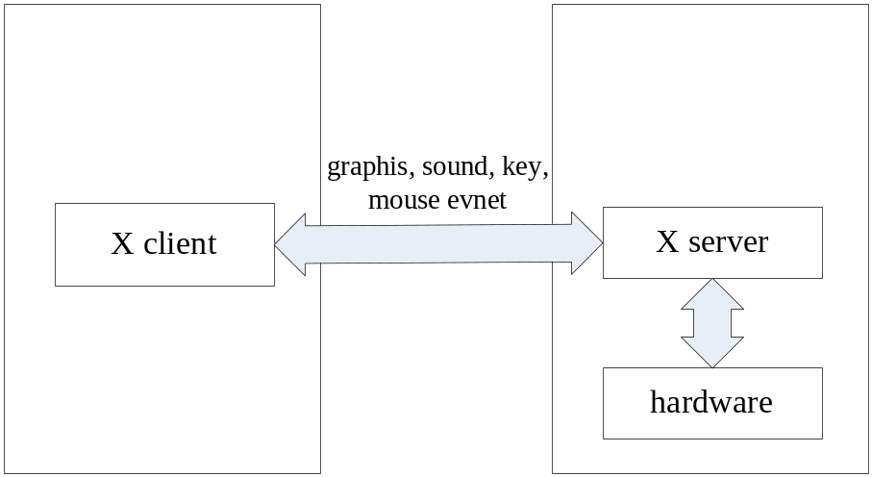
X
X is based on a client-server architecture
(1) X client and server at the same machine
(2) X client and server at different machines

Slide 3
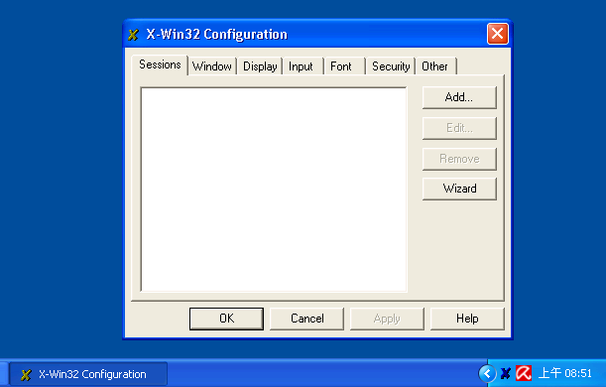
Requirement
X-Server to show graphs
  Linux (X client+server) – install Xwindow
  Linux (client) + Windows (server) – install Xwin32 in Windows

Slide 4
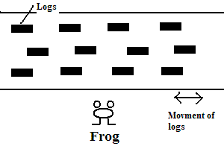
Example of HW2
River and frog arcade game

Slide 5
Xlib
Include xlib header file
#include <X11/Xlib.h> // basic X routine
#include <X11/keysym.h> // keyboard event
Compile
  Seq: gcc –L/usr/X11R6/lib –o foo foo.c –lX11
  Pthread: gcc –L/usr/X11R6/lib –o foo foo.c
  –lpthread –lX11
  MPI: mpicc –L/usr/X11R6/lib –o foo foo.c
  –lpthread –lX11
Execution
  $export DISPLAY=your_ip_address:0.0(first time only)
  e.g. $export DISPLAY=140.114.71.92:0.0

Slide 6
Xlib – Basic Datatype
Basic datatypes
  Display – specify the connection to the X server
  Window – specify the window
  GC – graphic context

Slide 7
Xlib – Basic API
Basic API
  XOpenDisplay - connect to X server
  XCreateSimpleWindow - create simple windows
  XMapWindow – map windows
  XCreateGC - create graphics contexts
  XSetBackground – set the background color
  XFlush - output buffer or event queue
  XDrawString - draw text characters
  XDrawPoint - draw points
  XFillRectangle - fill rectangles
  XFillArc - fill arcs

Slide 8
Xlib
Connect to X server
Display *XOpenDisplay(char *display_name);
display_name – IP address of X server
Return value – handle of this display to X server
e.g.
//assign statically
Display *display = XOpenDisplay(“your_ip_addr:0.0”);
or
//use DISPLAY env. variable
$export DISPLAY=your_ip_address:0.0
Display *display = XOpenDisplay(NULL);

Slide 9
Xlib
Create a window
  Window XCreateSimpleWindow(
  Display *display, Window parent, int x, int y,
  unsigned int width, unsigned int height,
  unsigned int border_width, unsigned long border,
  unsigned long background);
x, y – coordinate of top-left corner of window
width, height – width and height of window
e.g.
  Window win = XCreateSimpleWindow(
  display, DefaultRootWindow(display),
  0, 0, 300, 200, 0,
  WhitePixel(display, screen_num));

Slide 10
Xlib
Map a window (make the window viewable)
  Window XMapWindow( Display *display, Window w );
display – specify the connection to X server
w – specify the window

Slide 11
Xlib
Output the buffer and event queue
  int XFlush( Display *display );
When you change the state of the window or trigger an event, use XFlush() to update the screen
e.g.
  XFlush( display );

Slide 12
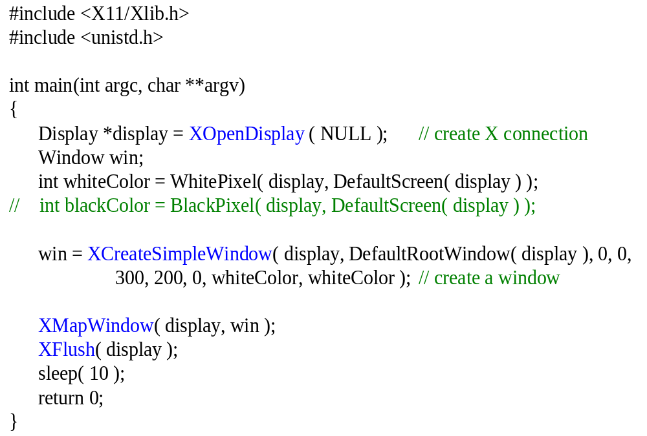
Example – create a simple window

Slide 13
Xlib
Create graphics contexts (create the basic structure to describe the graphics)
  GC XCreateGC(
  Display *display, Drawable d,
  unsigned long valuemask,
  XGCValues *values );
Drawable d – usually specify the window
e.g.
  GC gc = XCreateGC( display, win, 0, 0 );

Slide 14
Xlib
Set the foreground/background color
  int XSetForeground( Display *display,
  GC gc,
  unsigned long foreground );
  int XSetBackground( Display *display,
  GC gc,
  unsigned long background );
e.g.
  ret = XSetForeground( display, gc, 0xFFFFFF );
  ret = XSetBackground( display, gc, 0x000000 );

Slide 15
Xlib
Draw text characters
  int XDrawString( Display *display,
  Drawable d, GC gc, int x, int y,
  char *string, int length );
x, y – coordinate of first character of string
length – string length
e.g.
XDrawString( display, win, gc, 30, 30, “You Win”, 7 );
//You Win
XDrawString( display, win, gc, 100, 100, “You Lost”, 5);
// You L

Slide 16
Xlib
Draw graphics
XDrawPoint( Display *display, Drawable d, GC gc,
int x, int y );
  XFillRectangle( Display *display, Drawable d, GC gc,
  int x, int y, unsigned int width,
  unsigned int height );
  XFillArc( Display *display, Drawable d, GC gc,
  int x, int y, unsigned int width,
  unsigned int height, int angle1, int angle2);
e.g.
  Draw a rectangle of color 0xAABBCC
  XSetForeground( display, gc, 0xAABBCC );
  XFillRectangle( display, win, gc, 0, 0, 300, 300 );
  Draw a point of color 0xDDEEFF
  XSetForeground( display, gc, 0xDDEEFF );
  XDrawPoint( display, win, gc, 10, 10 );

Slide 17
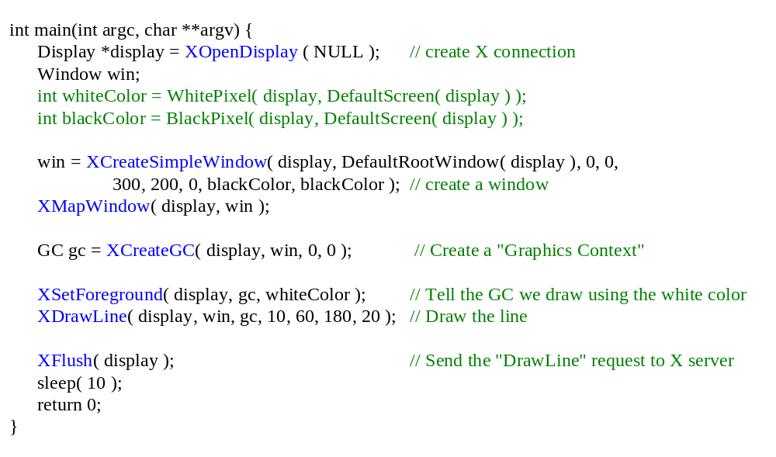
Example – draw a line

