Slide 1

1/40
Scheduling Asynchronous Inference in
Robotic Systems
2026.04.28
From Action Chunking to Real-Time VLA Execution
Ruixiang Wang
School of Data Science
Chinese University of Hong Kong, Shenzhen
香港中文大学（深圳）数据科学学院
CUHK-SZ School of Data Science

Slide 2
Outline
2/40
Problem: action chunks become a scheduling interface
01
ACT: define action chunking for fine-grained manipulation
02
RTC: make chunk inference asynchronous at test time
03
04
REMAC: train the policy for asynchronous mismatch
05
System view: queues, deadlines, committed prefixes, open problems
香港中文大学（深圳） 数据科学学院
CUHK-SZ School of Data Science
Notes:
这一版按 0409 模板走，页上内容更像论文报告：每篇都有原文截图、算法图、结果表和局限。

Slide 3
Control-Loop Mismatch
3/40
Classical Synchronous Control
Control Loop
observe
infer action
execute
observe
- Assumes inference is fast.
- Works for PID, small policies, lightweight planners.
- Breaks when inference takes tens or hundreds of milliseconds.
香港中文大学（深圳） 数据科学学院
CUHK-SZ School of Data Science
Notes:
这页用原文截图撑住延迟定义。不要读截图，只读右边三种执行模式。

Slide 4
Control-Loop Mismatch
4/40
Large Policies Change the Timing Assumption
Timing
- VLA policies
- Diffusion / flow policies
- World-model-based policies
control period: milliseconds
- Action chunking policies
control
large inference: tens/hundreds of milliseconds
VLA
The policy is now a slow producer; the robot remains a real-time consumer.
香港中文大学（深圳） 数据科学学院
CUHK-SZ School of Data Science
Notes:
这页用原文截图撑住延迟定义。不要读截图，只读右边三种执行模式。

Slide 5
Control-Loop Mismatch
5/40
Waiting for Inference Is Physically Harmful
Failure
move
wait
move
wait
failure
- Pause between chunks
- Stale observation
- Action discontinuity
- High jerk
- Task failure
香港中文大学（深圳） 数据科学学院
CUHK-SZ School of Data Science
Notes:
这页用原文截图撑住延迟定义。不要读截图，只读右边三种执行模式。

Slide 6
OS Scheduling View
6/40
How can robots keep executing actions while slow neural policies are still computing the next actions?
- Robot execution must be continuous.
- Large policies have inference latency.
robot motion
a_t
a_t+1
a_t+2
a_t+3
- Naive synchronization causes pauses and stale actions.
model thinking
infer next chunk
Scheduling target: keep the execution buffer non-empty while the policy computes.
香港中文大学（深圳） 数据科学学院
CUHK-SZ School of Data Science
Notes:
这一页把 OS 课题落地：调度目标不是传统中间件，而是在实时动作消费和慢速推理生产之间维持 buffer。

Slide 7
OS Scheduling View
7/40
Robot execution consumes actions; VLA inference produces them.
producer: policy(o_t) -> A_t
Control tick
consumer: robot.pop_front()
The controller needs one action every Delta t, often 20-67 ms.
deadline: queue not empty
hazard: boundary jump
Slow producer
A VLA / diffusion / flow policy may need 76-321 ms before the next chunk is available.
50 Hz
76 ms
control rate
pi0 latency
time ------------------------->
Scheduling object
The action queue tracks horizon, delay, committed prefix, and mutable suffix.
Exec.
a₀
a₁
a₂
a₃
a₄
a₅
Infer.
infer next
➜
infer later
香港中文大学（深圳） 数据科学学院
CUHK-SZ School of Data Science
Notes:
这一页把 OS 课题落地：调度目标不是传统中间件，而是在实时动作消费和慢速推理生产之间维持 buffer。

Slide 8
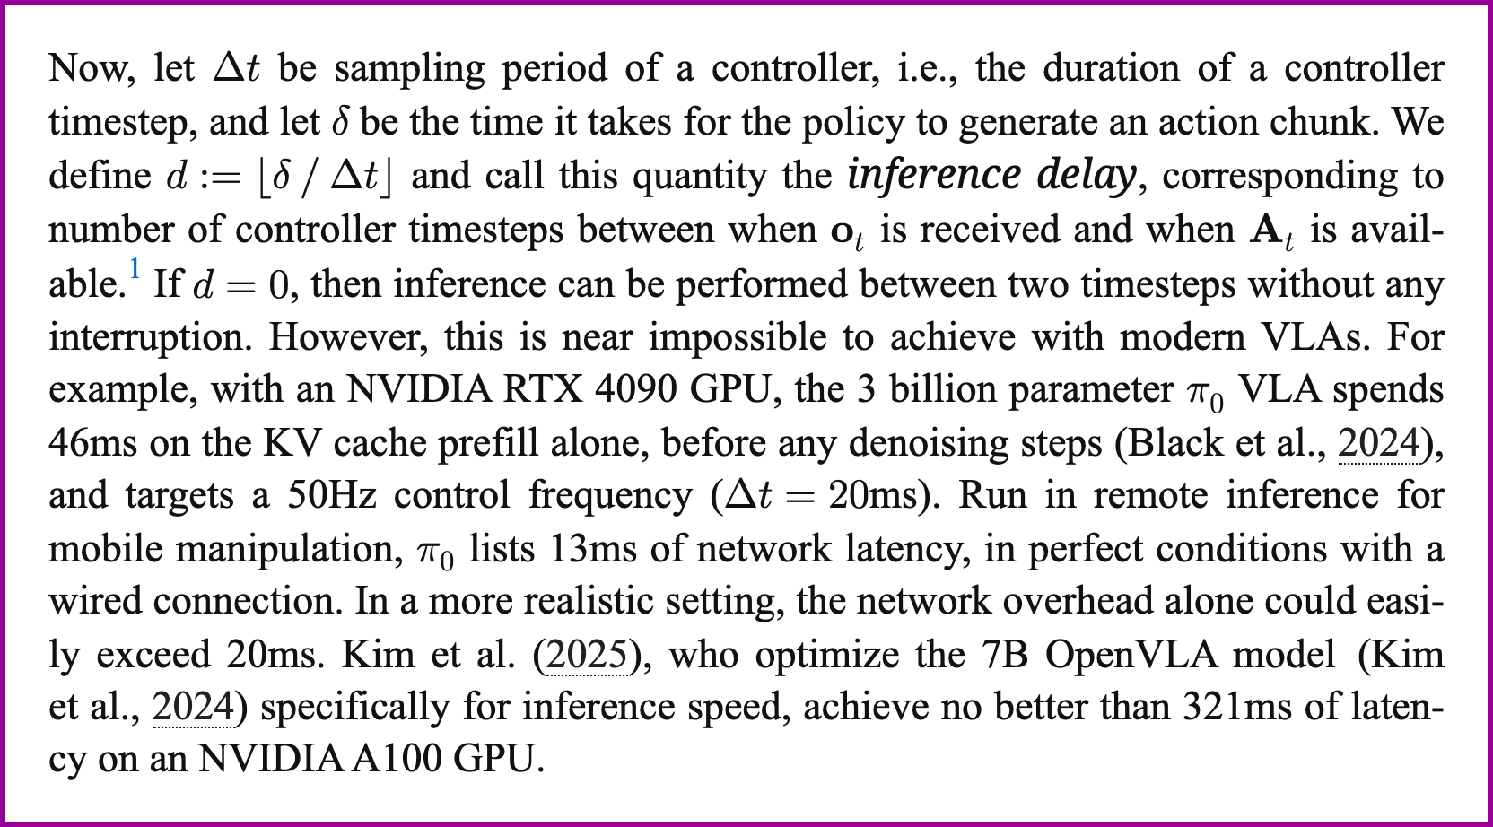
Control-Loop Mismatch
8/40
Evidence from RTC: real-time means response within the controller period
What goes wrong when delta > Delta t
Synchronous
observe -> infer -> execute. If inference is slow, the robot waits at chunk boundaries.
Naive asynchronous
infer while executing, but swap chunks without preserving the already committed actions.
Real-time chunking
start inference early and constrain the next chunk around actions that are guaranteed to execute.
Fig. 1. RTC excerpt defining inference delay relative to the controller period.
香港中文大学（深圳） 数据科学学院
CUHK-SZ School of Data Science
Notes:
这页用原文截图撑住延迟定义。不要读截图，只读右边三种执行模式。

Slide 9
Vocabulary: Action Queue Buffer
9/40
- prediction horizon P or H: full length of predicted action chunk
- execution horizon h or s: actions consumed before the next refresh
- inference delay d: how many controller ticks pass while inference runs
- committed prefix: actions that will execute before the new chunk arrives
- mutable suffix: future actions still safe to regenerate or correct
OS analogy
The action queue is a bounded buffer with real-time consumption and uncertain producer latency.
香港中文大学（深圳） 数据科学学院
CUHK-SZ School of Data Science
Notes:
把所有后续方法统一到一个 buffer 语言里：哪些动作已经不可更改，哪些动作还可以重新生成。

Slide 10
Execution Paradigms
10/40
Paradigm
Schedule
Benefit
Failure mode
single-step BC
infer every tick
reactive
compounding error
ACT chunk
infer, then execute
local trajectory
pause if model slow
RTC
execute + infer next
continuous actions
extra compute
REMAC
masked-prefix training
async robust
needs adaptation
SmolVLA async
client/server queues
deployment stack
engineering stack
香港中文大学（深圳） 数据科学学院
CUHK-SZ School of Data Science
Notes:
这里给完整故事线。之后每篇论文就按这个表的位置展开。

Slide 11
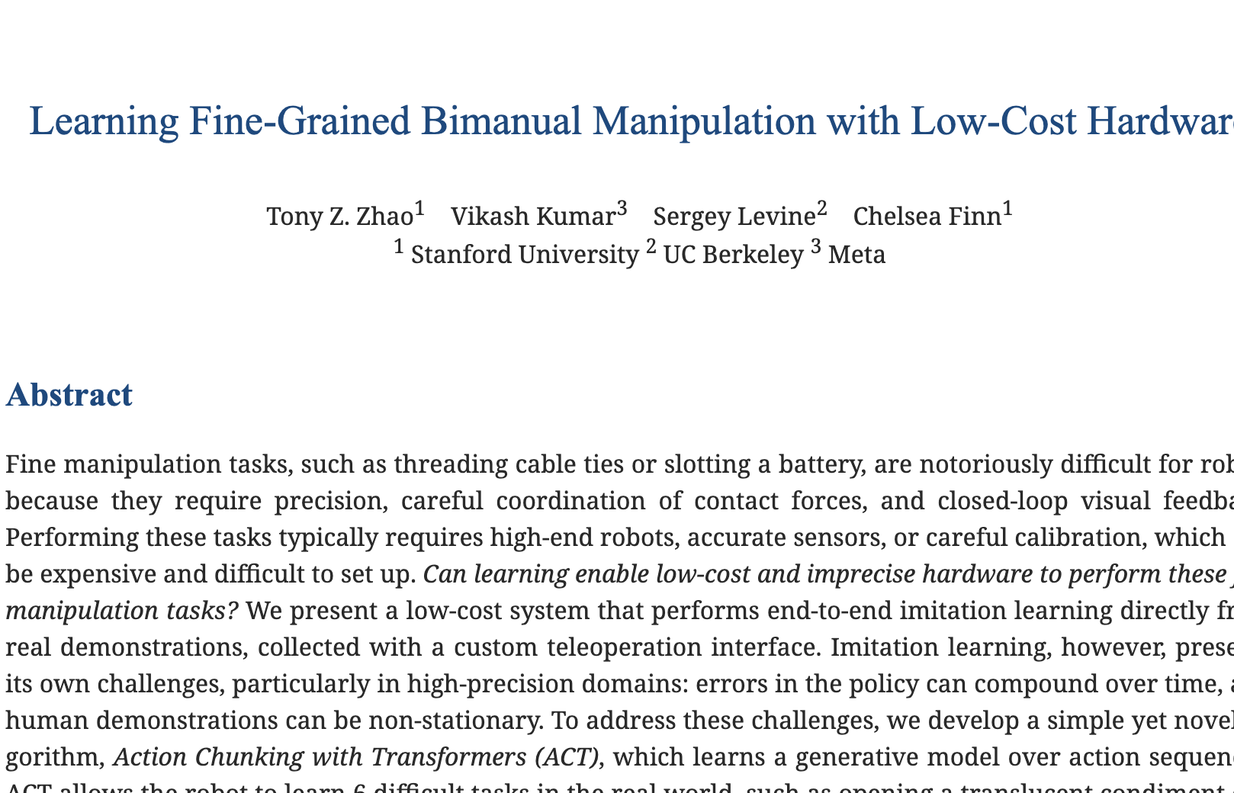
11/40
PART 2
Paper 1: ACT
Fig. 2. ACT overview: paper title, model architecture, and real-world manipulation tasks.
香港中文大学（深圳） 数据科学学院
CUHK-SZ School of Data Science
Notes:
Learning action chunks before asynchronous inference became the bottleneck.

Slide 12
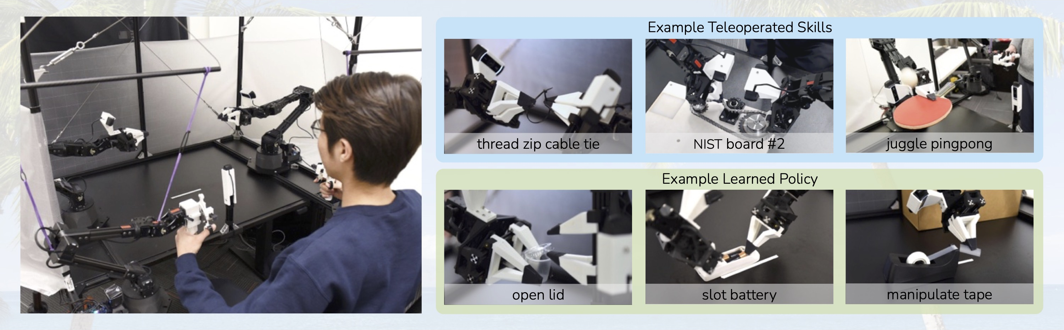
ACT: Why Action Chunking
12/40
Core problem
Fine manipulation is high-frequency, contact-rich, and sensitive to compounding error.
- Zhao et al., 2023
- Fine-grained bimanual manipulation
- Low-cost hardware
- End-to-end imitation learning
Fig. 3. ACT hardware setup and multi-view observations for low-cost bimanual manipulation.
香港中文大学（深圳） 数据科学学院
CUHK-SZ School of Data Science
Notes:
ACT 本身推理很快，所以它不是异步论文。但它定义了后面异步工作的对象：action chunk。

Slide 13
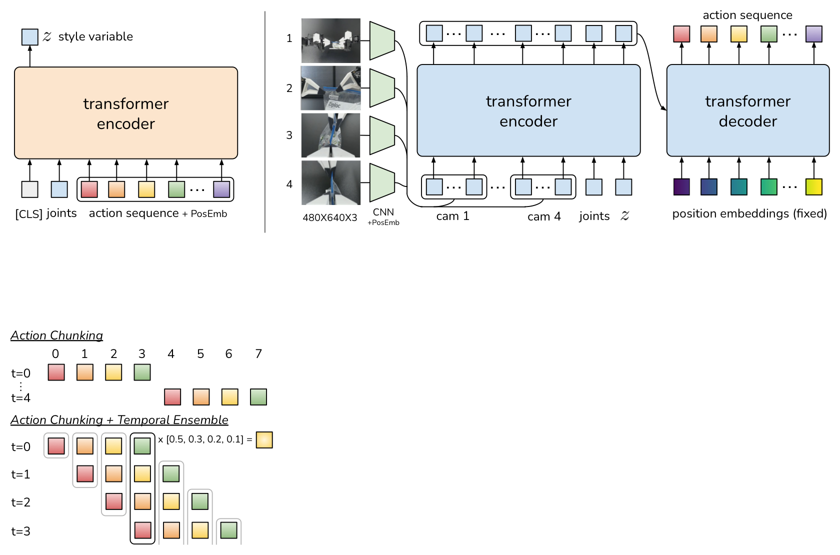
ACT: Future Action Sequence
13/40
Transformer + CVAE Policy
Inputs:
- Multi-view RGB images
- Robot joint states
- Latent style variable
Output:
- Future action sequence
Fig. 4. ACT architecture mapping observations and joint states to a future action sequence.
香港中文大学（深圳） 数据科学学院
CUHK-SZ School of Data Science
Notes:
把焦点放在接口上，不要陷入 CVAE 细节。

Slide 14
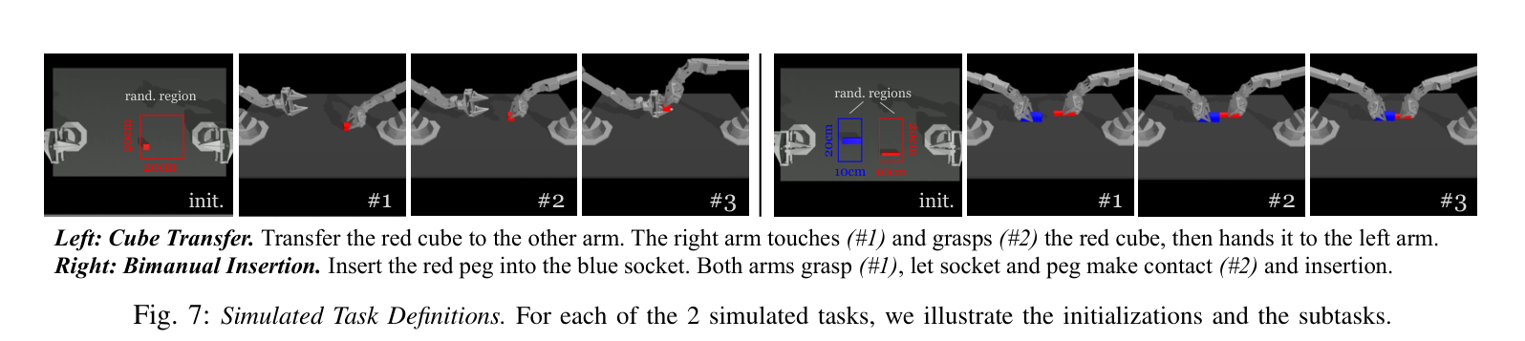
ACT: Future Action Sequence
14/40
Why Single-Step Behavior Cloning Fails
- Small errors compound over time.
- Policy drifts out of training distribution.
- High-frequency decisions amplify noise.
Fig. 5. ACT architecture: CVAE plus Transformer encoder-decoder for k-step action chunks.
- Contact-rich manipulation needs temporal consistency.
small error
larger error
off distribution
failure
香港中文大学（深圳） 数据科学学院
CUHK-SZ School of Data Science
Notes:
把焦点放在接口上，不要陷入 CVAE 细节。

Slide 15
ACT: Future Action Sequence
15/40
Predict a Future Action Sequence
Not: predict a_t
one observation
Instead: predict A_t = [a_t, a_t+1, ..., a_t+k-1]
- Lowers effective decision horizon.
- Produces smoother local trajectories.
a_t
a_t+1
a_t+2
a_t+3
a_t+4
- Captures short-horizon temporal structure.
香港中文大学（深圳） 数据科学学院
CUHK-SZ School of Data Science
Notes:
把焦点放在接口上，不要陷入 CVAE 细节。

Slide 16

ACT Evidence: Fine Manipulation
16/40
Task
ACT final
Baseline final
Slide Ziploc
88%
0%
Slot Battery
96%
0%
Open Cup
84%
0%
Put On Shoe
92%
0%
Takeaway
Chunking reduces effective decision horizon and strengthens temporal consistency for precision contact tasks.
Fig. 6. ACT real-world task demonstrations and success-rate evidence.
香港中文大学（深圳） 数据科学学院
CUHK-SZ School of Data Science
Notes:
这些数字足够展示 ACT 为什么成为后续工作基础。注意说 baseline final 是对应表中最好 baseline BeT/other methods 的最终任务完成率。

Slide 17
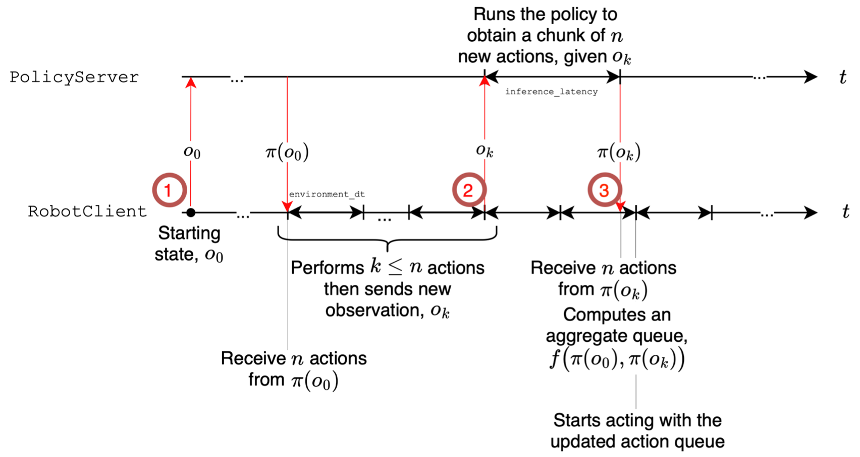
ACT Limitation: Synchronous Loop
17/40
observe o_t
-> infer A_t
-> execute chunk
-> observe again
Fine for ACT
ACT inference is about 0.01s in the original setup, so a synchronous loop is workable.
Not fine for VLAs
When policies become diffusion / flow / VLA models, chunk generation can exceed the control period.
Fig. 7. Asynchronous inference timeline motivating decoupled prediction and execution.
香港中文大学（深圳） 数据科学学院
CUHK-SZ School of Data Science
Notes:
ACT 的局限是转场：它定义动作块，但没有解决大模型慢推理。

Slide 18
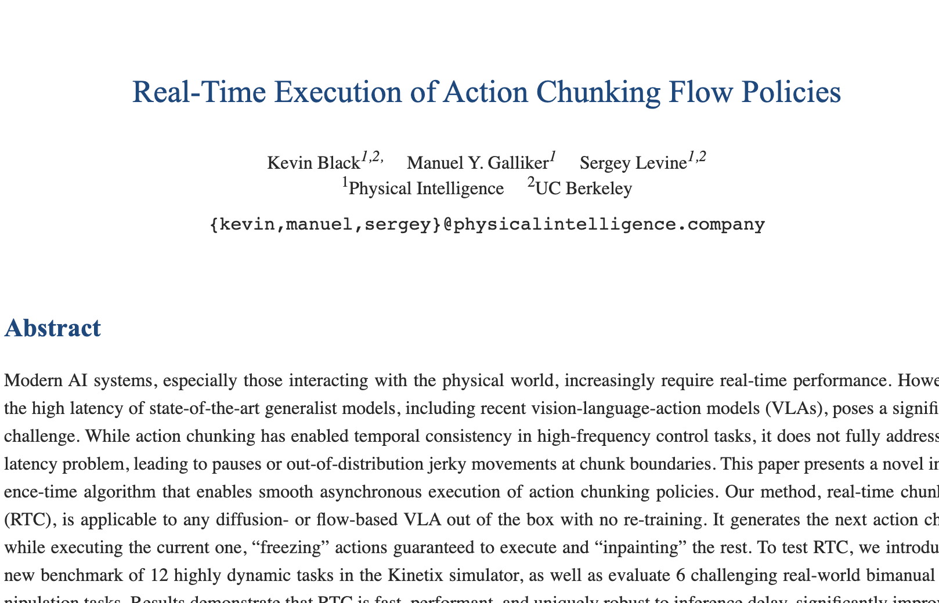
18/40
PART 3
Paper 2: RTC
Fig. 8. RTC overview: paper title, real-time chunking diagram, and trajectory evidence.
香港中文大学（深圳） 数据科学学院
CUHK-SZ School of Data Science
Notes:
Inference-time scheduling: generate the next chunk while executing the current one.

Slide 19
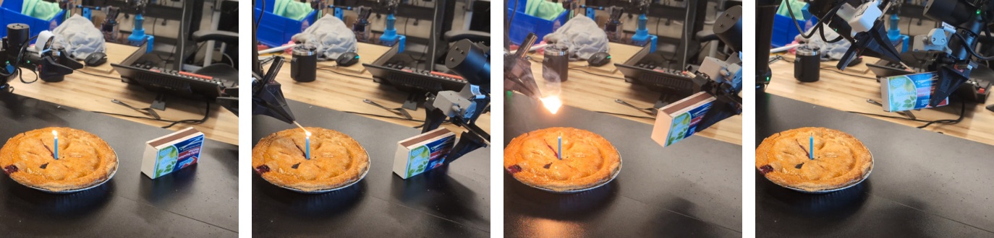
RTC: Real-Time Async Chunking
19/40
RTC
RTC: Real-Time Execution of Action Chunking Flow Policies
- Black, Galliker, Levine, 2025
- Inference-time algorithm
- No retraining
- Works with diffusion/flow-based VLA policies
Fig. 9. RTC trajectory evidence comparing real-time chunking with synchronous execution.
香港中文大学（深圳） 数据科学学院
CUHK-SZ School of Data Science
Notes:
讲 RTC 时要强调：这是 test-time algorithm，不需要重新训练，所以系统味更强。

Slide 20
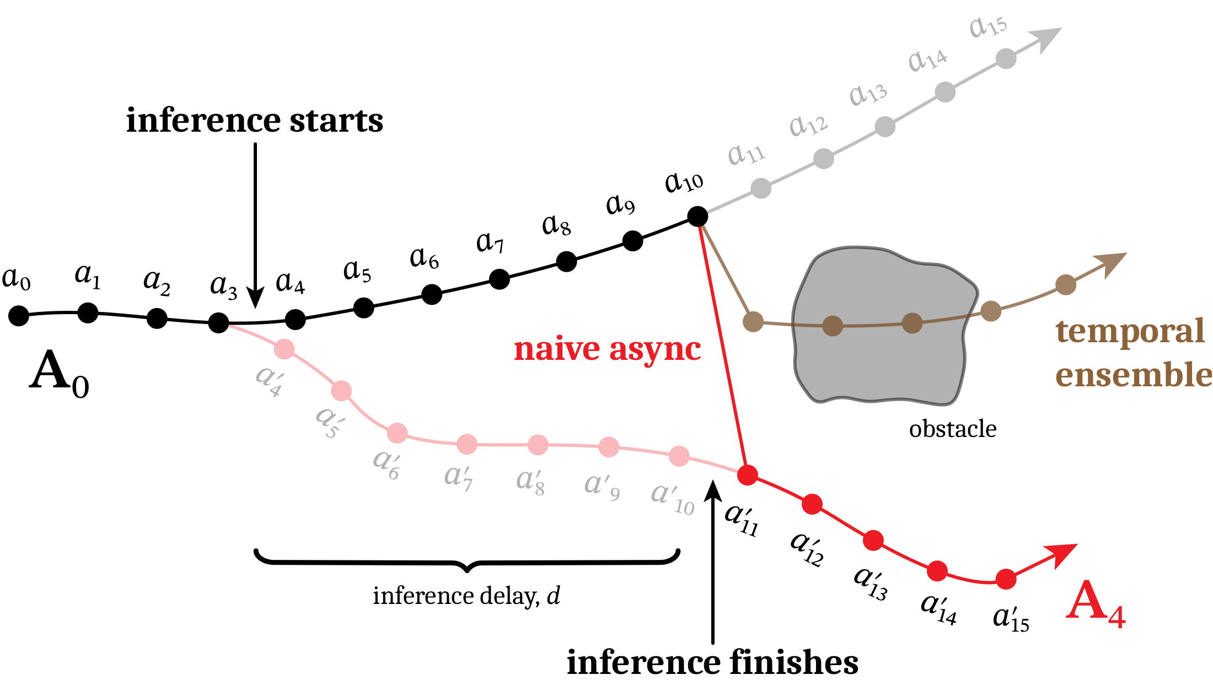
Naive Async Can Be Worse
20/40
Scheduling hazard
The new chunk is computed from a newer observation, but it arrives after several old actions have already been consumed.
Boundary jump
Swapping from old chunk to new chunk may jump between two valid but incompatible modes.
Why TE is insufficient
Averaging actions may smooth acceleration but can produce invalid actions between modes.
Fig. 10. RTC bifurcation example: old and new chunks choose incompatible motion modes.
香港中文大学（深圳） 数据科学学院
CUHK-SZ School of Data Science
Notes:
这页讲 mode switching。要把图中的黑线和红线解释成两个局部都合理、拼起来不合理的动作块。

Slide 21
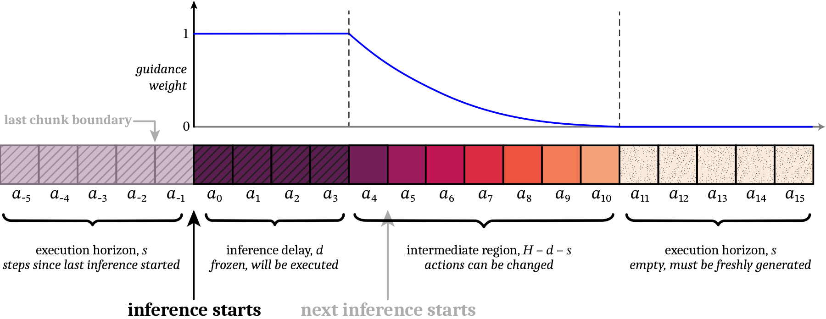
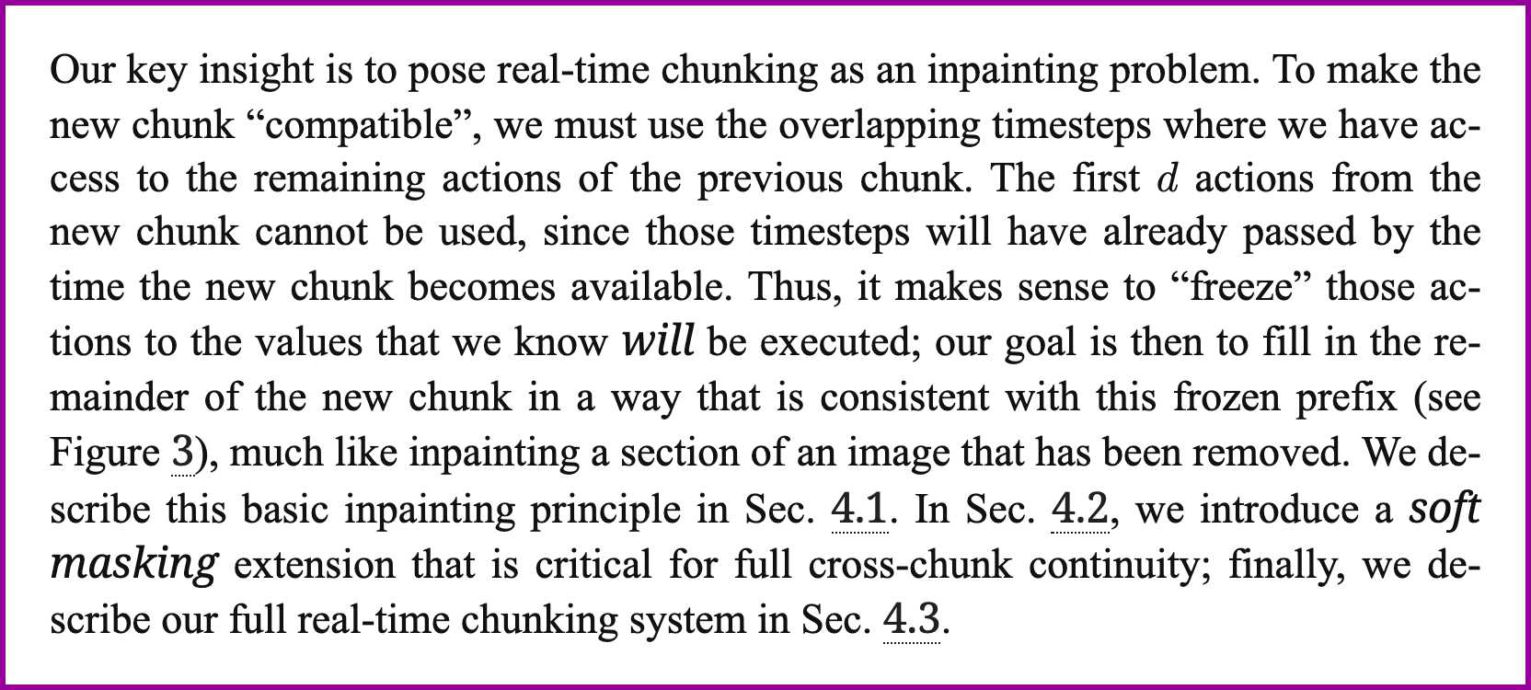
RTC: Freeze + Inpaint
21/40
a0
a1
a2
?
?
?
Freeze
Actions guaranteed to execute before inference returns are treated as fixed constraints.
Inpaint
The future suffix is generated to be compatible with that committed prefix.
Fig. 11. RTC guidance diagram: frozen prefix, soft overlap, and generated suffix.
Fig. 12. RTC paper excerpt framing real-time chunking as action inpainting.
香港中文大学（深圳） 数据科学学院
CUHK-SZ School of Data Science
Notes:
核心页。讲清楚 committed prefix 为什么不能被新模型输出覆盖。

Slide 22
RTC Runtime: Producer-Consumer
22/40
Controller thread:
every Delta t:
observe o_next
Mutex-protected shared state
return A_cur[t-1]
RTC separates real-time action consumption from slower chunk generation.
Inference thread:
wait until t >= s_min
Delay buffer
estimate delay d
The inference loop estimates future delay conservatively from recent observed delays.
GuidedInference(o_cur, A_prev, d, s)
swap A_cur when ready
Deadline condition
Choose execution horizon s such that actions remain available despite delay.
香港中文大学（深圳） 数据科学学院
CUHK-SZ School of Data Science
Notes:
这页最像 OS。可以类比生产者-消费者、mutex、condition variable、deadline。

Slide 23
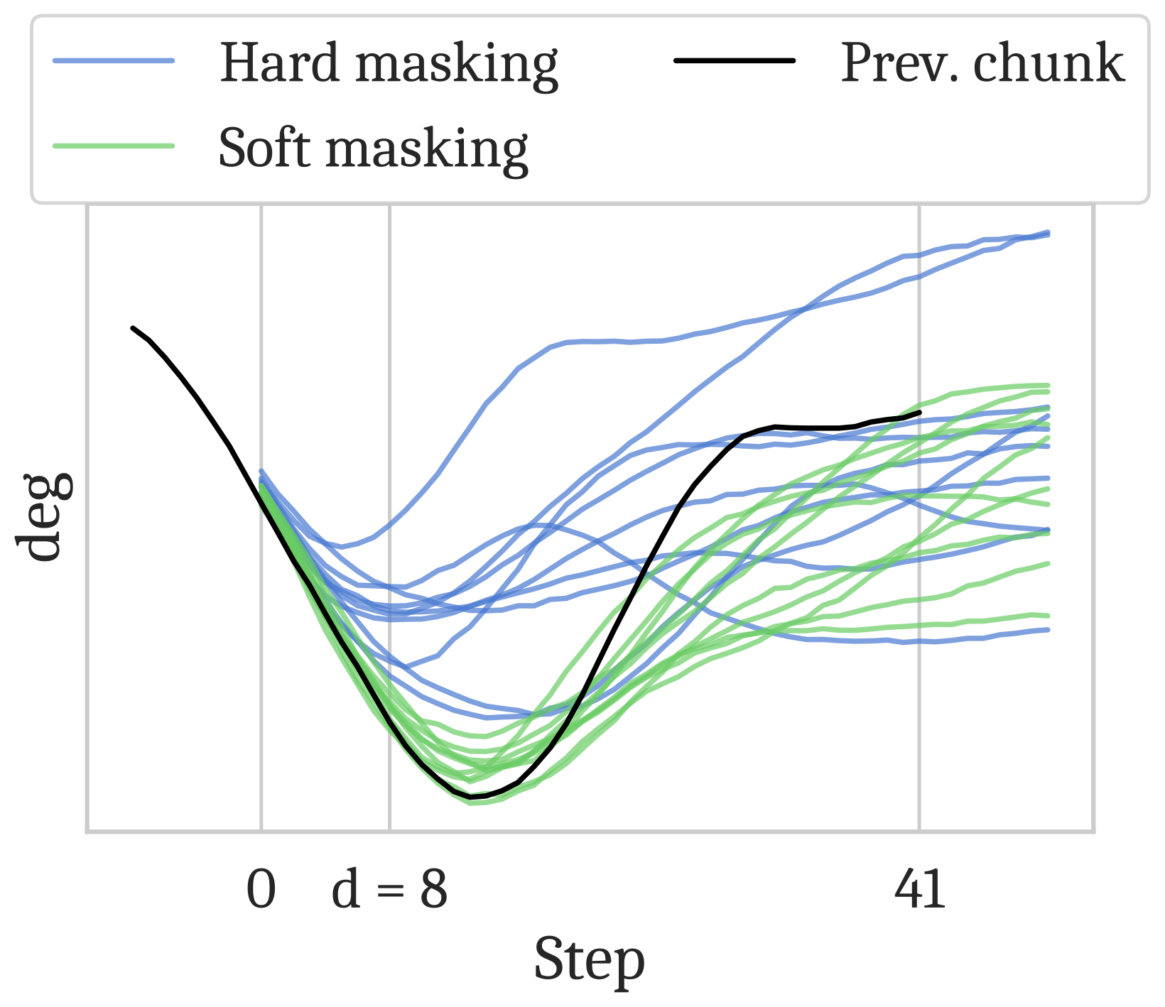
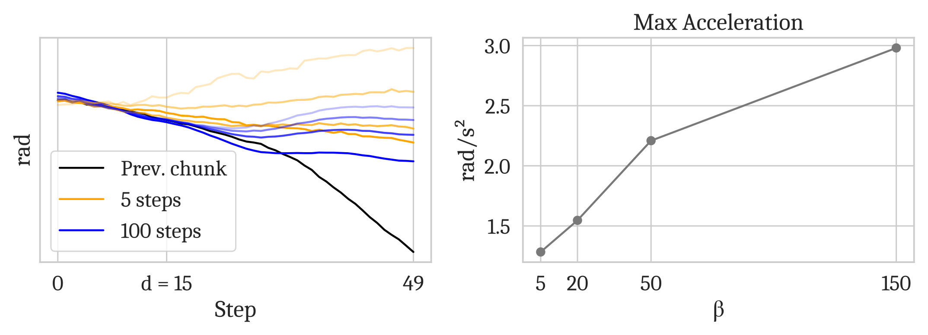
RTC: Soft Masking
23/40
Fig. 13. RTC hard versus soft masking under delayed inference.
Fig. 14. RTC guidance-strength ablation on real tasks.
香港中文大学（深圳） 数据科学学院
CUHK-SZ School of Data Science
Notes:
用这一页说明 RTC 不只是硬复制 prefix。软约束让 overlap 区域逐渐释放，避免过强约束影响反应性。

Slide 24
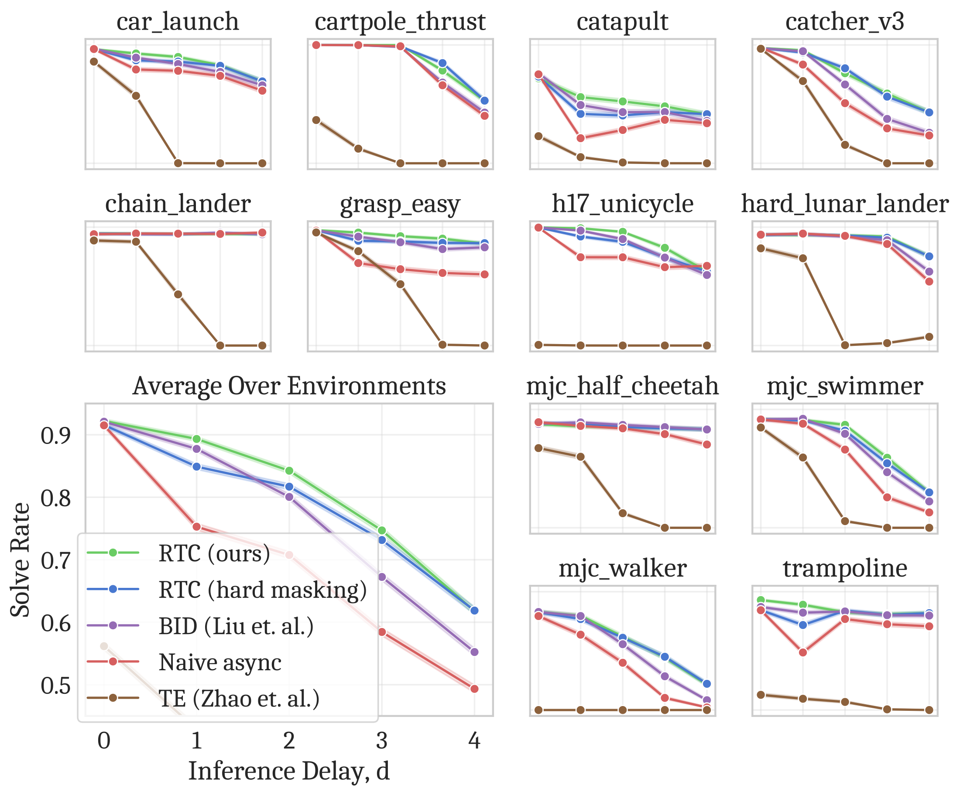
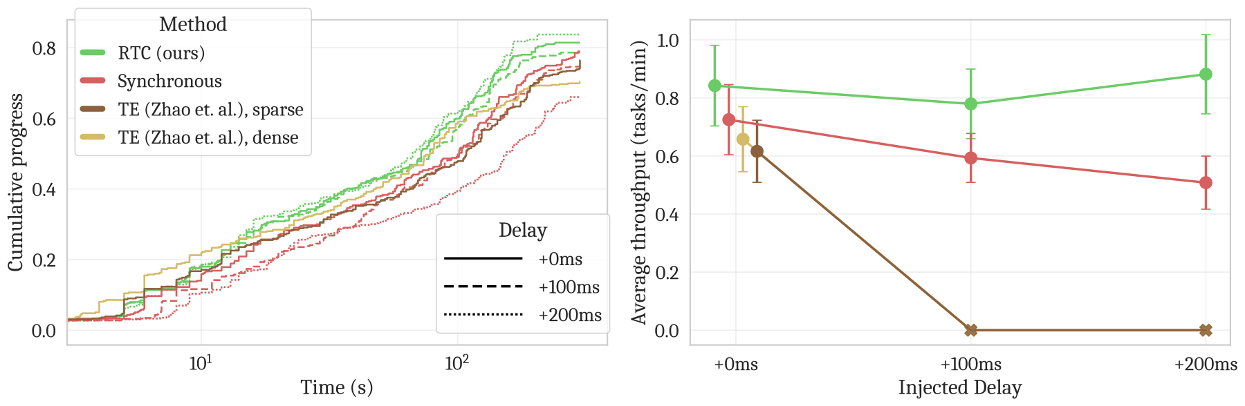
RTC Evaluation: Delay Robustness
24/40
Fig. 16. RTC real-world bimanual manipulation throughput under latency.
Fig. 15. RTC Kinetix benchmark showing robustness under injected delay.
香港中文大学（深圳） 数据科学学院
CUHK-SZ School of Data Science
Notes:
讲实验不用细抠曲线。重点：delay 增加时，RTC 曲线掉得更慢；真实机器人中吞吐更好。

Slide 25
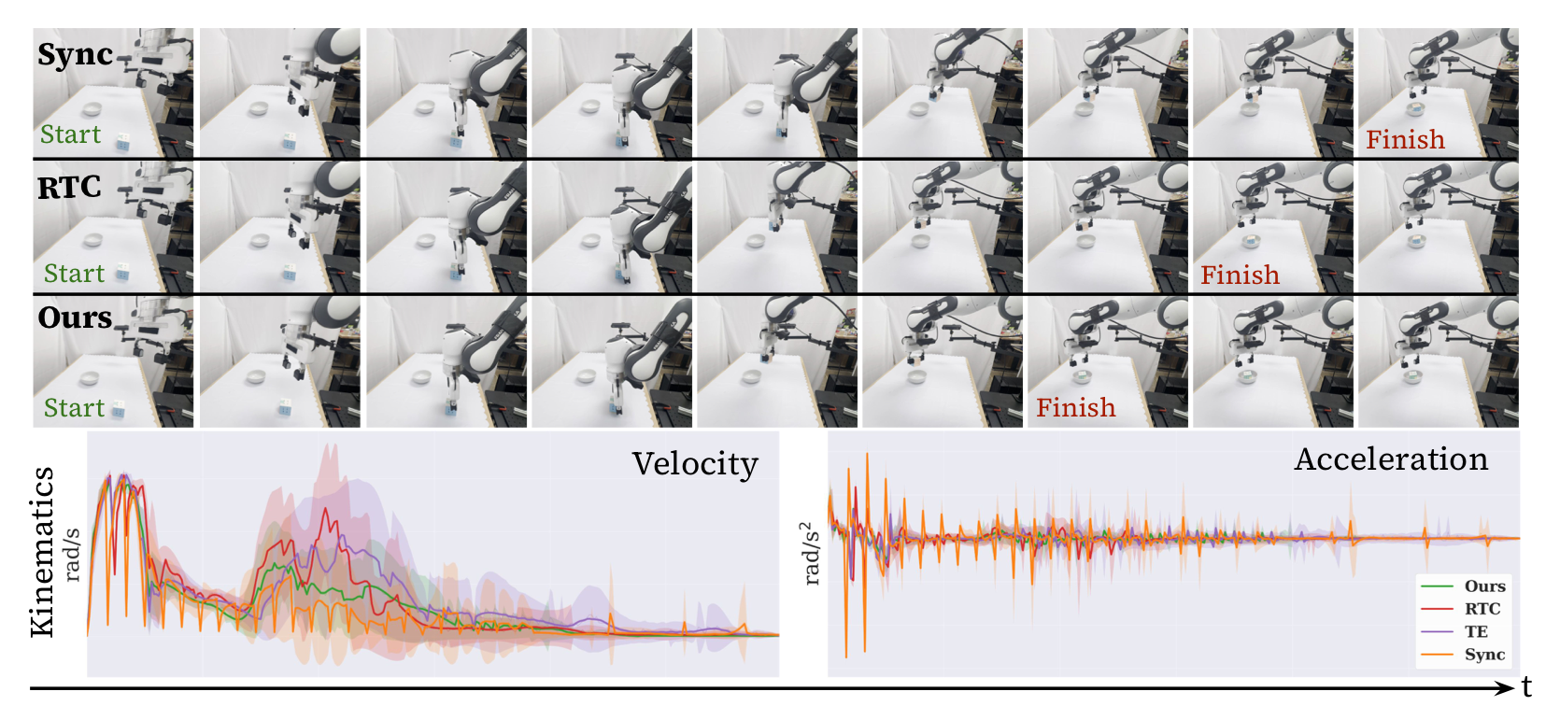
RTC Limitation: Compute Cost
25/40
Method
Latency
vanilla pi0.5
76 ms
RTC
97 ms
BID N=16
115-223 ms
RTC's tradeoff
No retraining, but guided inpainting adds compute. This motivates methods that make the base policy robust during training.
Fig. 17. RTC smoothness evidence from velocity and acceleration traces.
香港中文大学（深圳） 数据科学学院
CUHK-SZ School of Data Science
Notes:
这是转到 REMAC 的桥：RTC 解决边界，但代价是推理时额外计算，而且主要处理 inter-chunk。

Slide 26
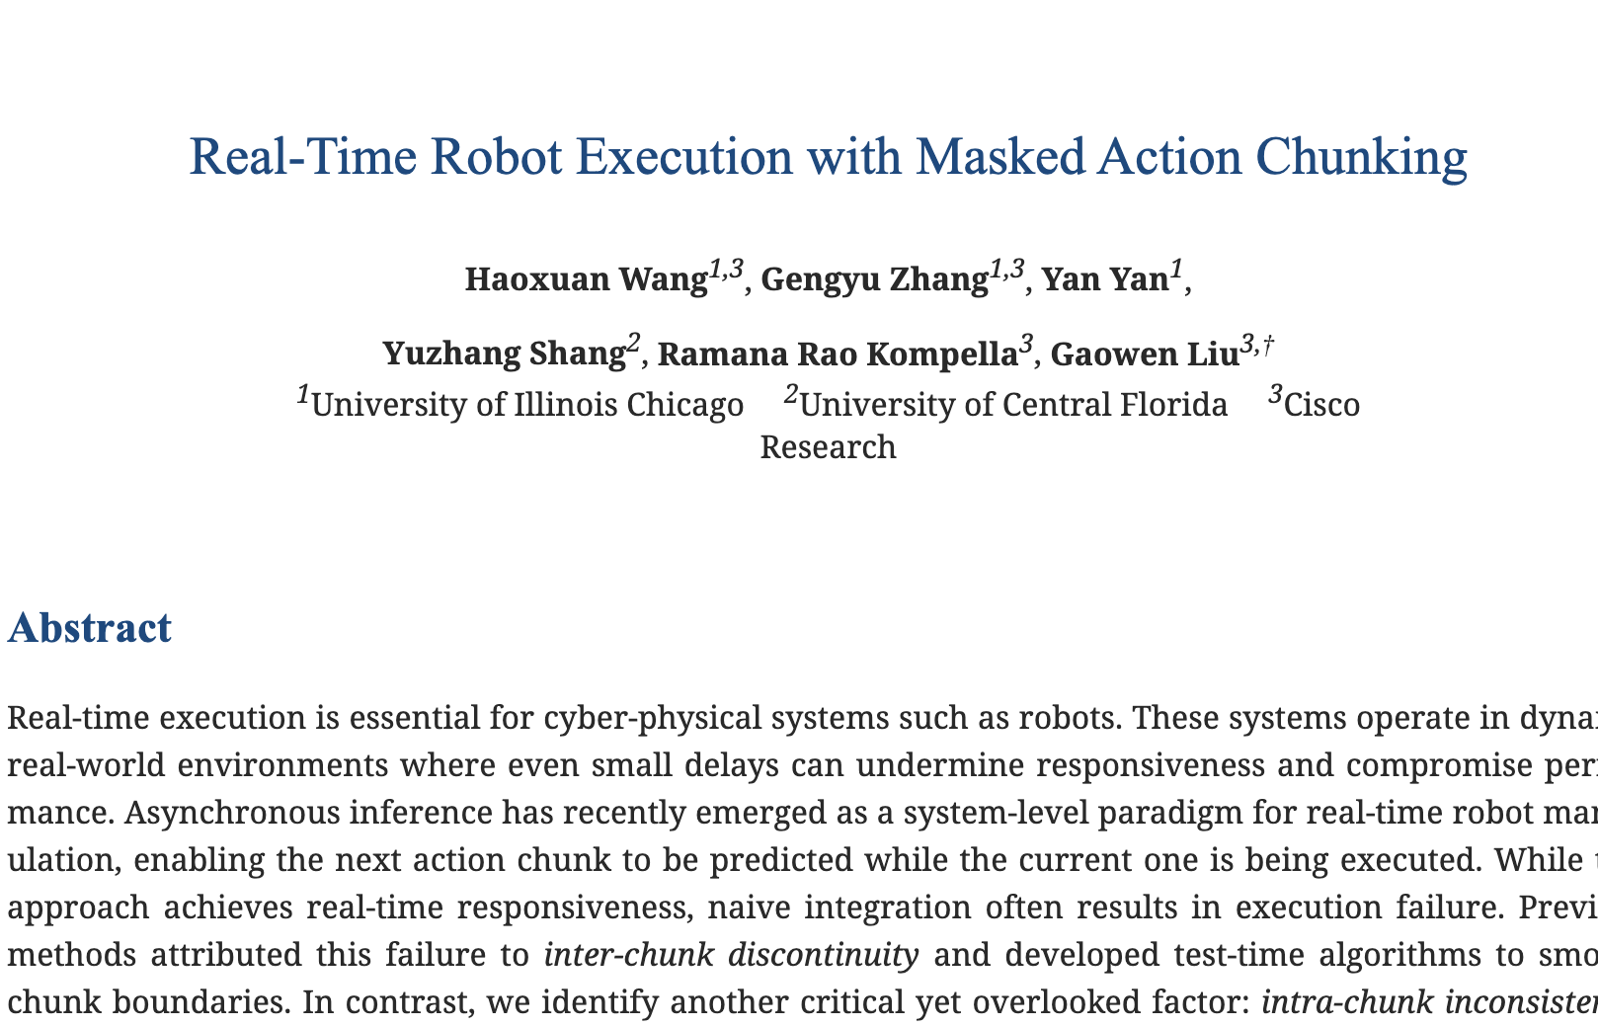
26/40
PART 4
Paper 3: REMAC
Fig. 18. REMAC overview: title, method diagram, and performance evidence.
香港中文大学（深圳） 数据科学学院
CUHK-SZ School of Data Science
Notes:
Training-time adaptation for asynchronous chunk mismatch.

Slide 27
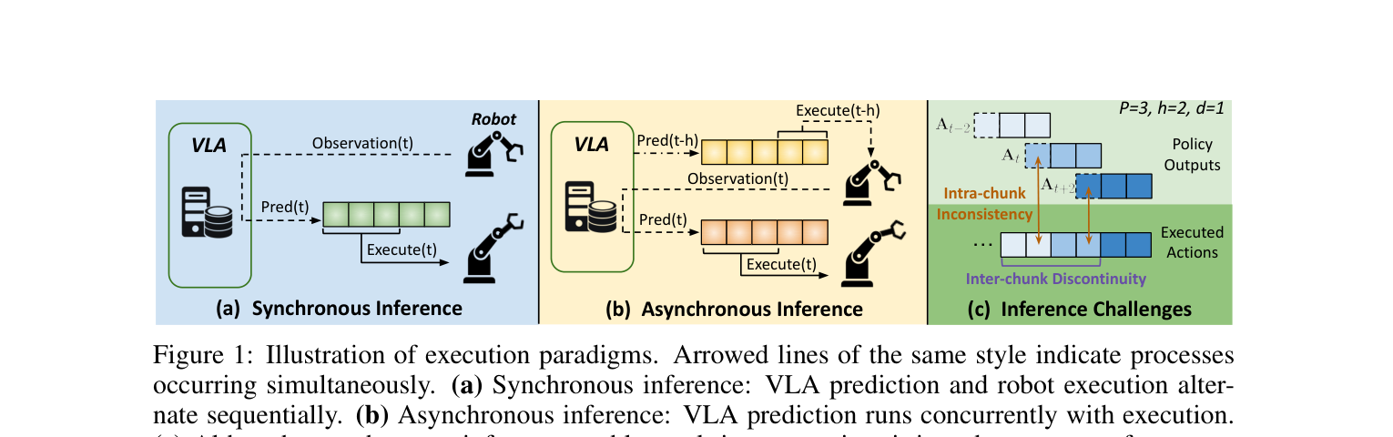
REMAC: Two Async Failure Modes
27/40
Inter-chunk discontinuity
- Chunk k and chunk k+1 may come from different valid modes and jump at the boundary.
Intra-chunk inconsistency
- Current perception o_t is paired with a prefix that came from an older observation.
Fig. 19. REMAC failure modes: inter-chunk discontinuity and intra-chunk inconsistency.
香港中文大学（深圳） 数据科学学院
CUHK-SZ School of Data Science
Notes:
REMAC 的贡献是指出 RTC 主要管边界，但还有更隐蔽的 chunk 内错位。

Slide 28
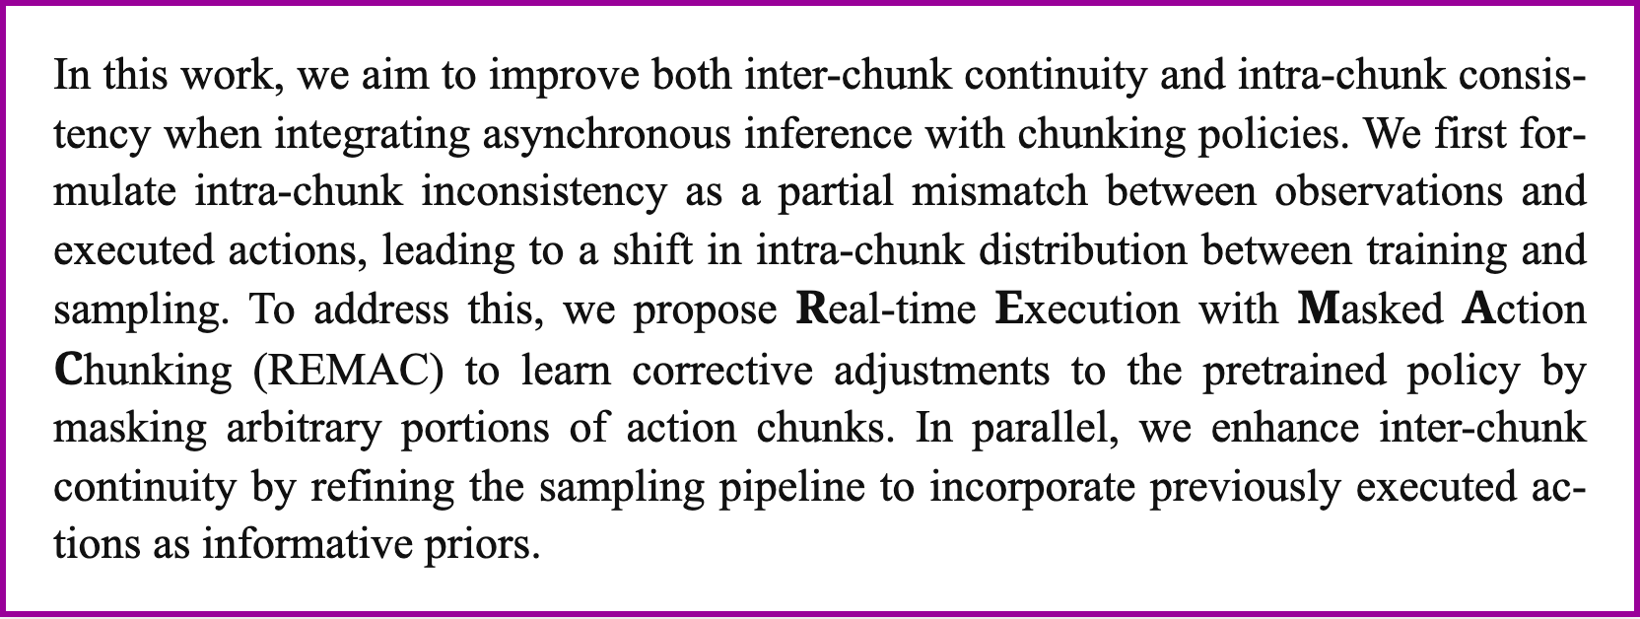
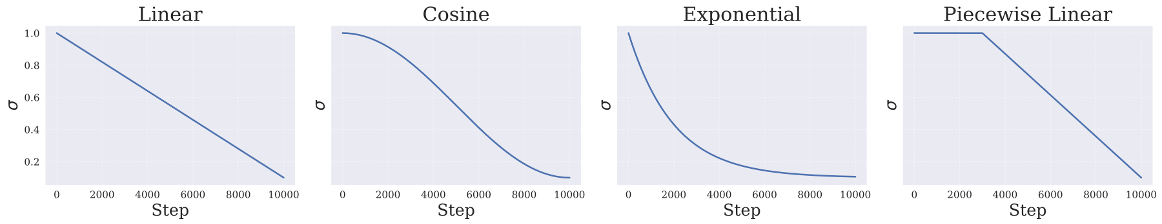
REMAC: Masked Action Chunking
28/40
old
old
mask
new
new
Training-time idea
Expose the policy to partial prefixes and ask it to learn corrective continuation under varying delays.
Fig. 20. REMAC paper excerpt describing masked action chunking.
Not just smoothing
The policy becomes delay-aware, instead of relying only on a test-time inpainting wrapper.
Fig. 21. REMAC mask schedule visualization for prefix-conditioned generation.
香港中文大学（深圳） 数据科学学院
CUHK-SZ School of Data Science
Notes:
这里要明确 REMAC 和 RTC 的分工：RTC 是 test-time；REMAC 是训练/适配阶段。

Slide 29
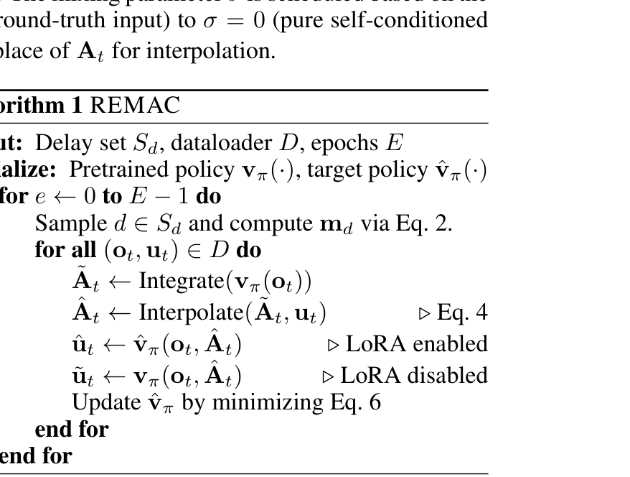
REMAC: Masked Action Chunking
29/40
Masked Action Chunking
clean chunk:
a0
a1
a2
a3
a4
a5
masked / mismatched chunk:
a0
a1
?
?
?
?
- Simulate asynchronous mismatch during training/adaptation.
- Learn corrective continuation.
- Improve robustness under delay.
Fig. 22. REMAC algorithm screenshot: masked corrective continuation on a pretrained policy.
香港中文大学（深圳） 数据科学学院
CUHK-SZ School of Data Science
Notes:
这里要明确 REMAC 和 RTC 的分工：RTC 是 test-time；REMAC 是训练/适配阶段。

Slide 30
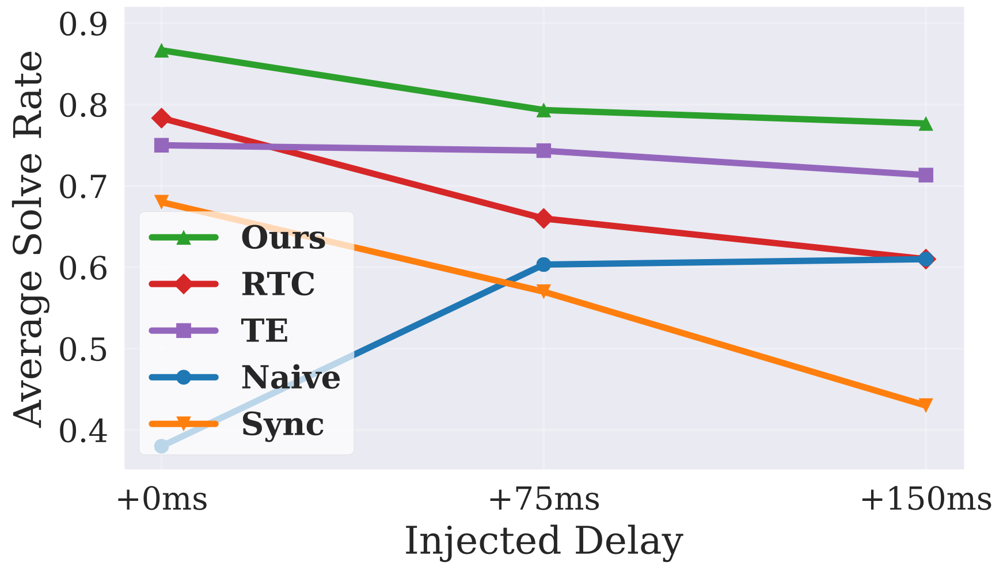
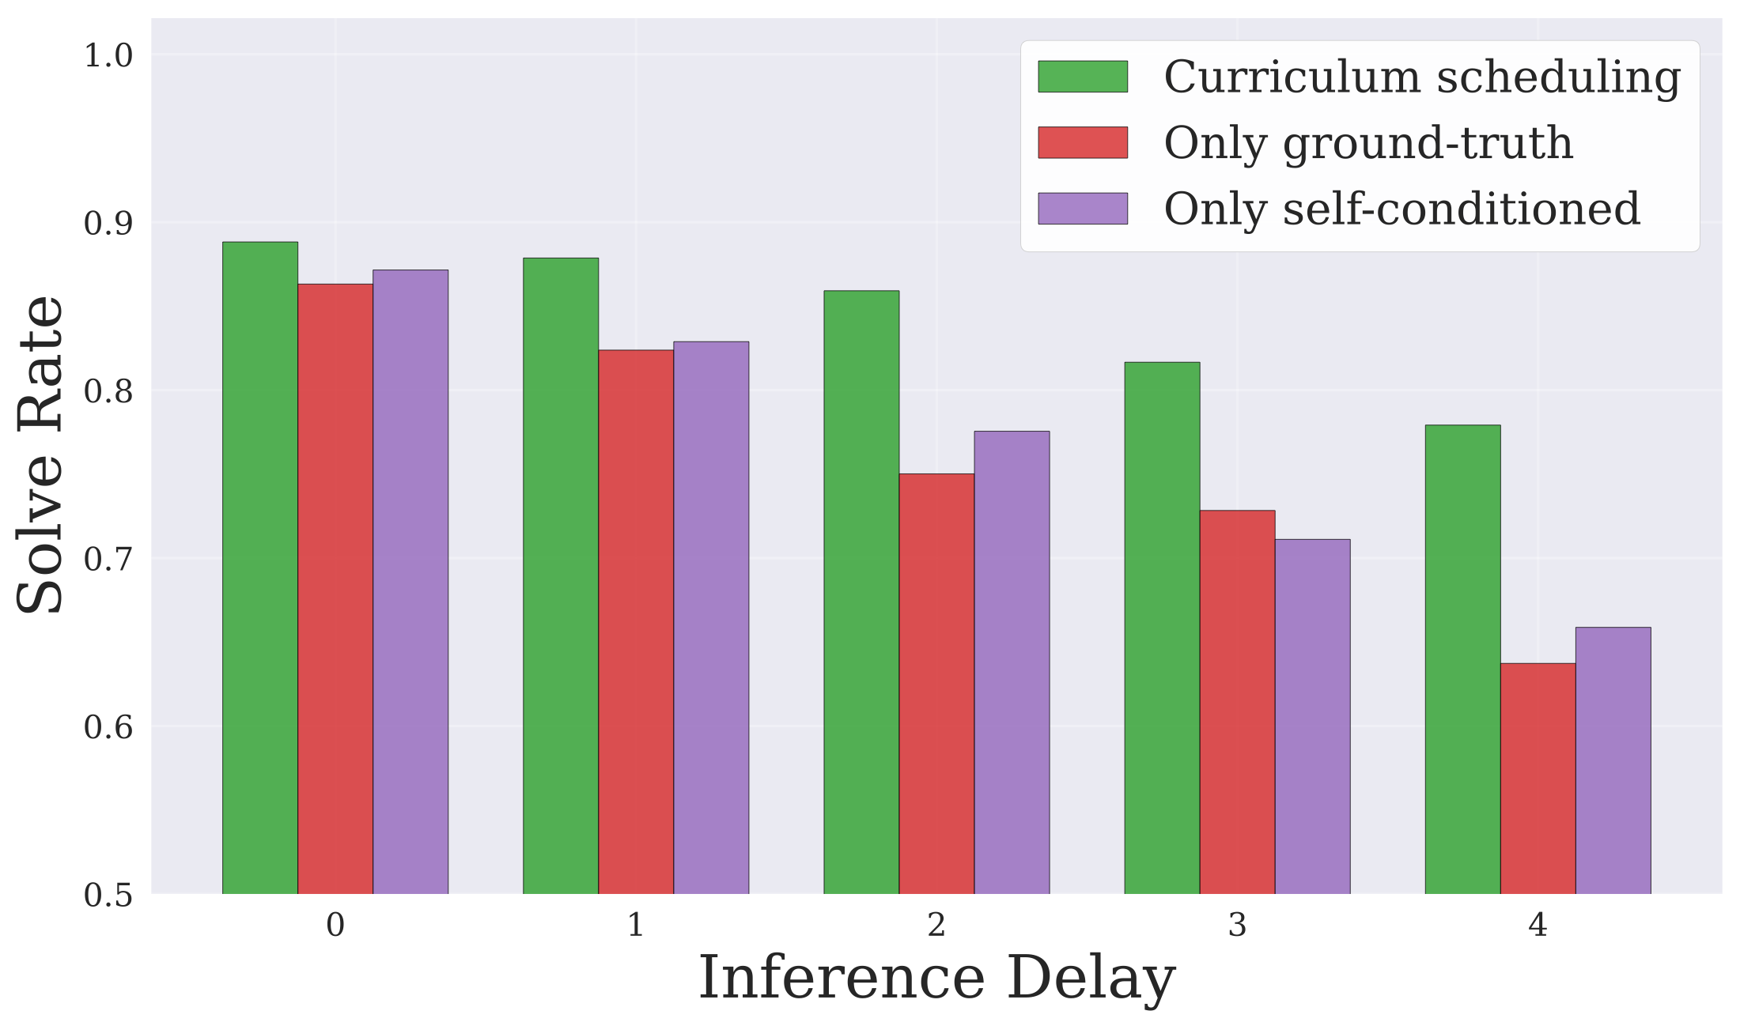
REMAC: Prefix-Preserved Sampling
30/40
Self-conditioned curriculum
Training gradually shifts from ground-truth chunks to the model's own predicted chunks.
Prefix-preserved sampling
At inference, overlapping actions from the current chunk are preserved while the remaining segment is synthesized.
Fig. 23. REMAC delay-injection and sampling pipeline.
Fig. 24. REMAC schedule ablation showing curriculum stability under delays.
香港中文大学（深圳） 数据科学学院
CUHK-SZ School of Data Science
Notes:
这一页解释为什么训练时要模拟测试时的错位，否则 policy 只见过干净 chunk。

Slide 31
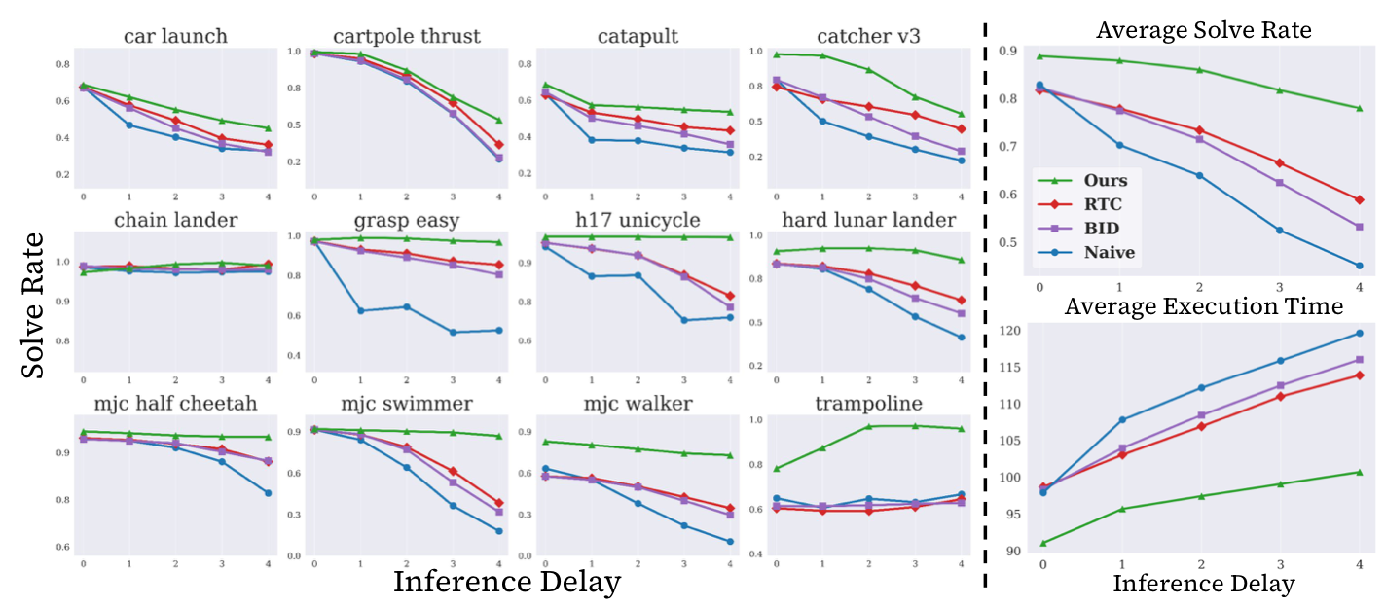
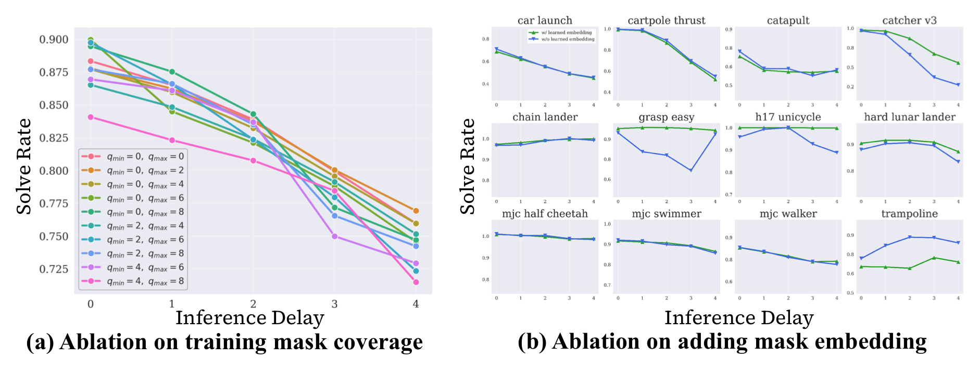
REMAC Evidence: Simulation
31/40
Method
d=0
d=2
d=4
Naive
0.828
0.639
0.451
+ Prefix mask
0.863
0.752
0.636
+ Curriculum
0.848
0.805
0.710
REMAC
0.888
0.859
0.779
Fig. 25. REMAC Kinetix performance under inference delays.
Fig. 26. REMAC ablations on mask coverage and mask embedding.
香港中文大学（深圳） 数据科学学院
CUHK-SZ School of Data Science
Notes:
这里挑 d=0,2,4 三列即可。让听众看到随着 delay 增大，REMAC 保持得最好。

Slide 32
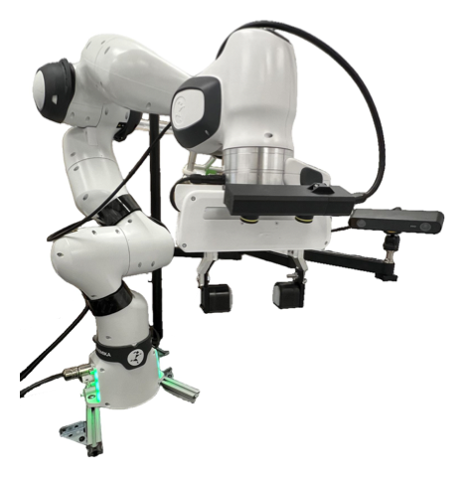
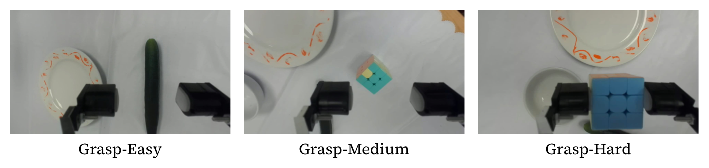
REMAC Evidence: Real Robot
32/40
Fig. 28. REMAC real-robot setup with Franka arm for grasp-and-place tasks.
Method
Easy
Medium
Hard
Sync
0.805
0.718
0.670
Naive
0.825
0.825
0.460
RTC
0.823
0.848
0.753
REMAC
0.903
0.943
0.812
Fig. 27. REMAC real-world robot.
香港中文大学（深圳） 数据科学学院
CUHK-SZ School of Data Science
Notes:
强调真实系统端到端 delay 约 122-140ms，对 15Hz 控制相当于 d=2 或 3。

Slide 33
ACT vs. RTC vs. REMAC
33/40
Paper
What it schedules
When it intervenes
Main contribution
ACT
future action sequence
policy output
turn BC into action chunks
RTC
queue + inference job
test-time runtime
freeze prefix; inpaint suffix
REMAC
prefix + correction
training/adaptation
robust to async mismatch
SmolVLA
client/server queues
deployment stack
decouple predict / execute
ACT
RTC
REMAC
➜
➜
chunked actions
async chunks
robust async
香港中文大学（深圳） 数据科学学院
CUHK-SZ School of Data Science
Notes:
这是整场最重要的总结页之一，可以停留久一点。

Slide 34
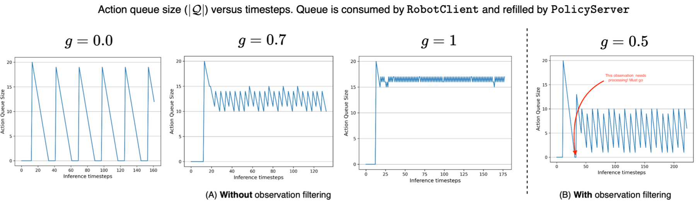
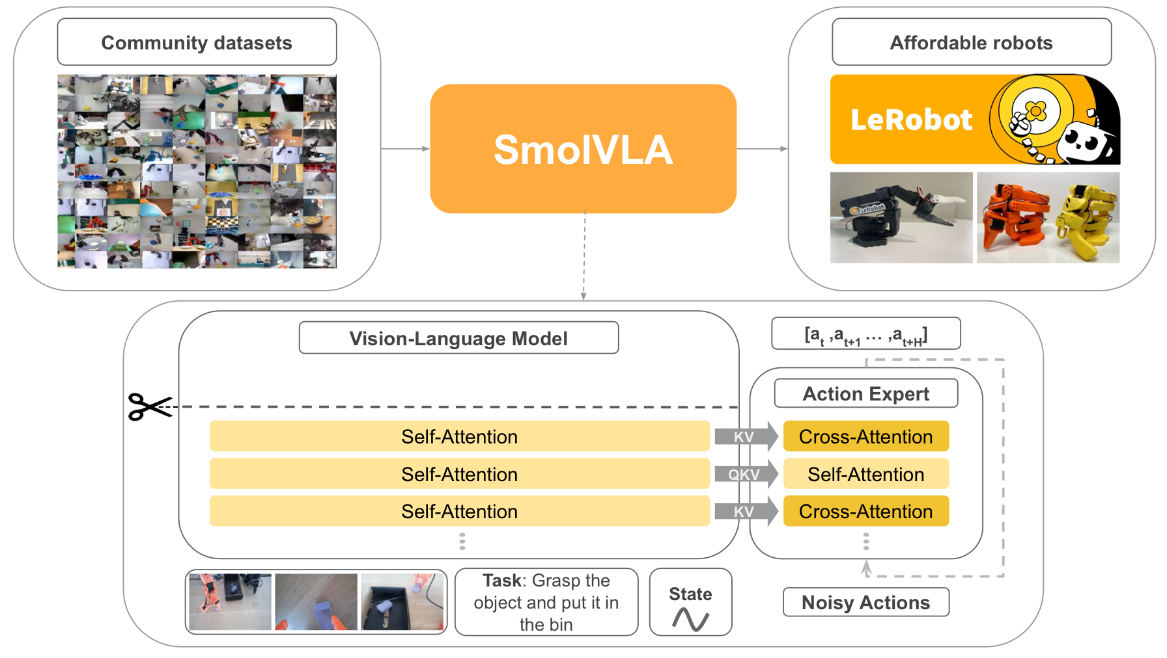
34/40
PART 5
System View
Fig. 30. SmolVLA asynchronous inference stack overview.
From paper algorithms to deployable asynchronous inference stacks.
Fig. 29. Asynchronous inference timeline for decoupled prediction and execution.
Fig. 31. System-view stack connecting datasets, policies, and deployment.
香港中文大学（深圳） 数据科学学院
CUHK-SZ School of Data Science
Notes:
From paper algorithms to deployable asynchronous inference stacks.

Slide 35
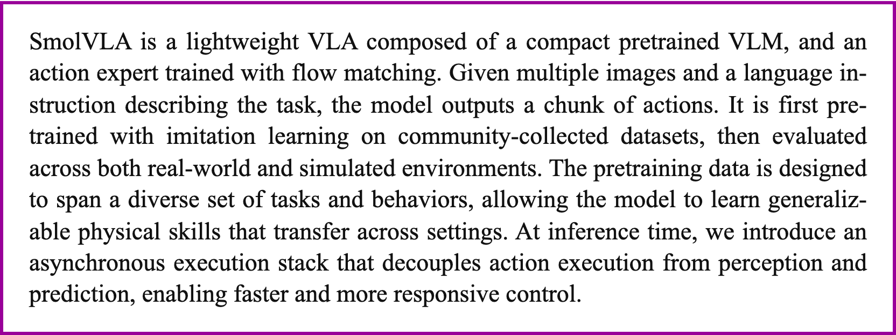
SmolVLA / LeRobot Stack
35/40
Fig. 33. SmolVLA action queue threshold controlling inference triggers.
Fig. 32. SmolVLA RobotClient and PolicyServer asynchronous inference timeline.
Mode
Time
# Cubes
Sync
13.75s avg
1.8 avg
Async
9.70s avg
3.8 avg
Why not a main paper?
SmolVLA is valuable as engineering context, but the async stack is not its only central contribution.
Fig. 34. SmolVLA excerpt showing decoupled prediction and execution.
香港中文大学（深圳） 数据科学学院
CUHK-SZ School of Data Science
Notes:
SmolVLA 作为 related work。它告诉我们实际部署长什么样，但主线仍是 ACT/RTC/REMAC。

Slide 36
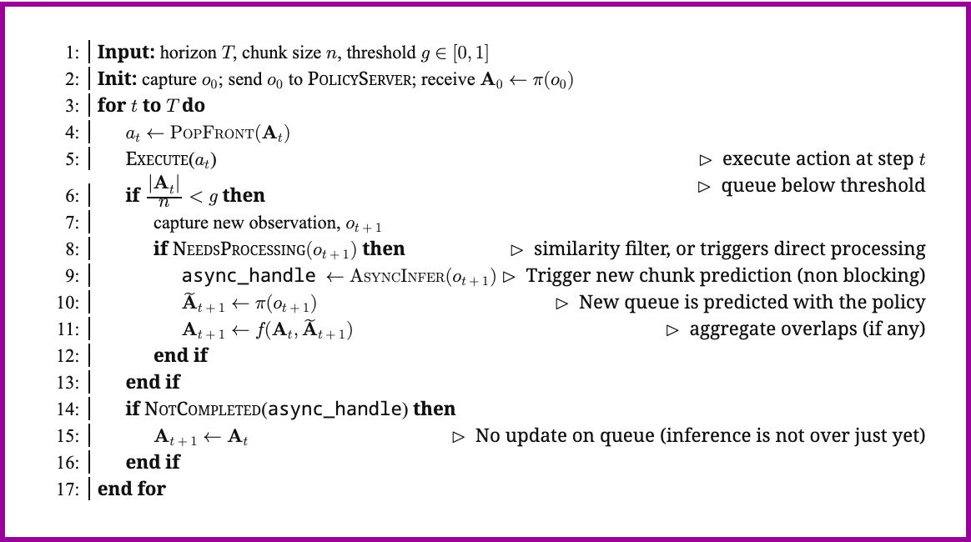
Rule 1: Keep Queue Non-Empty
36/40
Trigger early
Start inference before the current queue drains.
Estimate delay
Use recent latency measurements to pick a conservative delay d.
Avoid stale queues
Async is useful only if the returned chunk is still aligned with the robot state.
Runtime invariant
g
|Q|
d
The controller should never discover at tick t that the next action was not produced.
threshold
queue
delay
Fig. 35. SmolVLA asynchronous inference control-loop pseudocode.
香港中文大学（深圳） 数据科学学院
CUHK-SZ School of Data Science
Notes:
这一页从工程角度提炼第一条：动作不能断供。

Slide 37
Rule 2: Committed vs Mutable
37/40
on chunk_ready(A_new, d):
New chunk must respect time.
freeze committed prefix
past
fix
fix
soft
new
new
regenerate mutable suffix
swap queue atomically
Invariant
Never let a late inference job rewrite actions that are already physically committed.
Scheduling contract
Prefix actions are a hardware commitment; suffix actions are still a software decision.
System implication
The runtime API should expose prefix masks and delay estimates instead of hiding them inside the policy.
Fig. 36. RTC committed-prefix diagram illustrating mutable future suffix.
香港中文大学（深圳） 数据科学学院
CUHK-SZ School of Data Science
Notes:
第二条是 committed/mutable 分离。这个概念非常 OS。

Slide 38
Open Problems for OS Systems
38/40
Deadline miss policy
Safety envelope
If inference returns too late, should the robot hold, slow down, reuse old actions, or fall back to a small controller?
Committed actions should still respect collision, force, joint, and workspace constraints.
Backpressure
Multi-rate perception
If observations arrive faster than inference can consume them, which observations should be dropped?
Cameras, proprioception, language, and action queues update on different clocks.
Remote inference
Policy-aware runtime
Network jitter makes delay a distribution, not a constant.
Future runtimes may expose prefix masks, horizons, and delay estimates as first-class scheduling APIs.
香港中文大学（深圳） 数据科学学院
CUHK-SZ School of Data Science
Notes:
这里回扣 OS 课。不是要讲 ROS2，而是讲系统接口该如何支持 VLA 推理。

Slide 39
Final Takeaways
39/40
Final Takeaway
Paper
One-line role
Action chunking started as a policy representation trick.
ACT
defines action chunks
RTC
runtime scheduling
In modern VLA systems, it becomes the scheduling interface between slow inference and real-time robot execution.
REMAC
async-mismatch training
ACT
RTC
REMAC
slow producer: VLA inference
chunked
async
robust
fast consumer: robot controller
contract: prefix cannot change
time ->
Exec.
a₀
a₁
a₂
a₃
a₄
a₅
correction: suffix can update
Infer.
➜
infer next
infer later
香港中文大学（深圳） 数据科学学院
CUHK-SZ School of Data Science
Notes:
最后中文可以说：动作块最初是为了让模仿学习更稳定，但在现代 VLA 系统里，它已经变成了慢速大模型和实时机器人之间的调度接口。

Slide 40
Q & A
40/40
Thank You
Q & A
Scheduling Asynchronous Inference in Robotic Systems
ACT -> RTC -> REMAC
香港中文大学（深圳） 数据科学学院
CUHK-SZ School of Data Science
Notes:
Q&A 页保持简洁。

