Slide 1
CSC3050 – Computer Architecture HW/SW Co-Work
Prof. Yeh-Ching Chung
School of Science and Engineering
Chinese University of Hong Kong, Shenzhen

Slide 2
Compilation
High-level language program (in C)
swap (int v[], int k) {
int temp;
temp = v[k];
v[k] = v[k+1];
v[k+1] = temp;
}
Assembly language program (for MIPS)
swap: sll $2, $5, 2
add $2, $4, $2
lw $15, 0($2)
lw $16, 4($2)
sw $16, 0($2)
sw $15, 4($2)
jr $31
Machine (object) code (for MIPS)
000000 00000 00101 0001000010000000
000000 00100 00010 0001000000100000
one-to-many
C Compiler
one-to-one
Assembler

Slide 3
Code Input to Device
Object Code
000000 00000 00101 0001000010000000
000000 00100 00010 0001000000100000
100011 00010 01111 0000000000000000
100011 00010 10000 0000000000000100
101011 00010 10000 0000000000000000
101011 00010 01111 0000000000000100
000000 11111 00000 0000000000001000
Processor
Memory
Devices
Network
Control
Input
Datapath
Output

Slide 4
Code Stored in Memory
Processor
Memory
Devices
Network
000000 00000 00101 0001000010000000
000000 00100 00010 0001000000100000
100011 00010 01111 0000000000000000
100011 00010 10000 0000000000000100
101011 00010 10000 0000000000000000
101011 00010 01111 0000000000000100
000000 11111 00000 0000000000001000
Control
Input
Datapath
Output

Slide 5
Code Fetch from Memory
Processor
Memory
Devices
Network
Control
000000 00000 00101 0001000010000000
000000 00100 00010 0001000000100000
100011 00010 01111 0000000000000000
100011 00010 10000 0000000000000100
101011 00010 10000 0000000000000000
101011 00010 01111 0000000000000100
000000 11111 00000 0000000000001000
Input
Datapath
Output

Slide 6
Decoding Code
Processor
Memory
Devices
Network
Control
000000 00100 00010 0001000000100000
Input
Datapath
Output

Slide 7
Executing Code
Processor
Memory
Devices
Network
Control
000000 00100 00010 0001000000100000
Input
Datapath
Add Reg #4 and Reg #2, put result in Reg #2
Output

Slide 8
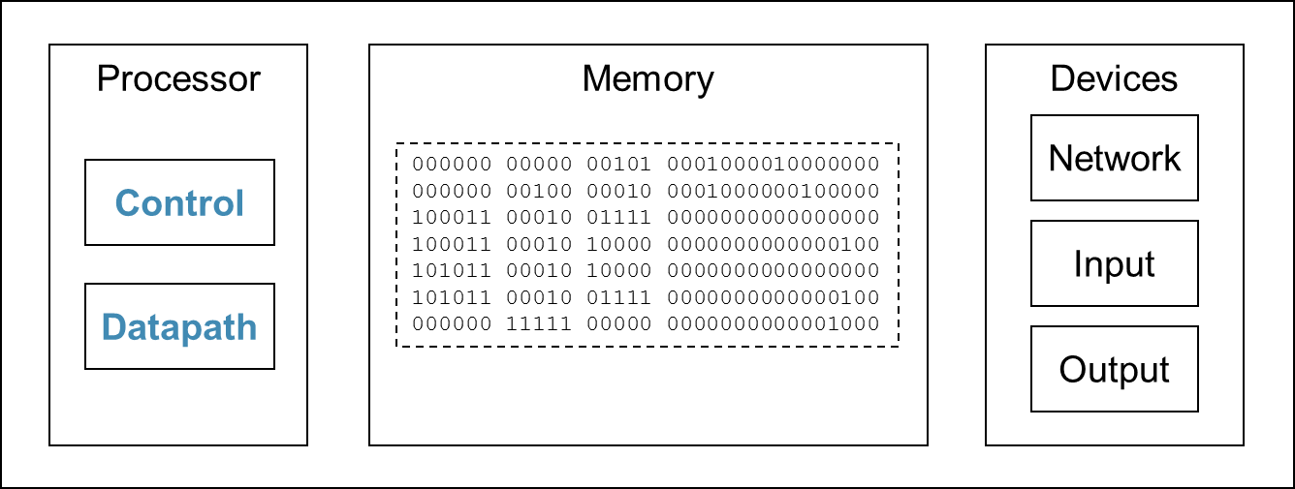
The Cycle
Fetch
Execute
Decode

Slide 9
Data Output to Device
Processor
Memory
Devices
Network
Control
Input
Datapath
Output
00000100010100000000000000000000
00000000010011110000000000000100
00000011111000000000000000001000

