Slide 1
CSC3050 – Computer Architecture
Prof. Yeh-Ching Chung
School of Science and Engineering
Chinese University of Hong Kong, Shenzhen

Slide 2
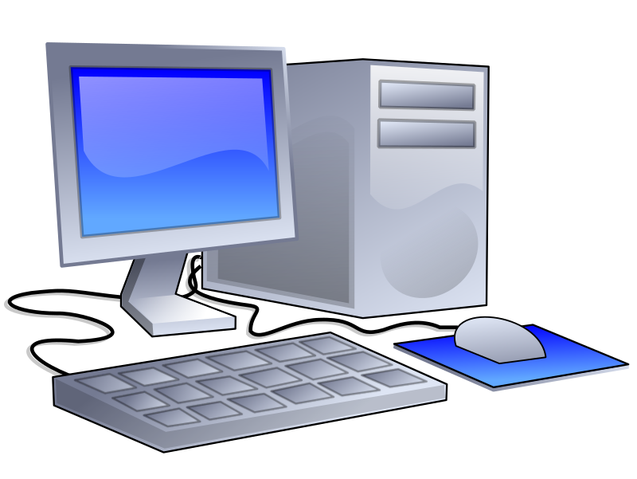
Computer
Desktop computers
Designed to deliver good performance to a single user at a low cost.
Usually executing third-party software.
Usually incorporating a graphics display, a keyboard and a mouse.

Slide 3
Other Classes of Computers
Servers
Used to run larger program for multiple users simultaneously, typically accessed only via a network, with a greater emphasis on dependability and (often) security.
Supercomputers
A high performance, high-cost class of servers with a large number of processors, huge memory and storage that are used for high-end scientific and engineering applications.
Embedded computers (microprocessors)
A computer within another system with a dedicated function or application.

Slide 4

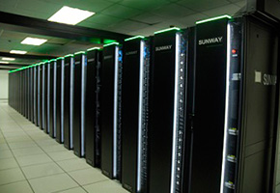
Supercomputers
Sunway TaihuLight
Fastest supercomputer in the world (as of June 2017)
Over 10 million CPU cores
Power: 15 MW
Speed: 93 PFLOPS
http://www.nsccwx.cn/wxcyw/

Slide 5
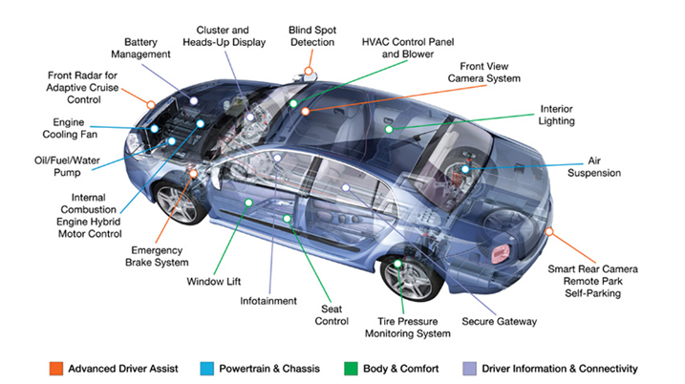
Automotive Embedded Systems
https://dcvizcayno.wordpress.com/2015/08/28/the-future-of-technology-privacy-security-and-risks-part-3-of-5/

Slide 6
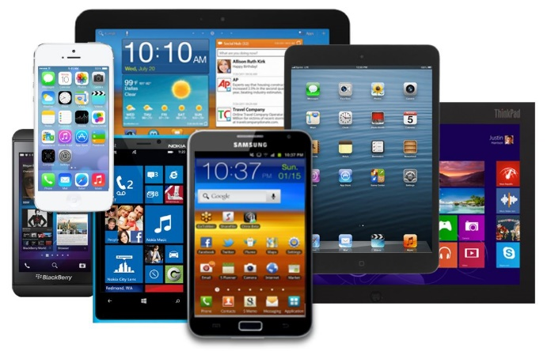

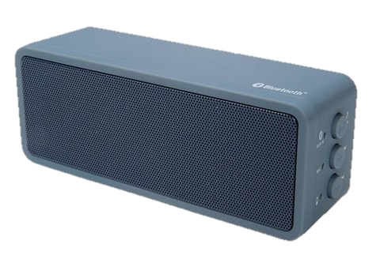
Post-PC Era
Personal Mobile Devices
Battery-operated devices with wireless connectivity.
Warehouse-Scale Computers
Datacenter containing hundreds of thousands of servers providing software as a service (SaaS).

Slide 7
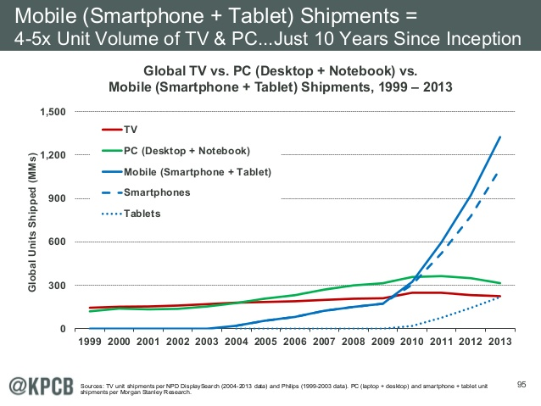
Embedded vs. Desktop

Slide 8
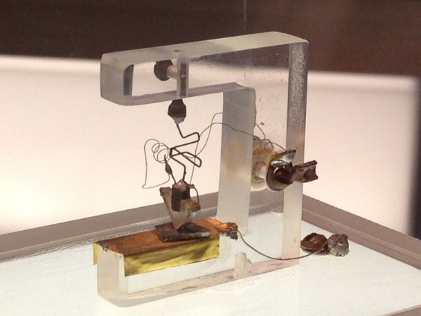
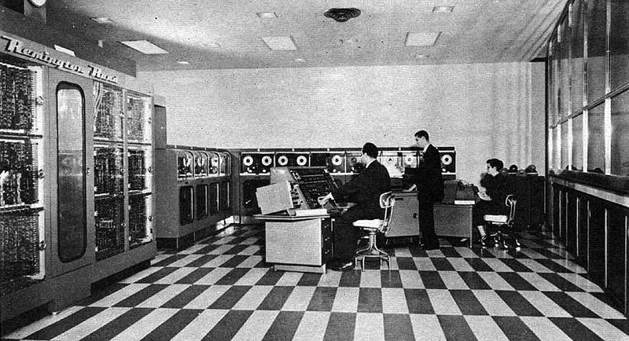
Evolution of Computer Hardware (1)
1st transistor invented by John Bardeen, Walter Brattain, and William Shockley at Bell Labs in 1947.
UNIVAC I (UNIVersal Automatic Computer I): 1st commercial computer sold in US in 1951.

Slide 9
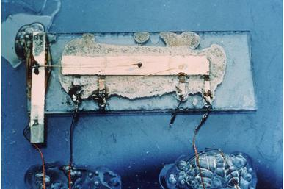
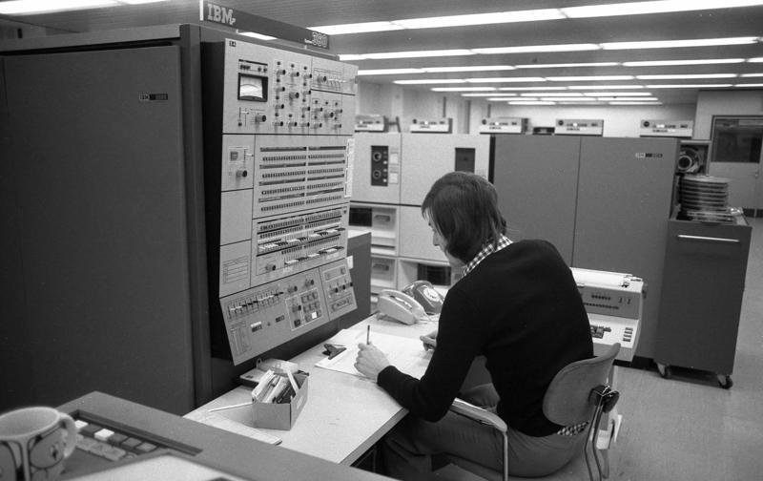
Evolution of Computer Hardware (2)
1st integrated circuit invented by Jack Kilby of Texas Instruments in 1958.
IBM System/360: 1st family of computers in 1964 with a range of performance but with the same instruction set.

Slide 10
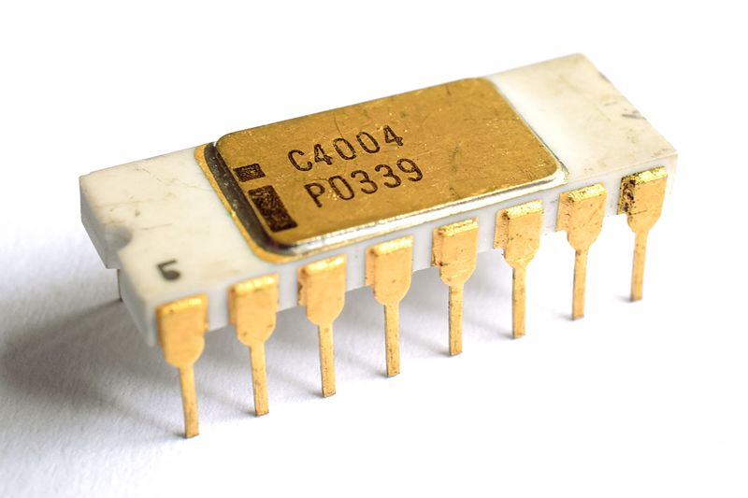
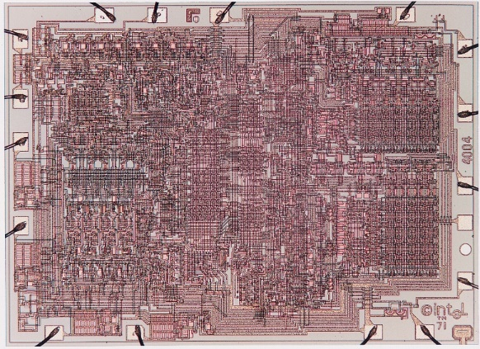
Evolution of Computer Hardware (3)
Intel 4004: 1st commercially available microprocessor by Intel in 1971.
https://en.wikipedia.org/wiki/Intel_4004

Slide 11
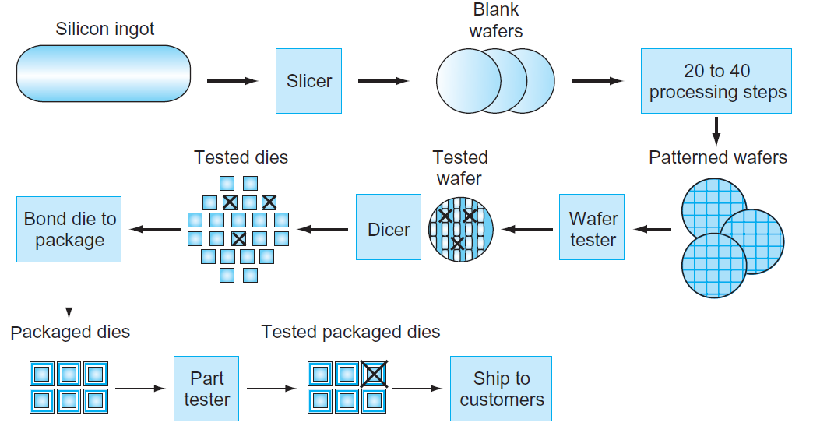
IC Manufacturing Process
Yield: proportion of working dies per wafer.

Slide 12
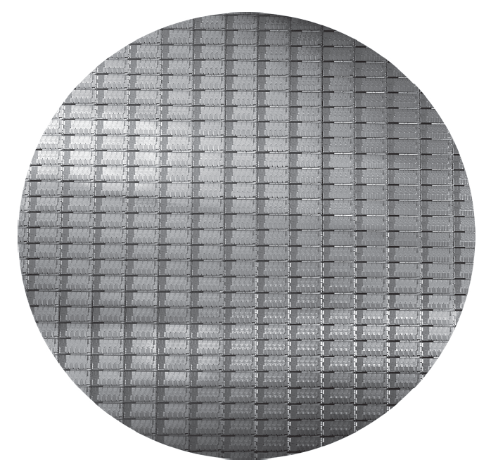
Intel Core i7 Wafer
300-mm wafer, 280 dies at 100% yield (32-nm technology).

Slide 13
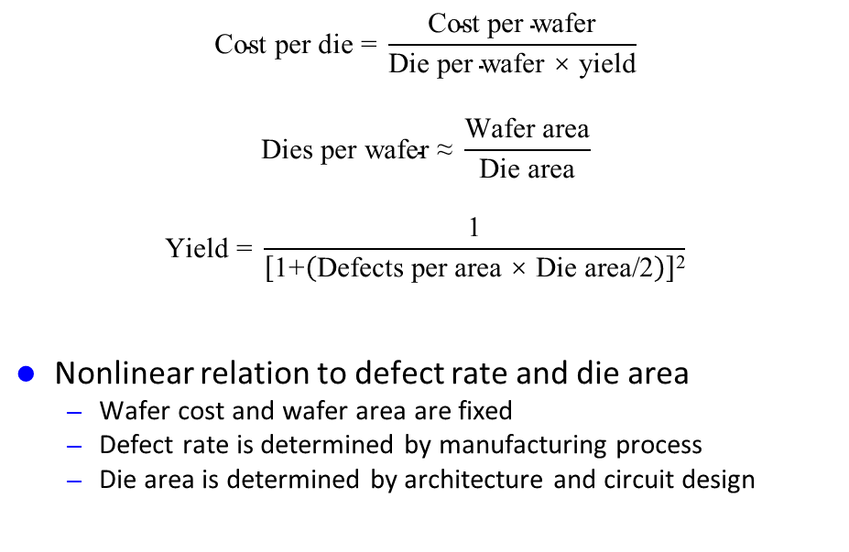
Integrated Circuit Cost
$$\text{Cost} \text{per} \text{die}\text{ = }\frac{\text{Cost} \text{per} \text{wafer}}{\text{Die} \text{per} \text{wafer}\text{ × }\text{yield}}$$
$$\text{Dies} \text{per} \text{wafer}\text{ ≈ }\frac{\text{Wafer} \text{area}}{\text{Die} \text{area}}$$
$$\text{Yield}\text{ = }\frac{\text{1}}{\left[\text{1+}\left(\text{Defects} \text{per} \text{area}\text{ × }\text{Die} \text{area}\text{/2}\right)\right]\text{2}}$$
Nonlinear relation to defect rate and die area
Wafer cost and wafer area are fixed
Defect rate is determined by manufacturing process
Die area is determined by architecture and circuit design

Slide 14
Impacts of Advancing Technology
Processor
Logic capacity: increases about 30% per year
Performance: 2× every 1.5 years
Memory
DRAM capacity: 4× every 3 years, about 60% per year
Memory speed: 1.5× every 10 years
Cost per bit: decreases about 25% per year
Storage
Capacity: increases about 60% per year

Slide 15
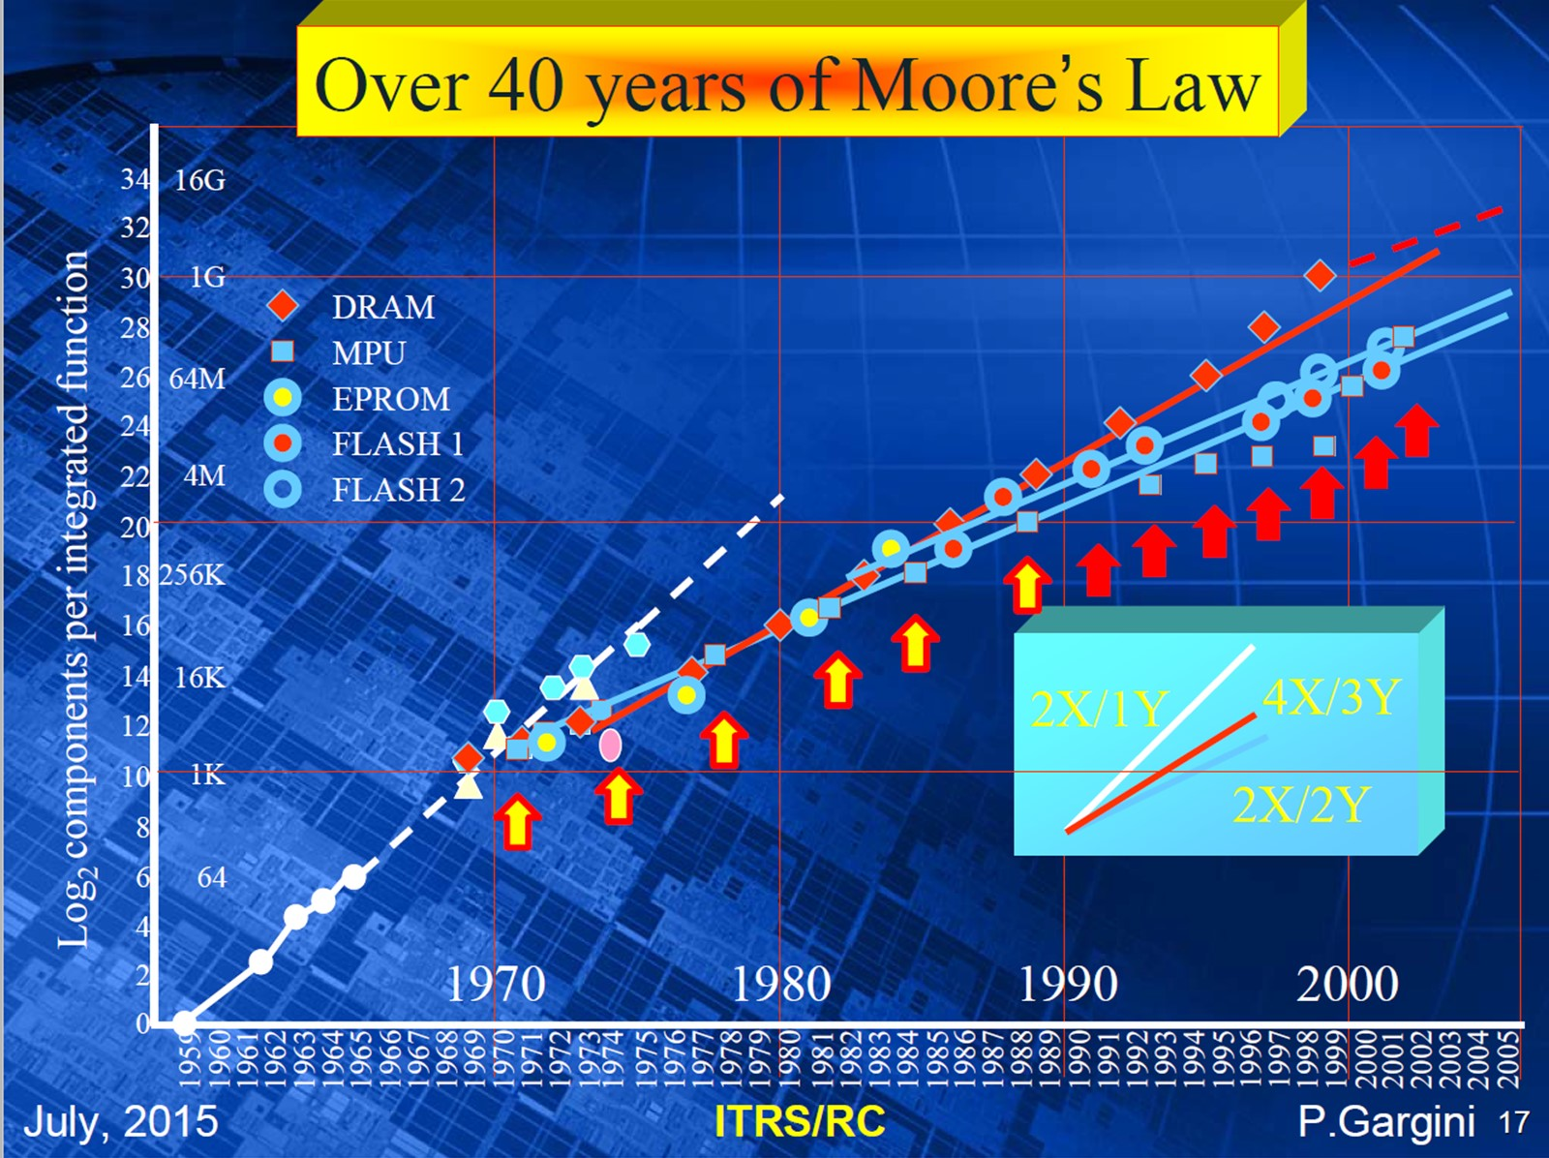
Moore’s Law
http://www.itrs2.net/

Slide 16
International Technology Roadmap for Semiconductors
Year | 2013 | 2015 | 2017 | 2019 | 2021 | 2023 | 2025 | 2028
Logic half pitch (nm) | 40 | 32 | 25 | 20 | 16 | 13 | 10 | 7
Gate Density (gates/mm²) | 4M | 6.4M | 10M | 16M | 25.5M | 40M | 64M | 128M
Double the circuitry in the same space
or
Same circuitry in half the space
equals
Same capability, half the die size

Slide 17
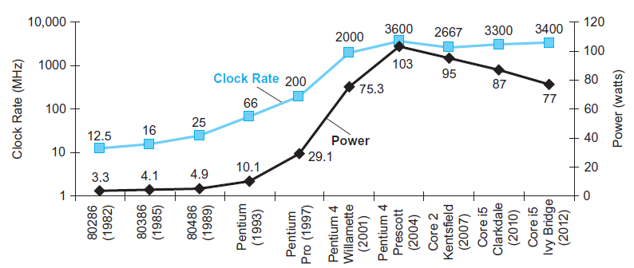
Clock Rate and Power
Pentium 4 had a dramatic jump in clock rate and power.
Core 2 reverts to simpler pipeline, lower clock rates and multiple processors per chip.

Slide 18
Power Wall
P_{dynamic} = 0.5 × C_{L} × V_{dd}² × f_{switching}
Example:
For a simple processor, if capacitive load is reduced by 15%, voltage is reduced by 15%, frequency is reduced by 15%, how much power consumption can be reduced?

Slide 19
From Uniprocessors to Multiprocessors
Power limit forced a dramatic change in microprocessor design.
Since 2002, the response time improvement has slowed from 1.5× per year to 1.2× per year.
As of 2006, all computer companies are shipping microprocessors with multiple processors per chip (called “multicore microprocessors”).

Slide 20
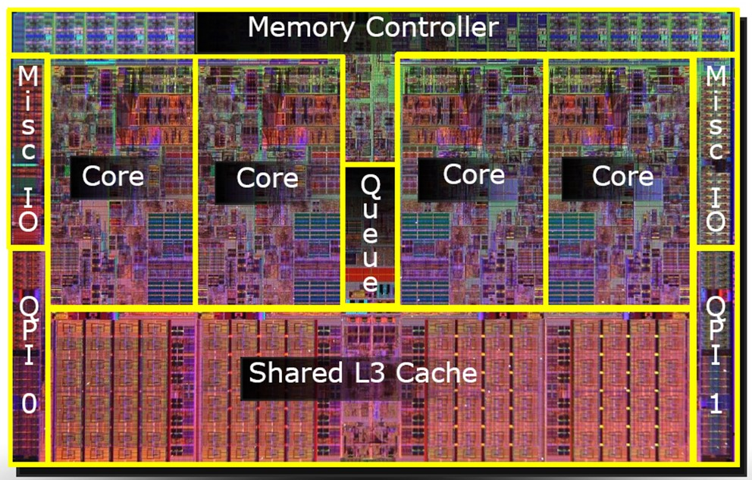
Intel Core i7
http://www.intel.com/

Slide 21
Major Components of a Computer

Slide 22
Computer Organization
Components
Processor (control, datapath)
Input (keyboard, mouse)
Output (display, printer)
Memory (cache, SRAM, disk drive, CD/DVD)
Network
Our main focus
The processor (control and datapath) and its interaction with memory systems
Implemented using hundreds of millions of transistors; impossible to understand by looking at each transistor

Slide 23
Machine Organization
Capabilities and performance characteristics of the principal functional units (e.g., registers, ALU, shifters, logic units).
Ways in which these components are interconnected
Logic and means by which such information flow is controlled
Instruction Set Architecture (ISA)
Register Transfer Level (RTL) description

Slide 24
Processor Organization (1)
Control needs to have circuitry to
Decide which is the next instruction and input it from memory
Decode the instruction
Issue signals that control the way information flows between datapath components
Control what operations the datapath’s functional units perform

Slide 25
Processor Organization (2)
Datapath needs to have circuitry to
Execute instructions – functional units (e.g., adder) and storage locations (e.g., register)
Interconnect the functional units so that the instructions can be executed as required
Load data from and store data to memory

Slide 26
System Software
Operating System
Supervising program that interfaces the user’s program with the hardware (e.g., Linux, iOS, Windows)
Handles basic input and output operations
Allocates storage and memory
Provides for protected sharing among multiple applications
Compiler
Translate high-level language programs (e.g., C, Java) into instructions that the hardware can execute
Application Software
System Software
Hardware

Slide 27
High-Level Languages
Allow the programmer to think in a more natural language and for their intended use (Fortran for scientific computation, Cobol for business programming, Lisp for symbol manipulation, Java for web programming, etc.).
Improve programmer productivity – more understandable code that is easier to debug and validate.
Improve program maintainability.
Allow programs to be independent of the computer on which they are developed (compilers and assemblers can translate high-level language programs to the binary instructions of any machine).
Emergence of optimizing compilers that produce very efficient assembly code optimized for the target machine.
As a result, very little programming is done today at the assembly level.

Slide 28
Below the Program
High-level language program (in C)
swap (int v[], int k) {
int temp;
temp = v[k];
v[k] = v[k+1];
v[k+1] = temp;
}
Assembly language program (for MIPS)
swap: sll $2, $5, 2
add $2, $4, $2
lw $15, 0($2)
lw $16, 4($2)
sw $16, 0($2)
sw $15, 4($2)
jr $31
Machine (object) code (for MIPS)
000000 00000 00101 0001000010000000
000000 00100 00010 0001000000100000
one-to-many
C Compiler
one-to-one
Assembler

Slide 29
Code Input to Device
Object Code
000000 00000 00101 0001000010000000
000000 00100 00010 0001000000100000
100011 00010 01111 0000000000000000
100011 00010 10000 0000000000000100
101011 00010 10000 0000000000000000
101011 00010 01111 0000000000000100
000000 11111 00000 0000000000001000
Processor
Memory
Devices
Network
Control
Input
Datapath
Output

Slide 30
Code Stored in Memory
Processor
Memory
Devices
Network
000000 00000 00101 0001000010000000
000000 00100 00010 0001000000100000
100011 00010 01111 0000000000000000
100011 00010 10000 0000000000000100
101011 00010 10000 0000000000000000
101011 00010 01111 0000000000000100
000000 11111 00000 0000000000001000
Control
Input
Datapath
Output

Slide 31
Code Fetch from Memory
Processor
Memory
Devices
Network
Control
000000 00000 00101 0001000010000000
000000 00100 00010 0001000000100000
100011 00010 01111 0000000000000000
100011 00010 10000 0000000000000100
101011 00010 10000 0000000000000000
101011 00010 01111 0000000000000100
000000 11111 00000 0000000000001000
Input
Datapath
Output

Slide 32
Decoding Code
Processor
Memory
Devices
Network
Control
000000 00100 00010 0001000000100000
Input
Datapath
Output

Slide 33
Executing Code
Processor
Memory
Devices
Network
Control
000000 00100 00010 0001000000100000
Input
Datapath
Add Reg #4 and Reg #2, put result in Reg #2
Output
Control decodes the instruction to determine what to execute
Datapath executes the instruction as directed by control

Slide 34
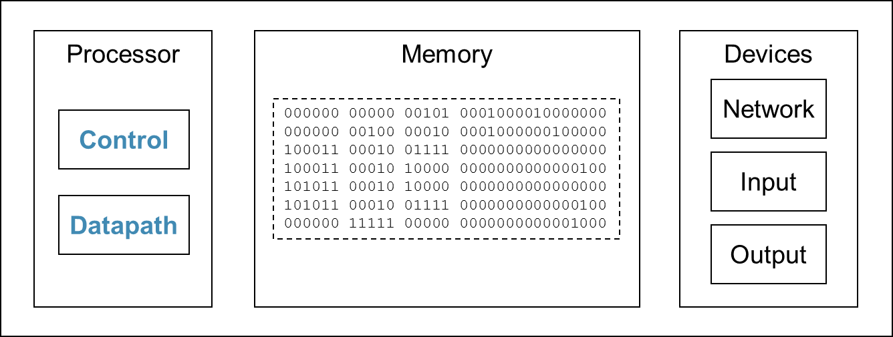
The Cycle
Fetch
Execute
Decode
Processor fetches the next instruction from memory
How does it know which location in memory to fetch from next?

Slide 35
Data Output to Device
Processor
Memory
Devices
Network
Control
Input
Datapath
Output
00000100010100000000000000000000
00000000010011110000000000000100
00000011111000000000000000001000

Slide 36
Instruction Set Architecture (ISA)
ISA, or simply architecture – the abstract interface between the hardware and the lowest level software that includes all the information necessary to write a machine language program, including instructions, registers, memory access, I/O, etc.
Enables implementations of varying cost and performance to run identical software.
The combination of the basic instruction set (the ISA) and the operating system interface is called the Application Binary Interface (ABI).
The user portion of the instruction set plus the operating system interfaces used by application programmers.
Define a standard for binary portability across computers.

Slide 37
MIPS ISA
Instruction Categories
Load/Store
Computational
Jump and Branch
Floating Point
Memory Management
Special
3 instruction formats: all 32-bit wide
Registers
R0–R31
PC
HI
LO
OP
rs
rt
rd
sa
funct
OP
rs
rt
immediate
OP
jump target

Slide 38
Computer Architecture
Applications
Operation System
Instruction Set Architecture
Compiler
Firmware
Memory System
Processor
I/O System
Network
Datapath & Control
Digital Design
Circuit Design
Coordination of many levels of abstraction
Under a rapidly changing set of forces
Design, measurement, and evaluation

