Slide 1
CSC3050 – Computer Architecture
Prof. Yeh-Ching Chung
School of Science and Engineering
Chinese University of Hong Kong, Shenzhen

Slide 2
Instruction-Level Parallelism (ILP)
Pipelining: executing multiple instructions in parallel
To increase ILP
Deeper pipeline
Less work per stage ➔ shorter clock cycle
Multiple issue
Replicate pipeline stages ➔ multiple pipelines
Start multiple instructions per clock cycle
CPI < 1, so use Instructions Per Cycle (IPC)
E.g., 4 GHz 4-way multiple-issue
16 BIPS, peak CPI = 0.25, peak IPC = 4
But dependencies reduce this in practice
Computer Architecture: A Quantitative Approach

Slide 3
Multiple Issue
Static multiple issue (at compile time)
Compiler groups instructions to be issued together
Packages them into “issue slots”
Compiler detects and avoids hazards
Dynamic multiple issue (during execution)
CPU examines instruction stream and chooses instructions to issue each cycle
Compiler can help by reordering instructions
CPU resolves hazards using advanced techniques at runtime

Slide 4
Speculation
“Guess” what to do with an instruction
Start operation as soon as possible
Check whether guess was right
If so, complete the operation
If not, roll-back and do the right thing
Common to static and dynamic multiple issue
Examples
Speculate on branch outcome, execute instructions after branch
Roll back if path taken is different
Speculate on store that precedes load does not refer to same address
Roll back if location is updated

Slide 5
Compiler or Hardware Speculation
Compiler can reorder instructions
e.g., move load before branch
Compiler inserts “fix-up” instructions to recover from incorrect guess
Hardware can look ahead for instructions to execute
Buffer results until it determines they are actually needed (written to the registers or memory)
Flush buffers on incorrect speculation

Slide 6
Speculation and Exceptions
What if exception occurs on a speculatively executed instruction?
Static speculation
Can add ISA support for deferring exceptions
Dynamic speculation
Can buffer exceptions until instruction completion (which may not occur)

Slide 7
Static Multiple Issue
Compiler groups instructions into “issue packets”
Group of instructions that can be issued on a single cycle
Determined by pipeline resources required
Think of an issue packet as a very long instruction
Specifies multiple concurrent operations ➔ Very Long Instruction Word (VLIW)

Slide 8
Scheduling Static Multiple Issue
Compiler must remove some/all hazards
Reorder instructions into issue packets
No dependencies with a packet
Possibly some dependencies between packets
Varies between ISAs; compiler must know!
Pad with nop if necessary

Slide 9
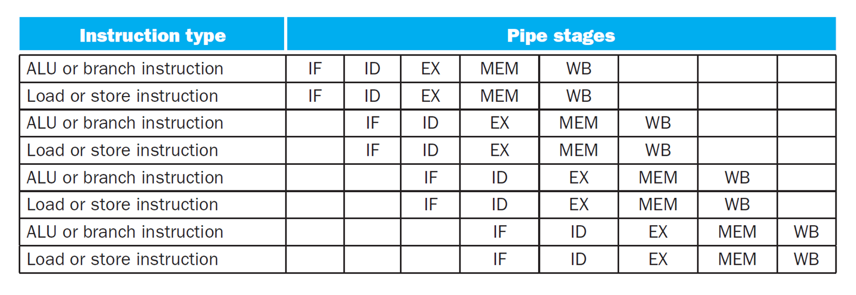
MIPS with Static Dual Issue
Two-issue packets
One ALU/branch instruction
One load/store instruction
64-bit aligned
ALU/branch, then load/store
Pad an unused instruction with nop

Slide 10
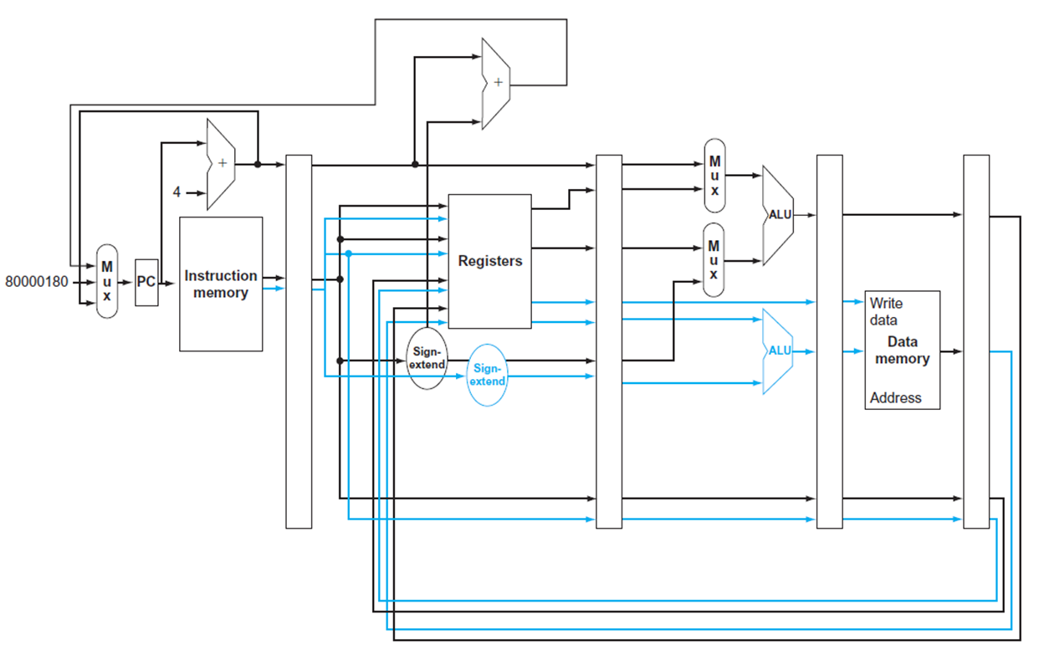
MIPS with Static Dual Issue

Slide 11
Hazards in the Dual-Issue MIPS
More instructions executing in parallel
EX data hazard
Forwarding avoided stalls with single-issue
Now cannot use ALU result in load/store in same packet
add $t0, $s0, $s1 load $s2, 0($t0)
Split into two packets, effectively a stall
Load-use hazard
Still one cycle use latency, but now two instructions
More aggressive scheduling required

Slide 12
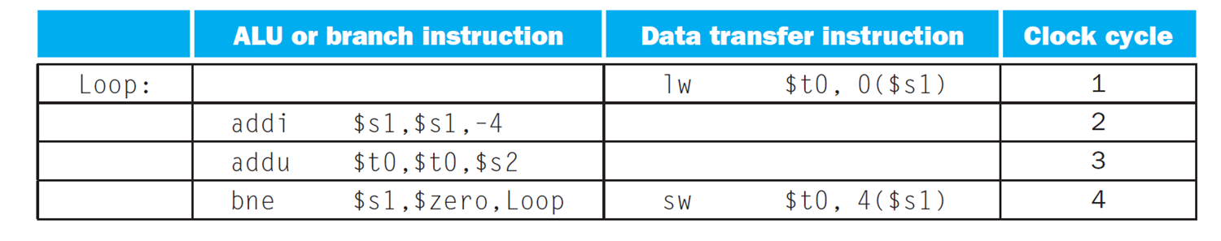
Scheduling Example
Schedule this for dual-issue MIPS
Loop: lw $t0, 0($s1) # $t0=array element addu $t0, $t0, $s2 # add scalar in $s2 sw $t0, 0($s1) # store result addi $s1, $s1,–4 # decrement pointer bne $s1, $zero, Loop # branch $s1!=0
IPC = 5/4 = 1.25 (c.f. peak IPC = 2)

Slide 13
Loop Unrolling
Replicate loop body to expose more parallelism
Reduces loop-control overhead
Use different registers per replication
Compiler applies “register renaming” to eliminate all data dependencies that are not true data dependencies

Slide 14
Unrolled Code Example
lp: lw $t0,0($s1) # $t0=array element lw $t1,-4($s1) # $t1=array element lw $t2,-8($s1) # $t2=array element lw $t3,-12($s1) # $t3=array element addu $t0,$t0,$s2 # add scalar in $s2 addu $t1,$t1,$s2 # add scalar in $s2 addu $t2,$t2,$s2 # add scalar in $s2 addu $t3,$t3,$s2 # add scalar in $s2 sw $t0,0($s1) # store result sw $t1,-4($s1) # store result sw $t2,-8($s1) # store result sw $t3,-12($s1) # store result addi $s1,$s1,-16 # decrement pointer bne $s1,$0,lp # branch if $s1 != 0

Slide 15
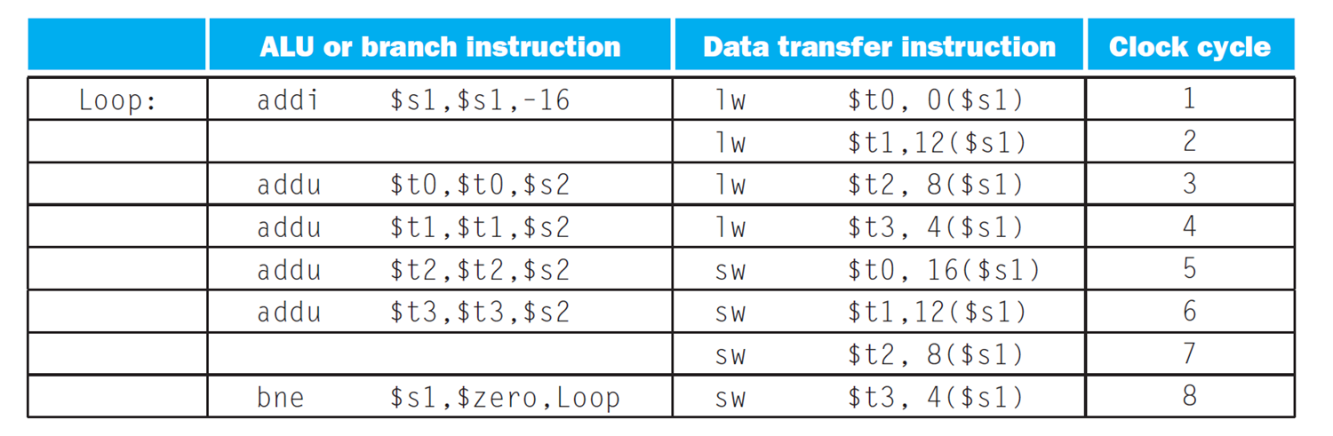
Loop Unrolling Example
IPC = 14/8 = 1.75
Closer to 2, but at cost of registers and code size

Slide 16
Dynamic Multiple Issue
“Superscalar” processors
CPU decides whether to issue 0, 1, 2, … each cycle
Avoiding structural and data hazards
Avoids the need for compiler scheduling
Though it may still help
Code semantics ensured by the CPU

Slide 17
Dynamic Pipeline Scheduling
Allow the CPU to execute instructions out of order to avoid stalls
But commit result to registers in order
Example
lw $t0, 20($s2) addu $t1, $t0, $t2 sub $s4, $s4, $t3 slti $t5, $s4, 20
Can start sub while addu is waiting for lw

Slide 18
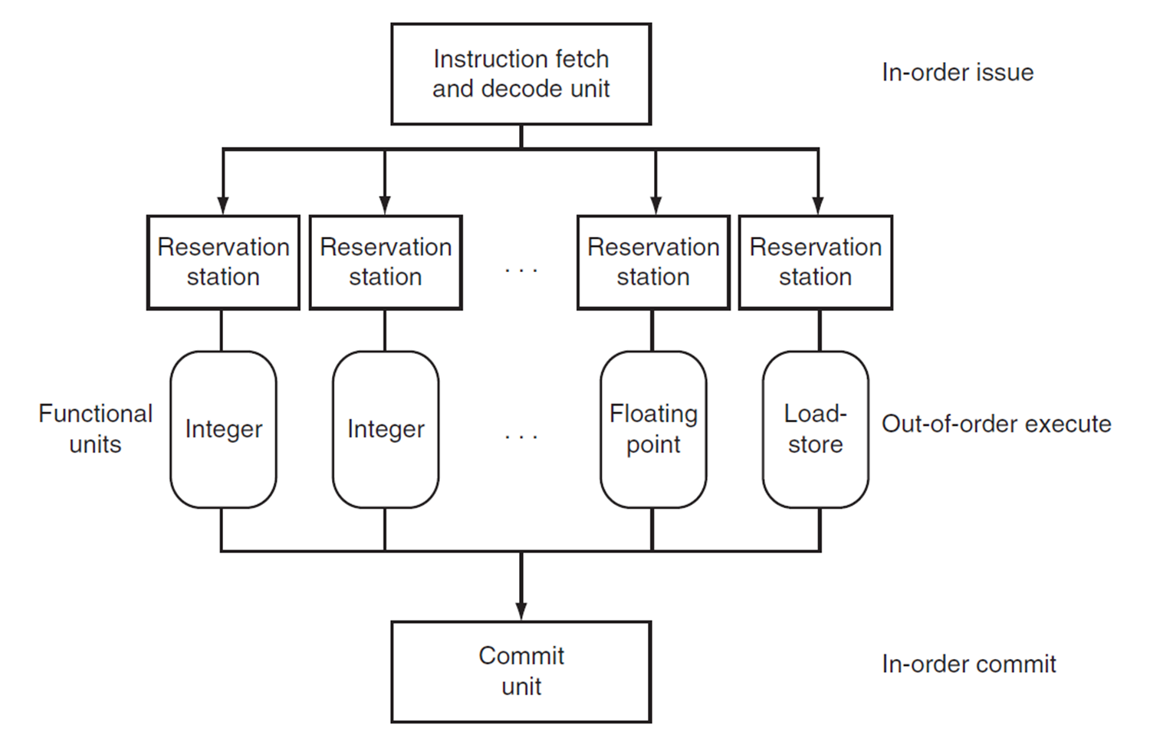
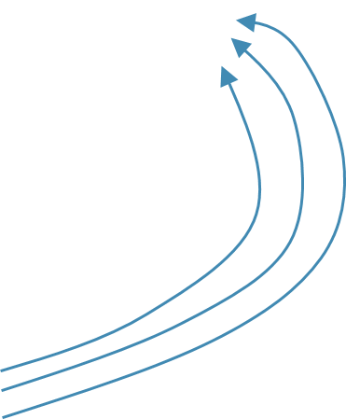
Dynamically Scheduled CPU
Preserves dependencies
Hold pending operands
Results also sent to any waiting reservation stations
Reorders buffer for register (memory) writes
Can supply operands for issued instructions

Slide 19
Why Do Dynamic Scheduling?
Why not just let the compiler schedule code?
Not all stalls are predicable
e.g., cache misses
Can’t always schedule around branches
Branch outcome is dynamically determined
Different implementations of an ISA have different latencies and hazards

Slide 20
Does Multiple Issue Work?
Yes, but not as much as we’d like:
Programs have real dependencies that limit ILP
Some dependencies are hard to eliminate
Some parallelism is hard to expose
Memory delays and limited bandwidth, hard to keep pipelines full
Speculation can help if done well

Slide 21
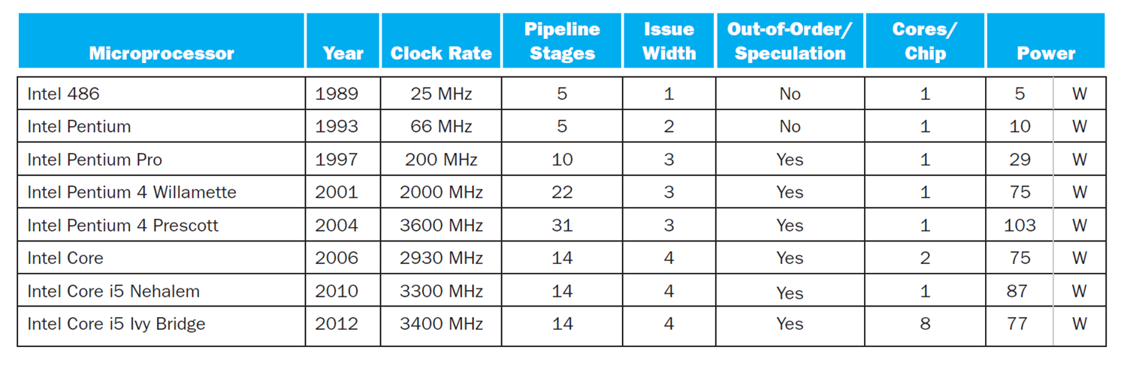
Power Efficiency
Complexity of dynamic scheduling and speculations requires power
Multiple simpler cores may be better

