Slide 1
CSC3050 – Computer Architecture
Prof. Yeh-Ching Chung
School of Science and Engineering
Chinese University of Hong Kong, Shenzhen

Slide 2
Introduction
Goal: connecting multiple computers to get higher performance
Multiprocessors
Scalability, availability, power efficiency
Job-level (process-level) parallelism
High throughput for independent jobs
Parallel processing program
Single program run on multiple processors
Multicore microprocessors
Chips with multiple processors (cores)

Slide 3
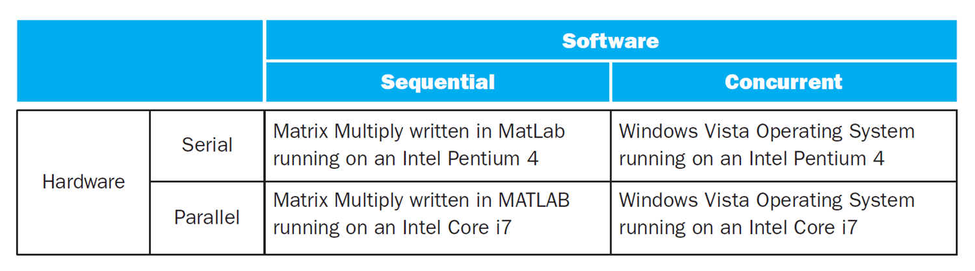
Hardware and Software
Sequential/concurrent software can run on serial/parallel hardware
Challenge: making effective use of parallel hardware

Slide 4
Parallel Programming
Parallel software is the problem
Need to get significant performance improvement
Otherwise, just use a faster uniprocessor, since it’s easier!
Difficulties
Partitioning, load balancing
Coordination, synchronization
Communications overhead
Sequential dependencies

Slide 5
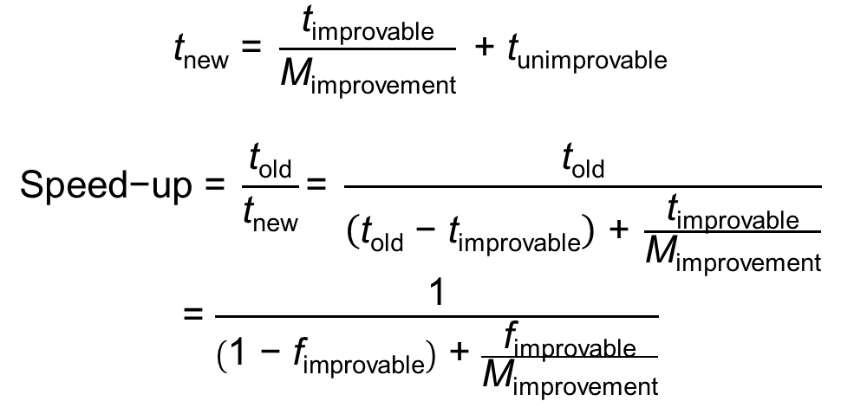
Amdahl’s Law (1)
$$\text{t}\text{new}\text{ = }\frac{\text{t}\text{improvable}}{\text{M}\text{improvement}} \text{+ }\text{t}\text{unimprovable}$$
$$\text{Speed}\text{−}\text{up}\text{ = }\frac{\text{t}\text{old}}{\text{t}\text{new}}\text{= }\frac{\text{t}\text{old}}{\left(\text{t}\text{old} \text{− }\text{t}\text{improvable}\right) \text{+} \frac{\text{t}\text{improvable}}{\text{M}\text{improvement}}}$$
= $\frac{\text{1}}{\left(\text{1 }\text{− }\text{f}\text{improvable}\right)\text{ + }\frac{\text{f}\text{improvable}}{\text{M}\text{improvement}}}$

Slide 6
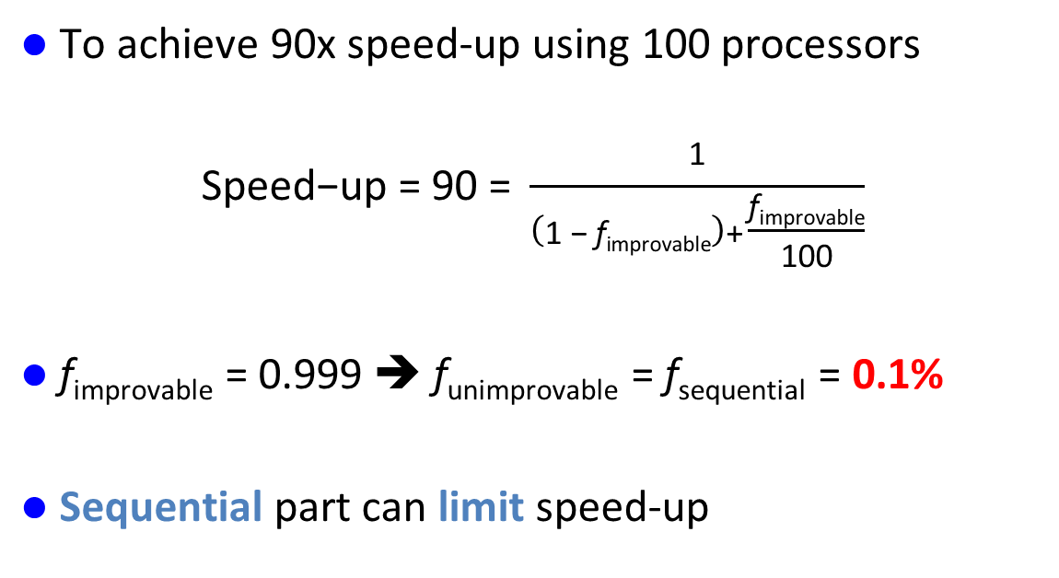
Amdahl’s Law (2)
To achieve 90x speed-up using 100 processors
$$\text{Speed}\text{−}\text{up}\text{ = 90 = }\frac{\text{1}}{\left(\text{1 }\text{− }\text{f}\text{improvable}\right)\text{+}\frac{\text{f}\text{improvable}}{\text{100}}}$$
f_{improvable} = 0.999 ➔ f_{unimprovable} = f_{sequential} = 0.1%
Sequential part can limit speed-up

Slide 7
Scaling Example
Calculate sum of 10 scalars, and sum of two 10×10 matrices
Single processor:
t_{total} = (10 + 100) × t_{add} = 110 t_{add}
10 processors:
t_{total} = 10 × t_{add} + (100/10) × t_{add} = 20 t_{add}
Speed-up = 110/20 = 5.5 (55% of ideal)
100 processors:
t_{total} = 10 × t_{add} + (100/100) × t_{add} = 11 t_{add}
Speed-up = 110/11 = 10 (10% of ideal)

Slide 8
Scaling Example (cont’d)
What if matrix size is 100 × 100?
Single processor:
t_{total} = (10 + 10000) × t_{add} = 10010 t_{add}
10 processors:
t_{total} = 10 × t_{add} + (10000/10) × t_{add} = 1010 t_{add}
Speed-up = 10010/1010 = 9.9 (99% of ideal)
100 processors:
t_{total} = 10 × t_{add} + (10000/100) × t_{add} = 110 t_{add}
Speed-up = 10010/110 = 91 (91% of ideal)

Slide 9
Strong vs Weak Scaling
Strong scaling
Speed-up achieved on a multiprocessor without increasing the size of the problem.
Weak scaling
Speedup achieved on a multiprocessor while increasing the size of the problem proportionally to the increase in the number of processors.

Slide 10
Multithreading
Difficult to continue to extract instruction-level parallelism (ILP) from a single sequential thread of control
Many workloads can make use of thread-level parallelism (TLP)
TLP from multiprogramming (run independent sequential jobs)
TLP from multithreaded applications (run one job faster using parallel threads)
Multithreading uses TLP to improve utilization of a single processor

Slide 11
Examples of Threads
A web browser
One thread displays images
One thread retrieves data from network
A word processor
One thread displays graphics
One thread reads keystrokes
One thread performs spell checking in the background
A web server
One thread accepts requests
When a request comes in, separate thread is created to service
Many threads to support thousands of client requests

Slide 12
Multithreading on a Chip
Find a way to “hide” true data dependency stalls, cache miss stalls, and branch stalls by finding instructions (from other process threads) that are independent of those stalling instructions
Hardware multithreading – increase the utilization of resources on a chip by allowing multiple processes (threads) to share the functional units of a single processor
Processor must duplicate the state hardware for each thread – a separate register file, PC, instruction buffer, and store buffer for each thread
The caches, Translation Look-aside Buffers (TLBs), Branch History Table (BHT), Branch Target Buffer (BTB), Register Update Unit (RUU) can be shared (although the miss rates may increase if they are not sized accordingly)
The memory can be shared through virtual memory mechanisms
Hardware must support efficient thread context switching

Slide 13
Types of Multithreading
Fine-grained multithreading
Switch threads after each cycle
Interleave instruction execution
If one thread stalls, others are executed
Coarse-grained multithreading
Only switch on long stall (e.g., L2-cache miss)
Simplifies hardware, but does not hide short stalls
Also has pipeline start-up costs

Slide 14
Simultaneous Multithreading (SMT)
In multiple-issue dynamically scheduled processor
Schedule instructions from multiple threads
Instructions from independent threads execute when function units are available
Within threads, dependencies handled by scheduling and register renaming
Example: Intel Pentium-4 HyperThreading
Two threads: duplicated registers, shared function units and caches

Slide 15
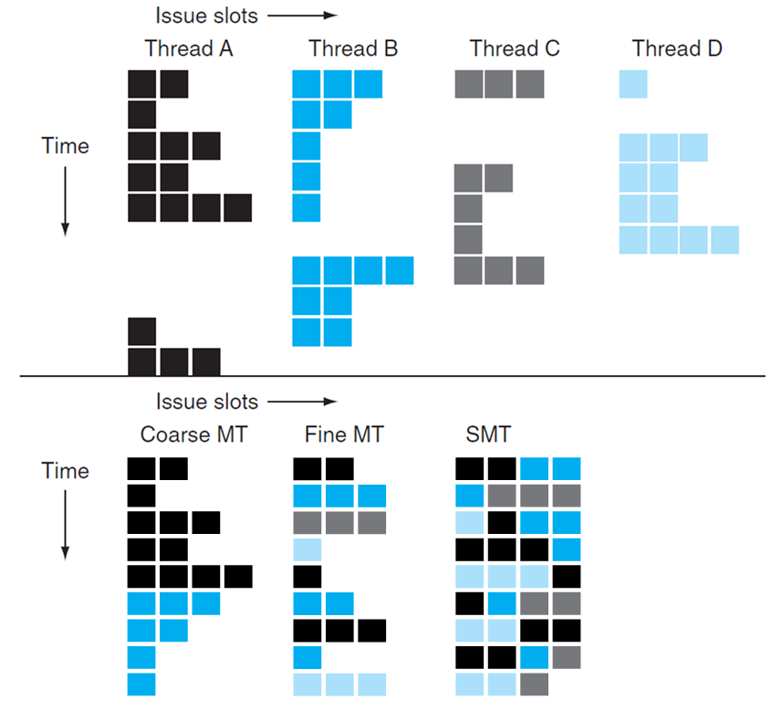
Threading on a 4-way SS Processor Example

Slide 16
The Big Picture: Where are We Now?
Multiprocessor – a computer system with at least two processors
Can deliver high throughput for independent jobs via job-level parallelism or process-level parallelism
And improve the run time of a single program that has been specially crafted to run on a multiprocessor – a parallel processing program

Slide 17
Multicores Now Universal
Power challenge has forced a change in microprocessor design
Since 2002 the rate of improvement in the response time of programs has slowed from a factor of 1.5 per year to less than a factor of 1.2 per year
Today’s microprocessors typically contain more than one core – Chip Multicore microProcessors (CMPs) – in a single IC
Product |  | AMD Barcelona | Intel Nehalem | IBM Power 6 | Sun Niagara 2
Cores per chip |  | 4 | 4 | 2 | 8
Clock rate |  | 2.5 GHz | ~2.5 GHz? | 4.7 GHz | 1.4 GHz
Power |  | 120 W | ~100 W? | ~100 W? | 94 W

Slide 18
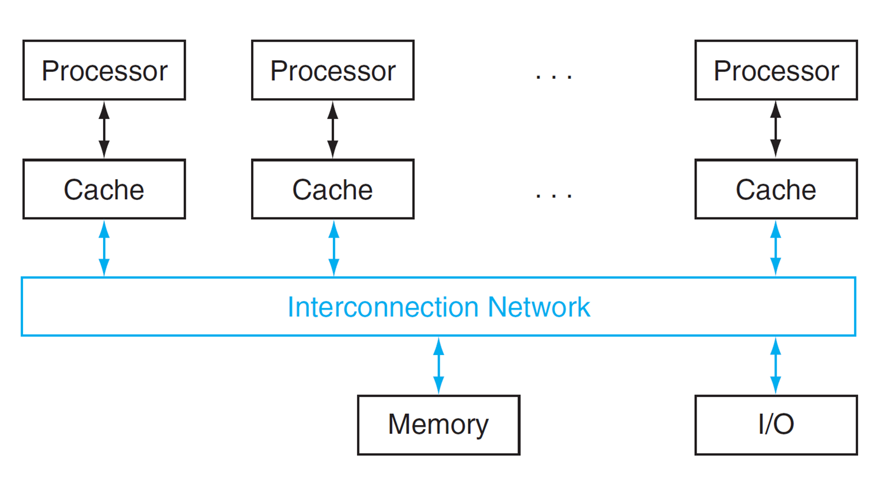
Shared Memory Multiprocessor
SMP: shared memory multiprocessor
Hardware provides single physical address space for all processors
Synchronize shared variables using locks
Memory access time
UMA (uniform) vs. NUMA (nonuniform)

Slide 19
Shared Address Space Example
Add 100,000 numbers in shared memory using 100 processors (P0–P99)
sum[Pn] = 0; for (i = 1000*Pn; i < 1000*(Pn+1); i += 1) sum[Pn] += A[i]; /*sum the assigned areas*/
Gather the partial sums (reduction)
half = 100; /*100 processors in multiprocessor*/ do synch(); /*wait for partial sum completion*/ if (half%2 != 0 && Pn == 0) sum[0] += sum[half–1]; half = half/2; if (Pn < half) sum[Pn] += sum[Pn+half]; while (half > 1);

Slide 20
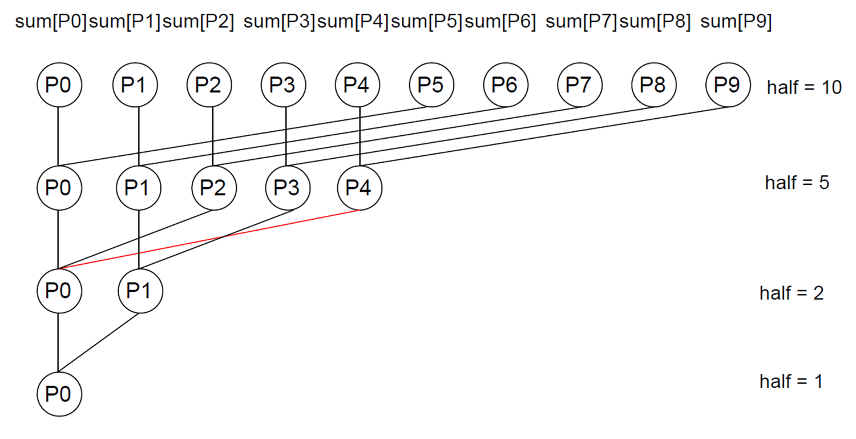
Reduction

Slide 21
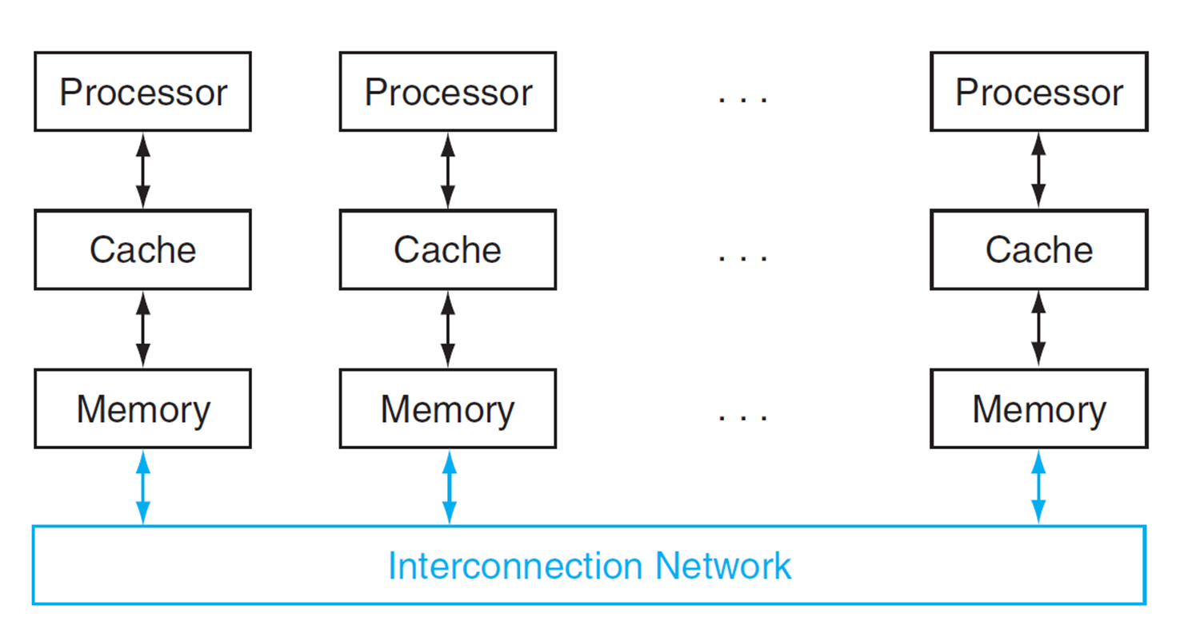
Message Passing
Each processor has private physical address space
Hardware sends/receives messages between processors

Slide 22
Sum Reduction (1)
Sum 100,000 on 100 processors
First distribute 100 numbers to each
The do partial sums
sum = 0; for (i = 0; i<1000; i = i + 1) sum += AN[i];
Reduction
Half the processors send, other half receive and add
The quarter send, quarter receive and add, …

Slide 23
Sum Reduction (2)
Given send() and receive() operations
limit = 100; half = 100;/* 100 processors */ do half = (half+1)/2; /* send vs. receive dividing line */ if (Pn >= half && Pn < limit) send(Pn - half, sum); if (Pn < (limit/2)) sum = sum + receive(); limit = half; /* upper limit of senders */ while (half > 1); /* exit with final sum */
Send/receive also provide synchronization
Assumes send/receive take similar time to addition (which is unrealistic)

Slide 24
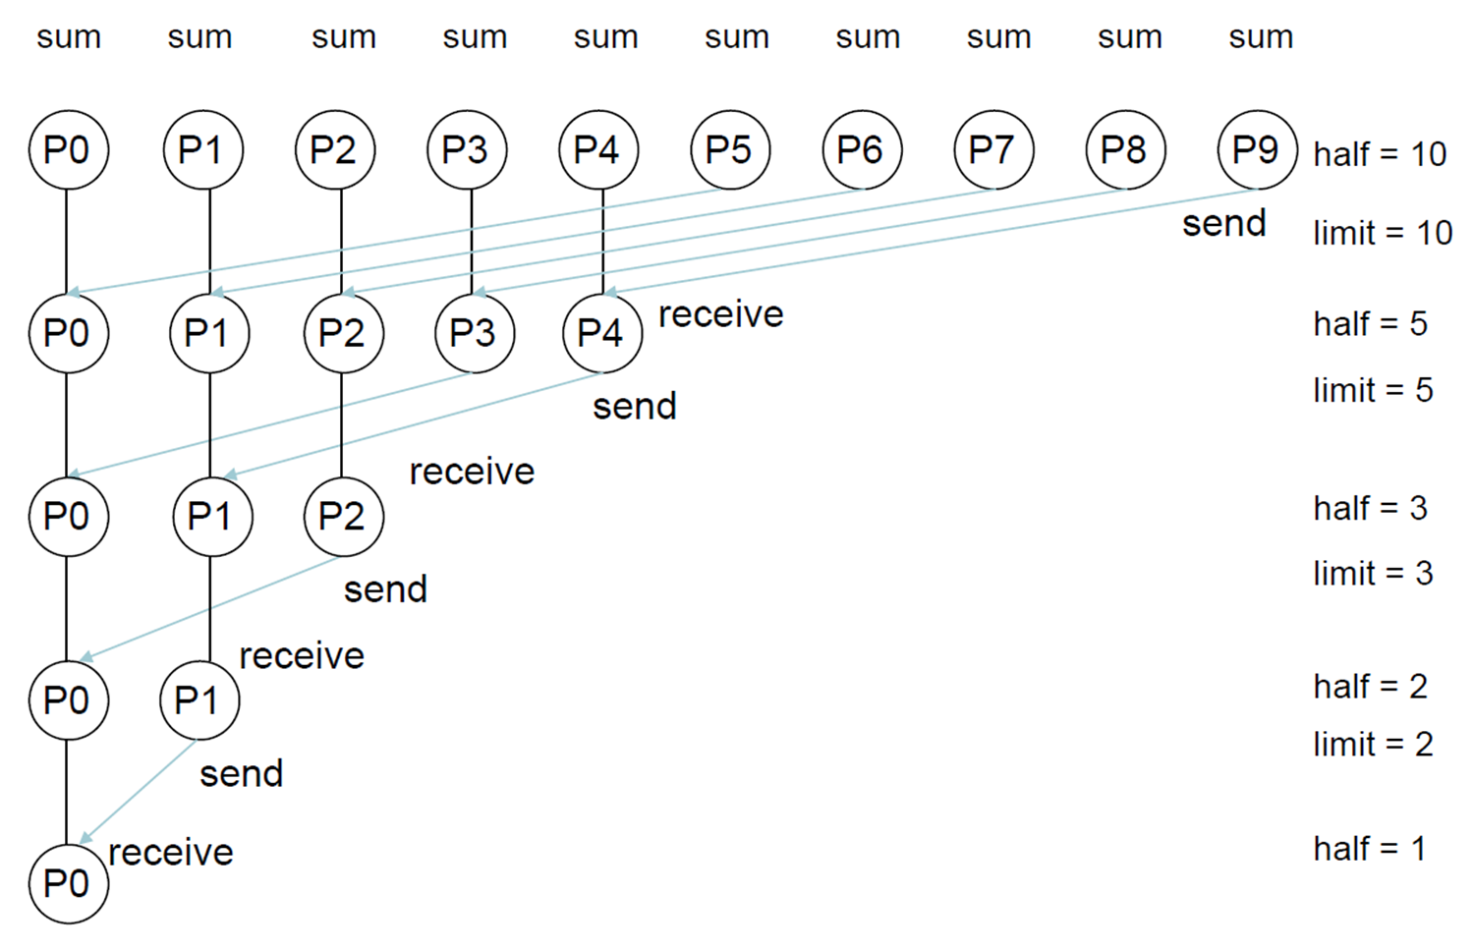
Message Passing Multiprocessors

Slide 25
Pros and Cons of Message Passing
Message sending and receiving is much slower than addition
But message passing multiprocessors are much easier for hardware designers to design
Don’t have to worry about cache coherency for example
The advantage for programmers is that communication is explicit, so there are fewer “performance surprises” than with the implicit communication in cache-coherent SMPs.
However, its harder to port a sequential program to a message passing multiprocessor since every communication must be identified in advance.
With cache-coherent shared memory the hardware figures out what data needs to be communicated

