Slide 1
CSC3050 – Computer Architecture
Prof. Yeh-Ching Chung
School of Science and Engineering
Chinese University of Hong Kong, Shenzhen

Slide 2
Review: Major Components of a Computer

Slide 3
Review: Instruction Set Architecture (ISA)
The interface description separating the software and hardware
Software
Instruction Set Architecture
Hardware

Slide 4
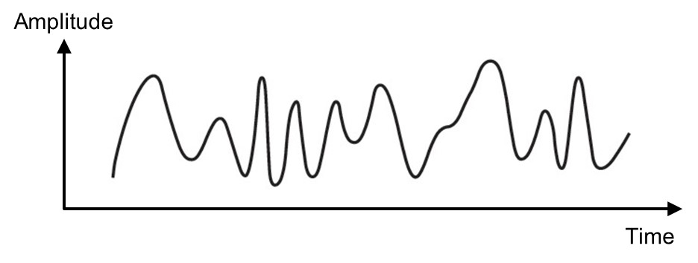
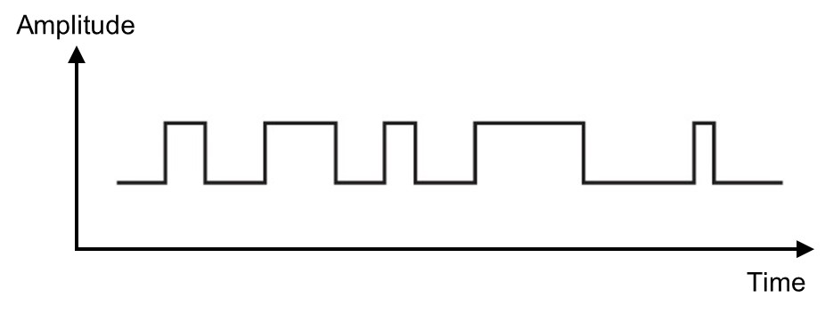
Analog vs. Digital
Analog Signal
Vary in a smooth way over time
Analog data are continuously valued
Example: audio, video
Digital Signal
Maintains a constant level then changes to another constant level (generally operate in one of the two states)
Digital data are discretely valued
Example: computer data

Slide 5
Radix or Base
An ordered set of symbols, called digits, with relations defined for addition, subtraction, multiplication and division
Radix or base of the number system is the total number of digits allowed in the number system

Slide 6
Decimal, Binary, Octal and Hexadecimal
System Name | Decimal | Binary | Octal | Hexadecimal
Radix | 10 | 2 | 8 | 16
 | 0 | 0000 | 0 | 0
 | 1 | 0001 | 1 | 1
 | 2 | 0010 | 2 | 2
 | 3 | 0011 | 3 | 3
 | 4 | 0100 | 4 | 4
 | 5 | 0101 | 5 | 5
 | 6 | 0110 | 6 | 6
 | 7 | 0111 | 7 | 7
 | 8 | 1000 | 10 | 8
 | 9 | 1001 | 11 | 9
 | 10 | 1010 | 12 | A
 | 11 | 1011 | 13 | B
 | 12 | 1100 | 14 | C
 | 13 | 1101 | 15 | D
 | 14 | 1110 | 16 | E
 | 15 | 1111 | 17 | F
 | 16 | 10000 | 20 | 10

Slide 7
Number Systems
Decimal numbers
Binary numbers
1’s column
10’s column
100’s column
1000’s column
five
thousands
three
hundreds
seven
tens
four
ones
8’s column
4’s column
2’s column
1’s column
one
eight
one
four
zero
two
one
one

Slide 8
Powers of Two
2⁰ = 1
2¹ = 2
2² = 4
2³ = 8
2⁴ = 16
2⁵ = 32
2⁶ = 64
2⁷ =128
2⁸ = 256
2⁹ = 512
2¹⁰ = 1024
2¹¹ = 2¹⁰ × 2¹ = 2048
2¹² = 2¹⁰ × 2² = 4096
2¹⁶ = 2¹⁰ 2⁶ = 65536
…
2²⁰ = 2¹⁰ × 2¹⁰ = 1048576
Handy to memorize up to 2¹⁰

Slide 9
Decimal vs Binary Numbers
Binary to decimal conversion:
Convert 10011₂ to decimal
16×1 + 8×0 + 4×0 + 2×1 + 1×1 = 19₁₀
Decimal to binary conversion:
Convert 47₁₀ to binary
32×1 + 16×0 + 8×1 + 4×1 + 2×1 + 1×1 = 101111₂
N-digit decimal number
How many values? 10^{N} Range: [0, 10^{N}−1]
Example: 3-digit decimal number:
10³ = 1000 possible values Range: [000, 999]
N-digit binary number
How many values? 2^{N} Range: [0, 2^{N}−1]
Example: 3-digit binary number:
2³ = 8 possible values Range: [000₂, 111₂]
[ 0 , 7 ]

Slide 10
Hexadecimal Numbers
Hexadecimal to binary conversion
4AF₁₆ (or 0x4AF)
0100 1010 1111₂
Hexadecimal to decimal conversion
4AF₁₆ (or 0x4AF)
16²×4 + 16¹×10 + 16⁰×15 = 1199₁₀

Slide 11
Exercise L02-1
Ex 1: Convert 36₈ to binary
Ex 2: Convert 36₁₀ to binary
Notes:
36₈=011 110₂
36₁₀=100100₂

Slide 12
Unsigned and Signed Numbers
Hexadecimal | Binary | Decimal (Unsigned) | Decimal (2’s Complement)
0x8F | 0111 1111 | 127 | 127
0x8E | 0111 1110 | 126 | 126
… | … | … | …
0x02 | 0000 0010 | 2 | 2
0x01 | 0000 0001 | 1 | 1
0x00 | 0000 0000 | 0 | 0
0xFF | 1111 1111 | 2⁸−1 = 255 | −1
0xFE | 1111 1110 | 254 | −2
… | … | … | …
0x82 | 1000 0010 | 130 | −126
0x81 | 1000 0001 | 129 | −127
0x80 | 1000 0000 | 128 | −128
Complement all bits
1000 0000
Then add 1
1000 0001
Complement all bits
0000 0001
Then add 1
0000 0010

Slide 13
Exercise L02-2
Ex 3: For a n-bit 2’s complement signed binary numeral system, what’s the largest positive number and the smallest negative number?

Slide 14
Digital Circuits
Digital circuits generally contain two parts
Combinational logic
Sequential logic
Combinational circuits consist of logic gates with inputs and outputs
The outputs at any instance of time depend only on the combination of the input values based on logic operations such as AND, OR, etc.
Sequential circuits, in addition to inputs and outputs also have storage elements, therefore the output depends on both the current inputs as well as the stored values

Slide 15
Digital Signal Representation
Active High
High voltage activates/enables the pin
Active Low
Low voltage activates/enables the pin

Slide 16
Logic Levels

Slide 17
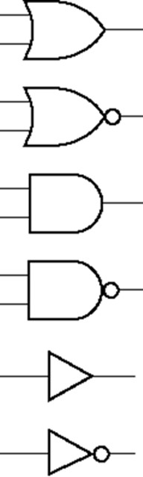
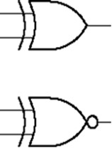
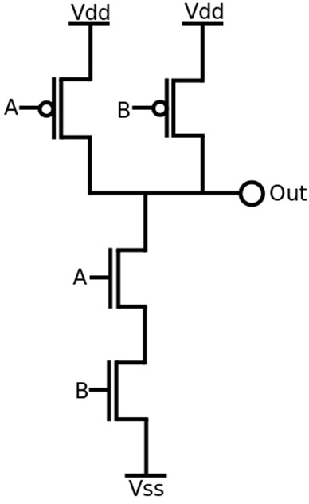
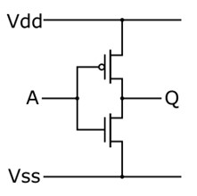
Logic Gates
OR
XOR
NOR
XNOR
AND
NAND
buffer
NOT (inverter)

Slide 18
Exercise L02-3
Ex 4: What is the schematic view of a NOR gate?
Notes:
36₈=011 110₂
36₁₀=100100₂

Slide 19
Truth Table
A tool for describing how the output of a logic circuit depends on the logic levels presented at the inputs
The number of input combinations will equal 2^{N} for an N-input truth table
Inputs
Output
A | B | Z
0 | 0 | 0
0 | 1 | 0
1 | 0 | 0
1 | 1 | 1
Logic Circuit
A
Z
B

Slide 20
Exercise L02-4
Ex 5: Draw the truth table of a 3-input AND gate.
Notes:
36₈=011 110₂
36₁₀=100100₂

Slide 21
Combinational Circuits
In combinational circuits, the output at any time is a direct function of the applied external inputs
Input X
Output Z
Combinational Circuits
…
…
Z = F(X)

Slide 22
Design Procedure of Combinational Circuits
Circuit Specification
Truth Table
(How many input/output?)
Minimization
(K-maps, algebraic manipulation, CAD tools)
Logic Diagram

Slide 23
Exercise L02-5
Ex 6: Implement AB+CD using NAND gates only

Slide 24
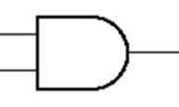
Propagation Delay
The delay when the signal arrives at the input of a circuit, and when the output of the circuit changes, is called the propagation delay.
A circuit is considered to be fast, if its propagation delay is small (ideally as close to 0 as possible).
X
Z
Y
Delay between input (X, Y) and change in output Z.

Slide 25
Timing Diagram
The inputs to a circuit can be changed over time.
The timing diagram shows the values of the input signals to a circuit with the passage of time, in the form of a waveform.
It also shows a waveform for the output.
X
Inputs
Y
τ
Propagation delay =
Output
Z
Time

Slide 26
Fan-in
Fan-in of a gate is the number of inputs to the gate.
For a 3-input OR gate, the fan-in = 3.
There is a limitation on the fan-in for any gate.
In CMOS IC technology, higher fan-in implies slower gates (higher propagation delays).

Slide 27
Fan-out
Fan-out is the number of gates that can be driven by a driver gate.
The driven gate is called the load gate.
There is a limit to the number of load gates that can be driven by a driver gate.
Fan-out = 3

Slide 28

Buffers
Buffers have a single input and a single output, where output = input.
Buffers help increase the driving capability of a circuit by increasing the fan-out.
Drive strength: how much load a gate can drive.
Greater drive strength, load gates are (dis)charged more quickly.

Slide 29
Decoders (1)
Information is represented by binary codes.
Circuits that perform decoding are called decoders.
A decoder is a minterm generator.
Minterm: product that includes all input variables
ABC, ABC, ABC
̅
̅
̅

Slide 30
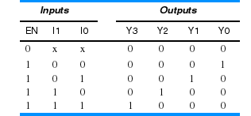
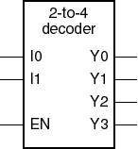
Decoders (2)
N inputs, 2^{N} outputs
One-hot outputs: only one output HIGH at once
Binary 2-to-4 Decoder
Note: “x” denotes don’t care.

Slide 31
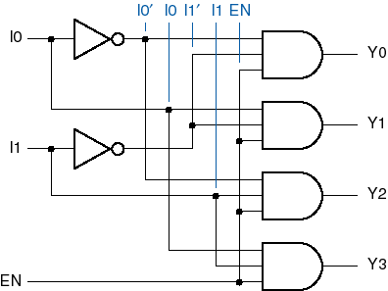
Decoders (3)
2-to-4 Decoder Logic Diagram

Slide 32
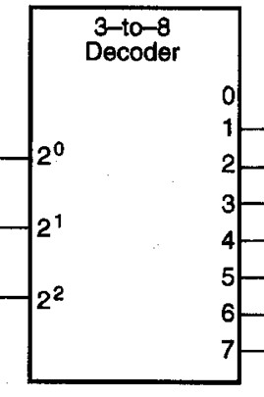
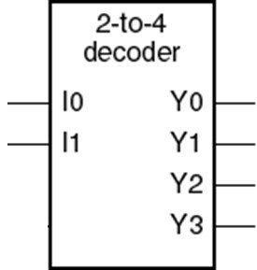
Decoder Applications
Decode 3-bit opcodes:
Home automation:
ADD
SUB
op0
AND
C₀
Light
XOR
C₁
A/C
op1
NOT
Door
op2
LOAD
TV
STORE
JUMP

Slide 33
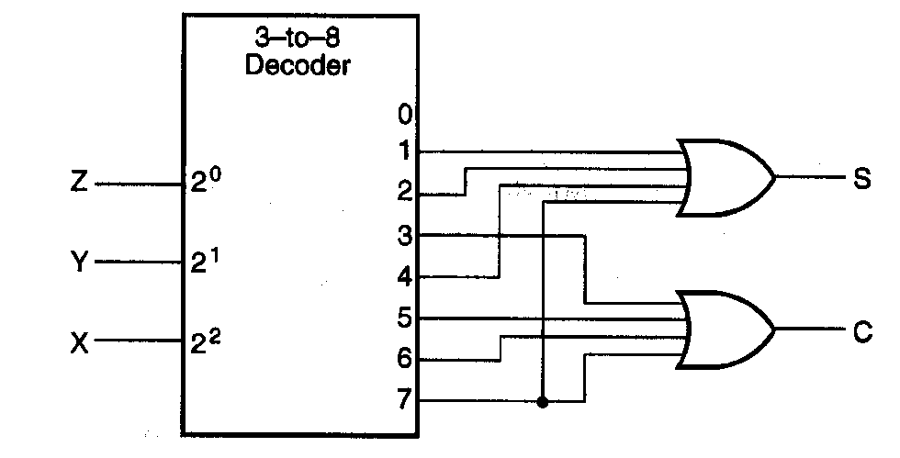
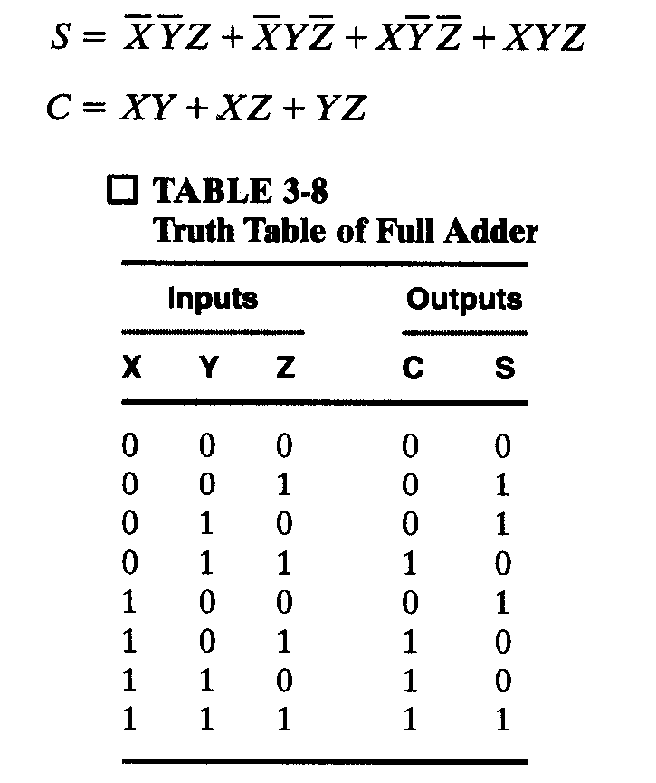
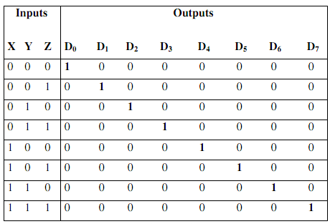
Decoders as Binary Adder

Slide 34
Multiplexers
Directs one of 2^{n} input to the output, basically a data selector.
Input to output direction is done based on a set of n select bits.
2^{n}-to-1 MUX
1 output
2^{n} inputs
…
n select bits

Slide 35
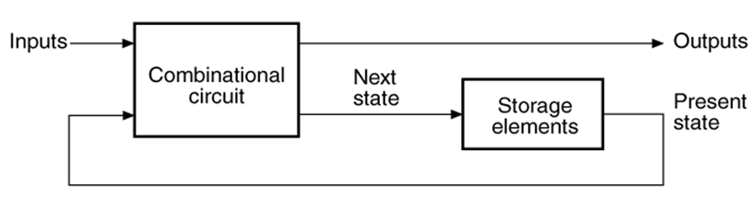
Sequential Circuits
Give sequence to events
Have memory (short-term)
Use feedback from output to input to store information
The state of a circuit influences its future behavior
State elements store state
Latch
Flip-flop

Slide 36
Bistable Circuit
Fundamental building block of other state elements
Two outputs: Q, Q
No inputs
Consider the two possible cases:
Q = 0: then Q = 1, Q = 0 (consistent)
Q = 1: then Q = 0, Q = 1 (consistent)
Stores 1 bit of state in the state variable, Q (or Q).
But there are no inputs to control the state.
̅
̅
̅
̅

Slide 37
SR (Set/Reset) Latch
SR Latch
Consider the four possible cases:
S = 1, R = 0
S = 0, R = 1
S = 0, R = 0
S = 1, R = 1

Slide 38
SR Latch Analysis（1）
S = 1, R = 0:
then Q = 1 and Q = 0
S = 0, R = 1:
then Q = 0 and Q = 1
̅
̅

Slide 39
SR Latch Analysis （2）
S = 0, R = 0:
then Q = Q_{prev}
Memory
S = 1, R = 1:
then Q = 0, Q = 0
Invalid (Q = Q)
̅
̅

Slide 40
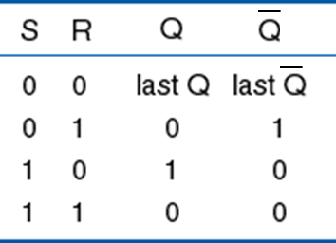
SR Latch Symbol
SR (Set/Reset) Latch
Stores one bit of state (Q)
Control what value is being stored with S, R inputs
Set: Make the output 1 (S = 1, R = 0, Q = 1)
Reset: Make the output 0 (S = 0, R = 1, Q = 0)
Must do something to avoid invalid state (when S = R = 1)

Slide 41
Gated D Latch
Two inputs: CLK, D
CLK: controls when the output changes.
D (data input): controls what the output changes to.
Function
When CLK = 1, D passes through to Q (transparent).
When CLK = 0, Q holds its previous value (opaque).
Avoids invalid case when Q ≠ NOT Q.
̅

Slide 42
Gated D Latch Internal Circuit

Slide 43
Master-Slave D Flip-Flop
Two back-to-back latches (L1 and L2) controlled by complementary clocks.
When CLK = 0
L1 is transparent
L2 is opaque
D passes through to Y
When CLK = 1
L1 is opaque
L2 is transparent
Y passes through to Q
Thus, on the edge of the clock (when CLK rises from 0➔1), D passes through to Q.
Y

Slide 44
Edge-Triggered D Flip-Flop
Inputs: CLK, D
Function
Samples D on rising edge of CLK
When CLK rises from 0 to 1, D passes through to Q
Otherwise, Q holds its previous value
Q changes only on rising edge of CLK
Called edge-triggered.
Activated on the clock edge.

Slide 45
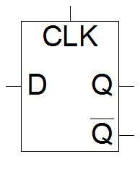
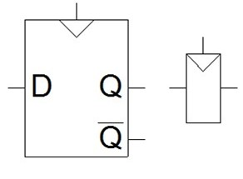
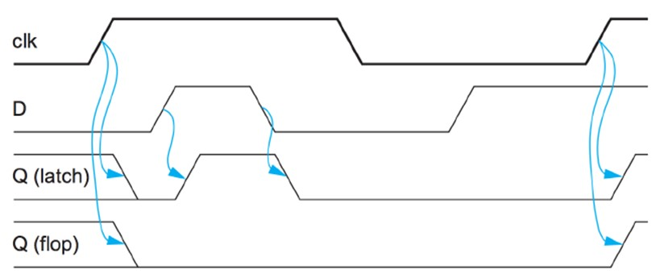
Latch and Flip-Flop
Latch is level-sensitive.
Flip-flop is edge-triggered.

Slide 46
Registers
A register is a simple memory device that is composed of a series of flip-flops wired together so that they share a common clock pulse.
Registers come in various sizes and types.
The size of a register is closely tied to the structure of the microprocessor, e.g. 8-bit registers for microprocessor architecture with 8-bit wide data.

Slide 47
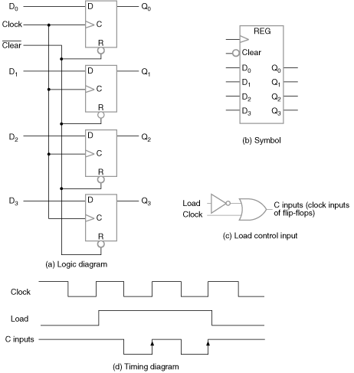
4-Bit Register
A simple 4-bit register can be made with 4 D-FF
Common Clock
At each positive-edge, 4 bits are loaded in parallel
Previous data is overwritten
Common Clear
Asynchronous clear
When Clear = 0, all FFs are cleared; i.e. 0 is stored.

Slide 48
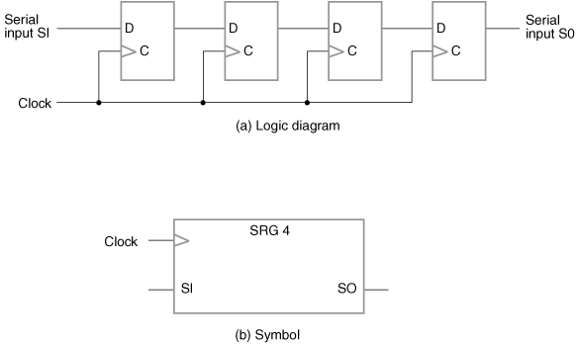
Shift Registers
Serial-in, serial-out: A register which can shift its stored bits laterally in one or both directions is called a shift registers.
Common Clock
At each positive-edge, 4 bits are loaded in parallel
Previous data is overwritten
Which direction is this registering shifting?

Slide 49
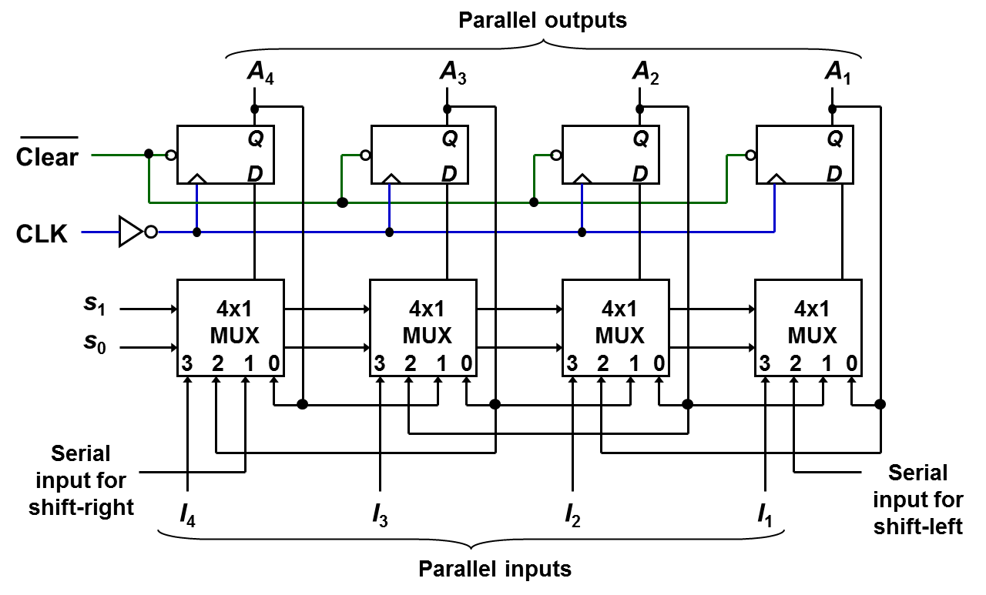
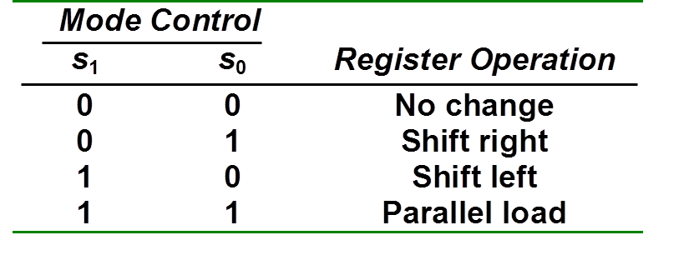
Bidirectional Shift Register with Parallel Load

