Slide 1
CSC3050 – Computer Architecture
Prof. Yeh-Ching Chung
School of Science and Engineering
Chinese University of Hong Kong, Shenzhen

Slide 2
Two Key Principles of Machine Design
Instructions are represented as (binary) numbers and, as such, are indistinguishable from data.
Programs are stored in alterable memory (that can be read from or written to) just like data.
Memory
Accounting Program (machine code)
C Compiler (machine code)
Accounting Data
Source Code (text file)

Slide 3
Stored-Program Concept
Programs can be shipped as files of binary numbers – binary-code compatibility.
Computers can inherit ready-made software provided they are compatible with an existing ISA – leads industry to align around a small number of ISAs.

Slide 4
Assembly Language Instructions
The language of the machine
Want an ISA that makes it easy to build the hardware and the compiler while maximizing performance and minimizing cost.
Our target: the MIPS ISA
Similar to other ISAs developed since the 1980’s
Used by Broadcom, Cisco, NEC, Nintendo, Sony, etc.
Design Goals:
Maximize performance, minimize cost, reduce design time (time-to-market), minimize memory space (embedded systems), minimize power consumption (mobile systems).

Slide 5
CISC vs. RISC
Complex Instruction Set Computer (CISC)
Lots of instructions of variable size, very memory optimal, typically less registers.
Intel x86
Reduced Instruction Set Computer (RISC)
Instructions, all of a fixed size, more registers, optimized for speed.
Usually called a “Load/Store” architecture.
MIPS, Sun SPARC, HP PA-RISC, IBM PowerPC

Slide 6
RISC – Reduced Instruction Set Computer
RISC Philosophy
fixed instruction lengths
load-store instruction sets
limited number of addressing modes
limited number of operations
Instruction sets are measured by how well compilers use them as opposed to how well assembly language programmers use them.

Slide 7
MIPS (RISC) Design Principles
Simplicity favors regularity
fixed size instructions
small number of instruction formats
opcode always the first 6 bits
Smaller is faster
limited instruction set
limited number of registers
limited number of addressing modes
Make the common case fast
arithmetic operands from the registers (load-store machine)
allow instructions to contain immediate operands
Good design demands good compromises
three instruction formats

Slide 8
MIPS ISA
Instruction Categories
Load/Store
Computational
Jump and Branch
Floating Point
Memory Management
Special
3 instruction formats: all 32-bit wide
Registers
R0–R31
PC
HI
LO
R format
OP
rs
rt
rd
shamt
funct
I format
OP
rs
rt
immediate
J format
OP
jump target

Slide 9
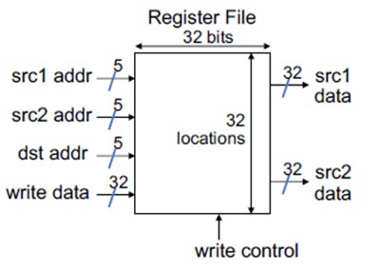
MIPS Registers (1)
Holds thirty-two 32-bit registers
Two read ports
One write ports

Slide 10
MIPS Registers (2)
Registers are
Faster than main memory
But registers with more locations are slower
Read/write port increase impacts speed quadratically
Easier for a complier to use
E.g., (A*B) – (C*D) – (E*F) can do multiplications in any order vs. stack
Can hold variables
so that code density improves (since register are named with fewer bits than a memory location).

Slide 11
MIPS Register Convention
Name | Register Number | Usage | Preserved on call?
$zero | 0 | Constant value 0 | N/A
$at | 1 | (Reserved for assembler) | No
$v0–$v1 | 2–3 | Returned values | No
$a0–$a3 | 4–7 | Arguments | No
$t0–$t7 | 8–15 | Temporaries | No
$s0–$s7 | 16–23 | Saved values | Yes
$t8–$t9 | 24–25 | Temporaries | No
$k0–$k1 | 26–27 | (Reserved for OS) | No
$gp | 28 | Global pointer | Yes
$sp | 29 | Stack pointer | Yes
$fp | 30 | Frame pointer | Yes
$ra | 31 | Return address | Yes

Slide 12
Arithmetic Operations
Add and subtract, three operands
Two sources and one destination
add a, b, c # a gets b + c
All arithmetic operations have this form
Design Principle 1: Simplicity favors regularity
Regularity makes implementation simpler
Simplicity enables higher performance at lower cost

Slide 13
Arithmetic Example
C code:
f = (g + h) - (i + j);
Compiled MIPS code:
add t0, g, h # temp t0 = g + h add t1, i, j # temp t1 = i + j sub f, t0, t1 # f = t0 - t1
Using registers (f–j are stored in $s0–$s4):
add $t0, $s1, $s2 # $t0 = g + h add $t1, $s3, $s4 # $t1 = i + j sub $s0, $t0, $t1 # f = $t0 - $t1

Slide 14
Register Operands
Arithmetic instructions use register operands
MIPS has 32 × 32-bit registers
Use for frequently accessed data
Numbered 0 to 31
32-bit data called a “word”
Assembler names (convention)
$t0, $t1, …, $t9 for temporary values
$s0, $s1, …, $s7 for saved variables

Slide 15
Memory Operands
Design Principle 2: Smaller is faster
(main memory: millions of locations)
Main memory used for composite data
Arrays, structures, dynamic data
To apply arithmetic operations
Load values from memory into registers
Store result from register to memory
Memory is byte addressed
Each address identifies an 8-bit byte
Words are aligned in memory
Address must be a multiple of 4
MIPS is Big Endian

Slide 16
Big Endian / Little Endian
Big Endian: The leftmost byte stores at the starting address of a word
IBM 360/370, Motorola 68k, MIPS, Sparc, HP PA
Little Endian: The rightmost byte stores at the starting address of a word
Intel 80x86, DEC Vax, DEC Alpha
Example: 0x1234abcd
Memory | Big-Endian | Little-Endian
0x0000 | 0x12 | 0xcd
0x0001 | 0x34 | 0xab
0x0002 | 0xab | 0x34
0x0003 | 0xcd | 0x12

Slide 17
Memory Operand Example (1)
C code
g = h + A[8];
g in $s1, h in $s2, base address of A in $s3
Compiled MIPS code
Index 8 requires offset of 32 (4 bytes × 8 words)
lw $t0, 32($s3) # load word add $s1, $s2, $t0
Offset
Base register

Slide 18
Memory Operand Example (2)
C code
A[12] = h + A[8];
h in $s2, base address of A in $s3
Compiled MIPS code
Index 8 requires offset of 32 (4 bytes × 8 words)
lw $t0, 32($s3) # load word add $t0, $s2, $t0 sw $t0, 48($s3) # store word

Slide 19
Registers vs. Memory
Registers are faster to access than memory
Operating on memory data requires loads and stores
More instructions to be executed
Compiler must use registers for variables as much as possible
Only spill to memory for less frequently used variables
Register optimization is important!

Slide 20
Immediate Operands
Constant data specified in an instruction
addi $s3, $s3, 4
No subtract immediate instruction
Just use a negative constant
addi $s2, $s1, -1

Slide 21
The Constant Zero
Design Principle 3: Make the common case fast
Small constants are common
Immediate operand avoids a load instruction
MIPS register 0 ($zero) is the constant 0
Cannot be overwritten
Useful for common operations
E.g., move between registers
add $t2, $s1, $zero

Slide 22
Binary Integers
Unsigned Binary Integers
Range: 0 to 2^{n} – 1
32 bit: 0 to 4,294,967,295
2’s-Complement Signed Integers
Range: –2^{(n – 1)} to +2^{(n – 1)} – 1
32 bits: –2,147,483,648 to +2,147,483,647
Bit 31 is sign bit: 1 is negative, 0 is positive
Some specific numbers
0: 0000 0000 … 0000
–1: 1111 1111 … 1111
Most-negative: 1000 0000 … 0000
Most-positive: 0111 1111 … 1111

Slide 23
Sign Extension
Representing a number using more bits
Preserve the numeric value
In MIPS instruction set
addi: extend immediate value
lb, lh: extend loaded byte/halfword
beq, bne: extend the displacement
Replicate the sign bit to the left
compare unsigned values: extend with 0s
Examples: 8-bit to 16-bit
+2: 0000 0010 => 0000 0000 0000 0010
–2: 1111 1110 => 1111 1111 1111 1110

Slide 24
MIPS ISA
Instruction Categories
Load/Store
Computational
Jump and Branch
Floating Point
Memory Management
Special
3 instruction formats: all 32-bit wide
Registers
R0–R31
PC
HI
LO
R format
OP
rs
rt
rd
shamt
funct
I format
OP
rs
rt
immediate
J format
OP
jump target

Slide 25
MIPS Instruction Fields
MIPS fields are given names to make them easier to refer to.
op: 6-bit opcode that specifies the operation
rs: 5-bit the first register source operand
rt: 5-bit the second register source operand
rd: 5-bit the register destination operand
shamt: 5-bit shift amount
funct: 6-bit function code that selects specific variant of the operation
6 | 5 | 5 | 5 | 5 | 6
op | rs | rt | rd | shamt | funct

Slide 26
R-format Example
op | rs | rt | rd | shamt | funct
6 bits | 5 bits | 5 bits | 5 bits | 5 bits | 6 bits
add $t0, $s1, $s2
$t0 ➔ R8
$s1 ➔ R17
$s2 ➔ R18
0 | $s1 | $s2 | $t0 | 0 | 32
0 | 17 | 18 | 8 | 0 | 32
000000 | 10001 | 10010 | 01000 | 00000 | 100000
0000 0010 0011 0010 0100 0000 0010 0000₂ = 02324020₁₆

Slide 27
MIPS I-format Instructions
Immediate arithmetic and load/store instructions
rt: destination or source register number
Constant: (–2¹⁵) to (+2¹⁵ – 1)
Address: offset added to base address in rs
Design Principle 4: Good design demands good compromises
Different formats complicate decoding, but allow 32-bit instructions uniformly
Keep formats as similar as possible
op | rs | rt | constant or address
6 bits | 5 bits | 5 bits | 16 bits

Slide 28
Load/Store (I-format)
op | rs | rt | constant or address
6 bits | 5 bits | 5 bits | 16 bits
$t0 ➔ R8
$s3 ➔ R19
lw $t0, 24($s3)
35 | 19 | 8 | 24
Memory
 | 0xFFFFFFFF
 | 0x120040AC
 | 0x12004094
 | 0x0000000C
 | 0x00000008
 | 0x00000004
 | 0x00000000
Data | Address
$s3 = 0x12004094
$s3 + 24 = 0x12004094 + 0x18
= 0x120040AC
$t0 = data[0x120040AC]
$t0
$s3

Slide 29
MIPS Instruction Encoding
Instruction | Format | op | rs | rt | rd | shamt | funct | address
add | R | 0 | reg | reg | reg | 0 | 32
sub | R | 0 | reg | reg | reg | 0 | 34
addi | I | 8 | reg | reg |  |  |  | constant
lw | I | 35 | reg | reg |  |  |  | address
sw | I | 43 | reg | reg |  |  |  | address
reg: 0–31
constant/address: 16-bit

Slide 30
Translating C Code to Machine Code (1)
C code:
A[300] = h + A[300];
h in $s2, base address of A in $t1
Compiled MIPS code:
lw $t0, 1200($t1) # $t0 = A[300] add $t0, $s2, $t0 # $t0 = h + A[300] sw $t0, 1200($t1) # A[300] = $t0
Machine code:
op | rs | rt | address rd shamt funct
35 | 9 | 8 | 1200
0 | 18 | 8 | 8 | 0 | 32
43 | 9 | 8 | 1200

Slide 31
Translating C Code to Machine Code (2)
Machine code (decimal)
Machine code (binary)
op | rs | rt | address rd shamt funct
35 | 9 | 8 | 1200
0 | 18 | 8 | 8 | 0 | 32
43 | 9 | 8 | 1200
100011 | 01001 | 01000 | 0000 0100 1011 0000
000000 | 10010 | 01000 | 01000 | 00000 | 100000
101011 | 01001 | 01000 | 0000 0100 1011 0000

Slide 32
Logical Operations
Instructions for bitwise manipulation
Useful for extracting and inserting groups of bits in a word
Operation | C | Java | MIPS
Shift Left | << | << | sll
Shift Right | >> | >>> | srl
Bitwise AND | & | & | and, andi
Bitwise OR | | | | | or, ori
Bitwise NOT | ~ | ~ | nor

Slide 33
Shift Operations
shamt: how many positions to shift
Shift Left Logical (sll):
Shift left and fill with bit 0
sll by i bits equals multiplication by 2^{i}
Shift Right Logical (srl):
Shift right and fill with bit 0
srl by i bits equals division by 2^{i} (for unsigned numbers)
op | rs | rt | rd | shamt | funct
6 bits | 5 bits | 5 bits | 5 bits | 5 bits | 6 bits

Slide 34
AND Operations
Useful to mask bits in a word
Select some bits, clear others to 0
and $t0, $t1, $t2
$t2 | 0000 0000 0000 0000 0000 1101 1100 0000
$t1 | 0000 0000 0000 0000 0011 1100 0000 0000
$t0 | 0000 0000 0000 0000 0000 1100 0000 0000

Slide 35
OR Operations
Useful to include bits in a word
Set some bits to 1, leave others unchanged
or $t0, $t1, $t2
$t2 | 0000 0000 0000 0000 0000 1101 1100 0000
$t1 | 0000 0000 0000 0000 0011 1100 0000 0000
$t0 | 0000 0000 0000 0000 0011 1101 1100 0000

Slide 36
NOT Operations
Useful to invert bits in a word
Change 0 to 1, and 1 to 0
MIPS has NOR 3-operand instruction
a NOR b == NOT (a OR b)
nor $t0, $t1, $zero
$t1 | 0000 0000 0000 0000 0011 1100 0000 0000
$t0 | 1111 1111 1111 1111 1100 0011 1111 1111

Slide 37
MIPS Logical Operations
There are a number of bit-wise logical operations in the MIPS ISA
R-format
and $t0, $t1, $t2 # $t0 = $t1 & $t2 or $t0, $t1, $t2 # $t0 = $t1 | $t2 nor $t0, $t1, $t2 # $t0 = not($t1 | $t2)
I-format
andi $t0, $t1, 0xFF00 # $t0 = $t1 & 0xFF00 ori $t0, $t1, 0xFF00 # $t0 = $t1 | 0XFF00

Slide 38
Conditional Operations
Branch to a labeled instruction if a condition is true
Otherwise, continue sequentially
beq rs, rt, L1
if (rs == rt) branch to instruction labeled L1
bne rs, rt, L1
if (rs != rt) branch to instruction labeled L1
j L1
unconditional jump to instruction labeled L1

Slide 39
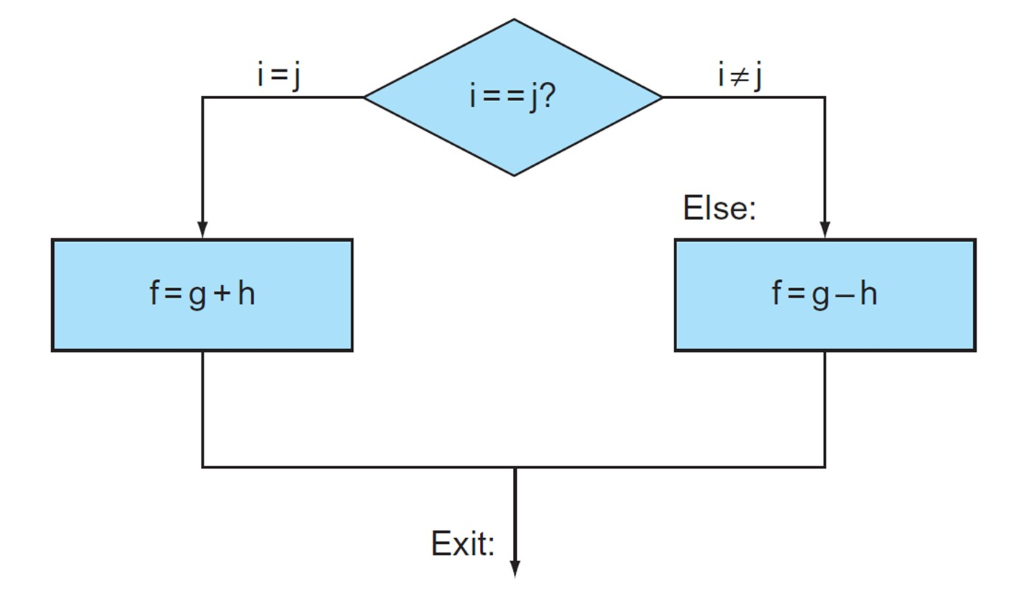
Compiling If Statements
C code:
if (i == j) f = g + h; else f = g – h;
f in $s0, g in $s1, h in $s2
Compiled MIPS code:
bne $s3, $s4, Else # go to Else if i≠j add $s0, $s1, $s2 # f=g+h (skipped if i≠j) j Exit # go to Exit Else: sub $s0, $s1, $s2 # f=g-h (skipped if i=j) Exit: ...
Assembler calculates addresses

Slide 40
Compiling Loop Statements
C code:
while (save[i] == k) i += 1;
i in $s3, k in $s5, address of save in $s6
Compiled MIPS code:
Loop: sll $t1, $s3, 2 # $t1 = i * 4 add $t1, $t1, $s6 # $t1 = addr of save[i] lw $t0, 0($t1) # $t0 = save[i] bne $t0, $s5, Exit # Exit if save[i]≠k addi $s3, $s3, 1 # i = i+1 j Loop # go to Loop Exit: ...

Slide 41
Basic Blocks
A basic block is a sequence of instructions with
No embedded branches (except at end)
No branch targets (except at beginning)
A compiler identifies basic blocks for optimization

Slide 42
More Conditional Operations
Set result to 1 if a condition is true
Otherwise, set to 0
slt rd, rs, rt
if (rs < rt) rd = 1; else rd = 0;
slti rt, rs, constant
if (rs < constant) rt = 1; else rt = 0;
Use in combination with beq, bne
slt $t0, $s1, $s2 # if ($s1 < $s2) bne $t0, $zero, L # branch to L

Slide 43
Branch Instruction Design
Why not blt, bge, etc?
Hardware for <, ≥, … slower than =, ≠
Combining with branch involves more work per instruction, requiring a slower clock
All instructions penalized!
beq and bne are the common case
This is a good design compromise

Slide 44
Signed vs. Unsigned
Signed comparison: slt, slti
Unsigned comparison: sltu, sltui
Example:
$s0 = 1111 1111 1111 1111 1111 1111 1111 1111
$s1 = 0000 0000 0000 0000 0000 0000 0000 0000
slt $t0, $s0, $s1 # signed
$s0 = −1, $s1 = 0, $s0 < $s1 ➔ $t0 = 1
sltu $t0, $s0, $s1 # unsigned
$s0 = +4,294,967,295, $s1 = 0, $s0 > $s1 ➔ $t0 = 0

Slide 45
Bounds Check Shortcut
Treating signed numbers as if they were unsigned gives a low cost way of checking if 0 ≤ x < y (index out of bounds for arrays)
sltu $t0, $s1, $t2 # $t0 = 0 if # $s1 > $t2 (max) # or $s1 < 0 (min) beq $t0, $zero, IOOB # go to IOOB if # $t0 = 0
The key is that negative integers in two’s complement look like large numbers in unsigned notation. Thus, an unsigned comparison of x < y also checks if x is negative as well as if x is less than y

Slide 46
Procedure Calling
Main routine (caller) places parameters in a place where the procedure (callee) can access them
$a0–$a3: four argument registers
Caller transfers control to the callee
Callee acquires the storage resources needed
Callee performs the desired task
Callee places the result value in a place where the caller can access it
$v0–$v1: two value registers for result values
Callee returns control to the caller
$ra: one return address register to return to the point of origin

Slide 47
Register Usage
$a0–$a3: arguments (reg 4–7)
$v0, $v1: result values (reg 2 and 3)
$t0–$t9: temporaries
Can be overwritten by callee
$s0–$s7: saved
Must be saved/restored by callee
$gp: global pointer for static data (reg 28)
$sp: stack pointer (reg 29)
$fp: frame pointer (reg 30)
$ra: return address (reg 31)

Slide 48
Procedure Call Instructions
Procedure call: jump and link (jal)
jal ProcedureLabel
Address of following instruction is put in $ra
Jumps to target address
Procedure return: jump register (jr)
jr $ra
Copies $ra to program counter

Slide 49
Leaf Procedure Example（1）
C code:
int leaf_example (int g, int h, int i, int j) { int f; f = (g + h) – (i + j); return f; }
Arguments g–j in $a0–$a3
f in $s0 (hence, need to save $s0 on stack)
Result in $v0

Slide 50
Leaf Procedure Example（2）
MIPS code:
leaf_example: addi $sp, $sp, -4 sw $s0, 0($sp) add $t0, $a0, $a1 add $t1, $a2, $a3 sub $s0, $t0, $t1 add $v0, $s0, $zero lw $s0, 0($sp) addi $sp, $sp, 4 jr $ra
Save $s0 on stack
Procedure body
Result
Restore $s0 from stack
Return

Slide 51
Stack Layout
 | Memory
0xFFFFFFFF
$sp →
0x00000000
Address | Data
 | Memory
0xFFFFFFFF
$sp → | $s0
0x00000000
Address | Data
 | Memory
0xFFFFFFFF
$sp →
0x00000000
Address | Data
Before procedure call
During procedure call
After procedure call

Slide 52
Non-Leaf Procedures
Procedures that call other procedures
For nested call, caller needs to save on the stack:
Its return address
Any arguments and temporaries needed after the call
Restore from the stack after the call

Slide 53
Non-Leaf Procedure Example (1)
C code:
int fact (int n) { if (n < 1) return f; else return n * fact(n – 1); }
Arguments n in $a0
Result in $v0

Slide 54
Non-Leaf Procedure Example (2)
MIPS code
fact: addi $sp, $sp, -8 sw $ra, 4($sp) sw $a0, 0($sp) slti $t0, $a0, 1 beq $t0, $zero, L1 addi $v0, $zero, 1 addi $sp, $sp, 8 jr $ra L1: addi $a0, $a0, -1 jal fact lw $a0, 0($sp) lw $ra, 4($sp) addi $sp, $sp, 8 mul $v0, $a0, $v0 jr $ra
Adjust stack pointer for 2 items
Save return address
Save argument
Test for n < 1
If so, result is 1
pop 2 items from stack
and return
Else decrement n
Recursive call
Restore original n
and return address
Pop 2 items from stack
Multiply to get result
And return

Slide 55
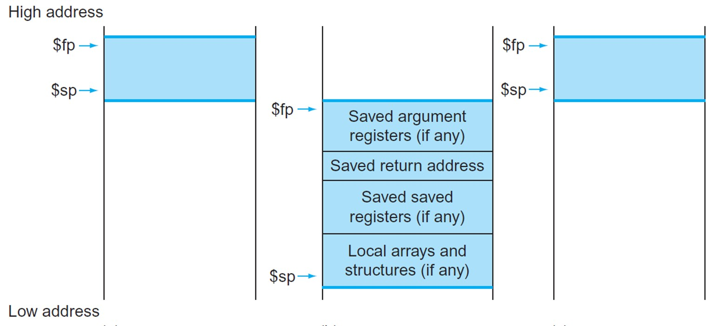
Local Data on the Stack
Local data allocated by callee
e.g., C automatic variables
Procedure frame (activation record)
Used by some compilers to manage stack storage

Slide 56
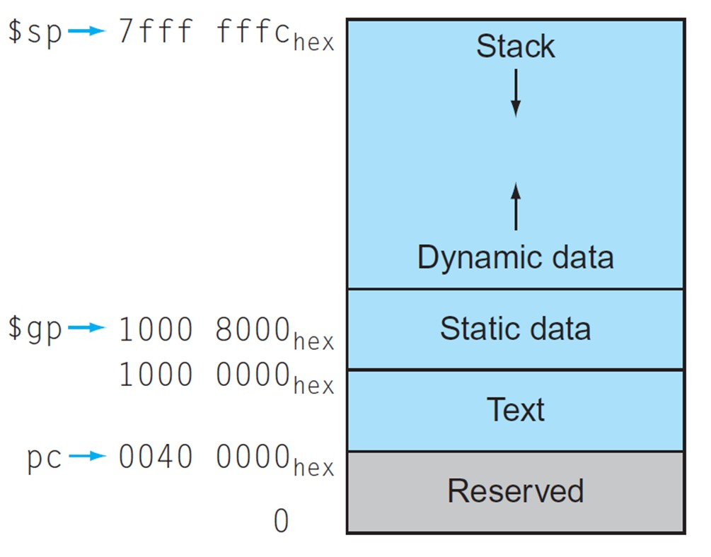
Memory Layout
Text: program code
Static data: global variables
e.g., static variables in C, constant arrays and strings
$gp initialized to address allowing ±offsets into this segment
Dynamic data: heap
e.g., malloc in C, new in Java
Stack: automatic storage

Slide 57
Character Data
Byte-encoded character sets
ASCII: 128 characters
95 graphic, 33 control
Latin-1: 256 characters
ASCII, +96 more graphic characters
Unicode: 32-bit character set
Used in Java, C++ wide characters, …
Most of the world’s alphabets, plus symbols
UTF-8, UTF-16: variable-length encodings

Slide 58
Byte/Halfword Operations
Could use bitwise operations
MIPS byte/halfword load/store
String processing is a common case
lb rt, offset(rs) lh rt, offset(rs)
Sign extend to 32 bits in rt
lbu rt, offset(rs) lhu rt, offset(rs)
Zero extend to 32 bits in rt
sb rt, offset(rs) sh rt, offset(rs)
Store just rightmost byte/halfword

Slide 59
32-bit Constants
Most constants are small
16-bit immediate is sufficient
For the occasional 32-bit constant
lui rt, constant
Copies 16-bit constant to left (upper) 16 bits of rt
Clears right 16 bits of rt to 0
lui $s0, 61
ori $s0, $s0, 2304
0000 0000 0011 1101 | 0000 0000 0000 0000
0000 0000 0011 1101 | 0000 1001 0000 0000

Slide 60
Branch Addressing
Branch instructions specify
Opcode, two registers, target address
Most branch targets are near branch
Forward or backward
PC-relative addressing
Target address = PC + offset × 4
PC already incremented by 4 by this time
op | rs | rt | constant or address
6 bits | 5 bits | 5 bits | 16 bits

Slide 61
Specifying Branch Destinations
Program Counter (PC) gets updated (PC+4) when fetched.
Branch distance is limited to −2¹⁵ to +2¹⁵−1 (word) instructions away.
16-bit address
sign-extend
offset
16
00
32
+
32
32
4
32
32
+
PC
Branch destination address

Slide 62
Jump Addressing
Jump (j and jal) targets could be anywhere in text segment
Encode full address in instruction
Pseudodirect jump addressing
op | address
6 bits | 26 bits
PC[31:28] | address | 00
4 bits | 26 bits | 2 bits

Slide 63
Jump Addressing
Target address must be within the 256-MB region.
26-bit address
address
PC[31:28]
26
00
32
4
32
PC
Jump destination address

Slide 64
Branching Far Away
If branch target is too far to encode with 16-bit offset, assembler rewrites the code:
beq $s0, $s1, L1
may be replaced by
bne $s0, $s1, L2 j L1 L2: ...

Slide 65
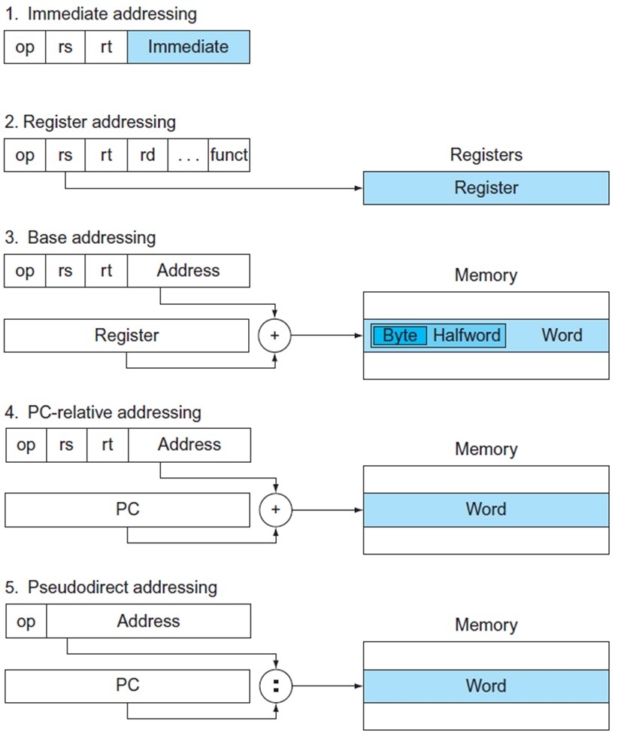
Addressing Mode Summary

Slide 66
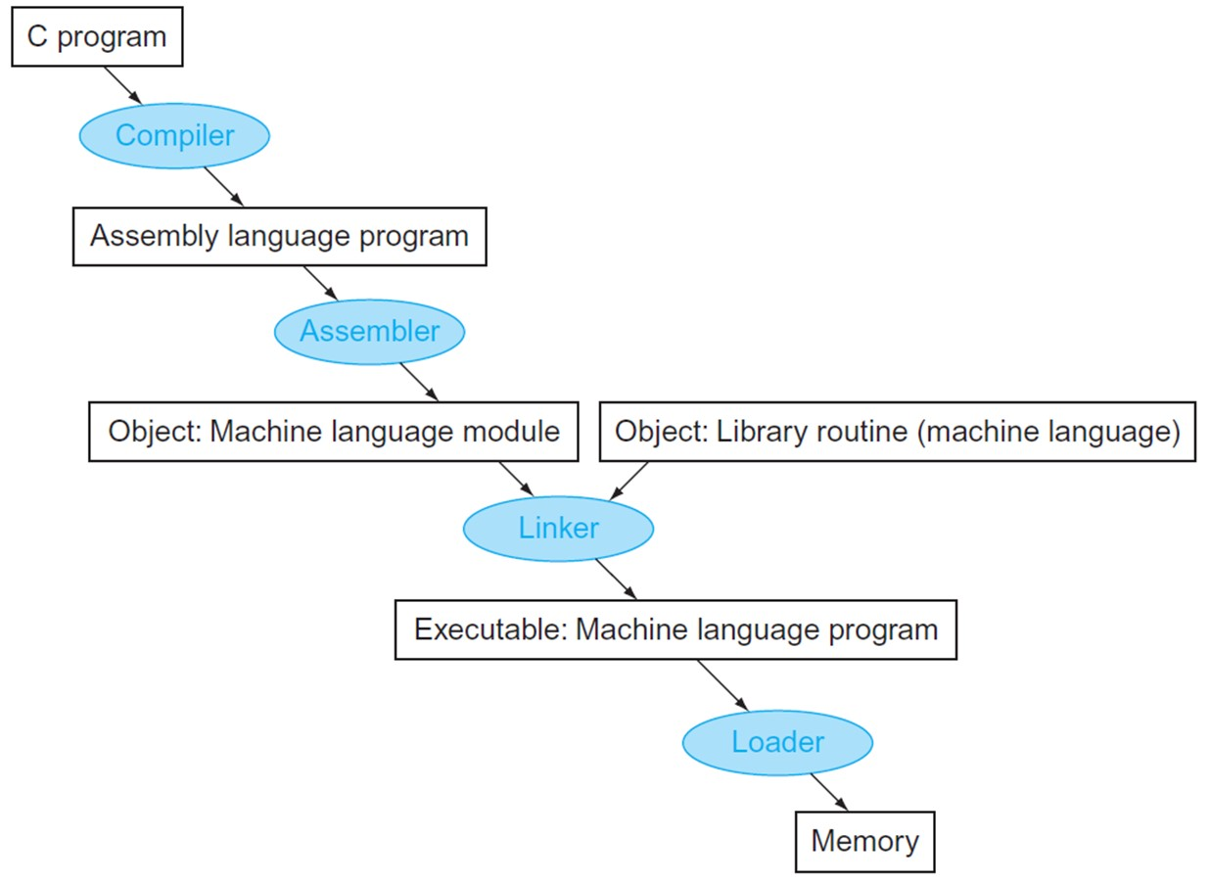
C Code Translation Hierachy

Slide 67
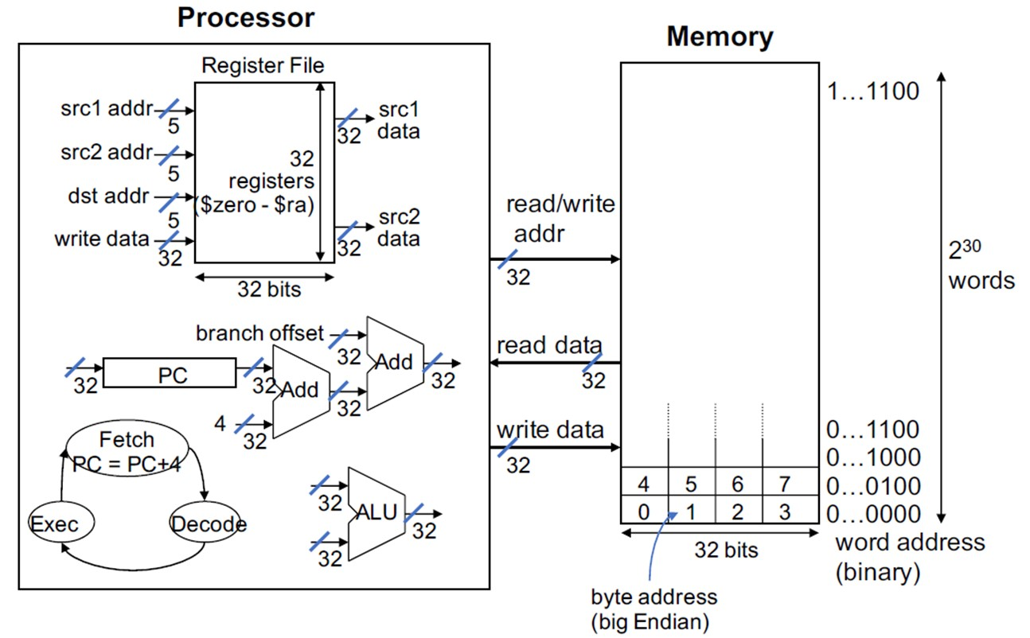
MIPS Organization So Far

