Slide 1
CSC3050 – Computer Architecture
Prof. Yeh-Ching Chung
School of Science and Engineering
Chinese University of Hong Kong, Shenzhen

Slide 2
Datapath and Control
Our implementation of the MIPS is simplified
Memory-reference instructions: lw, sw
Arithmetic-logical instructions: add, sub, and, or, slt
Control flow instructions: beq, j
Generic implementation
Use the program counter (PC) to supply the instruction address and fetch the instruction from memory (and update the PC)
Decode the instruction (and read registers)
Execute the instruction
All instructions (except j) use the ALU after reading the registers
Fetch PC=PC+4
Execute
Decode

Slide 3
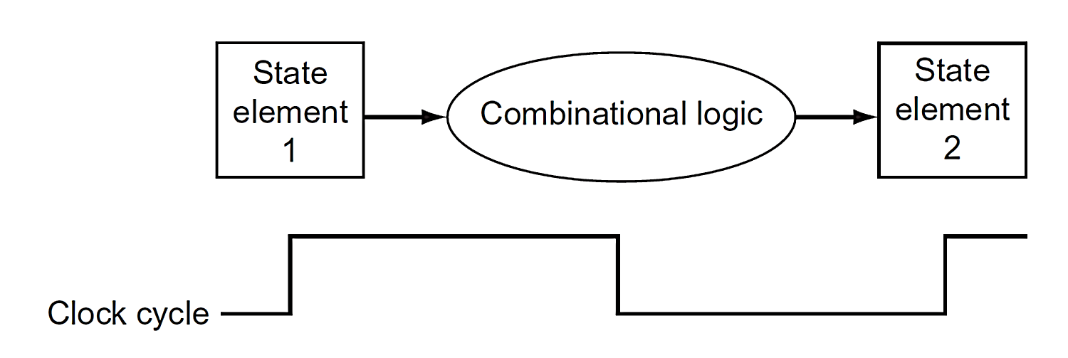
Clock Methodology
The clock methodology defines when data in a state element is valid and stable relative to the clock
State elements: A memory element such as a register
Edge-triggered: All state changes occur on a clock edge
Typical execution
Read contents of state elements ➔ send values through combinational logic ➔ write results to one or more state elements
Assumes state elements are written on every clock cycle; if not, need explicit write control signal
Write occurs only when both the write control is asserted and the clock edge occurs

Slide 4
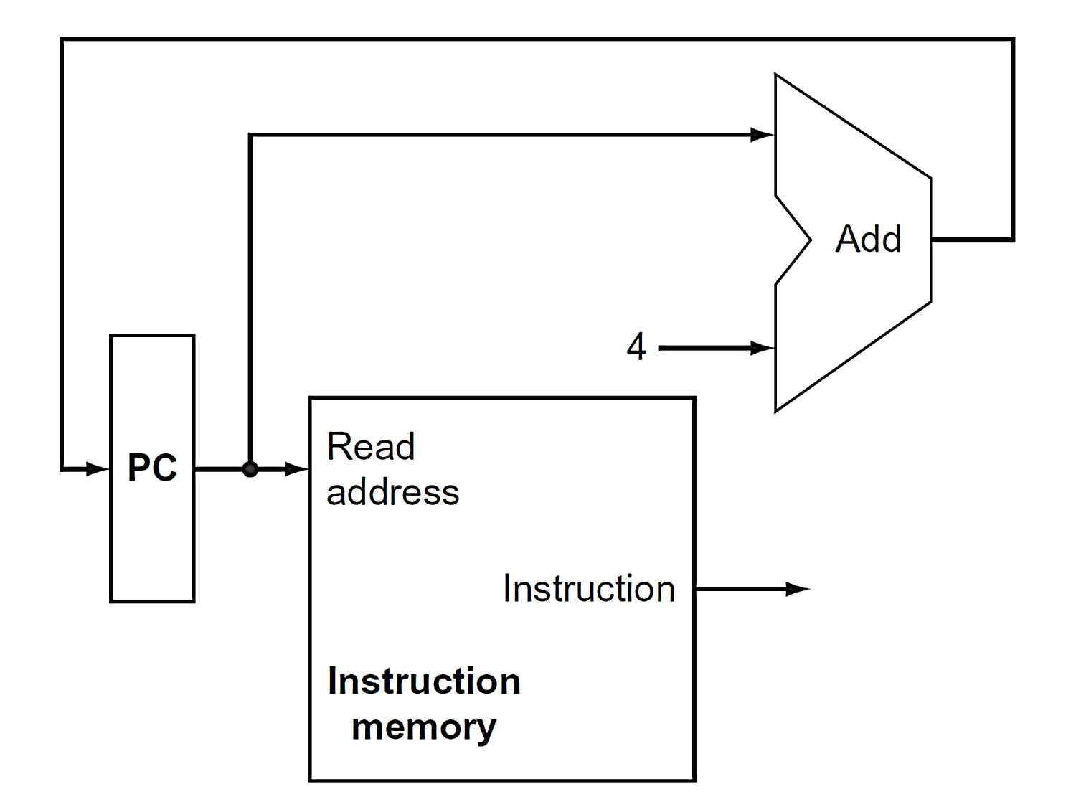
Fetch Instructions
Fetch instructions involves
Read the instruction from the Instruction Memory
Update the PC value to be the address of the next (sequential) instruction
PC is updated every clock cycle, so it does not need an explicit write control signal just a clock signal
Read from the Instruction Memory is a combinational activity. It does not need an explicit read control signal
Fetch PC=PC+4
Execute
Decode

Slide 5
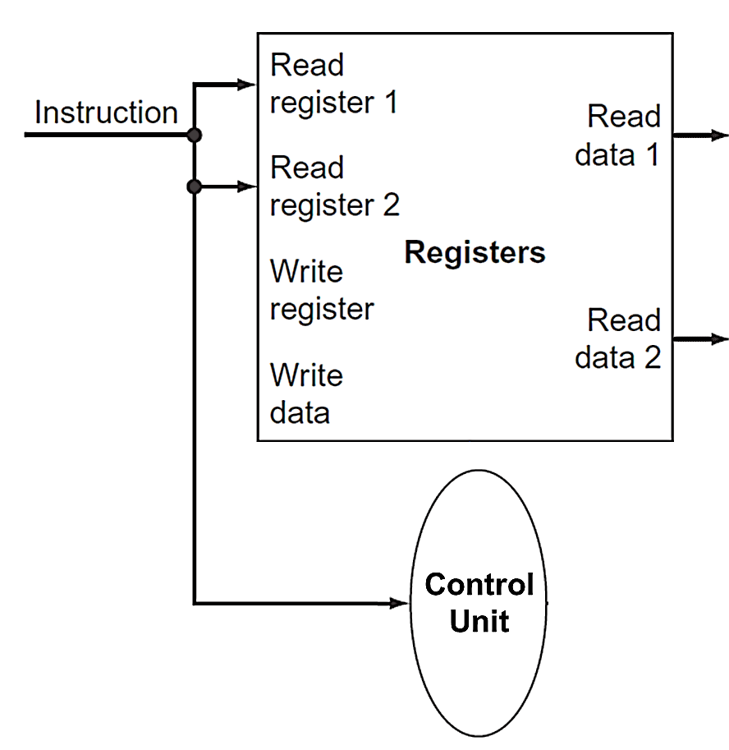
Decode Instructions
Decode instructions involves
Send the fetched instruction’s opcode and function field bits to the control unit
Read two values from the Registers
Register addresses are contained in the instruction
Fetch PC=PC+4
Execute
Decode

Slide 6
Read Registers “Just in Case”
Note that both read ports of the Registers are active for all instructions during the decode cycle, using the rs and rt instruction field addresses
Since haven’t decoded the instruction yet, don’t know what the instruction is
Just in case the instruction uses values from the Registers do “work ahead” by reading the two source operands

Slide 7
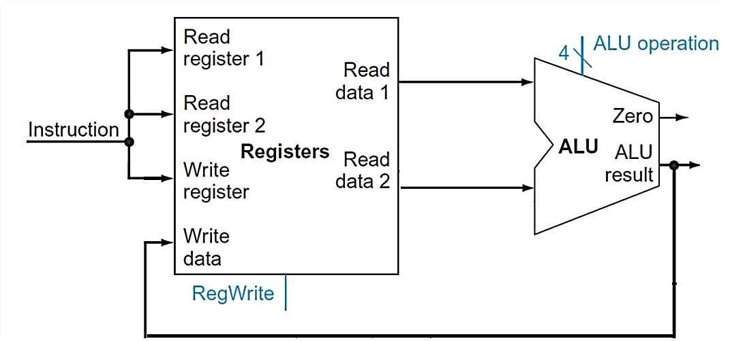
Executing R Format Operations
R format operations (add, sub, slt, and, or)
Perform operation (op and funct) on values in rs and rt
Store the result back into the Registers (into location rd)
Note that register is not written every cycle (e.g. sw), so we need an explicit write control signal for the Registers
31 25 20 15 10 5 0
R format
op
rs
rt
rd
shamt
funct
Fetch PC=PC+4
Execute
Decode

Slide 8
Execute Load and Store Operations (1)
Load and store operations have to
Compute a memory address by adding the base register (in rs) to the 16-bit signed offset field in the instruction
base register was read from the Registers during decode
offset value in the low order 16 bits of the instruction, must be sign-extended to create a 32-bit signed value
Store value, read from the Registers during decode, must be written to the Data Memory
Load value, read from the Data Memory, must be stored in the Registers
31 25 20 15 0
I format
OP
rs
rt
offset

Slide 9
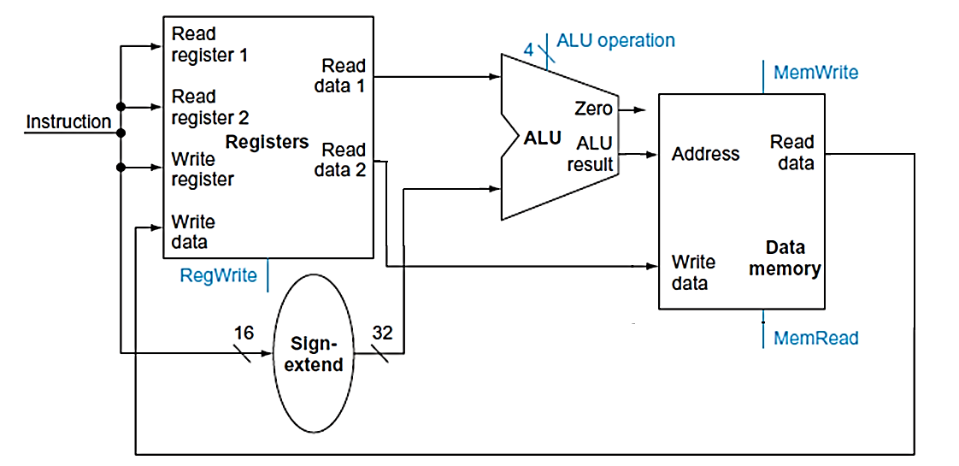
Execute Load and Store Operations (2)

Slide 10
Execute Branch Operations (1)
Branch operations have to
Compare the operands read from the Registers during decode (rs and rt values) for equality (zero ALU output)
Compute the branch target address by adding the updated PC to the sign-extended 16-bit offset field in the instruction
“base register” is the updated PC
Offset value in the low order 16 bits of the instruction must be sign extended to create a 32-bit signed value and then shifted left 2 bits to turn it into a word address
31 25 20 15 0
I format
OP
rs
rt
offset

Slide 11
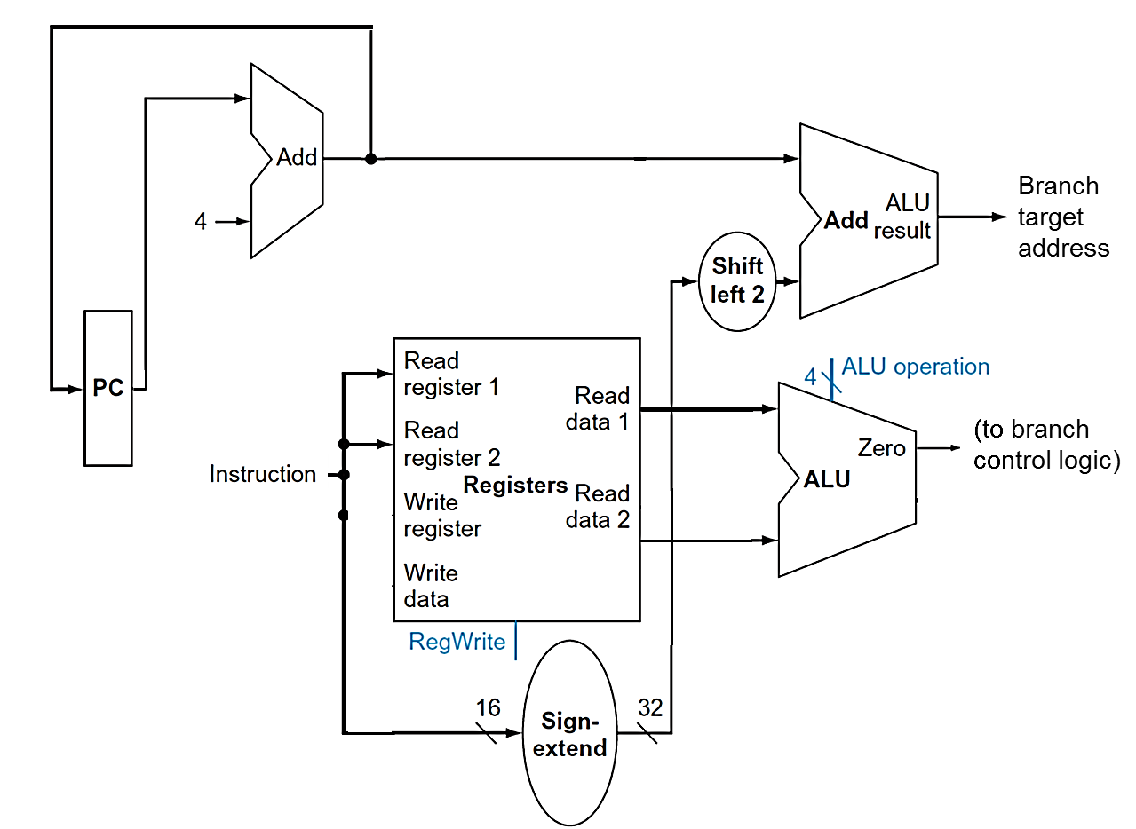
Executing Branch Operations (2)

Slide 12
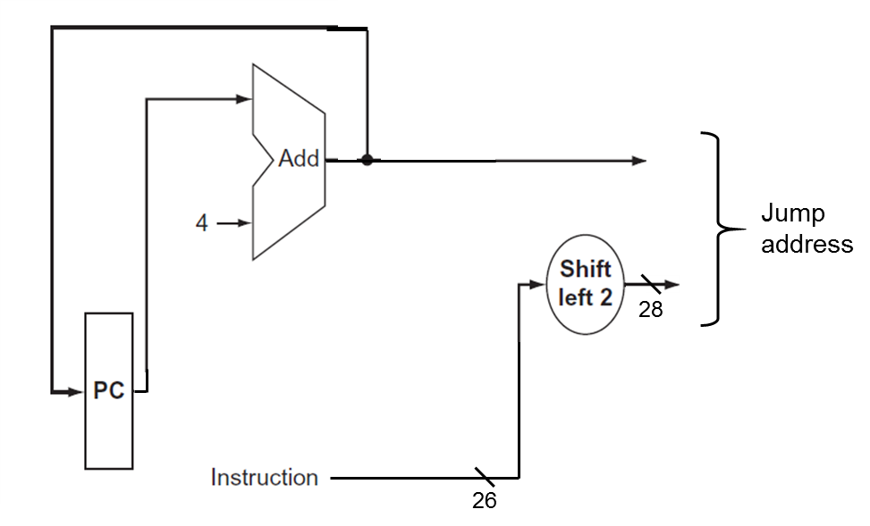
Execute Jump Operations
Jump operations have to
Replace the lower 28 bits of the PC with the lower 26 bits of the fetched instruction shifted left by 2 bits
31 25 0
J format
op
jump target address

Slide 13
Create a Single Datapath from the Parts
Assemble the datapath segments and add control lines and multiplexors as needed
Single-cycle design – fetch, decode and execute each instructions in one clock cycle
No datapath resource can be used more than once per instruction, so some must be duplicated (e.g., separate Instruction Memory and Data Memory, several adders)
Multiplexors needed at the input of shared elements with control lines to do the selection
write signals to control writing to the Register File and Data Memory
Cycle time is determined by length of the longest path

Slide 14
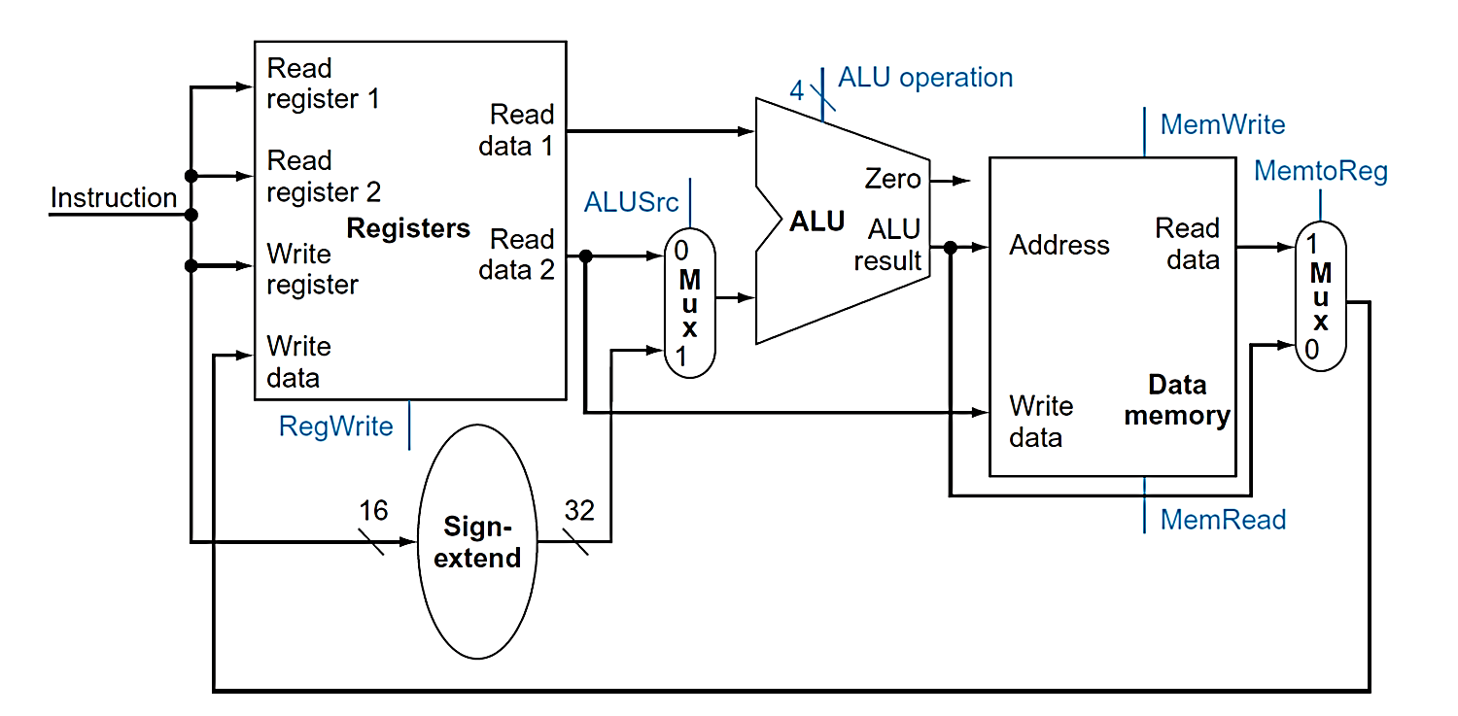
Datapath for R-type and Memory Instructions

Slide 15
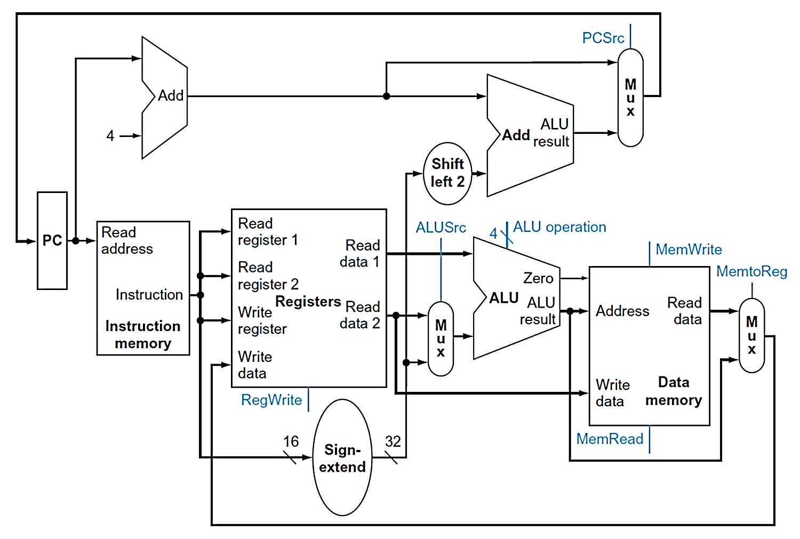
Add Branch Instructions

Slide 16
Our Simple Control Structure
We wait for everything to settle down
ALU might not produce “right answer” right away
Read from Memory and Registers are combinational (as are ALU, adders, muxes, shifter, sign-extender)
Use write signals along with the clock edge to determine when to write to the sequential elements (to the PC, to the Registers and to the Data Memory)
The clock cycle time is determined by the logic delay through the longest path
We ignore some details like register setup and hold times

Slide 17
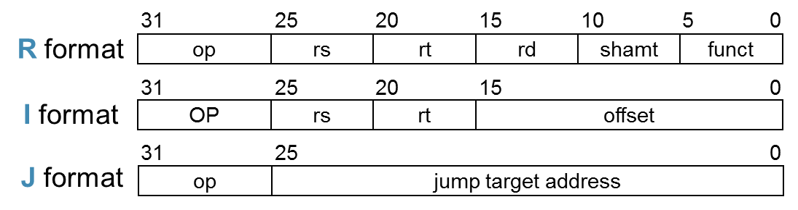
Add the Control
Select the operations to perform (ALU, Register and Memory read/write)
Control the flow of data (multiplexor inputs)
Information comes from the 32 bits of the instruction
Observations
Op field always in bits 31–26
Addresses of two registers to be read are always specified by the rs and rt fields (bits 25–21 and 20–16)
Base register for lw and sw always in rs (bits 25–21)
Address of register to be written is in one of two places: in rt (bits 20–16) for lw; in rd (bits 15–11) for R-type instructions
Offset for beq, lw, and sw always in bits 15–0

Slide 18
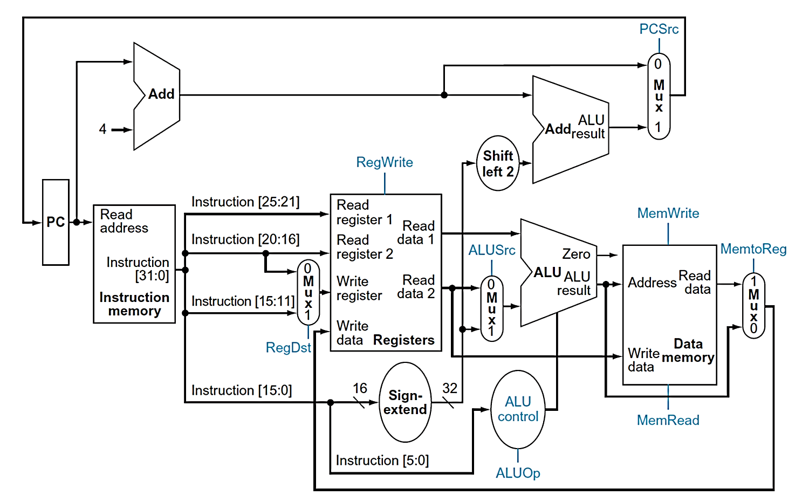
Complete Single-Cycle Datapath

Slide 19
ALU Control (1)
ALU used for
Load/Store: add
Branch: subtract (compare in beq)
R-type: depends on funct field
ALU Control | Function
0000 | AND
0001 | OR
0010 | add
0110 | subtract
0111 | set-on-less-than
1100 | NOR

Slide 20
ALU Control (2)
Assume 2-bit ALUOp derived from opcode
Combinational logic derives ALU control
Opcode | ALUOp | Opeation | funct | ALU function | ALU control
lw | 00 | load word | XXXXXX | add | 0010
Sw | 00 | store word | XXXXXX | add | 0010
Beq | 01 | branch equal | XXXXXX | subtract | 0110
R-type | 10 | add | 100000 | add | 0010
 |  | subtract | 100010 | subtract | 0110
 |  | AND | 100100 | AND | 0000
 |  | OR | 100101 | OR | 0001
 |  | set-on-less-than | 101010 | set-on-less-than | 0111

Slide 21
Design the Main Control Unit
ALUOp |  | Funct field |  |  |  |  |  | Operation
ALUOp1 | ALUOp0 | F5 | F4 | F3 | F2 | F1 | F0
0 | 0 | X | X | X | X | X | X | 0010
X | 1 | X | X | X | X | X | X | 0110
1 | X | X | X | 0 | 0 | 0 | 0 | 0010
1 | X | X | X | 0 | 0 | 1 | 0 | 0110
1 | X | X | X | 0 | 1 | 0 | 0 | 0000
1 | X | X | X | 0 | 1 | 0 | 1 | 0001
1 | X | X | X | 1 | 0 | 1 | 0 | 0111

Slide 22
The Main Control Unit
Control signals derived from instruction
R-type
0
rs
rt
rd
shamt
funct
31:26
25:21
20:16
15:11
10:6
5:0
Load/Store
35 or 43
rs
rt
address
31:26
25:21
20:16
15:0
Branch
4
rs
rt
address
31:26
25:21
20:16
15:0
opcode
always read
read, except for load
write for R-type and load
sign-extend and add

Slide 23

Complete Single-Cycle Datapath

Slide 24
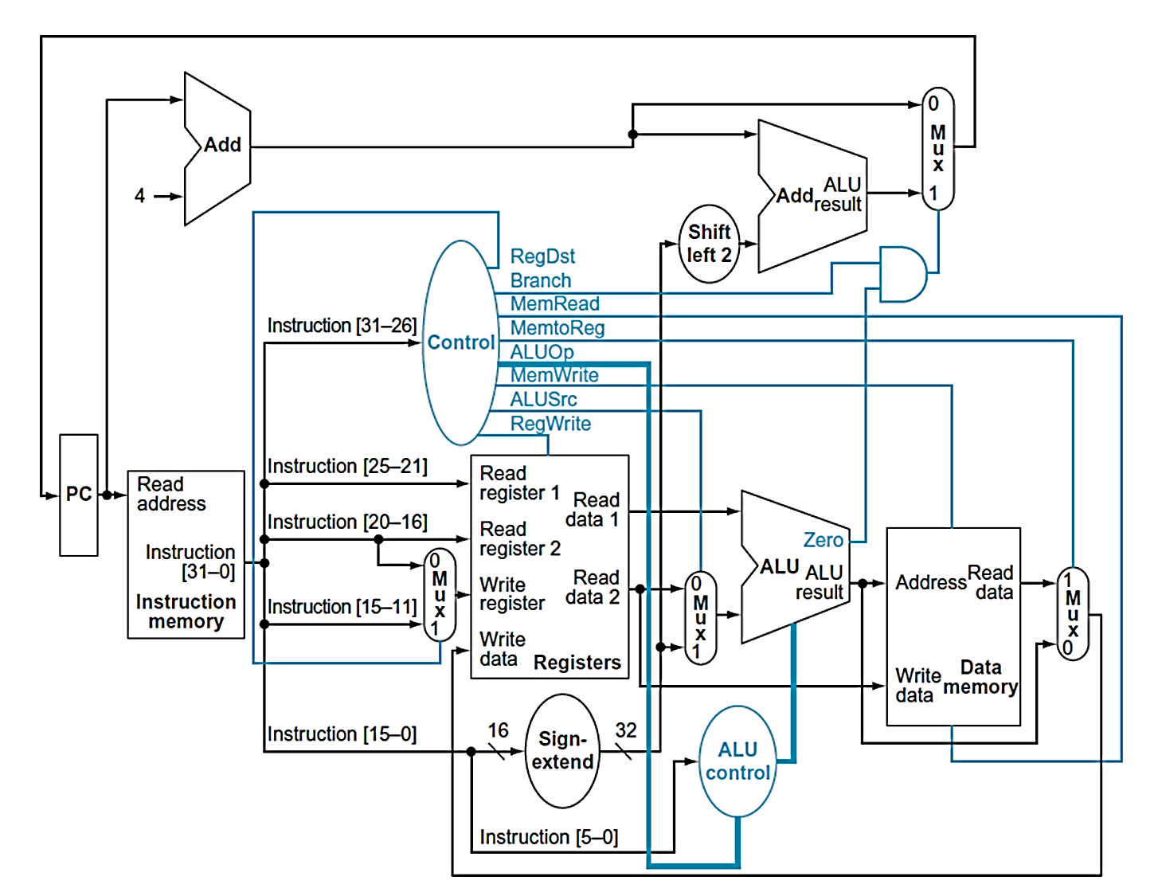
Datapath with Control

Slide 25
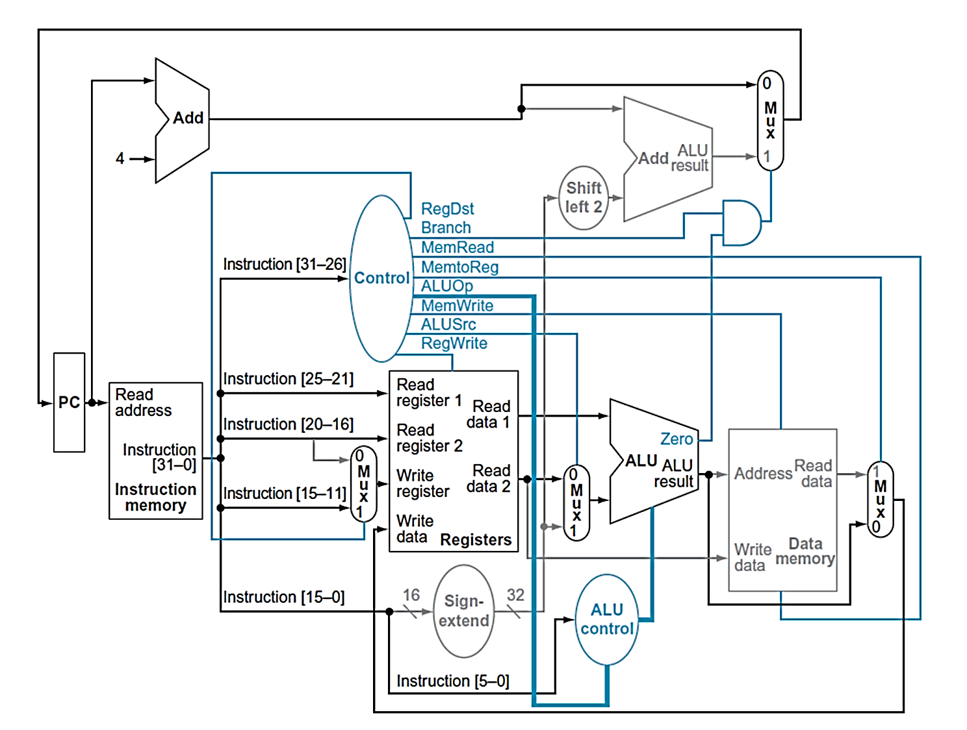
R-type Instruction
1
0
0

Slide 26
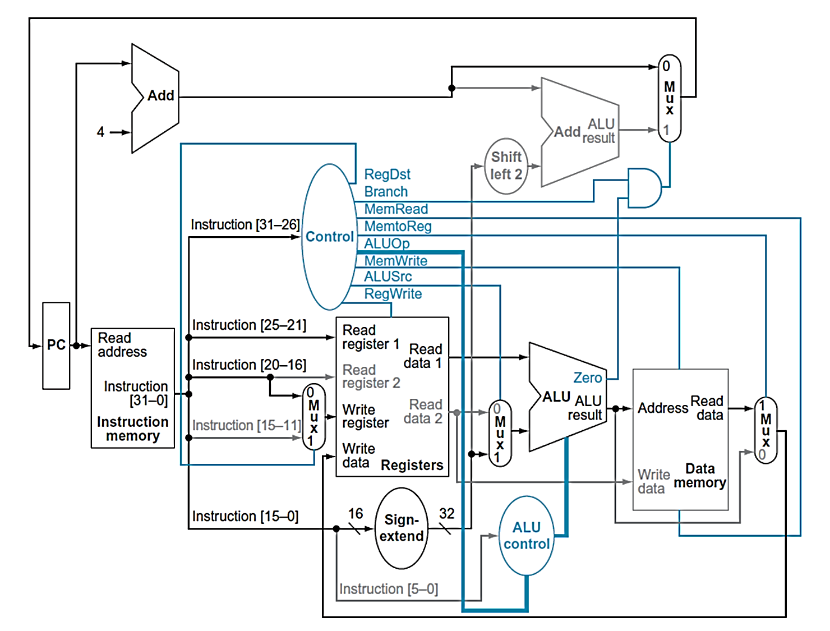
Load Instruction
1
0
1

Slide 27
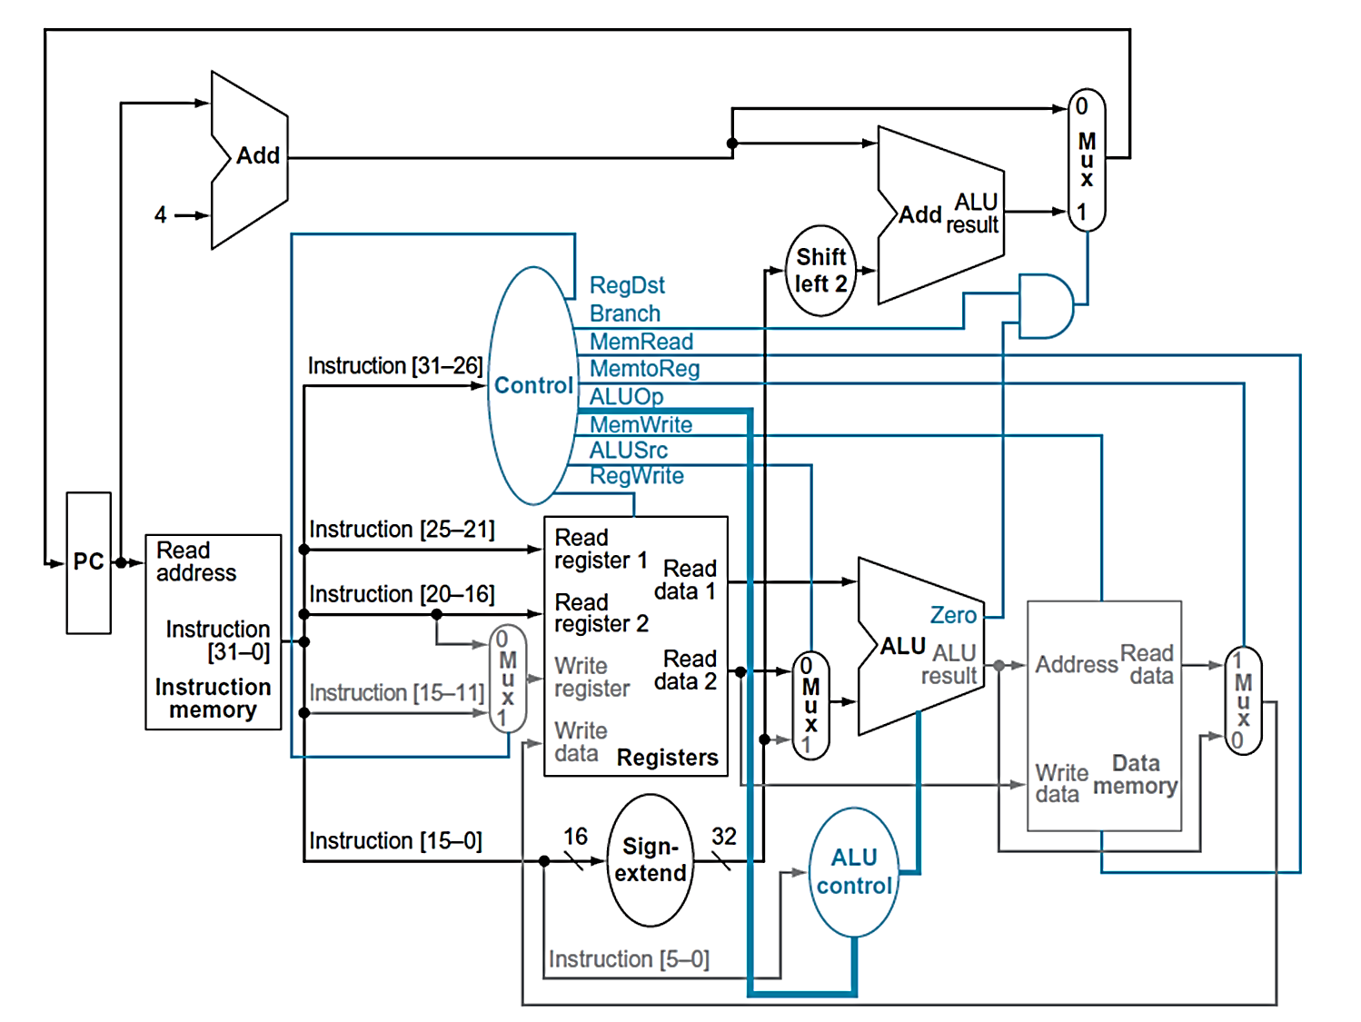
Branch-on-Equal Instruction
1
0
0
0

Slide 28
Control Lines
Instruction | RegDst | ALUSrc | MemtoReg | RegWrite | MemRead | MemWrite | Branch | ALUOp
R-type 000000 | 1 | 0 | 0 | 1 | 0 | 0 | 0 | 10
lw 100011 | 0 | 1 | 1 | 1 | 1 | 0 | 0 | 00
sw 101011 | X | 1 | X | 0 | 0 | 1 | 0 | 00
beq 000100 | X | 0 | X | 0 | 0 | 0 | 1 | 01

Slide 29
Implement Jumps
Jump uses word address
Update PC with concatenation of
Top 4 bits of old PC
26-bit jump address
00
Need an extra control signal decoded from opcode
Jump
2
address
31:26
25:0

Slide 30
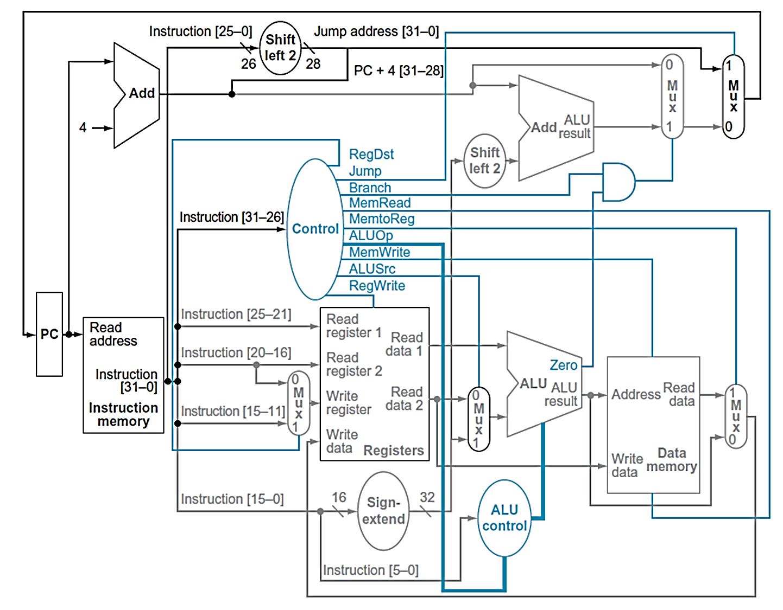
Datapath With Jump Added
0
0
0

Slide 31
Single-Cycle Implementation Cycle Time
Unfortunately, though simple, the single cycle approach is not used because it is very slow
Clock cycle must have the same length for every instruction
What is the longest path (slowest instruction)?

Slide 32
Instruction Critical Paths
Calculate cycle time assuming negligible delays (for muxes, control unit, sign extend, PC access, shift left 2, wires) except:
Instruction and Data Memory (4 ns)
ALU and adders (2 ns)
Register File access (reads or writes) (1 ns)
Instruction | I Mem | Reg Rd | ALU Op | D Mem | Reg Wr | Total
R-type | 4 | 1 | 2 |  | 1 | 8
Load
store
beq
jump
4
1
2
4
1
12
4
1
2
4
11
4
1
2
7
4
4

Slide 33
Performance Issues
Longest delay determines clock period
Critical path: load instruction
Instruction Memory → Registers → ALU → Data Memory → Registers
Not feasible to vary period for different instructions
Violates design principle
Making the common case fast

Slide 34
Single Cycle Disadvantages & Advantages
Uses the clock cycle inefficiently – the clock cycle must be timed to accommodate the slowest instruction
Especially problematic for more complex instructions, e.g., floating-point multiplication
May be wasteful of area since some functional units (e.g., adders) must be duplicated since they can not be shared during a clock cycle
But it is simple and easy to understand
Cycle 1
Cycle 2
Clk
lw
sw
waste

