Slide 1
CSC3050 – Computer Architecture
Prof. Yeh-Ching Chung
School of Science and Engineering
Chinese University of Hong Kong, Shenzhen

Slide 2
Single-Cycle Advantages & Disadvantages
Uses the clock cycle inefficiently – the clock cycle must be timed to accommodate the slowest instruction
Especially problematic for more complex instructions, e.g., floating-point multiplication
May be wasteful of area since some functional units (e.g., adders) must be duplicated since they can not be shared during a clock cycle
But it is simple and easy to understand
Cycle 1
Cycle 2
Clk
lw
sw
waste

Slide 3
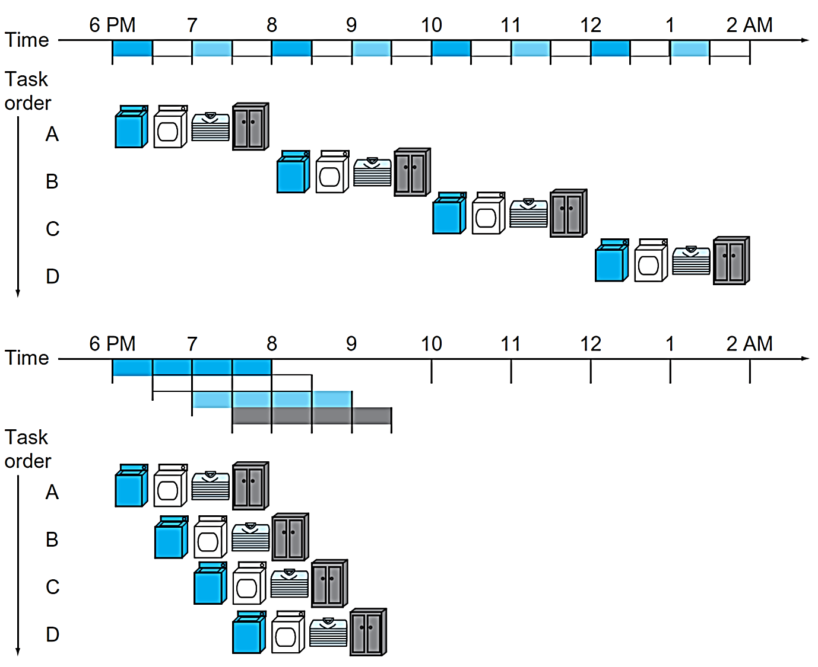
Pipelining Analogy
Pipelined laundry: overlapping execution
Parallelism improves performance
4-load speedup = 8/3.5 = 2.3
20-load speedup = 40/11.5 = 3.478
Under ideal conditions
The speedup from pipelining ≈ The number of pipe stages

Slide 4
Five Stages of Load Instruction
Five stages, one step per stage
IF: Instruction fetch from (instruction) memory
ID: Instruction decode & register read
EX: Execute operation or calculate address
MEM: Access (data) memory operand
WB: Write result back to register

Slide 5
Pipeline Performance (1)
Assume time for stages is
100 ns for register read or write
200 ns for other stages
Compare pipelined datapath with single-cycle datapath
Instruction | IF | Reg Read | ALU Op | Mem Access | Reg Write | Total
lw | 200 | 100 | 200 | 200 | 100 | 800
sw | 200 | 100 | 200 | 200 |  | 700
R-format | 200 | 100 | 200 |  | 100 | 600
beq | 200 | 100 | 200 |  |  | 500

Slide 6
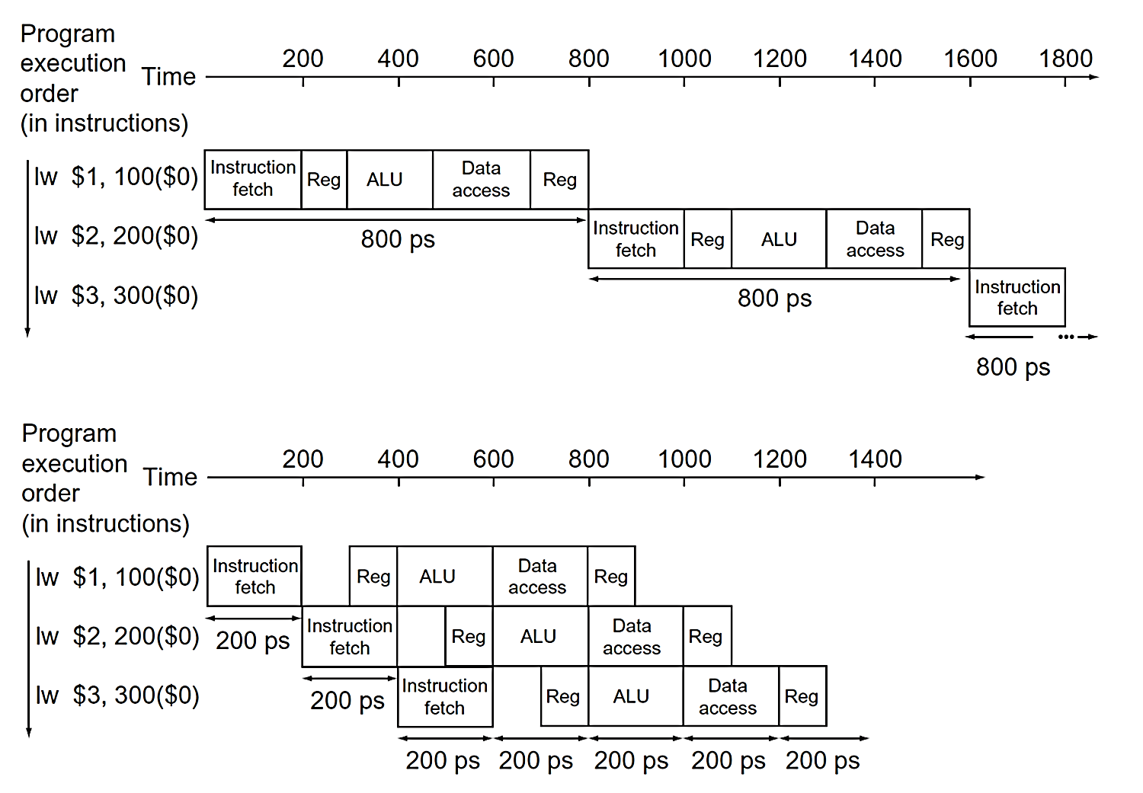
Pipeline Performance (2)

Slide 7
Pipeline Speedup
If all stages are balanced, i.e., all take the same time
If not balanced, speedup is less
Speedup due to increased throughput
Latency (time for each instruction) does not decrease
Time between instructions_{pipelined} = | Time between instructions_{nonpipelined}
 | Number of pipeline stages

Slide 8
Pipelining and ISA Design
MIPS ISA designed for pipelining
All instructions are 32-bits
Easier to fetch and decode in one cycle
c.f. x86: 1- to 17-byte instructions
Few and regular instruction formats
Can decode and read registers in one step
Load/store addressing
Can calculate address in the 3rd stage, access memory in the 4th stage
Alignment of memory operands
Memory access takes only one cycle

Slide 9
Hazards
Situations that prevent starting the next instruction in the next cycle
Structure hazards
A required resource is busy
Data hazard
Need to wait for previous instruction to complete its data read/write
Control hazard
The decision on control action depends on previous instruction

Slide 10
Structure Hazards
Conflict for use of a resource
In MIPS pipeline with a single memory
Load/store requires data access
Instruction fetch would have to stall for that cycle
Would cause a pipeline “bubble”
Hence, pipelined datapaths require separate instruction/data memories
Or separate instruction/data caches

Slide 11
Data Hazards
An instruction depends on completion of data access by a previous instruction
add $s0, $t0, $t1 sub $t2, $s0, $t3
We may need to insert a pipeline stall (or bubble)

Slide 12
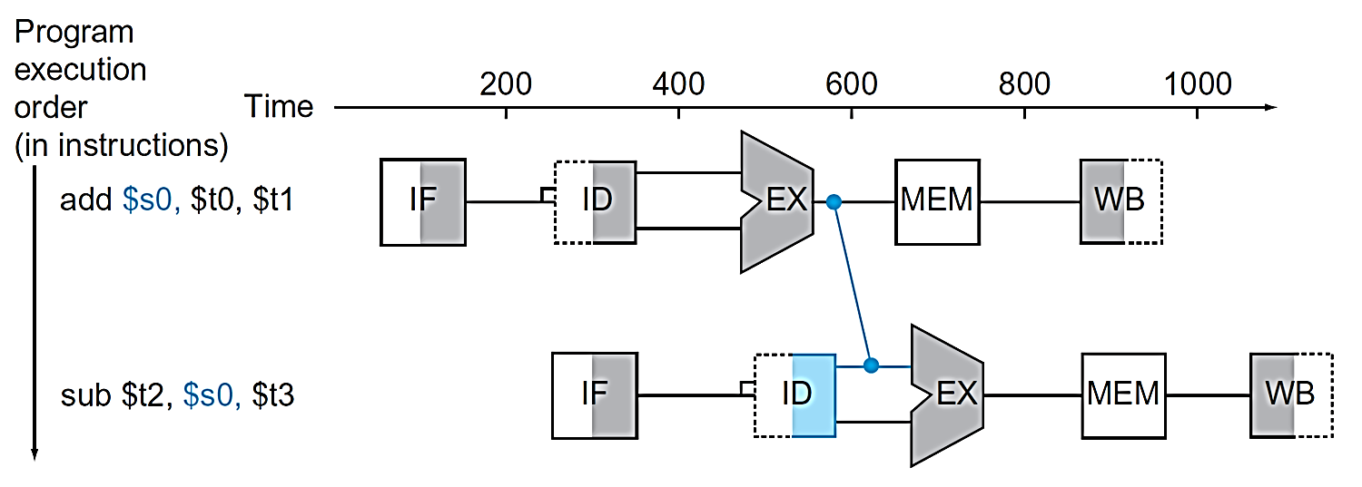
Forwarding (or Bypassing)
Use result when it is computed
Do not wait for it to be stored in a register
Requires extra connections in the datapath

Slide 13
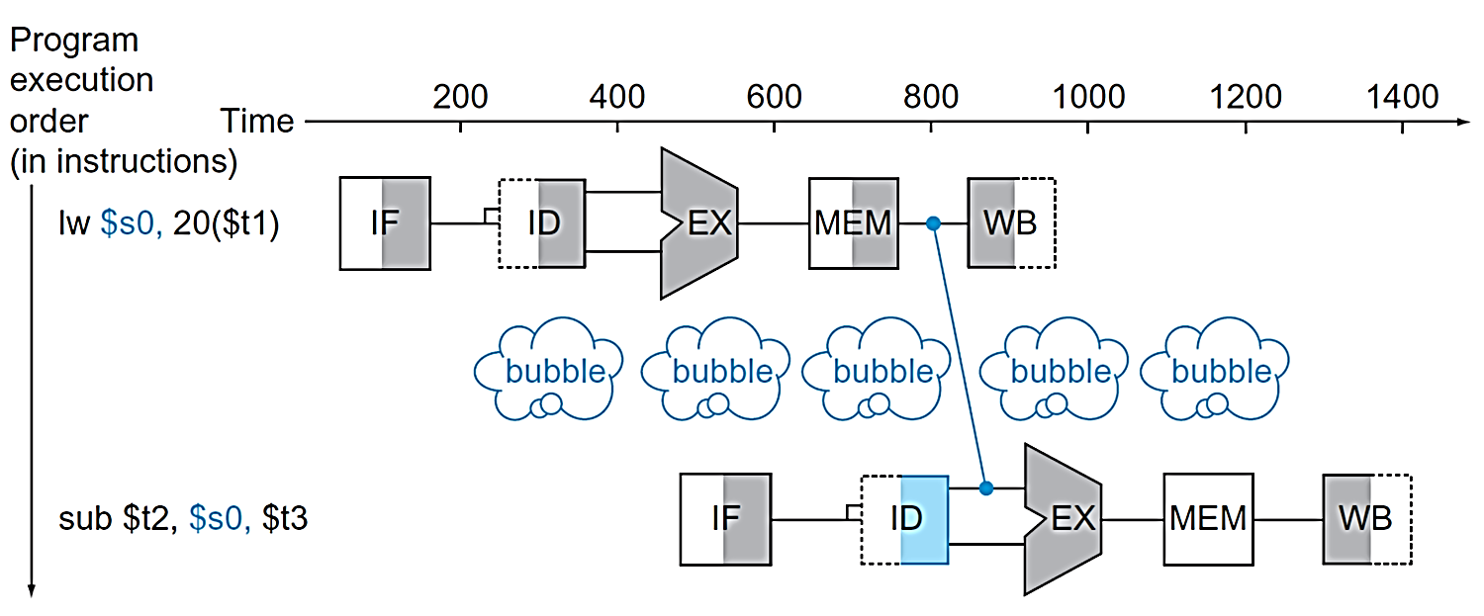
Load-Use Data Hazard
Cannot always avoid stalls by forwarding
If value not computed when needed
Can not forward in time!

Slide 14
Reorder Code to Avoid Pipeline Stalls
Reorder code to avoid the use of load result in the next instruction
Consider the C-code
a = b + e; c = b + f;
lw $t1, 0($t0)
lw $t2, 4($t0)
add $t3, $t1, $t2
sw $t3, 12($t0)
lw $t4, 8($t0)
add $t5, $t1, $t4
sw $t5, 16($t0)
lw $t1, 0($t0)
lw $t2, 4($t0)
lw $t4, 8($t0)
add $t3, $t1, $t2
sw $t3, 12($t0)
add $t5, $t1, $t4
sw $t5, 16($t0)
stall
stall

Slide 15
Control Hazards
Branch determines flow of control
Fetch next instruction depends on branch outcome
Pipeline cannot always fetch correct instruction
Still working on ID stage of branch
In MIPS pipeline
Need to compare registers and compute target early in the pipeline
Add hardware to do it in ID stage

Slide 16
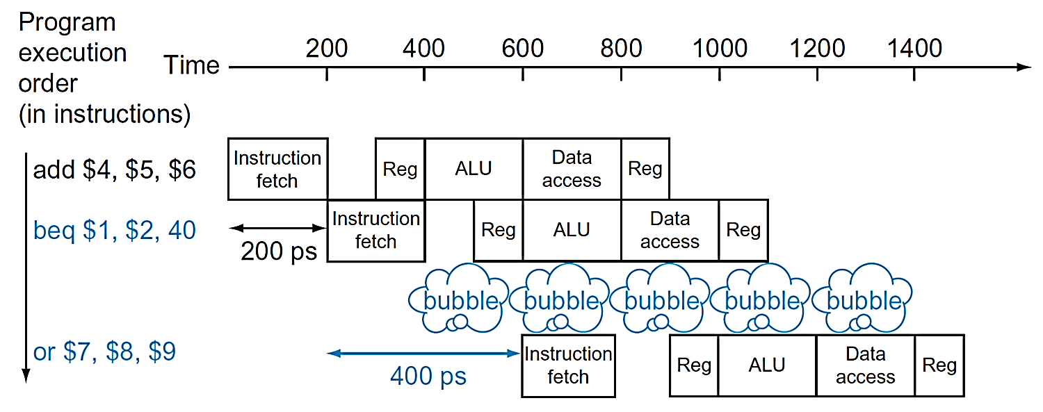
Stall on Branch
Wait until branch outcome determined before fetching the next instruction
Conservative approach: Stall immediately after fetching a branch, wait until outcome of branch is known and fetch branch address

Slide 17
Branch Prediction
Longer pipelines cannot readily determine branch outcome early
Stall penalty becomes unacceptable
Predict outcome of branch
Only stall if prediction is wrong
In MIPS pipeline
Can predict branches not taken
Fetch instruction after branch, with no delay

Slide 18
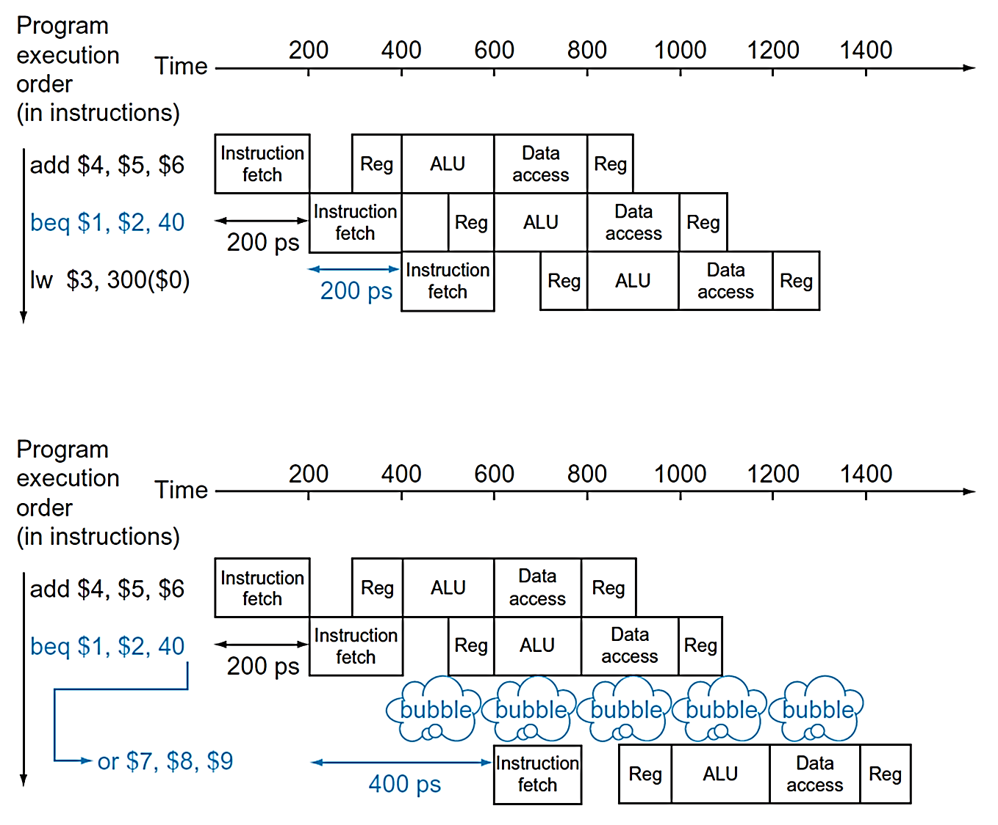
Predict Branches Are Not Taken
Prediction Correct
No penalty
Prediction Incorrect
Stall

Slide 19
More-Realistic Branch Prediction
Static branch prediction
Based on typical branch behavior
Example: loop and if-statement branches
Predict backward branches taken
Predict forward branches not taken
Dynamic branch prediction
Hardware measures actual branch behavior
e.g., record recent history of each branch
Assume future behavior will continue the trend
When wrong, stall while re-fetching, and update history

Slide 20
Pipeline Big-Picture Summary
Pipelining improves performance by increasing instruction throughput
Executes multiple instructions in parallel
Each instruction has the same latency
Subject to hazards
Structure, data, control
Instruction set design affects complexity of pipeline implementation

Slide 21
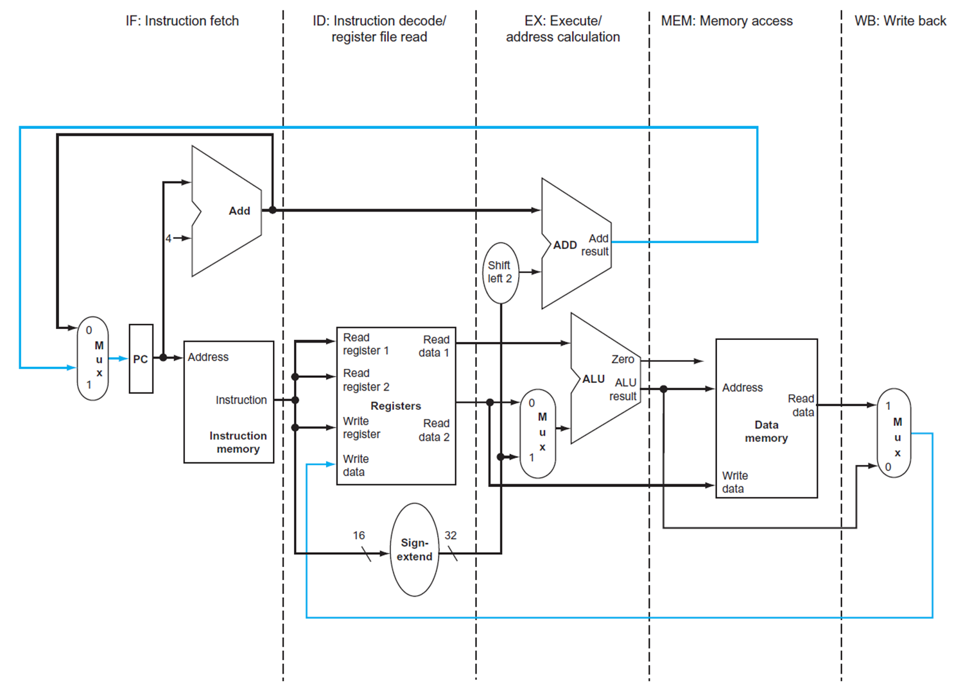
MIPS Pipelined Datapath
MEM
Control hazard
WB
Data hazard

Slide 22
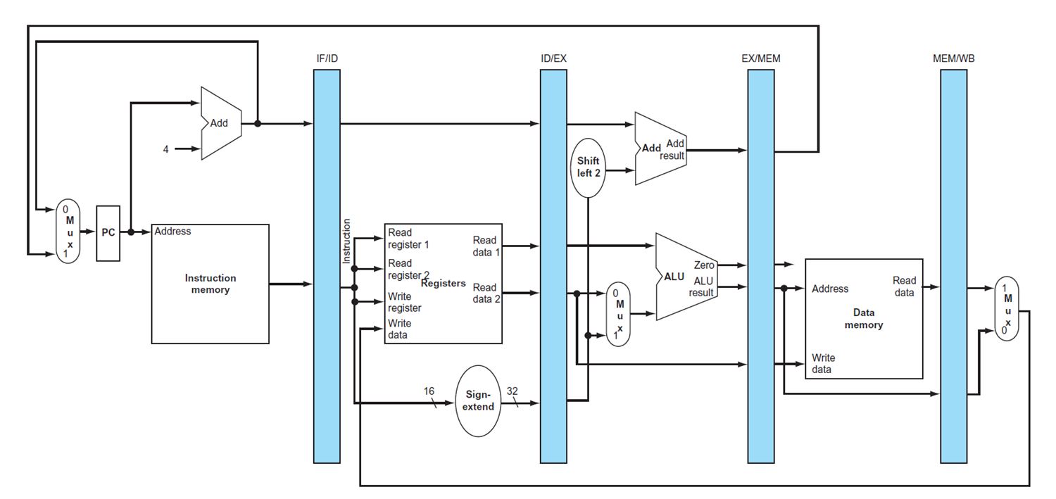
Pipeline Registers
Need registers between stages
To hold information produced in previous cycle
[64]
[128]
[97]
[64]

Slide 23
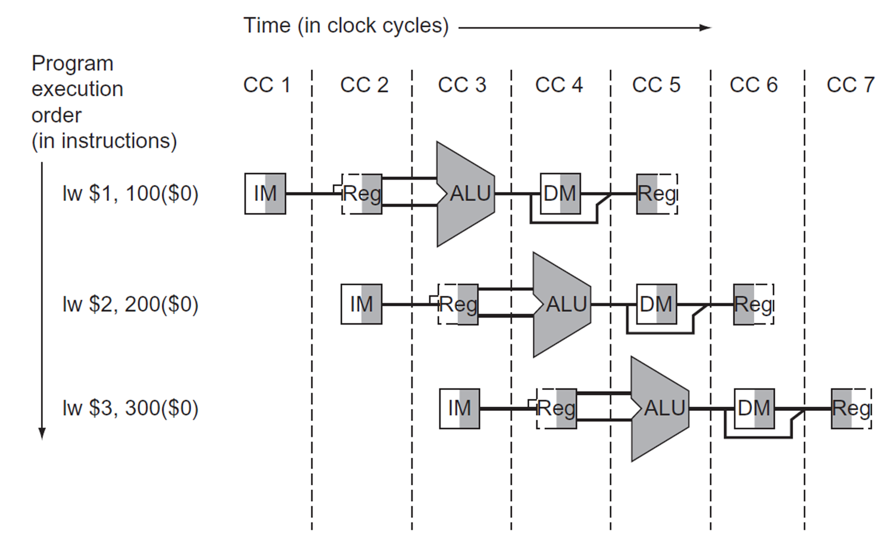
Timeline of Instruction Execution

Slide 24
Pipeline Operation
Cycle-by-cycle flow of instructions through the pipelined datapath
“Single-clock-cycle” pipeline diagram
Shows pipeline usage in a single cycle
Highlight resources used
We will look at “single-clock-cycle” diagrams for load & store

Slide 25
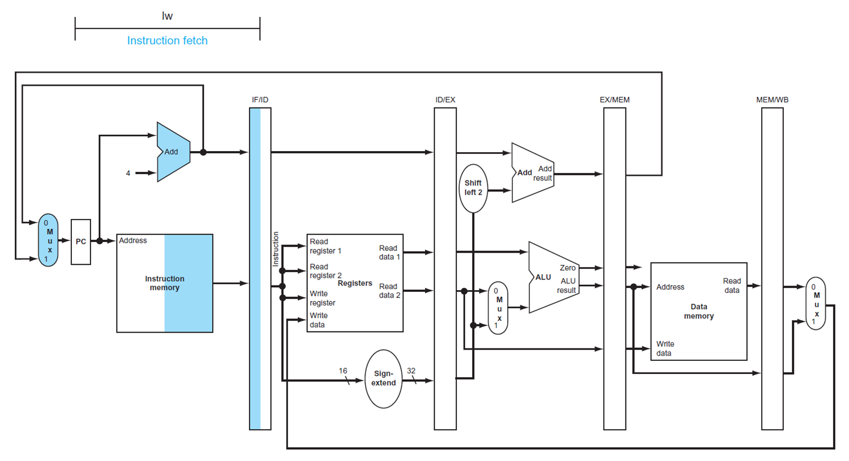
IF for Load

Slide 26
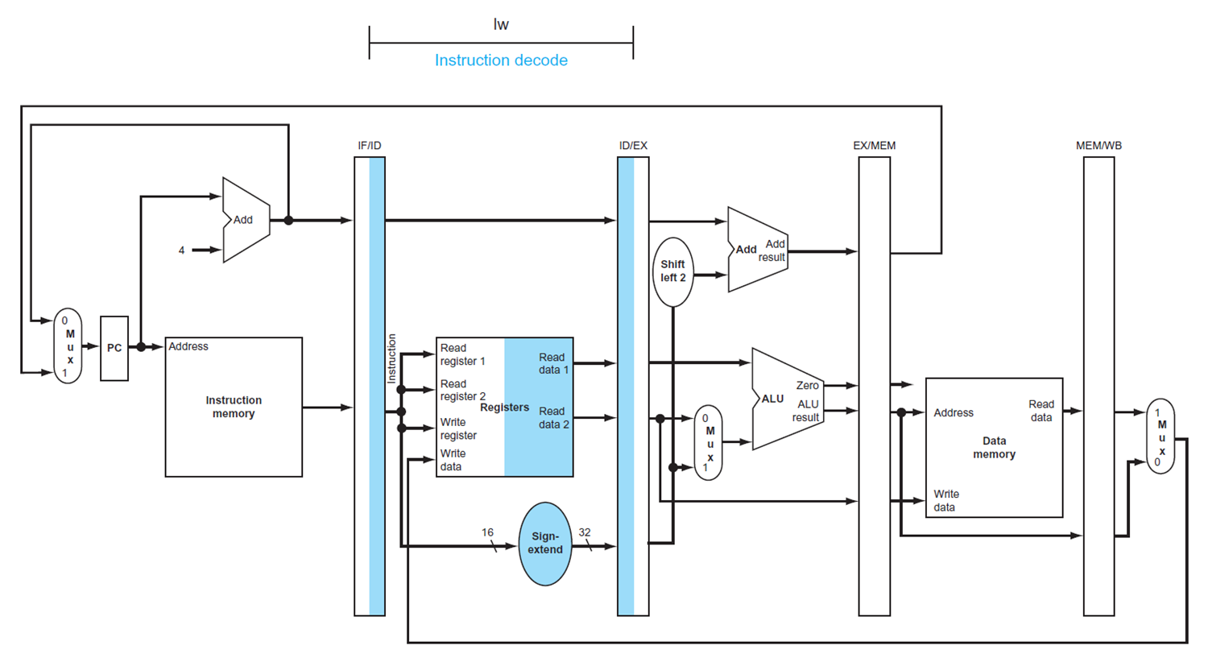
ID for Load

Slide 27
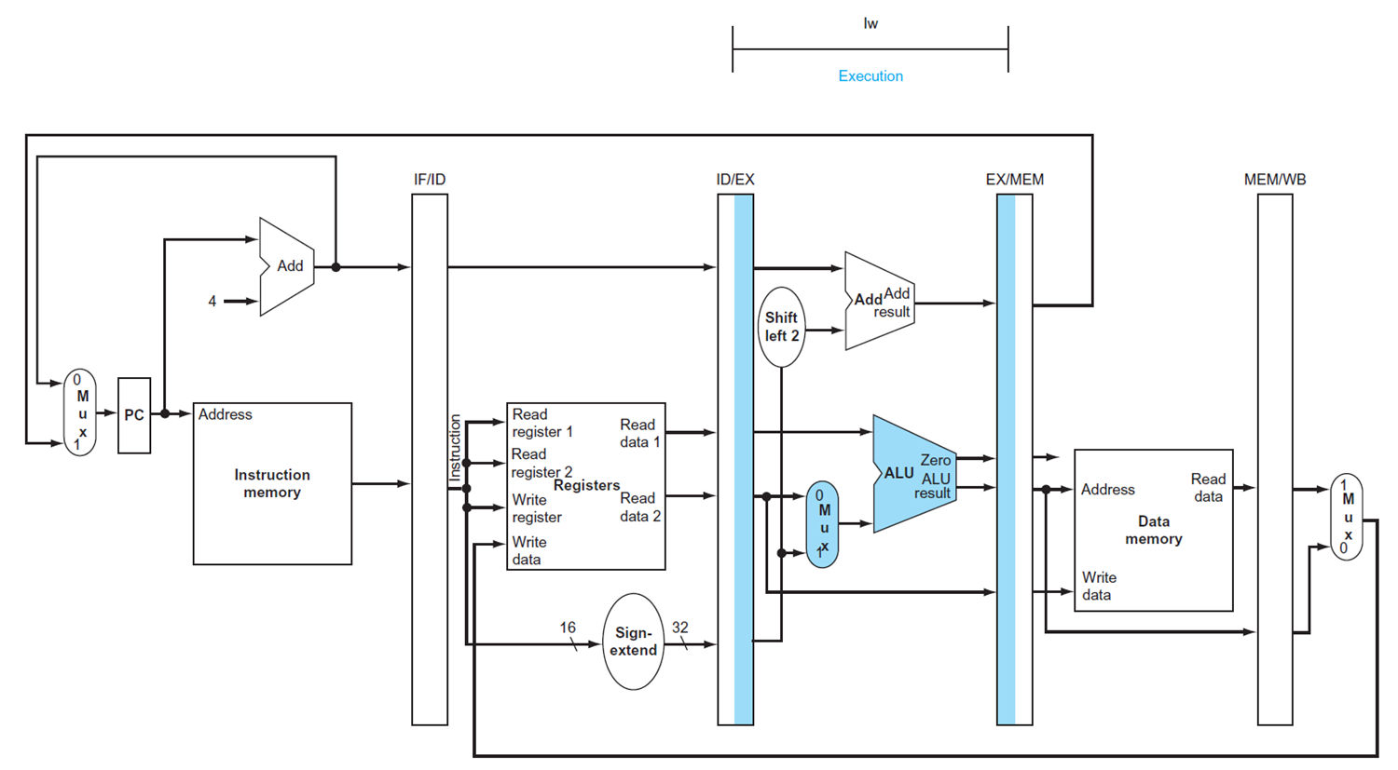
EX for Load

Slide 28
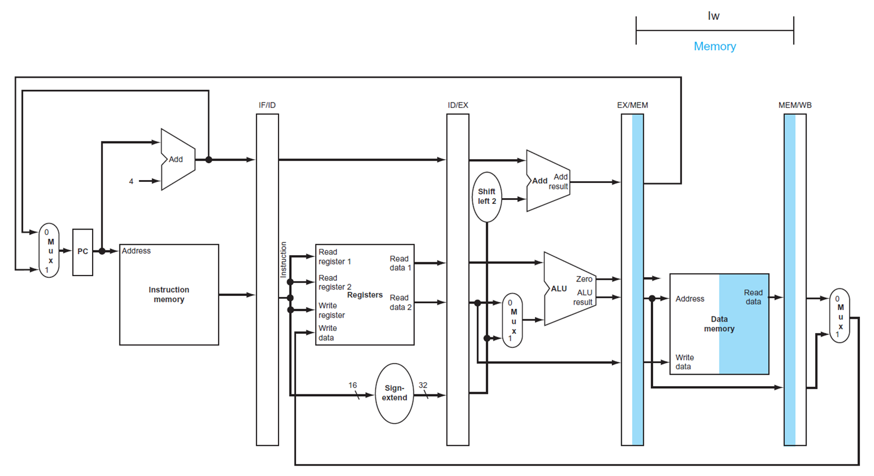
MEM for Load

Slide 29
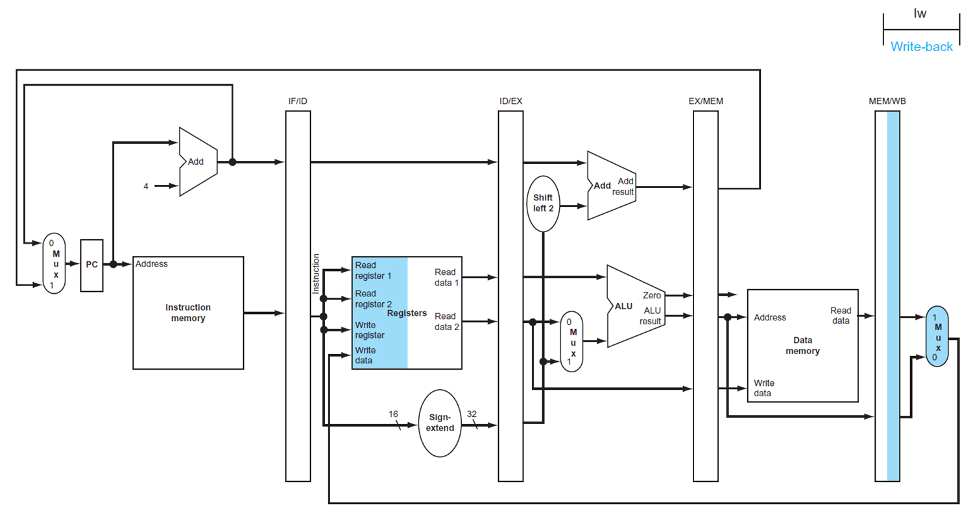
WB for Load (with bug)
Incorrect destination register

Slide 30
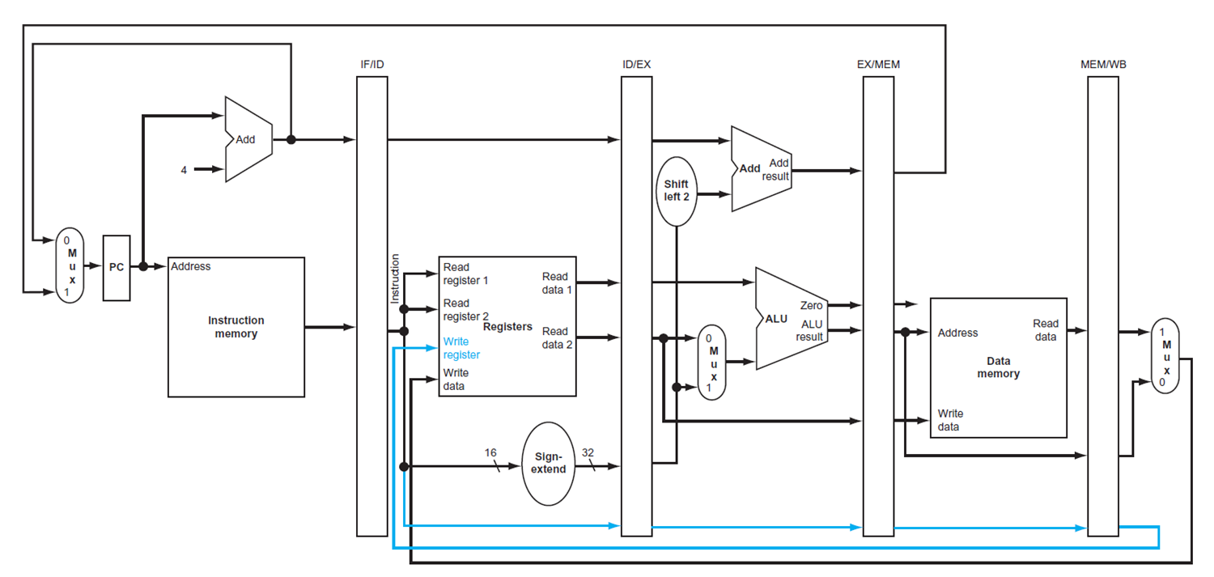
Corrected Datapath for Load

Slide 31
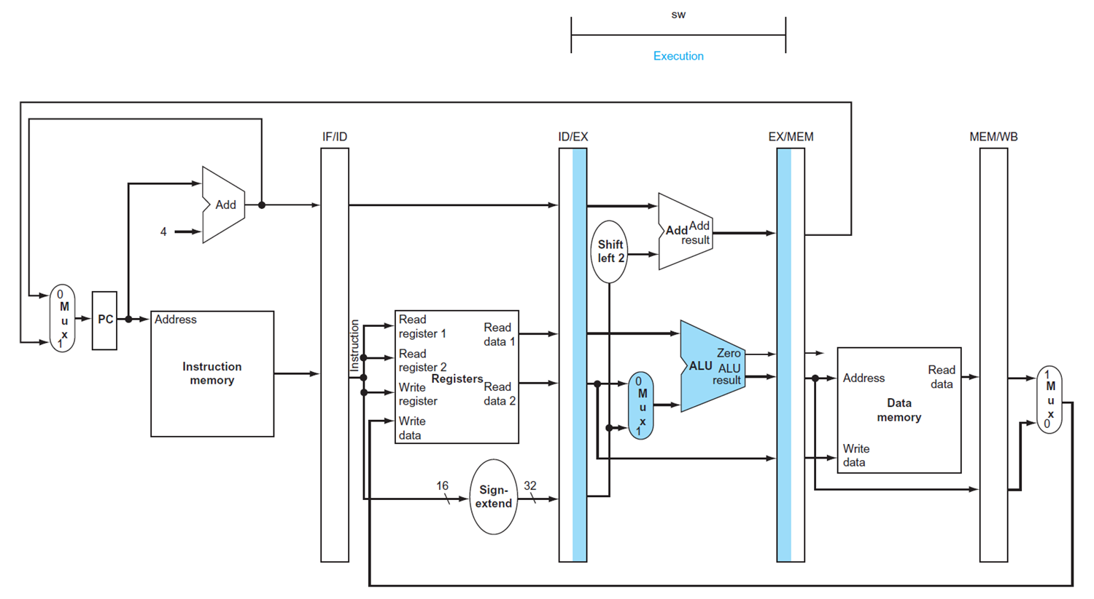
EX for Store

Slide 32
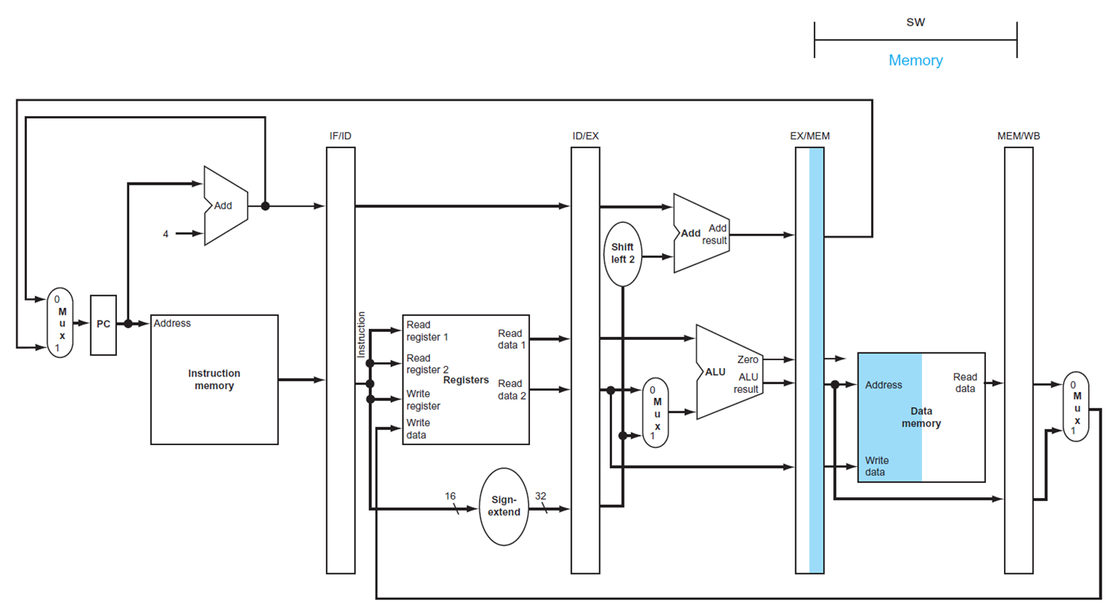
MEM for Store

Slide 33
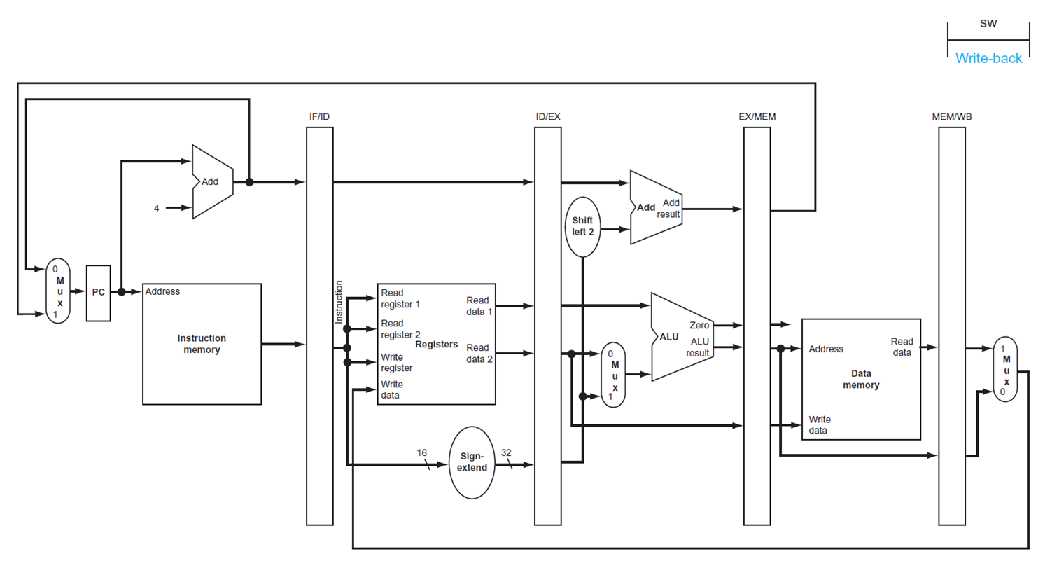
WB for Store

Slide 34
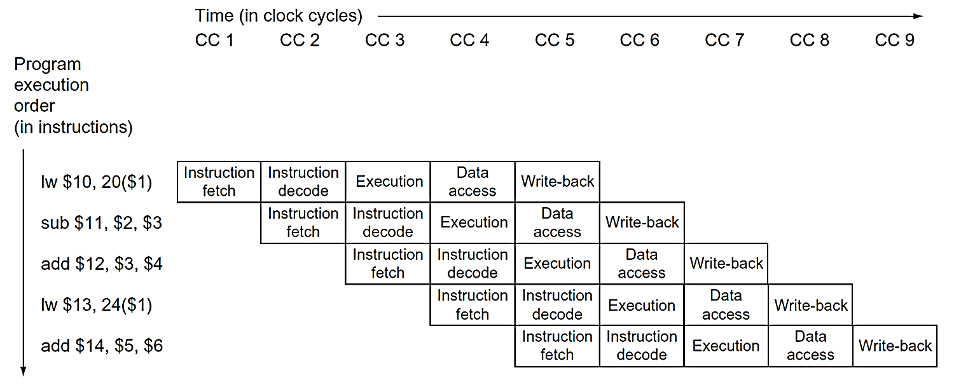
Multi-Cycle Pipeline Diagram (1)
Traditional diagram

Slide 35
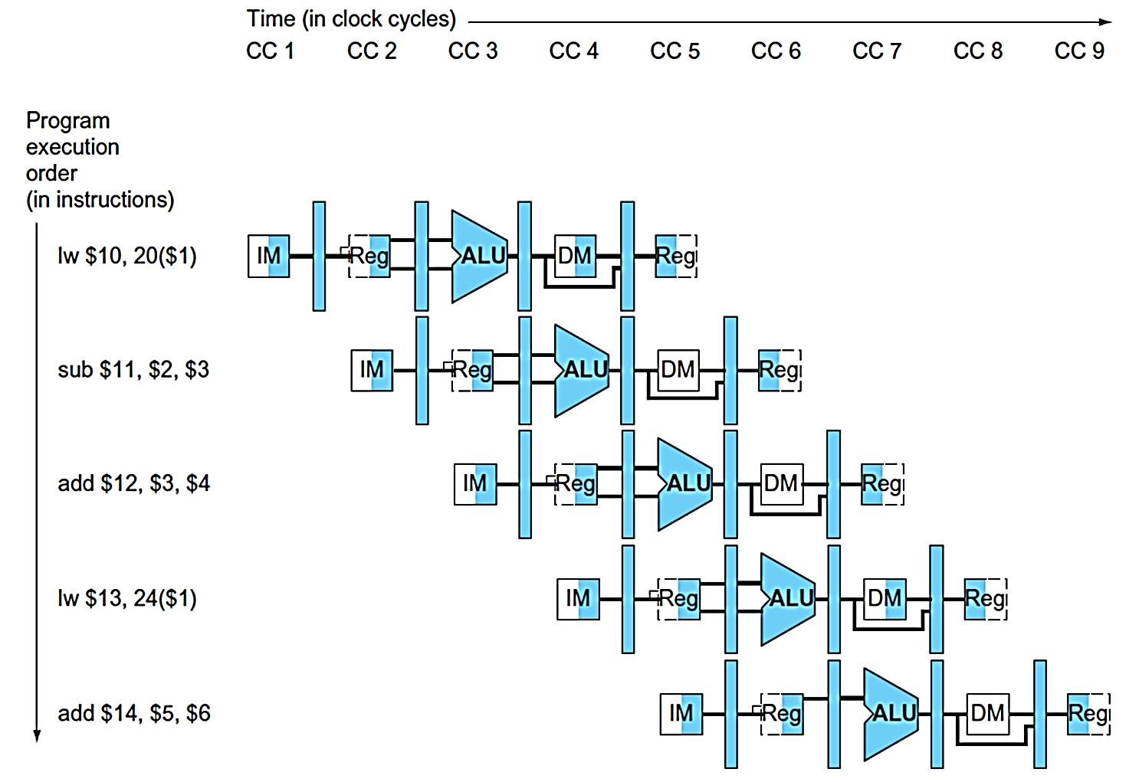
Multi-Cycle Pipeline Diagram (2)
Resources usage is shown

Slide 36
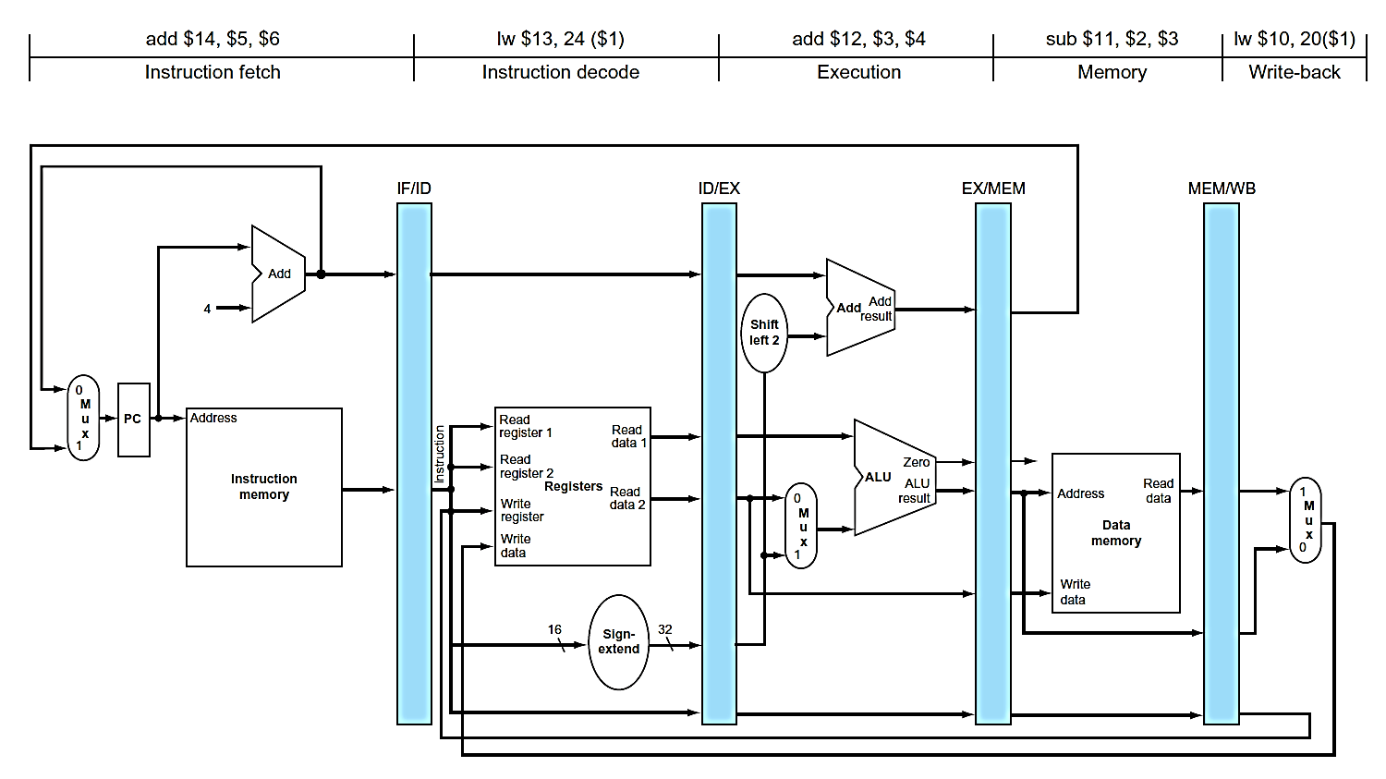
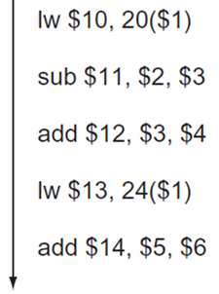
Single-Cycle Pipeline Diagram
State of the pipeline at a specific cycle

Slide 37
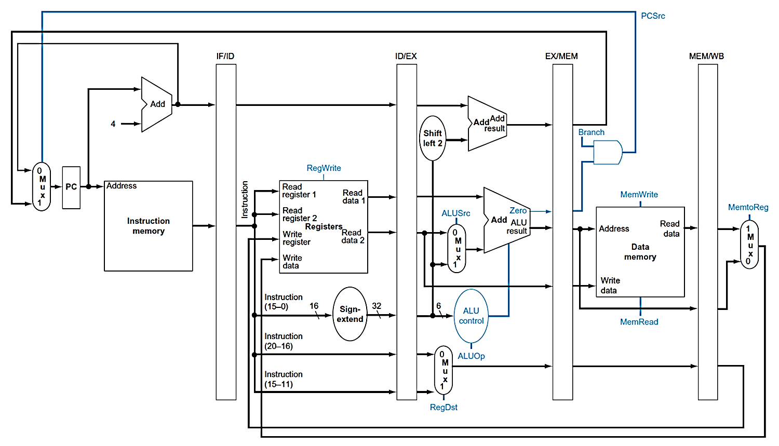
Pipelined Datapath with Control Signals

Slide 38
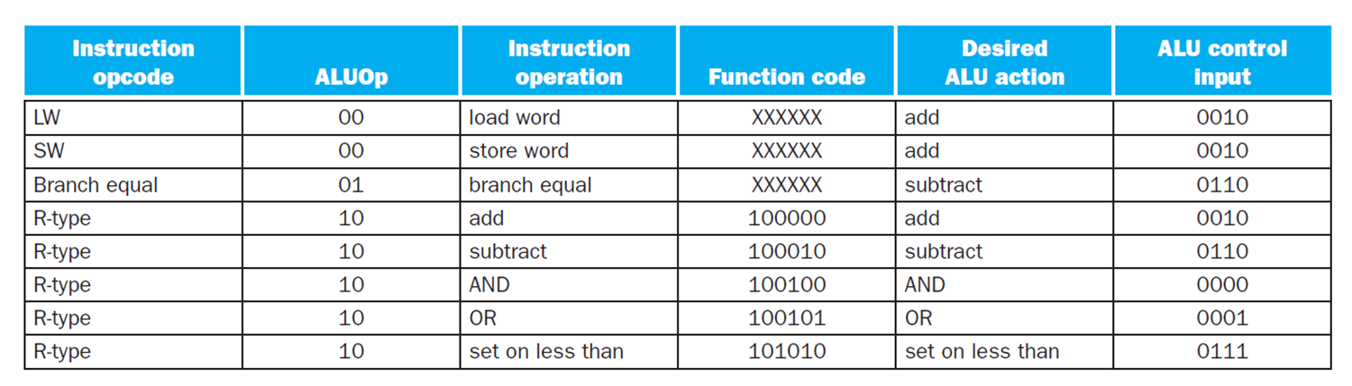
Control Signals (1)

Slide 39
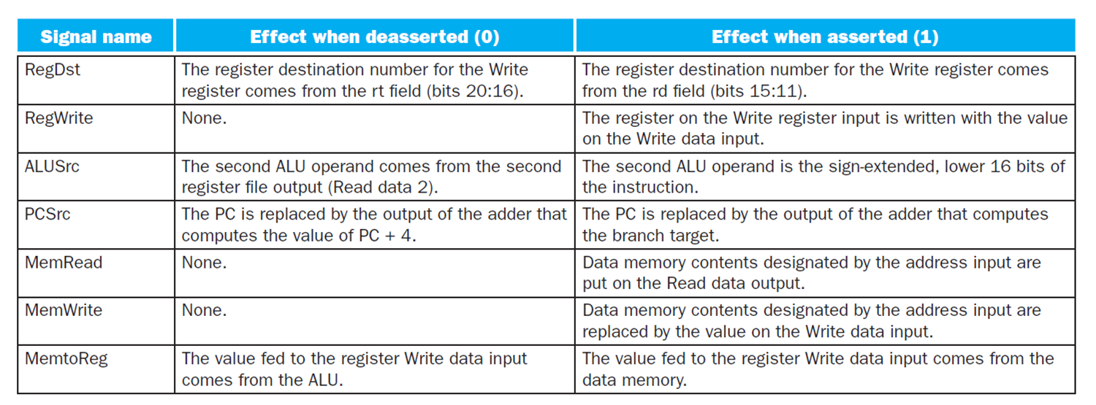
Control Signals (2)

Slide 40
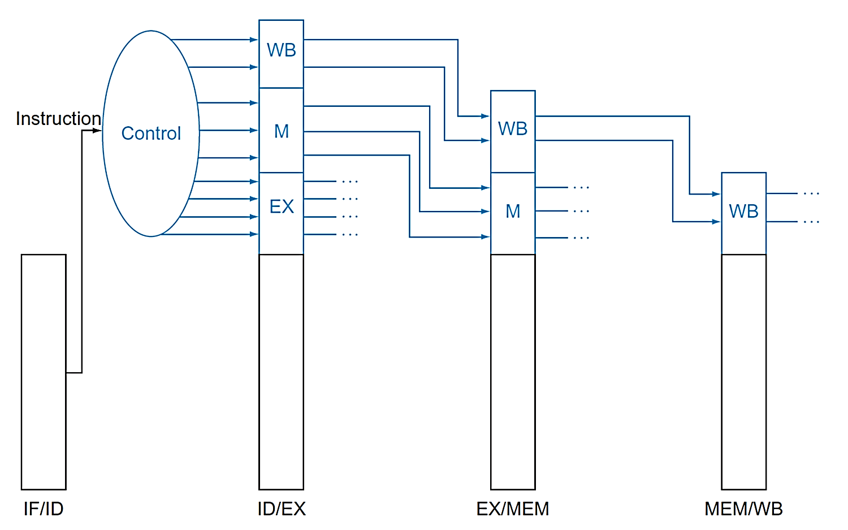
Pipeline Control
Control signals derived from instruction
As in single-cycle implementation

Slide 41
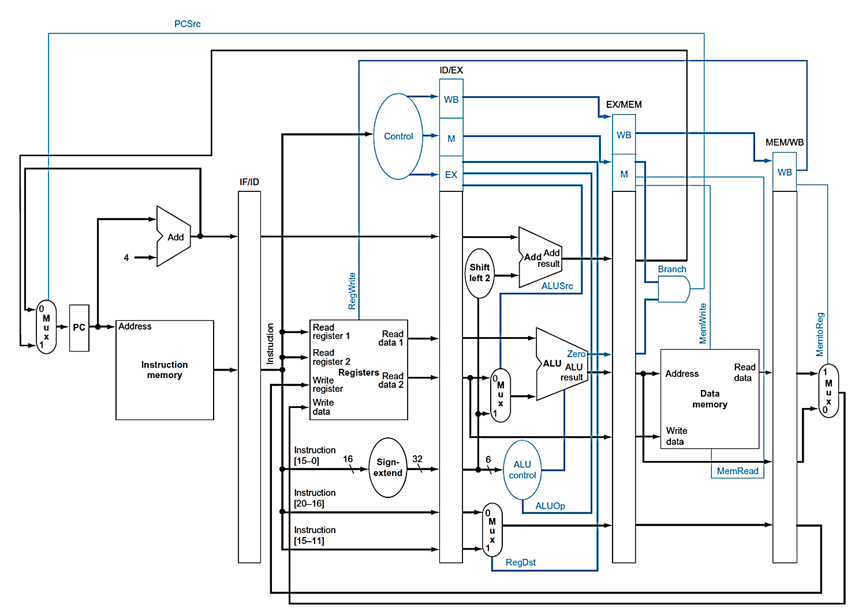
Pipeline Datapath with Control

Slide 42
Data Hazards in ALU Instructions
Consider this sequence
sub $2, $1,$3 # Register $2 written by sub
and $12,$2,$5 # 1st operand($2) depends on sub
or $13,$6,$2 # 2nd operand($2) depends on sub
add $14,$2,$2 # 1st($2) & 2nd($2) depend on sub
sw $15,100($2) # Base ($2) depends on sub
We can resolve hazards with forwarding
How do we detect when to forward?

Slide 43
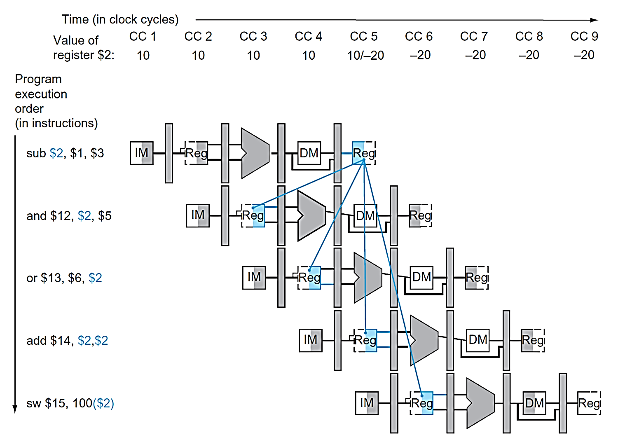
Dependencies and Forwarding

Slide 44
Detect the Need to Forward (1)
Pass register numbers along pipeline
e.g., ID/EX.RegisterRs = register number for Rs sitting in ID/EX pipeline register
ALU operand register numbers in EX stage are given by
ID/EX.RegisterRs, ID/EX.RegisterRt
Data hazards when
1a. EX/MEM.RegisterRd = ID/EX.RegisterRs
1b. EX/MEM.RegisterRd = ID/EX.RegisterRt
2a. MEM/WB.RegisterRd = ID/EX.RegisterRs
2b. MEM/WB.RegisterRd = ID/EX.RegisterRt
Forward from EX/MEM pipeline registers
Forward from MEM/WB pipeline registers

Slide 45
Detect the Need to Forward (2)
But only if forwarding instruction will write to a register
EX/MEM.RegWrite
MEM/WB.RegWrite
And only if Rd for that instruction is not $zero
EX/MEM.RegisterRd ≠ 0
MEM/WB.RegisterRd ≠ 0

Slide 46
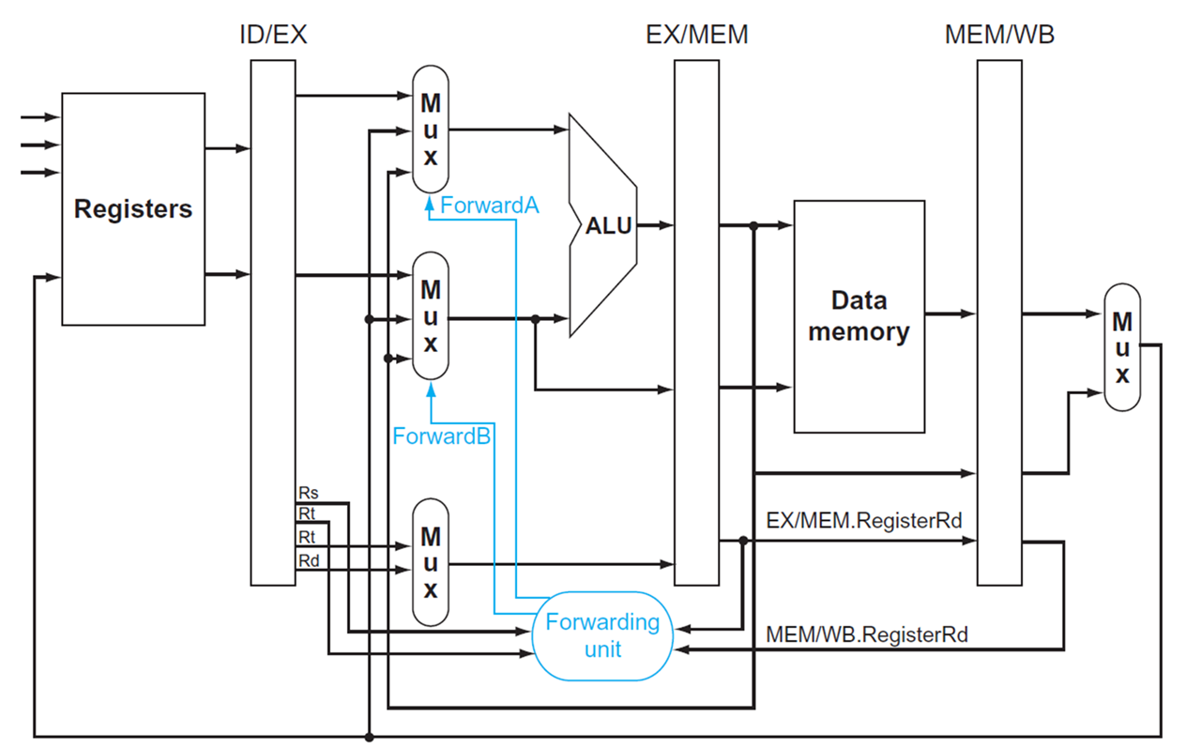
Forwarding Paths

Slide 47
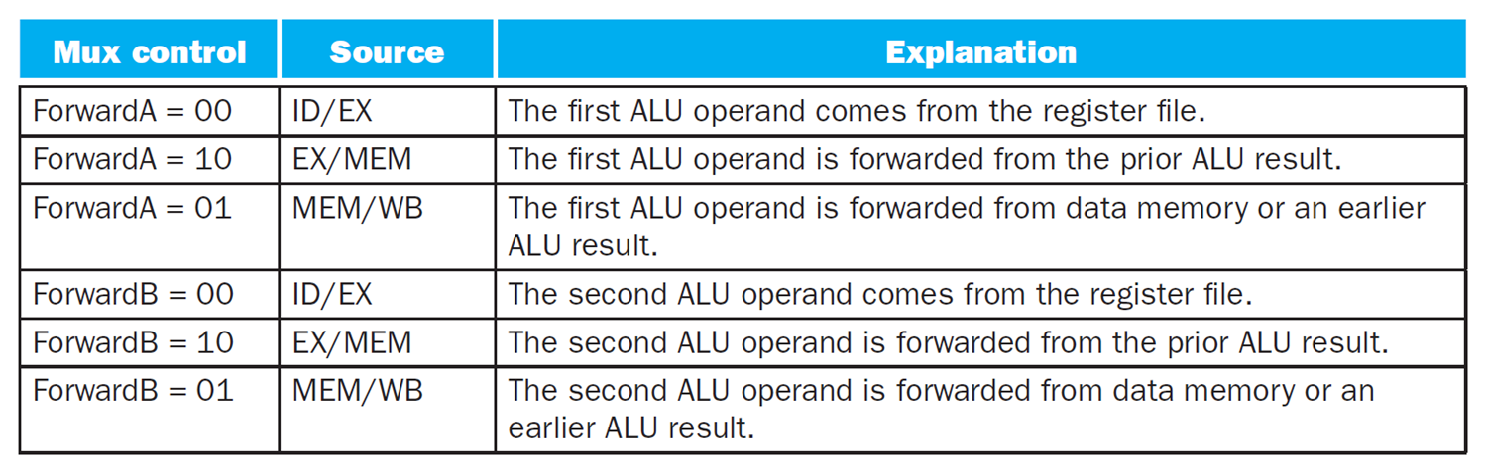
Forwarding Control

Slide 48
Forwarding Conditions
EX hazard
if (EX/MEM.RegWrite and (EX/MEM.RegisterRd ≠ 0) and (EX/MEM.RegisterRd = ID/EX.RegisterRs))
ForwardA = 10
if (EX/MEM.RegWrite and (EX/MEM.RegisterRd ≠ 0) and (EX/MEM.RegisterRd = ID/EX.RegisterRt))
ForwardB = 10
MEM hazard
if (MEM/WB.RegWrite and (MEM/WB.RegisterRd ≠ 0) and (MEM/WB.RegisterRd = ID/EX.RegisterRs))
ForwardA = 01
if (MEM/WB.RegWrite and (MEM/WB.RegisterRd ≠ 0) and (MEM/WB.RegisterRd = ID/EX.RegisterRt))
ForwardB = 01

Slide 49
Double Data Hazard
Consider the sequence:
add $1,$1,$2
add $1,$1,$3
add $1,$1,$4
Both hazards occur
Want to use the most recent
Revise MEM hazard condition
Only forward if EX hazard condition is not true

Slide 50
Revised Forwarding Conditions
MEM hazard
if (MEM/WB.RegWrite and (MEM/WB.RegisterRd ≠ 0) and not (EX/MEM.RegWrite and (EX/MEM.RegisterRd ≠ 0) and (EX/MEM.RegisterRd = ID/EX.RegisterRs)) and (MEM/WB.RegisterRd = ID/EX.RegisterRs))
ForwardA = 01
if (MEM/WB.RegWrite and (MEM/WB.RegisterRd ≠ 0) and not (EX/MEM.RegWrite and (EX/MEM.RegisterRd ≠ 0) and (EX/MEM.RegisterRd = ID/EX.RegisterRt)) and (MEM/WB.RegisterRd = ID/EX.RegisterRt))
ForwardB = 01

Slide 51
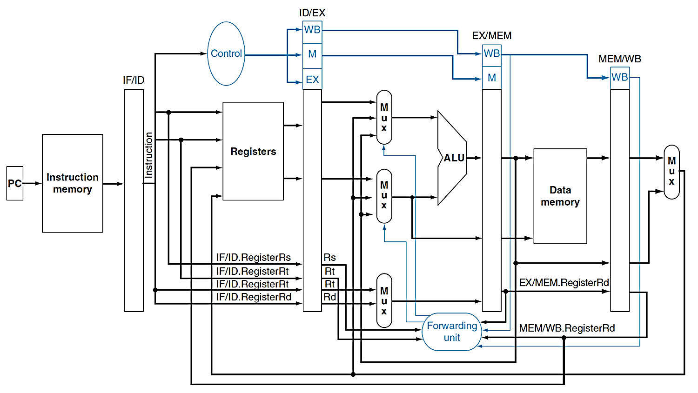
Datapath with Forwarding

Slide 52
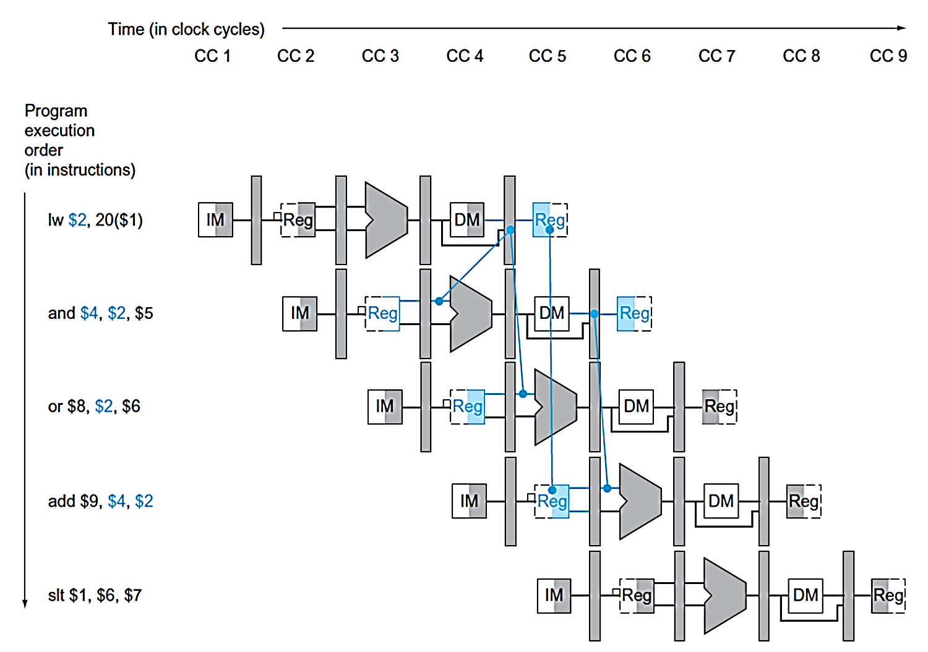
Load-Use Data Hazard
Need to stall for one cycle

Slide 53
Load-Use Hazard Detection
Check when using instruction is decoded in ID stage
ALU operand register numbers in ID stage are given by
IF/ID.RegisterRs
IF/ID.RegisterRt
Load-use hazard when
ID/EX.MemRead and ((ID/EX.RegisterRt = IF/ID.RegisterRs) or (ID/EX.RegisterRt = IF/ID.RegisterRt))
If detected, stall and insert bubble

Slide 54
How to Stall the Pipeline
Force control values in ID/EX register to 0
EX, MEM and WB do nop (no-operation)
Prevent update of PC and IF/ID register
Using instruction is decoded again
Following instruction is fetched again
1-cycle stall allows MEM to read data for lw
Can subsequently forward to EX stage

Slide 55
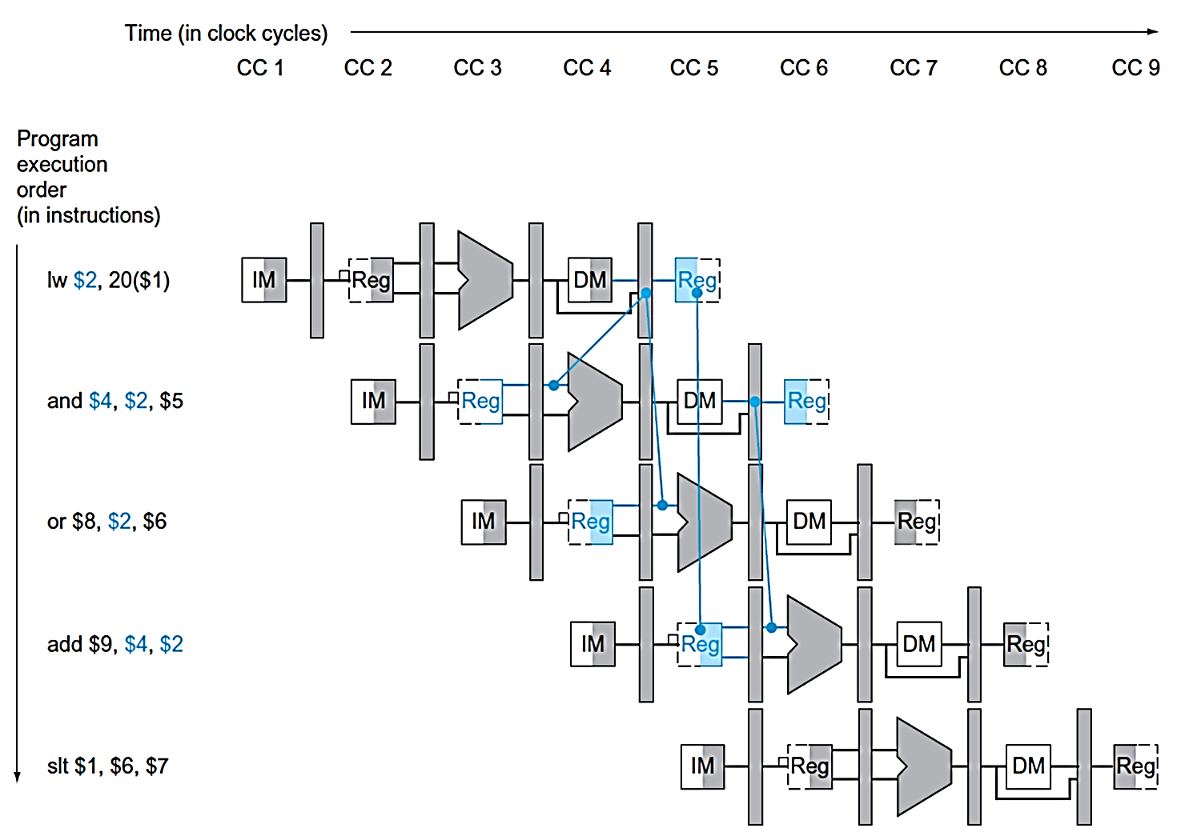
Without Stalling

Slide 56
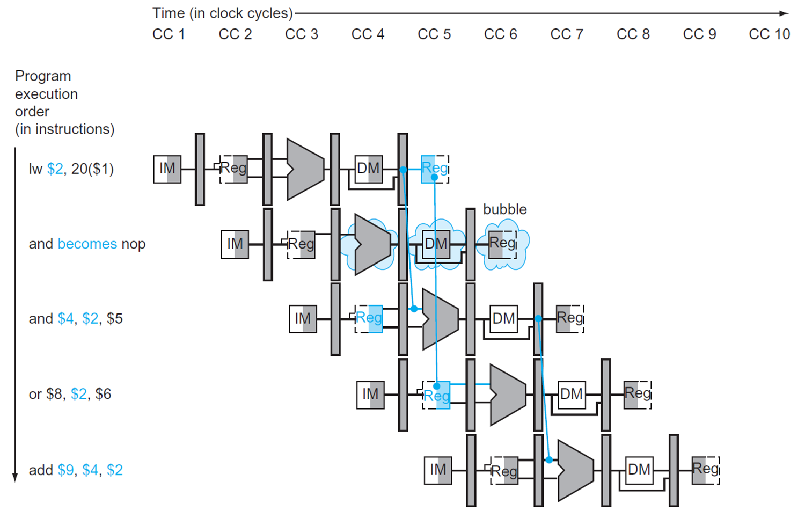
Stall/Bubble in the Pipeline

Slide 57
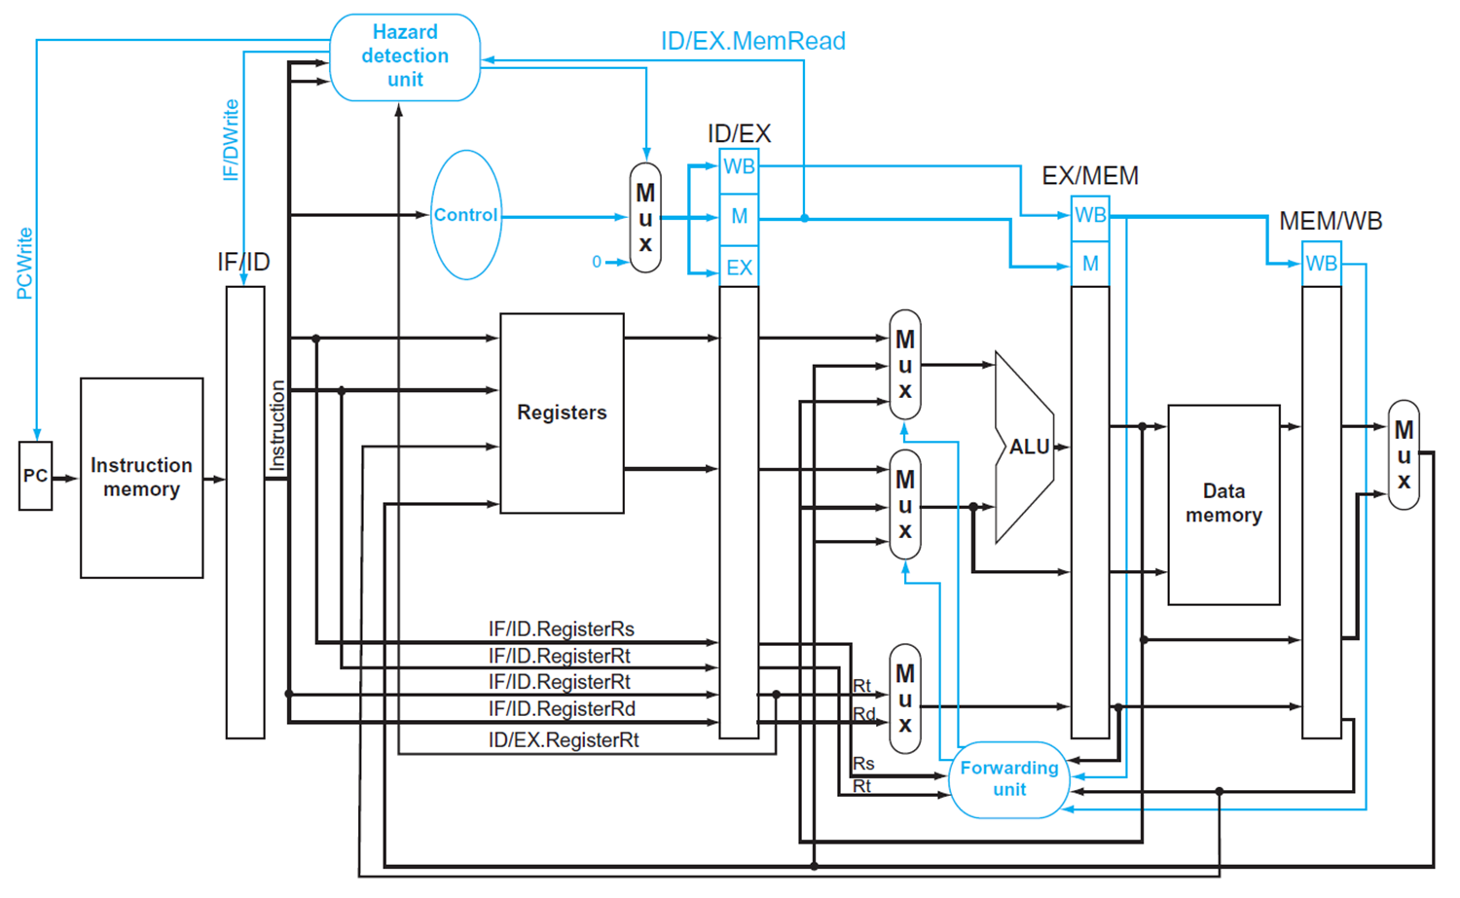
Datapath with Hazard Detection

Slide 58
Stalls and Performance
Stalls reduce performance
But are required to get correct results
Compiler can arrange code to avoid hazards and stalls
Requires knowledge of the pipeline structure

Slide 59
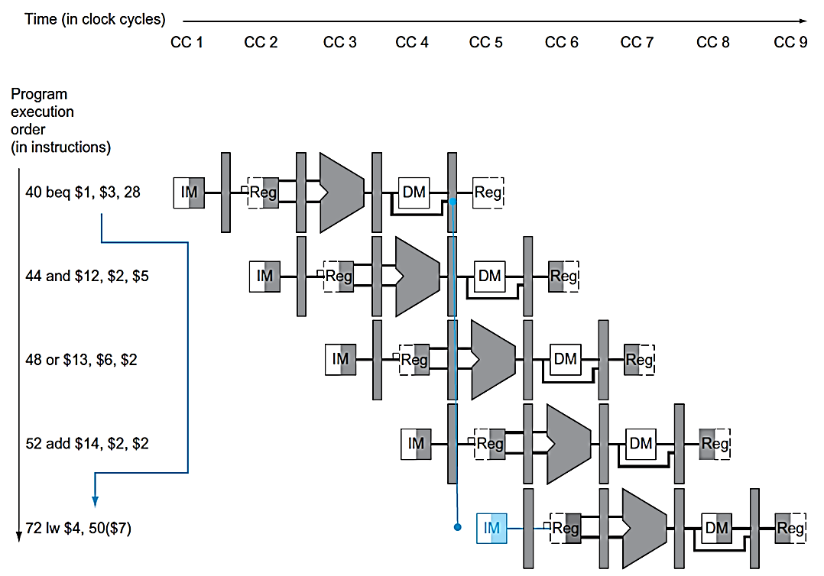
Branch Hazards
If branch outcome determined in MEM
Flush these instructions (Set control values to 0)

Slide 60
Control Hazards
When the flow of instruction addresses is not sequential (i.e., PC = PC + 4); incurred by change of flow instructions
Unconditional branches (j, jal, jr)
Conditional branches (beq, bne)
Exceptions
Possible approaches
Stall (impacts CPI)
Move decision point as early in the pipeline as possible, thereby reducing the number of stall cycles
Delay decision (requires compiler support)
Predict and hope for the best!
Control hazards occur less frequently than data hazards, but there is nothing as effective against control hazards as forwarding is for data hazards

Slide 61
Reducing Branch Delay
Move hardware to determine outcome to ID stage to reduce cost of the taken branch
Target address adder
Register comparator
Example: branch taken
36: sub $10, $4, $8 40: beq $1, $3, 7 44: and $12, $2, $5 48: or $13, $2, $6 52: add $14, $4, $2 56: slt $15, $6, $7 ... 72: lw $4, 50($7)

Slide 62
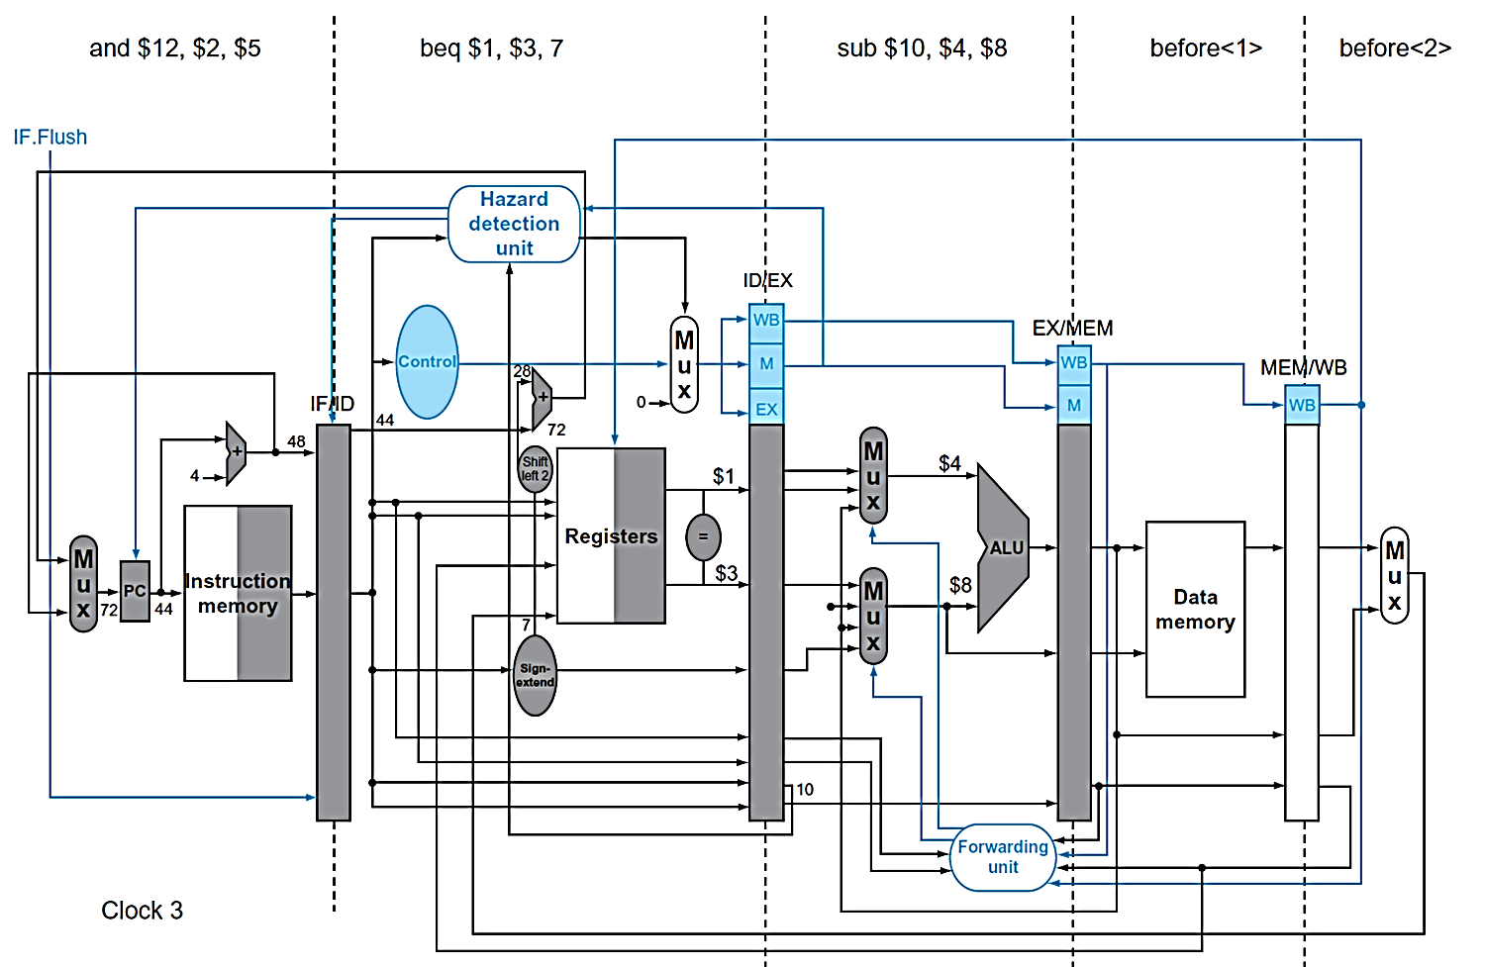
Example - Branch Taken (1)

Slide 63
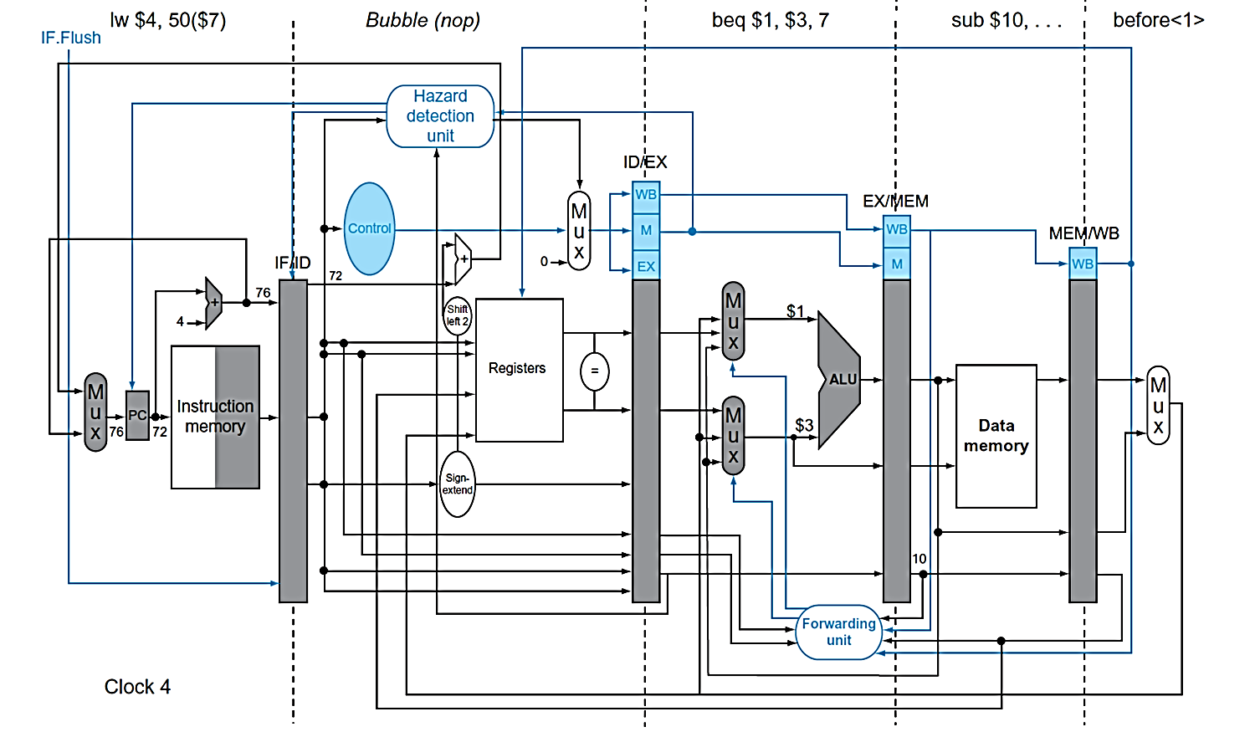
Example - Branch Taken (2)

Slide 64
Dynamic Branch Prediction
In deeper and superscalar pipelines, branch penalty is more significant
Use dynamic prediction
Branch prediction buffer (aka branch history table)
Indexed by recent branch instruction addresses
Stores outcome (taken/not taken)
To execute a branch
Check table, expect the same outcome
Start fetching from fall-through or target
If wrong, flush pipeline and flip prediction

Slide 65
1-Bit Predictor - Shortcoming
A 1-bit predictor will be incorrect twice when not taken
Assume predict_bit = 0 to start (indicating branch not taken) and loop control is at the bottom of the loop code
First time through the loop, the predictor mispredicts the branch since the branch is taken back to the top of the loop; invert prediction bit (predict_bit = 1)
As long as branch is taken (looping), prediction is correct
Exiting the loop, the predictor again mispredicts the branch since this time the branch is not taken falling out of the loop; invert prediction bit (predict_bit = 0)
For 10 times through the loop we have a 80% prediction accuracy for a branch that is taken 90% of the time

Slide 66
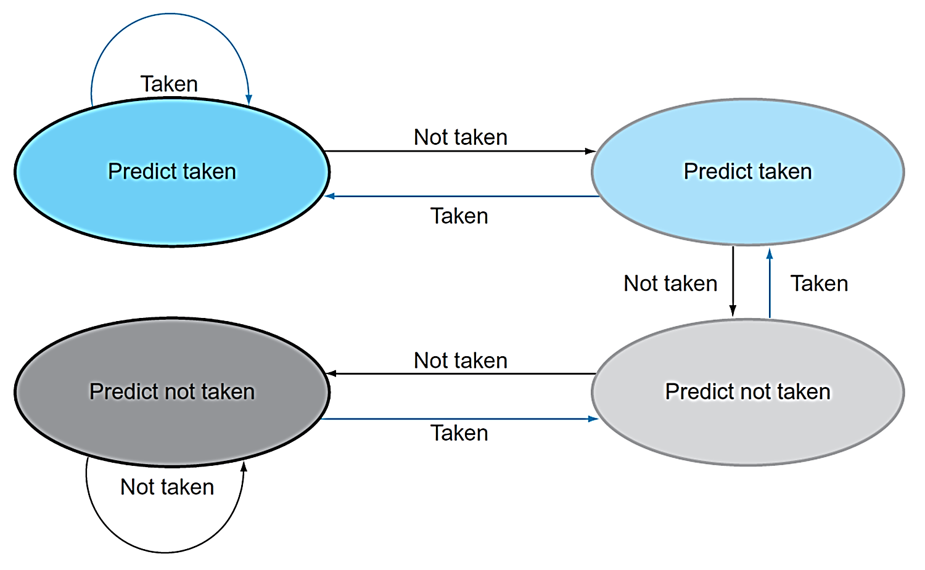
2-Bit Predictor
A 2-bit scheme can give 90% accuracy since a prediction must be wrong twice before the prediction bit is changed

Slide 67
Calculating the Branch Target
Even with predictor, still need to calculate the target address
1-cycle penalty for a taken branch
Branch target buffer
Cache of target addresses
Indexed by PC when instruction fetched
If hit and instruction is branch predicted taken, can fetch target immediately

Slide 68
Exceptions and Interrupts
“Unexpected” events requiring change in flow of control
Different ISAs use the terms differently
Exception
Arises within the CPU
e.g., undefined opcode, overflow, syscall, …
Interrupt
From an external I/O controller
Dealing with them without sacrificing performance is hard

Slide 69
Handling Exceptions
In MIPS, exceptions managed by a System Control Coprocessor (CP0)
Save PC of offending (or interrupted) instruction
In MIPS: Exception Program Counter (EPC)
Save indication of the problem
In MIPS: Cause register
Jump to handler at 0x8000 0180

Slide 70
Summary
ISA influences design of datapath and control
Datapath and control influence design of ISA
Pipelining improves instruction throughput using parallelism
More instructions completed per second
Latency for each instruction not reduced
Hazards
Structural
designing the pipeline correctly
Data
Stall (impacts CPI)
Forward (requires hardware support)
Control
Stall (impacts CPI)
Delay decision (requires compiler support)
Static and dynamic prediction (requires hardware support)
Pipelining complicates exception handling

