Slide 1
CSC3050 – Computer Architecture
Prof. Yeh-Ching Chung
School of Science and Engineering
Chinese University of Hong Kong, Shenzhen

Slide 2
Outline
An overview of pipelining
A pipelined datapath
Pipelined control
Hazards: types of hazard
Handling data hazards
Inserting NOP（software）
Forwarding, R-Type-use（hardware)
Stalls, load-use (hardware)
Handling branch hazards
Exceptions
Superscalar and dynamic pipelining

Slide 3
Single-Cycle Advantages & Disadvantages
Uses the clock cycle inefficiently – the clock cycle must be timed to accommodate the slowest instruction
Especially problematic for more complex instructions, e.g., floating-point multiplication
May be wasteful of area since some functional units (e.g., adders) must be duplicated since they can not be shared during a clock cycle
But it is simple and easy to understand
Cycle 1
Cycle 2
Clk
lw
sw
waste

Slide 4
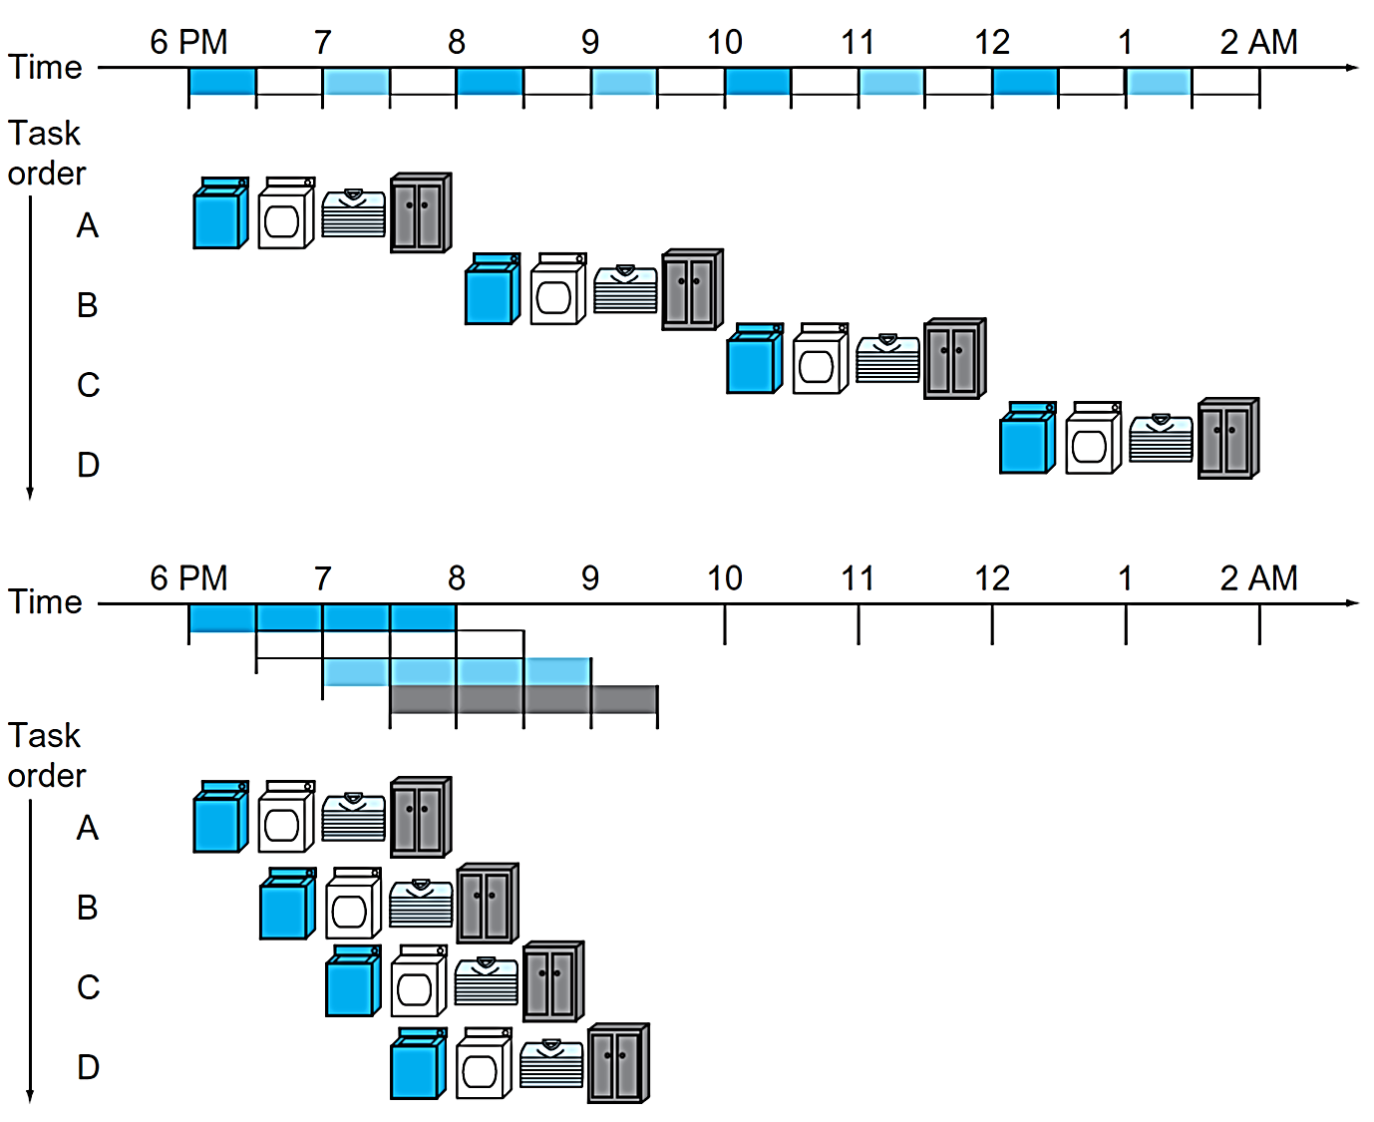
Pipelining Analogy
Pipelined laundry: overlapping execution
Parallelism improves performance
4-load speedup = 8/3.5 = 2.3
20-load speedup = 40/11.5 = 3.478
Under ideal conditions
The speedup from pipelining ≈ The number of pipe stages

Slide 5
Five Stages of Load Instruction
Five stages, one step per stage
IF: Instruction fetch from (instruction) memory
ID: Instruction decode & register read
EX: Execute operation or calculate address
MEM: Access (data) memory operand
WB: Write result back to register

Slide 6
Single Cycle VS Pipeline
Cycle 1
Cycle 2
Clk
Single Cycle Implementation:
Load
Store
Waste
Cycle 1
Cycle 2
Cycle 3
Cycle 4
Cycle 5
Cycle 6
Cycle 7
Cycle 8
Cycle 9
Cycle 10
Clk
Pipeline Implementation
Load
IF
ID
EX
MEM
WB
Store
IF
ID
EX
MEM
WB
R-type
IF
ID
EX
MEM
WB
Notes:
Here are the timing diagrams showing the differences between the single cycle, multiple cycle, and pipeline implementations.
For example, in the pipeline implementation, we can finish executing the Load, Store, and R-type instruction sequence in seven cycles.
In the multiple clock cycle implementation, however, we cannot start executing the store until Cycle 6 because we must wait for the load instruction to complete.
Similarly, we cannot start the execution of the R-type instruction until the store instruction has completed its execution in Cycle 9.
In the Single Cycle implementation, the cycle time is set to accommodate the longest instruction, the Load instruction.
Consequently, the cycle time for the Single Cycle implementation can be five times longer than the multiple cycle implementation.
But may be more importantly, since the cycle time has to be long enough for the load instruction, it is too long for the store instruction so the last part of the cycle here is wasted.
+2 = 77 min. (X:57)

Slide 7
Pipeline Performance (1)
Assume time for stages is
100 ns for register read or write
200 ns for other stages
Compare pipelined datapath with single-cycle datapath
Instruction | IF | Reg Read | ALU Op | Mem Access | Reg Write | Total
lw | 200 | 100 | 200 | 200 | 100 | 800
sw | 200 | 100 | 200 | 200 |  | 700
R-format | 200 | 100 | 200 |  | 100 | 600
beq | 200 | 100 | 200 |  |  | 500

Slide 8
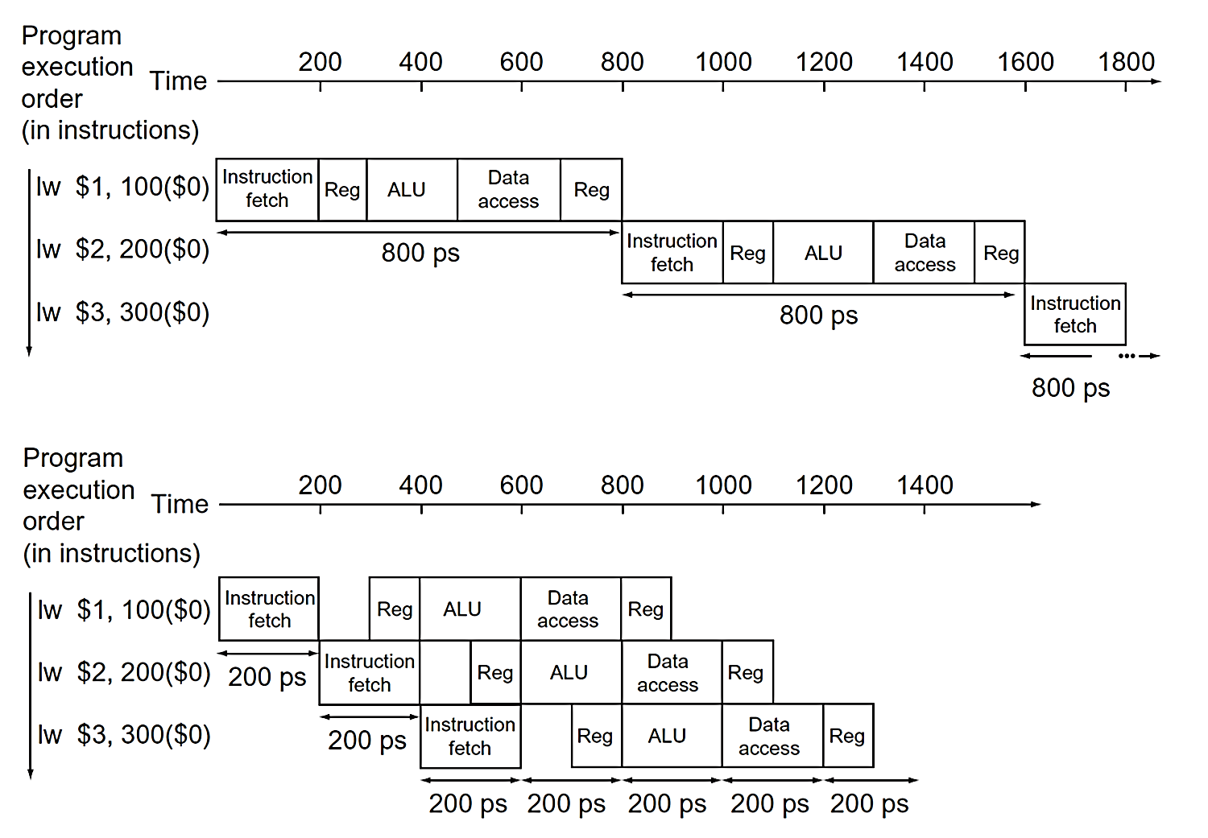
Pipeline Performance (2)

Slide 9
Pipeline Speedup
If all stages are balanced, i.e., all take the same time
If not balanced, speedup is less
Speedup due to increased throughput
Latency (time for each instruction) does not decrease
Time between instructions_{pipelined} = | Time between instructions_{nonpipelined}
 | Number of pipeline stages

Slide 10
Pipeline and ISA Design
MIPS ISA designed for pipelining
All instructions are 32-bits
Easier to fetch and decode in one cycle
c.f. x86: 1- to 17-byte instructions
Few and regular instruction formats
Can decode and read registers in one step
Load/store addressing
Can calculate address in the 3rd stage, access memory in the 4th stage
Alignment of memory operands
Memory access takes only one cycle

Slide 11
Pipeline Lessons
Does not help latency of single task, but throughput of entire
Pipeline rate limited by slowest stage
Multiple tasks working at the same time using different resources
Potential speedup = Number pipeline stages
Unbalanced stage length; time to “fill” & “drain” the pipeline reduce speedup
Stall for dependences

Slide 12
Outline
An overview of pipelining
A pipelined datapath
Pipelined control
Hazards: types of hazard
Handling data hazards
Inserting NOP（software）
Forwarding, R-Type-use（hardware)
Stalls, load-use (hardware)
Handling branch hazards
Exceptions
Superscalar and dynamic pipelining

Slide 13
Design a Pipelined Processor
Examine the datapath and control diagram
Starting with single cycle datapath
Single cycle control?
Partition datapath into stages:
IF (instruction fetch), ID (instruction decode and register file read), EX (execution or address calculation), MEM (data memory access), WB (write back)
Associate resources with stages
Ensure that flows do not conflict, or figure out how to resolve
Assert control in appropriate stage

Slide 14
Multi-Execution Steps
But, use single-cycle datapath ...

Slide 15
Split Single-cycle Datapath
Feedback
Path
What to add to split the datapath into stages?

Slide 16
Add Pipeline Registers
Use registers between stages to carry data and control
Pipeline registers (latches)

Slide 17
Consider load
IF: Instruction Fetch
Fetch the instruction from the Instruction Memory
ID: Instruction Decode
Registers fetch and instruction decode
EX: Calculate the memory address
MEM: Read the data from the Data Memory
WB: Write the data back to the register file
Cycle 1
Cycle 2
Cycle 3
Cycle 4
Cycle 5
Load
Ifetch
Reg/Dec
Exec
Mem
Wr
Notes:
As shown here, each of these five steps will take one clock cycle to complete.
And in pipeline terminology, each step is referred to as one stage of the pipeline.
+1 = 8 min. (X:48)

Slide 18
Pipelining load
5 functional units in the pipeline datapath are
Instruction Memory for the Ifetch stage
Register File’s Read ports (busA and busB) for the Reg/Dec stage
ALU for the Exec stage
Data Memory for the MEM stage
Register File’s Write port (busW) for the WB stage
Cycle 1
Cycle 2
Cycle 3
Cycle 4
Cycle 5
Cycle 6
Cycle 7
Clock
1st lw
Ifetch
Reg/Dec
Exec
Mem
Wr
2nd lw
Ifetch
Reg/Dec
Exec
Mem
Wr
3rd lw
Ifetch
Reg/Dec
Exec
Mem
Wr
Notes:
For the load instructions, the five independent functional units in the pipeline datapath are:
(a) Instruction Memory for the Ifetch stage.
(b) Register File Read ports for the Reg/Decode stage.
(c) ALU for the Exec stage. (d) Data memory for the Mem stage.
(e) And finally Register File write port for the Write Back stage.
Notice that I have treat Register File read and write ports as separate functional units because the register file we have allows us to read and write at the same time.
Notice that as soon as the 1st load finishes its Ifetch stage, it no longer needs the Instruction Memory. Consequently, the 2nd load can start using the Instruction Memory (2nd Ifetch).
Furthermore, since each functional unit is only used ONCE per instruction, we will not have any conflict down the pipeline (Exec-Ifet, Mem-Exec, Wr-Mem) either.
I will show you the interaction between instructions in the pipelined datapath later. But for now, I want to point out the performance advantages of pipelining.
If these 3 load instructions are to be executed by the multiple cycle processor, it will take 15 cycles. But with pipelining, it only takes 7 cycles. This (7 cycles), however, is not the best way to look at the performance advantages of pipelining.
A better way to look at this is that we have one instruction enters the pipeline every cycle so we will have one instruction coming out of the pipeline (Wr stages) every cycle.
Consequently, the ffective?(or average) number of cycles per instruction is now ONE even though it takes a total of 5 cycles to complete each instruction.
+3 = 14 min. (X:54)

Slide 19
IF Stage of load
IR = mem[PC]; PC = PC + 4
IR, PC+4

Slide 20
ID Stage of load
A = Reg[IR[25-21]]; B = Reg[IR[20-16]];

Slide 21
EX Stage of load
ALUout = A + sign-ext(IR[15-0])

Slide 22
MEM State of load
MDR = mem[ALUout]

Slide 23
WB Stage of load
Reg[IR[20-16]] = MDR
Who will supply this address?

Slide 24
The Four Stages of R-type
IF: fetch the instruction from the Instruction Memory
ID: registers fetch and instruction decode
EX: ALU operates on the two register operands
WB: write ALU output back to the register file
Cycle 1
Cycle 2
Cycle 3
Cycle 4
R-type
Ifetch
Reg/Dec
Exec
Wr
Notes:
Well, so far so good. Let take a look at the R-type instructions.
The R-type instruction does NOT access data memory so it only takes four clock cycles, or in our new pipeline terminology, four stages to complete.
The Ifetch and Reg/Dec stages are identical to the Load instructions. Well they have to be because at this point, we do not know we have a R-type instruction yet.
Instead of calculating the effective address during the Exec stage, the R-type instruction will use the ALU to operate on the register operands.
The result of this ALU operation is written back to the register file during the Wr back stage.
+1 = 15 min. (55)

Slide 25
Pipelining R-type and load
Cycle 1
Cycle 2
Cycle 3
Cycle 4
Cycle 5
Cycle 6
Cycle 7
Cycle 8
Cycle 9
Clock
R-type
Ifetch
Reg/Dec
Exec
Wr
Ops! We have a problem!
R-type
Ifetch
Reg/Dec
Exec
Wr
Load
Ifetch
Reg/Dec
Exec
Mem
Wr
R-type
Ifetch
Reg/Dec
Exec
Wr
R-type
Ifetch
Reg/Dec
Exec
Wr
Notes:
What happened if we try to pipeline the R-type instructions with the Load instructions?
Well, we have a problem here!!!
We end up having two instructions trying to write to the register file at the same time!
Why do we have this problem (the write ubble??
Well, the reason for this problem is that there is something I have not yet told you.
+1 = 16 min. (X:56)

Slide 26
Important Observation
Each functional unit can only be used once per instruction
Each functional unit must be used at the same stage for all instructions
Load uses Register File’s write port during its 5th stage
R-type uses Register File’s write port during its 4th stage
Several ways to solve: forwarding, adding pipeline bubble, making instructions same length
1
2
3
4
5
Load
Ifetch
Reg/Dec
Exec
Mem
Wr
1
2
3
4
R-type
Ifetch
Reg/Dec
Exec
Wr
Notes:
I already told you that in order for pipeline to work perfectly, each functional unit can ONLY be used once per instruction.
What I have not told you is that this (1st bullet) is a necessary but NOT sufficient condition for pipeline to work.
The other condition to prevent pipeline hiccup is that each functional unit must be used at the same stage for all instructions.
For example here, the load instruction uses the Register File Wr port during its 5th stage but the R-type instruction right now will use the Register File port during its 4th stage.
This (5 versus 4) is what caused our problem. How do we solve it? We have 2 solutions.
+1 = 17 min. (X:57)

Slide 27
Solution - Delay R-type’s Write
Delay R-type’s register write by one cycle
R-type also use Reg File’s write port at Stage 5
MEM is a NOP stage: nothing is being done.
1
2
3
4
5
R-type
Ifetch
Reg/Dec
Exec
Mem
Wr
Cycle 1
Cycle 2
Cycle 3
Cycle 4
Cycle 5
Cycle 6
Cycle 7
Cycle 8
Cycle 9
Clock
R-type
Ifetch
Reg/Dec
Exec
Mem
Wr
R-type
Ifetch
Reg/Dec
Exec
Mem
Wr
Load
Ifetch
Reg/Dec
Exec
Mem
Wr
R-type
Ifetch
Reg/Dec
Exec
Mem
Wr
R-type also has 5 stages
R-type
Ifetch
Reg/Dec
Exec
Mem
Wr
Notes:
Well one thing we can do is to add a op?stage to the R-type instruction pipeline to delay its register file write by one cycle.
Now the R-type instruction ALSO uses the register file witer port at its 5th stage so we eliminate the write conflict with the load instruction.
This is a much simpler solution as far as the control logic is concerned. As far as performance is concerned, we also gets back to having one instruction completes per cycle.
This is kind of like promoting socialism: by making each individual R-type instruction takes 5 cycles instead of 4 cycles to finish, our overall performance is actually better off.
The reason for this higher performance is that we end up having a more efficient pipeline.
+1 = 20 min. (Y:00)

Slide 28
The Four Stages of store
IF: fetch the instruction from the Instruction Memory
ID: registers fetch and instruction decode
EX: calculate the memory address
MEM: write the data into the Data Memory
Add an extra stage:
WB: NOP
Cycle 1
Cycle 2
Cycle 3
Cycle 4
Store
Ifetch
Reg/Dec
Exec
Mem
WB
Notes:
Let continue our lecture by looking at the store instruction.
Once again, the Ifetch and Reg/Decode stages are the same as all other instructions.
The Exec stage of the store instruction calculates the memory address.
Once the address is calculated, the store instruction will write the data it read from the register file back at the Reg/Decode stage into the data memory during the Mem stage.
Notice that unlike the load instruction which takes five cycles to accomplish its task, the Store instruction only takes four cycles or four pipe stages.
In order to keep our pipeline diagram looks more uniform, however, we will keep the Wr stage for the store instruction in the pipeline diagram.
But keep in mind that as far as the pipelined control and pipelined datapath are concerned, the store instruction requires NOTHING to be done once it finishes its Mem stage.
+2 = 27 min. (Y:07)

Slide 29
The Three Stages of beq
IF: fetch the instruction from the Instruction Memory
ID: registers fetch and instruction decode
EX:
Compares the two register operand
Select correct branch target address
Latch into PC
Add two extra stages:
MEM: NOP
WB: NOP
Cycle 1
Cycle 2
Cycle 3
Cycle 4
Beq
Ifetch
Reg/Dec
Exec
Mem
WB
Notes:
Well similar to the store instruction, the branch instruction only consists of four pipe stages.
Ifetch and Reg/decode are the same as all other instructions because we do not know what instruction we have at this point. We have not finish decoding the instruction yet.
During the Execute stage of the pipeline, the BEQ instruction will use the ALU to compare the two register operands it fetched during the Reg/Dec stage.
At the same time, a separate adder is used to calculate the branch target address.
If the registers we compared during the Execute stage (point to the last bullet) have the same value, the branch is taken.
That is, the branch target address we calculated earlier (last bullet) will be written into the Program Counter.
Once again, similar to the Store instruction, the BEQ instruction will require NEITHER the pipelined control nor the pipelined datapath to do ANY thing once it finishes its Mem stage.
With all these talk about pipelined datapath and pipelined control, let take a look at how the pipelined datapath looks like.
+2 = 29 min. (Y:09)

Slide 30
Graphically Representing Pipelines
Can help with answering questions like
How many cycles to execute this code?
What is the ALU doing during cycle 4?
Help understand datapaths

Slide 31
Example 1 - Cycle 1

Slide 32
Example 1 - Cycle 2

Slide 33
Example 1 - Cycle 3

Slide 34
Example 1 - Cycle 4

Slide 35
Example 1 - Cycle 5

Slide 36
Example 1 - Cycle 6

Slide 37
Outline
An overview of pipelining
A pipelined datapath
Pipelined control
Hazards: types of hazard
Handling data hazards
Inserting NOP（software）
Forwarding, R-Type-use（hardware)
Stalls, load-use (hardware)
Handling branch hazards
Exceptions
Superscalar and dynamic pipelining

Slide 38
Pipeline Control - Control Signals

Slide 39
Group Signals According to Stages
Can use control signals of single-cycle CPU

Slide 40
Data Stationary Control (1)
Pass control signals along just like the data
Main control generates control signals during ID

Slide 41
Data Stationary Control (2)
Signals for EX (ExtOp, ALUSrc, ...) are used 1 cycle later
Signals for MEM (MemWr, Branch) are used 2 cycles later
Signals for WB (MemtoReg, MemWr) are used 3 cycles later
ID
EX
MEM
WB
ExtOp
ExtOp
ALUSrc
ALUSrc
ALUOp
ALUOp
Main
Control
RegDst
RegDst
MemWr
ID/Ex Register
MemWr
Ex/MEM Register
MEM/WB Register
IF/ID Register
MemW
Branch
Branch
Branch
MemtoReg
MemtoReg
MemtoReg
MemtoReg
RegWr
RegWr
RegWr
RegWr
Notes:
The main control here is identical to the one in the single cycle processor. It generate all the control signals necessary for a given instruction during that instruction Reg/Decode stage.
All these control signals will be saved in the ID/Exec pipeline register at the end of the Reg/Decode cycle.
The control signals for the Exec stage (ALUSrc, ... etc.) come from the output of the ID/Exec register. That is they are delayed ONE cycle from the cycle they are generated.
The rest of the control signals that are not used during the Exec stage is passed down the pipeline and saved in the Exec/Mem register.
The control signals for the Mem stage (MemWr, Branch) come from the output of the Exec/Mem register. That is they are delayed two cycles from the cycle they are generated.
Finally, the control signals for the Wr stage (MemtoReg & RegWr) come from the output of the Exec/Wr register: they are delayed three cycles from the cycle they are generated.
+2 = 45 min. (Y:45)

Slide 42
WB Stage of load
Reg[IR[20-16]] = MDR
Who will supply this address?

Slide 43
Datapath with Control

Slide 44
Let’s Try it Out
lw $10, 20($1)
sub $11, $2, $3
and $12, $4, $5
or $13, $6, $7
add $14, $8, $9

Slide 45
Example 2 - Cycle 1

Slide 46
Example 2 - Cycle 2

Slide 47
Example 2 - Cycle 3

Slide 48
Example 2 - Cycle 4

Slide 49
Example 2 - Cycle 5

Slide 50
Example 2 - Cycle 6

Slide 51
Example 2 - Cycle 7
Fig. 6.34

Slide 52
Example 2 - Cycle 8

Slide 53
Example 2 - Cycle 9

Slide 54
Summary of Pipeline Basics
Pipelining is a fundamental concept
Multiple steps using distinct resources
Utilize capabilities of datapath by pipelined instruction processing
Start next instruction while working on the current one
Limited by length of longest stage (plus fill/flush)
Need to detect and resolve hazards
What makes it easy in MIPS?
All instructions are of the same length
Just a few instruction formats
Memory operands only in loads and stores
What makes pipelining hard? hazards

Slide 55
Outline
An overview of pipelining
A pipelined datapath
Pipelined control
Hazards: types of hazard
Handling data hazards
Inserting NOP（software）
Forwarding, R-Type-use（hardware)
Stalls, load-use (hardware)
Handling branch hazards
Exceptions
Superscalar and dynamic pipelining

Slide 56
Pipeline Hazards
Situations that prevent starting the next instruction in the next cycle
Structure hazards
A required resource is busy
Data hazard
Need to wait for previous instruction to complete its data read/write
Control hazard
The decision on control action depends on previous instruction
Branch instructions
Can always resolve hazards by waiting
Pipeline control must detect the hazard
Take action (or delay action) to resolve hazards

Slide 57
Structure Hazards
Conflict for use of a resource
In MIPS pipeline with a single memory
Load/store requires data access
Instruction fetch would have to stall for that cycle
Would cause a pipeline “bubble”
Hence, pipelined datapaths require separate instruction/data memories
Or separate instruction/data caches

Slide 58
Structural Hazard - Single Memory (1)
Time
Load
Mem
Reg
ALU
Mem
Reg
I
n
s
t
r.
O
r
d
e
r
Instr 1
Mem
Reg
ALU
Mem
Reg
Instr 2
Mem
Reg
ALU
Mem
Reg
Instr 3
Mem
Reg
ALU
Mem
Reg
Instr 4
Mem
Reg
ALU
Mem
Reg

Slide 59
Structural Hazard - Single Memory (2)
Time
Load
Mem
Reg
ALU
Mem
Reg
I
n
s
t
r.
O
r
d
e
r
Instr 1
Mem
Reg
ALU
Mem
Reg
Instr 2
Mem
Reg
ALU
Mem
Reg
Instr 3
Mem
Reg
ALU
Mem
Reg
Instr 4
Mem
Reg
ALU
Mem
Reg
Use 2 memory: data memory and instruction memory

Slide 60
Data Hazards (1)
An instruction depends on completion of data access by a previous instruction
add $s0, $t0, $t1 sub $t2, $s0, $t3
We may need to insert a pipeline stall (or bubble)

Slide 61
Data Hazards (2)
T
i
m
e
(
i
n
c
l
o
c
k
c
y
c
l
e
s
)
V
a
l
u
e
o
f
C
C
1
C
C
2
C
C
3
C
C
4
C
C
5
C
C
6
C
C
7
C
C
8
C
C
9
r
e
g
i
s
t
e
r
$
2
:
1
0
1
0
1
0
1
0
1
0
/
-2
0
-20
-2
0
-2
0
-2
0
P
r
o
g
r
a
m
e
x
e
c
u
t
i
o
n
o
r
d
e
r
(
i
n
i
n
s
t
r
u
c
t
i
o
n
s
)
s
u
b
$
2
,
$
1
,
$
3
I
M
R
e
g
D
M
R
e
g
a
n
d
$
1
2
,
$
2
,
$
5
I
M
R
e
g
D
M
R
e
g
o
r
$
1
3
,
$
6
,
$
2
I
M
R
e
g
D
M
R
e
g
a
d
d
$
1
4
,
$
2
,
$
2
I
M
R
e
g
D
M
R
e
g
s
w
$
1
5
,
1
0
0
(
$
2
)
I
M
R
e
g
D
M
R
e
g

Slide 62
Types of Data Hazards
RAW (read after write) - i2 tries to read operand before i1 writes it
WAR (write after read) - i2 tries to write operand before i1 reads it
Can not happen in MIPS 5-stage pipeline because
All instructions take 5 stages, and reads are always in stage 2, and writes are always in stage 5
WAW (write after write) - i2 tries to write operand before i1 writes it
Leaves wrong result ( i1’s not i2’s); occur only in pipelines that write in more than one stage
Can not happen in MIPS 5-stage pipeline because
All instructions take 5 stages, and writes are always in stage 5

Slide 63
Pipeline Data Hazards Illustrated
IF ID EX MEM WB
RAW (read after write) Data Hazard
IF ID EX MEM WB
WAW Data Hazard (write after write)
IF ID EX MEM WB
IF ID EX Mem
IF ID EX MEM WB
WAR Data Hazard (write after read)
time

Slide 64
Outline
An overview of pipelining
A pipelined datapath
Pipelined control
Hazards: types of hazard
Handling data hazards
Inserting NOP（software）
Forwarding, R-Type-use (hardware)
Stalls, load-use (hardware)
Handling branch hazards
Exceptions
Superscalar and dynamic pipelining

Slide 65
Handling Data Hazards
Use simple, fixed design
Eliminate WAR by always fetching operands early (ID) in pipeline
Eliminate WAW by doing all write backs in order (last stage, static)
These features have a lot to do with ISA design
Internal forwarding in register file
Write in first half of clock and read in second half
Read delivers what is written, resolve hazard between sub and add
Detect and resolve remaining ones
Compiler inserts NOP (software solution)
Forward (hardware solution)
Stall (hardware solution)

Slide 66
Software Solution
Have compiler guarantee no hazards
Where do we insert the NOPs sub $2, $1, $3 and $12, $2, $5 or $13, $6, $2 add $14, $2, $2 sw $15, 100($2)
Problem: this really slows us down

Slide 67
Data Hazards
T
i
m
e
(
i
n
c
l
o
c
k
c
y
c
l
e
s
)
V
a
l
u
e
o
f
C
C
1
C
C
2
C
C
3
C
C
4
C
C
5
C
C
6
C
C
7
C
C
8
C
C
9
r
e
g
i
s
t
e
r
$
2
:
1
0
1
0
1
0
1
0
1
0
/
-2
0
-20
-2
0
-2
0
-2
0
P
r
o
g
r
a
m
e
x
e
c
u
t
i
o
n
o
r
d
e
r
(
i
n
i
n
s
t
r
u
c
t
i
o
n
s
)
s
u
b
$
2
,
$
1
,
$
3
I
M
R
e
g
D
M
R
e
g
Insert two nops
a
n
d
$
1
2
,
$
2
,
$
5
I
M
R
e
g
D
M
R
e
g
o
r
$
1
3
,
$
6
,
$
2
I
M
R
e
g
D
M
R
e
g
a
d
d
$
1
4
,
$
2
,
$
2
I
M
R
e
g
D
M
R
e
g
s
w
$
1
5
,
1
0
0
(
$
2
)
I
M
R
e
g
D
M
R
e
g

Slide 68
Outline
An overview of pipelining
A pipelined datapath
Pipelined control
Hazards: types of hazard
Handling data hazards
Inserting NOP（software）
Forwarding, R-Type-use（hardware)
Stalls, load-use (hardware)
Handling branch hazards
Exceptions
Superscalar and dynamic pipelining

Slide 69
Resolve Data Hazards - Forwarding
Use result when it is computed
Do not wait for it to be stored in a register
Requires extra connections in the datapath

Slide 70
Detect Data Hazards (1)
Hazard conditions
1a. EX/MEM.RegisterRd = ID/EX.RegisterRs
1b. EX/MEM.RegisterRd = ID/EX.RegisterRt
2a. MEM/WB.RegisterRd = ID/EX.RegisterRs
2b. MEM/WB.RegisterRd = ID/EX.RegisterRt
Two optimizations
Do not forward if instruction does not write register => check if RegWrite is asserted
Do not forward if destination register is $0 => check if RegisterRd = 0
Forward from EX/MEM pipeline registers
Forward from MEM/WB pipeline registers

Slide 71
Detect Data Hazards (2)
Hazard conditions using control signals
At EX stage EX/MEM.RegWrite and (EX/MEM.RegRd≠0) and (EX/MEM.RegRd=ID/EX.RegRs)
At MEM stage MEM/WB.RegWrite and (MEM/WB.RegRd≠0) and (MEM/WB.RegRd=ID/EX.RegRs)
(replace ID/EX.RegRt for ID/EX.RegRs for the other two conditions)

Slide 72
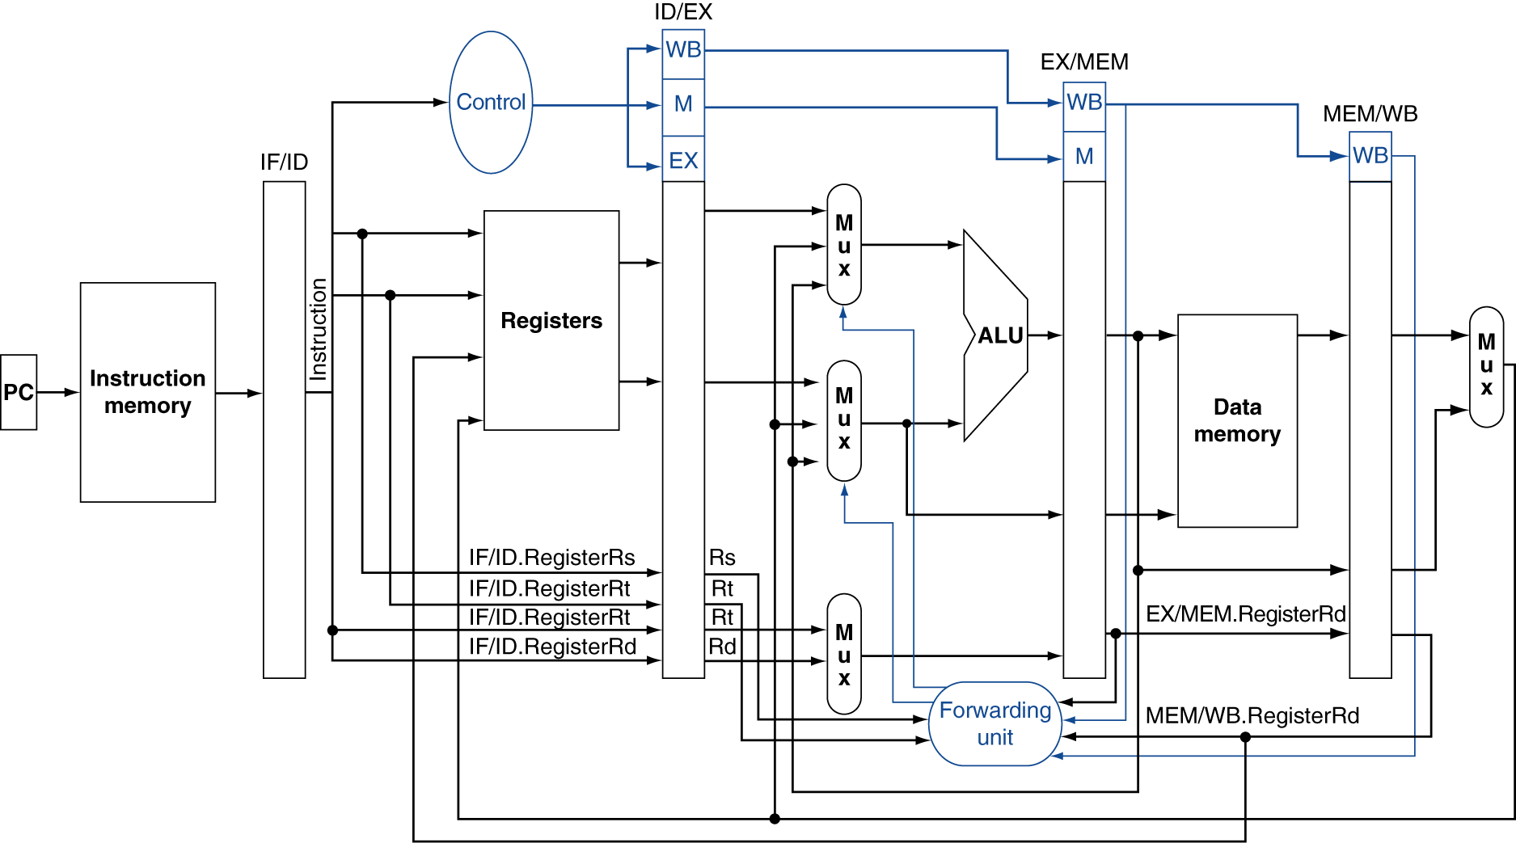
Datapath with Forwarding (MEM and WB Stages Forwards)

Slide 73
Forwarding Logic
Forwarding: input to ALU from any pipe register
Add multiplexors to ALU input 
Control forwarding in EX => carry Rs in ID/EX
Control signals for forwarding
If both WB and MEM forward, e.g., add $1,$1,$2; add $1,$1,$3; add $1,$1,$4; => let MEM forward
EX hazard
if (EX/MEM.RegWrite and (EX/MEM.RegRd≠0) and (EX/MEM.RegRd=ID/EX.RegRs)) ForwardA=10
MEM hazard
if (MEM/WB.RegWrite and (MEM/WB.RegRd≠0) and (EX/MEM.RegRd ≠ ID/EX.Reg.Rs) and (MEM/WB.RegRd=ID/EX.RegRs)) ForwardA=01

Slide 74
Example 3 - Cycle 3

Slide 75
Example 3 - Cycle 4

Slide 76
Example 3 - Cycle 5

Slide 77
Example 3 - Cycle 6
Fig. 6.42

Slide 78
Outline
An overview of pipelining
A pipelined datapath
Pipelined control
Hazards: types of hazard
Handling data hazards
Inserting NOP（software）
Forwarding, R-Type-use（hardware)
Stalls, load-use (hardware)
Handling branch hazards
Exceptions
Superscalar and dynamic pipelining

Slide 79
Cannot Always Forwarding
lw can still cause a hazard
if is followed by an instruction to read the loaded register
Use stalling or compiler to resolve

Slide 80
Stalling
Stall pipeline by keeping instructions in same stage and inserting an NOP instead

Slide 81
Datapath with Stalling Unit
Forwarding controls ALU inputs, hazard detection controls PC, IF/ID, control signals

Slide 82
Control - Handling Stalls
Hazard detection unit in ID to insert stall between a load instruction and its use if (ID/EX.MemRead and ((ID/EX.RegisterRt = IF/ID.RegisterRs) or (ID/EX.RegisterRt = IF/ID.registerRt)) stall the pipeline for one cycle (ID/EX.MemRead=1 indicates a load instruction)
How to stall?
Stall instruction in IF and ID: not change PC and IF/ID => the stages re-execute the instructions
What to move into EX: insert an NOP by changing EX, MEM, WB control fields of ID/EX pipeline register to 0
All control signals to EX, MEM, WB are deasserted and no registers or memories are written

Slide 83
Example 4 - Cycle 2

Slide 84
Example 4 - Cycle 3

Slide 85
Example 4 - Cycle 4

Slide 86
Example 4 - Cycle 5

Slide 87
Example 4 - Cycle 6

Slide 88
Example 4 - Cycle 7

Slide 89
Outline
An overview of pipelining
A pipelined datapath
Pipelined control
Hazards: types of hazard
Handling data hazards
Inserting NOP（software）
Forwarding, R-Type-use（hardware)
Stalls, load-use (hardware)
Handling branch hazards
Exceptions
Superscalar and dynamic pipelining

Slide 90
Pipeline Datapath with Control Signals

Slide 91
Branch Hazards
When decide to branch, other inst. are in pipeline!

Slide 92
Handle Branch Hazard
Predict branch always not taken
Need to add hardware for flushing instruction if wrong
Branch decision made at MEM => need to flush instruction in IF/ID, ID/EX by changing control values to 0
Reduce delay of taken branch by moving branch execution earlier in the pipeline
Move up branch address calculation to ID
Check branch equality at ID (using XOR) by comparing the two registers read during ID
Branch decision made at ID => one instruction to flush
Add a control signal, IF.Flush, to zero instruction field of IF/ID => making the instruction an NOP
Dynamic branch prediction
Compiler rescheduling, delay branch

Slide 93
Pipeline with Flushing

Slide 94
Example 5 - Cycle 3

Slide 95
Example 5 - Cycle 4

Slide 96
Dynamic Branch Prediction
In deeper and superscalar pipelines, branch penalty is more significant
Use dynamic prediction (e.g. loop)
Branch prediction buffer (i.e., branch history table)
Indexed by recent branch instruction addresses
Stores outcome (taken/not taken)
To execute a branch
Check table, expect the same outcome
Start fetching from fall-through or target
If wrong, flush pipeline and flip prediction

Slide 97
Calculating the Branch Target
Even with predictor, still need to calculate the target address
1-cycle penalty for a taken branch
Branch target buffer
Cache of target addresses
Indexed by PC when instruction fetched
If hit and instruction is branch predicted taken, can fetch target immediately

Slide 98
Delayed Branch
Predict-not-taken + branch decision at ID => the following instruction is always executed => branches take effect 1 cycle later
0 clock cycle penalty per branch instruction if can find instruction to put in slot (≅50% of time)
I
n
s
t
r.
O
r
d
e
r
Time (clock cycles)
add
Mem
Reg
ALU
Mem
Reg
beq
Mem
Reg
ALU
Mem
Reg
misc
Mem
Reg
ALU
Mem
Reg
lw
Mem
Reg
ALU
Mem
Reg

Slide 99
Outline
An overview of pipelining
A pipelined datapath
Pipelined control
Hazards: types of hazard
Handling data hazards
Inserting NOP（software）
Forwarding, R-Type-use（hardware)
Stalls, load-use (hardware)
Handling branch hazards
Exceptions
Superscalar and dynamic pipelining

Slide 100
Exceptions and Interrupts
Unexpected events requiring change in flow of control
Different ISAs use the terms differently
Exception
Arises within the CPU
e.g., undefined opcode, overflow, syscall, …
Interrupt
From an external I/O controller
In MIPS, exceptions managed by a System Control Coprocessor (CP0)
Dealing with them without sacrificing performance is hard

Slide 101
Handling Exceptions
Before jump to OS
Save PC of offending (or interrupted) instruction
In MIPS: Exception Program Counter (EPC)
Save indication of the problem
In MIPS: Cause register
We will assume 1-bit
0 for undefined opcode, 1 for overflow
Jump to handler at 8000 00180

Slide 102
An Alternate Mechanism
Vectored Interrupts
Handler address determined by the cause
Example:
Undefined opcode: C000 0000
Overflow: C000 0020
…: C000 0040
Instructions either
Deal with the interrupt, or
Jump to real handler

Slide 103
Handler Actions
In OS
Read cause, and transfer to relevant handler
Determine action required
If restartable
Take corrective action
Use EPC to return to program
Otherwise
Terminate program
Report error using EPC, cause, …

Slide 104
Exceptions in a Pipeline
Another form of control hazard
Consider overflow on add in EX stage
add $1, $2, $1
Prevent $1 from being clobbered
Complete previous instructions
Flush add and subsequent instructions
Set Cause and EPC register values
Transfer control to handler
Similar to mispredicted branch
Use much of the same hardware

Slide 105
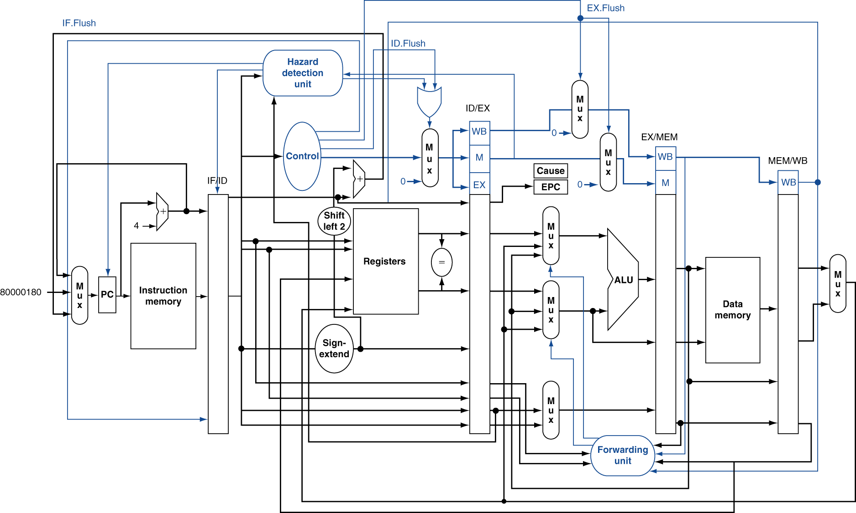
Pipeline with Exceptions

Slide 106
Exception Example (1)
Exception on add in
40 sub $11, $2, $4 44 and $12, $2, $5 48 or $13, $2, $6 4C add $1, $2, $1 50 slt $15, $6, $7 54 lw $16, 50($7) …
Handler
80000180 sw $25, 1000($0) 80000184 sw $26, 1004($0) …

Slide 107
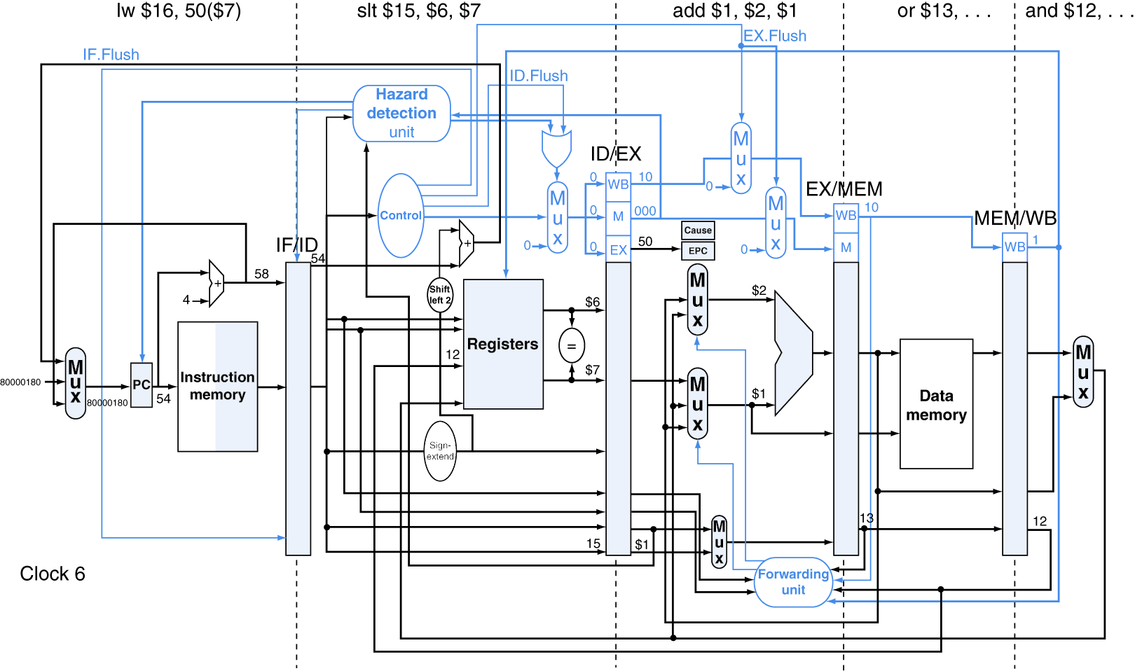
Exception Example (2)

Slide 108
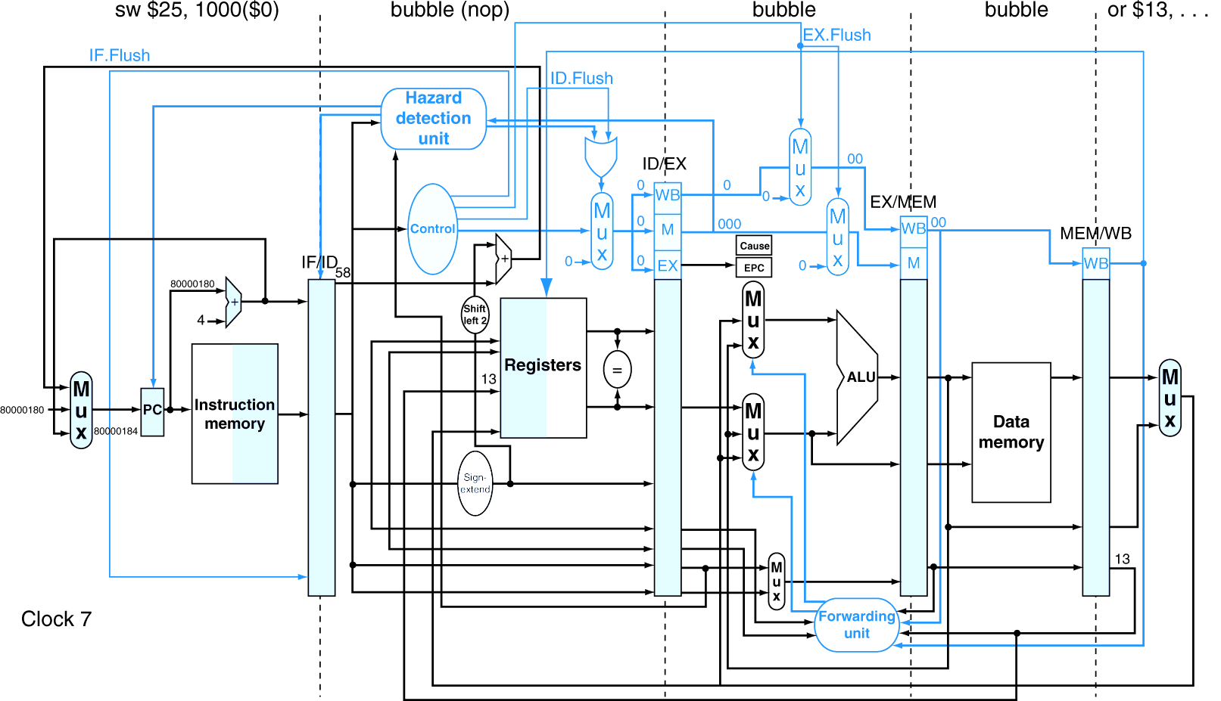
Exception Example（3）

Slide 109
Multiple Exceptions
Pipelining overlaps multiple instructions
Could have multiple exceptions at once
Simple approach: deal with exception from the earliest instruction
Flush subsequent instructions
“Precise” exceptions
In complex pipelines
Multiple instructions issued per cycle
Out-of-order completion
Maintaining precise exceptions is difficult!

Slide 110
Imprecise Exceptions
Just stop pipeline and save state
Including exception cause(s)
Let the handler work out
Which instruction(s) had exceptions
Which to complete or flush
May require “manual” completion
Simplifies hardware, but more complex handler software
Feasible for complex multiple-issue out-of-order pipelines

Slide 111
Outline
An overview of pipelining
A pipelined datapath
Pipelined control
Hazards: types of hazard
Handling data hazards
Inserting NOP（software）
Forwarding, R-Type-use（hardware)
Stalls, load-use (hardware)
Handling branch hazards
Exceptions
Superscalar and dynamic pipelining

Slide 112
Instruction-Level Parallelism (ILP)
Pipelining: executing multiple instructions in parallel
To increase ILP
Deeper pipeline
Less work per stage ⇒ shorter clock cycle
Multiple issue
Replicate pipeline stages ⇒ multiple pipelines
Start multiple instructions per clock cycle
Clock cycle Per Instruction (CPI) < 1, so use Instructions Per Cycle (IPC)
E.g., 4GHz 4-way multiple-issue (Assume 1 instruction completed in 1 cycle)
16 billion instruction per second (BIPS), peak CPI = 0.25, peak IPC = 4
But dependencies reduce this in practice

Slide 113
Multiple Issue
Static multiple issue
Compiler groups instructions to be issued together
Packages them into “issue slots”
Compiler detects and avoids hazards
Dynamic multiple issue
CPU examines instruction stream and chooses instructions to issue each cycle
Compiler can help by reordering instructions
CPU resolves hazards using advanced techniques at runtime

Slide 114
Speculation
Guess what to do with an instruction
Start operation as soon as possible
Check whether guess was right
If so, complete the operation
If not, roll-back and do the right thing
Common to static and dynamic multiple issue
Examples
Speculate on branch outcome
Roll back if path taken is different
Speculate on load
A store that proceeds a load does not refer to the same address (load first)
Roll back if location is updated

Slide 115
Compiler/Hardware Speculation
Compiler can reorder instructions
e.g., move load before store
Can include “fix-up” instructions to recover from incorrect guess
Hardware can look ahead for instructions to execute
Buffer results until determining they are actually needed
Flush buffers on incorrect speculation

Slide 116
Multiple Issue
Static multiple issue (compiler approach)
Dynamic multiple issue (hardware approach)

Slide 117
Static Multiple Issue
Compiler groups instructions into “issue packets”
Group of instructions that can be issued on a single cycle
Determined by pipeline resources required
Think of an issue packet as a very long instruction
Specifies multiple concurrent operations
⇒ Very Long Instruction Word (VLIW)

Slide 118
Scheduling Static Multiple Issue
Compiler must remove some/all hazards
Reorder instructions into issue packets
No dependencies with a packet
Possibly some dependencies between packets
Varies between ISAs; compiler must know!
Pad with nop if necessary

Slide 119
MIPS with Static Dual Issue (1)
Two-issue packets
One ALU/branch instruction
One load/store instruction
64-bit aligned
ALU/branch, then load/store
Pad an unused instruction with nop
Address | Instruction type | Pipeline Stages
n | ALU/branch | IF | ID | EX | MEM | WB
n + 4 | Load/store | IF | ID | EX | MEM | WB
n + 8 | ALU/branch |  | IF | ID | EX | MEM | WB
n + 12 | Load/store |  | IF | ID | EX | MEM | WB
n + 16 | ALU/branch |  |  | IF | ID | EX | MEM | WB
n + 20 | Load/store |  |  | IF | ID | EX | MEM | WB

Slide 120
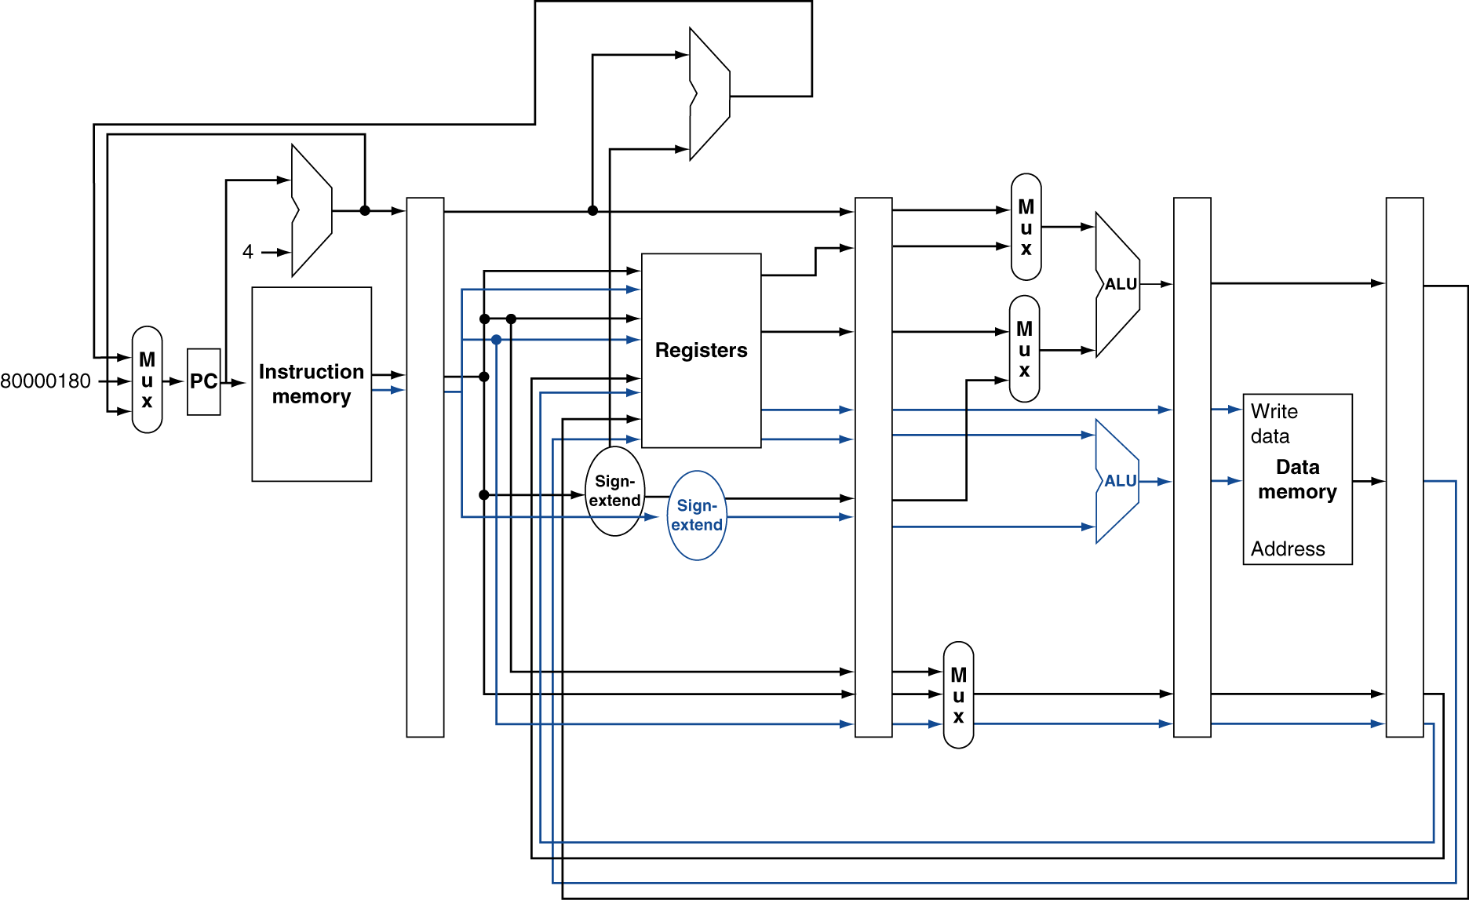
MIPS with Static Dual Issue (2)
Notes:
Hardware required: (beyond hazard detection)
Register file with 4 read ports and two write ports (one r-type and one load instructions)
One more ALU to compute load/store address

Slide 121
Hazards in the Dual-Issue MIPS
More instructions executing in parallel
EX data hazard
Forwarding avoided stalls with single-issue
Now can’t use ALU result in load/store in same packet
add $t0, $s0, $s1 load $s2, 0($t0)
Split into two packets, effectively a stall
Load-use hazard
Still one cycle use latency, but now two instructions
More aggressive scheduling required

Slide 122
Scheduling Example
Schedule this for dual-issue MIPS
Loop: lw $t0, 0($s1) # $t0=array element addu $t0, $t0, $s2 # add scalar in $s2 sw $t0, 4($s1) # store result addi $s1, $s1,–4 # decrement pointer bne $s1, $zero, Loop # branch $s1!=0
 | ALU/branch | Load/store | cycle
Loop: | nop | lw $t0, 0($s1) | 1
 | addi $s1, $s1,–4 | nop | 2
 | addu $t0, $t0, $s2 | nop | 3
 | bne $s1, $zero, Loop | sw $t0, 4($s1) | 4
IPC = 5/4 = 1.25 (c.f. peak IPC = 2)

Slide 123
Loop Unrolling
Replicate loop body to expose more parallelism
Reduces loop-control overhead
Use different registers per replication
Called “register renaming”
Avoid loop-carried “anti-dependencies”
Store followed by a load of the same register (the value in the register is differrent)
Aka “name dependence”
Reuse of a register name

Slide 124
Scheduling Example
Schedule this for dual-issue MIPS
Loop: lw $t0, 0($s1) # $t0=array element addu $t0, $t0, $s2 # add scalar in $s2 sw $t0, 4($s1) # store result addi $s1, $s1,–4 # decrement pointer bne $s1, $zero, Loop # branch $s1!=0
Replicate loop body 4 times to expose more parallelism

Slide 125
Unrolling Two Iterations
Schedule this for dual-issue MIPS
Loop: lw $t0, 0($s1) # $t0=array element addu $t0, $t0, $s2 # add scalar in $s2 sw $t0, 4($s1) # store result addi $s1, $s1,–4 # decrement pointer bne $s1, $zero, Loop # branch $s1!=0
lw $t0, 0($s1) # $t0=array element addu $t0, $t0, $s2 # add scalar in $s2 sw $t0, 4($s1) # store result addi $s1, $s1,–4 # decrement pointer bne $s1, $zero, Loop # branch $s1!=0

Slide 126
Loop Unrolling Example
IPC = 14/8 = 1.75
Closer to 2, but at cost of registers and code size
 | ALU/branch | Load/store | cycle
Loop: | addi $s1, $s1,–16 | lw $t0, 0($s1) | 1
 | nop | lw $t1, 4($s1) | 2
 | addu $t0, $t0, $s2 | lw $t2, 8($s1) | 3
 | addu $t1, $t1, $s2 | lw $t3, 12($s1) | 4
 | addu $t2, $t2, $s2 | sw $t0, 4($s1) | 5
 | addu $t3, $t4, $s2 | sw $t1, 8($s1) | 6
 | nop | sw $t2, 12($s1) | 7
 | bne $s1, $zero, Loop | sw $t3, 16($s1) | 8

Slide 127
Multiple Issue
Static multiple issue (compiler approach)
Dynamic multiple issue (hardware approach)

Slide 128
Dynamic Multiple Issue
Simplest version of “Superscalar”processors
CPU decides whether to issue 0, 1, 2, … each cycle
Avoiding structural and data hazards
Avoid the need for compiler scheduling
Though it may still help
Code semantics ensured by the CPU

Slide 129
Dynamic Pipeline Scheduling
Allow the CPU to execute instructions out of order to avoid stalls
But commit result to registers in order
Example
lw $t0, 20($s2) addu $t1, $t0, $t2 sub $s4, $s4, $t3 slti $t5, $s4, 20
Can start sub while addu is waiting for lw

Slide 130
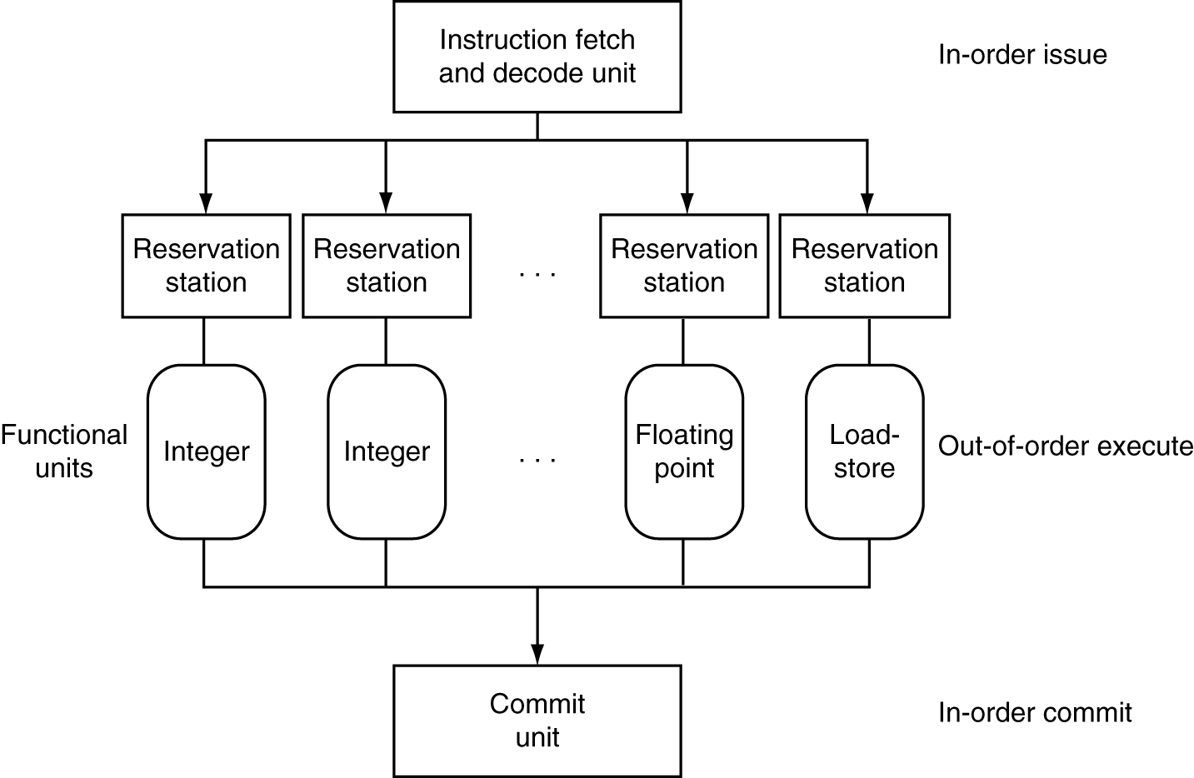
Dynamically Scheduled CPU
Preserves dependencies
Hold pending operands
Results also sent to any waiting reservation stations
Reorders buffer for register writes
Can supply operands for issued instructions

Slide 131
Speculation
Predict branch and continue issuing
Do not commit until branch outcome determined
Load speculation
Avoid load and cache miss delay
Predict the effective address
Predict loaded value
Load before completing outstanding stores
Bypass stored values to load unit
Do not commit load until speculation cleared

Slide 132
Why Do Dynamic Scheduling?
Why not just let the compiler schedule code?
Not all stalls are predicable
e.g., cache misses
Can not always schedule around branches
Branch outcome is dynamically determined
Different implementations of an ISA have different latencies and hazards

Slide 133
Does Multiple Issue Work?
Yes, but not as much as we would like
Programs have real dependencies that limit ILP
Some dependencies are hard to eliminate
e.g., pointer aliasing
Some parallelism is hard to expose
Limited window size during instruction issue
Memory delays and limited bandwidth
Hard to keep pipelines full
Speculation can help if done well

Slide 134
Power Efficiency
Complexity of dynamic scheduling and speculations requires power
Multiple simpler cores may be better
Microprocessor | Year | Clock Rate | Pipeline Stages | Issue width | Out-of-order/ Speculation | Cores | Power
i486 | 1989 | 25MHz | 5 | 1 | No | 1 | 5W
Pentium | 1993 | 66MHz | 5 | 2 | No | 1 | 10W
Pentium Pro | 1997 | 200MHz | 10 | 3 | Yes | 1 | 29W
P4 Willamette | 2001 | 2000MHz | 22 | 3 | Yes | 1 | 75W
P4 Prescott | 2004 | 3600MHz | 31 | 3 | Yes | 1 | 103W
Core | 2006 | 2930MHz | 14 | 4 | Yes | 2 | 75W
UltraSparc III | 2003 | 1950MHz | 14 | 4 | No | 1 | 90W
UltraSparc T1 | 2005 | 1200MHz | 6 | 1 | No | 8 | 70W

Slide 135
Fallacies
Pipelining is easy
The basic idea is easy
The devil is in the details
e.g., detecting data hazards
Pipelining is independent of technology
So why haven’t we always done pipelining?
More transistors make more advanced techniques feasible
Pipeline-related ISA design needs to take the technology trends into account
e.g., predicted instructions

Slide 136
Pitfalls
Poor ISA design can make pipelining harder
e.g., complex instruction sets (VAX, IA-32)
Significant overhead to make pipelining work
IA-32 micro-op approach
e.g., complex addressing modes
Register update side effects, memory indirection
e.g., delayed branches
Advanced pipelines have long delay slots

Slide 137
Concluding Remarks
ISA influences design of datapath and control
Datapath and control influence the design of ISA
Pipelining improves instruction throughput using parallelism
More instructions completed per second
Latency for each instruction not reduced
Hazards: structural, data, control
Multiple issue and dynamic scheduling (ILP)
Dependencies limit achievable parallelism
Complexity leads to the power wall

