Slide 1
CSC3050 – Computer Architecture
Prof. Yeh-Ching Chung
School of Science and Engineering
Chinese University of Hong Kong, Shenzhen

Slide 2
Memory Technology
Static RAM (SRAM)
0.5ns – 2.5ns, $500 – $1000 per GB (2012)
Dynamic RAM (DRAM)
50ns – 70ns, $10 – $20 per GB (2012)
Flash Memory
5µs – 50µs, $0.75 – $1.00 per GB (2012)
Magnetic disk
5ms – 20ms, $0.05 – $0.10 per GB (2012)
Ideal memory
Access time of SRAM
Capacity and cost/GB of disk

Slide 3
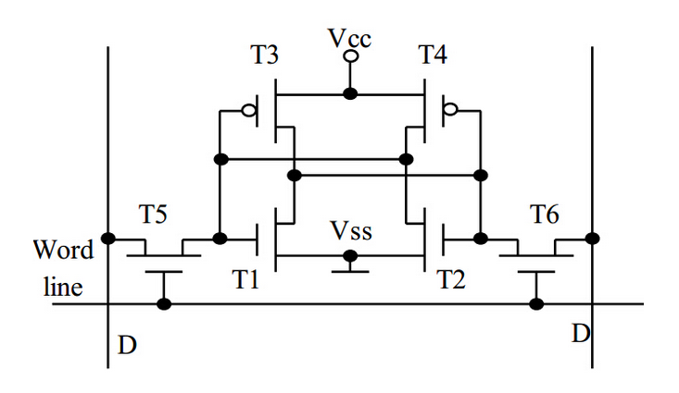
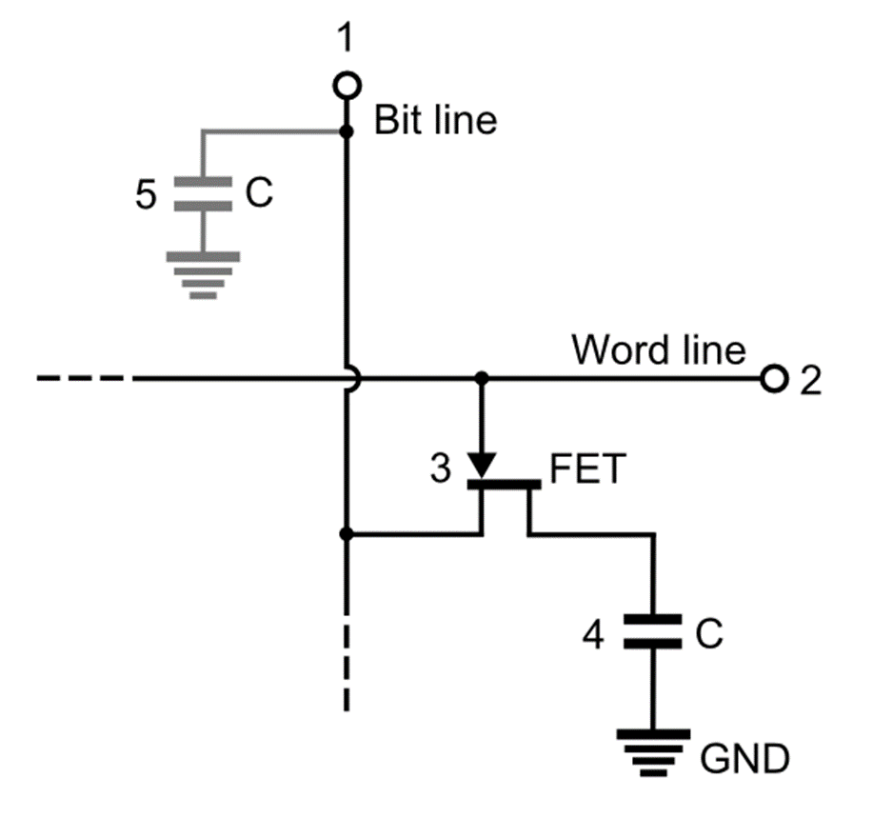
SRAM vs. DRAM
SRAM
DRAM

Slide 4
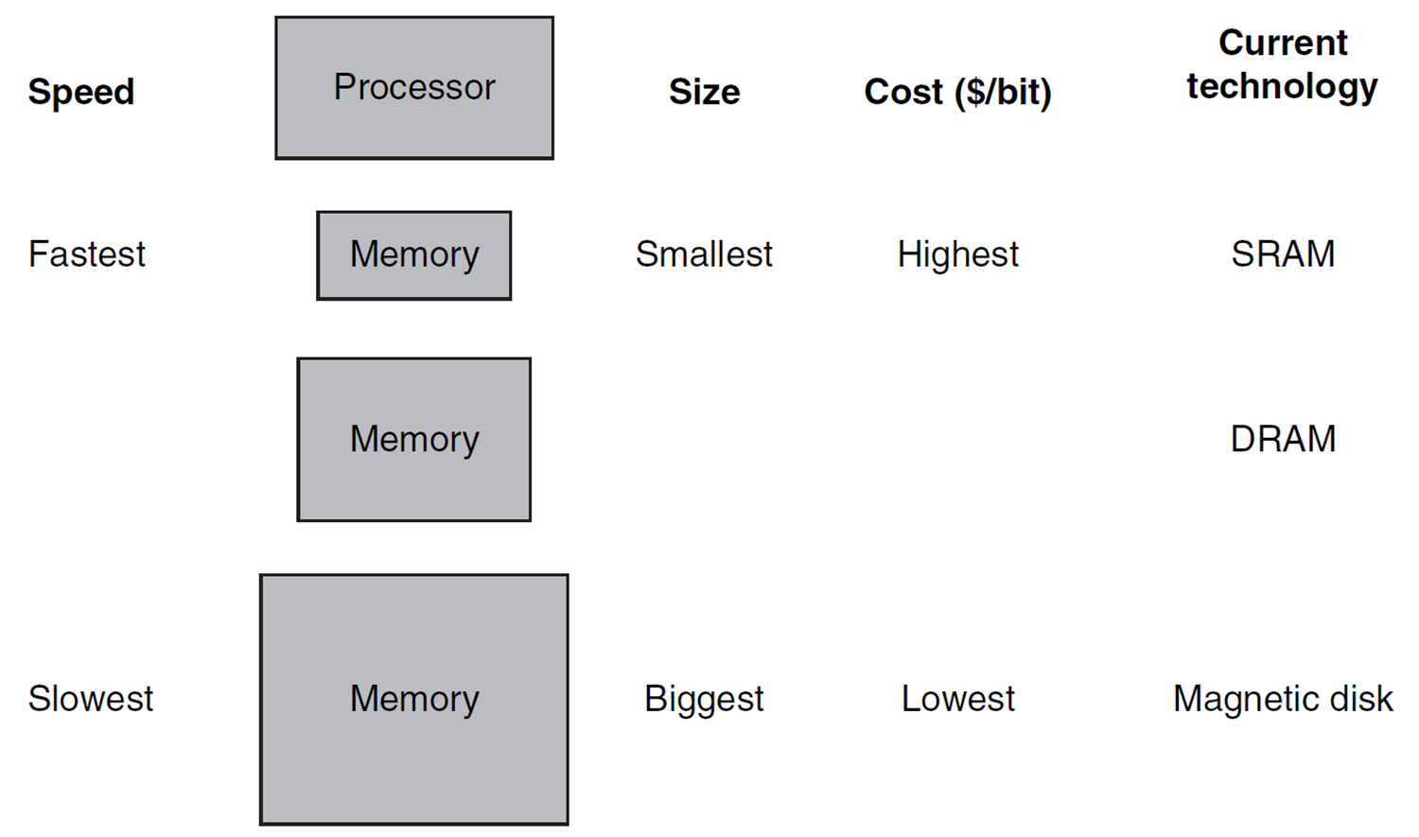
A Typical Memory Hierarchy
Take advantage of the principle of locality to present the user with as much memory as is available in the cheapest technology at the speed offered by the fastest technology

Slide 5
Principle of Locality
Programs access a small proportion of their address space at any time
Temporal locality
Items accessed recently are likely to be accessed again soon
e.g., instructions in a loop, induction variables
Spatial locality
Items near those accessed recently are likely to be accessed soon
e.g., sequential instruction access, array data

Slide 6
Taking Advantage of Locality
Memory hierarchy
Store everything on disk
Copy recently accessed (and nearby) items from disk to smaller DRAM memory
Main memory
Copy more recently accessed (and nearby) items from DRAM to smaller SRAM memory
Cache memory attached to CPU

Slide 7
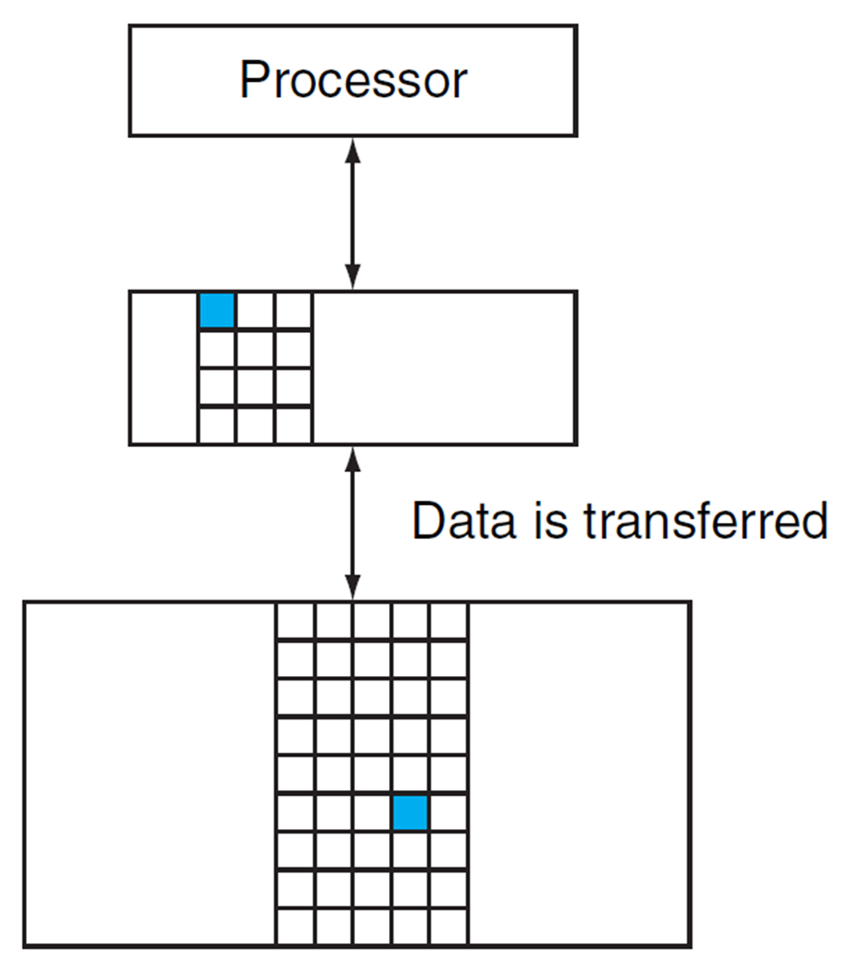
Memory Hierarchy Levels
Block (aka line): unit of copying
May be multiple words
If accessed data is present in upper level
Hit: access satisfied by upper level
Hit ratio: hits/accesses
If accessed data is absent
Miss: block copied from lower level
Miss penalty: extra time taken
Miss ratio: misses/accesses = (1 – hit ratio)
Then accessed data supplied from upper level
Hit time << Miss penalty

Slide 8
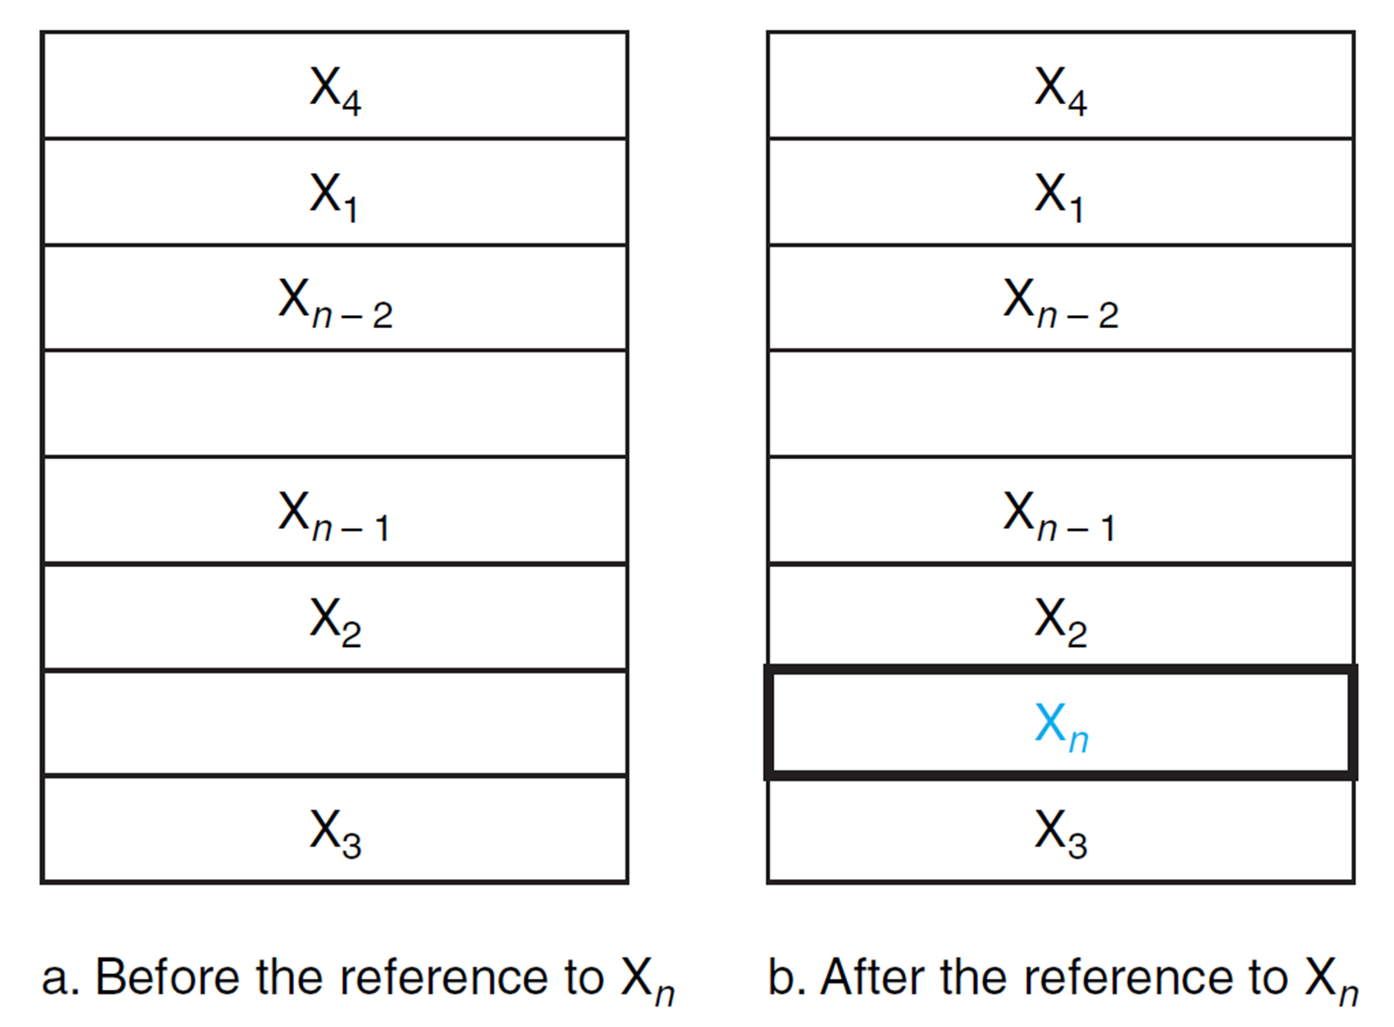
Cache Memory
The level of the memory hierarchy closest to the CPU
Given accesses X₁, …, X_{n–1}, X_{n}
How do we know if the data is present?
Where do we look?

Slide 9
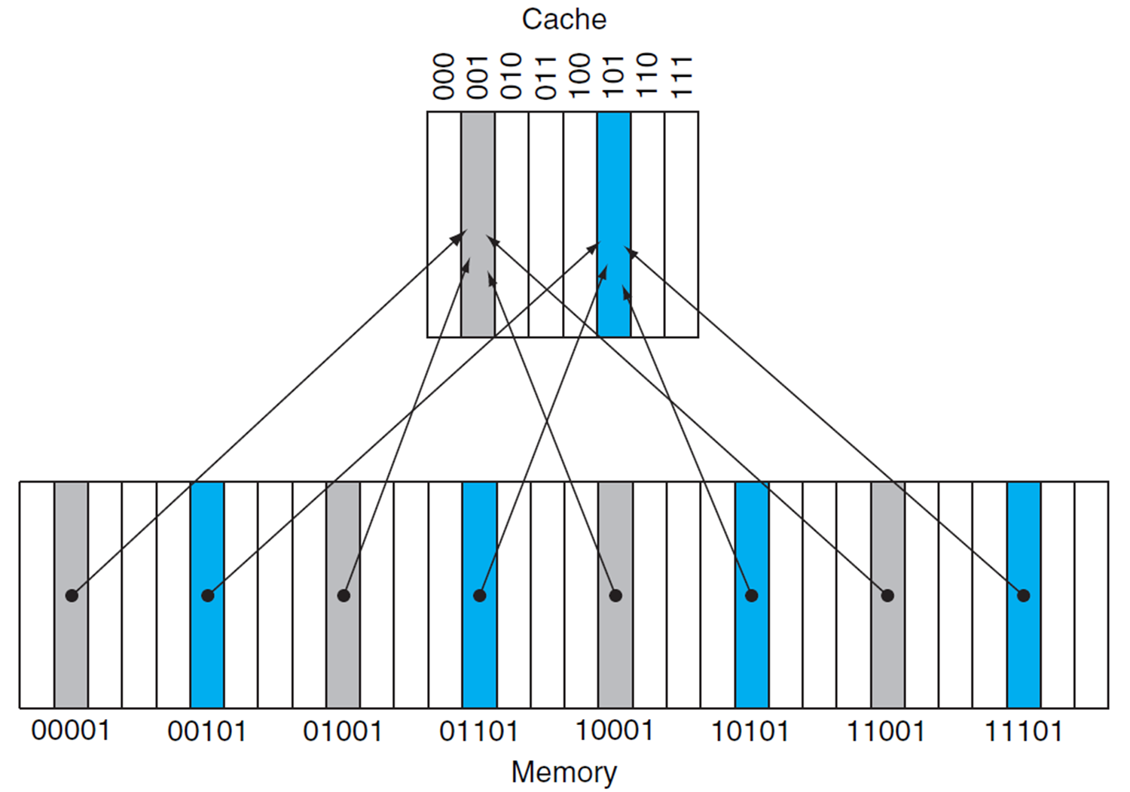
Direct Mapped Cache
Location determined by address
Direct mapped: only one choice
(Block address) modulo (#Blocks in cache)
#Blocks is a power of 2
Use low-order address bits

Slide 10
Tags and Valid Bits
How do we know which particular block is stored in a cache location?
Store block address as well as the data
Actually, only need the high-order bits
Called the tag
What if there is no data in a location?
Valid bit: 1 = present, 0 = not present
Initially 0

Slide 11
Cache Example (1)
8-blocks, 1 word/block, direct mapped
Initial state of cache
Index | V | Tag | Data
000 | N
001 | N
010 | N
011 | N
100 | N
101 | N
110 | N
111 | N

Slide 12
Cache Example (2)
Address (decimal) | Address (binary) | Hit/miss | Cache block
22 | 10 110 | Miss | 110
Index | V | Tag | Data
000 | N
001 | N
010 | N
011 | N
100 | N
101 | N
110 | Y | 10 | Memory[10110₂]
111 | N

Slide 13
Cache Example (3)
Address (decimal) | Address (binary) | Hit/miss | Cache block
26 | 11 010 | Miss | 010
Index | V | Tag | Data
000 | N
001 | N
010 | Y | 11 | Memory[11010₂]
011 | N
100 | N
101 | N
110 | Y | 10 | Memory[10110₂]
111 | N

Slide 14
Cache Example (4)
Address (decimal) | Address (binary) | Hit/miss | Cache block
22 | 10 110 | Hit | 110
26 | 11 010 | Hit | 010
Index | V | Tag | Data
000 | N
001 | N
010 | Y | 11 | Memory[11010₂]
011 | N
100 | N
101 | N
110 | Y | 10 | Memory[10110₂]
111 | N

Slide 15
Cache Example (5)
Address (decimal) | Address (binary) | Hit/miss | Cache block
16 | 10 000 | Miss | 000
3 | 00 011 | Miss | 011
16 | 10 000 | Hit | 000
Index | V | Tag | Data
000 | Y | 10 | Memory[10000₂]
001 | N
010 | Y | 11 | Memory[11010₂]
011 | Y | 00 | Memory[00011₂]
100 | N
101 | N
110 | Y | 10 | Memory[10110₂]
111 | N

Slide 16
Cache Example (6)
Address (decimal) | Address (binary) | Hit/miss | Cache block
18 | 10 010 | Miss | 010
Index | V | Tag | Data
000 | Y | 10 | Memory[10000₂]
001 | N
010 | Y | 10 | Memory[10010₂]
011 | Y | 00 | Memory[00011₂]
100 | N
101 | N
110 | Y | 10 | Memory[10110₂]
111 | N

Slide 17
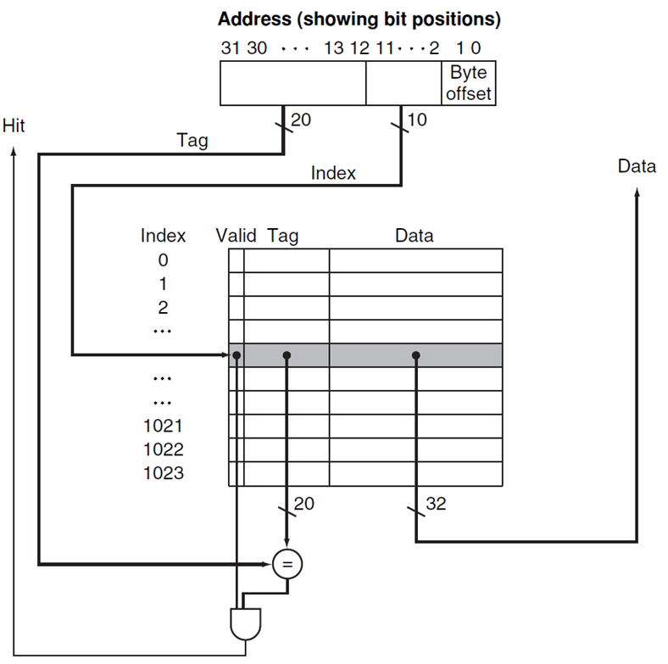
Address Subdivision

Slide 18
Example: Larger Block Size
64 blocks, 16 bytes/block
To what block number does address 1200 map?
Block address = [1200/16] = 75
Block number = 75 modulo 64 = 11
This block maps all addresses between 1200 and 1215
31 10 9 4 3 0
Tag
Index
Offset
22 bits
6 bits
4 bits

Slide 19
Block Size Considerations
Larger blocks should reduce miss rate
Due to spatial locality
But in a fixed-sized cache
Larger blocks ➔ fewer of them
More competition ➔ increased miss rate
Larger blocks ➔ spatial locality decreases
Larger miss penalty
Can override benefit of reduced miss rate
Early restart and critical-word-first can help

Slide 20
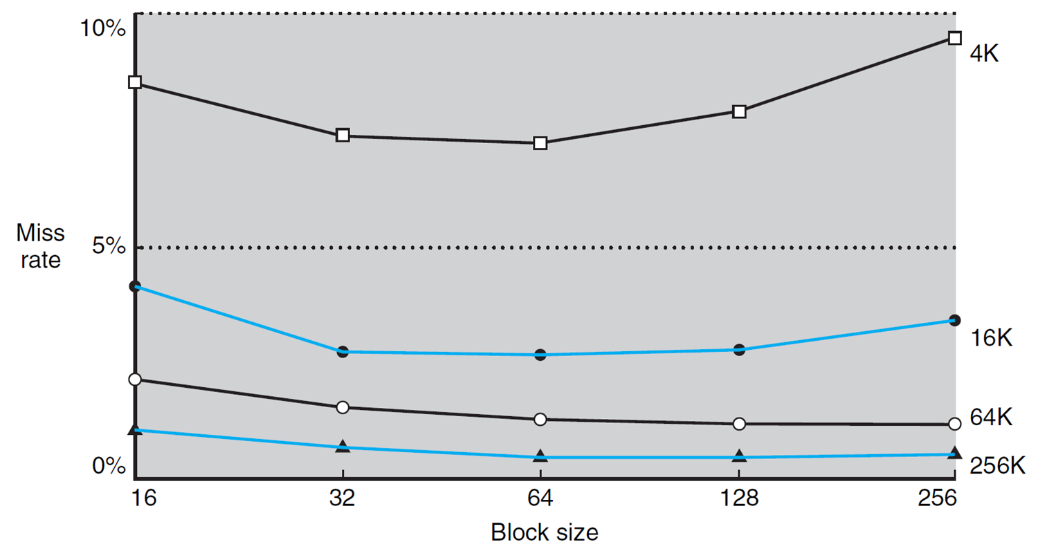
Miss Rate vs. Block Size vs. Cache Size
Miss rate goes up if the block size becomes a significant fraction of the cache size because the number of blocks that can be held in the same size cache is smaller (increasing capacity misses)

Slide 21
Cache Misses
On cache hit, CPU proceeds normally
On cache miss
Stall the CPU pipeline
Fetch block from next level of hierarchy
Instruction cache miss
Restart instruction fetch
Data cache miss
Complete data access

Slide 22
Write-Through
On data-write hit, could just update the block in cache
But then cache and memory would be inconsistent
Write-through: also update memory
But makes writes take longer
e.g., if base CPI = 1, 10% of instructions are stores, write to memory takes 100 cycles
Effective CPI = 1 + 0.1×100 = 11
Solution: write buffer
Holds data waiting to be written to memory
CPU continues immediately
Only stalls on write if write buffer is already full

Slide 23
Write-Back
Alternative: On data-write hit, just update the block in cache
Keep track of whether each block is dirty
When a dirty block is replaced
Write it back to memory
Can use a write buffer to allow replacing block to be read first

Slide 24
Write Allocation
What should happen on a write miss?
Alternatives for write-through
Allocate on miss: write allocate
Don’t update cache: no write allocate
Since programs often write a whole block before reading it (e.g., initialization)
For write-back
Usually write allocate, but need to check if the block being replaced is dirty or not (and write-back if dirty).

Slide 25
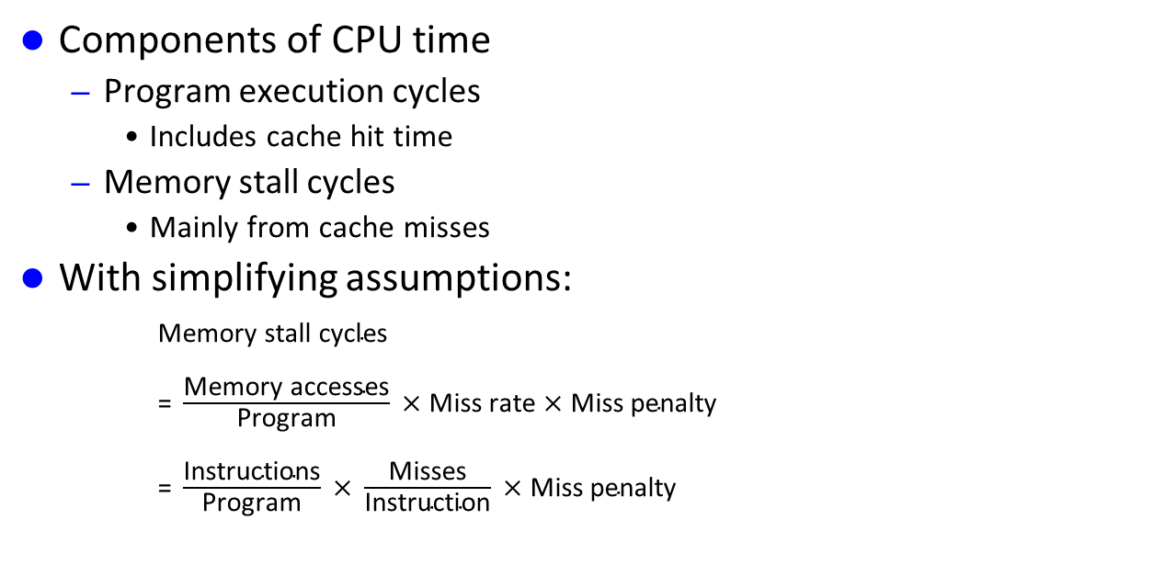
Measuring Cache Performance
Components of CPU time
Program execution cycles
Includes cache hit time
Memory stall cycles
Mainly from cache misses
With simplifying assumptions:
$\text{Memory} \text{stall} \text{cycles}$
$\text{= }\frac{\text{Memory} \text{accesses}}{\text{Program}} \text{×} \text{Miss} \text{rate} \text{×} \text{Miss} \text{penalty}$
$\text{= }\frac{\text{Instructions}}{\text{Program}} \text{×} \frac{\text{Misses}}{\text{Instruction}} \text{×} \text{Miss} \text{penalty}$

Slide 26
Cache Performance Example
Given
I-cache miss rate = 2%
D-cache miss rate = 4%
Miss penalty = 100 cycles
Base CPI (ideal cache) = 2
Load & stores are 36% of instructions
Miss cycles per instruction
I-cache: 0.02 × 100 = 2
D-cache: 0.36 × 0.04 × 100 = 1.44
Actual CPI = 2 + 2 + 1.44 = 5.44
Ideal CPU is 5.44/2 = 2.72 times faster

Slide 27
Average Access Time
Hit time is also important for performance
Average memory access time (AMAT)
AMAT = Hit time + Miss rate × Miss penalty
Example
CPU with 1ns clock, hit time = 1 cycle, miss penalty = 20 cycles, I-cache miss rate = 5%
AMAT = 1 + 0.05 × 20 = 2ns
In average 2 cycles per instruction

Slide 28
Performance Summary
When CPU performance increased
Miss penalty becomes more significant
Decreasing base CPI
Greater proportion of time spent on memory stalls
Increasing clock rate
Memory stalls account for more CPU cycles
Can not neglect cache behavior when evaluating system performance

Slide 29
Associative Caches
Fully associative
Allow a given block to go in any cache entry
Requires all entries to be searched at once
Comparator per entry (expensive)
n-way set associative
Each set contains n entries
Block number determines which set
(Block number) modulo (#Sets in cache)
Search all entries in a given set at once
n comparators (less expensive)

Slide 30
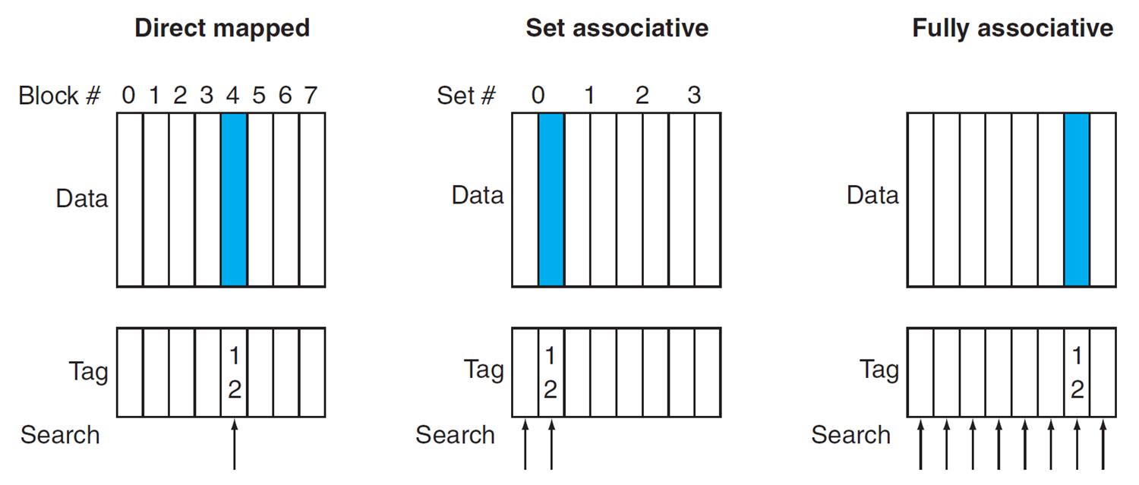
Associative Cache Example

Slide 31
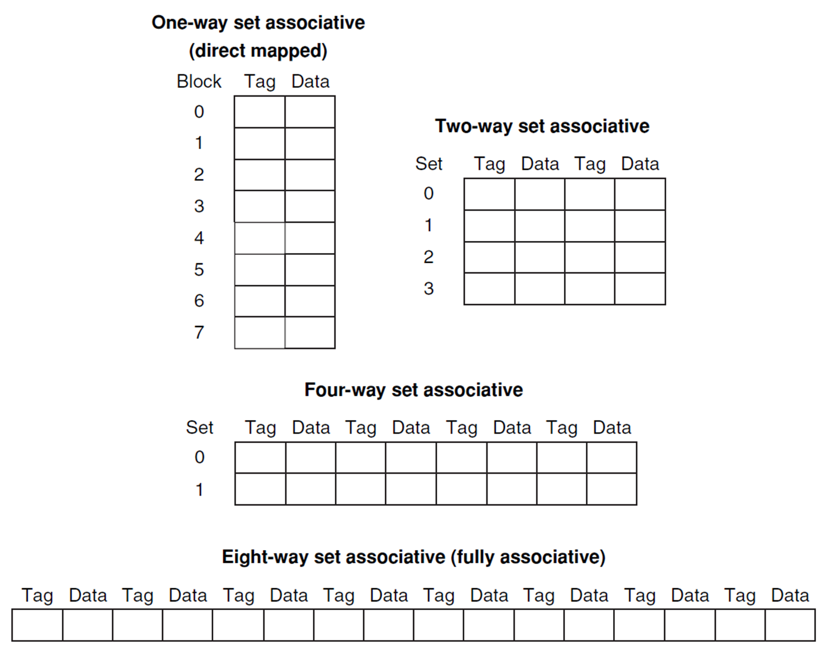
Spectrum of Associativity
For a cache with 8 entries

Slide 32
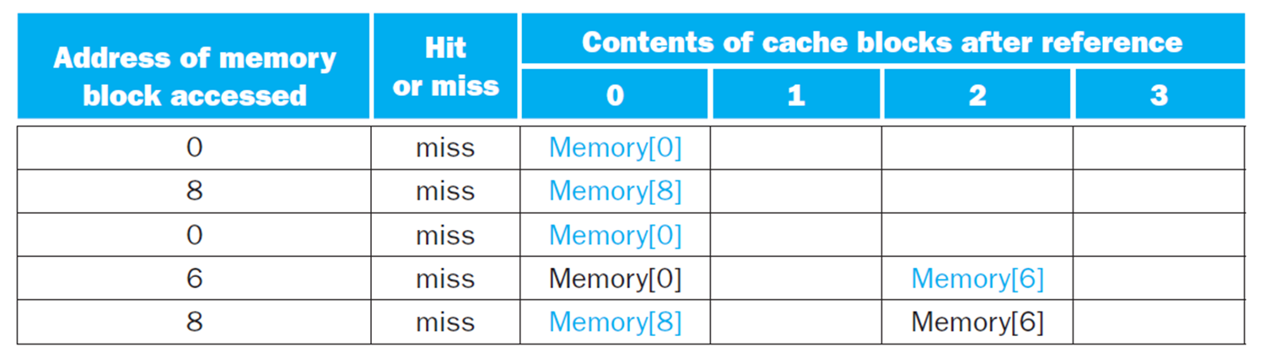
Associativity Example
Compare 4-block caches
Direct mapped, 2-way set associative, fully associative
Block access sequence: 0, 8, 0, 6, 8
Direct mapped

Slide 33
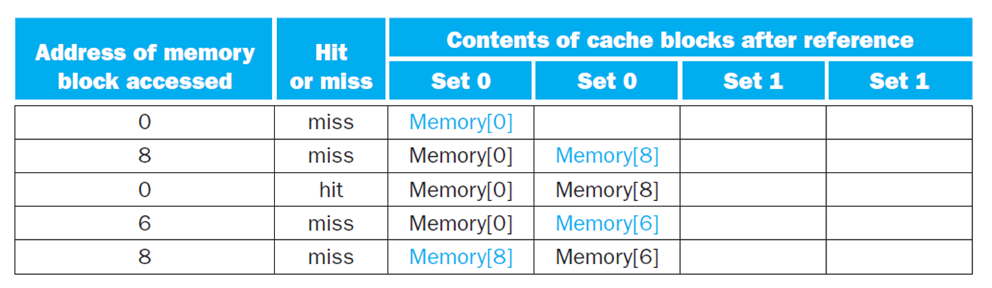
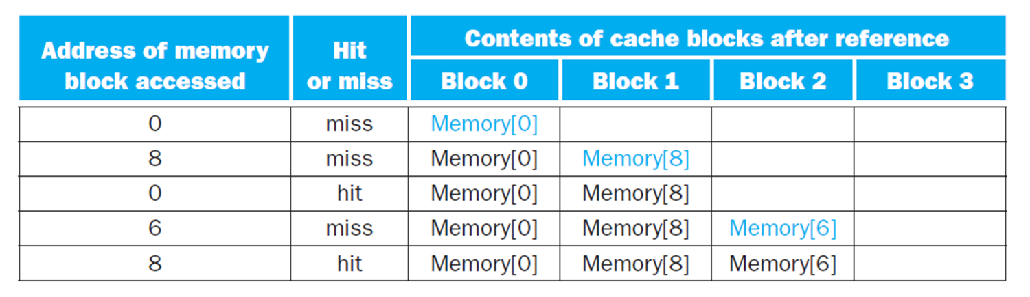
Associativity Example
2-way set associative
Fully associative

Slide 34
How Much Associativity
Increased associativity decreases miss rate
But with diminishing returns
Simulation of a system with 64KB D-cache, 16-word blocks, SPEC2000
1-way: 10.3%
2-way: 8.6%
4-way: 8.3%
8-way: 8.1%

Slide 35
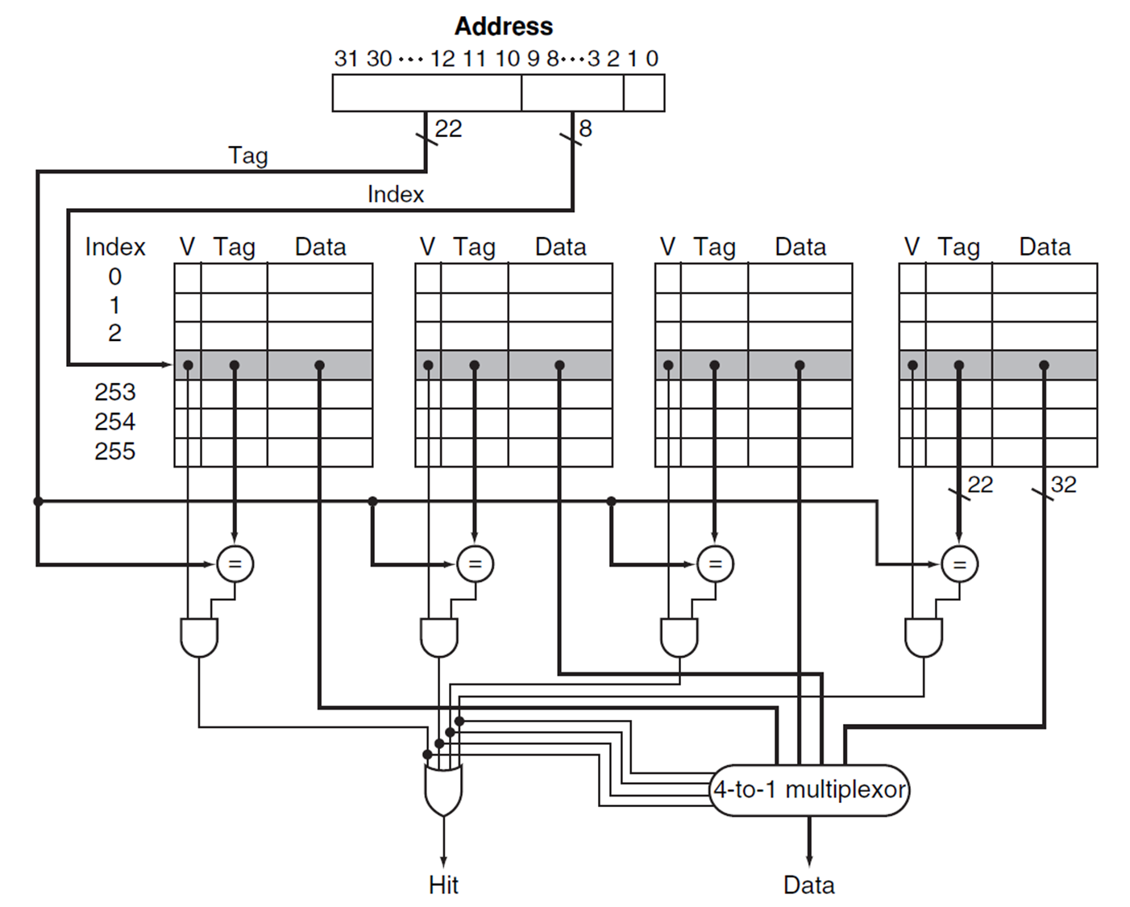
Set Associative Cache Organization

Slide 36
Replacement Policy
Direct mapped: no choice
Set associative
Prefer non-valid entry, if there is one
Otherwise, choose among entries in the set
Least-recently used (LRU)
Choose the one unused for the longest time
Simple for 2-way, manageable for 4-way, too hard beyond that
Random
Gives approximately the same performance as LRU for high associativity

Slide 37
Multilevel Caches
Primary cache attached to CPU
Small, but fast
Level-2 cache services misses from primary cache
Larger, slower, but still faster than main memory
Main memory services L-2 cache misses
Some high-end systems include L-3 cache

Slide 38
Multilevel Cache Example (1)
Given
CPU base CPI = 1, clock rate = 4GHz (1 cycle = 0.25ns)
Miss rate/instruction = 2%
Main memory access time = 100ns
With just primary cache
Miss penalty = 100ns/0.25ns = 400 cycles
Effective CPI = 1 + 0.02 × 400 = 9

Slide 39
Multilevel Cache Example (2)
Now add L-2 cache
Access time = 5ns
Miss rate/instruction = 2% (same)
Global miss rate to main memory = 0.5%
Primary miss with L-2 hit
Penalty = 5ns/0.25ns = 20 cycles
Primary miss with L-2 miss
Extra penalty = 400 + 20 cycles
CPI = 1 + 0.02 × 20 + 0.005 × 400 = 3.4
Performance ratio = 9/3.4 = 2.6

Slide 40
Multilevel Cache Considerations
Primary cache
Focus on minimal hit time
L-2 cache
Focus on low miss rate to avoid main memory access
Hit time has less overall impact
Results
L-1 cache usually smaller than a single cache
L-1 block size smaller than L-2 block size

Slide 41
Interactions with Advanced CPUs
Out-of-order CPUs can execute instructions during cache miss
Pending store stays in load/store unit
Dependent instructions wait in reservation stations
Independent instructions continue
Effect of miss depends on program data flow
Much harder to analyze
Use system simulation

