Slide 1
CSC3050 – Computer Architecture
Prof. Yeh-Ching Chung
School of Science and Engineering
Chinese University of Hong Kong, Shenzhen

Slide 2
Outline
Memory hierarchy
The basics of caches
Direct-mapped cache
Address sub-division
Cache hit and miss
Memory support
Measuring cache performance
Improving cache performance
Set associative cache
Multiple level cache

Slide 3
Memory Technology
Random access
Access time same for all locations
SRAM (Static Random Access Memory)
Low density, high power, expensive, fast
Static: content will last forever until lose power
Address not divided
Use for caches
DRAM (Dynamic Random Access Memory)
High density, low power, cheap, slow
Dynamic: need to be refreshed regularly
Addresses in 2 halves (memory as a 2D matrix)
RAS/CAS (Row/Column Access Strobe)
Use for main memory
Magnetic disk
Notes:
The technology we used to build our memory hierarchy can be divided into two categories: Random Access and Non-so-Random Access.
Unlike all other aspects of life where the word random usually associates with bad things, random, when associates with memory access, for the lack of a better word, is good!
Because random access means you can access any random location at any time and the access time will be the same as any other random locations.
Which is NOT the case for disks or tape where the access time for a given location at any time can be quite different from some other random locations at some other random time.
As far as Random Access technology is concerned, we will concentrate on two specific technologies: Dynamic RAM and Static RAM.
The advantages of Dynamic RAMs are high density, low cost, and low power so we can have a lot of them without burning a hole in our budget or our desktop.
The disadvantages of DRAM are they are slow. Also they will forget what you tell them if you don remind them constantly (Refresh). We will talk more about refresh later today.
SRAM only has one redeeming feature: it is fast. Other than that, they have low density, expensive, and burn a lot of power. Oh, SRAM actually has another redeeming feature. They will not forget what you tell them. They will keep whatever you write to them forever.
Well orever?is a long time. So lets just say it will keep your data as long as you don pull the plug on your computer.
In the next two lectures, we will be focusing on DRAMs and SRAMs.
We will not get into disk until the Virtual Memory lecture a week from now.
+3 = 19 min. (X:59)

Slide 4
Comparisons of Various Technologies
Idea memory
Access time of DRAM
Capacity and cost/GB
Memory
technology
Typical access
time
$ per GB
in 2008
SRAM
0.5 – 2.5 ns
$2000 – $5,000
DRAM
50 – 70 ns
$20 – $75
Magnetic
disk
5,000,000 –
20,000,000 ns
$0.20 – $2
Notes:
From the truth table we had before the break, we can derive the logic equation for ALUctr bit 2 but collecting all the rows that has ALUCtr bit 2 equals to 1 and this table is the result.
Each row becomes a product term and we need to OR the prodcut terms together.
Notice that the last row are identical except the bit<3> of the func fields. One is zero and the other is one. Together, they make bit<3> a don care term.
With all these don care terms, the logic equation is rather simple.
The first prodcut term is: not ALUOp<2> and ALUOp<0>.
The second product term, after we making Func<3> a don care becomes ...
+2 = 57 min. (Y:37)

Slide 5
Solution - Memory Hierarchy
An Illusion of a large, fast, cheap memory
Fact: Large memories slow, fast memories small
How to achieve: hierarchy, parallelism
An expanded view of memory system
Processor
Control
Memory
Memory
Datapath
Memory
Memory
Memory
Speed:
Fastest
Slowest
Size:
Smallest
Biggest
Cost:
Highest
Lowest

Slide 6
Memory Hierarchy - Principle
At any given time, data is copied between only two adjacent levels
Upper level: The one closer to the processor
Smaller, faster, uses more expensive technology
Lower level: The one away from the processor
Bigger, slower, uses less expensive technology
Block: Basic unit of information transfer
Minimum unit of information that can either be present or not present in a level of the hierarchy
Lower Level
Memory
To Processor
Upper Level
Memory
Block X
From Processor
Block Y

Slide 7
Why Hierarchy Works
Principle of Locality
Program access a relatively small portion of the address space at any instant of time
90-10 rule: 10% of code executed 90% of time
Two types of locality
Temporal locality: If an item is referenced, it will tend to be referenced again soon, e.g., loop
Spatial locality: If an item is referenced, items whose addresses are close by tend to be referenced soon., e.g., instruction access, array data structure
Probability
of reference
0
address space
2^{n} - 1
Notes:
The principle of locality states that programs access a relatively small portion of the address space at any instant of time.
This is kind of like in real life, we all have a lot of friends. But at any given time most of us can only keep in touch with a small group of them.
There are two different types of locality: Temporal and Spatial. Temporal locality is the locality in time which says if an item is referenced, it will tend to be referenced again soon.
This is like saying if you just talk to one of your friends, it is likely that you will talk to him or her again soon.
This makes sense. For example, if you just have lunch with a friend, you may say, let go to the ball game this Sunday. So you will talk to him again soon.
Spatial locality is the locality in space. It says if an item is referenced, items whose addresses are close by tend to be referenced soon.
Once again, using our analogy. We can usually divide our friends into groups. Like friends from high school, friends from work, friends from home.
Let say you just talk to one of your friends from high school and she may say something like: o did you hear so and so just won the lottery.
You probably will say NO, I better give him a call and find out more.
So this is an example of spatial locality. You just talked to a friend from your high school days. As a result, you end up talking to another high school friend. Or at least in this case, you hope he still remember you are his friend.
+3 = 10 min. (X:50)
Temporal locality: loop
Spatial locality: instruction executed sequentially, access of array element.

Slide 8
Levels of Memory Hierarchy
Upper Level
Staging
Transfer Unit
faster
Registers
Instr. Operands
prog./compiler
Cache
Blocks
cache controller
Memory
Pages
OS
Disk
Files
user/operator
Larger
Tape
Lower Level

Slide 9
How Is the Hierarchy Managed
Registers <-> Memory
By compiler (programmer?)
Cache <-> Memory
By the hardware
Memory <-> Disks
By the hardware and operating system (virtual memory)
By the programmer (files)

Slide 10
Memory Hierarchy - Terminology
Hit: Data appears in upper level (Block X)
Hit rate: Fraction of memory access found in the upper level
Hit time: Time to access the upper level
RAM access time + Time to determine hit/miss
Miss: Data needs to be retrieved from a block in the lower level (Block Y)
Miss Rate = 1 - (Hit Rate)
Miss Penalty: Time to replace a block in the upper level + time to deliver the block to the processor (latency + transmit time)
Hit Time << Miss Penalty
Lower Level
Memory
To Processor
Upper Level
Memory
From Processor
Block X
Block Y
Notes:
A HIT is when the data the processor wants to access is found in the upper level (Blk X).
The fraction of the memory access that are HIT is defined as HIT rate.
HIT Time is the time to access the Upper Level where the data is found (X). It consists of:
(a) Time to access this level.
(b) AND the time to determine if this is a Hit or Miss.
If the data the processor wants cannot be found in the Upper level. Then we have a miss and we need to retrieve the data (Blk Y) from the lower level.
By definition (definition of Hit: Fraction), the miss rate is just 1 minus the hit rate.
This miss penalty also consists of two parts:
(a) The time it takes to replace a block (Blk Y to BlkX) in the upper level.
(b) And then the time it takes to deliver this new block to the processor.
It is very important that your Hit Time to be much much smaller than your miss penalty. Otherwise, there will be no reason to build a memory hierarchy.
+2 = 14 min. (X:54)

Slide 11
Four Questions for Hierarchy Design
Q1: Where can a block be placed in the upper level? => Block placement
Q2: How is a block found if it is in the upper level? => Block finding
Q3: Which block should be replaced on a miss? => Block replacement
Q4: What happens on a write? => Write strategy

Slide 12
Summary of Memory Hierarchy
DRAM is slow but cheap and dense
Good for presenting users with a BIG memory system
SRAM is fast but expensive, not very dense
Good choice for providing users FAST accesses
Two different types of locality
Temporal Locality (Locality in Time)
Spatial Locality (Locality in Space)
Use the principle of locality
Present the user with as much memory as is available in the cheapest technology
Provide access at the speed offered by the fastest technology
Notes:
Let summarize today lecture. The first thing we covered is the principle of locality.
There are two types of locality: temporal, or locality of time and spatial, locality of space.
We talked about memory system design.
The key idea of memory system design is to present the user with as much memory as possible in the cheapest technology while by taking advantage of the principle of locality, create an illusion that the average access time is close to that of the fastest technology.
As far as Random Access technology is concerned, we concentrate on 2: DRAM and SRAM.
DRAM is slow but cheap and dense so is a good choice for presenting the use with a BIG memory system.
SRAM, on the other hand, is fast but it is also expensive both in terms of cost and power, so it is a good choice for providing the user with a fast access time.
I have already showed you how DRAMs are used to construct the main memory for the SPARCstation 20.
On Friday, we will talk about caches.
+2 = 78 min. (Y:58)

Slide 13
Outline
Memory hierarchy
The basics of caches
Direct-mapped cache
Address sub-division
Cache hit and miss
Memory support
Measuring cache performance
Improving cache performance
Set associative cache
Multiple level cache

Slide 14
Processor Memory Latency Gap
1000
Proc
60%/yr.
(2X/1.5 yr)
Moore’s Law
100
Processor-memory
performance gap: (grows 50% / year)
Performance
10
DRAM
9%/yr.
(2X/10 yrs)
1
1980
Year
1981
1982
1983
1984
1985
1986
1987
1988
1989
1990
1991
1992
1993
1994
1995
1996
1997
1998
1999
2000
Notes:
Y-axis is performance
X-axis is time
Latency
Clich?
Not e that x86 didn have cache on chip until 1989

Slide 15
Levels of Memory Hierarchy
Upper Level
Staging
Transfer Unit
faster
Registers
Instr. Operands
prog./compiler
Cache
Blocks
cache controller
Memory
Pages
OS
Disk
Files
user/operator
Larger
Tape
Lower Level

Slide 16
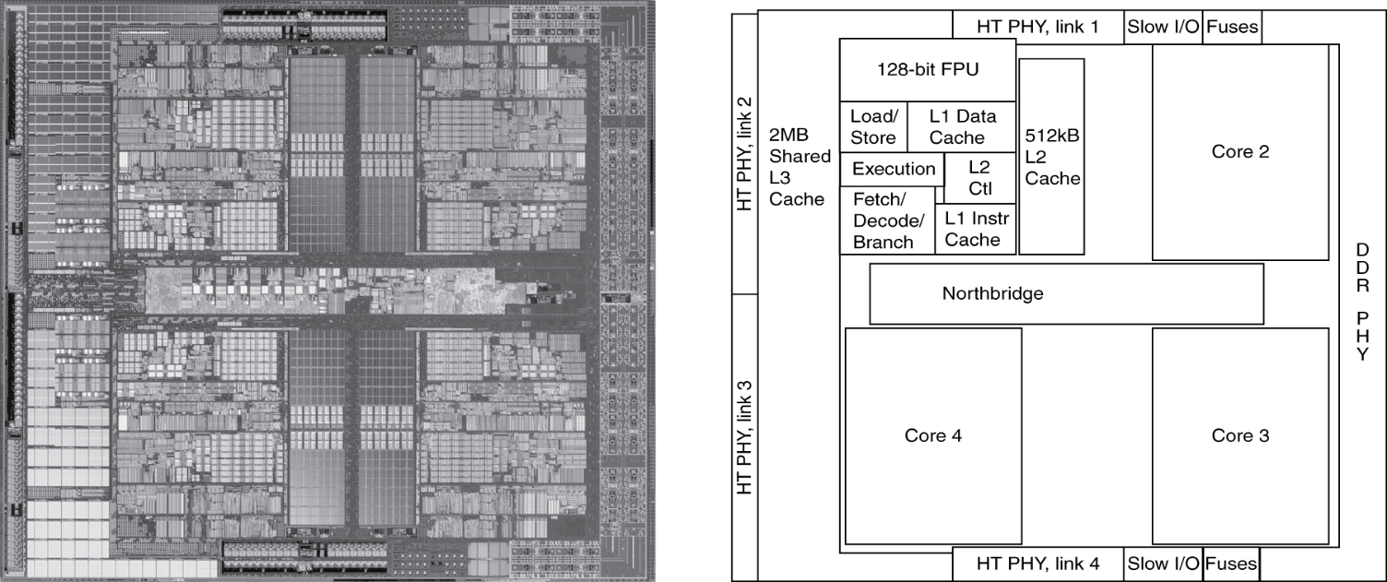
Inside the Processor
AMD Barcelona: 4 processor cores

Slide 17
Basics of Cache
Our first example: Direct-mapped cache
Block Placement
For each item of data at the lower level, there is exactly one location in cache where it might be
Address mapping: modulo number of blocks
0
1
0
1
0
1
0
1
0
0
1
1
0
0
1
1
0
0
0
0
1
1
1
1
0
0
0
0
1
0
0
1
0
1
0
1
0
0
1
0
1
1
0
1
1
0
0
0
1
1
0
1
0
1
1
1
0
0
1
1
1
1
0
1
M
r
y

Slide 18
Tags and Valid Bits - Block Finding
How do we know which particular block is stored in a cache location
Store block address as well as the data
Actually, only need the high-order bits
Called the tag
What if there is no data in a location
Valid bit: 1 = present, 0 = not present
Initially 0

Slide 19
Cache Example (1)
8-blocks, 1 word/block, direct mapped
Initial state of cache
Index | V | Tag | Data
000 | N
001 | N
010 | N
011 | N
100 | N
101 | N
110 | N
111 | N

Slide 20
Cache Example (2)
Address (decimal) | Address (binary) | Hit/miss | Cache block
22 | 10 110 | Miss | 110
Index | V | Tag | Data
000 | N
001 | N
010 | N
011 | N
100 | N
101 | N
110 | Y | 10 | Memory[10110₂]
111 | N

Slide 21
Cache Example (3)
Address (decimal) | Address (binary) | Hit/miss | Cache block
26 | 11 010 | Miss | 010
Index | V | Tag | Data
000 | N
001 | N
010 | Y | 11 | Memory[11010₂]
011 | N
100 | N
101 | N
110 | Y | 10 | Memory[10110₂]
111 | N

Slide 22
Cache Example (4)
Address (decimal) | Address (binary) | Hit/miss | Cache block
22 | 10 110 | Hit | 110
26 | 11 010 | Hit | 010
Index | V | Tag | Data
000 | N
001 | N
010 | Y | 11 | Memory[11010₂]
011 | N
100 | N
101 | N
110 | Y | 10 | Memory[10110₂]
111 | N

Slide 23
Cache Example (5)
Address (decimal) | Address (binary) | Hit/miss | Cache block
16 | 10 000 | Miss | 000
3 | 00 011 | Miss | 011
16 | 10 000 | Hit | 000
Index | V | Tag | Data
000 | Y | 10 | Memory[10000₂]
001 | N
010 | Y | 11 | Memory[11010₂]
011 | Y | 00 | Memory[00011₂]
100 | N
101 | N
110 | Y | 10 | Memory[10110₂]
111 | N

Slide 24
Cache Example (6)
Address (decimal) | Address (binary) | Hit/miss | Cache block
18 | 10 010 | Miss | 010
Index | V | Tag | Data
000 | Y | 10 | Memory[10000₂]
001 | N
010 | Y | 10 | Memory[10010₂]
011 | Y | 00 | Memory[00011₂]
100 | N
101 | N
110 | Y | 10 | Memory[10110₂]
111 | N

Slide 25
Outline
Memory hierarchy
The basics of caches
Direct-mapped cache
Address sub-division
Cache hit and miss
Memory support
Measuring cache performance
Improving cache performance
Set associative cache
Multiple level cache

Slide 26
Memory Address
100000
100001
100010
100011
100100
100101
100110
100111
101000

Slide 27
Address Subdivision
1K words, 1-word block
Cache index: lower 10 bits
Cache tag: upper 20 bits
Valid bit (When start up, valid is 0)

Slide 28
Example - Larger Block Size
64 blocks, 16 bytes/block
To what block number does address 1200 map?
Block address = ⎣1200/16⎦ = 75
Block number = 75 modulo 64 = 11
1200=00…00100101100002 /100002 =>00…0010010112
10010112 =>0010112
31
10
9
4
3
0
Tag
Index
Offset
22 bits
6 bits
4 bits

Slide 29
Example - Intrinsity FastMATH (1)
Embedded MIPS processor
12-stage pipeline
Instruction and data access on each cycle
Split cache: Separate I-cache and D-cache
Each 16KB: 256 blocks × 16 words/block

Slide 30
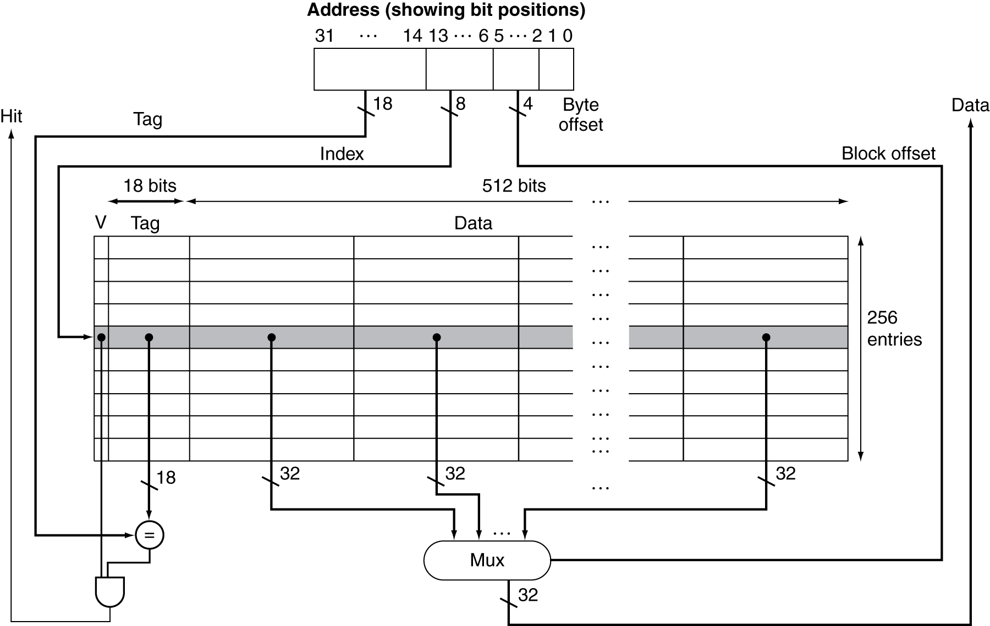
Example - Intrinsity FastMATH (2)
Cache: 16KB
256 blocks × 16 words/block

Slide 31
Block Size Considerations
Larger blocks should reduce miss rate
Due to spatial locality
But in a fixed-sized cache
Larger blocks ⇒ fewer number of blocks
More competition ⇒ increased miss rate
Larger miss penalty
Larger blocks ⇒ pollution
Can override benefit of reduced miss rate
Early restart and critical-word-first can help
Notes:
Eearly restart: to resume the execution as soon as the requested word of block is returned rather than wait for the entire block. Work good for instruction.
critical word first: the requested word is transferred first. Then the remaining transfer start from the word next to the requested word and wrapping around to the beginning.

Slide 32
Block Size on Performance
Increase block size tends to decrease miss rate
Notes:
Each line represents a cache of different size.

Slide 33
Outline
Memory hierarchy
The basics of caches
Direct-mapped cache
Address sub-division
Cache hit and miss
Memory support
Measuring cache performance
Improving cache performance
Set associative cache
Multiple level cache

Slide 34
Cache Hit and Miss
Cache read
Read hit
Read miss
Cache write
Write hit
Write-through
Write-back
Write miss

Slide 35
Read Cache
Read Hit
On cache hit, CPU proceeds normally
Read Miss
On cache miss
Stall the CPU pipeline
Fetch block from next level of hierarchy
Instruction cache miss
Restart instruction fetch
Data cache miss
Complete data access

Slide 36
Write Hit - Write-Through
There are two copies of data, one in cache and one in memory
Write Hit
Write through: also update memory
Increase the traffic to memory
Also makes writes take longer
e.g., if base CPI = 1, 10% of instructions are stores, write to memory takes 100 cycles
Effective CPI = 1 + 0.1×100 = 11
Solution: write buffer
Holds data waiting to be written to memory
CPU continues immediately
Only stalls on write if write buffer is already full

Slide 37
Avoid Waiting for Memory in Write Through
Use a write buffer (WB)
Processor: Writes data into cache and WB
Memory controller: Write WB data to memory
Write buffer is just a FIFO
Typical number of entries: 4
Memory system designer’s nightmare
Store frequency > 1 / DRAM write cycle
Write buffer saturation => CPU stalled
Processor
Cache
DRAM
Write Buffer
Notes:
You are right, memory is too slow. We really didn't writ e to the memory directly. We are writing to a write buffer.
Once the data is written into the write buffer and assuming a cache hit, the CPU is done with the write. The memory controller will then move the write buffer contents to the real memory behind the scene.
The write buffer works as long as the frequency of store is not too high. Notice here, I am referring to the frequency with respect to time, not with respect to number of instructions.
Remember the DRAM cycle time we talked about last time. It sets the upper limit on how frequent you can write to the main memory.
If the store are too close together or the CPU time is so much faster than the DRAM cycle time, you can end up overflowing the write buffer and the CPU must stop and wait.
+2 = 60 min. (Y:40)

Slide 38
Write Hit - Write-Back
Alternative: On data-write hit, just update the block in cache
Keep track of whether each block is dirty
When a dirty block is replaced
Write it back to memory
Can use a write buffer to allow a replacing block to be read first
Data in cache and memory is inconsistent

Slide 39
Write Miss - Write Allocation
Write Miss
What should happen on a write miss?
Alternatives for write-through
Allocate on miss: Fetch the block
Write around: Do not fetch the block
Since programs often write a whole block before reading it (e.g., initialization)
For write-back
Usually fetch the block

Slide 40
Example - Intrinsity FastMATH
Embedded MIPS processor
12-stage pipeline
Instruction and data access on each cycle
Split cache: Separate I-cache and D-cache
Each 16KB: 256 blocks × 16 words/block
D-cache: Write-through or write-back
SPEC2000 miss rates
I-cache: 0.4%
D-cache: 11.4%
Weighted average: 3.2%

Slide 41
Outline
Memory hierarchy
The basics of caches
Direct-mapped cache
Address sub-division
Cache hit and miss
Memory support
Measuring cache performance
Improving cache performance
Set associative cache
Multiple level cache

Slide 42
Memory Design to Support Cache
How to increase memory bandwidth to reduce miss penalty?

Slide 43
Interleaving for Bandwidth
Access pattern without interleaving
Cycle time
Access time
D1 available
Start access for D1
Start access for D2
Access pattern with interleaving
Data ready
Access Bank 0
Access Bank 1
Access Bank 2
Access Bank 3
Access
Transfer time
Access Bank 0 again

Slide 44
Miss Penalty for Different Memory Organizations
Assume
1 memory bus clock to send the address
15 memory bus clocks for each DRAM access initiated
1 memory bus clock to send a word of data
A cache block = 4 words
Three memory organizations :
A one-word-wide bank of DRAMs
Miss penalty = 1 + 4 x 15 + 4 x 1 = 65
A four-word-wide bank of DRAMs
Miss penalty = 1 + 15 + 1 = 17
A four-bank, one-word-wide bus of DRAMs
Miss penalty = 1 + 1 x 15 + 4 x 1 = 20

Slide 45
Access of DRAM
2048 x 2048
array
21-0

Slide 46
DRAM Generations
Year | Capacity | $/GB
1980 | 64Kbit | $1500000
1983 | 256Kbit | $500000
1985 | 1Mbit | $200000
1989 | 4Mbit | $50000
1992 | 16Mbit | $15000
1996 | 64Mbit | $10000
1998 | 128Mbit | $4000
2000 | 256Mbit | $1000
2004 | 512Mbit | $250
2007 | 1Gbit | $50
Trac:access time to a new row
Tcac:column access time to existing row

Slide 47
DDR SDRAM
Double Data Rate Synchronous DRAMs
Burst access from a sequential locations
Starting address, burst length
Data transferred under control of clock
(300 MHz, 2004)
Clock is used to eliminate the need of synchronization and the need of supplying successive address
Data transfer on both leading an falling edge of clock

Slide 48
Outline
Memory hierarchy
The basics of caches
Direct-mapped cache
Address sub-division
Cache hit and miss
Memory support
Measuring cache performance
Improving cache performance
Set associative cache
Multiple level cache

Slide 49
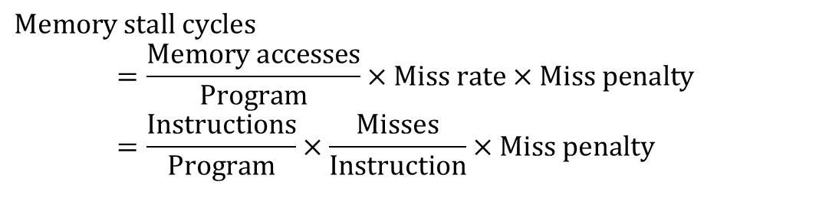
Measuring Cache Performance
Components of CPU time
Program execution cycles
Includes cache hit time
Memory stall cycles
Mainly from cache misses
With simplified assumptions
$$Memory stall cycles \\ =\frac{Memory accesses}{Program}×Miss rate×Miss penalty \\ =\frac{Instructions}{Program}×\frac{Misses}{Instruction}×Miss penalty$$

Slide 50
Cache Performance Example
Given
I-cache miss rate = 2%
D-cache miss rate = 4%
Miss penalty = 100 cycles
Base CPI (ideal cache) = 2
Load & stores are 36% of instructions
Compute the actual CPI?
Miss cycles per instruction
I-cache: 0.02 × 100 = 2
D-cache: 0.36 × 0.04 × 100 = 1.44
Actual CPI = 2 + 2 + 1.44 = 5.44
Ideal CPU is 5.44/2 =2.72 times faster

Slide 51
Average Access Time
Hit time is also important for performance
Average memory access time (AMAT)
AMAT = Hit time + Miss rate × Miss penalty
Example
CPU with 1ns clock, hit time = 1 cycle, miss penalty = 20 cycles, I-cache miss rate = 5%
AMAT = 1 + 0.05 × 20 = 2ns
2 cycles per instruction

Slide 52
Performance Summary
When CPU performance increased
Miss penalty becomes more significant
Decreasing base CPI
Greater proportion of time spent on memory stalls
Increasing clock rate
Memory stalls account for more CPU cycles
Cannot neglect cache behavior when evaluating system performance

Slide 53
Outline
Memory hierarchy
The basics of caches
Direct-mapped cache
Address sub-division
Cache hit and miss
Memory support
Measuring cache performance
Improving cache performance
Set associative cache
Multiple level cache

Slide 54
Improving Cache Performance
Reduce the time to hit in the cache
Decrease the miss ratio
Decrease the miss penalty

Slide 55
Direct Mapped
Block Placement
For each item of data at the lower level, there is exactly one location in cache where it might be
Address mapping: modulo number of blocks
0
1
0
1
0
1
0
1
0
0
1
1
0
0
1
1
0
0
0
0
1
1
1
1
0
0
0
0
1
0
0
1
0
1
0
1
0
0
1
0
1
1
0
1
1
0
0
0
1
1
0
1
0
1
1
1
0
0
1
1
1
1
0
1
M
e
m
o
r
y

Slide 56
Associative Caches
Fully associative
Allow a given block to go in any cache entry
Requires all entries to be searched at once
Comparator per entry (expensive)
n-way set associative
Each set contains n entries
Block number determines which set
(Block number) modulo (#Sets in cache)
Search all entries in a given set at once
n comparators (less expensive)

Slide 57
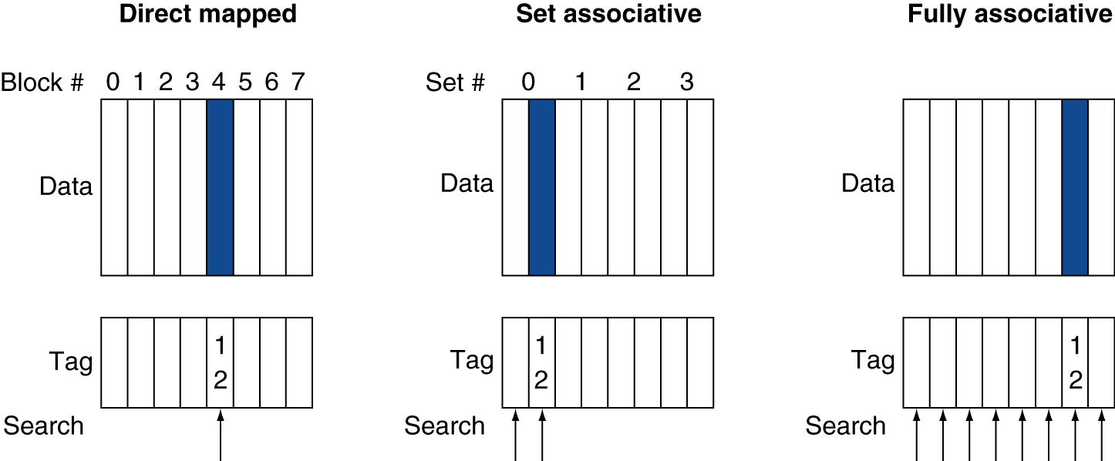
Associative Cache Example
Placement of a block whose address is 12

Slide 58
Possible Associativity Structures
An 8-block cache

Slide 59
Associativity Example (1)
Compare 4-block caches
Direct mapped, 2-way set associative, fully associative
Block access sequence: 0, 8, 0, 6, 8
Direct mapped
Block address | Cache index | Hit/miss | Cache content after access
 |  |  | 0 | 1 | 2 | 3
0 | 0 | miss | Mem[0]
8 | 0 | miss | Mem[8]
0 | 0 | miss | Mem[0]
6 | 2 | miss | Mem[0] |  | Mem[6]
8 | 0 | miss | Mem[8] |  | Mem[6]
time

Slide 60
Associativity Example (2)
2-way set associative (0, 8, 0, 6, 8)
Block address | Cache index | Hit/miss | Cache content after access
 |  |  | Set 0 |  | Set 1
0 | 0 | miss | Mem[0]
8 | 0 | miss | Mem[0] | Mem[8]
0 | 0 | hit | Mem[0] | Mem[8]
6 | 0 | miss | Mem[0] | Mem[6]
8 | 0 | miss | Mem[8] | Mem[6]
time
Fully associative (0, 8, 0, 6, 8)
Block address |  | Hit/miss | Cache content after access
0 |  | miss | Mem[0]
8 |  | miss | Mem[0] | Mem[8]
0 |  | hit | Mem[0] | M[em8]
6 |  | miss | Mem[0] | Mem[8] | Mem[6]
8 |  | hit | Mem[0] | Mem[8] | Mem[6]
time

Slide 61
How Much Associativity
Increased associativity decreases miss rate
But with diminishing returns
Simulation of a system with 64KB D-cache, 16-word blocks, SPEC2000
1-way: 10.3%
2-way: 8.6%
4-way: 8.3%
8-way: 8.1%

Slide 62
A 4-Way Set-Associative Cache
Increasing associativity shrinks index, expands tag

Slide 63
Comparing Data Available Time
Direct mapped cache
Cache block is available BEFORE Hit/Miss
Possible to assume a hit and continue, recover later if miss
N-way set-associative cache
Data comes AFTER Hit/Miss decision
Extra MUX delay for the data

Slide 64
Data Placement Policy
Direct mapped cache
Each memory block mapped to one location
No need to make any decision
Current item replaces previous one in location
N-way set associative cache
Each memory block has choice of N locations
Fully associative cache
Each memory block can be placed in ANY cache location
Misses in N-way set-associative or fully associative cache
Bring in new block from memory
Throw out a block to make room for new block
Need to decide on which block to throw out

Slide 65
Cache Block Replacement
Direct mapped: No choice
Set associative or fully associative
Random
LRU (Least Recently Used)
Hardware keeps track of the access history and replace the block that has not been used for the longest time
An example of a pseudo LRU (for a two-way set associative)
Use a pointer pointing at each block in turn
Whenever an access to the block the pointer is pointing at, move the pointer to the next block
When need to replace, replace the block currently pointed at

Slide 66
Comparison of the Structures
N-way set-associative cache
N comparators vs. 1
Extra MUX delay for the data
Data comes AFTER Hit/Miss decision and set selection
Direct mapped cache
Cache block is available BEFORE Hit/Miss
Possible to assume a hit and continue, recover later if miss

Slide 67
Outline
Memory hierarchy
The basics of caches
Direct-mapped cache
Address sub-division
Cache hit and miss
Memory support
Measuring cache performance
Improving cache performance
Set associative cache
Multiple level cache

Slide 68
Multilevel Caches
Primary cache attached to CPU
Small, but fast
Level-2 cache services misses from primary cache
Larger, slower, but still faster than main memory
Main memory services L-2 cache misses
Some high-end systems include L-3 cache

Slide 69
Multilevel Cache Example (1)
Given
CPU base CPI = 1, clock rate = 4GHz
Miss rate/instruction = 2%
Main memory access time = 100ns
With just primary cache
Miss penalty = 100ns/0.25ns = 400 cycles
Effective CPI = 1 + 0.02 × 400 = 9

Slide 70
Multilevel Cache Example (2)
Now add L-2 cache
L-1 miss rate to L-2 = 2% (with one cache: to M)
L-2 access time = 5ns (to M: 100ns)
L-2 miss rate to main memory = 0.5%
Primary miss with L-2 hit (2%)
Penalty to access L-2 = 5ns/0.25ns = 20 cycles
Primary miss with L-2 miss (0.5%)
Penalty to access memory = 400 cycles
CPI = 1 + 0.02 × 20 + 0.005 × 400 = 3.4
Performance ratio = 9/3.4 = 2.6

Slide 71
Multilevel Cache Considerations
Primary cache
Focus on minimal hit time
L-2 cache
Focus on low miss rate to avoid main memory access
Hit time has less overall impact
Results
L-1 cache usually smaller than a single-level cache
L-1 block size smaller than L-2 block size

Slide 72
Interactions with Advanced CPUs
Out-of-order CPUs can execute instructions during cache miss
Pending store stays in load/store unit
Dependent instructions wait in reservation stations
Independent instructions continue
Effect of miss depends on program data flow
Much harder to analyze
Use system simulation

Slide 73
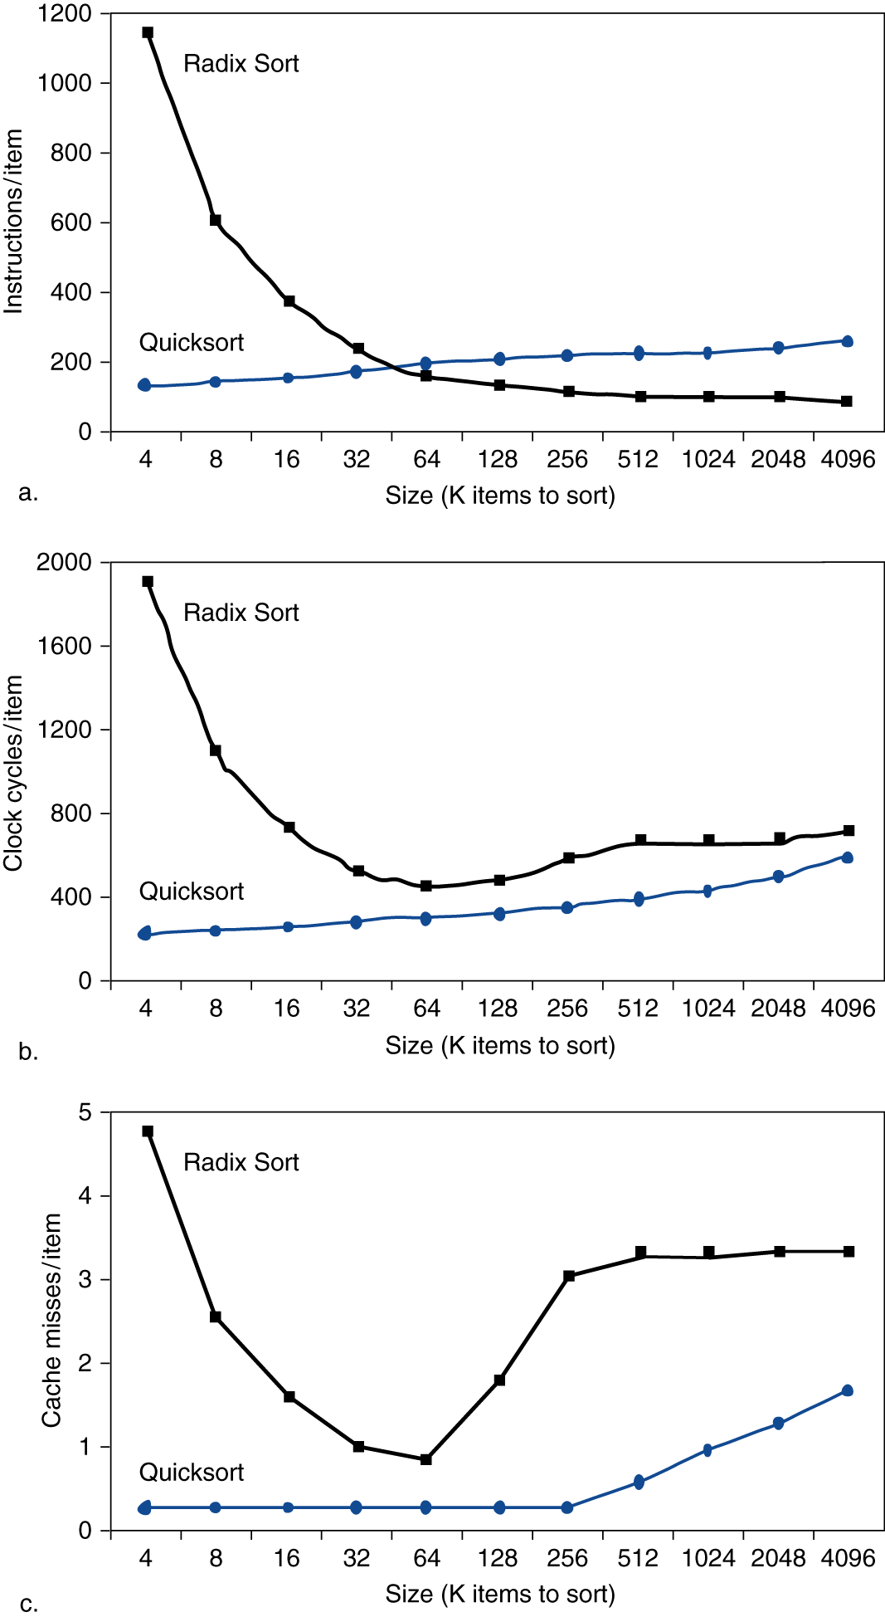
Interactions with Software
Misses depend on memory access patterns
Algorithm behavior
Compiler optimization for memory access

