Slide 1
CSC3050 – Computer Architecture
Prof. Yeh-Ching Chung
School of Science and Engineering
Chinese University of Hong Kong, Shenzhen

Slide 2
Virtual Memory
Use main memory as a “cache” for secondary (disk) storage
Managed jointly by CPU hardware and the operating system (OS)
Programs share main memory
Each gets a private virtual address space holding its frequently used code and data
Protected from other programs
CPU and OS translate virtual addresses to physical addresses
VM “block” is called a page
VM translation “miss” is called a page fault

Slide 3
Two Programs Sharing Physical Memory
A program’s address space is divided into pages (all one fixed size) or segments (variable sizes)
Program 1
virtual address space
Main memory
Program 2
virtual address space

Slide 4
Address Translation
A virtual address is translated to a physical address by a combination of hardware and software
So each memory request first requires an address translation from the virtual space to the physical space
A virtual memory miss (i.e., when the page is not in physical memory) is called a page fault.
31 12 11 0
Virtual page number
Page offset
Virtual Address (VA)
Translation
29 12 11 0
Physical page number
Page offset
Physical Address (PA)

Slide 5
Page Fault Penalty
On page fault, the page must be fetched from disk
Takes millions of clock cycles
Handled by OS code
Try to minimize page fault rate
Fully associative placement in memory
Smart replacement algorithms

Slide 6
Page Tables
Stores placement information
Array of page table entries, indexed by virtual page number
Page table register in CPU points to page table in physical memory
If page is present in memory
Page table entry (PTE) stores the physical page number
Plus other status bits (referenced, dirty, …)
If page is not present
PTE can refer to location in swap space on disk

Slide 7
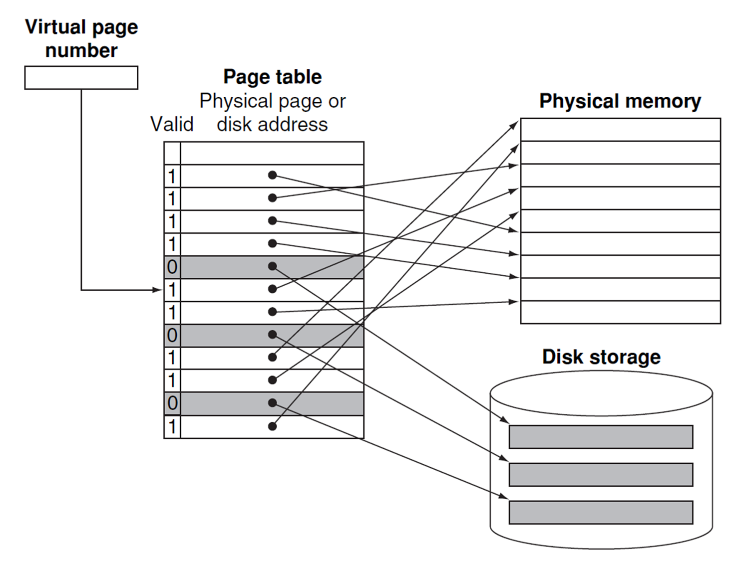
Address Translation Mechanisms

Slide 8
Replacement and Writes
To reduce page fault rate, prefer least-recently used (LRU) replacement
Reference bit (aka use bit) in PTE set to 1 on access to page
Periodically cleared to 0 by OS
A page with reference bit = 0 has not been used recently
Disk writes take millions of cycles
Block at once, not individual locations
Write through is impractical
Use write-back
Dirty bit in PTE set when page is written

Slide 9
Fast Translation Using a TLB
Address translation would appear to require extra memory references
One to access the PTE
Then the actual memory access
But access to page tables has good locality
So use a fast cache of PTEs within the CPU
Called a Translation Look-aside Buffer (TLB)
Typical: 16–512 PTEs, 0.5–1 cycle for hit, 10–100 cycles for miss, 0.01%–1% miss rate
Misses could be handled by hardware or software

Slide 10
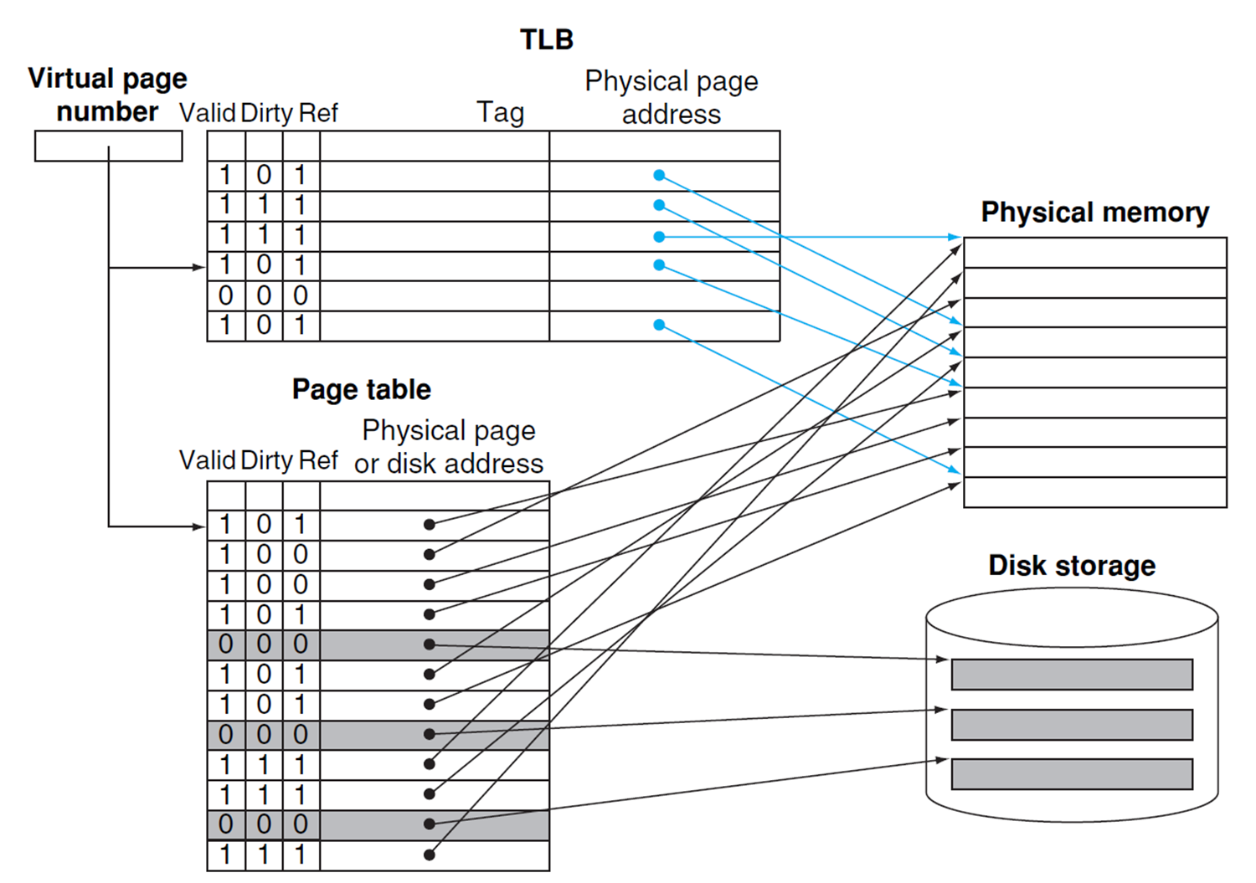
Fast Translation Using a TLB

Slide 11
TLB Misses
If page is in memory
Load the PTE from memory and retry
Could be handled in hardware or in software
If page is not in memory (page fault)
OS handles fetching the page and updating the page table
Then restart the faulting instruction

Slide 12
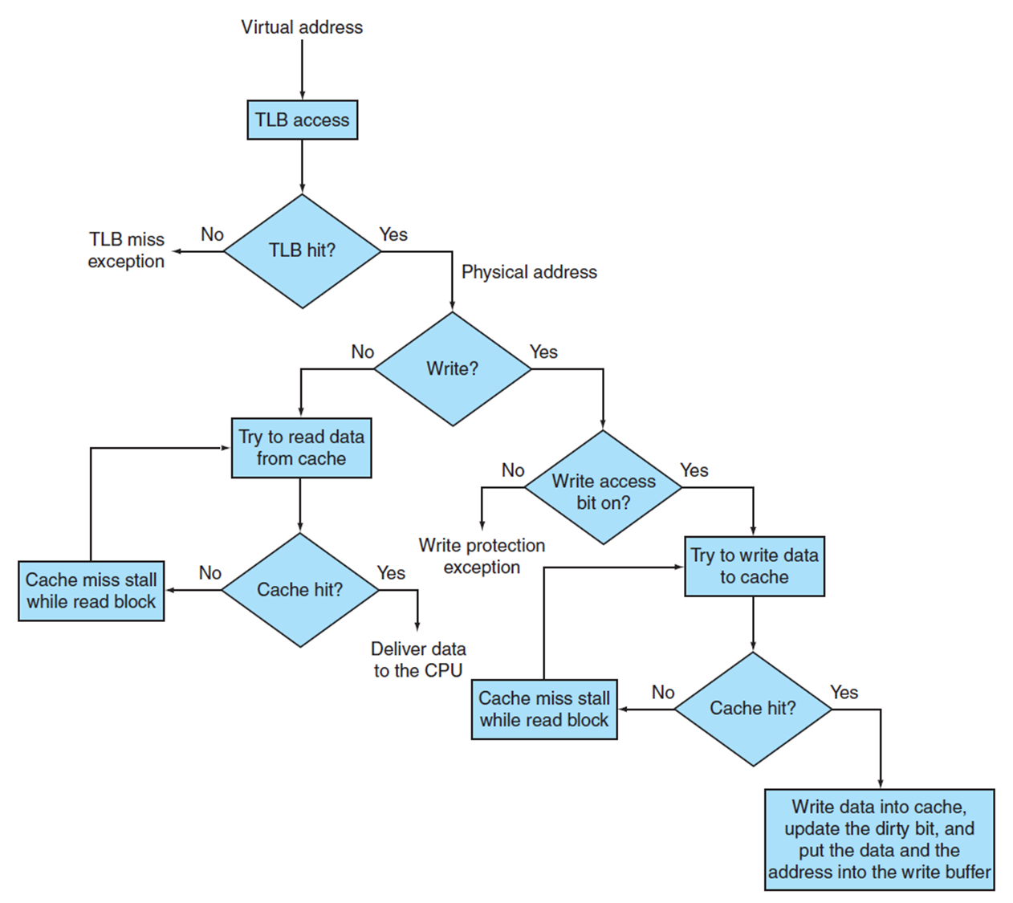
TLB and Cache

Slide 13
TLB Event Combinations
TLB miss: PTE not in TLB
Page Table miss: page not in memory
Cache miss: block not in cache
TLB | Page Table | Cache | Possible? Under what circumstances?
Hit | Hit | Miss | Yes. Although page table is never checked if TLB hits.
Miss | Hit | Hit | Yes. TLB misses, PA in page table, data in cache.
Miss | Hit | Miss | Yes. TLB misses, PA in page table, data not in cache.
Miss | Miss | Miss | Yes. Page fault.
Hit | Miss | Miss/Hit | Impossible. Cannot have TLB translation if page is not in memory.
Miss | Miss | Hit | Impossible. Data cannot be allowed in cache if the page is not in memory

Slide 14
The Hardware / Software Boundary
Which part of address translation is done by hardware?
TLB that caches recent translations:
TLB access time is part of cache hit time
May allot extra stage in pipeline
Page Table storage, fault detection and updating
Dirty & Reference bits
Page faults result in interrupts
Disk Placement:
(Hardware)
(Hardware)
(Software)
(Software)

Slide 15
The Memory Hierarchy
Common principles apply at all levels of the memory hierarchy
Based on notions of caching
At each level in the hierarchy
Block placement
Finding a block
Replacement on a miss
Write policy

Slide 16
Block Placement
Determined by associativity
Direct mapped (1-way associative)
One choice for placement
n-way set associative
n choices within a set
Fully associative
Any location
Higher associativity reduces miss rate
Increases complexity, cost, and access time

Slide 17
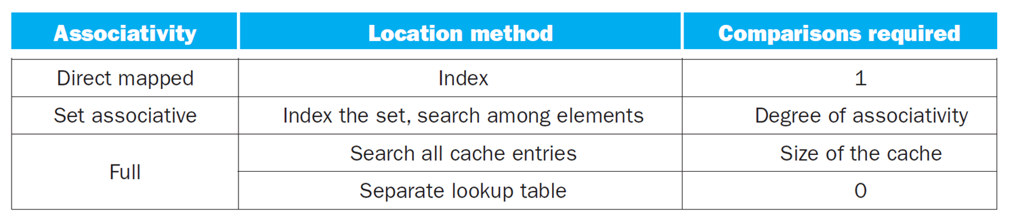
Finding a Block
Hardware caches
Reduce comparisons to reduce cost
Virtual memory
Full table lookup makes full associativity feasible
Benefit in reduced miss rate

Slide 18
Replacement
Choice of entry to replace on a miss
Least recently used (LRU)
Complex and costly hardware for high associativity
Random
Close to LRU, easier to implement
Virtual memory
LRU approximation with hardware support

Slide 19
Write Policy
Write-through
Update both upper and lower levels
Simplifies replacement, but may require write buffer
Write-back
Update upper level only
Update lower level when block is replaced
Need to keep more state (e.g., dirty bit)
Virtual memory
Only write-back is feasible, given disk write latency

Slide 20
Sources of Misses
Compulsory misses (aka cold start misses)
First access to a block
Capacity misses
Due to finite cache size
A replaced block is later accessed again
Conflict misses (aka collision misses)
In a non-fully associative cache
Due to competition for entries in a set
Would not occur in a fully associative cache of the same total size

Slide 21
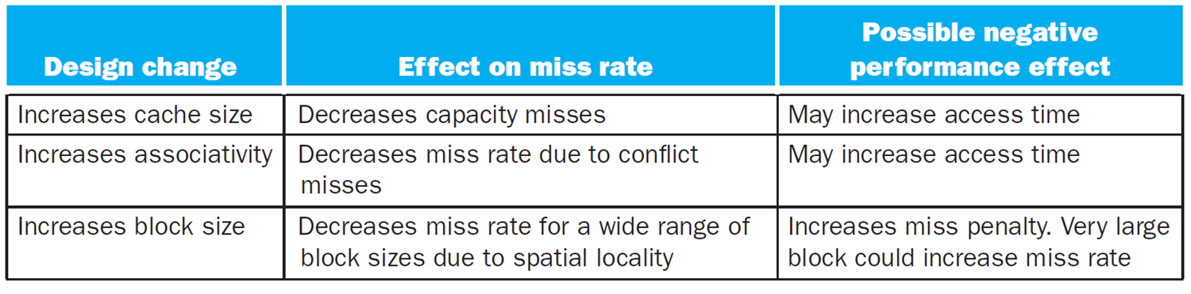
Cache Design Trade-offs

