Slide 1
CSC3050 – Computer Architecture
Prof. Yeh-Ching Chung
School of Science and Engineering
Chinese University of Hong Kong, Shenzhen

Slide 2
Outline
Virtual memory
Basics
Issues in virtual memory
Handling huge page table
TLB (Translation Lookaside Buffer)
TLB and cache
A common framework for memory hierarchy
Using a Finite State Machine to Control a Simple Cache
Parallelism and Memory Hierarchies: Cache Coherence

Slide 3
Levels of Memory Hierarchy
Upper Level
Staging
Transfer Unit
faster
Registers
Instr. Operands
prog./compiler
Cache
Blocks
cache controller
Memory
Pages
OS
Disk
Files
user/operator
Larger
Tape
Lower Level

Slide 4
Virtual Memory
cache
register
memory
disk
pages
frame
4

Slide 5
Diagram of Process State
admitted
interrupt
terminated
new
exit
ready
running
I/O or
event completion
scheduler dispatch
I/O or event wait
waiting

Slide 6
CPU Scheduler
Select one of the ready processes, and allocates the CPU to it.
ready queue
CPU
I/O
I/O queue(s)

Slide 7
Virtual Memory (1)
Programs share main memory (Multi-programming and I/O)
Program executed in a name space (virtual address space) different from memory space (physical address space)
Each gets a private virtual address space holding its frequently used code and data, starting at address 0, only accessible to itself
Yet, any can run anywhere in physical memory
Virtual memory implements the translation from virtual space to physical space
Every program has lots of memory (> physical memory)
Protected from other programs

Slide 8
Virtual Memory (2)
Use main memory as a “cache” for secondary (disk) storage
Managed jointly by CPU hardware and the operating system (OS)
CPU and OS translate virtual addresses to physical addresses
VM “block” is called page
VM translation “miss” is called page fault

Slide 9
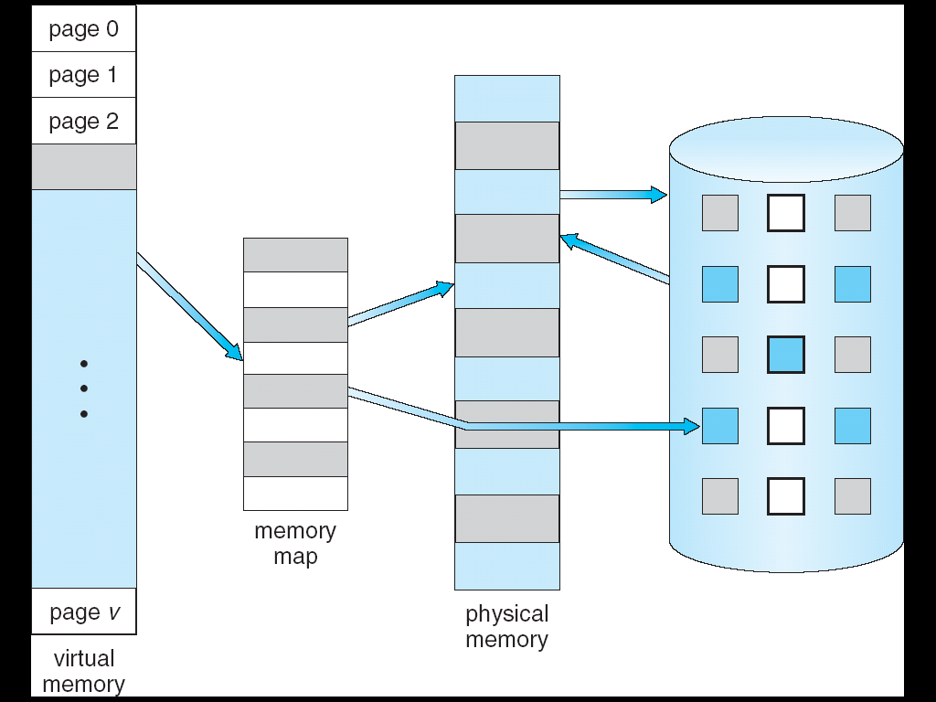
Virtual Memory (3)
⇒
Notes:
9

Slide 10
Outline
Virtual memory
Basics
Issues in virtual memory
Handling huge page table
TLB (Translation Lookaside Buffer)
TLB and cache
A common framework for memory hierarchy
Using a Finite State Machine to Control a Simple Cache
Parallelism and Memory Hierarchies: Cache Coherence

Slide 11
Basic Issues in Virtual Memory
Size of data blocks that are transferred from disk to main memory
Which region of memory to hold new block => Placement policy (how to the page?)
When memory is full, then some region of memory must be released to make room for the new block => replacement policy
When to fetch missing items from disk?
Fetch only on a fault => demand load policy
register
cache
disk
memory
pages
frame

Slide 12
Block Size and Placement Policy
Huge miss penalty
A page fault may take millions of cycles to process
Pages should be fairly large (e.g., 4KB) to amortize the high access time
Reducing page faults is important
Fully associative placement => use page table (in memory) to locate pages

Slide 13
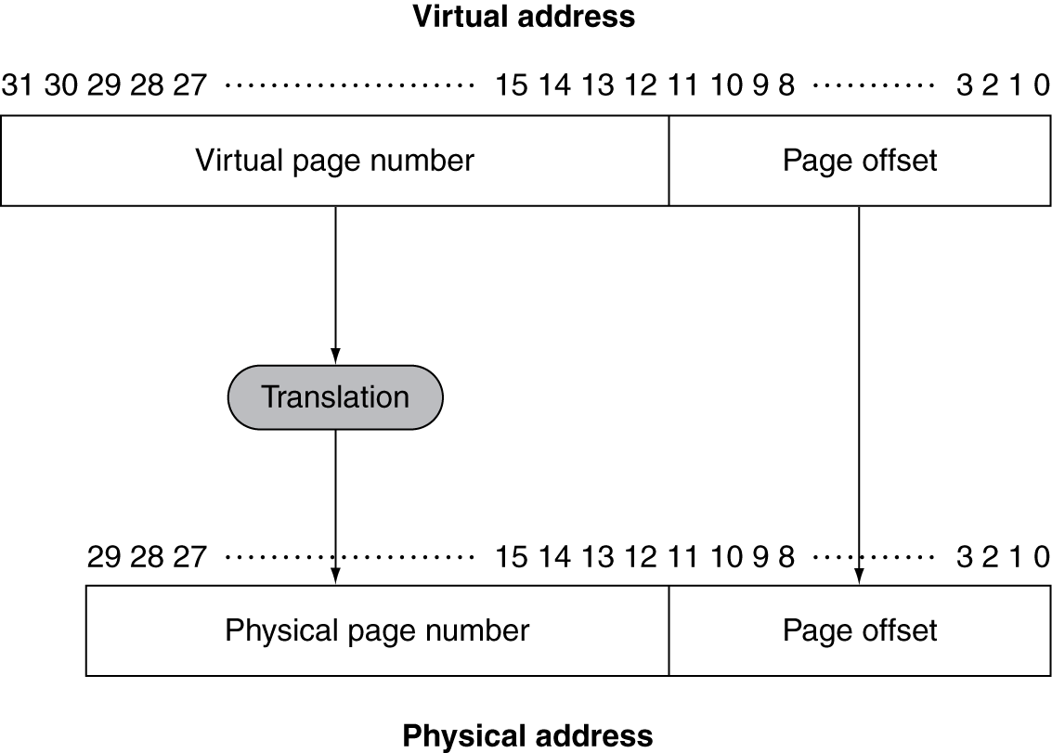
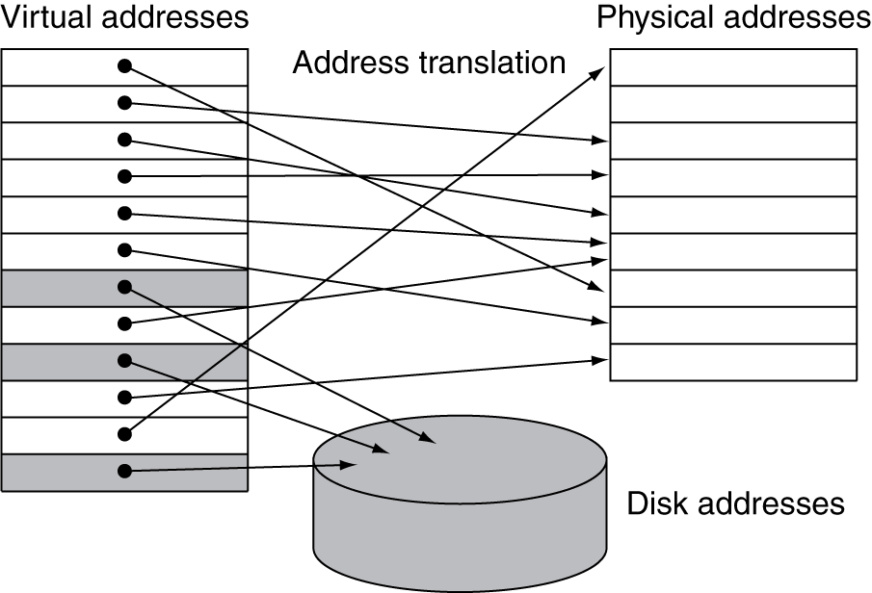
Address Translation
Fixed-size pages (e.g., 4K)

Slide 14
Paging
Virtual and physical address space partitioned into blocks of equal size
Key operation: address mapping
MAP: V → M ∪ {∅} address mapping function
MAP(a) = a' if data at virtual address a is present in physical address a' and a' in M
= ∅ if data at virtual address a is not present in M
pages
page frames
a
missing item fault
Name Space V
fault
handler
Processor
∅
Secondary
Memory
Addr Trans
Mechanism
Main
Memory
a
physical address
a'
OS does this transfer

Slide 15
Page Tables
Stores placement information
Page table stored in main memory
Array of page table entries, indexed by virtual page number
Page table register in CPU points to page table in physical memory
If page is present in memory
Page table entry (PTE) stores the physical page number
Plus other status bits (referenced, dirty, …)
If page is not present
PTE can refer to location in swap space on disk

Slide 16
Page Tables
How many memory references for each address translation?
All addresses generated by the program are virtual addresses
Table located in physical memory

Slide 17
Page Fault
Page hit, proceed normally
Page fault means that page is not in memory
Huge miss penalty
A page fault may take millions of cycles to process
Hardware must detect situation but it cannot remedy the situation
Can handle the faults in software instead of hardware, because handling time is small compared to disk access
The software can be very smart or complex
The faulting process can be context-switched

Slide 18
OS Handling Page Faults
Hardware must trap to the operating system so that it can remedy the situation
Pick a page to discard (may write it to disk)
Load the page in from disk
Update the page table
Resume to program so HW will retry and succeed!
In addition, OS must know where to find the page
Create space on disk for all pages of process (swap space)
Use a data structure to record where each valid page is on disk (may be part of page table)
Use another data structure to track which process and virtual addresses use each physical page => for replacement purpose

Slide 19
When to Fetch Missing Items From Disk
Fetch only on a fault
=> Demand load policy

Slide 20
Page Replacement and Writes
To reduce page fault rate, prefer least-recently used (LRU) replacement
Reference bit (aka use bit) in PTE set to 1 on access to page
Periodically cleared to 0 by OS
A page with reference bit = 0 has not been used recently
Disk writes take millions of cycles
Block at once, not individual locations
Write through is impractical
Use write-back
Dirty bit in PTE set when page is written

Slide 21
Problems of Page Table
Page table is too big
Access to page table is too slow (needs one memory read)

Slide 22
Outline
Virtual memory
Basics
Issues in virtual memory
Handling huge page table
TLB (Translation Lookaside Buffer)
TLB and cache
A common framework for memory hierarchy
Using a Finite State Machine to Control a Simple Cache
Parallelism and Memory Hierarchies: Cache Coherence

Slide 23
Impact of Paging - Huge Page Table
Page table occupies storage 32-bit VA, 4KB page, 4bytes/entry => 2²⁰ PTE, 4MB table
Possible solutions
Use bounds register to limit table size; add more if exceed
Let pages to grow in both directions => 2 tables, 2 limit registers, one for hash, one for stack
Use hashing => page table same size as physical pages
Multiple levels of page tables
Paged page table (page table resides in virtual space)

Slide 24
Hashing - Inverted Page Tables
28-bit virtual address,4 KB per page, and 4 bytes per page-table entry
The number of pages: 64K
The number of physical frames: 16K
Page table size : 64 K (pages #) x 4 = 256 KB
Inverted page table : 16 K (frame #) x (4+?) = 64 KB
=> TLBs or virtually addressed caches are critical
Virtual
Page
Hash
V.Page P. Frame
=
Notes:
Page 520

Slide 25
Two-level Page Tables
32-bit address:
1K
PTEs
10
10
12
4KB
P1 index
P2 index
page offset
4 GB virtual address space
4 KB of PTE1
(Each entry indicate if any page in the segment is allocated)
4 MB of PTE2
paged, holes
4 bytes
What about a 48-64 bit address space?
4 bytes

Slide 26
Outline
Virtual memory
Basics
Issues in virtual memory
Handling huge page table
TLB (Translation Lookaside Buffer)
TLB and cache
A common framework for memory hierarchy
Using a Finite State Machine to Control a Simple Cache
Parallelism and Memory Hierarchies: Cache Coherence

Slide 27
Impact of Paging - More Memory Access
Each memory operation (instruction fetch, load, store) requires a page-table access
Basically double number of memory operations
One to access the PTE
Then the actual memory access

Slide 28
Translation Lookaside Buffer (TLB)
Access to page tables has good locality
Fast cache of PTEs within the CPU
Called a Translation Look-aside Buffer (TLB)
Typical RISC processors have memory management unit (MMU) which includes TLB that does page table lookup
TLB can be organized as fully associative, set associative, or direct mapped
TLBs are small, typically 16–512 PTEs, 0.5–1 cycle for hit, 10–100 cycles for miss, 0.01%–1% miss rate
Misses could be handled by hardware or software

Slide 29
Fast Translation Using TLB (Translation Lookaside Buffer)
TLB

Slide 30
TLB Hit
TLB hit on read
TLB hit on write
Toggle dirty bit (write back to page table on replacement)

Slide 31
TLB Miss
If page is in memory
Load the PTE from memory and retry
Could be handled in hardware
Can get complex for more complicated page table structures
Or in software
Raise a special exception, with optimized handler
If page is not in memory (page fault)
OS fetches the page and updates the page table (software)
Then restarts the faulting instruction

Slide 32
Outline
Virtual memory
Basics
Issues in virtual memory
Handling huge page table
TLB (Translation Lookaside Buffer)
TLB and cache
A common framework for memory hierarchy
Using a Finite State Machine to Control a Simple Cache
Parallelism and Memory Hierarchies: Cache Coherence

Slide 33
Making Address Translation Practical
In VM, memory acts like a cache for disk
Page table maps virtual page numbers to physical frames
Use a page table cache for recent translation => Translation Lookaside Buffer (TLB)
hit
VA
TLB
Lookup
PA
Cache
miss
Main
Memory
CPU
Translation
with a TLB
miss
hit
Trans-
lation
data
1/2 t
t
20 t

Slide 34
Integrate TLB and Cache

Slide 35
TLBs and Caches

Slide 36
Possible Combinations of Events
Cache
TLB
Page
table
Possible? Conditions?
Miss
Hit
Hit
Yes; but page table never checked if
TLB hits
Hit
Miss
Hit
TLB miss, but entry found in page
table;after retry, data in cache
Miss
Miss
Hit
TLB miss, but entry found in page
table; after retry, data miss in cache
Miss
Miss
Miss
TLB miss and is followed by a page
fault; after retry, data miss in cache
Miss
Hit
Miss
impossible;
not in TLB if page not in memory
Hit
Hit
Miss
impossible;
not in TLB if page not in memory
Hit
Miss
Miss
impossible;
not in cache if page not in memory

Slide 37
Virtual Address and Cache
TLB access is serial with cache access
Cache is physically indexed and tagged
Alternative: Virtually addressed cache
Cache is virtually indexed and virtually tagged
CPU
VA
Trans-
lation
PA
Cache
miss
Main
Memory
hit
data
CPU
VA
Trans-
lation
PA
Main
Memory
Cache
hit
data

Slide 38
Virtually Addressed Cache
Require address translation only on miss!
Problem
Same virtual addresses (different processes) map to different physical addresses
Synonym/alias problem: two different virtual addresses map to same physical address
Two different cache entries holding data for the same physical address!
For update: must update all cache entries with same physical address or memory becomes inconsistent
Determining this requires significant hardware, essentially an associative lookup on the physical address tags to see if you have multiple hits;
Or software enforced alias boundary: same least-significant bits of VA &PA > cache size
tag + process id

Slide 39
Integrating TLB and Cache

Slide 40
An Alternative:Virtually Indexed but Physically Tagged
TLB
Cache
32
associative
lookup
index
1 K
4 bytes
10
2
00
PA
Hit/
Miss
PA
Data
Hit/
Miss
20
12
page #
displace
=
IF cache hit AND (cache tag = PA) then deliver data to CPU
ELSE IF [cache invalid OR (cache tag ! = PA)] and TLB hit THEN
access memory with the PA from the TLB
ELSE do standard VA translation

Slide 41
Problem with Overlapped Access
Address bits to index into cache must not change as a result of VA translation
Limits to small caches, large page sizes, or high n-way set associativity if want a large cache
Ex.: cache is 8K bytes instead of 4K
11
2
cache
index
00
This bit is changed by VA translation, but is needed for cache lookup
20
12
Solutions:
go to 8K byte page sizes;
go to 2 way set associative cache
SW guarantee VA[13]=PA[13]
virt page #
disp
1K
2-way set associative cache
10
4
4

Slide 42
Outline
Virtual memory
Basics
Issues in virtual memory
Handling huge page table
TLB (Translation Lookaside Buffer)
TLB and cache
A common framework for memory hierarchy
Using a Finite State Machine to Control a Simple Cache
Parallelism and Memory Hierarchies: Cache Coherence

Slide 43
The Memory Hierarchy
The BIG Picture
Common principles apply at all levels of the memory hierarchy
Based on notions of caching
At each level in the hierarchy
Block placement
Finding a block
Replacement on a miss
Write policy

Slide 44
Block Placement
Determined by associativity
Direct mapped (1-way associative)
One choice for placement
n-way set associative
n choices within a set
Fully associative
Any location
Higher associativity reduces miss rate
Increases complexity, cost, and access time

Slide 45
Find a Block
Hardware caches
Reduce comparisons to reduce cost
Virtual memory
Full table lookup makes full associativity feasible
Benefit in reduced miss rate
Associativity | Location method | Tag comparisons
Direct mapped | Index | 1
n-way set associative | Set index, then search entries within the set | n
Fully associative | Search all entries | #entries
 | Full lookup table | 0

Slide 46
Replacement
Choice of entry to replace on a miss
Least recently used (LRU)
Complex and costly hardware for high associativity
Random
Close to LRU, easier to implement
Virtual memory
LRU approximation with hardware support

Slide 47
Write Policy
Write-through
Update both upper and lower levels
Simplifies replacement, but may require write buffer
Write-back
Update upper level only
Update lower level when block is replaced
Need to keep more state
Virtual memory
Only write-back is feasible, given disk write latency

Slide 48
Sources of Misses
Compulsory misses (aka cold start misses)
First access to a block
Capacity misses
Due to finite cache size
A replaced block is later accessed again
Conflict misses (aka collision misses)
In a non-fully associative cache
Due to competition for entries in a set
Would not occur in a fully associative cache of the same total size

Slide 49
Challenge in Memory Hierarchy
Every change that potentially improves miss rate can negatively affect overall performance
Design change Effects on miss rate Possible effects
size ↑ capacity miss ↓ access time ↑
associativity ↑ conflict miss ↓ access time ↑
block size ↑ spatial locality ↑ miss penalty ↑
Trends
Synchronous SRAMs (provide a burst of data)
Redesign DRAM chips to provide higher bandwidth or processing
Restructure code to increase locality
Use prefetching (make cache visible to ISA)

Slide 50
Outline
Virtual memory
Basics
Issues in virtual memory
Handling huge page table
TLB (Translation Lookaside Buffer)
TLB and cache
A common framework for memory hierarchy
Using a Finite State Machine to Control a Simple Cache
Parallelism and Memory Hierarchies: Cache Coherence

Slide 51
Cache Control
Example cache characteristics
Direct-mapped, write-back, write allocate
Block size: 4 words (16 bytes)
Cache size: 16 KB (1024 blocks)
32-bit byte addresses
Valid bit and dirty bit per block
Blocking cache
CPU waits until access is complete
31
14
13
4
3
0
Tag
Index
Offset
18 bits
10 bits
4 bits

Slide 52
Interface Signals
CPU
Cache
Memory
Read/Write
Read/Write
Valid
Valid
Address
32
Address
32
Write Data
32
Write Data
128
Read Data
32
Read Data
128
Ready
Ready
Multiple cycles per access

Slide 53
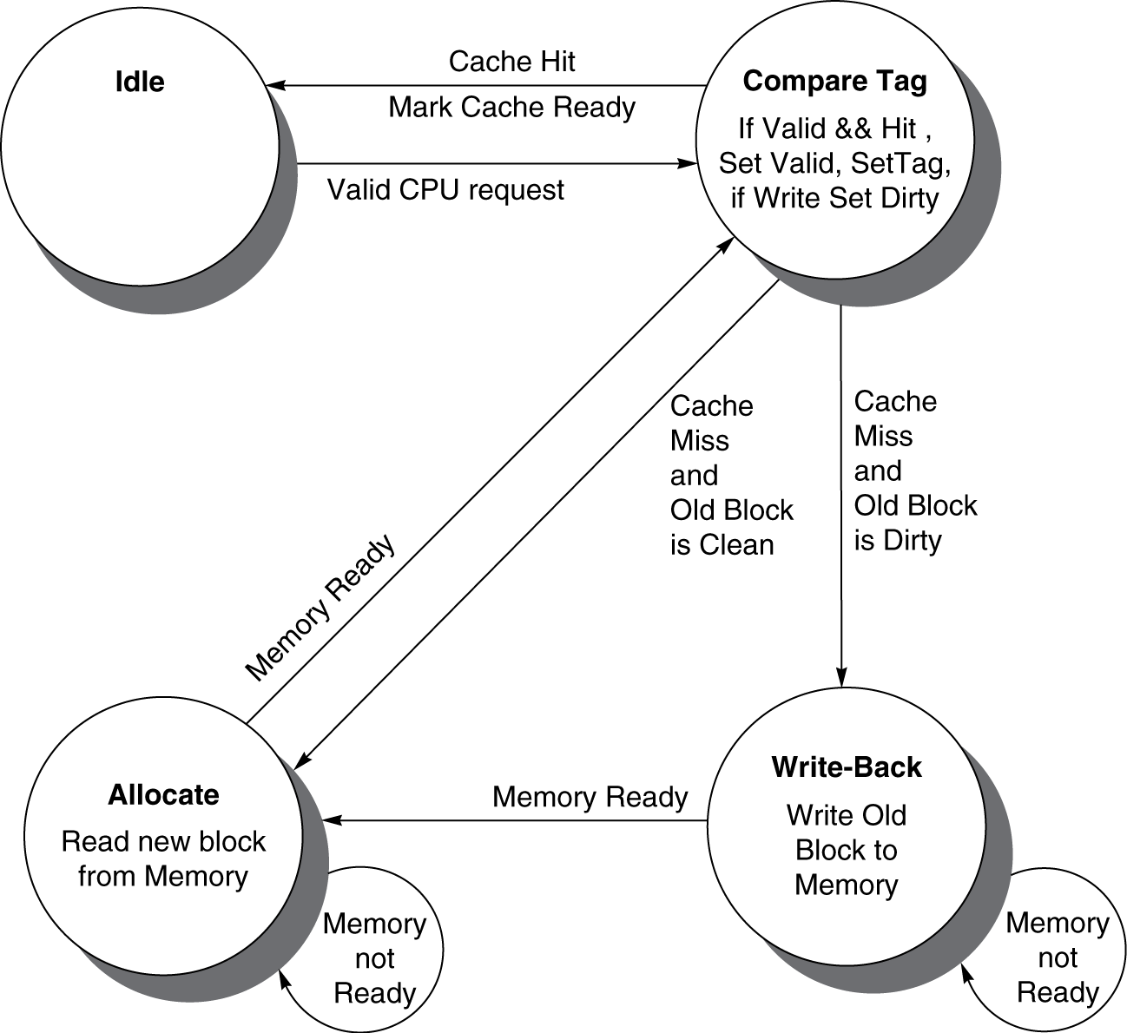
Cache Controller FSM
Could partition into separate states to reduce clock cycle time

Slide 54
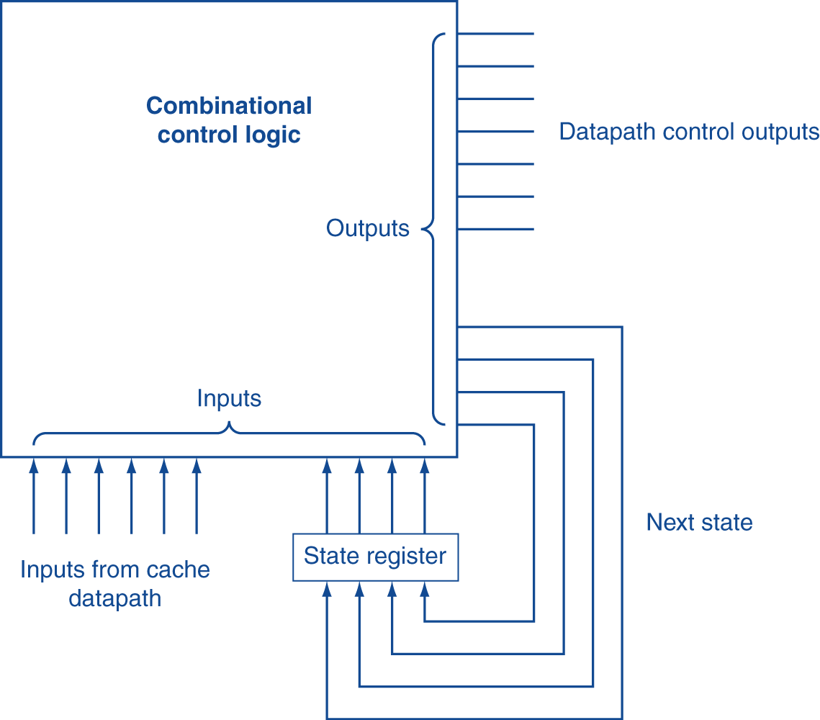
Finite State Machines
Use an FSM to sequence control steps
Set of states, transition on each clock edge
State values are binary encoded
Current state stored in a register
Next state = f_{n} (current state, current inputs)
Control output signals = f_{o} (current state)

Slide 55
Outline
Virtual memory
Basics
Issues in virtual memory
Handling huge page table
TLB (Translation Lookaside Buffer)
TLB and cache
A common framework for memory hierarchy
Using a Finite State Machine to Control a Simple Cache
Parallelism and Memory Hierarchies: Cache Coherence

Slide 56
Cache Coherence Problem
Suppose two CPU cores share a physical address space
Write-through caches
Time step | Event | CPU A’s cache | CPU B’s cache | Memory
0 |  |  |  | 0
1 | CPU A reads X | 0 |  | 0
2 | CPU B reads X | 0 | 0 | 0
3 | CPU A writes 1 to X | 1 | 0 | 1
Two different processors have two different values for the same location

Slide 57
Coherence Defined
Informally: Reads return most recently written value
Formally:
P writes X; P reads X (no intervening writes) ⇒ read returns written value
P₁ writes X; P₂ reads X (sufficiently later) ⇒ read returns written value
c.f. CPU B reading X after step 3 in example
P₁ writes X, P₂ writes X ⇒ all processors see writes in the same order
End up with the same final value for X

Slide 58
Cache Coherence Protocols
Operations performed by caches in multiprocessors
Migration of data to local caches
Reduces bandwidth for shared memory
Replication of read-shared data
Reduces contention for access
Snooping protocols
Each cache monitors bus reads/writes
Directory-based protocols
Caches and memory record sharing status of blocks in a directory

Slide 59
Invalidating Snooping Protocols
Cache gets exclusive access to a block when it is to be written
Broadcasts an invalidate message on the bus
A subsequent read results in another cache miss
CPU activity | Bus activity | CPU A’s cache | CPU B’s cache | Memory
 |  |  |  | 0
CPU A reads X | Cache miss for X | 0 |  | 0
CPU B reads X | Cache miss for X | 0 | 0 | 0
CPU A writes 1 to X | Invalidate for X | 1 |  | 0
CPU B read X | Cache miss for X | 1 | 1 | 1

Slide 60
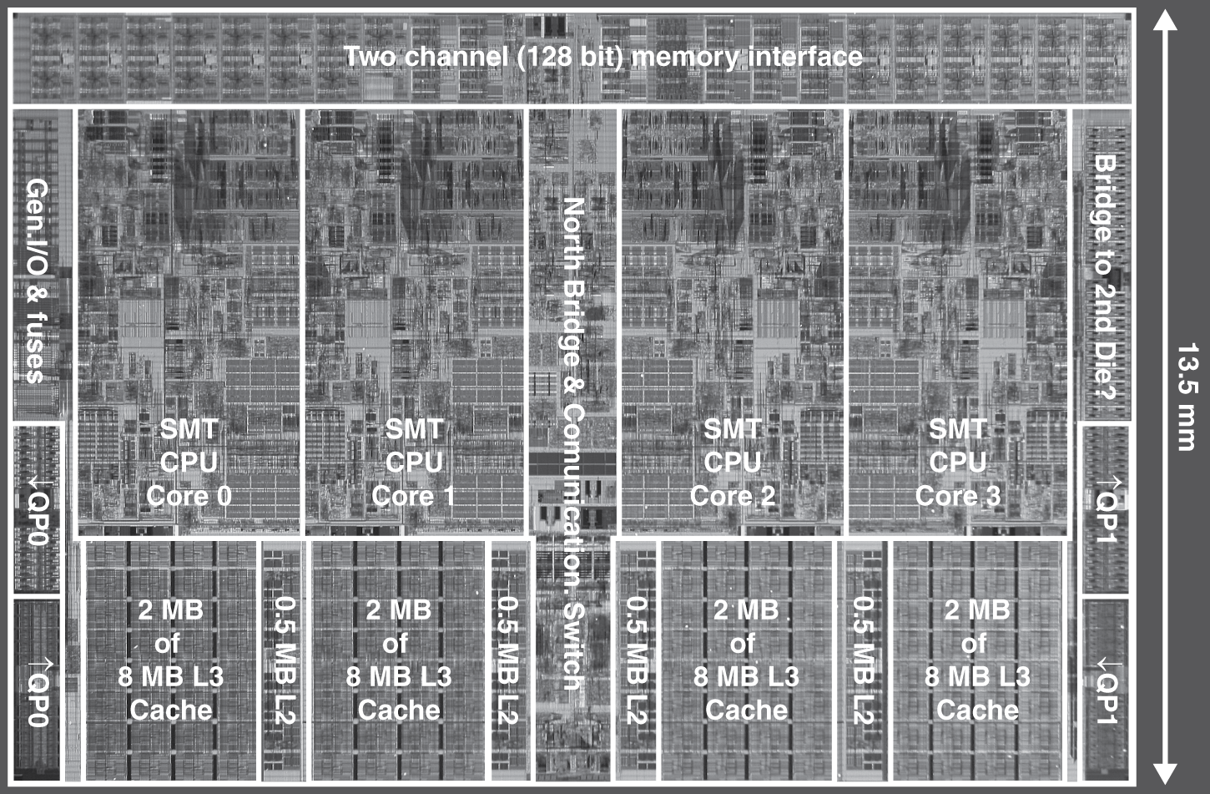
Multilevel On-Chip Caches
Intel Nehalem 4-core processor
Per core: 32KB L1 I-cache, 32KB L1 D-cache, 512KB L2 cache

Slide 61
2-Level TLB Organization
 | Intel Nehalem | AMD Opteron X4
Virtual addr | 48 bits | 48 bits
Physical addr | 44 bits | 48 bits
Page size | 4KB, 2/4MB | 4KB, 2/4MB
L1 TLB (per core) | L1 I-TLB: 128 entries for small pages, 7 per thread (2×) for large pages L1 D-TLB: 64 entries for small pages, 32 for large pages Both 4-way, LRU replacement | L1 I-TLB: 48 entries L1 D-TLB: 48 entries Both fully associative, LRU replacement
L2 TLB (per core) | Single L2 TLB: 512 entries 4-way, LRU replacement | L2 I-TLB: 512 entries L2 D-TLB: 512 entries Both 4-way, round-robin LRU
TLB misses | Handled in hardware | Handled in hardware

Slide 62
3-Level Cache Organization
 | Intel Nehalem | AMD Opteron X4
L1 caches (per core) | L1 I-cache: 32KB, 64-byte blocks, 4-way, approx LRU replacement, hit time n/a L1 D-cache: 32KB, 64-byte blocks, 8-way, approx LRU replacement, write-back/allocate, hit time n/a | L1 I-cache: 32KB, 64-byte blocks, 2-way, LRU replacement, hit time 3 cycles L1 D-cache: 32KB, 64-byte blocks, 2-way, LRU replacement, write-back/allocate, hit time 9 cycles
L2 unified cache (per core) | 256KB, 64-byte blocks, 8-way, approx LRU replacement, write-back/allocate, hit time n/a | 512KB, 64-byte blocks, 16-way, approx LRU replacement, write-back/allocate, hit time n/a
L3 unified cache (shared) | 8MB, 64-byte blocks, 16-way, replacement n/a, write-back/allocate, hit time n/a | 2MB, 64-byte blocks, 32-way, replace block shared by fewest cores, write-back/allocate, hit time 32 cycles
n/a: data not available

Slide 63
Pitfalls (1)
Byte vs. word addressing
Example: 32-byte direct-mapped cache, 4-byte blocks
Byte 36 maps to block 1
Word 36 maps to block 4
Ignore memory system effects when writing or generating code
Example: iterating over rows vs. columns of arrays
Large strides result in poor locality

Slide 64
Pitfalls (2)
In multiprocessor with shared L2 or L3 cache
Less associativity than cores results in conflict misses
More cores ⇒ need to increase associativity
Using AMAT (Average Memory Access Time) to evaluate performance of out-of-order processors
Ignore effect of non-blocked accesses
Instead, evaluate performance by simulation

Slide 65
Concluding Remarks
Fast memories are small, large memories are slow
We really want fast, large memories ☹
Caching gives this illusion ☺
Principle of locality
Programs use a small part of their memory space frequently
Memory hierarchy
L1 cache ↔ L2 cache ↔ … ↔ DRAM memory ↔ disk
Memory system design is critical for multiprocessors

