Slide 1
CSC3050 – Computer Architecture
Prof. Yeh-Ching Chung
School of Science and Engineering
Chinese University of Hong Kong, Shenzhen

Slide 2
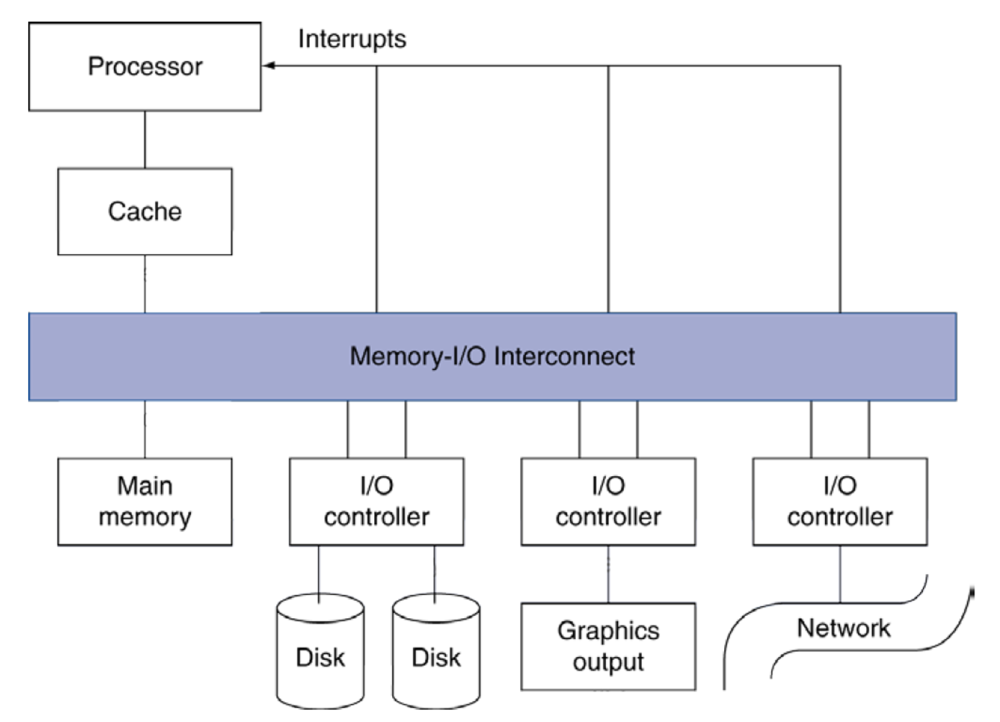
Introduction
I/O devices can be characterized by
Behaviour: input, output, storage
Partner: human or machine
Data rate: bytes/sec, transfers/sec
I/O bus connections

Slide 3
I/O System Characteristic
Dependability is important
Particularly for storage devices
Performance measures
Latency (response time)
Throughput (bandwidth)
Desktops & embedded systems
Mainly interested in response time & diversity of devices
Servers
Mainly interested in throughput & expandability of devices

Slide 4
Dependability Measures
Reliability: mean time to failure (MTTF)
Service interruption: mean time to repair (MTTR)
Mean time between failures
MTBF = MTTF + MTTR
Availability = MTTF / (MTTF + MTTR)
Improving Availability
Increase MTTF: fault avoidance, fault tolerance, fault forecasting
Reduce MTTR: improved tools and processes for diagnosis and repair

Slide 5
Interconnecting Components
Need interconnections between
CPU, memory, I/O controllers
Bus: shared communication channel
Parallel set of wires for data and synchronization of data transfer
Can become a bottleneck
Performance limited by physical factors
Wire length, number of connections
More recent alternative: high-speed serial connections with switches
Like networks

Slide 6
Bus Types
Processor-Memory buses
Short, high speed
Design is matched to memory organization
I/O buses
Longer, allowing multiple connections
Specified by standards for interoperability
Connect to processor-memory bus through a bridge

Slide 7
Bus Signals and Synchronization
Data lines
Carry address and data
Multiplexed or separate
Control lines
Indicate data type, synchronize transactions
Synchronous
Uses a bus clock
Asynchronous
Uses request/acknowledge control lines for handshaking

Slide 8
I/O Bus Examples
 | Firewire | USB 2.0 | PCI Express | Serial ATA | Serial Attached SCSI
Intended use | External | External | Internal | Internal | Internal
Devices per channel | 63 | 127 | 1 | 1 | 4
Data width | 4 | 2 | 2/lane | 4 | 4
Peak bandwidth | 50MB/s or 100MB/s | 0.2MB/s, 1.5MB/s, or 60MB/s | 250MB/s/lane 1×, 2×, 4×, 8×, 16×, 32× | 300MB/s | 300MB/s
Hot pluggable | Yes | Yes | Depends | Yes | Yes
Max length | 4.5m | 5m | 0.5m | 1m | 8m
Standard | IEEE 1394 | USB Implementers Forum | PCI-SIG | SATA-IO | INCITS TC T10

Slide 9
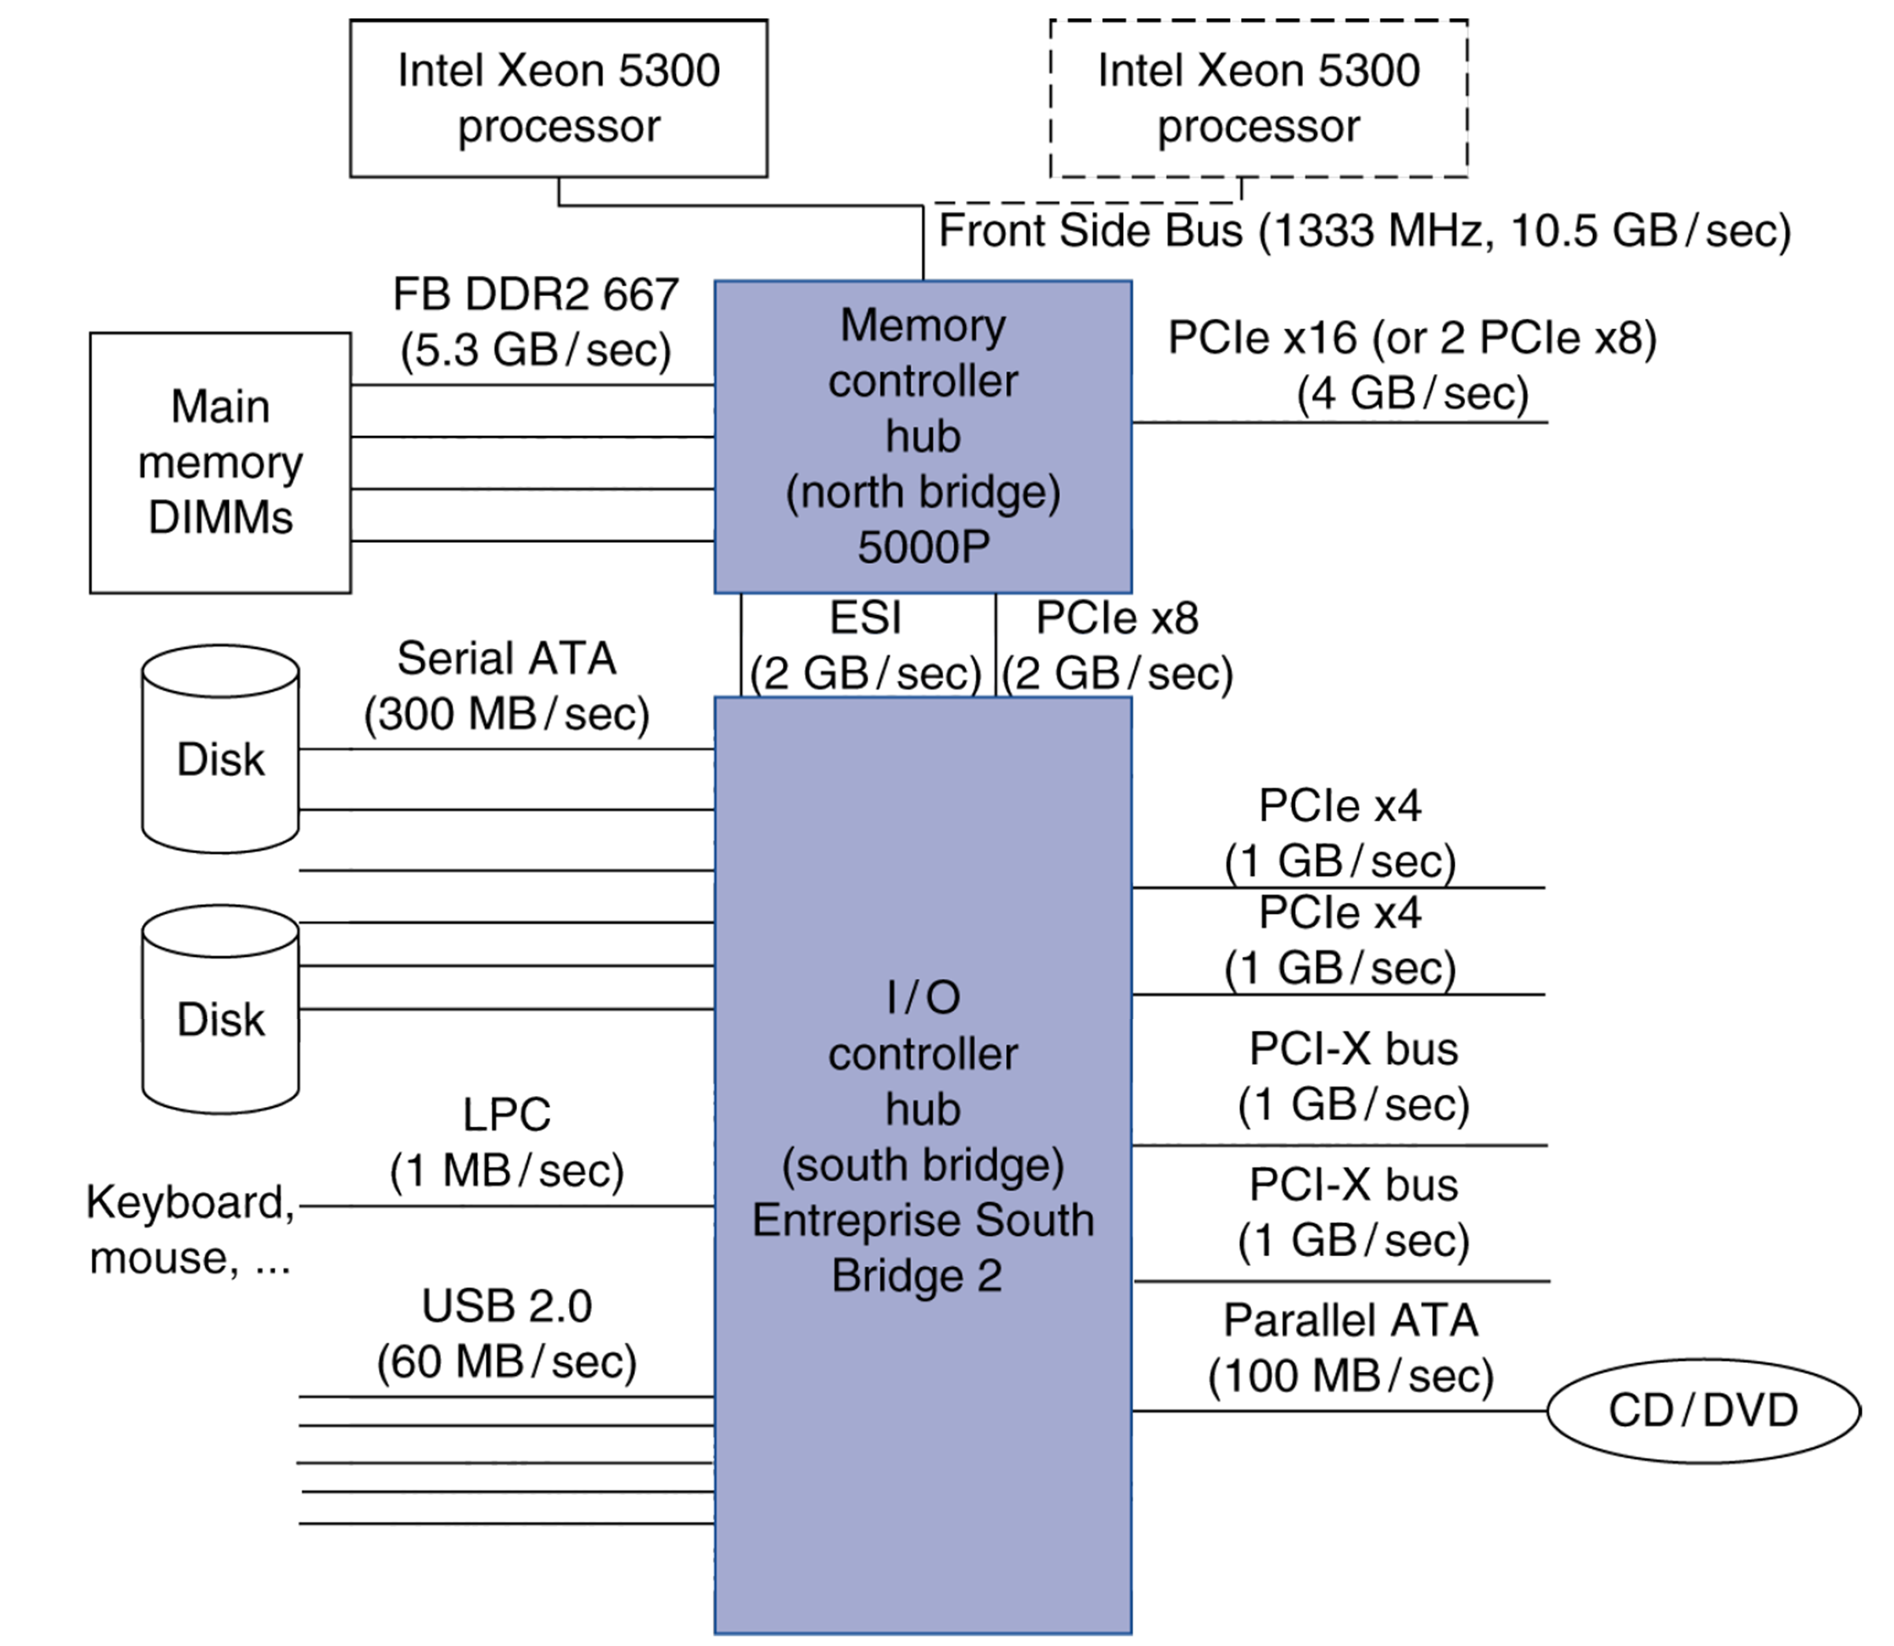
Typical x86 PC I/O System

Slide 10
I/O Management
I/O is mediated by the OS
Multiple programs share I/O resources
Need protection and scheduling
I/O causes asynchronous interrupts
Same mechanism as exceptions
I/O programming is complicated
OS provides abstractions to programs

Slide 11
I/O Commands
I/O devices are managed by I/O controller hardware
Transfers data to/from device
Synchronizes operations with software
Command registers
Cause device to do something
Status registers
Indicate what the device is doing and occurrence of errors
Data registers
Write: transfer data to a device
Read: transfer data from a device

Slide 12
I/O Register Mapping
Memory-mapped I/O
Registers are addressed in same space as memory
Address decoder distinguishes between them
OS uses address translation mechanism to make them only accessible to kernel
I/O instructions (or port-mapped I/O)
Separate instructions to access I/O registers
Can only be executed in kernel mode
Example: x86 (in and out)

Slide 13
Polling
Periodically check I/O status register
If device ready, do operation
If error, take action
Common in small or low-performance real-time embedded systems
Predictable timing
Low hardware cost
In other systems, wastes CPU time

Slide 14
Interrupts
When a device is ready or error occurs
Controller interrupts CPU
Interrupt is like an exception
But not synchronized to instruction execution
Can invoke handler between instructions
Cause information often identifies the interrupting device
Priority interrupts
Devices needing more urgent attention get higher priority
Can interrupt handler for a lower priority interrupt

Slide 15
I/O Data Transfer
Polling and interrupt-driven I/O
CPU transfers data between memory and I/O data registers
Time consuming for high-speed devices
Direct memory access (DMA)
OS provides starting address in memory
I/O controller transfers to/from memory autonomously
Controller interrupts on completion or error

Slide 16
DMA/Cache Interaction
If DMA writes to a memory block that is cached
Cached copy becomes stale
If write-back cache has dirty block, and DMA reads memory block
Reads stale data
Need to ensure cache coherence
Flush blocks from cache if they will be used for DMA
Or use non-cacheable memory locations for I/O

Slide 17
DMA/VM Interaction
OS uses virtual addresses for memory
DMA blocks may not be contiguous in physical memory
Should DMA use virtual addresses?
Would require controller to do translation
If DMA uses physical addresses
May need to break transfers into page-sized chunks
Or chain multiple transfers
Or allocate contiguous physical pages for DMA
Whichever is used, the OS must cooperate by not remapping pages while a DMA transfer involving that page is in progress

Slide 18
The DMA Stale Data Problem
In systems with caches, there can be two copies of a data item, one in the cache and one in the main memory
For a DMA input (from disk to memory) – the processor will be using stale data if that location is also in the cache
For a DMA output (from memory to disk) and a write-back cache –the I/O device will receive stale data if the data is in the cache and has not yet been written back to the memory
The coherency problem can be solved by
Routing all I/O activity through the cache – expensive and a large negative performance impact
Having the OS invalidate all the entries in the cache for an I/O input or force write-backs for an I/O output (called a cache flush)
Providing hardware to selectively invalidate cache entries – i.e., need a snooping cache controller

