Slide 1
Chapter 11: Implementing File Systems

Slide 2
Chapter 11: Implementing File Systems
File-System Structure
File-System Implementation
Directory Implementation
Allocation Methods
Free-Space Management
Efficiency and Performance
Recovery
NFS
Example: WAFL File System

Slide 3
Objectives
To describe the details of implementing local file systems and directory structures
To describe the implementation of remote file systems
To discuss block allocation and free-block algorithms and trade-offs

Slide 4
File-System Structure
File structure
  Logical storage unit
  Collection of related information
File system resides on secondary storage (disks)
  Provided user interface to storage, mapping logical to physical
  Provides efficient and convenient access to disk by allowing data to be stored, located retrieved easily
Disk provides in-place rewrite and random access
  I/O transfers performed in blocks of sectors (usually 512 bytes)
File control block – storage structure consisting of information about a file
Device driver controls the physical device
File system organized into layers

Slide 5

Layered File System

Slide 6
File System Layers
Device drivers manage I/O devices at the I/O control layer
  Given commands like “read drive1, cylinder 72, track 2, sector 10, into memory location 1060” outputs low-level hardware specific commands to hardware controller
Basic file system given command like “retrieve block 123” translates to device driver
  Also manages memory buffers and caches (allocation, freeing, replacement)
        Buffers hold data in transit
        Caches hold frequently used data
File organization module understands files, logical address, and physical blocks
  Translates logical block # to physical block #
  Manages free space, disk allocation
  Logical file system manages metadata information
  Translates file name into file number, file handle, location by maintaining file control blocks (inodes in Unix)
  Directory management
  Protection

Slide 7
File System Layers (Cont.)
  Layering useful for reducing complexity and redundancy, but adds overhead and can decrease performance
    Logical layers can be implemented by any coding method according to OS designer
  Many file systems, sometimes many within an operating system
    Each with its own format (CD-ROM is ISO 9660; Unix has UFS, FFS; Windows has FAT, FAT32, NTFS as well as floppy, CD, DVD Blu-ray, Linux has more than 40 types, with extended file system ext2 and ext3 leading; plus distributed file systems, etc)
    New ones still arriving – ZFS, GoogleFS, Oracle ASM, FUSE

Slide 8
File-System Implementation
We have system calls at the API level, but how do we implement their functions?
  On-disk and in-memory structures
Boot control block contains info needed by system to boot OS from that volume
  Needed if volume contains OS, usually first block of volume
Volume control block (superblock, master file table) contains volume details
  Total # of blocks, # of free blocks, block size, free block pointers or array
Directory structure organizes the files
  Names and inode numbers, master file table
Per-file File Control Block (FCB) contains many details about the file
  Inode number, permissions, size, dates
  NTFS stores into in master file table using relational DB structures

Slide 9

A Typical File Control Block

Slide 10
In-Memory File System Structures
Mount table storing file system mounts, mount points, file system types
The following figure illustrates the necessary file system structures provided by the operating systems
Figure 11-3(a) refers to opening a file
Figure 11-3(b) refers to reading a file
Plus buffers hold data blocks from secondary storage
Open returns a file handle for subsequent use
Data from read eventually copied to specified user process memory address

Slide 11

In-Memory File System Structures

Slide 12
Partitions and Mounting
Partition can be a volume containing a file system (“cooked”) or raw – just a sequence of blocks with no file system
Boot block can point to boot volume or boot loader set of blocks that contain enough code to know how to load the kernel from the file system
  Or a boot management program for multi-os booting
Root partition contains the OS, other partitions can hold other Oses, other file systems, or be raw
  Mounted at boot time
  Other partitions can mount automatically or manually
At mount time, file system consistency checked
  Is all metadata correct?
    If not, fix it, try again
    If yes, add to mount table, allow access

Slide 13
Virtual File Systems
Virtual File Systems (VFS) on Unix provide an object-oriented way of implementing file systems
VFS allows the same system call interface (the API) to be used for different types of file systems
  Separates file-system generic operations from implementation details
  Implementation can be one of many file systems types, or network file system
    Implements vnodes which hold inodes or network file details
  Then dispatches operation to appropriate file system implementation routines
The API is to the VFS interface, rather than any specific type of file system
For example, Linux has four object types:
  inode, file, superblock, dentry
VFS defines set of operations on the objects that must be implemented
  Every object has a pointer to a function table
    Function table has addresses of routines to implement that function on that object

Slide 14

Schematic View of Virtual File System

Slide 15
Directory Implementation
Linear list of file names with pointer to the data blocks
  Simple to program
  Time-consuming to execute
    Linear search time
    Could keep ordered alphabetically via linked list or use B+ tree
Hash Table – linear list with hash data structure
  Decreases directory search time
  Collisions – situations where two file names hash to the same location
  Only good if entries are fixed size, or use chained-overflow method

Slide 16
Allocation Methods - Contiguous
An allocation method refers to how disk blocks are allocated for files:
Contiguous allocation – each file occupies set of contiguous blocks
  Best performance in most cases
  Simple – only starting location (block #) and length (number of blocks) are required
  Problems include finding space for file, knowing file size, external fragmentation, need for compaction off-line (downtime) or on-line

Slide 17

Contiguous Allocation of Disk Space

Slide 18
Extent-Based Systems
Many newer file systems (i.e., Veritas File System) use a modified contiguous allocation scheme
Extent-based file systems allocate disk blocks in extents
An extent is a contiguous block of disks
  Extents are allocated for file allocation
  A file consists of one or more extents

Slide 19
Allocation Methods - Linked
Linked allocation – each file a linked list of blocks
  File ends at nil pointer
  No external fragmentation
  Each block contains pointer to next block
  No compaction, external fragmentation
  Free space management system called when new block needed
  Improve efficiency by clustering blocks into groups but increases internal fragmentation
  Reliability can be a problem
  Locating a block can take many I/Os and disk seeks
FAT (File Allocation Table) variation
  Beginning of volume has table, indexed by block number
  Much like a linked list, but faster on disk and cacheable
  New block allocation simple

Slide 20

Linked Allocation

Slide 21

File-Allocation Table

Slide 22
Allocation Methods - Indexed
Indexed allocation
  Each file has its own index block(s) of pointers to its data blocks
Logical view
index table

Slide 23

Example of Indexed Allocation

Slide 24
Indexed Allocation (Cont.)
Need index table
Random access
Dynamic access without external fragmentation, but have overhead of index block
Mapping from logical to physical in a file of maximum size of 256K bytes and block size of 512 bytes. We need only 1 block for index table

Slide 25
Indexed Allocation – Mapping (Cont.)
Two-level index (4K blocks could store 1,024 four-byte pointers in outer index -> 1,048,567 data blocks and file size of up to 4GB)
Q₁
LA / (512 x 512)
R₁
  Q₁ = displacement into outer-index
  R₁ is used as follows:
Q₂
R₁ / 512
R₂
  Q₂ = displacement into block of index table
  R₂ displacement into block of file:

Slide 26
Indexed Allocation – Mapping (Cont.)

outer-index
index table
file

Slide 27

Combined Scheme: UNIX UFS
(4K bytes per block, 32-bit addresses)
Note: More index blocks than can be addressed with 32-bit file pointer

Slide 28
Performance
Best method depends on file access type
  Contiguous great for sequential and random
Linked good for sequential, not random
Declare access type at creation -> select either contiguous or linked
Indexed more complex
  Single block access could require 2 index block reads then data block read
  Clustering can help improve throughput, reduce CPU overhead

Slide 29
Performance (Cont.)
Adding instructions to the execution path to save one disk I/O is reasonable
  Intel Core i7 Extreme Edition 990x (2011) at 3.46Ghz = 159,000 MIPS
    http://en.wikipedia.org/wiki/Instructions_per_second
  Typical disk drive at 250 I/Os per second
    159,000 MIPS / 250 = 630 million instructions during one disk I/O
  Fast SSD drives provide 60,000 IOPS
    159,000 MIPS / 60,000 = 2.65 millions instructions during one disk I/O

Slide 30
Free-Space Management
File system maintains free-space list to track available blocks/clusters
  (Using term “block” for simplicity)
Bit vector or bit map (n blocks)
0
1
2
n-1
…

1 ⇒ block[i] free
0 ⇒ block[i] occupied
bit[i] =
Block number calculation
(number of bits per word) * (number of 0-value words) + offset of first 1 bit
CPUs have instructions to return offset within word of first “1” bit

Slide 31
Free-Space Management (Cont.)
Bit map requires extra space
  Example:
block size = 4KB = 2¹² bytes
disk size = 2⁴⁰ bytes (1 terabyte)
n = 2⁴⁰/2¹² = 2²⁸ bits (or 256 MB)
if clusters of 4 blocks -> 64MB of memory
Easy to get contiguous files

Slide 32

Free-Space Management (Cont.)
Linked list (free list)
  Cannot get contiguous space easily
  No waste of space
  No need to traverse the entire list (if # free blocks recorded)

Slide 33
Free-Space Management (Cont.)
Grouping
  Modify linked list to store address of next n-1 free blocks in the first free block, plus a pointer to next block that contains free-block-pointers (like this one)
Counting
  Because space is frequently contiguously used and freed, with contiguous-allocation, extents, or clustering
    Keep address of first free block and count of following free blocks
    Free space list then has entries containing addresses and counts

Slide 34
Free-Space Management (Cont.)
Space Maps
  Used in ZFS
  Consider meta-data I/O on very large file systems
    Full data structures like bit maps couldn’t fit in memory -> thousands of I/Os
  Divides device space into metaslab units and manages metaslabs
    Given volume can contain hundreds of metaslabs
  Each metaslab has associated space map
    Uses counting algorithm
  But records to log file rather than file system
    Log of all block activity, in time order, in counting format
  Metaslab activity -> load space map into memory in balanced-tree structure, indexed by offset
    Replay log into that structure
    Combine contiguous free blocks into single entry

Slide 35
Efficiency and Performance
Efficiency dependent on
  Disk allocation and directory algorithms
  Types of data kept in file’s directory entry
  Pre-allocation or as-needed allocation of metadata structures
  Fixed-size or varying-size data structures

Slide 36
Efficiency and Performance (Cont.)
Performance
  Keeping data and metadata close together
  Buffer cache – separate section of main memory for frequently used blocks
  Synchronous writes sometimes requested by apps or needed by OS
    No buffering / caching – writes must hit disk before acknowledgement
  Asynchronous writes more common, buffer-able, faster
  Free-behind and read-ahead – techniques to optimize sequential access
  Reads frequently slower than writes

Slide 37
Page Cache
A page cache caches pages rather than disk blocks using virtual memory techniques and addresses
Memory-mapped I/O uses a page cache
Routine I/O through the file system uses the buffer (disk) cache
This leads to the following figure

Slide 38
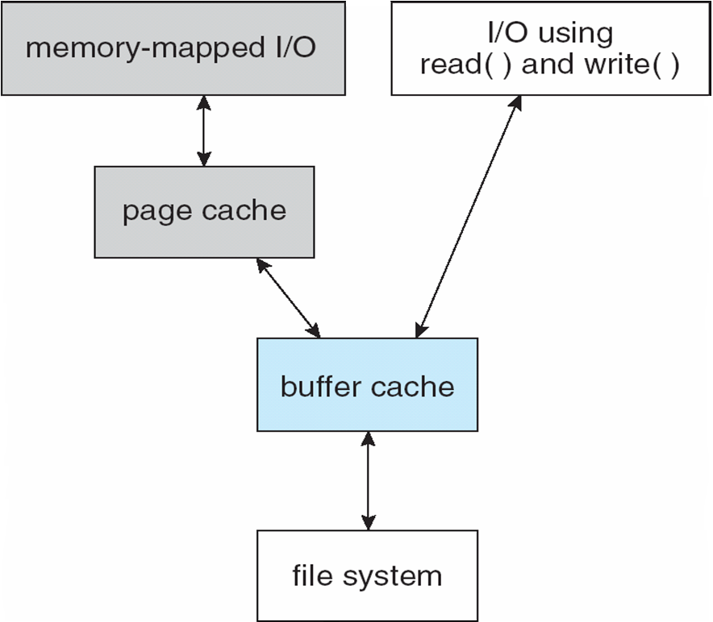
I/O Without a Unified Buffer Cache

Slide 39
Unified Buffer Cache
A unified buffer cache uses the same page cache to cache both memory-mapped pages and ordinary file system I/O to avoid double caching
  But which caches get priority, and what replacement algorithms to use?

Slide 40
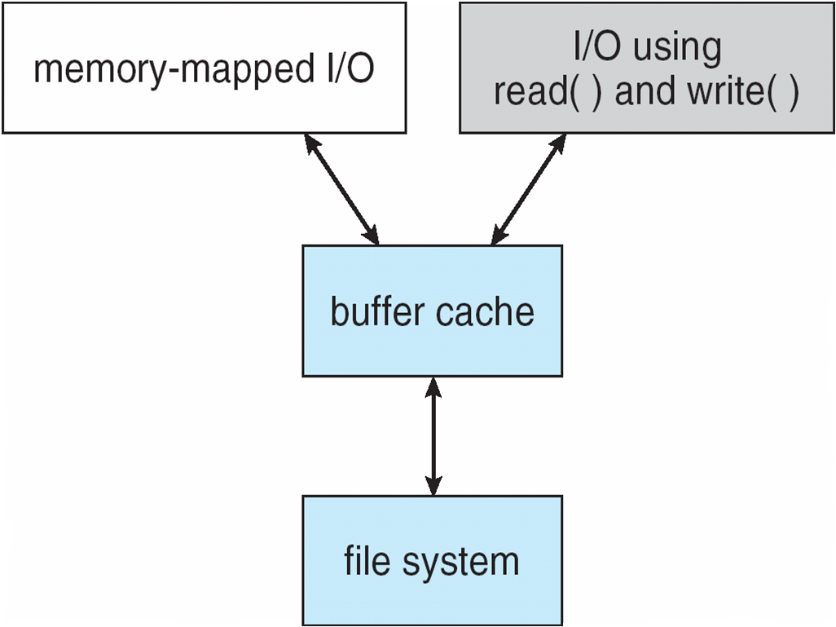
I/O Using a Unified Buffer Cache

Slide 41
Recovery
Consistency checking – compares data in directory structure with data blocks on disk, and tries to fix inconsistencies
  Can be slow and sometimes fails
Use system programs to back up data from disk to another storage device (magnetic tape, other magnetic disk, optical)
Recover lost file or disk by restoring data from backup

Slide 42
Log Structured File Systems
Log structured (or journaling) file systems record each metadata update to the file system as a transaction
All transactions are written to a log
  A transaction is considered committed once it is written to the log (sequentially)
  Sometimes to a separate device or section of disk
  However, the file system may not yet be updated
The transactions in the log are asynchronously written to the file system structures
  When the file system structures are modified, the transaction is removed from the log
If the file system crashes, all remaining transactions in the log must still be performed
Faster recovery from crash, removes chance of inconsistency of metadata

Slide 43
The Sun Network File System (NFS)
An implementation and a specification of a software system for accessing remote files across LANs (or WANs)
The implementation is part of the Solaris and SunOS operating systems running on Sun workstations using an unreliable datagram protocol (UDP/IP protocol and Ethernet

Slide 44
NFS (Cont.)
Interconnected workstations viewed as a set of independent machines with independent file systems, which allows sharing among these file systems in a transparent manner
  A remote directory is mounted over a local file system directory
    The mounted directory looks like an integral subtree of the local file system, replacing the subtree descending from the local directory
  Specification of the remote directory for the mount operation is nontransparent; the host name of the remote directory has to be provided
    Files in the remote directory can then be accessed in a transparent manner
  Subject to access-rights accreditation, potentially any file system (or directory within a file system), can be mounted remotely on top of any local directory

Slide 45
NFS (Cont.)
NFS is designed to operate in a heterogeneous environment of different machines, operating systems, and network architectures; the NFS specifications independent of these media
This independence is achieved through the use of RPC primitives built on top of an External Data Representation (XDR) protocol used between two implementation-independent interfaces
The NFS specification distinguishes between the services provided by a mount mechanism and the actual remote-file-access services

Slide 46

Three Independent File Systems

Slide 47
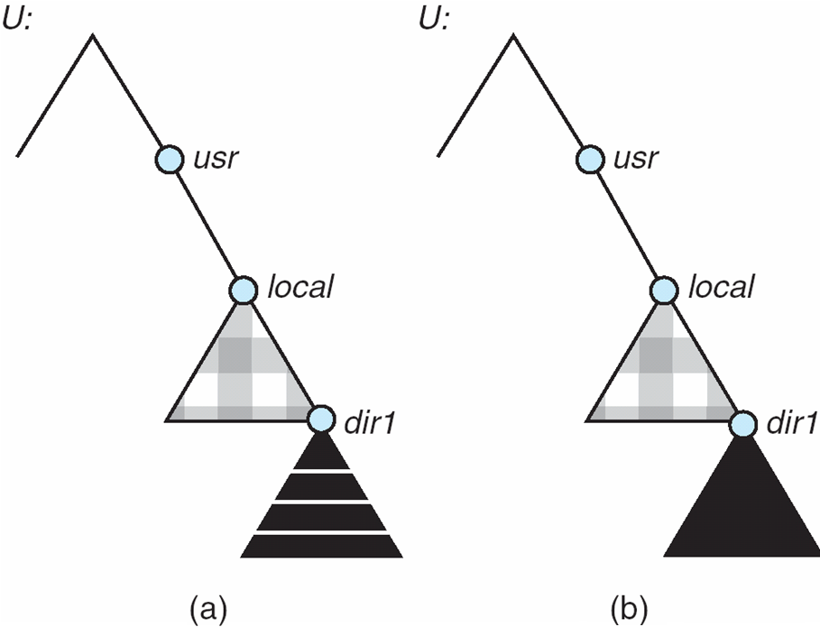
Mounting in NFS
Mounts
Cascading mounts

Slide 48
NFS Mount Protocol
Establishes initial logical connection between server and client
Mount operation includes name of remote directory to be mounted and name of server machine storing it
  Mount request is mapped to corresponding RPC and forwarded to mount server running on server machine
  Export list – specifies local file systems that server exports for mounting, along with names of machines that are permitted to mount them
Following a mount request that conforms to its export list, the server returns a file handle—a key for further accesses
File handle – a file-system identifier, and an inode number to identify the mounted directory within the exported file system
The mount operation changes only the user’s view and does not affect the server side

Slide 49
NFS Protocol
Provides a set of remote procedure calls for remote file operations. The procedures support the following operations:
  searching for a file within a directory
  reading a set of directory entries
  manipulating links and directories
  accessing file attributes
  reading and writing files
NFS servers are stateless; each request has to provide a full set of arguments (NFS V4 is just coming available – very different, stateful)
Modified data must be committed to the server’s disk before results are returned to the client (lose advantages of caching)
The NFS protocol does not provide concurrency-control mechanisms

Slide 50
Three Major Layers of NFS Architecture
UNIX file-system interface (based on the open, read, write, and close calls, and file descriptors)
Virtual File System (VFS) layer – distinguishes local files from remote ones, and local files are further distinguished according to their file-system types
  The VFS activates file-system-specific operations to handle local requests according to their file-system types
  Calls the NFS protocol procedures for remote requests
NFS service layer – bottom layer of the architecture
  Implements the NFS protocol

Slide 51
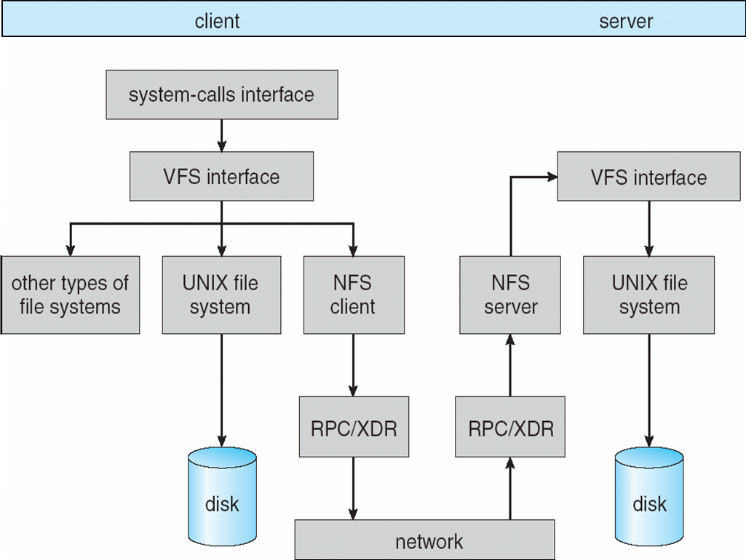
Schematic View of NFS Architecture

Slide 52
NFS Path-Name Translation
Performed by breaking the path into component names and performing a separate NFS lookup call for every pair of component name and directory vnode
To make lookup faster, a directory name lookup cache on the client’s side holds the vnodes for remote directory names

Slide 53
NFS Remote Operations
Nearly one-to-one correspondence between regular UNIX system calls and the NFS protocol RPCs (except opening and closing files)
NFS adheres to the remote-service paradigm, but employs buffering and caching techniques for the sake of performance
File-blocks cache – when a file is opened, the kernel checks with the remote server whether to fetch or revalidate the cached attributes
  Cached file blocks are used only if the corresponding cached attributes are up to date
File-attribute cache – the attribute cache is updated whenever new attributes arrive from the server
Clients do not free delayed-write blocks until the server confirms that the data have been written to disk

Slide 54
Example: WAFL File System
Used on Network Appliance “Filers” – distributed file system appliances
“Write-anywhere file layout”
Serves up NFS, CIFS, http, ftp
Random I/O optimized, write optimized
  NVRAM for write caching
Similar to Berkeley Fast File System, with extensive modifications

Slide 55
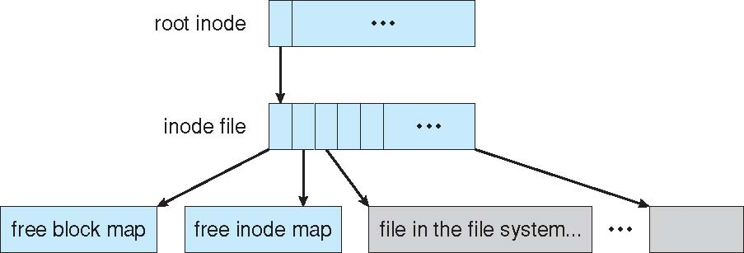
The WAFL File Layout

Slide 56
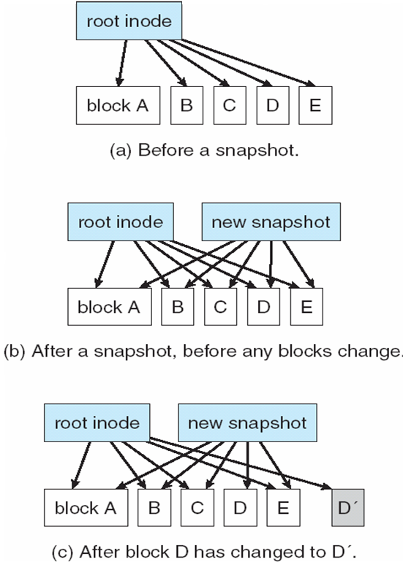
Snapshots in WAFL

