Slide 1
Modify Linux Kernel Scheduler
ZHANG Yuning 225040144
Cui Ningyu 225040147
School of Data Science
Chinese University of Hong Kong, Shenzhen

Slide 2
Development Environment
Windows host system
Ubuntu virtual machine
xv6-riscv operating system
QEMU hardware emulator
Single CPU mode

Slide 3
Lottery Scheduler Outline
Lottery Scheduling Algorithm
Implement Lottery Scheduling In xv6
Add System Call: settickets()
Design Testing Program
Build Real-time GUI Visualization
Visualization Results

Slide 4
Lottery Scheduler Algorithm
Probabilistic scheduling algorithm
Each process owns a number of tickets
Scheduler draws a random winning ticket
Process holding the winning ticket runs
Goal:
CPU share ∝ number of tickets
Example:
10 : 20 : 30 → CPU share ≈ 1 : 2 : 3

Slide 5
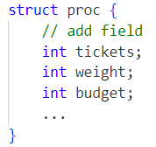
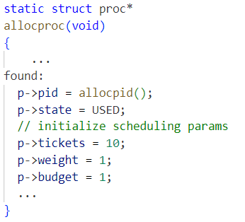
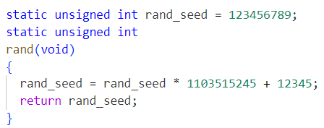
Implement Lottery Scheduling In xv6 (1)
Extend struct proc in kernel/proc.h:
Initialize scheduling params in allocproc() in kernel/proc.c
Add rand_seed and rand() function

Slide 6
Implement Lottery Scheduling In xv6 (2)
Modify scheduler()
Scheduler scans all processes and calculates the total number of tickets among RUNNABLE processes.
Generate a random number in [0, total ticket count] as winning_ticket.
Scan again and accumulates their ticket counts. When ticket_sum > winning_ticket, that process is selected as the winner and scheduled to run.
Add a structured log line inside the scheduler. the log format looks like this:

Slide 7


Add System Call: settickets()
Add a new system call definition in the kernel.
Declare the function prototype in kernel headers: kernel/defs.h
Assign a unique system call number in the system call table: kernel/syscall.h
Register syscall in kernel/syscall.c
Implement the kernel-side function sys_settickets().
Add a user-space wrapper function.

Slide 8
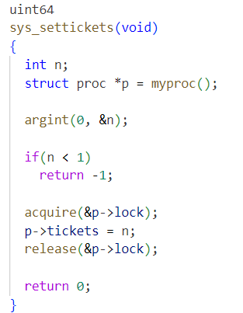
Add System Call: settickets()
myproc(): Get the current process
argint(0, &n): Take the first parameter passed by the user
n < 1 direct rejection: prevent 0 or negative votes
Lock before changing p-> tickets
Return:
0: success
-1: failure

Slide 9
Design Testing Program
Process design:
Parent creates 3 child processes
Children call settickets()
Process A → 10
Process B → 20
Process C → 30
Children run CPU-intensive loops
Expected ratio:1 : 2 : 3

Slide 10
Build Real-time GUI Visualization
Python GUI Technologies:
Tkinter for the interface
Matplotlib for visualization
Functions:
Launch xv6 through QEMU
Read scheduler logs
Parse SCHEDLOG lines
Update charts in real time

Slide 11
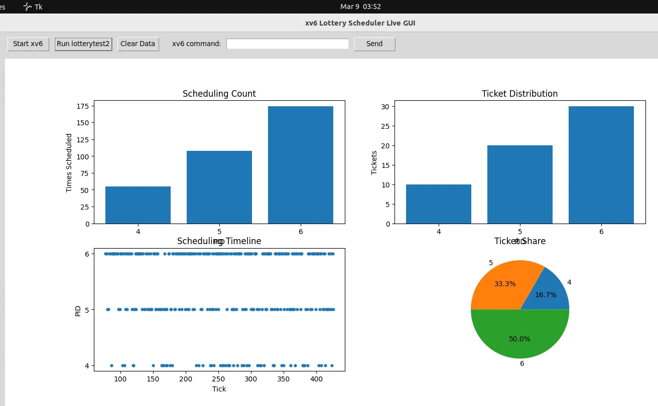
Visualization Results
Charts:
Scheduling count per process
Ticket distribution
Scheduling timeline
Observation:
CPU share follows ticket ratio≈1 : 2 : 3

Slide 12
WRR Scheduler Outline
WRR Scheduling Algorithm
Implement WRR Scheduling in xv6
Design Testing Program
Build Real-time GUI Visualization
Visualization Results

Slide 13
WRR Scheduling Algorithm
WRR is an extension of the Round Robin scheduling algorithm.
Each process is assigned a weight that represents its share of CPU time.
Processes with larger weights receive more CPU scheduling opportunities.

Slide 14
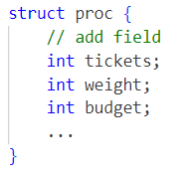
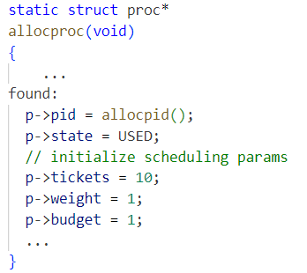
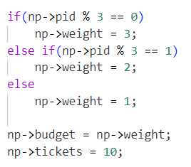
Implement WRR Scheduling In xv6 (1)
Extend struct proc in kernel/proc.h:
Initialize scheduling params in allocproc() in kernel/proc.c
Initialize the weight and budget of the child process in fork().

Slide 15
Implement WRR Scheduling In xv6 (2)
Main Variables
weight: assigned scheduling share of each process
budget: remaining quota in the current WRR round of each process
last_wrr_idx: last scheduled position
Procedure
Check whether RUNNABLE processes still exist, and whether any RUNNABLE process still has remaining budget
If all budgets are exhausted, reset budget = weight
Start scanning from the position after last_wrr_idx
Select the first RUNNABLE && budget > 0 process
Decrease its budget and run it

Slide 16
Design Testing Program
Process Design:
Parent creates 3 child processes using fork().
Different weights are assigned to the processes:
PID 4 → weight = 2
PID 5 → weight = 1
PID 6 → weight = 3
Children run CPU-intensive loops.
Expected ratio:1 : 2 : 3

Slide 17
Build Real-time GUI Visualization
Python GUI Technologies:
Tkinter for the interface
Matplotlib for visualization
Functions:
Launch xv6 through QEMU
Read scheduler logs
Parse SCHEDLOG lines
Update charts in real time

Slide 18
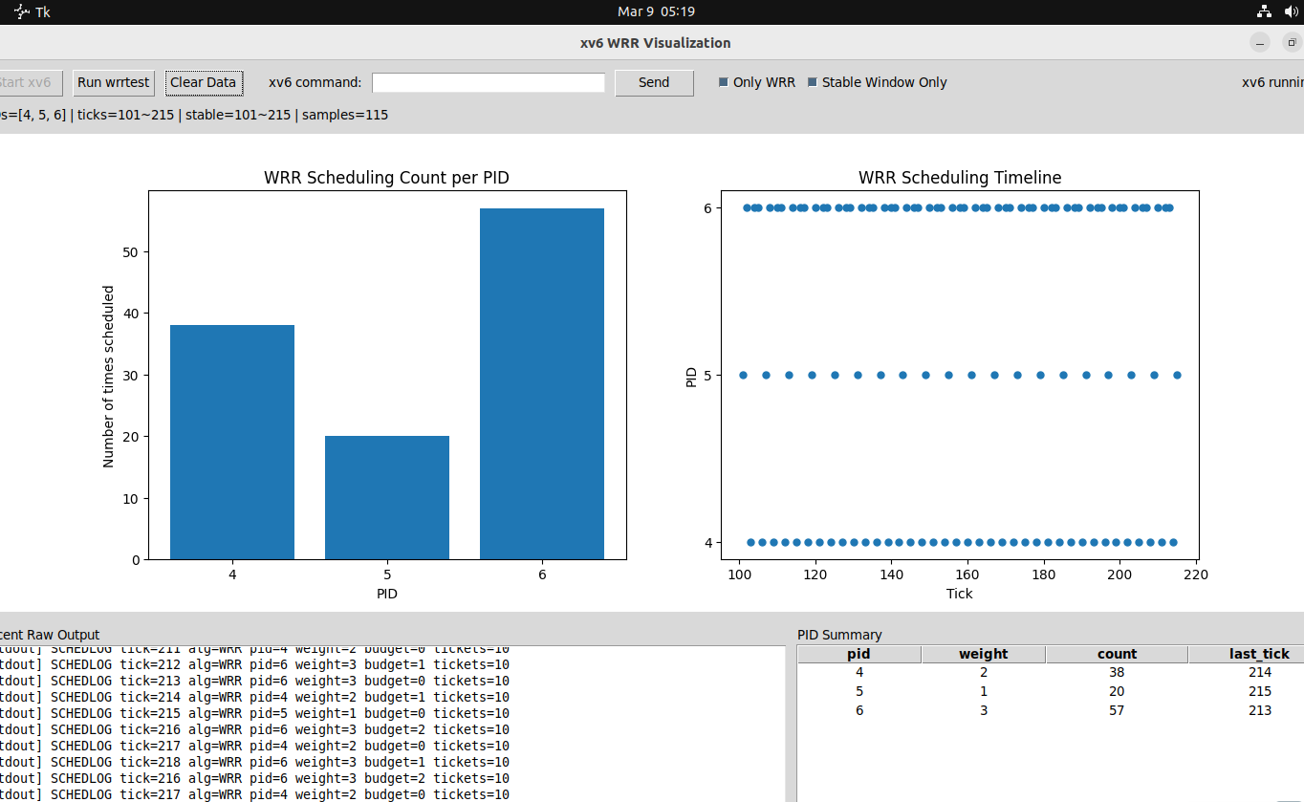
Visualization Results
Charts:
Scheduling count per process
Scheduling timeline
Observation:
CPU share follows the weight ratio ≈ 2 : 1 : 3

Slide 19
SRTF Scheduler Outline
SRTF Scheduling Algorithm
Implement SRTF Scheduling in xv6
Add system call: setburst()
Design testing program
Build real-time GUI visualization
Visualization Results

Slide 20
SRTF Scheduler Algorithm
Shortest Remaining Time First, a preemptive scheduling algorithm
Each process is assigned a burst time (total CPU time required)
Maintain a remaining time field for each process (dynamic update)
Scheduler always selects the process with the minimum remaining time to run
Preemptive mechanism: timer interrupt updates remaining time, re-schedule if a new shorter process appears
Goal:Minimize process turnaround time, optimize short process response efficiency

Slide 21
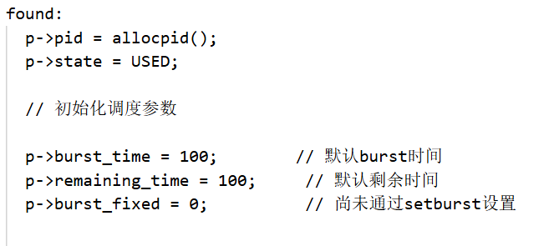
Implement SRTF Scheduling in xv6 (1)
Extend struct proc in kernel/proc.h:
Initialize scheduling params in allocproc() in kernel/proc.c
Update remaining time in timer interrupt (usertrap())
Inherit scheduling params in fork() for child processes

Slide 22
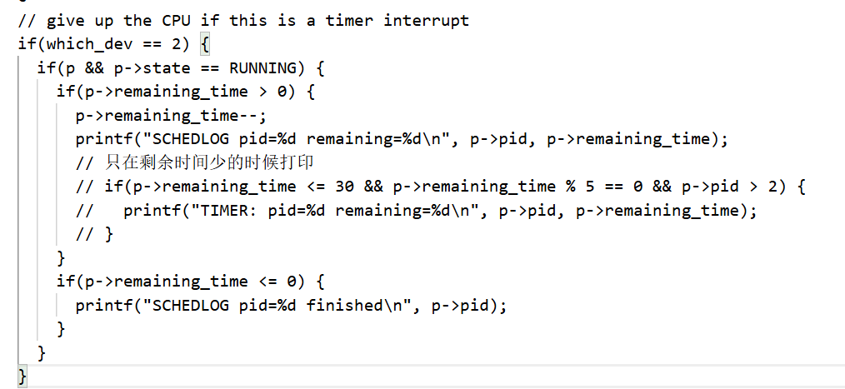
Implement SRTF Scheduling in xv6 (2)
Extend struct proc in kernel/proc.h:
Initialize scheduling params in allocproc() in kernel/proc.c
Update remaining time in timer interrupt (usertrap())
Inherit scheduling params in fork() for child processes

Slide 23
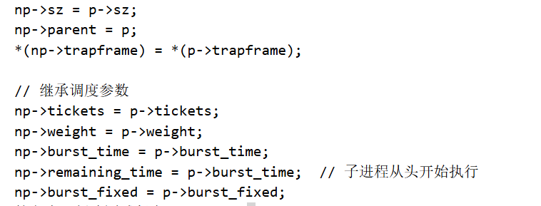
Implement SRTF Scheduling in xv6 (3)
Extend struct proc in kernel/proc.h:
Initialize scheduling params in allocproc() in kernel/proc.c
Update remaining time in timer interrupt (usertrap())
Inherit scheduling params in fork() for child processes

Slide 24
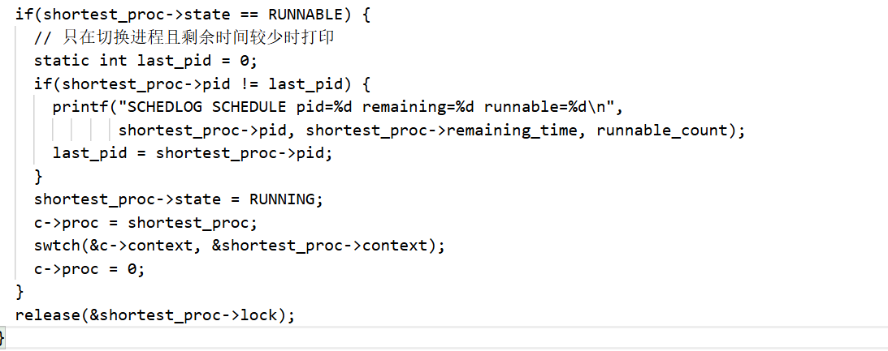
Modify scheduler()
Traverse all processes and count RUNNABLE processes.
Find the RUNNABLE process with the minimum remaining_time as the target.
Output structured SCHEDLOG for scheduling tracking.
Switch context to run the selected process, reset state to RUNNING.

Slide 25
Add System Call: setburst() (1)
Add a new system call definition in the kernel、.
Declare prototype in kernel/defs.h: kernel/defs.h
Assign a unique system call number in the system call table: kernel/syscall.h
Register syscall in kernel/syscall.c
Implement kernel-side function sys_setburst() in kernel/sysproc.c.
Add user-space wrapper function in user/user.h.

Slide 26
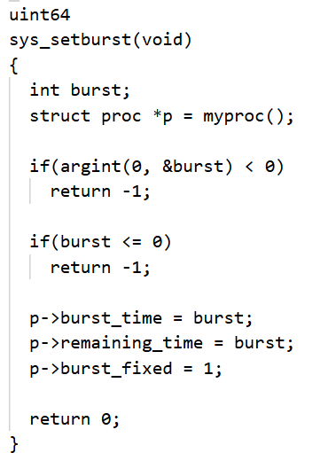
Add System Call: setburst() (2)
myproc(): Get the current running process
argint(0, &burst): Read user-side burst time parameter
Burst time check: Reject ≤0 values to avoid invalid scheduling
Update both burst_time and remaining_time (initialize remaining time)

Slide 27
Design Testing Program (1)
Process design:
Parent creates 3 child processes via fork()
Children call setburst() to set different burst times
Children run CPU-intensive busy loops (consume CPU time)
Parent waits for all child processes to finish
Burst time assignment:
● Process 1 → burst = 30
● Process 2 → burst = 20
● Process 3 → burst = 10

Slide 28
Design Testing Program (2)
Expected scheduling result:
Scheduler prioritizes the process with the smallest burst time (3→2→1)
Preemption is triggered by timer interrupt, remaining time is dynamically reduced
Shorter processes finish first, achieving the goal of SRTF algorithm
Final completion order:
pid with burst=10 → burst=20 → burst=30

Slide 29
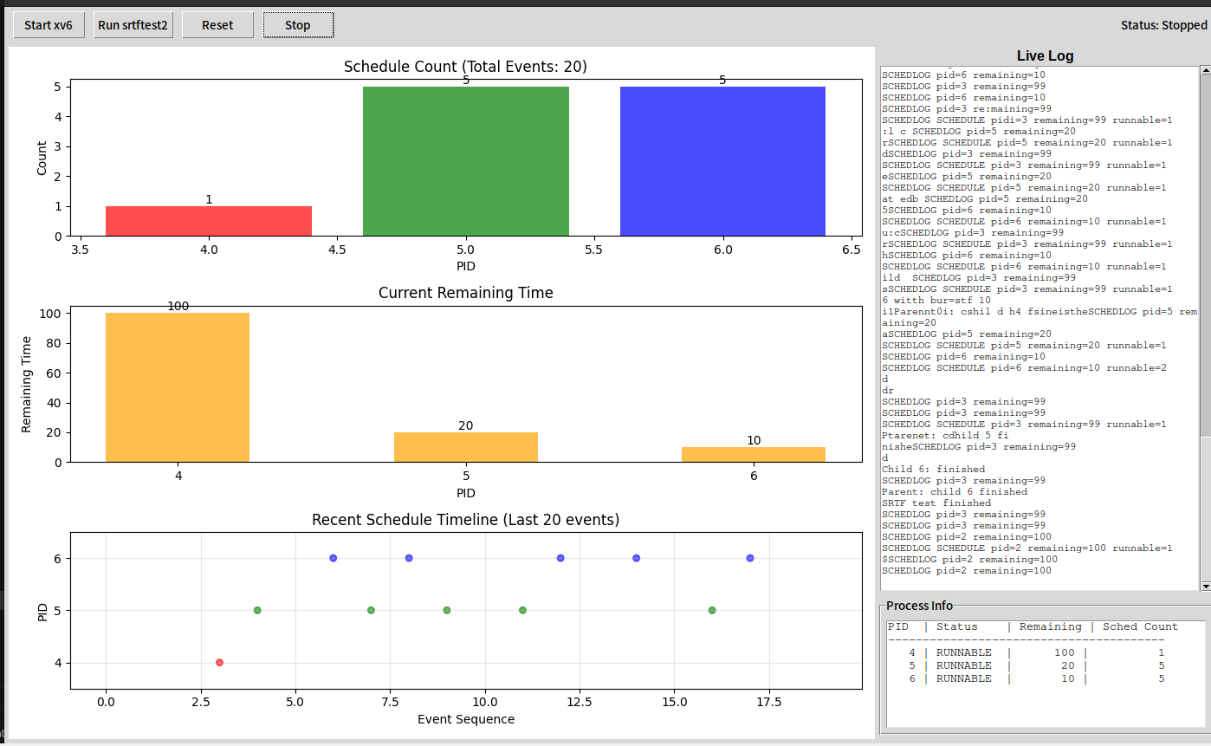
Visualization Results
The SRTF algorithm prioritizes scheduling processes with shorter remaining time (PID 5 and 6) and reduces the execution of long-duration processes (PID 4) to improve system response speed.
PID 4 has 100 time slices remaining, PID 5 has 20 time slices remaining, and PID 6 has 10 time slices remaining (the least).
All three processes are scheduled in the initial stage; PID 6 and 5 dominate the scheduling in the middle and later stages, with almost no scheduling for PID 4; PID 6 is scheduled continuously at the end, entering the final execution phase.

