Slide 1
Kernel-Level Thread Implementation and Analysis
Zhao Yiheng Su Zhekai
225040146 121090492

Slide 2
Outline
Introduction
Related Work
Preliminaries
Proposed Methods
Performance Evaluation
Conclusions
Q&A

Slide 3
Introduction - Contribution
Group member | Contribution | Percentage
Zhao Yiheng | Code Implementation, Making PPT file | 50%
Su Zhekai | Code Implementation, Making PPT file, Presentation | 50%

Slide 4
Introduction
To compare the performance of three concurrency models under different scenarios
To deeply analyze context switch overhead and its influencing factors
To explore the impact of CPU affinity and thread count on scalability

Slide 5
Related Work
Ingo Molnár. "Completely Fair Scheduler Design and Implementation."
Bradford Nichols, Dick Buttlar. "Pthreads Programming."
Melvin E. Conway. "Design of a Separable Transition-Diagram Compiler."

Slide 6
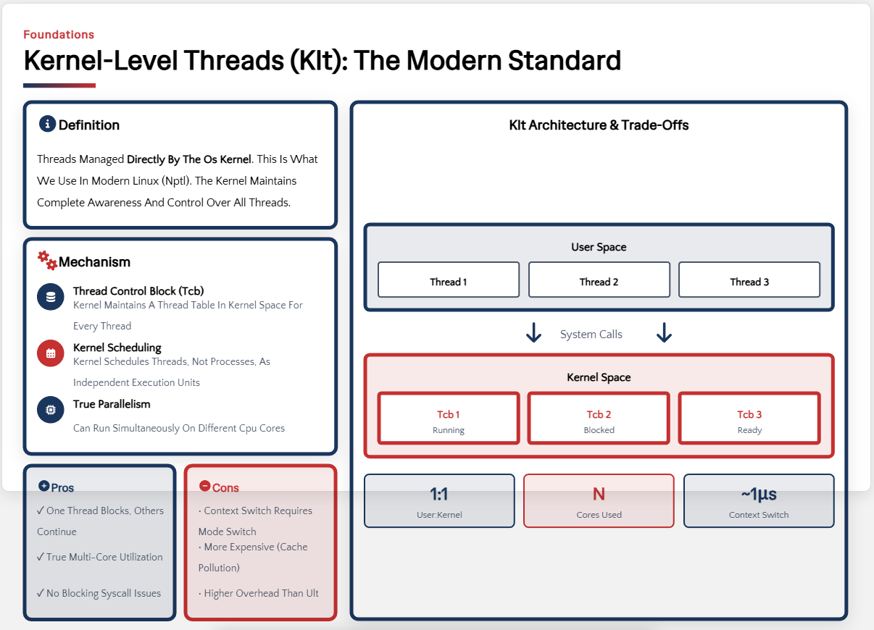
Preliminaries - Kernel-Level Threads

Slide 7
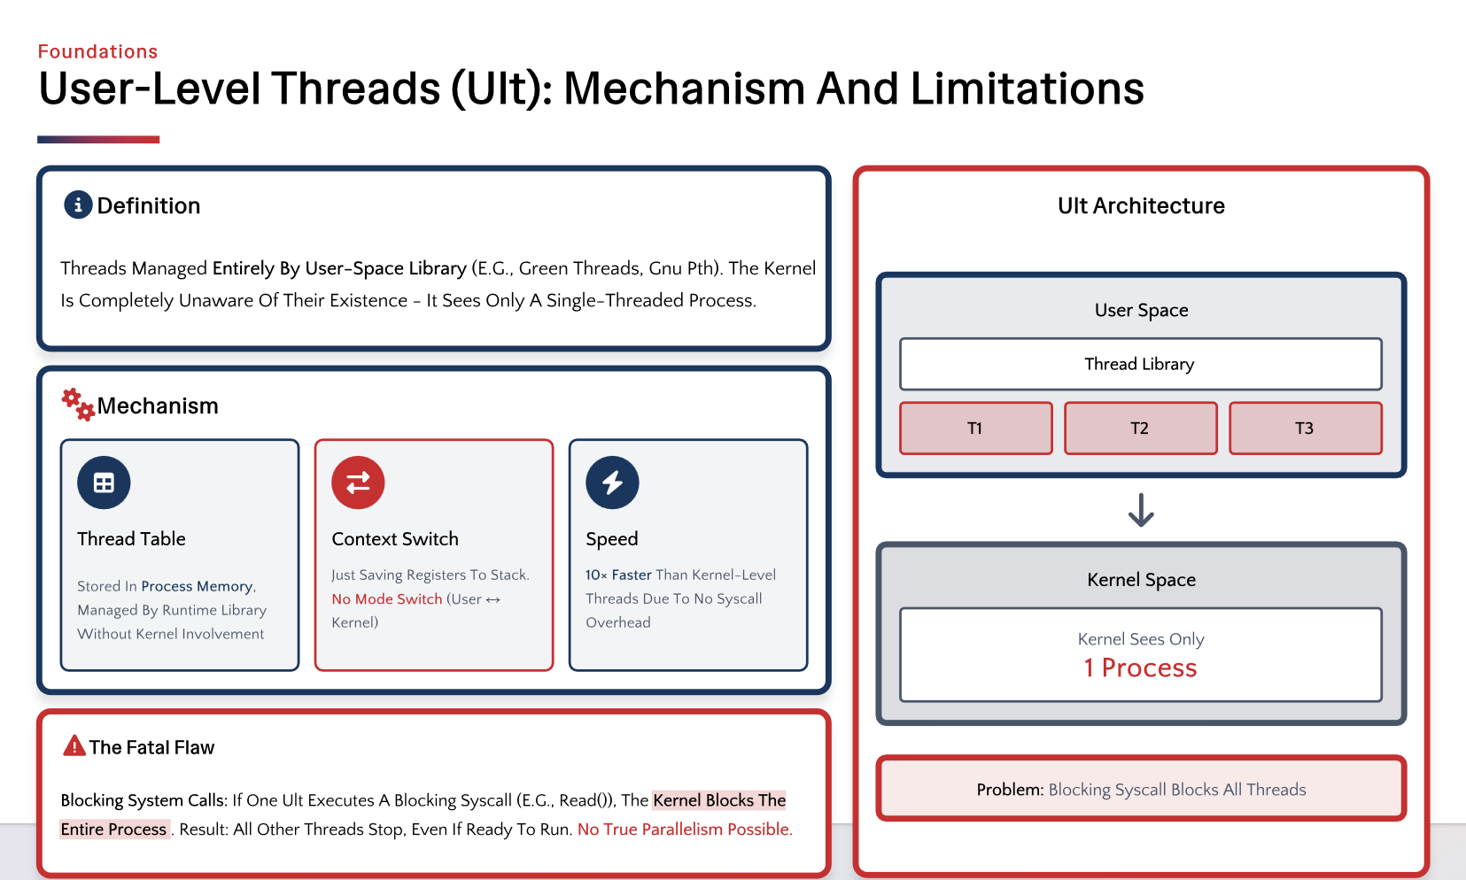
Preliminaries- User-Level Threads

Slide 8
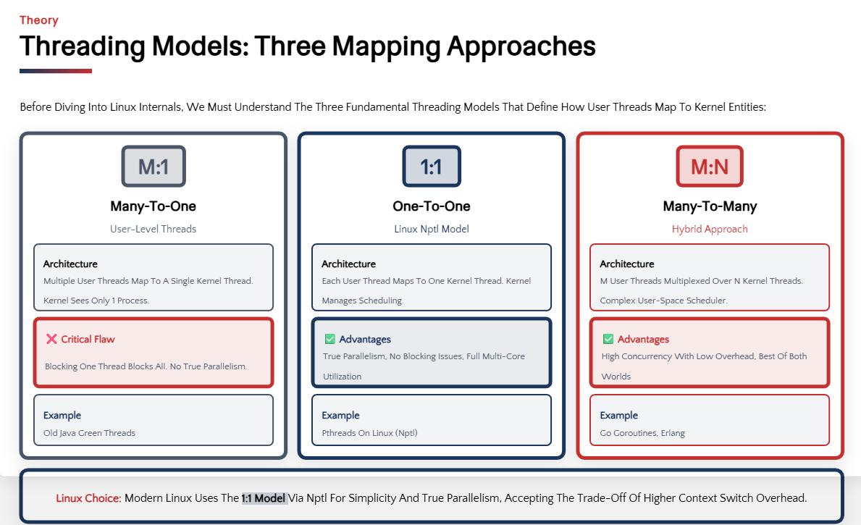
Preliminaries

Slide 9
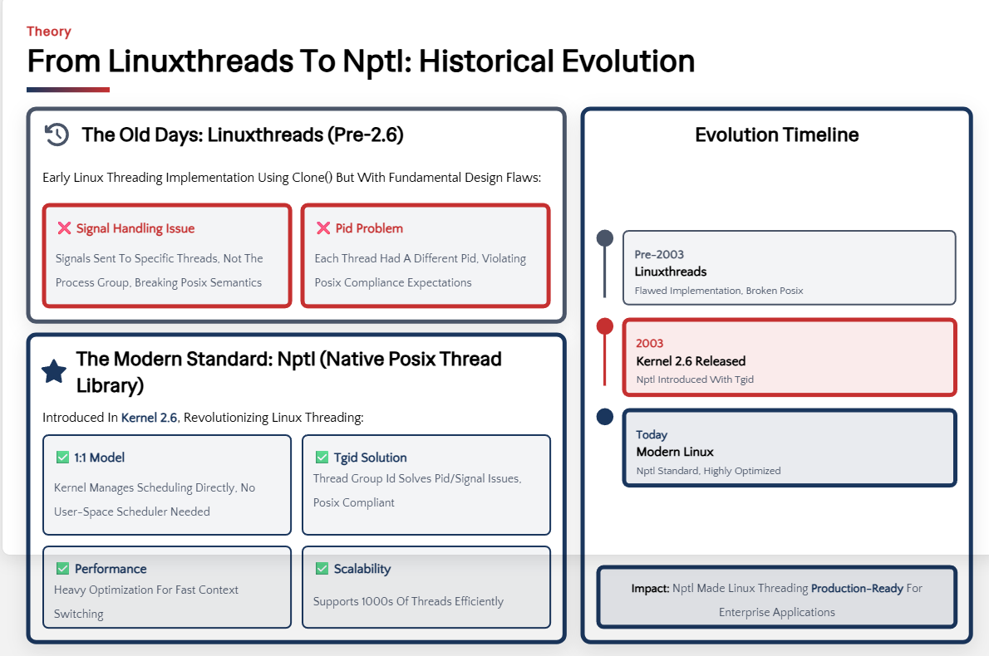
Preliminaries

Slide 10
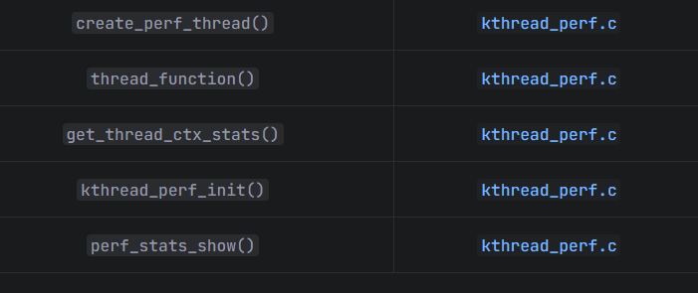
Proposed Methods - Kernel Module (Zhao)
Create kernel threads
Output statistics
Support CPU affinity binding

Slide 11
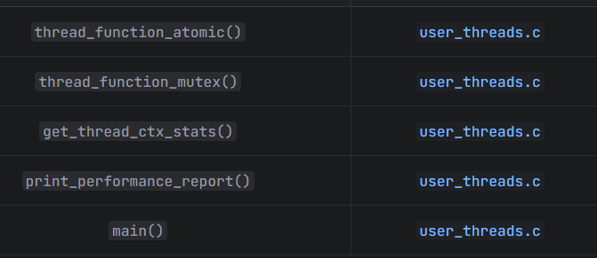
Proposed Methods - User-Level Thread Program (Zhao)
User-Level Thread Program
Create user-level threads
Support two synchronization methods

Slide 12
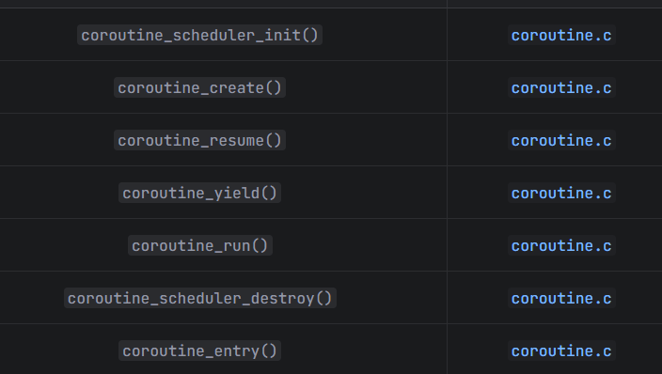
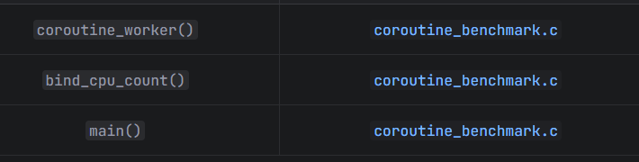
Proposed Methods - Coroutine Library (Su)
Implemented based on ucontext
Managed by user-space scheduler

Slide 13
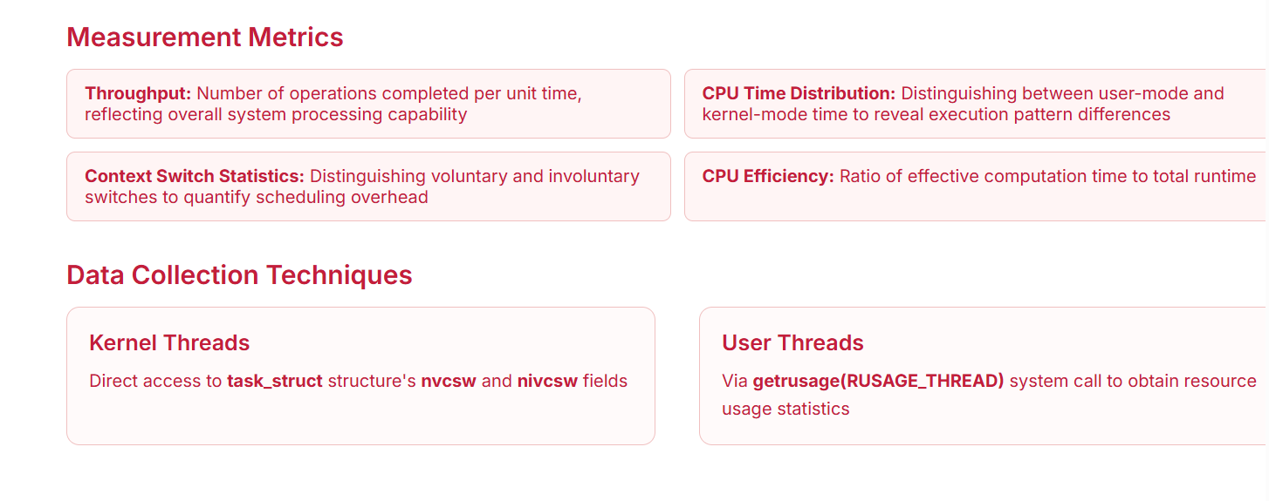
Proposed Method (Zhao)

Slide 14
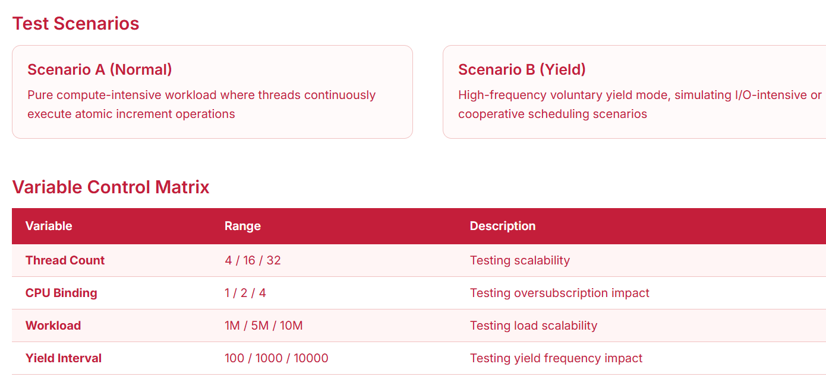
Proposed Method (Zhao)

Slide 15
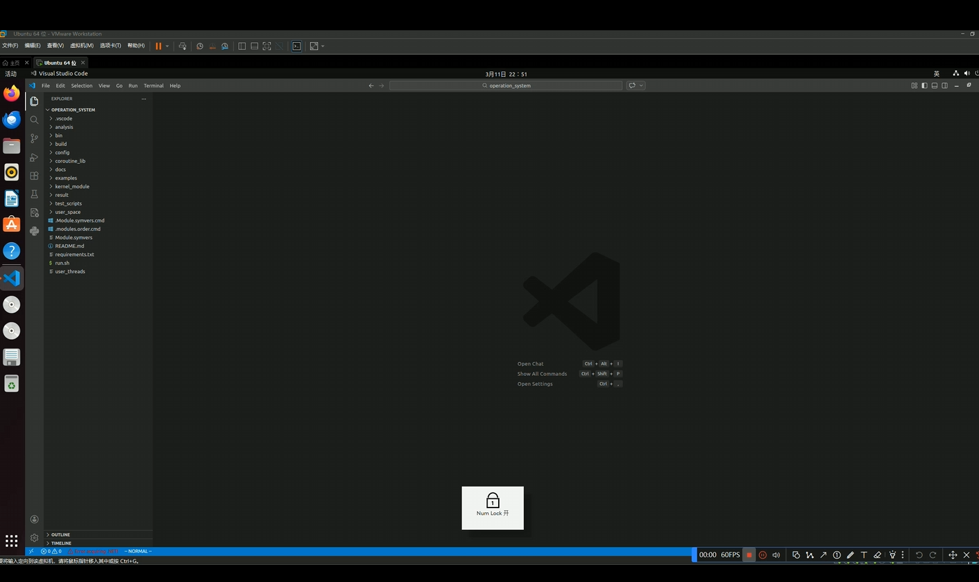
Proposed Methods - Live Demo (Zhao)

Slide 16
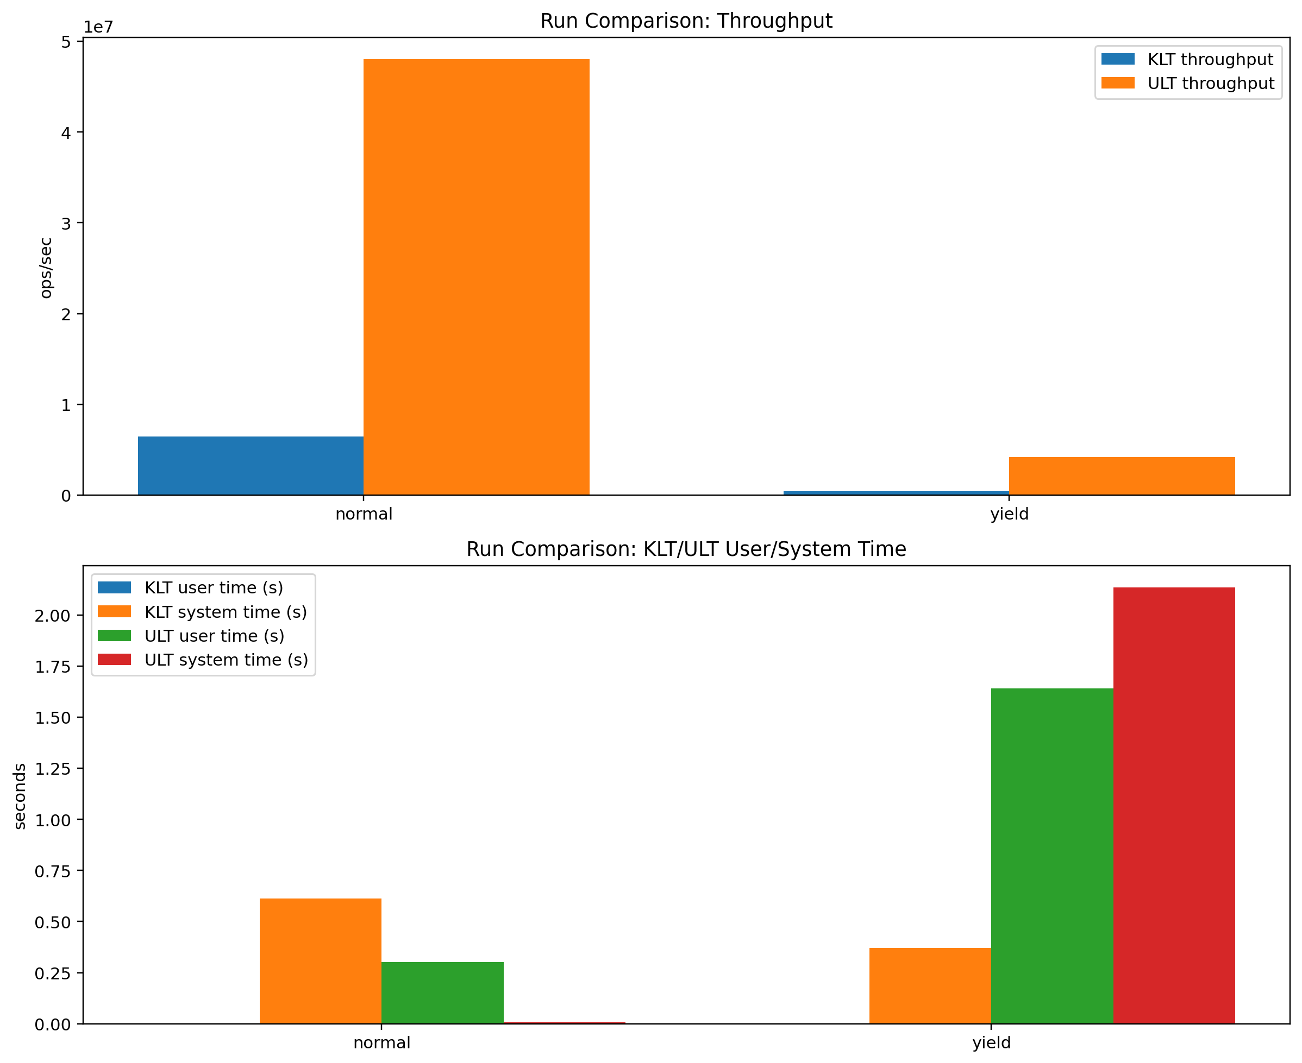
Performance Evaluation - KLT vs ULT Comparison

Slide 17
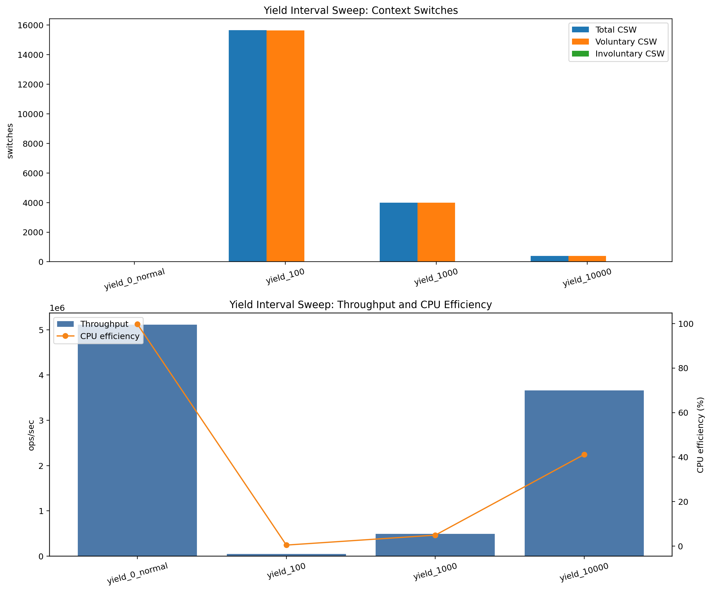
Performance Evaluation - Context Switch Analysis
CSW during test =
Current cumulative value -
Initial value at startup
Total CSW = Voluntary switches
+ Involuntary switches

Slide 18
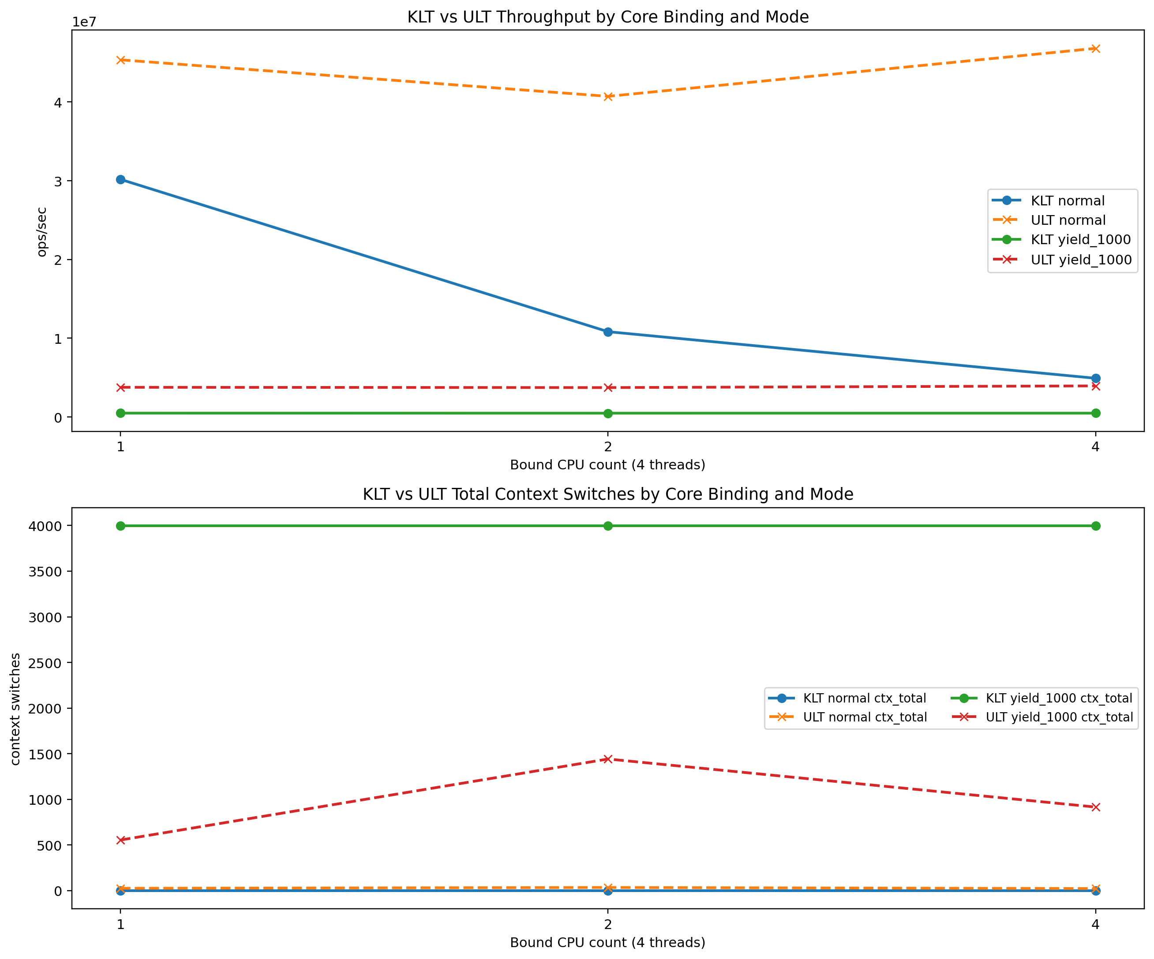
Performance Evaluation - CPU Affinity Impact

Slide 19
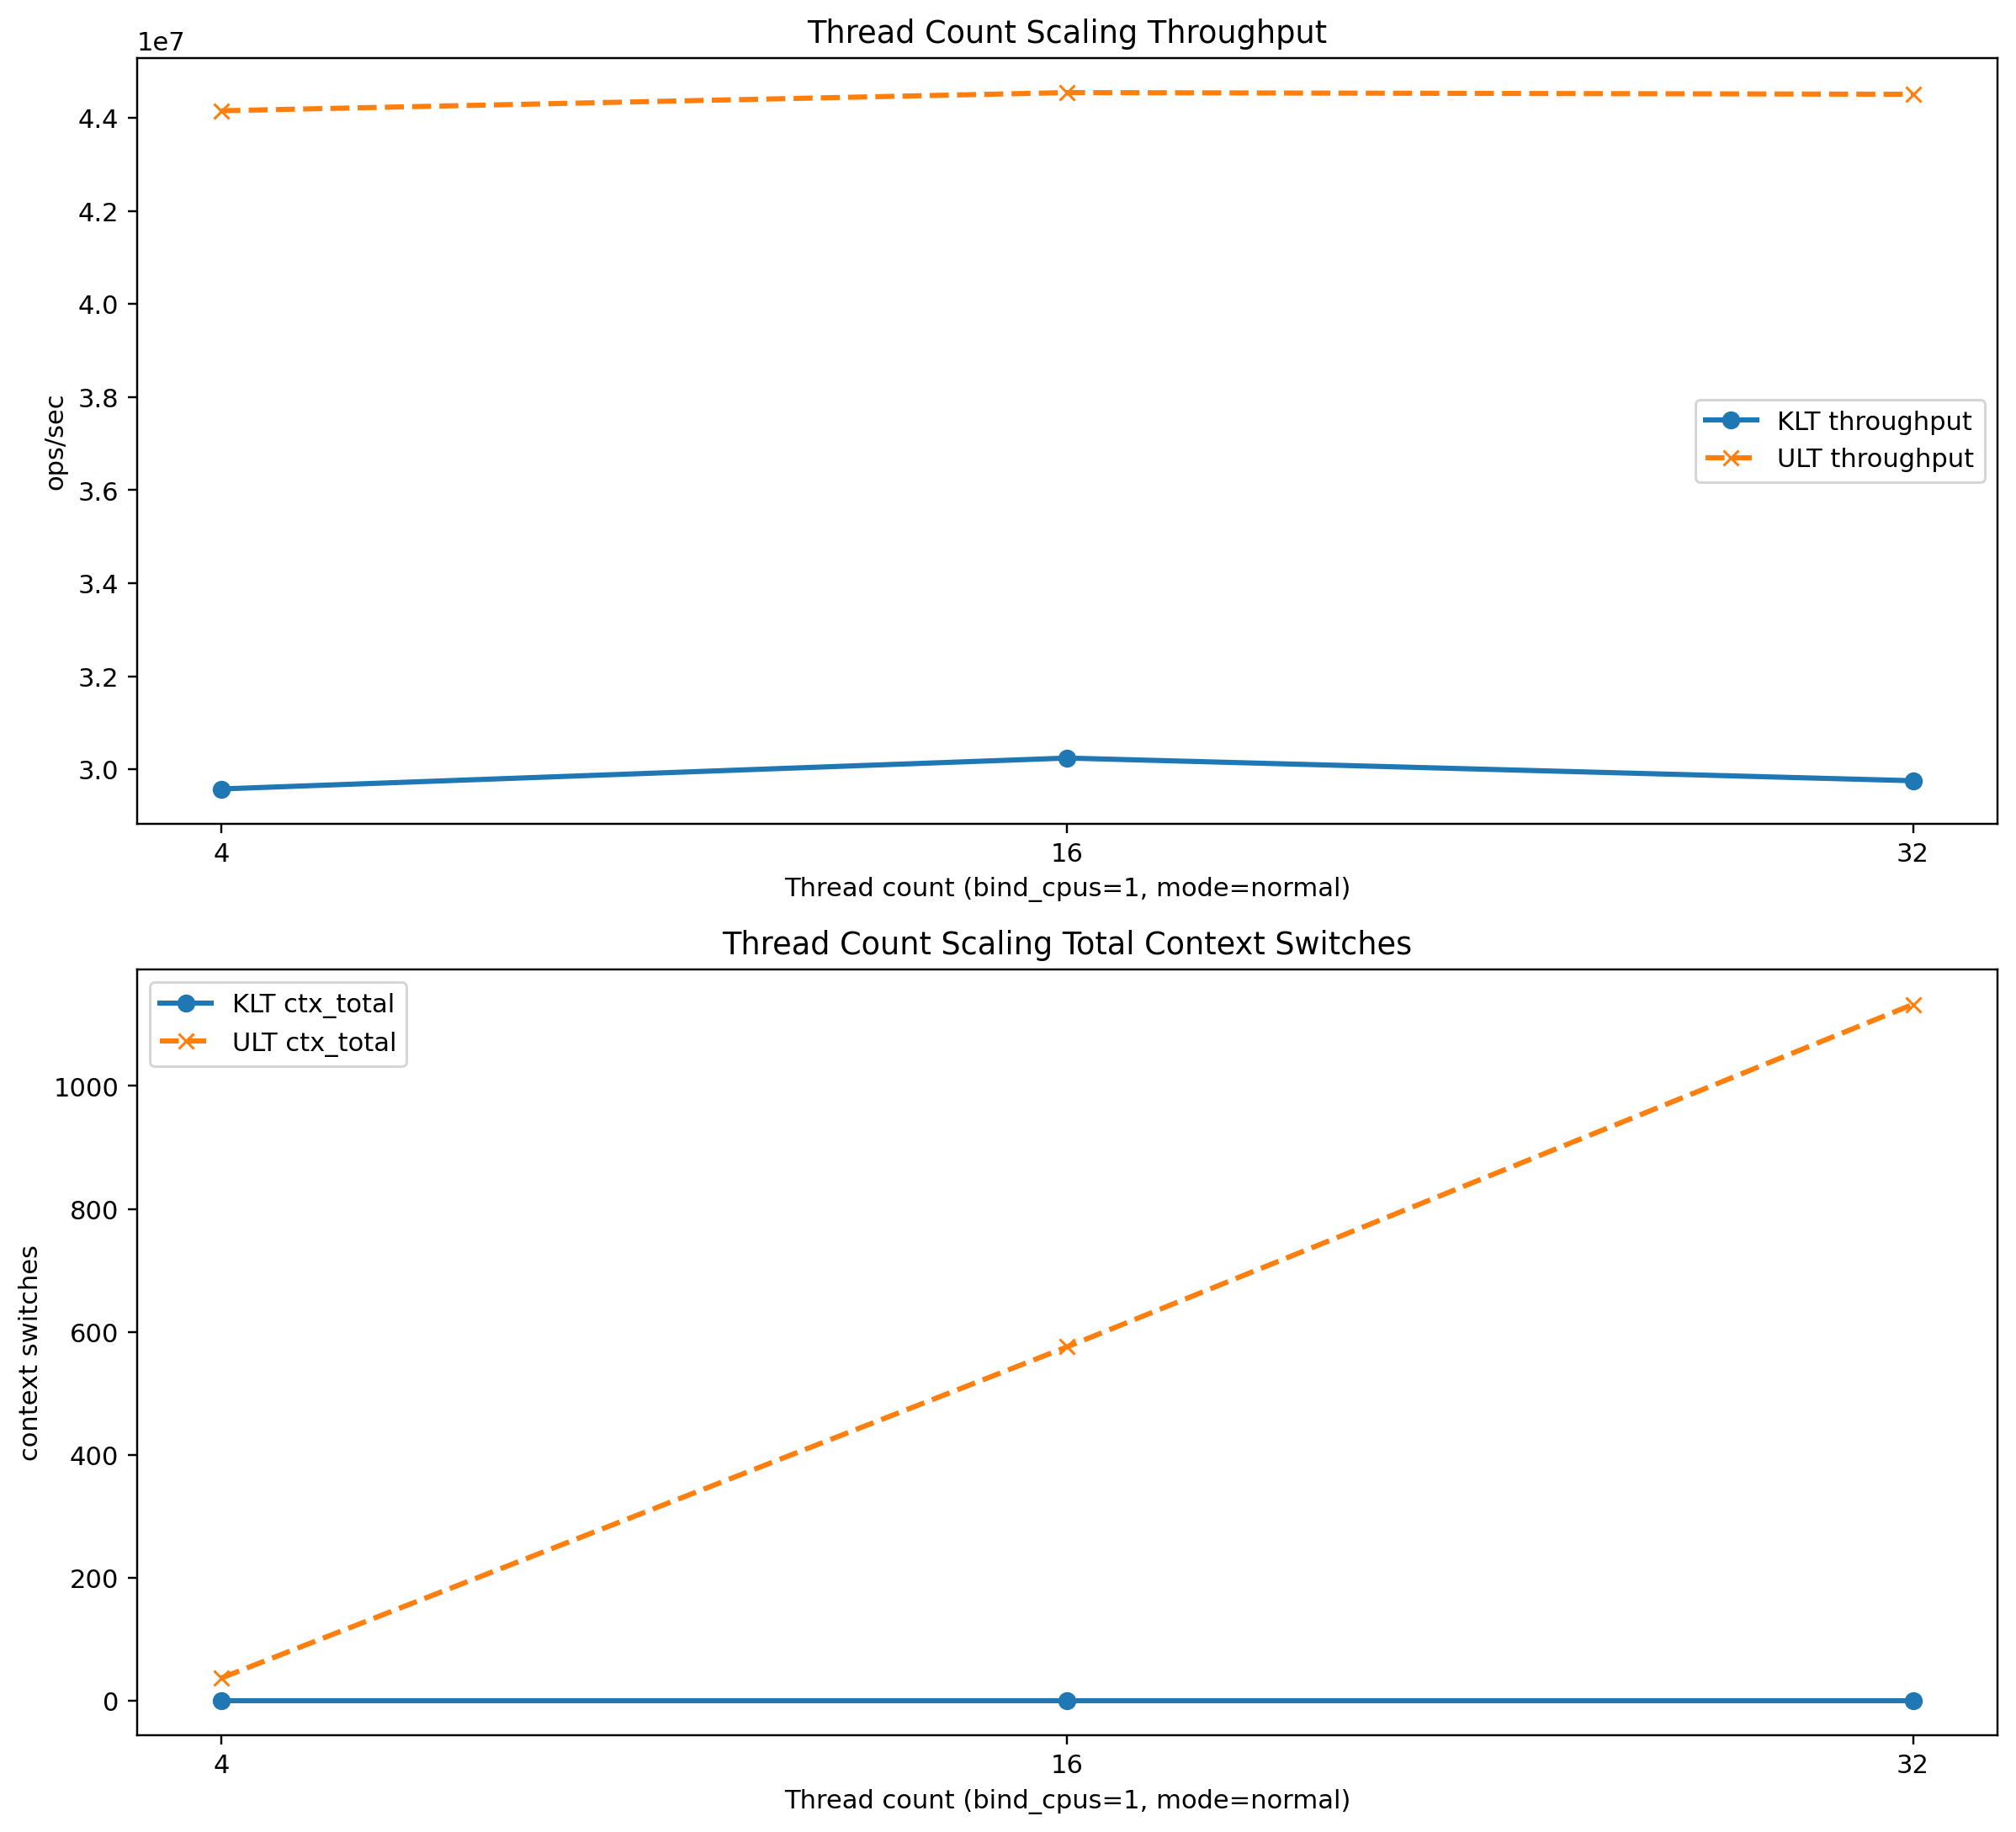
Performance Evaluation-Thread Count Scalability Analysis

Slide 20
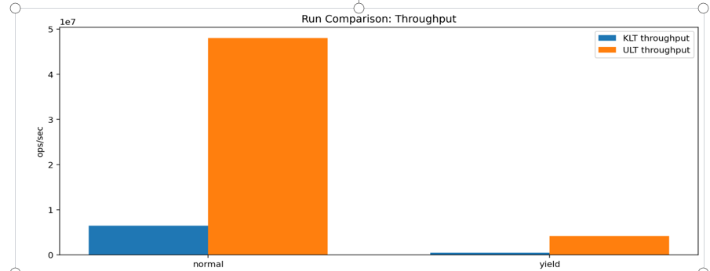
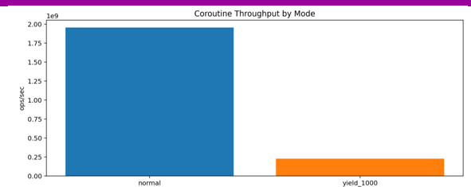
Performance Evaluation-Coroutine throughput

Slide 21
Conclusion
This study provides a systematic performance comparison of three concurrency models: Kernel-Level Threads (KLT), User-Level Threads (ULT), and Coroutine

Slide 22
References
[1] Ingo Molnár. "Completely Fair Scheduler Design and Implementation."
Linux Kernel Documentation, 2007.
[2] Bradford Nichols, Dick Buttlar. "Pthreads Programming."
[3] Melvin E. Conway. "Design of a Separable Transition-Diagram Compiler." Communications of the ACM, 1963.

Slide 23
Q &A

