Slide 1
Operating Systems Project - Topic 2 Kernel-Level Thread Implementation and Analysis
Jin Zemin 225040149@link.cuhk.edu.cn
Zou Haonan 225040132@link.cuhk.edu.cn
March 12th, 2026
Notes:
﻿Morning everyone.
Today we will present our Operating Systems project, Topic 2: Kernel-Level Thread Implementation and Analysis.
My name is Jin Zemin, and my partner is Zou Haonan.
In this project, we designed several experiments to analyze how different thread models behave inside the Linux kernel, and what factors influence their performance.

Slide 2
Contents
Kernel Level Implementation – By Jin
Motivation
Experiment Design
Observations and Analysis
User-space Coroutines Implementation – By Zou
Notes:
﻿This presentation has two main parts.
First, I will introduce the kernel-level experiment, including the motivation, the experiment design, and the observations we obtained.
Then Zou will briefly introduce an advanced implementation of user-space coroutines.
In today's presentation I will mainly focus on the experimental analysis of kernel-levelthreads.

Slide 3
Motivation——Why Do This Experiment?
Operating systems provide two main thread interfaces
User-Level Threads (ULT)
Kernel-Level Threads (KLT)
Different conceptually ?? ☹
How large are the real performance differences, and where do they come from?
To answer this, we design experiments, hoping to address three concrete questions. ☺
Notes:
﻿Before designing the experiment, we started from a few simple but interesting questions.
Modern operating systems support multiple types of threads and scheduling mechanisms, but their internal behaviors are often hidden from users.
Therefore, we wanted to design experiments that could directly observe how the Linux scheduler behaves in practice.

Slide 4

Question 1 — Voluntary vs Involuntary Context Switches
How does Linux distinguish between:
Voluntary context switches
Involuntary context switches
Specifically:
sched_yield() vs usleep()
And:
Do they lead to different scheduling behaviors inside the kernel?
此照片，作者: 未知作者，许可证: CC BY-NC-ND
Notes:
﻿Our first question concerns voluntary and involuntary context switches.
In Linux, these two types of context switches are recorded separately.
We wanted to understand how the kernel distinguishes between them.
In particular, we compared two common operations:
sched_yield() and usleep().
Do they lead to different scheduling behaviors inside the kernel?

Slide 5

Question 2 — Does More CPU Always Improve Throughput?
When multiple CPUs operate on shared data, does performance always improve?
Notes:
﻿Our second question is related to parallel performance.
Intuitively, if we use more CPUs, we might expect higher throughput.
However, when multiple CPUs operate on shared data, the situation becomes more complicated.
So we asked:
Does adding more CPUs always improve performance?

Slide 6
Question 3 — Where Does the Performance Gap Between KLT and ULT Come From?
We want quantitative evidence, not intuition.
So we hope to design two experiments hoping for KLT and ULT, in order to determine:
Which implementation is faster
Why the difference occurs
Notes:
﻿Our third question focuses on the difference between kernel-level threads (KLT) and userlevel threads (ULT).
Both models can execute concurrent tasks, but they interact with the operating system differently.
So we wanted to investigate:
Where does the performance gap between KLT and ULT actually come from?

Slide 7
Experiment Design
CPU allocation
Shared memory contention
Scheduling intervention
Notes:
﻿To answer the three questions raised in the motivation part, we designed a set of controlled
experiments.
The key idea is to isolate different system factors and observe how they influence thread scheduling and throughput.
In particular, we focus on three aspects:
CPU allocation
Shared memory contention
Scheduling intervention
By carefully controlling these variables, we can compare different execution scenarios and identify the main sources of performance differences.

Slide 8
Experiment Environment
Project Files
OS
Ubuntu 24.04 (aarch64)
Kernel
6.8.0-101-generic
uthread_demo.c ← ULT: all 5 scenarios
kthread_demo.c ← KLT: kernel module
Makefile ← builds kthread_demo.ko
Architecture
ARM64 (Apple Silicon via UTM VM)
CPUs
4 cores (nproc = 4)
Compiler
gcc-13 / aarch64-linux-gnu-gcc-13
ULT tool
pthreads (NPTL) · gcc -O0 -lpthread
KLT tool
Linux kthread API · kernel module (.ko)
Notes:
﻿All experiments were conducted in a controlled environment.
The system runs Ubuntu 24.04 with Linux kernel 6.8 on an ARM64 architecture.
To ensure fair comparisons, all tests were executed under the same system configuration, and
each experiment was repeated multiple times.
The final results shown later are averaged measurements of throughput.

Slide 9
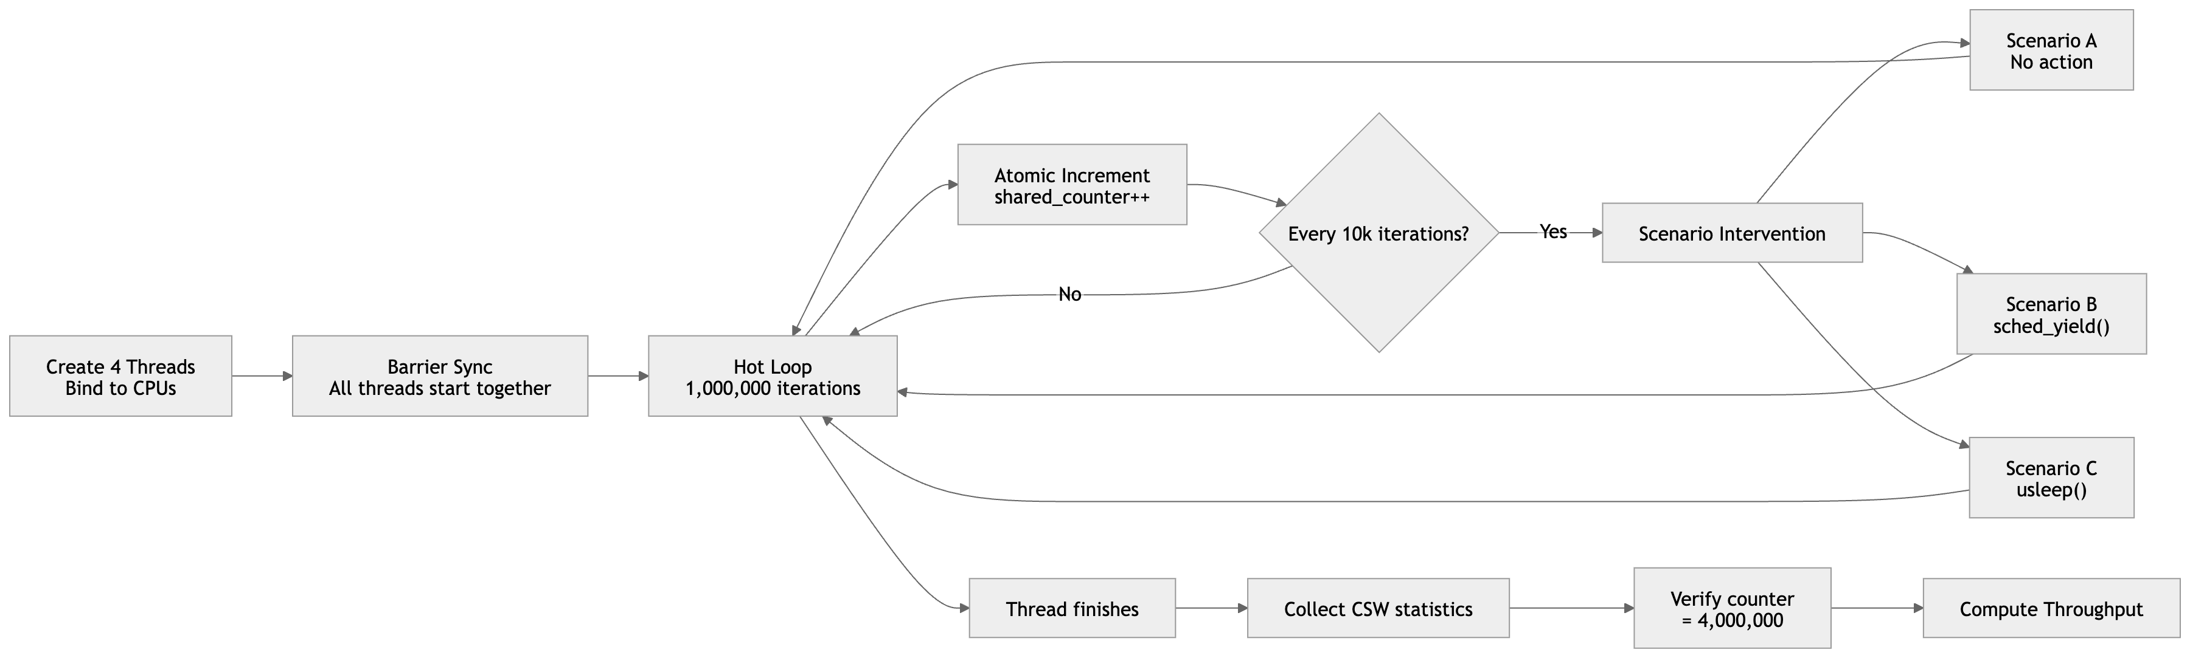
Experiment Design
Notes:
﻿Our workload is intentionally simple.
Multiple threads repeatedly perform atomic increments on a shared counter.
This workload has two advantages:
1. It creates a measurable amount of CPU scheduling activity.
2. When multiple CPUs access the same variable simultaneously, it exposes cache coherence effects between cores.
Therefore, this setup allows us to observe both scheduler behavior and hardware-level contention

Slide 10
Experiment Design - Scenario A/B/C and intervention
A
B1
B2
C1
C2
4T / 4 CPU
4T / 2 CPU
4T / 1 CPU
4T / 2 CPU
4T / 1 CPU
None
sched_yield()
sched_yield()
usleep(1)
usleep(1)
Baseline: zero contention.
Each thread owns a CPU.
Measures peak throughput.
Moderate contention.
2 threads compete per CPU.
Expects inv_csw to rise.
Max contention.
4 threads on 1 CPU.
Tests cache + scheduler.
Voluntary CSW at
moderate contention.
Expects vol_csw ≈ 100.
Voluntary CSW at
max contention.
Longest wakeup wait.
Notes:
﻿We designed five different scenarios: A, B1, B2, C1, and C2. These scenarios gradually introduce different levels of scheduling intervention and CPU contention. Scenario A is the baseline.
• 4 threads run on 4 separate CPUs
• No intervention
This measures the maximum throughput under full parallel execution.Scenarios B1 and B2 explore the effect of CPU sharing.
Multiple threads are forced to run on the same CPU core, removing cross-core cache communication and serializing execution.
Scenarios C1 and C2 introduce scheduling intervention using sched_yield() or usleep(), forcing the scheduler to make more context-switching decisions.
By comparing these scenarios, we can observe how different scheduling behaviors influence system performance.

Slide 11
Create 4 Threads
ULT — pthread
KLT — kthread
pthread_create()
kthread_create() + wake_up_process()
pthread_t handles[4];
thread_arg_t args[4];
for (int i = 0; i < NUM_THREADS; i++) {
args[i].thread_id = i;
args[i].cpu_id = i % cpus_used;
args[i].intervention = cfg->intervention;
pthread_create(&handles[i], NULL,
worker_thread, &args[i]);
}
for (i = 0; i < num_threads; i++) {
threads[i] = kthread_create(
worker_function, // entry point
(void*)(long)i, // arg: thread id
"klt_worker_%d", i
);
// bind BEFORE wake (critical order)
kthread_bind(threads[i], target_cpu);
wake_up_process(threads[i]);
}
vs
All 4 pthreads share one PID.
Shared memory: volatile int shared_counter
Atomic op: __sync_fetch_and_add()
Each kthread gets its own unique PID.
Shared: atomic_t shared_counter = ATOMIC_INIT(0)
Atomic op: atomic_inc(&shared_counter)
Notes:
﻿Next, let us briefly explain how threads are created in our experiments.
For user-level threads, we use the standard POSIX pthread library.
Threads are created using pthread_create().
Although these are user-space APIs, each pthread is actually mapped to a kernel thread managed by the Linux scheduler.
For the kernel-level implementation, threads are created using kernel mechanisms kthread_create()
These threads are managed directly by the kernel scheduler and have their own task structures inside the kernel.

Slide 12
Bind to CPUs
CPU Affinity Binding
ULT
KLT
cpu_set_t cpuset;
CPU_ZERO(&cpuset);
CPU_SET(t->cpu_id, &cpuset);
pthread_setaffinity_np(pthread_self(),
sizeof(cpu_set_t), &cpuset);
int target_cpu = i % cpus_used;
// MUST bind before wake_up_process()!
kthread_bind(threads[i], target_cpu);
wake_up_process(threads[i]);
CPU Formula: target_cpu = thread_id % cpus_used A (4 CPUs): 0→0 1→1 2→2 3→3 | B1/C1 (2 CPUs): 0→0 1→1 2→0 3→1 | B2/C2 (1 CPU): all→0
Safe Thread Stop
ULT
KLT
for (int i=0; i<NUM_THREADS; i++)
pthread_join(handles[i], NULL);
// thread polls kthread_should_stop()
while (!kthread_should_stop())
schedule_timeout_interruptible(100ms);
// rmmod calls: kthread_stop(threads[i]);
Notes:
﻿To control where each thread runs, we explicitly set CPU affinity.For the ULT implementation, we use:
pthread_setaffinity_np()
This binds each pthread to a specific CPU core.
For the kernel-level implementation, CPU affinity is controlled using the kernel scheduler interface, binding the thread to a designated CPU.
We also implement a safe thread stop mechanism.
Instead of forcibly terminating threads, we use a shared stop flag.
Each thread periodically checks this flag and exits the loop safely, avoiding inconsistent states and ensuring clean termination.

Slide 13
Barrier Synchronisation
Why?
ULT — pthread_barrier
KLT — atomic barrier
pthread_barrier_t start_barrier;
pthread_barrier_init(&start_barrier,
NULL, NUM_THREADS);
// In each thread:
pthread_barrier_wait(&start_barrier);
static atomic_t barrier_count = ATOMIC_INIT(0);
atomic_inc(&barrier_count);
while (atomic_read(&barrier_count) < N)
schedule();
All threads must start the hot-loop simultaneously to produce meaningful contention.
Notes:
﻿Another important issue is ensuring that all threads start executing at the same time.
Without synchronization, some threads might begin earlier than others, distorting the measurements.
To solve this, we use barrier synchronization.
For the pthread implementation, we use pthread_barrier_wait(). Similarly for KLT implementation.
This guarantees that all threads reach the same starting point before the workload begins.

Slide 14
Observations and Some Analysis
Notes:
﻿After running all scenarios multiple times, we collected throughput measurements for both implementations.
In the following slides, we will first show the raw results and then analyze the underlying system behavior.

Slide 15
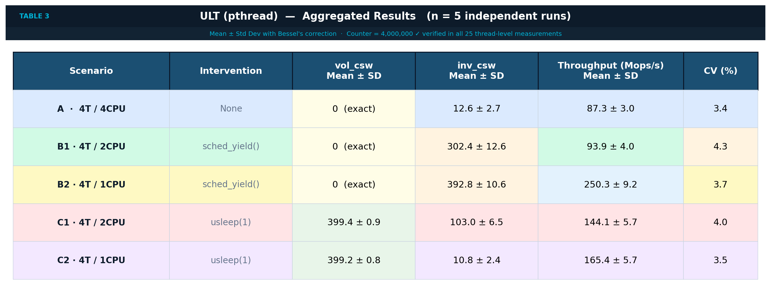
ULT Results
Notes:
﻿Across five runs, the ULT results are very consistent. In Scenario A (4 threads on 4 CPUs), voluntary switches remain zero and involuntary switches stay very low, indicating almost no scheduling contention in the baseline case.
In the B scenarios, we insert sched_yield(). Here we observe hundreds of involuntary context switches while voluntary switches remain zero.
Interestingly, B2 achieves nearly three times the baseline throughput.
Finally, in the C scenarios, using usleep(1) produces about 400 voluntary context switches, exactly matching the expected number of sleep calls.

Slide 16
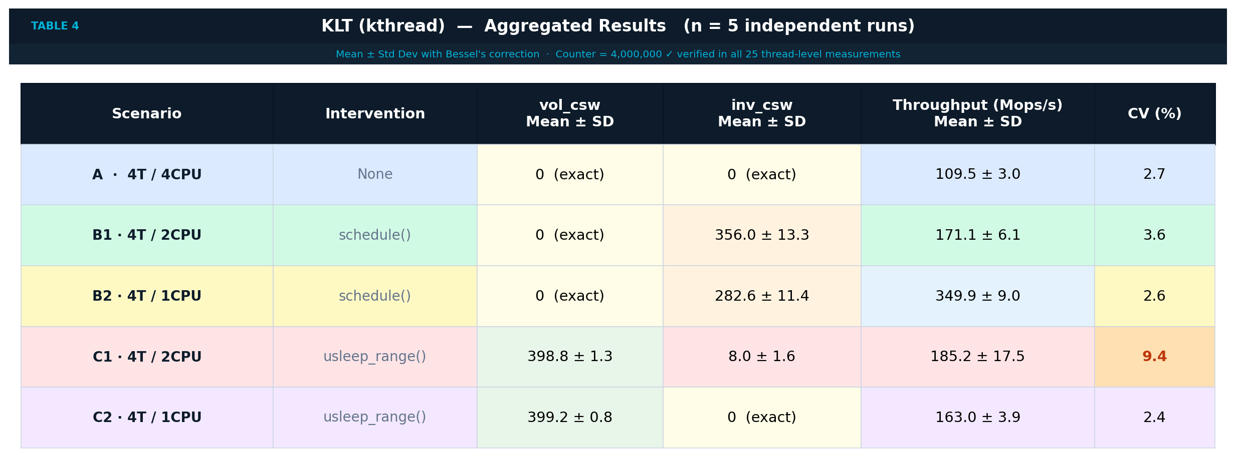
KLT Results
Notes:
﻿Kernel threads show the same overall patterns as ULT but with two notable differences.
First, the baseline throughput is about 27% higher.
Second, the B scenarios again confirm that schedule() leads to non-voluntary switches, while the single-CPU case achieves the highest throughput due to the same L1 cache advantage.
In the C scenarios, we observe slightly higher variance, especially when two kthreads share one CPU.

Slide 17
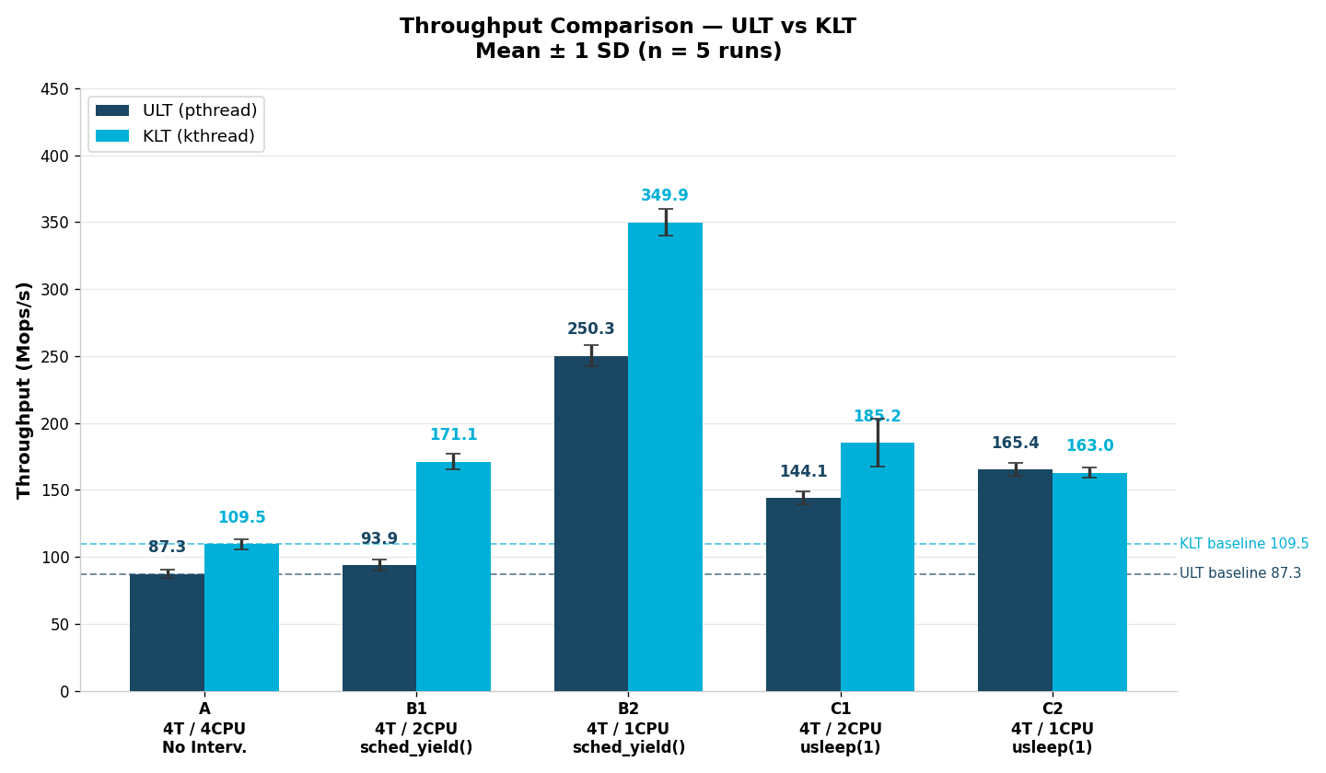
Throughput Comparison
Notes:
﻿This chart directly compares the throughput between ULT and KLT.
Although the difference is not extremely large, KLT consistently performs slightly better in most scenarios.
To understand why this happens, we now return to the three questions raised at the beginning of the presentation.

Slide 18
1 – schedule_yield() vs usleep(): Two different Mechanisms
sched_yield() / schedule()
usleep(1) / usleep_range(1,2)
Thread state: TASK_RUNNING (never sleeps)
Thread state: TASK_INTERRUPTIBLE (truly sleeps)
Moves to back of run queue.
Kernel still sees it as competing for CPU.
Linux records this as NON-VOLUNTARY
→ increments current->nivcsw
→ vol_csw stays = 0
Calls nanosleep() → hrtimer set → removed
from run queue. Wakes after ≥ 1µs.
Linux records this as VOLUNTARY
→ increments current->nvcsw
→ vol_csw ≈ 100 per thread ✓
// B group — B1, B2:
for (i=0; i<ITERS; i++) {
atomic_inc(&shared_counter);
if (i % 10000 == 0)
schedule(); // stays RUNNABLE
}
// Result: vol_csw = 0 always
// C group — C1, C2:
for (i=0; i<ITERS; i++) {
atomic_inc(&shared_counter);
if (i % 10000 == 0)
usleep_range(1,2); // SLEEPS
}
// Result: vol_csw = ~100 per thread
Notes:
﻿The first question concerns voluntary and involuntary context switches. We compared two operations: sched_yield() and usleep().
When a thread calls sched_yield(), it does not sleep.
Instead, it remains in the TASK_RUNNING state and is moved to the back of the run queue.
From the kernel's perspective, the thread is still runnable. Linux records this as a non-voluntary context switch, increasing the counter nivcsw.
When a thread calls usleep(), it enters a sleeping state. The scheduler removes it from the run queue, leading to a voluntary context switch.
This explains why these two seemingly similar operations produce different scheduling statistics.

Slide 19
II – MESI Cache Coherency: Why Single-CPU is 3xFaster
Scenario A — 4 CPUs
4 CPUs — Cache Invalidation
Each CPU writes to shared_counter simultaneously.
MESI protocol: each write invalidates cache
lines on all other CPUs.
→ Other CPUs must re-fetch from L3/memory.
→ Each atomic op costs ~100–300 clock cycles
(cross-core bus latency).
→ ULT: 87.4 M KLT: 111.2 M
CPU0
L1 Cache ✗
CPU1
L1 Cache ✗
CPU2
L1 Cache ✗
CPU3
L1 Cache ✗
INVALIDATE ⇆
Scenario B2 / C2 — 1 CPU
1 CPU — L1 Cache Always Hot
Only CPU0 works. shared_counter stays in
L1 cache permanently (Modified state).
No invalidation signals. No bus traffic.
→ Each atomic op costs ~5–10 cycles (L1 hit).
→ ULT: 250.7 M KLT: 344.9 M (3× faster!)
CPU0
L1 Cache ✓ HOT
5–10 cycles vs 100–300 cycles
Notes:
﻿The second question concerns parallel performance:
Why does running on multiple CPUs sometimes perform worse than using only one CPU?
The answer lies in cache coherence, particularly the MESI protocol.
When several CPUs repeatedly write to the same shared variable, each write invalidates the corresponding cache lines on other cores. This forces other CPUs to reload data from higher-level caches or memory. As a result, each atomic operation becomes much more expensive due to cross-core communication latency.
However, when the workload runs on a single CPU, the shared counter remains in the local L1 cache.This avoids cache invalidation and greatly reduces memory latency. That is why, in some scenarios, a single CPU can actually achieve higher throughput.

Slide 20

III – KLT vs ULT Performance & Identity
Baseline Performance (Scenario A, zero contention):
ULT (pthread)
87.3 Mops/s
+27% faster
KLT (kthread)
109.5 Mops/s
Why KLT is 27% faster at baseline:
No syscall overhead
Direct struct access
KLT runs in ring 0 — zero user↔kernel transitions during the hot loop
CSW read: current->nvcsw directly vs. open()/read() on /proc (ULT)
Thread Identity:
 | PID (getpid) | TID (gettid) | task_struct | Scheduling
ULT pthread | 1401 (shared all threads) | 1402, 1403, 1404, 1405 (unique) | 4 per process | Linux CFS (1:1)
KLT kthread | 1767, 1768, 1769, 1770 (each unique) | PID = TID (no separate TID) | 4 independent | Linux CFS (1:1)
Notes:
﻿Finally, we return to the third question:
Where does the performance gap between KLT and ULT come from?
Our experiments show that the difference mainly comes from how threads interact with the
kernel scheduler.
Kernel-level threads are managed directly by the kernel and can be scheduled independently
on different CPUs.
User-level threads rely on user-space libraries and additional abstraction layers.
Although the difference is not dramatic, kernel-managed threads usually achieve slightly
higher efficiency in scheduling and execution.

Slide 21

User-space Coroutines Implementation
By Zou

Slide 22
Advanced Option: User-Space Coroutines
Overview
Introduction to ucontext function
According to the guidance, we implement a cooperative multitasking program based on user-space context switching. It leverages the <ucontext.h> series of functions to manually save and restore context.
This mechanism enables non-preemptive multitasking concurrency.
getcontext
Retrieves and saves context.
makecontext
Specifies function to be executed when this context is restored.
swapcontext
Saves the current execution context.
Restores another context.
Notes:
According to the guidance, we implement a user-level coroutine scheduler. It leverages the Linux ucontext series of functions to manually save and restore context.
This mechanism enables non-preemptive multitasking concurrency.
Before diving into the experimental program, let's first introduce a few key functions that provide methods for user-space context management.
Firstly, getcontext: Retrieves the current execution context of the program (including CPU register states, Program Counter, Stack Pointer, signal mask, etc.) and saves it into the structure pointed to by the argument.
Next, makecontext: Modifies a ucontext_t structure that has already been initialized by getcontext. It specifies which function should be executed when this context is subsequently restored.
At last, swapcontext: Atomically performs two operations: it saves the current execution context into the first argument (oucp, old context) and immediately restores the context saved in the second argument (ucp, new context).

Slide 23
Advanced Option: User-Space Coroutines
init
Coroutine Pool Initialization
Independent memory stack.
Simulates workloads using iterative loop.
Save the Main Thread Context
Invoke function getcontext.
Save the context of the Main function.
Switching to Sub-Coroutine
Invoke function swapcontext.
Transfer control to coroutine.
task
yield
scheduler
Co 1
Co 2
…
Co n
No
Have all thread tasks completed?
Yes
return
exit
Notes:
And then, let’s take a look at the experimental program flow.
The first stage is
Coroutine Pool Initialization
Each coroutine is assigned an independent memory stack (via a stack array) to ensure isolation and prevent interference. Each coroutine's task(iteration=5) simulates a workload using iterative loop.
Secondly
Save the Main Thread Context
In this stage , it Invoke function getcontext to save the context of the Main function so as to returning to the main thread later.
next
Switching to Sub-Coroutine
Invoke function swapcontext to perform a context switch, transferring control to coroutine.

Slide 24
Advanced Option: User-Space Coroutines
init
Coroutine task
A coroutine completes an iteration.
Requests the scheduler to switch to another coroutine.
Scheduler
Traverses the coroutine list.
Search for the first coroutine which has not finished.
Return to Main
Return to the main thread.
Print logs, and terminate.
task
yield
scheduler
Co 1
Co 2
…
Co n
No
Have all thread tasks completed?
Yes
return
exit
Notes:
And then , get into
Coroutine task
In this step, a coroutine completes an iteration, and requests the scheduler to switch to another coroutine.
And The scheduler traverses the coroutine list starting from the next position of the current one, searching for the first coroutine whose iteration has not finished.
If an active coroutine is found: It saves the context of the current coroutine and switches to the next one.
If all coroutines have finished: It switches back to the main function.
After that,
Return to Main
Return to the main thread, print logs, and terminate.

Slide 25
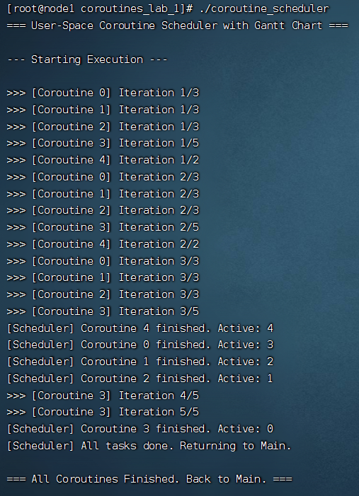
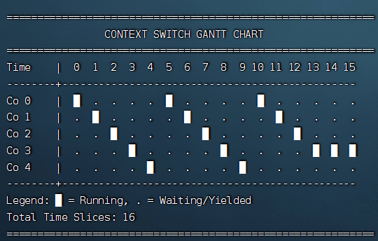
Advanced Option: User-Space Coroutines
Log Output
Iter 3: coroutine 0 1 2
Iter 2: coroutine 4
Iter 5: coroutine 3
Notes:
At last, lets take a look at the log output. We set the iteration count to 3 for coroutines 0, 1, and 2; 5 for coroutine 3; and 2 for coroutine 4.
From the logs, we can see that the program simulates a lightweight, user-space cooperative multi-coroutine scenario. The five coroutines, numbered 0 to 4, take turns executing in order. Specifically, after each coroutine finishes one iteration, it yields the CPU, allowing the scheduler to switch to the next available coroutine.

Slide 26
Thank You！

