Slide 1
Enhanced IPC Mechanism: Design & Implementation
Weiqin Pan 225040150
Jiayi Chen 225040157
School of Data Science
Chinese University of Hong Kong, Shenzhen

Slide 2
Outline
Introduction
System design
Implementation
Testing
QA

Slide 3
Enhance ipc mechanism
Introduction
System Design
Inplementation
Testing
QA

Slide 4
Introduction – Process in computer
Process concept: A process is the basic unit of resource allocation, exclusively occupying resources such as CPU and memory, and being isolated from each other.
Communication requirements: Processes that are isolated need to exchange data or collaborate → Introduce inter-process communication (IPC).
Common IPC mechanisms: Pipes, shared memory, message queues, signals, sockets, etc.

Slide 5
Introduction - VFS & device driver
The design philosophy of Linux: "Everything is a file".
- File acts as a unique view of an instance
The VFS (Virtual File System) provides a unified abstraction layer: Users perform operations on files using open/read/write, and VFS forwards these calls to the corresponding drivers.
Character device drivers take advantage of this mechanism:
-We create device files under /dev, and implement the read/write logic in the file_operations ourselves.

Slide 6
Enhance ipc mechanism
Introduction
System Design
Inplementation
Testing
QA

Slide 7
System design
Character device driver layer: Responsible for device registration, file operation interfaces (open/release/read/write/poll).
Pipe data layer: Implements all the logic of the pipe, including circular buffer, synchronization waiting, reader/writer management.
Builder ：Character device driver
Tester : Benchmark test framework

Slide 8
System design – Builder System
User
File data manager
Open/Realease
Read/write
poll
Pipe operator
Pipe allocate/cleanup
Blocking read/write
Pipe full/empty
Pipe full/empty

Slide 9
System design – Data Structure
struct data_node {
union
{
unsigned long head_tail;
struct
{
unsigned int head;
unsigned int tail;
};
};
struct buffer_node *buffers;
unsigned int size;
struct mutex lock;
wait_queue_head_t rq, wq;
unsigned int readers, writers;
};
buffer
·····
head
tail
rq
wq

Slide 10
System design – Data Structure
buffer
·····
struct buffer_node { struct page *page; unsigned int offset; unsigned int len; };
head
tail
page
…
……
xxxxxx
xxxxxxxx
xxxxxxxxxxx
xxxxxxx
offset
len

Slide 11
System design – Data Structure
struct cgroup_pipe_entry
{
struct rb_node node;
u64 cgroup_id;
struct data_node *pipe;
};
Process 1
Process 2
pipe
Process 3

Slide 12
Enhance ipc mechanism
Introduction
System Design
Inplementation
Testing
QA

Slide 13
Implementation - Open/Release
Obtain the cgroup ID of the current process
Search for or create pipe instances in the red-black tree
Store the instance pointer in the private data of the file
Update the reader/writer count based on the open mode
user
device
pipe
Cgroup_id
FMODE_READ/WRITE
Allocate/Find instance
Reader/Writer ++
filp->private_data = pipe

Slide 14
Implementation - Open/Release
Obtain the cgroup ID of the current process
Search for or create pipe instances in the red-black tree
Store the instance pointer in the private data of the file
Update the reader/writer count based on the open mode
Lock cgroup tree
Lock pipe instance

Slide 15
Implementation - Open/Release
Obtain the pointer of the pipe instance
Reduce the reader/writer count based on the open mode
Check whether the instance can be completely destroyed
Lock pipe instance
Lock cgroup tree

Slide 16
Implementation – Read/Write
Overview
user
device
pipe
Part 1: Initialization
and Lock Acquisition
1. Acquire file’s buffer
2. Acquire mutex lock
Read() / Write()
User buffer/pipe
Copy data

Slide 17
Implementation – Read/Write
Part 2: Data Transfer Loop
Check pipe availability
Calculate chunk size
Copy to/from user ( )
Update buffer state
Advance head/tail
Check completion
buffer
·····
tail
head
page
…
……
xxxxxx
xxxxxxxx
xxxxxxxxxxx
xxxxxxx
offset
len

Slide 18
Implementation – Read/Write
Part 2: Data Transfer Loop
Check pipe availability
Calculate chunk size
Copy to user ( )
Update buffer state
Advance read pointer
Check completion
buffer
·····
tail
head
page
…
……
………..
……………..
xxxxxxxxxxx
xxxxxxx
offset
len

Slide 19
Implementation – Read/Write
Small Write Optimization
Check if last page has space for small remaining data
If yes, append directly to that page without allocating new one
Update statistics; if all data written, jump to cleanup
The Head always points to the next empty node to be written to
buffer
·····
tail
head
page
…
……
………..
……………..
xxxxxxxxxxx
xxxxxxx
Page
size
offset
len

Slide 20
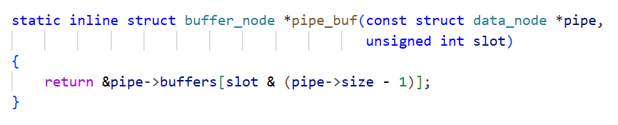
Implementation – Read/Write
How to map the head/tail pointer to the index of the circular buffer

Slide 21
Implementation – Read/Write
Part 3: Blocking IO
If no data read yet and pipe is empty:
Release lock
Wait on read wait queue until data becomes available
After wake, reacquire lock and restart the loop
If interrupted by signal, return error

Slide 22
Implementation – Read/Write
Part 4: Wake-up and Cleanup
After loop ends, check if writers/reader need to be woken
Wake one waiting writer if needed
Wake next reader if needed (fairness)
Release lock and return bytes read or error

Slide 23
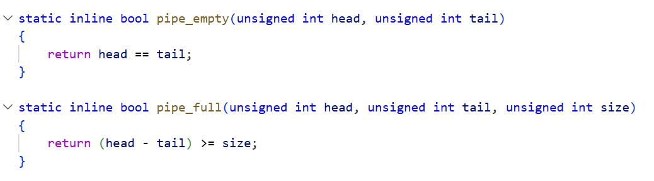
Implementation – Read/Write
How to determine whether the pipeline is empty or full. (No need to operate complex ring buffer)
buffer
·····
·····
tail
head

Slide 24
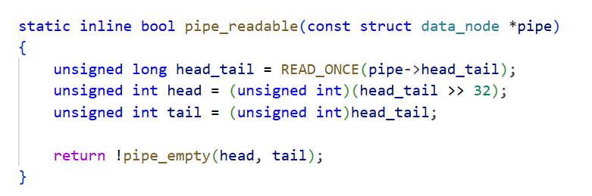
Implementation – Read/Write
How to keep head and tail consistency?
Head_tail
head
tail

Slide 25
Implementation – Read/Write
How to keep wait queue work correctly and fairly?
When the reader queue (rq) is full, readers are blocked;
When the writer queue (wq) is full, writers are blocked.
After a writer finishes writing, it wakes up the readers;
After a reader finishes reading, it wakes up the writer.
The awakened reader or writer will wake up the next waiting one before exiting, ensuring correct scheduling.
The release operation wakes up the other queue to convey the signal that the other party has disappeared. ensuring fair scheduling

Slide 26
Implementation – Read/Write
Why so complex?
Empty/Full state is hard to switch frequently.

Slide 27

Implementation – Read/Write
Solve Thundering herd - Exclusive Wait
Traditional wake-up operation: waking up all processes on the wait queue
meaningless context switches,
waste of CPU resources, and intensified lock contention,
leading to performance degradation.

Slide 28

Implementation – Read/Write
Solve Thundering herd - Exclusive Wait
1. When joining the wait queue, mark as "exclusive“
2. When waking up, only the first exclusive waiter is awakened:

Slide 29
Implementation – Poll (Advanced)
Problem: Blocking on a single fd prevents handling multiple fds concurrently.
Value: Multiplexing (select/poll/epoll) monitors many fds and operates only when ready, boosting concurrency.

Slide 30
Implementation – Poll (Advanced)
User process calls poll
The driver
registers the waiting queue
checks the current state and returns the mask
If there are no events, the process enters sleep and waits to be awakened.
When the read/write operation changes the state of the pipe (data arrives / space becomes available) or the other party closes it, the driver awakens the corresponding waiting queue.
The awakened process re-calls poll to obtain the latest status, and the kernel returns the result to the user mode.

Slide 31
Enhance ipc mechanism
Introduction
System Design
Inplementation
Testing
QA

Slide 32
Testing - Overview & Objectives
Goal
To verify the functional correctness of our custom IPC driver (/dev/hello).
To evaluate its performance (latency & throughput) against standard Linux IPC mechanisms.
Scope
Focus on character device operations: open, read, write, release.
Testing environment setup and benchmark execution.

Slide 33
Testing - Test Environment
Hardware
Architecture: AArch64 / x86_64 (Virtual Machine).
CPU/RAM: Allocated resources (e.g., 2 vCPUs, 4GB RAM).
Software
OS: Ubuntu 24.04 LTS.
Kernel Version: Linux 6.8.0-101-generic.
Compiler: GCC 13.3.0.
Significance
Running on the latest LTS kernel ensures our driver is compatible with modern Linux standards.

Slide 34
Testing - IPC-Bench
Tool Selection
We utilized goldsborough/ipc-bench, an industry-standard open-source framework.
Why IPC-Bench?
Standardization: Provides consistent metrics for Latency and Throughput.
Automation: Automates the message passing loop (Ping-Pong) and timing measurements.
Precision: Captures microsecond-level latency (μs).

Slide 35
Testing - Test Scenarios
Architecture
Writer Process -> User Buffer -> Kernel Page Buffer -> User Buffer -> Reader Process.
Metrics
Test Case: 1-Byte Message Size (Matching standard memory page size).
Iterations: 1,000 message exchanges.
Key Indicators:
Average Duration (Latency): Time taken to send and receive one message.
Message Rate (Throughput): Number of messages processed per second.

Slide 36
Testing - Implementation Challenges
The driver was originally designed for older kernels (Linux 5.x), but our testing environment runs Linux 6.8.
Key Issues & Fixes:
API Changes
Issue: class_create() prototype changed in Linux 6.4+.
Fix: Removed the THIS_MODULE argument.
Type Safety
Issue: pipe_write implementation mismatched the file_operations struct.
Fix: Added const qualifier to the user buffer pointer to match the kernel signature.
Data Types
Issue: printk format specifier mismatch for u64 on 64-bit architecture.
Fix: Cast to unsigned long long and used %llu.

Slide 37
Testing - Functional Verification
Evidence
Kernel Log: Screenshot of dmesg | tail showing
hello_driver_init
hello driver major=XXX, minor=0
Device Node: Screenshot of ls -l /dev/hello showing correct permissions.
Status
Success. The driver loads, unloads, and handles basic I/O without crashing the kernel.

Slide 38
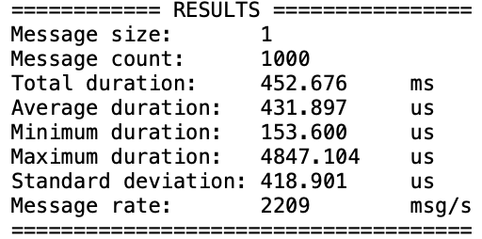
Testing - Results - Latency
Test Case: 1-Byte Message Size, 1000 Iterations.
Key Data
Average RTT: 431.9 μs (microseconds).
Minimum RTT: 153.6 μs.
Maximum Duration: 4847.104 μs (Significant outlier).
Analysis
High Variance: The standard deviation (418.9 μs) is nearly equal to the mean, indicating significant jitter. This is likely due to scheduling delays or context switches in the virtualized environment.
Base Overhead: The minimum latency (~153 μs) represents the inherent cost of the read/write system calls and driver logic.

Slide 39
Testing - Results - Throughput
Test Case: 1-Byte Message Size.
Data
Message Rate: 2209msg/s.
Analysis
System Call Bound: With such small messages (1 byte), the performance is dominated by the overhead of entering and exiting the kernel, rather than memory copying.
Efficiency: Despite the overhead, processing >2,000 system call pairs per second demonstrates the driver's functional stability under rapid-fire conditions.

Slide 40
Testing - Comparison
IPC Mechanism | Latency (RTT, 1B) | Throughput (msg/s, 1KB)
My Driver | 431.897 μs | 2209 msg/s
Linux Pipe | 577.768 μs | 1730 msg/s
Shared Memory | 30.266 μs | 33039 msg/s
Analysis:
Test Case: 1KB Message Size, 1000 Iterations.
Vs. Pipe: Our driver reduces latency by ~146 μs and improves throughput by ~28%.
Vs. Shared Memory: Still slower due to the overhead of memory copying (copy_to_user), whereas shared memory avoids copies entirely.

Slide 41
Enhance ipc mechanism
Introduction
System Design
Inplementation
Testing
QA

Slide 42
Q&A
Thank you!
Any questions?

