Slide 1
IPC Design and Benchmark
Lan Rui, Chen yanbin 3.17
Notes:
中文讲稿
各位老师好，我今天汇报的题目是 自定义 IPC 机制设计与性能评估。
在这个项目中，我在 Linux 内核中实现了一个基于 字符设备驱动的 IPC 机制，并使用 Ring Buffer 结构支持进程间通信。
随后我通过 benchmark，将该机制与 Pipe 和 Shared Memory 进行了性能对比，并分析了不同 IPC 机制在 延迟和吞吐量方面的差异。
English Script
Good afternoon professors.
Today I will present my course project titled IPC Design and Benchmark.
In this project, I implemented a custom IPC mechanism in the Linux kernel using a character device driver and a ring buffer data structure.
Then I conducted benchmark experiments to compare it with Pipe and Shared Memory, and analyzed their performance differences in terms of latency and bandwidth.

Slide 2
Project Background
Inter-Process Communication (IPC) enables communication between processes.
Common IPC mechanisms:
• Pipe • Shared Memory • Message Queue • Socket
Different mechanisms provide different trade-offs between latency and throughput.
Notes:
中文讲稿
进程间通信，也就是 IPC，是操作系统中的一个基础机制，用于支持不同进程之间的数据交换。
在 Linux 中，常见的 IPC 机制包括：
Pipe
Shared Memory
Message Queue
Socket
不同 IPC 机制在 延迟、吞吐量以及实现复杂度方面存在不同的权衡。
因此，本项目的目标是通过实现一个 自定义 IPC 机制，来进一步理解这些机制的设计原理以及性能特点。
English Script
Inter-Process Communication, or IPC, is a fundamental mechanism in operating systems that allows processes to exchange data.
In Linux systems, common IPC mechanisms include:
Pipes
Shared Memory
Message Queues
Sockets
Different IPC mechanisms provide different trade-offs in terms of latency, throughput, and complexity.
Therefore, the goal of this project is to implement a custom IPC mechanism and study its design and performance characteristics.

Slide 3
Project Objectives
The goal of this project is to implement a custom IPC mechanism in Linux.
Main objectives:
• Implement IPC using a Linux character device driver • Design a FIFO ring buffer • Support blocking read and write • Compare performance with Pipe and Shared Memory
Notes:
中文讲稿
本项目的主要目标包括四个方面。
第一，在 Linux 内核中实现一个 字符设备驱动形式的 IPC 机制。
第二，设计一个 FIFO ring buffer 来存储进程之间传输的数据。
第三，实现 阻塞式读写操作，使得进程在 buffer 满或空的时候可以进入等待状态。
第四，通过 benchmark 实验，将该机制与 Pipe 和 Shared Memory 进行性能对比。
English Script
The objectives of this project can be summarized in four parts.
First, to implement a custom IPC mechanism using a Linux character device driver.
Second, to design a FIFO ring buffer for message storage.
Third, to support blocking read and write operations, so processes will wait when the buffer is full or empty.
Finally, to conduct benchmark experiments and compare the performance with Pipe and Shared Memory.

Slide 4
System Architecture
System components:
• Kernel Character Device Driver • FIFO Ring Buffer • Synchronization Mechanism • User-space Benchmark Programs
Device nodes:
/dev/myipc0
/dev/myipc1
Used for bidirectional communication.
Notes:
整个系统主要由四个部分组成。
第一部分是 Linux 内核中的字符设备驱动。
第二部分是用于存储数据的 FIFO ring buffer。
第三部分是同步机制，包括 mutex 和 wait queue。
最后一部分是用户态的 benchmark 程序，用于测试性能。
在驱动中我创建了两个设备节点：
/dev/myipc0 /dev/myipc1
这两个设备节点分别用于 发送和返回数据，从而支持双向通信。
English Script
The system consists of four main components.
First, a Linux kernel character device driver.
Second, a FIFO ring buffer used to store messages.
Third, synchronization mechanisms including mutex and wait queues.
Finally, user-space benchmark programs used for performance evaluation.
The driver creates two device nodes:
/dev/myipc0 /dev/myipc1
These two devices allow bidirectional communication between processes.

Slide 5
Core Data Structure
struct myipc_dev {
char *buffer;
int head;
int tail;
int size;
struct mutex lock;
wait_queue_head_t read_queue;
wait_queue_head_t write_queue;
};
Notes:
每个 IPC 设备都维护一个 ring buffer 结构。
其中：
buffer 用于存储数据
head 表示写入位置
tail 表示读取位置
同时，该结构还包含：
一个 mutex 用于保证并发安全
两个 wait queue 用于实现阻塞读写
通过这些结构，可以实现一个 线程安全的 FIFO 数据队列。
English Script
Each IPC device maintains a ring buffer structure.
In this structure:
buffer stores the data
head indicates the write position
tail indicates the read position
It also contains:
a mutex for mutual exclusion
two wait queues for blocking read and write
Together, these components implement a thread-safe FIFO communication buffer.

Slide 6
Core Data Structure
Features:
• FIFO ring buffer • Blocking read/write • Kernel synchronization
Notes:
每个 IPC 设备都维护一个 ring buffer 结构。
其中：
buffer 用于存储数据
head 表示写入位置
tail 表示读取位置
同时，该结构还包含：
一个 mutex 用于保证并发安全
两个 wait queue 用于实现阻塞读写
通过这些结构，可以实现一个 线程安全的 FIFO 数据队列。
English Script
Each IPC device maintains a ring buffer structure.
In this structure:
buffer stores the data
head indicates the write position
tail indicates the read position
It also contains:
a mutex for mutual exclusion
two wait queues for blocking read and write
Together, these components implement a thread-safe FIFO communication buffer.

Slide 7
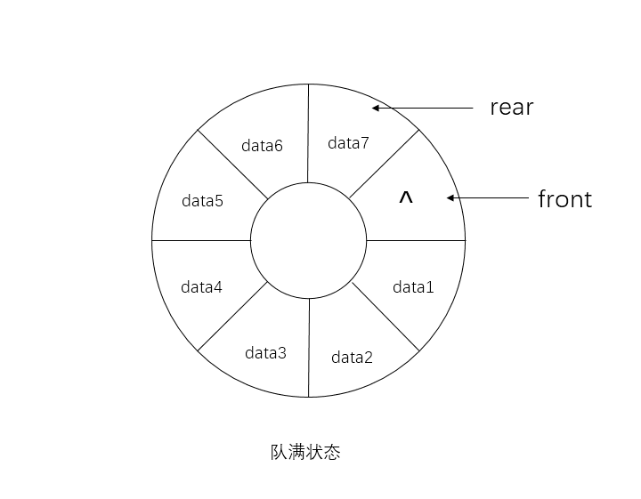
Ring Buffer Design
FIFO circular buffer
• Head → write position • Tail → read position
Advantages:
• Efficient memory usage • Continuous data flow
Notes:
中文讲稿
Ring buffer 是一种循环队列结构。
当 head 或 tail 到达数组末尾时，会重新回到数组起始位置。
这种设计有两个优点：
第一，可以避免频繁的内存分配。
第二，可以持续复用同一块内存空间，从而提高效率。
因此 ring buffer 非常适合用于 IPC 数据交换场景。
English Script
A ring buffer is a circular queue structure.
When the head or tail reaches the end of the array, it wraps around to the beginning.
This design has two advantages.
First, it avoids frequent memory allocation.
Second, it allows continuous reuse of the same memory space.
Therefore, ring buffers are well suited for IPC data exchange scenarios.

Slide 8
Communication Workflow
Write Operation
acquire mutex
check if buffer is full
sleep if full
copy_from_user
wake readers
Read Operation
acquire mutex
check if buffer empty
sleep if empty
copy_to_user
wake writers
Notes:
中文讲稿
写操作的流程如下：
首先获取 mutex，然后检查 buffer 是否已满。
如果 buffer 已满，进程会进入 wait queue 等待。
当 buffer 有空间时，再执行数据写入，并唤醒读进程。
读操作流程类似，如果 buffer 为空，则进入等待状态，直到有新的数据写入。
English Script
The write operation works as follows.
First, the process acquires the mutex and checks whether the buffer is full.
If the buffer is full, the process goes to sleep in the wait queue.
When space becomes available, it writes the data and wakes up waiting readers.
The read operation works in a similar way. If the buffer is empty, the process sleeps until new data arrives.

Slide 9
Benchmark Methodology
RTT Latency Test
• Ping-pong communication • Message size: 1 byte • Iterations: 10000
Bandwidth Test
• Total data: 64 MB • Unified chunk size: 512 B • Fair comparison across all IPC mechanisms
Notes:
中文讲稿
为了评估 IPC 机制的性能，我设计了两类 benchmark 实验。
第一类是 RTT 延迟测试。
在该测试中，父进程发送 1 字节消息，子进程接收后立即返回，重复 10000 次。
第二类是 带宽测试。
通过传输 64MB 数据，计算整个数据传输过程的吞吐量。
English Script
To evaluate the performance of the IPC mechanism, two benchmark experiments were designed.
The first is the RTT latency test.
In this test, the parent process sends a 1-byte message and the child process immediately sends it back. This is repeated 10,000 times.
The second is the bandwidth test, which measures the throughput by transferring a total of 64MB of data.

Slide 10
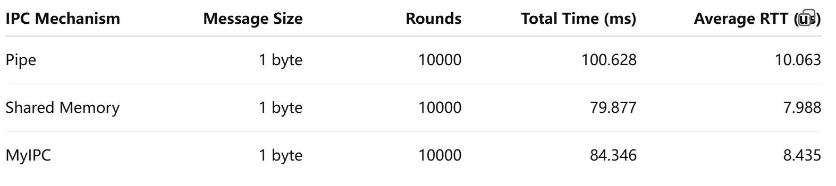
RTT Latency Results
MyIPC latency is close to shared memory and slightly faster than pipe.
Notes:
中文讲稿
实验结果表明：
共享内存的延迟最低，大约为 7.99 微秒。
MyIPC 的延迟为 8.43 微秒，与共享内存非常接近，并且略优于 pipe。
这说明在 小消息通信场景下，我实现的 IPC 机制具有较好的性能。
English Script
The results show that Shared Memory achieves the lowest latency at about 7.99 microseconds.
MyIPC has a latency of 8.43 microseconds, which is very close to Shared Memory and slightly better than Pipe.
This indicates that the custom IPC mechanism performs well for small message communication.

Slide 11
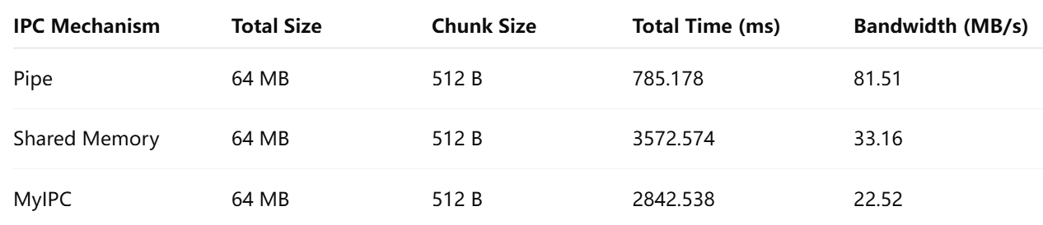
Bandwidth Results
Pipe achieves the highest throughput.
Notes:
这一页展示的是在统一 chunk size 为 512 字节条件下的带宽测试结果。
可以看到：
Pipe 的带宽为 81.5 MB/s，是三者中最高的
Shared Memory 为 33.1 MB/s
MyIPC 为 22.5 MB/s
在这种统一粒度的条件下，三者的性能差距较小。
这说明 IPC 的性能不仅取决于机制本身，也受到数据粒度和系统调用频率的影响。
This slide shows the bandwidth results under a unified chunk size of 512 bytes.
We can see that:
Pipe achieves 81.5 MB/s, which is the highest
Shared Memory achieves 33.1 MB/s
MyIPC achieves 22.5 MB/s
This indicates that IPC performance depends not only on the mechanism itself, but also on data granularity and system call frequency.

Slide 12
Discussion
Bandwidth
• limited by small ring buffer • frequent system calls • synchronization overhead
RTT
• MyIPC performs well for small messages
Possible optimizations：
• larger buffer • batch writes • lock-free structures
Notes:
总体来看，MyIPC 在 延迟方面表现较好，但在 吞吐量方面仍有优化空间。
主要瓶颈包括：
buffer 较小
系统调用频繁
同步开销较大
未来可以通过 增大 buffer、批量传输以及减少锁开销来进一步优化性能。
English Script
Overall, MyIPC performs well in terms of latency, but there is still room for improvement in throughput.
The main bottlenecks include:
small buffer size
frequent system calls
synchronization overhead
Future optimizations may include larger buffers, batch transfers, and reduced locking overhead.

Slide 13
Conclusion
This project implemented a custom IPC mechanism using a Linux kernel driver.
Achievements:
• FIFO ring buffer IPC design • Blocking read/write support • Benchmark comparison with Pipe and Shared Memory
The results demonstrate the trade-offs between different IPC mechanisms.
Notes:
中文讲稿
本项目实现了一个基于 Linux 字符设备驱动的 IPC 机制，并使用 ring buffer 实现进程间通信。
通过 benchmark 实验，对比了该机制与 pipe 和 shared memory 的性能。
实验结果展示了不同 IPC 机制在 延迟与吞吐量之间的权衡关系。
English Script
In conclusion, this project implemented a custom IPC mechanism using a Linux character device driver and a ring buffer.
Benchmark experiments were conducted to compare it with Pipe and Shared Memory.
The results demonstrate the trade-offs between latency and throughput among different IPC mechanisms.

