Slide 1


Minicontainer:
Lightweight Container Implementation with Linux Namespaces
CSCI3150 Introduction to Operating Systems — Topic 4 Project
Ren Xiangyu 225040153
Zhang Jing 225040148

Slide 2
Team Division of Work
Ren Xiangyu（50%Work）
Code: container.c, nsproxy.c, Makefile, rootfs preparation
Presents: Theory + Core Implementation + Verification
Demo: Steps 0-4
Zhang Jing （50%Work）
Code: cgroup.c/h, benchmark.c, image.sh
Presents: cgroup + benchmark + image + challenges + conclusion
Demo: Steps 5-6
Notes:
So the workload was divided quite evenly. One person focused on the core runtime and verification, and the other focused on the advanced features and the final summary.

Slide 3
OUTLINE
Project Overview
Background & Theory
Design & Implementation
Evaluation
Advanced Features
Conclusion
Q&A

Slide 4
1- Project Overview
1.1 Project Goals
Build a lightweight container runtime from scratch
No Docker — only Linux system calls
Reproduce core container isolation mechanisms

Slide 5
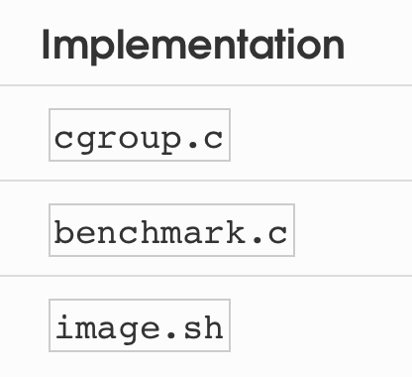
1- Project Overview
1.2 Requirements
1.2.1 Mandatory
5 namespaces: PID / MNT / UTS / IPC / NET
Run /bin/sh inside container
Verify isolation of each namespace
1.2.1 Advanced
Cgroup v2 resource limits
Performance benchmark
Image packaging and import

Slide 6
OUTLINE
Project Overview
Background & Theory
Design & Implementation
Evaluation
Advanced Features
Conclusion
Q&A

Slide 7
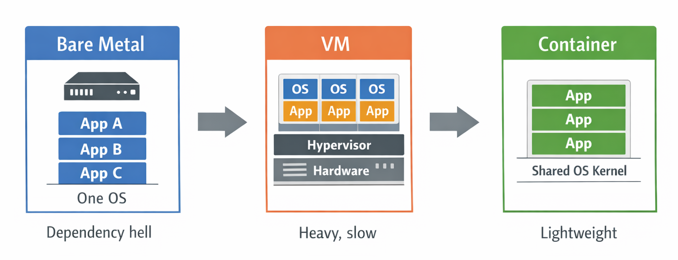
2- Background & Theory
2.1 The Evolution of Isolation
2.1.1 Three Eras of Deployment

Slide 8
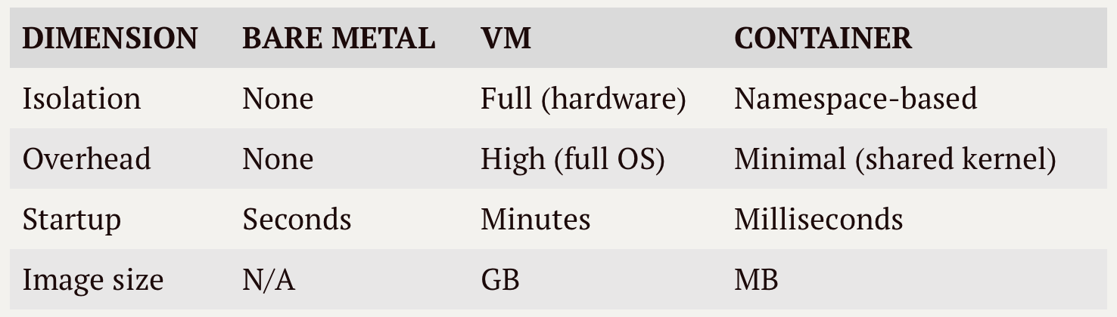
2- Background & Theory
2.1 The Evolution of Isolation
2.1.2 Comparison
Key Insight: Containers share the same Linux kernel as the host.
Isolation is achieved purely through kernel features: Namespaces + Cgroups.

Slide 9
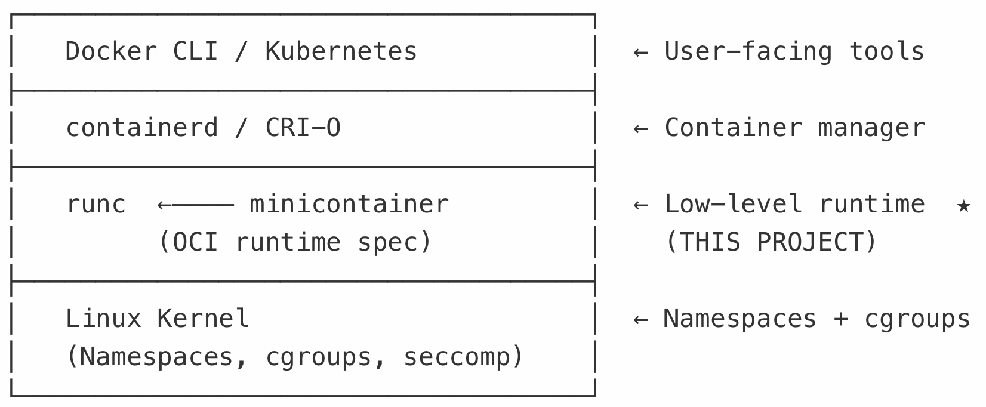
2- Background & Theory
2.2 Where minicontainer Fits
The Container Software Stack

Slide 10
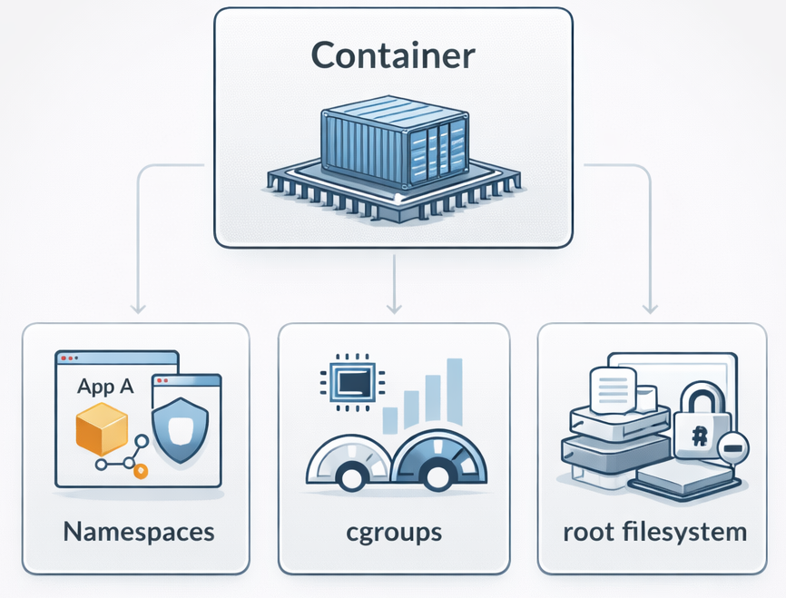
2- Background & Theory
2.3 Three Pillars of Containers
Namespaces
Cgroups
Rootfs

Slide 11
2- Background & Theory
2.3 Three Pillars of Containers
Container, in essence, is:
Namespaces
Cgroups
Rootfs
+
+
(isolation)
(resource limiting)
(filesystem)

Slide 12
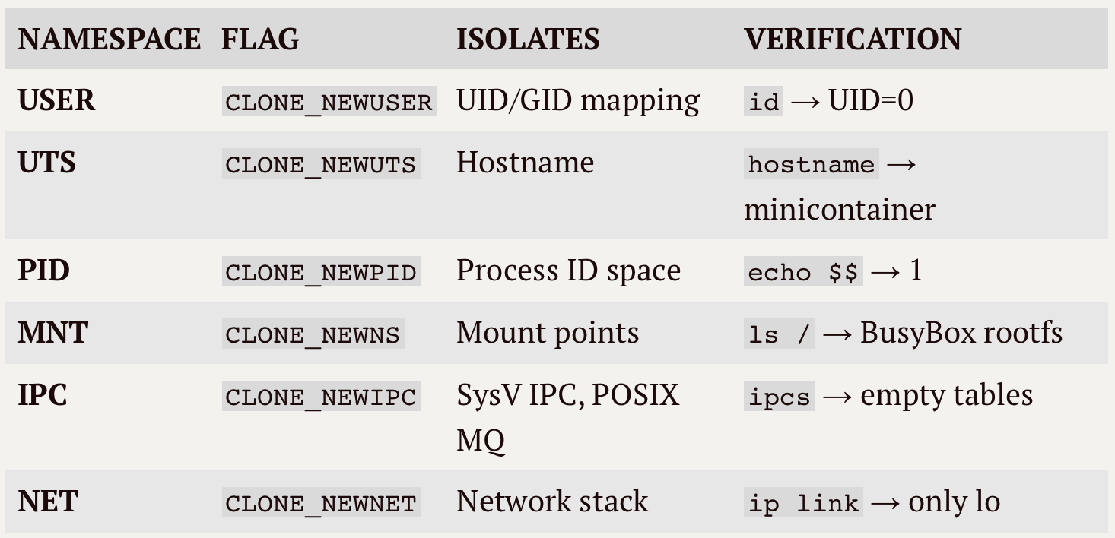
2- Background & Theory
2.4 Namespaces
All 6 namespaces used in minicontainer：

Slide 13
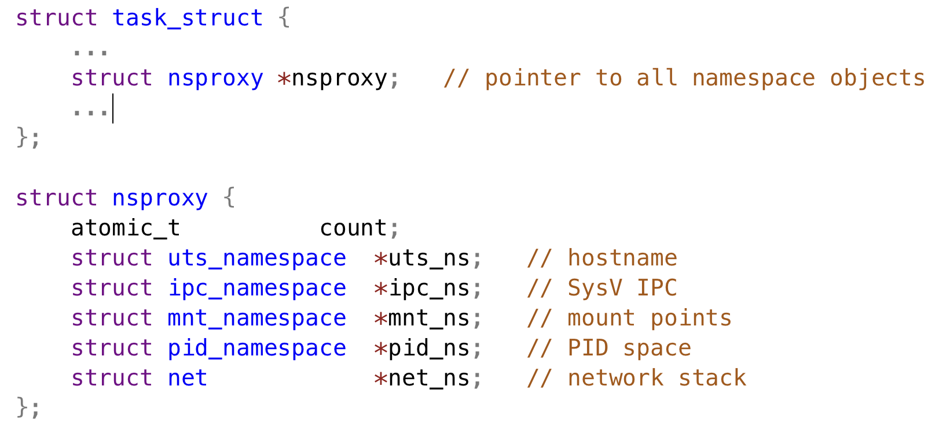
2- Background & Theory
2.5 Kernel Mechanics: nsproxy
2.5.1 How the Kernel Tracks Namespaces
Every process (task_struct) holds a pointer to an nsproxy struct！
Key Insight：A container is not a special object
It is simply a regular process that points to a different nsproxy.

Slide 14
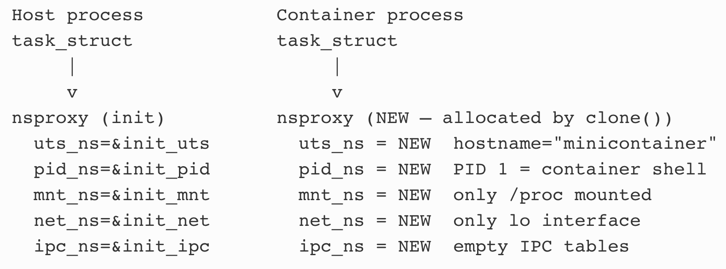
2- Background & Theory
2.5 Kernel Mechanics: nsproxy
2.5.2 Normal Processes vs Container Process
Container is just a simply regular process + different namespace (nsproxy)!

Slide 15
OUTLINE
Project Overview
Background & Theory
Design & Implementation
Evaluation
Advanced Features
Conclusion
Q&A

Slide 16
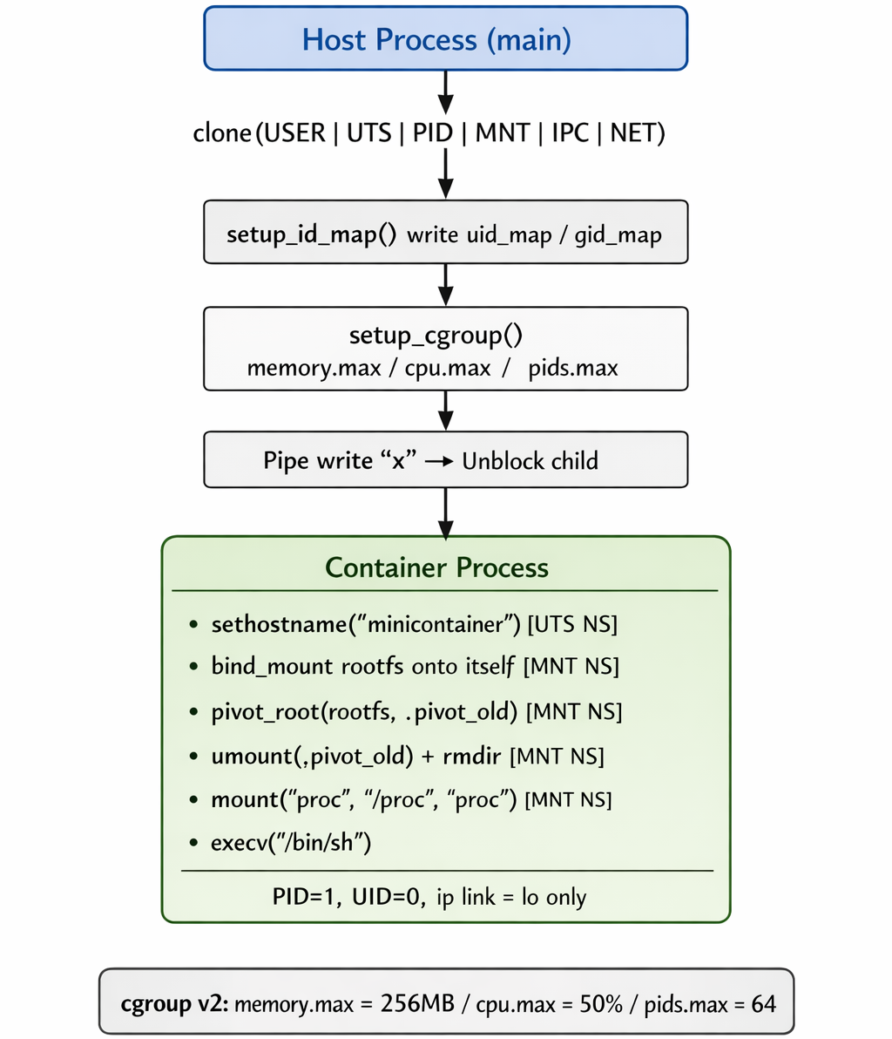
3- Design & Implementation
3.1 System Architecture
3.1.1 Complete System Architecture

Slide 17
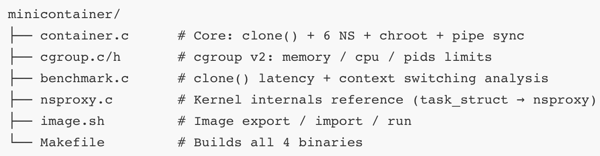
3- Design & Implementation
3.1 System Architecture
3.1.2 File Structure

Slide 18
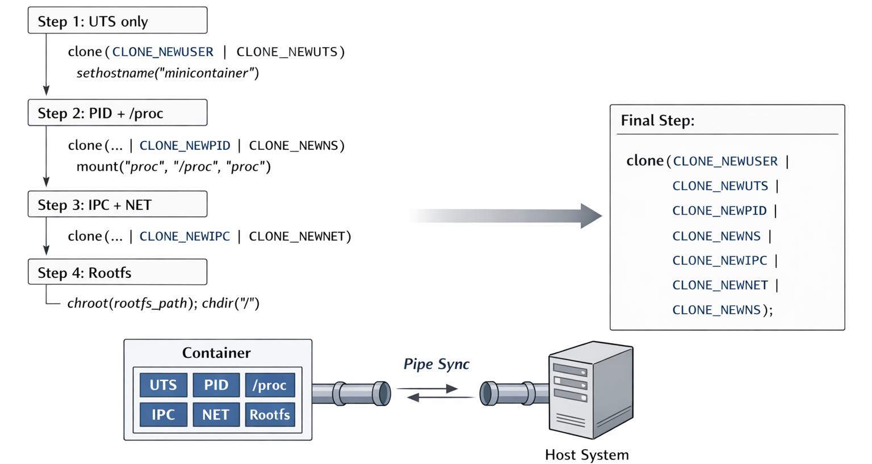
3- Design & Implementation
3.2 clone() & Pipe Sync
3.2.1 Implementation Roadmap

Slide 19
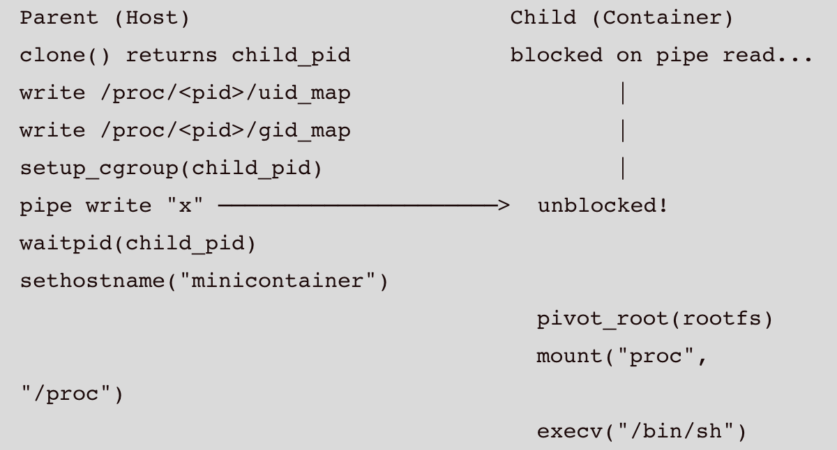
3- Design & Implementation
3.2 clone() & Pipe Sync
3.2.2 Parent-Child Synchronisation via Pipe

Slide 20
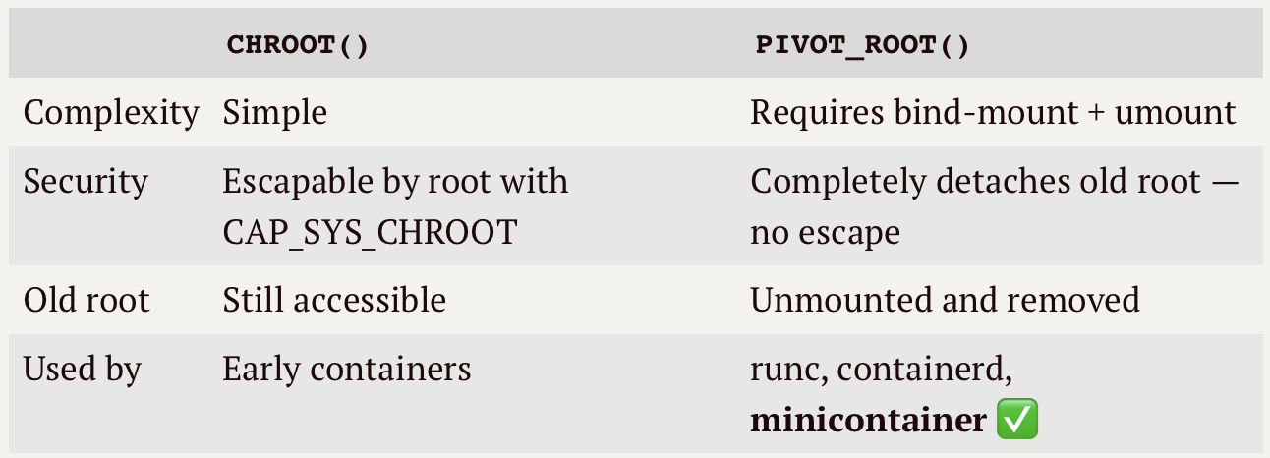
3- Design & Implementation
3.2 clone() & Pipe Sync
3.2.3 chroot vs pivot_root

Slide 21
OUTLINE
Project Overview
Background & Theory
Design & Implementation
Evaluation
Advanced Features
Conclusion
Q&A

Slide 22
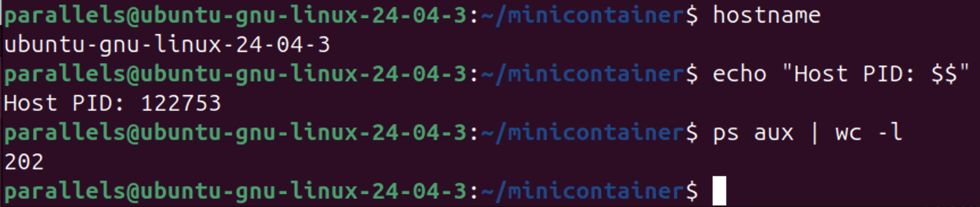
4- Evaluation
4.1 Isolation Verification
Host：

Slide 23
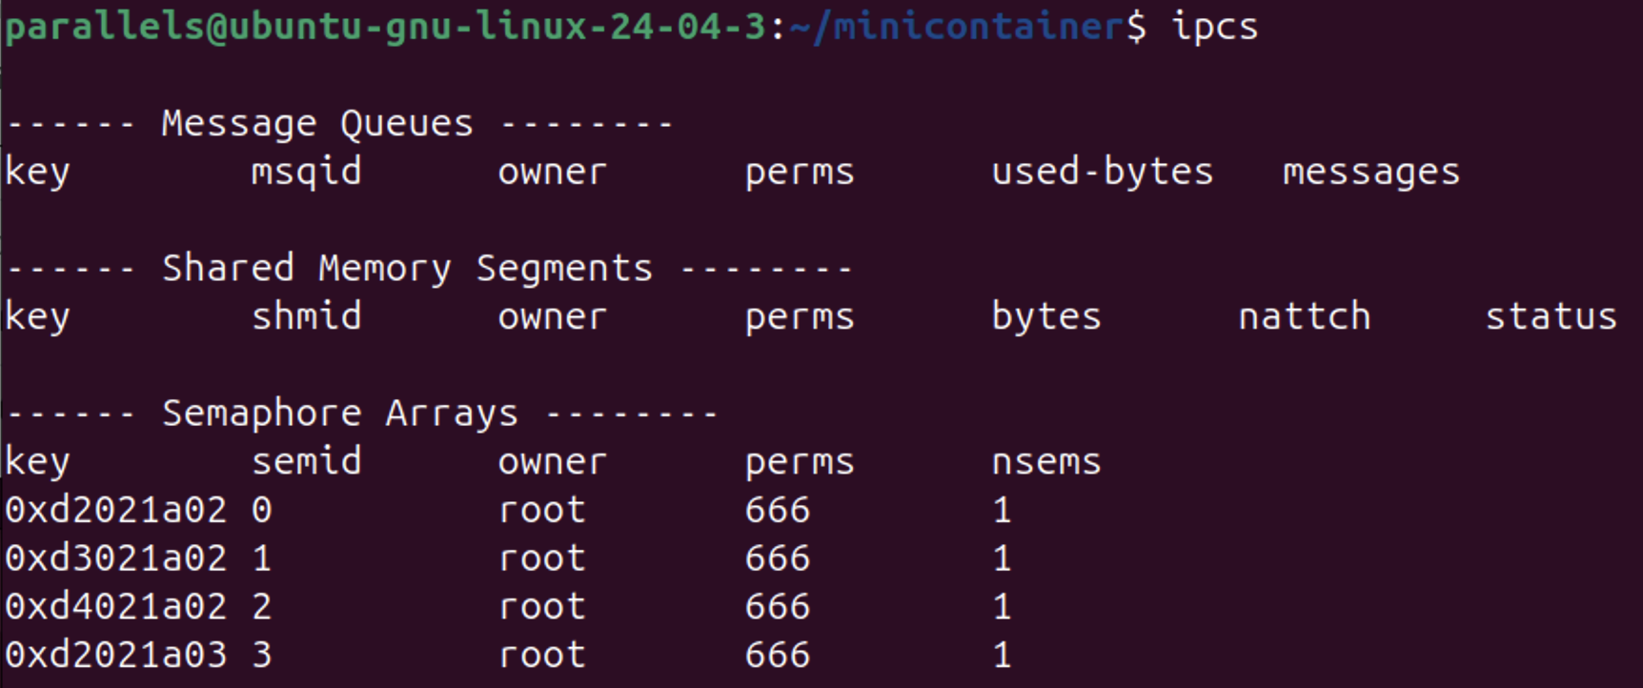
4- Evaluation
4.1 Isolation Verification
Host：

Slide 24
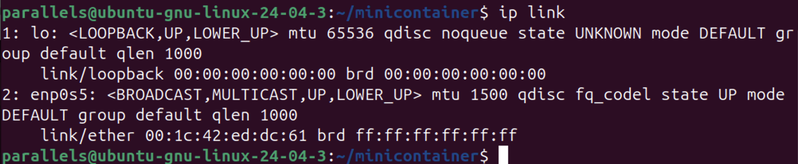
4- Evaluation
4.1 Isolation Verification
Host：

Slide 25
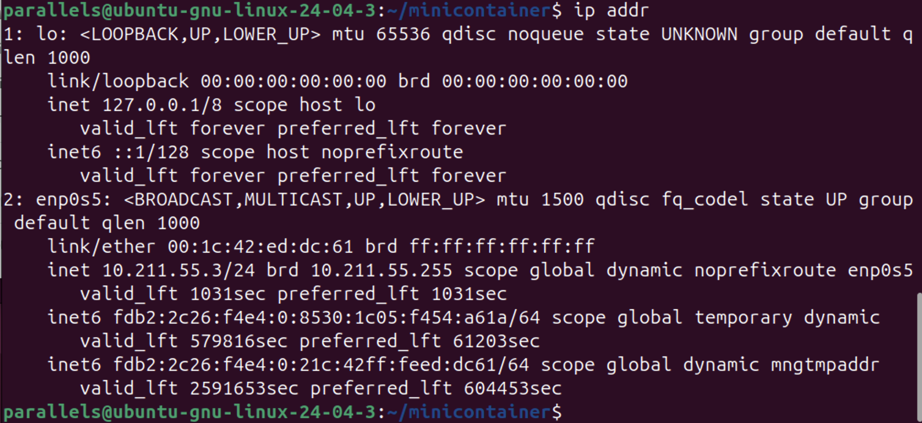
4- Evaluation
4.1 Isolation Verification
Host：

Slide 26
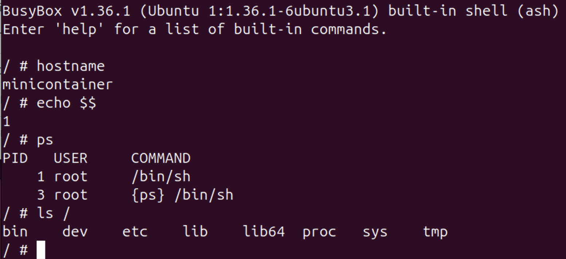
4- Evaluation
4.1 Isolation Verification
Container：

Slide 27
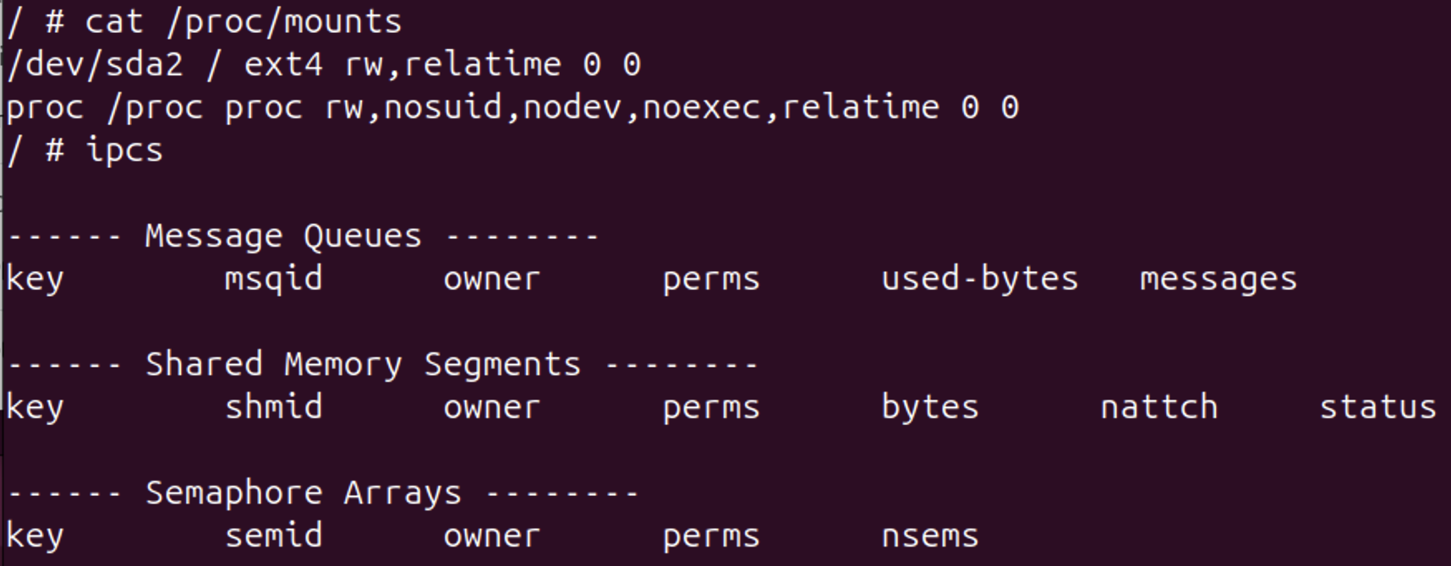
4- Evaluation
4.1 Isolation Verification
Container：

Slide 28
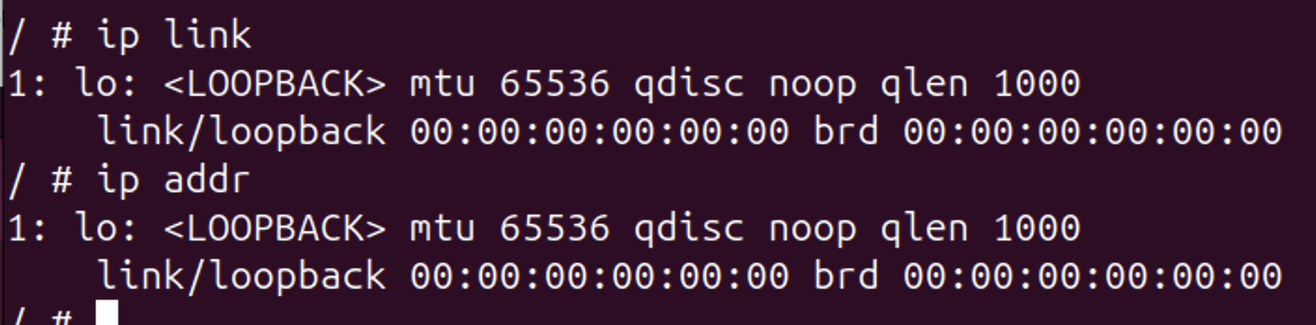
4- Evaluation
4.1 Isolation Verification
Container：

Slide 29
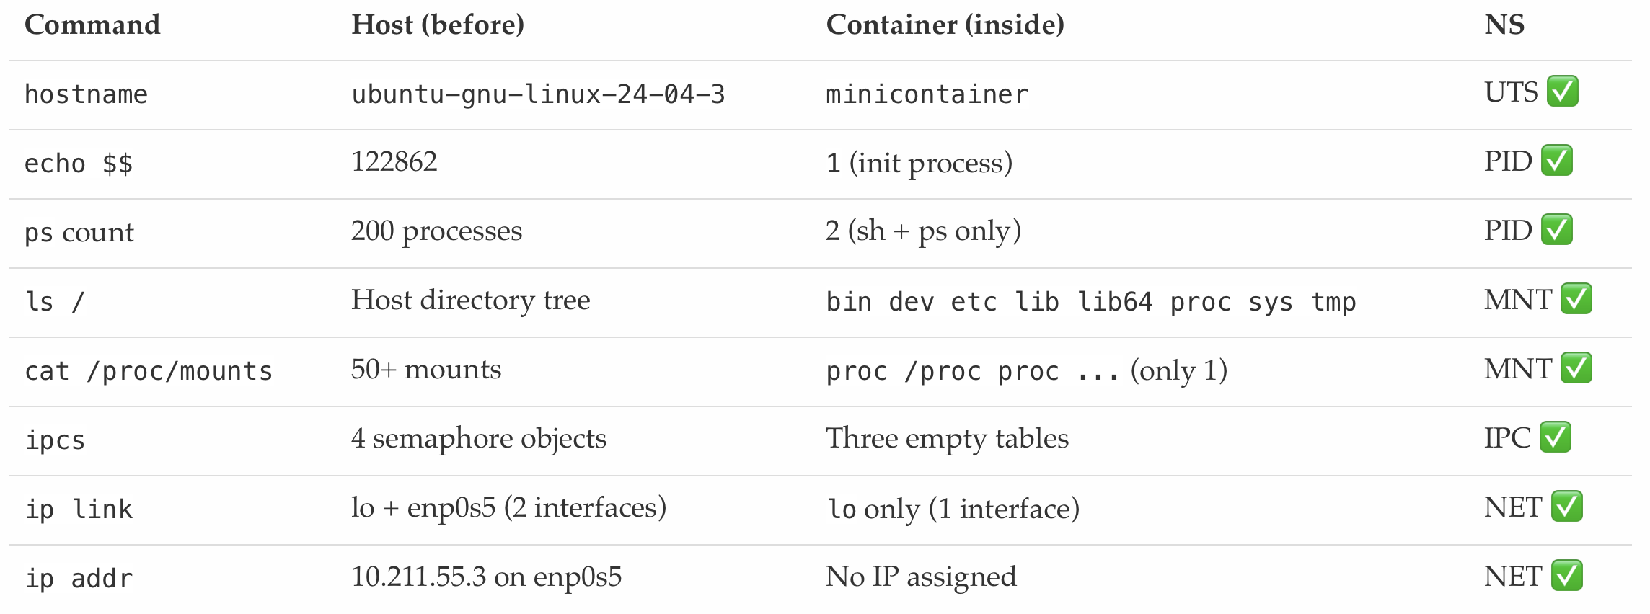
4- Evaluation
4.1 Isolation Verification
4.1.1 Host vs Container: Side-by-Side

Slide 30
4- Evaluation
4.1 Isolation Verification
4.1.2 Key Observations
PID=1: Shell is the init process. If it exits, namespace is destroyed.
MNT: Host filesystem completely invisible. Only fresh /proc mounted.
NET: Container has its own network stack. Only loopback, no connectivity.
IPC: All SysV objects (queues, semaphores, shared mem) invisible from host.

Slide 31
OUTLINE
Project Overview
Background & Theory
Design & Implementation
Evaluation
Advanced Features
Conclusion
Q&A

Slide 32
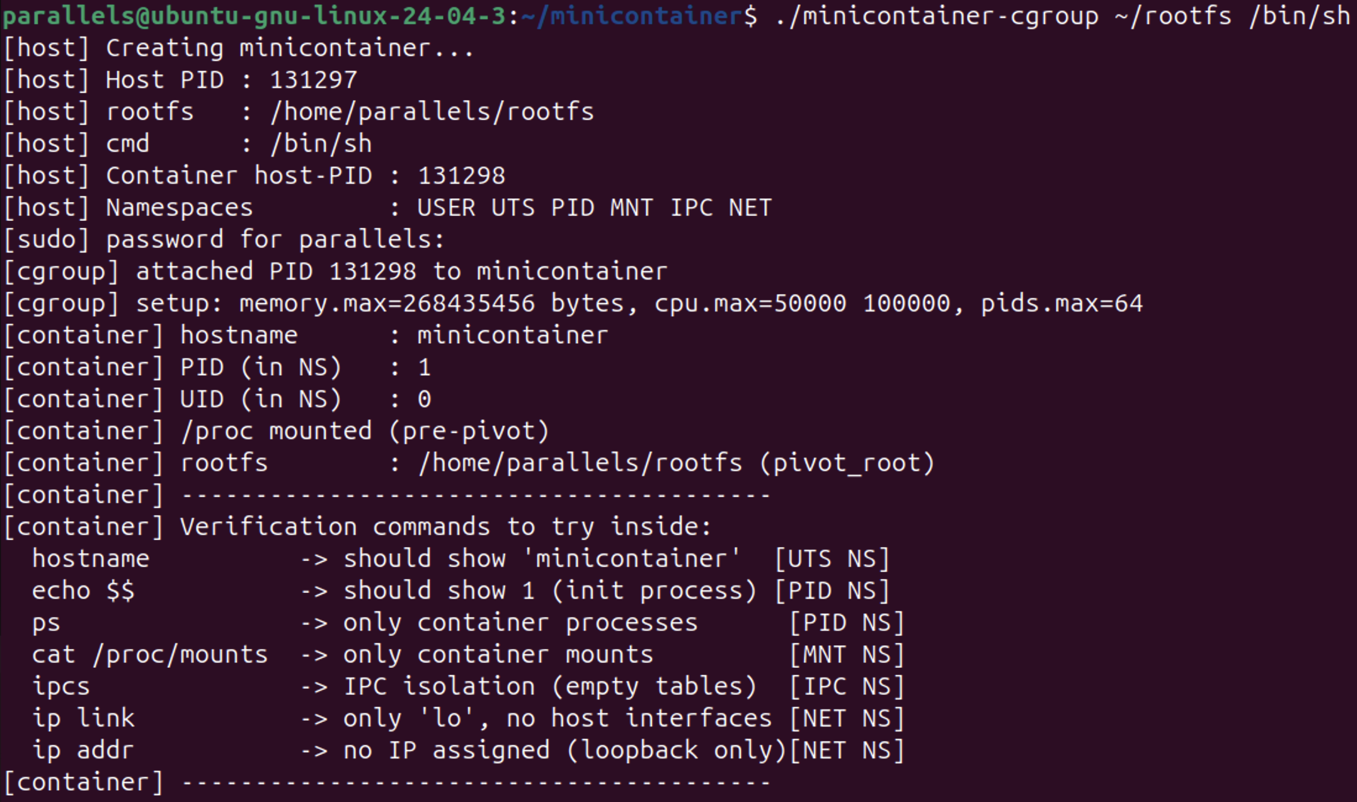
5- Advanced Features
5.1 Advanced 1: cgroup v2 Resource Limits
Notes:
t

Slide 33
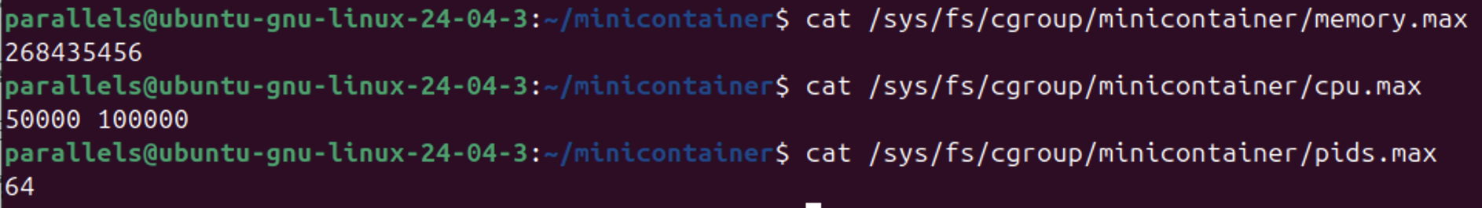
5- Advanced Features
5.1 Advanced 1: cgroup v2 Resource Limits
5.1.1 Verify resource limit values
*Execute on the host terminal (open a new terminal window).

Slide 34
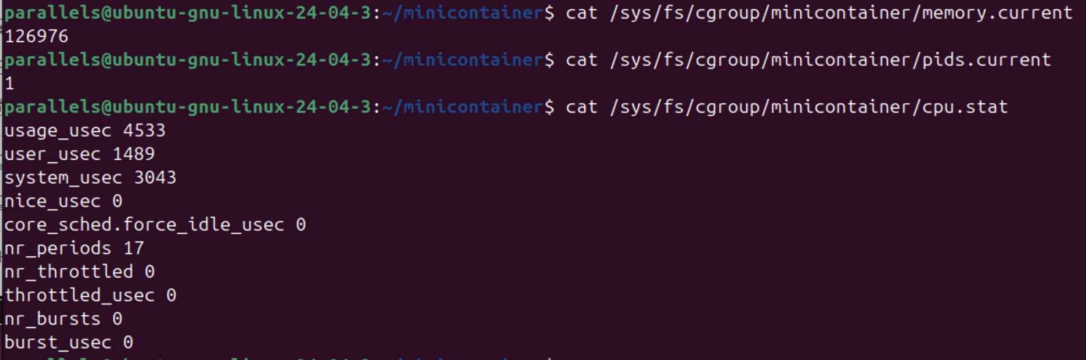
5- Advanced Features
5.1 Advanced 1: cgroup v2 Resource Limits
5.1.2 Check real-time resource usage
*Execute on the host terminal (open a new terminal window).

Slide 35
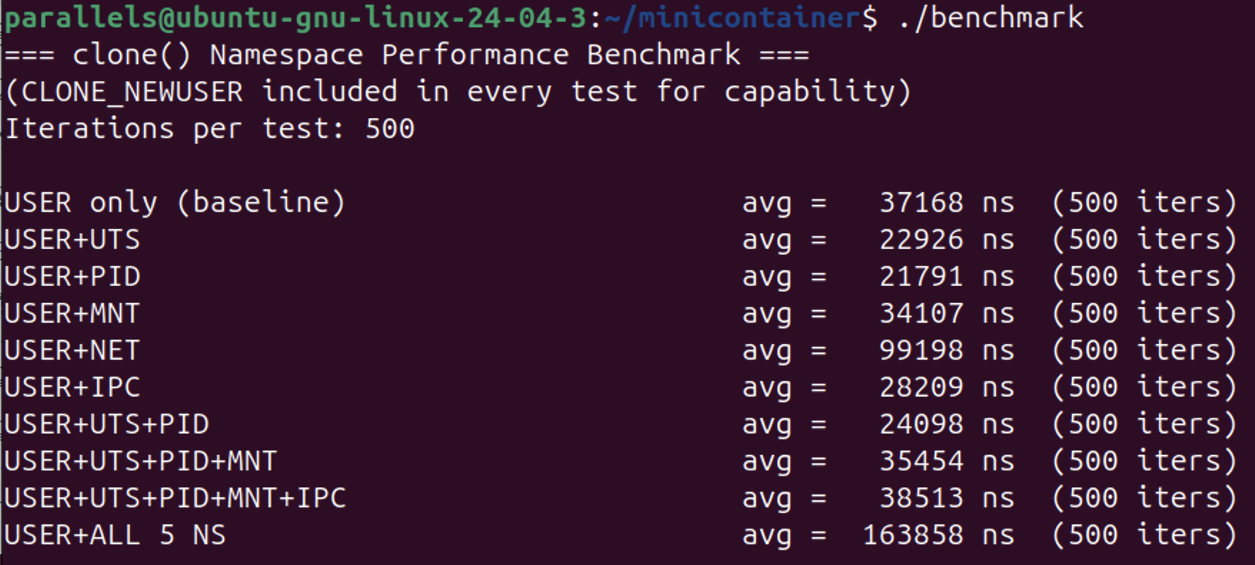
5- Advanced Features
5.2 Advanced 2: Performance Benchmark
5.2.1 clone() Namespace Creation Latency

Slide 36
5- Advanced Features
5.2 Advanced 2: Performance Benchmark
5.2.1 clone() Namespace Creation Latency
Key observations:
UTS/PID/IPC: negligible overhead (kernel just allocates a new ns struct)
MNT: copies parent mount tree (~2-3x vs baseline)
NET: builds full independent network stack (~3-12x vs baseline)
Cost is paid ONCE at clone() — runtime scheduling overhead is zero

Slide 37
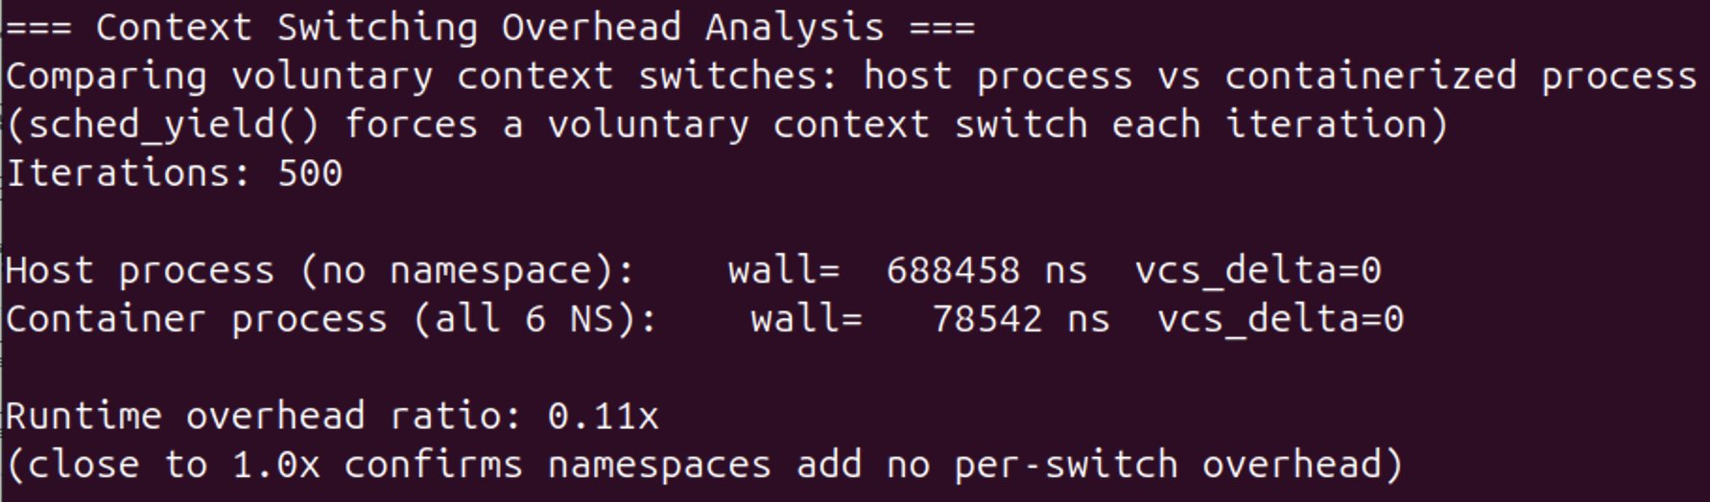
5- Advanced Features
5.2 Advanced 2: Performance Benchmark
5.2.2 Context Switching Overhead Analysis

Slide 38
5- Advanced Features
5.2 Advanced 2: Performance Benchmark
5.2.1 clone() Namespace Creation Latency
Conclusion:
Namespace isolation cost is front-loaded into clone() creation.
Once running, containerized processes are scheduled identically to host processes — the kernel scheduler is namespace-agnostic.

Slide 39
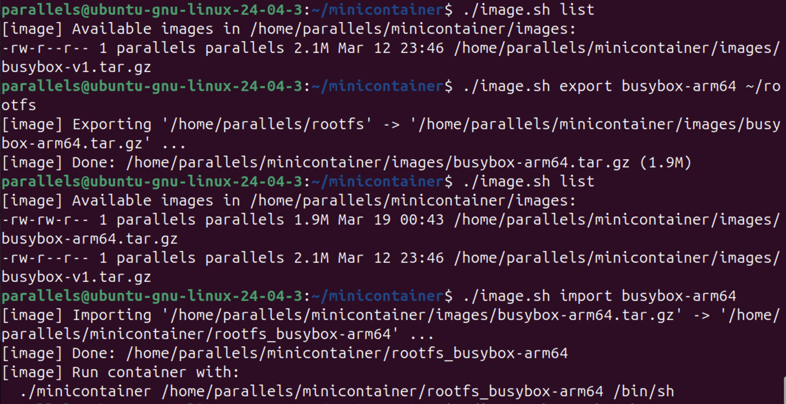
5- Advanced Features
5.3 Advanced 3: Image Packaging

Slide 40
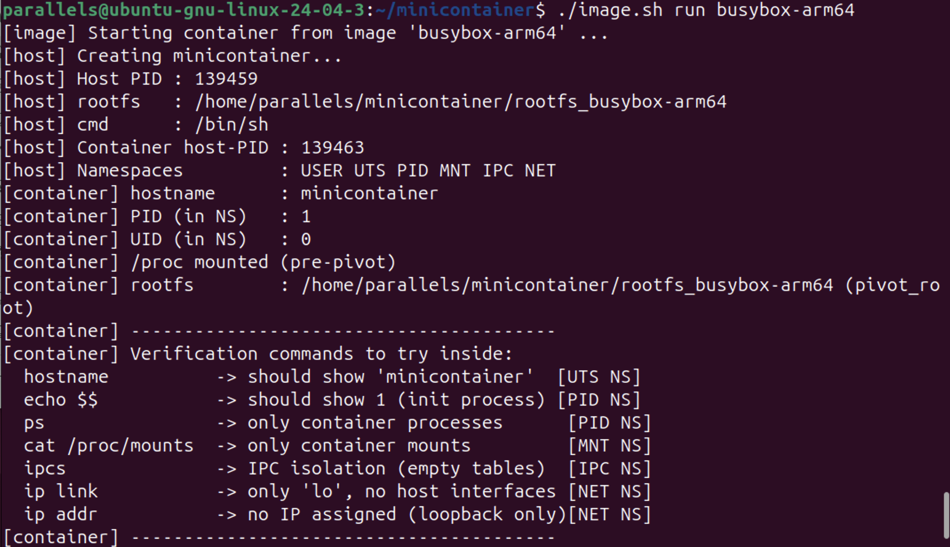
5- Advanced Features
5.3 Advanced 3: Image Packaging
Demo Flow：

Slide 41
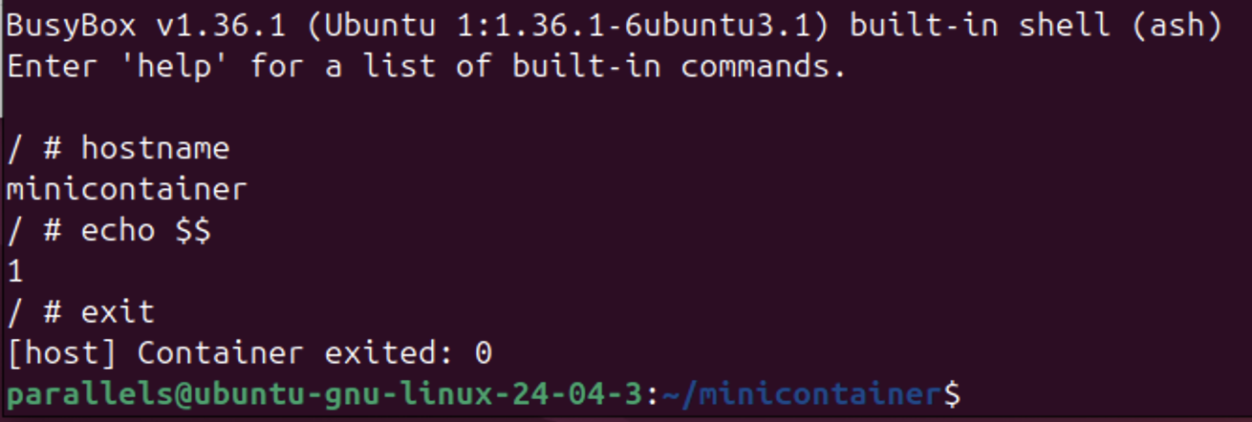
5- Advanced Features
5.3 Advanced 3: Image Packaging
Demo Flow

Slide 42
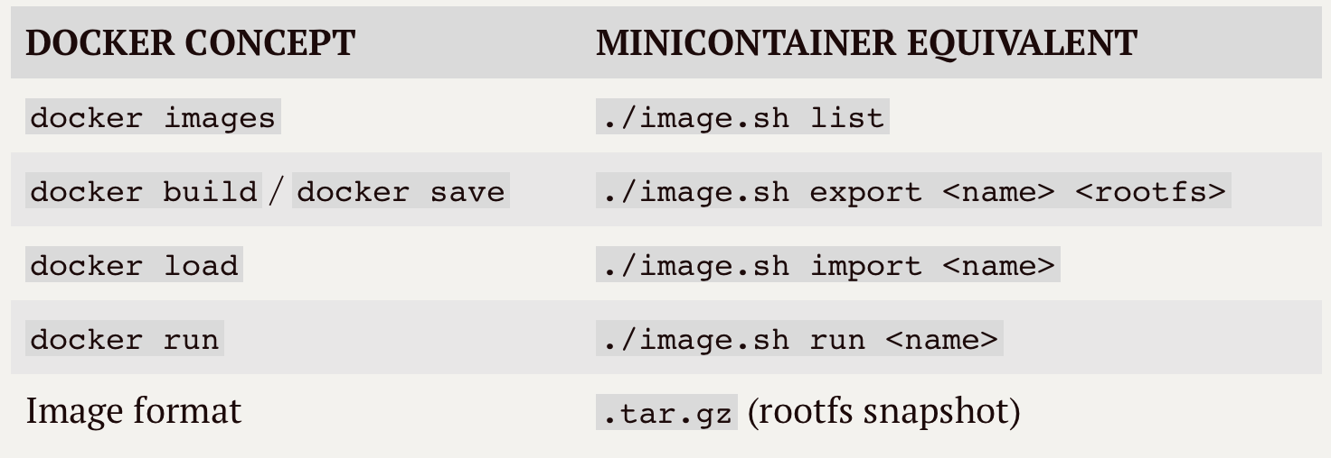
5- Advanced Features
5.3 Advanced 3: Image Packaging
Comparison with Docker:

Slide 43
OUTLINE
Project Overview
Background & Theory
Design & Implementation
Evaluation
Advanced Features
Conclusion
Q&A

Slide 44
6- Conclusion
6.1 Challenges & Solutions
Challenge 1: Ubuntu 24.04 AppArmor Restriction
Symptom: sethostname: Operation not permitted
Root Cause: Ubuntu 24.04 restricts unprivileged user namespaces by default
Solution: sudo sysctl -w kernel.apparmor_restrict_unprivileged_userns=0
Challenge 2: cgroup v2 Permission Delegation
Symptom: cgroup.procs: Permission denied
Root Cause: cgroup v2 requires explicit delegation of cgroup.procs to non-root users
Solution: Pre-create cgroup dir with sudo and chown each interface file

Slide 45
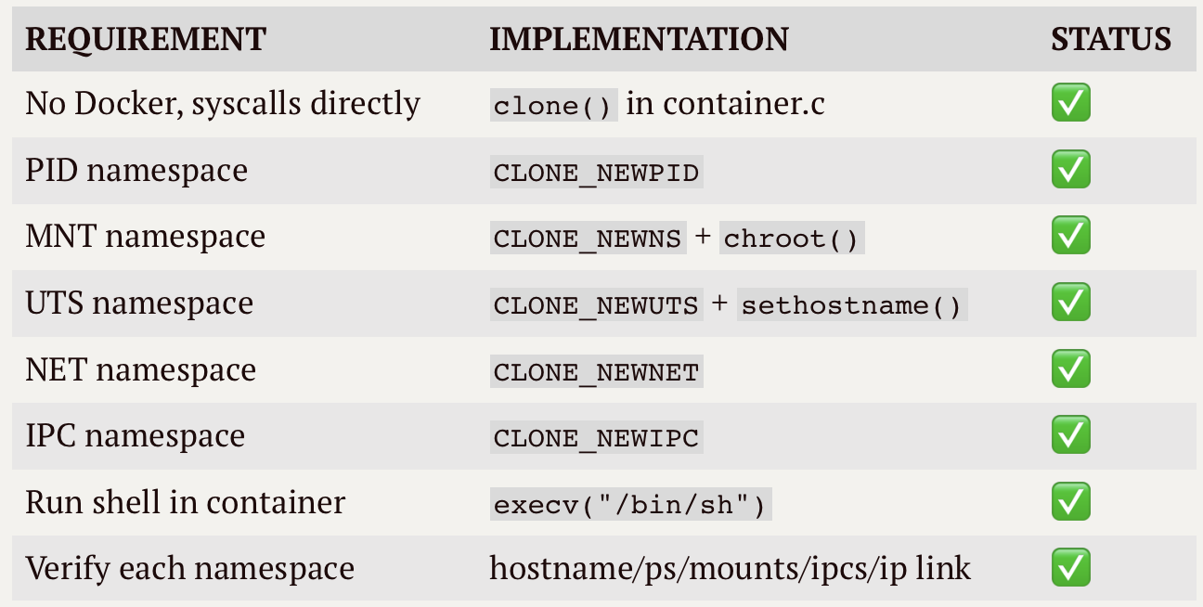
6- Conclusion
6.2 Requirements Coverage
Mandatory Requirements:

Slide 46
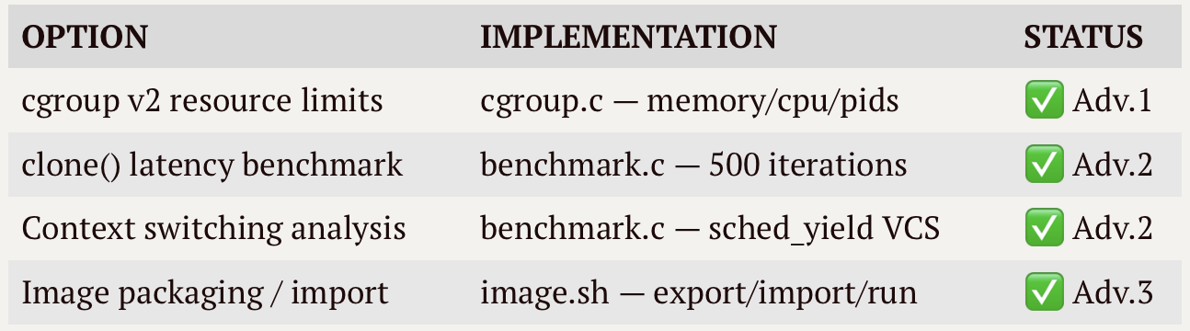
6- Conclusion
6.2 Requirements Coverage
Advanced Options：

Slide 47
6- Conclusion
6.2 Requirements Coverage
What We Built ？
Complete lightweight container runtime
6 namespace types — all mandatory requirements satisfied
cgroup v2 resource enforcement (memory 256MB + CPU 50% + PIDs 64)
Docker-like image packaging workflow
Kernel internals documentation (nsproxy, task_struct)

Slide 48
OUTLINE
Project Overview
Background & Theory
Design & Implementation
Evaluation
Advanced Features
Conclusion
Q&A

Slide 49
7- Q&A
Any Questions？

Slide 50
7- Q&A
Thank you！

