Slide 1
Lightweight Container
Implementation with Linux Namespaces
KaiWen Wu 225040152
YuJie Li 225040136
CSC5031 Operating Systems — Topic 4
2026-03-19
"From scratch: 460 lines of C code,
powered by Linux syscalls"

Slide 2
Contribution
A
KaiWen Wu
B
Yujie Li
Development (50%)
Core Namespace Implementation: Integration of UTS, PID, NET, and IPC namespaces via clone() configuration
Critical Isolation Mechanisms: MS_PRIVATE mount propagation fix, six-step pivot_root filesystem isolation, parent-child pipe synchronization
Resource Control Core: Cgroup v1/v2 auto-detection and memory limiting logic (cgroup_setup/teardown)
Error Handling Framework: Unified error handling wrappers (die(), die_errno())
Documentation & Presentation (50%)
Technical Documentation: Phase 1-6 implementation details (including MS_PRIVATE solution analysis)
Code Documentation: Core function comments and architectural annotations (CN/EN)
Technical Review: PPT technical content verification and architecture diagram design
Presentation Support: Demo technical narration scripts and Q&A preparation
Development (50%)
Engineering Interface Development: CLI argument parsing (getopt), privilege checks (check_root()), help system (usage())
Filesystem Automation: setup_rootfs.sh script for Alpine Rootfs download and preparation
Cgroup Adaptation Layer: Cgroup file operation encapsulation and v1/v2 cross-version compatibility
Testing & Verification: Boundary condition testing, OOM Kill validation, Ubuntu 20.04/22.04 compatibility verification
Documentation & Presentation (50%)
Project Documentation: README overview and complete project report (LaTeX typesetting)
Presentation Materials: PPT visual design (70% layout/animation), speaker notes, and presentation flow design
User Guides: Usage instructions, FAQ compilation, and quick reference sheets
Documentation Review: Technical document formatting and standardization proofreading

Slide 3
Contents
01
Motivation & Objectives
02
Key Kernel Components
Namespaces, Cgroups, and pivot_root
Why containers matter and what we aim to achieve
03
Implementation
04
Live Demo
6 phases from UTS to full isolation
Isolation, resource limits, and rootfs
05
06
Contribution
Challenges & Insights
Lessons learned from building a container runtime from scratch
Out cooperation for this work

Slide 4
MOTIVATION
Why Containers?
Traditional Pain Points
Container Solutions
1 Dependency Hell
Shared Kernel
App A requires Python 3.6, App B requires Python 3.9 — cannot coexist on the same system.
No Guest OS needed. Lightweight and fast with near-native performance.
2 VM Overhead
Strong Isolation
Each VM needs a full Guest OS. Minutes to boot , GBs of RAM , and GBs of disk .
Complete dependency independence. Each container is self-contained .
VM vs CONTAINER COMPARISON
Boot Time
Memory
Image Size
Overhead
Isolation
min
→
ms
GB
→
MB
GB
→
MB
5-10%
→
<2%
VM
≈
Container

Slide 5
PROJECT GOALS
Objectives
Mandatory
Optional
PID Namespace — Process isolation
Option A: Cgroups
MNT Namespace — Mount isolation
Memory limit with OOM Kill testing. Precise resource control .
UTS Namespace — Hostname isolation
NET Namespace — Network isolation
Option B: Rootfs
IPC Namespace — IPC object isolation
pivot_root implementation with Alpine Linux environment .
Verify: ps aux only shows container processes
Core Code
Phases
Coverage
~460 lines C
6 stages
100 %
All mandatory + both options

Slide 6
ARCHITECTURE
System Overview
THREE PILLARS
CONTAINER TECHNOLOGY STACK
1
Namespaces
Controls what processes can see — view isolation
Docker CLI / Kubernetes
Orchestration
2
Cgroups
Controls how much resources can use — resource limits
3
pivot_root
containerd
Lifecycle Management
Controls where processes live — filesystem isolation
PARENT-CHILD TIMELINE
runc
Low-level Runtime
Parent (Host)
Child (Container)
◄ Our Implementation
clone() →
child_function()
cgroup_setup()
read(pipe) ← wait
write(pipe) ──→
sethostname()
waitpid()
execvp() → shell
Linux Kernel
clone / cgroups / pivot_root

Slide 7
CODEBASE
Code Organization
PROJECT STRUCTURE
CONTAINER.C MODULES
CSC5031-container-project/
15%
Error Handling
├── src/
die(), die_errno()
└── container.c [460 lines]
├── report/
20%
Helper Functions
├── Phase1-6.md
check_root(), parse_mem_limit(), validate_rootfs()
├── presentation.tex
└── report.tex
25%
Cgroups Layer
├── scripts/
cgroup_setup(), cgroup_teardown()
└── setup_rootfs.sh
├── rootfs/ [Alpine]
15%
pivot_root Layer
└── Makefile
do_pivot_root()
# Build
15%
Container Entry
$ make
child_function()
# Prepare rootfs
Main Flow
$ make rootfs
10%
main()
# Run
$ sudo ./container

Slide 8
PHASE 1
UTS Namespace
VERIFICATION
Hostname Isolation — The Simplest Form of Isolation
GOAL
Inside Container
$ hostname
Isolate hostname and domainname between host and container
mini-container
On Host
CORE CODE
$ hostname
// Create child process with UTS isolation
ubuntu
int flags = CLONE_NEWUTS | SIGCHLD;
Unaffected!
pid_t pid = clone (child_func, stack_top, flags, NULL);
// Set hostname inside child
sethostname ( "mini-container" , 14 );
KEY INSIGHTS
UTS namespace isolates hostname and domainname
Each namespace has independent kernel data structures
Changes do not propagate to parent namespace

Slide 9
PHASE 2
PID + Mount Namespace
Process View & Mount Table Isolation — The Critical Phase
VERIFICATION
PROBLEMS
Inside Container
PID Isolation Insufficient
ps reads /proc which still points to host
$ ps aux
Mount Propagation Trap
PID USER COMMAND
1 root /bin/bash
Ubuntu default MS_SHARED leaks mount /proc to host
7 root ps aux
SOLUTIONS
$ cat /proc/1/comm
bash
Remount /proc
mount ( "proc" , "/proc" , "proc" , 0 , NULL);
On Host
$ cat /proc/1/comm
Cut Mount Propagation
systemd
Host unaffected!
mount (NULL, "/" , NULL,
MS_REC | MS_PRIVATE, NULL);
Critical: Must run before mount /proc
Mount Propagation Comparison
Without MS_PRIVATE
With MS_PRIVATE
Container: mount /proc
↓
Leaks to host
Container: mount /proc
↓
Only in container

Slide 10
PHASE 3
Network + IPC Namespace
Completing All 5 Mandatory Namespaces
Network Namespace
IPC Namespace
ISOLATES
ISOLATES
Shared memory segments (shmget)
Network interfaces
IP addresses
Semaphore arrays (semget)
Routing tables
iptables rules
Message queues (msgget)
INITIAL STATE
VERIFICATION
$ ip link show
Host:
1: lo: mtu 65536
$ ipcmk -M 4096
qdisc noop state DOWN
# Create shared memory
Only loopback, no eth0/wlan0
Container:
$ ipcs -m
Empty table — host IPC invisible
✓
✓
✓
✓
✓
UTS
PID
MNT
NET
IPC
All 5 mandatory namespaces completed

Slide 11
PHASE 4
Engineering Quality
From Prototype to Production-Ready
1
Unified Error Handling
3
Pipe Synchronization
// Instead of repeating:
Ensures deterministic output order
if (...) { perror(); exit(); }
pipe(pipefd); // Create pipe
// Use unified functions:
clone(...); // Create child
static void die( const char *msg);
// Parent: configure cgroup first
static void die_errno( const char *ctx);
write(pipefd[1], "g" , 1); // Signal go
// Child: wait before proceeding
read(pipefd[0], ...); // Block & wait
2
CLI Parameterization
4
Early Permission Check
# Custom hostname
$ sudo ./container mybox
if (getuid() != 0) {
# Custom command
fprintf(stderr, "must run as root\n" );
$ sudo ./container testbox /bin/ls /etc
exit(EXIT_FAILURE);
# PATH search (execvp)
}
$ sudo ./container mybox bash
Fail early with clear message

Slide 12
PHASE 5 & 6
Cgroups + Rootfs
Resource Limits & Filesystem Isolation — Optional Features
Cgroups
Rootfs
GOAL
GOAL
Limit container memory usage to prevent resource exhaustion
Container has independent filesystem (Alpine Linux)
MECHANISM
CHROOT VS PIVOT_ROOT
chroot
# v1 path
Old root still reachable, can escape
/sys/fs/cgroup/memory/mini-container/
pivot_root
├── memory.limit_in_bytes
Unmounts old root, truly isolated
└── cgroup.procs
6-STEP IMPLEMENTATION
CODE
1. mount --bind new_root new_root
2. mkdir new_root/.old_root
// 1. Create cgroup directory
3. pivot_root (new_root, .old_root)
mkdir(cgroup_dir, 0755);
4. chdir ( "/" )
// 2. Set memory limit
5. umount2 (/.old_root, MNT_DETACH)
echo 104857600 > memory.limit_in_bytes;
6. rmdir /.old_root
// 3. Register container PID
echo $PID > cgroup.procs;

Slide 13
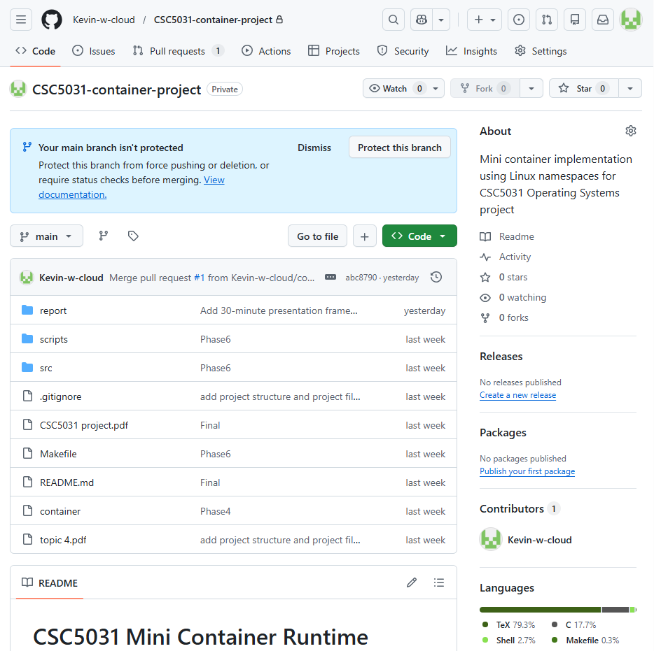
GitHub repository
Notes:
We created a GitHub repository for this group project.
You can find all the source code inside the src directory.
Our development process is divided into six stages, and each stage corresponds to a specific function.
After completing each stage, we committed the code to GitHub, so the entire development process is clearly recorded.

Slide 14
LIVE DEMO
Demonstration
A
Basic Run
B
Isolation Check
Foundation
Comparison
hostname verification
Host vs Container side-by-side
PID = 1 inside container
All 5 namespaces verified
C
Memory Limit
D
Alpine Rootfs
Cgroups
Filesystem
50MB memory limit
Alpine Linux environment
OOM Kill demonstration
Complete filesystem isolation
ENVIRONMENT CHECKLIST
WSL2 Ubuntu 5.15+
Compiled ./container
rootfs ready
Two terminals ready
Notes:
Next, I will demonstrate our implementation step by step.
The demo consists of four parts:
Basic container setup
Isolation verification
Memory limitation
Root filesystem integration
For each step, I will show the commands we use and the expected results.

Slide 15
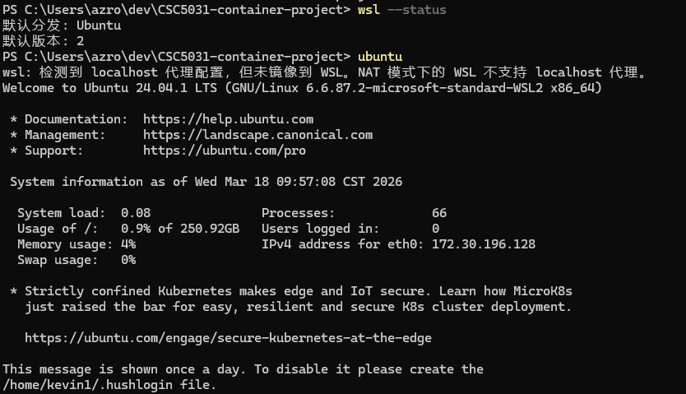
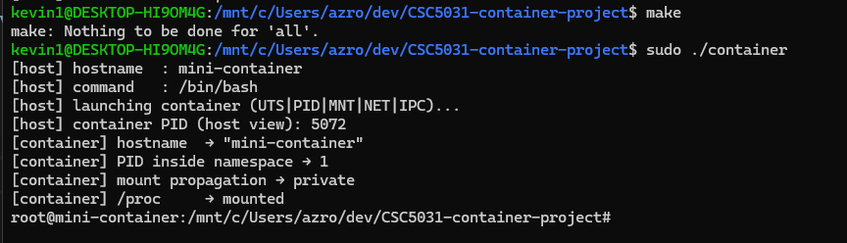
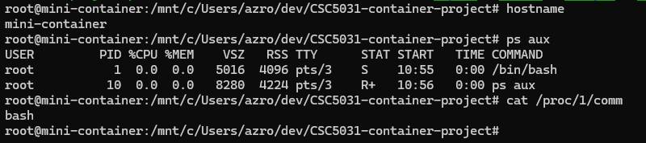
DEMO A
Basic Container Run
Verifying UTS, PID, and Mount Isolation
COMMAND
VERIFICATION COMMANDS
$ sudo ./container
✓ hostname = mini-container
EXPECTED OUTPUT
$ hostname
mini-container
[host] hostname : mini-container
[host] command : /bin/bash
[host] launching container (UTS|PID|MNT|NET|IPC)...
✓ PID = 1 (inside container)
[host] container PID (host view): 12345
[container] hostname → "mini-container"
$ ps aux
PID USER COMMAND
[container] PID inside namespace → 1
1 root /bin/bash
[container] mount propagation → private
7 root ps aux
[container] /proc → mounted
root@mini-container:/#
✓ /proc/1/comm = bash
$ cat /proc/1/comm
bash
/proc correctly mounted in container's PID namespace
Notes:
For this demonstration, I am using a Windows machine with the built-in WSL Linux environment.
First, I navigate to the project directory and compile the code using the make command.
Now, I start our basic container.
Inside the container, I run several commands to verify the isolation:
I check the hostname
I inspect the shell process
And I examine the init process
As we can see here, the hostname has already been changed to the container name.
When I run ps, the shell process appears as PID 1, which indicates that it is the first process inside the container.
Additionally, when we check /proc/1/comm, it corresponds to the container’s init process, rather than the host’s systemd.
This demonstrates that UTS, PID, and MNT are working correctly.

Slide 16
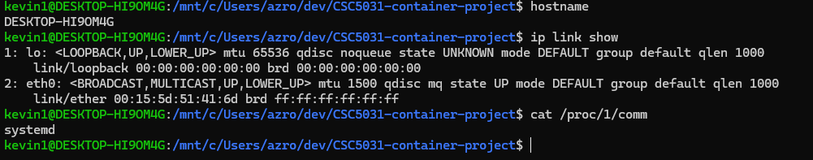
DEMO B
Host vs Container
Side-by-Side Isolation Verification
COMPARISON (Execute simultaneously in two terminals)
Container
Host
Inside namespace
Parent namespace
$ hostname
$ hostname
mini-container
ubuntu
$ ps aux | wc -l
$ ps aux | wc -l
3
150+
bash + ps + header
All system processes
$ cat /proc/1/comm
$ cat /proc/1/comm
bash
systemd
$ ip link show
$ ip link show
1: lo: ...
1: lo: ...
Only loopback
2: eth0: ...
3: wlan0: ...
$ ipcs -m
(empty table)
$ ipcs -m
(may show IPC objects)
Conclusion: Two completely different worlds
Notes:
Next, we perform a side-by-side comparison using two terminals.
In another Linux terminal, which represents the host environment, I run the same set of commands.
Inside the container, we can see that the network interface only includes the loopback device.
However, on the host machine, we still have real network interfaces, such as eth0.
We can also observe that the hostname inside the container is different from the host.
In addition, the host’s PID 1 process is still systemd, and it is not affected by the container.
This demonstrates that the isolation is both effective and bidirectional, meaning the container is isolated from the host, and the host remains unaffected by the container.

Slide 17
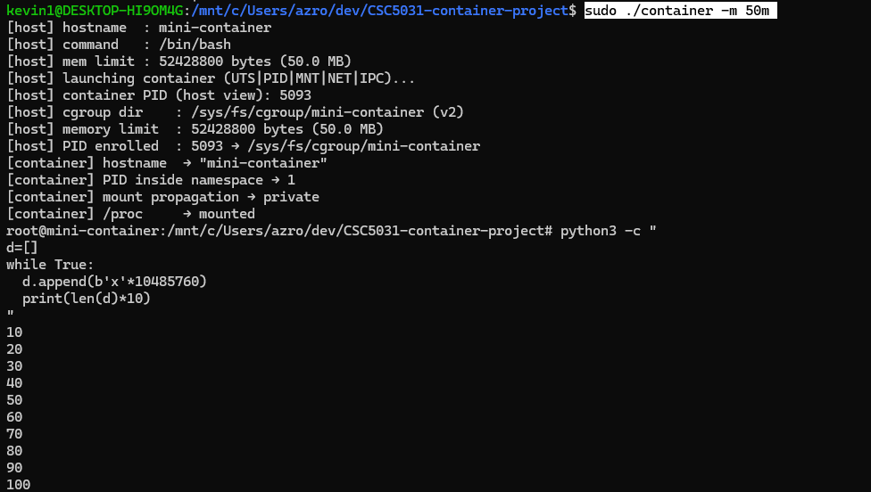
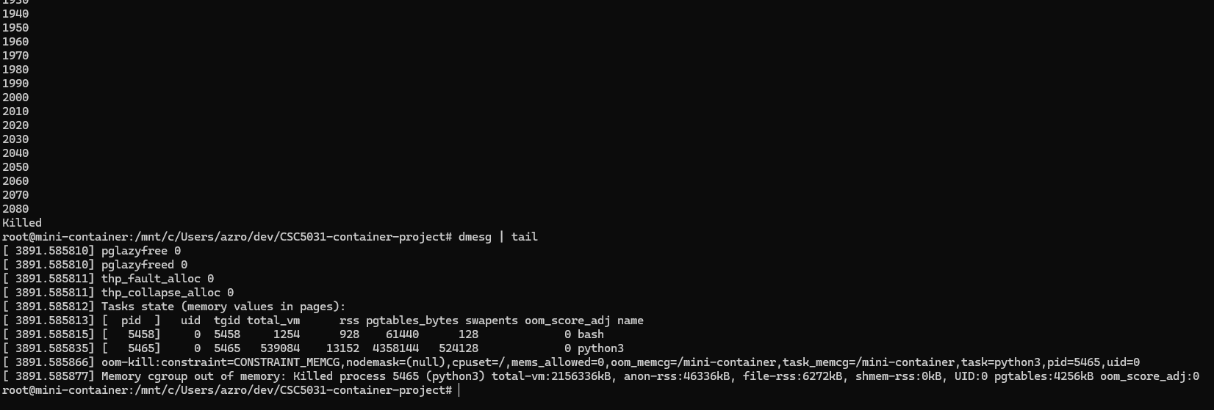
DEMO C
Memory Limit with Cgroups
OOM Kill Demonstration — Precise Resource Control
LAUNCH CONTAINER (50MB LIMIT)
$ sudo ./container -m 50m
STARTUP OUTPUT
[host] mem limit : 52428800 bytes (50.0 MB)
[host] cgroup dir: /sys/fs/cgroup/.../mini-container
[host] PID enrolled: 12345 → cgroup.procs
MEMORY USAGE PROGRESSION
10MB
20MB
30MB
40MB
50MB
Killed
Notes:
Now, I will demonstrate memory limitation using cgroups.
First, I set the memory limit of the container to 50 MB.
Then, I run a test script inside the container that continuously allocates memory.
As we can observe, once the memory usage exceeds the limit, the process is automatically killed by the system.
This behavior is expected under cgroup memory control.
Importantly, the host system remains stable and unaffected throughout this process.

Slide 18
DEMO D
Alpine Rootfs
Complete Filesystem Isolation with pivot_root
LAUNCH ALPINE CONTAINER
VERIFICATION
$ sudo ./container -r rootfs/
✓ Alpine Version
/ # cat /etc/alpine-release
STARTUP OUTPUT
3.21.0
/ # cat /etc/os-release | head -3
[host] command: /bin/sh (Alpine has no bash)
NAME="Alpine Linux"
[host] rootfs : rootfs/
ID=alpine
[container] rootfs → "rootfs/" (pivot_root done)
VERSION_ID=3.21.0
/ # ← Alpine prompt
✓ Alpine Directory Tree
ALPINE ENVIRONMENT
/ # ls /
Alpine Linux
bin dev etc home lib media mnt opt proc root run sbin srv sys tmp usr var
Version 3.21.0
Lightweight, security-focused Linux distribution
✓ Host Filesystem Invisible
/ # ls /snap
ls: cannot access '/snap': No such file or directory
/ # ls /home
(empty — Alpine has no preset users)
Host's /home is completely isolated
Conclusion: A completely independent Alpine Linux system
Notes:
Finally, I will demonstrate root filesystem integration.
First, we prepare an Alpine Linux root filesystem.
Then, we start the container using the -r option to enable rootfs support.
Inside the container, we check the system version information, and we can see that it is now Alpine Linux.
The directory structure has also changed to match the Alpine user space.
This indicates that the root filesystem has been successfully switched, and the file system isolation is working as expected.
Together with namespaces and cgroups, this completes a fully functional lightweight container.

Slide 19
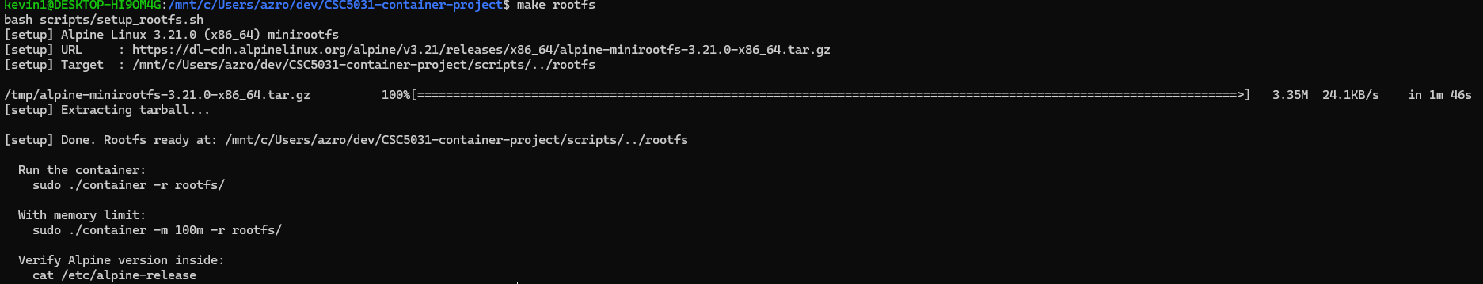
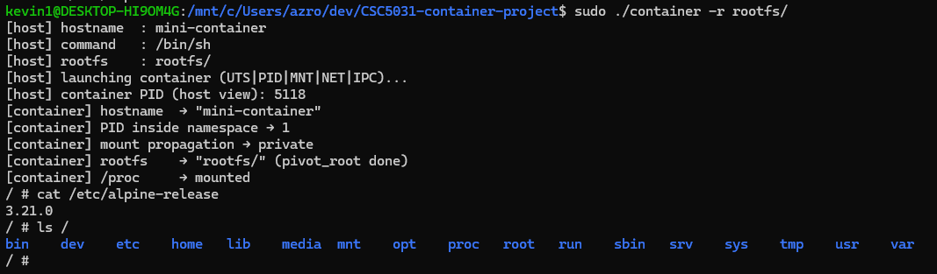
DEMO D
Alpine Rootfs

Slide 20
CHALLENGES
Key Challenges
5 Engineering Problems & Solutions
Mount Propagation Leak
4
Timing Synchronization
1
Problem: mount /proc pollutes host
Problem: cgroup config may lag container startup
Cause: Ubuntu default MS_SHARED
Cause: Race condition in parent-child
Solution: mount(MS_REC | MS_PRIVATE)
Solution: Pipe sync — config first, then signal go
Cgroup v1/v2 Compatibility
5
Permissions & Capabilities
2
Problem: Ubuntu 20.04 vs 22.04 paths differ
Problem: "Operation not permitted"
Cause: Different cgroup versions
Cause: Requires CAP_SYS_ADMIN
Solution: Auto-detect cgroup.controllers
Solution: Early check_root() with clear message
3
pivot_root Constraints
Most Subtle Bug
Problem: "Invalid argument" error
Cause: new_root must be independent mount point
Solution: mount --bind new_root new_root
Notes:
This slide summarizes the key engineering challenges we encountered during the implementation, along with our solutions.
First, we faced a mount propagation leak issue.
When mounting /proc inside the container, it unintentionally affected the host system.
This was caused by Ubuntu’s default shared mount configuration.
We resolved this by remounting with MS_PRIVATE, which prevents propagation.
Second, we dealt with cgroup v1 and v2 compatibility.
Different Ubuntu versions use different cgroup layouts, which can break our code.
To address this, we implemented automatic detection of cgroup controllers, making our solution more portable.
Third, we encountered constraints with pivot_root.
The system may return an “invalid argument” error if the new root is not a proper mount point.
We fixed this by using a bind mount to ensure the new root is valid.
Fourth, we had a timing synchronization issue between the parent and child processes.
If cgroup configuration is delayed, the container may start without proper limits.
We solved this using pipe-based synchronization, ensuring configuration happens before execution.
Finally, we handled permission and capability issues.
Some operations require elevated privileges such as CAP_SYS_ADMIN.
We added an early root privilege check with clear error messages to improve usability.
Overall, these challenges reflect the complexity of working directly with low-level kernel features.

Slide 21
TAKEAWAYS
Key Insights
Three Levels of Learning
Technical
Engineering
Architecture
Namespaces solve "what can be seen"
Syscall error handling is critical
Understand Docker/containerd/runc layers
View isolation, not full isolation. Must combine with MS_PRIVATE to prevent leaks.
Every syscall can fail. Unified error handling improves code quality.
Clear separation of concerns: CLI, lifecycle, runtime, kernel.
Cgroups solve "how much can be used"
Timing sync is concurrency foundation
Resource limits are key to production readiness. OOM provides precise isolation.
Parent-child coordination requires careful synchronization primitives.
Container is special process, not light VM
Shares kernel, uses namespaces for isolation, cgroups for limits.
pivot_root solves "where to live"
Version compatibility cannot be ignored
More secure than chroot. Unmounting old root prevents escape.
Cgroup v1/v2 differences require runtime detection and adaptation.
Master kernel perspective on isolation
View isolation from kernel's point of view, not just user space.
Core Insight: Container = Namespaces + Cgroups + pivot_root
Shared kernel + Strong isolation + Lightweight & fast
Notes:
This slide summarizes the key insights we gained from this project, across three levels: technical, engineering, and architectural.
From a technical perspective, we learned that
namespaces control what a container can see,
cgroups control how much resources it can use,
and pivot_root defines where the container lives in terms of filesystem.
From an engineering perspective, we realized that
handling system call errors is critical,
synchronization between processes must be carefully designed,
and compatibility across different system versions cannot be ignored.
From an architectural perspective, we now better understand the container stack, including Docker, containerd, and runc.
More importantly, we see that a container is essentially a process with isolation, rather than a lightweight virtual machine.
Overall, this project helped us understand containerization from the kernel level, not just from user-space tools.
To conclude, the core insight is:
A container is built from namespaces, cgroups, and pivot_root,
achieving lightweight yet strong isolation on top of a shared kernel.

Slide 22
Project Completion
MANDATORY FEATURES
PID Namespace
MNT Namespace
UTS Namespace
NET Namespace
IPC Namespace
ps aux verification
OPTIONAL FEATURES
Option A: Cgroups memory limit + OOM Kill
Option B: Rootfs + pivot_root (Alpine Linux)
PROJECT SCALE
~460
6
100%
Lines of C
Phases
Coverage
Notes:
For the mandatory features, we successfully implemented multiple namespaces, including PID, UTS, IPC, mount, and network namespaces.
We also verified process isolation using ps aux, ensuring that only container processes are visible.
For the optional features, we implemented cgroup-based memory limits with OOM kill, as well as root filesystem support using pivot_root with Alpine Linux.
In terms of project scale, our implementation consists of approximately 460 lines of C code, developed across six stages, with full feature coverage.
Overall, we have built a functional lightweight container system that demonstrates the core principles of modern container technology.

Slide 23
APPENDIX
Quick Reference
QUICK COMMANDS
FAQ
Build
Q: "must run as root"
$ make
A: Add sudo
Q: "clone: Operation not permitted"
Prepare rootfs
A: Confirm WSL2 Ubuntu, can sudo
$ make rootfs
Q: "ip: command not found"
A: sudo apt install iproute2
Basic run
$ sudo ./container
Q: "rootfs missing /proc"
A: mkdir -p rootfs/proc
Custom hostname
$ sudo ./container mybox
Memory limit
REFERENCES
$ sudo ./container -m 100m
man 2 clone
man 7 namespaces
man 2 pivot_root
Alpine rootfs
man 7 cgroups
$ sudo ./container -r rootfs/

