Slide 1
Operating Systems Project: Topic 5
Implement a Custom Page Replacement Policy
Team9 Lei LI
225040154@link.cuhk.edu.cn
Notes:
﻿Morning everyone. My name is Lei LI.
Today I will present our Operating Systems project, Topic 5: Implement a Custom Page Replacement Policy.
In this project, I have designed a Custom Page Replacement Policy based on the original Linux kernel by tracking page frequency.

Slide 2
Content
Motivation & Objectives
Replacement Policy Design
Experiment and Analysis
Notes:
Here are the main contents of today's presentation.

Slide 3
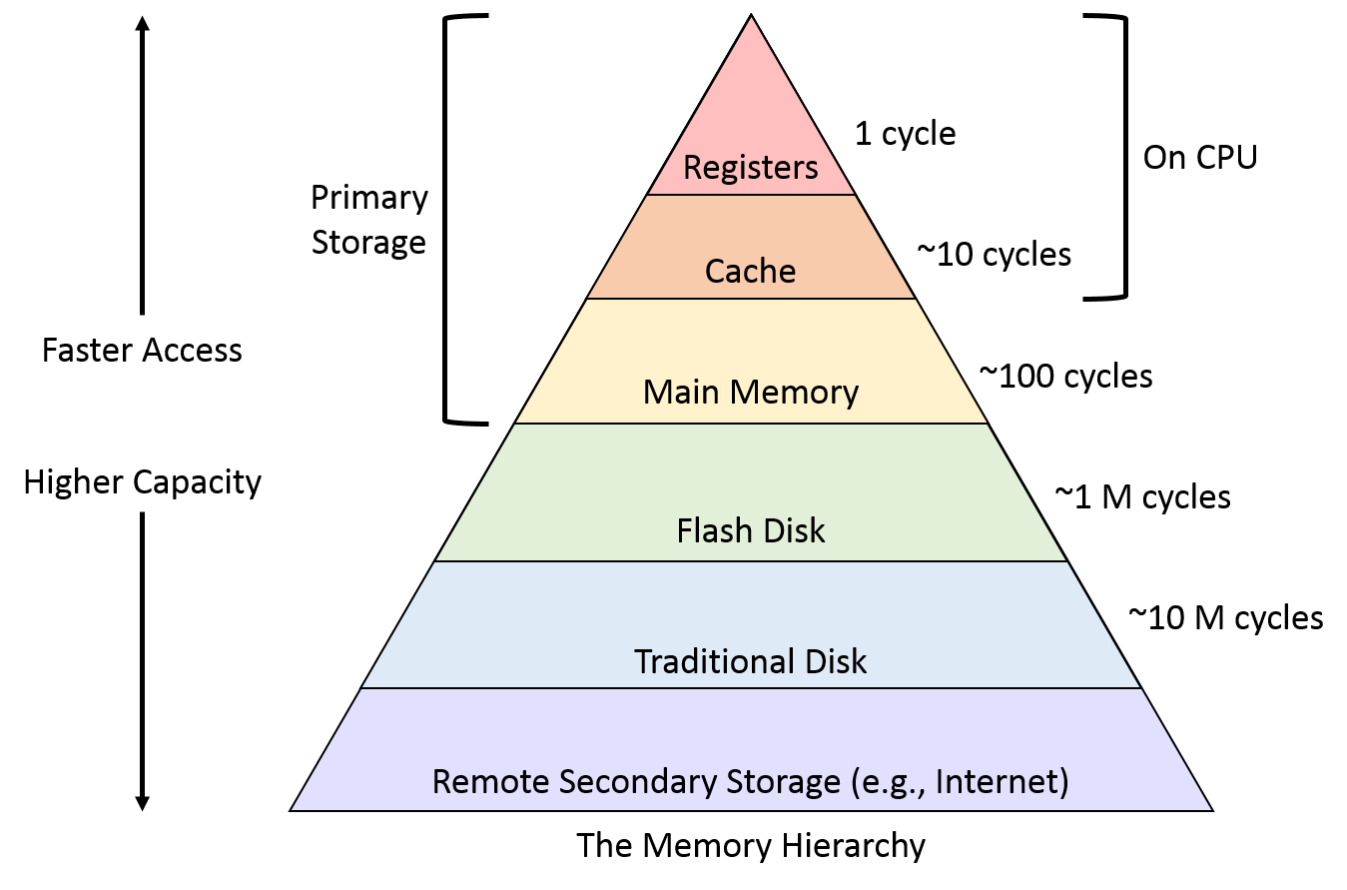
Motivation
Why do we need page replacement?
Faster storage resources are more rare.
Conflicts: available RAM < memory required by processes
Page Replacement: if memory is full and a page not currently in memory needs to be loaded, a page must be selected from memory and evicted.
Notes:
All storage resources are limited. In the structure of operating system storage, faster storage resources are even more rare.
If the available RAM is less than the memory required by a process, a conflict will occur.
Since it is I,mpossible to keep all pages in memory at the same time, if memory is full and a page not currently in memory needs to be loaded, a page must be selected from memory and evicted.

Slide 4
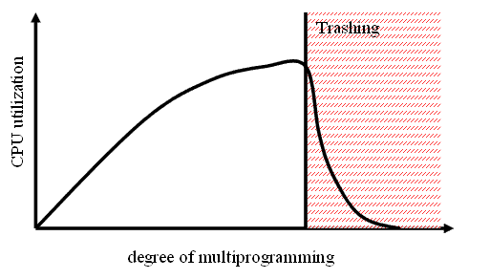
Motivation
Thrashing
Features:
High page fault rate;
Disk I/O rate approaching 100%;
Increasing the multiprogramming level, makes the situation worse.
Causes:
Too little memory allocated to the process;
Bad page replacement policy;
……
The system spends most of its time on page swapping
rather than executing the program.
Notes:
However, paging itself also comes with I/O costs.
Thrashing refers to a situation where the system spends most of its time on paging rather than executing the program.
Characteristics of thrashing include:
- High page fault rate;
- Disk I/O rate approaching 100%;
While the scheduler attempts to increase CPU utilization by raising the multiprogramming level, but this makes the situation worse.
Causes of thrashing include:
- Too little memory allocated to the process;
And also Bad page replacement policy;
Therefore, it is necessary to design an appropriate page replacement strategy.

Slide 5
Goals
Implement an alternative policy;
Display the page replacement behavior and page status through the GUI;
Testing page faults and thrashing points under varying memory loads.
Notes:
In addition to implementing an alternative strategy, the goals also include:
make a GUI to display the page replacement behavior and page status;
And
Testing page faults and thrashing points under varying memory loads through experiments.

Slide 6
Typical page replacement strategies
OPT(The Optimal)
Remove the pages that are least likely to be accessed in the near future.
Impossible to implement.
FIFO(First In First Out)
Belady’s Anomaly
LRU(Least Recently Used)
Scan Pollution:
A single, large-scale scan pushes frequently accessed “hot pages” out of the list.
LFU(Least Frequently Used)
Prevent Scan Pollution
Notes:
OPT:
- The ideal page replacement strategy is to remove the pages that are least likely to be accessed in the near future.
- However, since it is impossible to predict the future, this strategy cannot be implemented.
In addition, other common page replacement strategies include First In First, LRU and LFU.
LRU:
LRU is a classic algorithm that evicts the page that has not been accessed for the longest time.
It is based on the assumption of temporal locality: if a page has not been accessed for a long time, it is unlikely to be accessed in the future.
LFU:
LFU, on the other hand, removes the least-visited pages.
Scan pollution refers to a single, large-scale scan that pushes frequently visited hot pages out of the queue.
LFU can identify “long-term hot pages” while remaining insensitive to “short-term sudden visits, thereby preventing scan pollution.

Slide 7
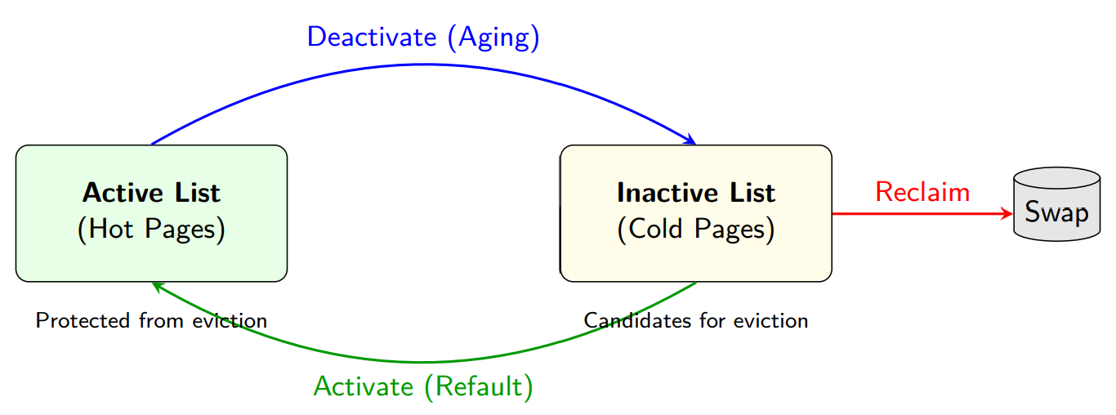
Linux's default page replacement policy
multi-list approximation of LRU
Avoids the high cost of precise LRU by using “grouping” instead of sorting;
Is resistant to scan pollution.
Notes:
For the actual project, modifications are planned to be made to Linux's default page replacement algorithm.
Linux's page replacement mechanism is a multi-list approximation of the LRU.
It maintains both an “active list” and an “inactive list.”
The system prioritizes evicting pages from the inactive list.
New pages are typically placed in the inactive list first;
If a page is accessed again, it is promoted to the active list
Pages in the active list that have not been accessed for a long time are demoted to the inactive list. This is known as the aging mechanism.
By using grouping rather than precise ordering, this strategy avoids the high overhead of the exact LRU, thereby reducing kernel complexity;
at the same time, it is resistant to scan pollution.

Slide 8
Modification: Frequency-Awareness
General Approach:
Include Tracking Access Frequency.
Intuitively closer to The Optimal.
Maintain the Active List/Inactive List.
Reduce overhead.
File | Method | Role
mm/swap.c | mark_page_accessed() | Mark the page as “Recently Visited” and move it to the active list.
mm/vmscan.c | shrink_page_list() | Returns the number of reclaimed pages.
mm/vmscan.c | shrink_active_list() | Move the page from the active list to the inactive list.
mm/vmscan.c | shrink_inactive_list() | Remove pages from the inactive list
Notes:
The main idea of the Modification of the default algorithm is:
First, we introduce Tracking Access Frequency.
This is because Access Frequency intuitively closer to the concept of the Optimal.
At the same time, the Active List and Inactive List mechanism is maintained to reduce the overhead.
From the table on the right, you can see the functions primarily associated with the algorithm.

Slide 9
void mark_page_accessed(struct page *page)
{
page = compound_head(page);
if (!PageReferenced(page)) {
SetPageReferenced(page);
/* Initialize the counter*/
if (page->private == 0)
page->private = 1;
} else {
/* When access pages, the counter increments */
if (page->private < 1024)
page->private++;
if (PageUnevictable(page)) {
/*
* Unevictable pages...
*/
} else if (!PageActive(page)) {
if (page->private >= THRESHOLD){
if (PageLRU(page))
activate_page(page);
else
__lru_cache_activate_page(page);
ClearPageReferenced(page);
workingset_activation(page);
}
}
}
if (page_is_idle(page))
clear_page_idle(page);
}
Modification
Tracking Frequency: Add a counter to the page; When the page is visited, increment counter; (use an unused field on the page)
Inactive->Active: Modify :referenced=1 -> referenced=1 && freq_count > threshold;
referenced bit indicates a recent visit;
freq_count reflects long-term visit trends;
1
1
2
Notes:
First, to track the access frequency, add a counter to the page;
when the page is visited, increment the counter;
Here use an unused field private on the page to act as the counter.
The counter's upper limit is set to 1024.
Second, I modified the conditions for moving a page from the inactive list to the active list.
Check whether the referenced bit is set to 1 and the frequency count is greater than the threshold
Here the referenced bit indicates a recent visit;
freq_count reflects long-term visit trends;

Slide 10
Modification
3. Combined Aging:
For the scanning of the inactive list, perform :
referenced bit=0
freq_count >>= 1;
static unsigned int shrink_inactive_list(...){
...
{
struct page *page;
list_for_each_entry(page, &page_list, lru) {
if (page->private > 0)
page->private >>= 1;
}
}
nr_reclaimed = shrink_page_list(&page_list, pgdat, sc, &stat, false);
spin_lock_irq(&lruvec->lru_lock);
move_pages_to_lru(lruvec, &page_list);
...
}
Notes:
Next, in combination with the aging mechanism, the counter value is shifted one bit to the right during each scan of the inactive list.
Each time the scan finds the entry for all pages, perform the shift operation.
This mechanism can gradually deactivate and remove pages that have been used frequently before, but are inactive now.

Slide 11
static unsigned long find_and_move_min_freq_page(struct list_head *page_list, unsigned long window_size){
struct page *page, *min_page = NULL;
unsigned long min_freq = ULONG_MAX;
unsigned long count = 0;
if (list_empty(page_list))
return 0;
list_for_each_entry(page, page_list, lru) {
unsigned long freq = page->private;
if (freq < min_freq) {
min_freq = freq;
min_page = page;
}
if (++count >= window_size)
break;
}
/* Move the minimum frequency page to the front for prioritized eviction */
if (min_page && min_page != list_first_entry(page_list, struct page, lru)) {
list_del(&min_page->lru);
list_add(&min_page->lru, page_list);
}
return (min_page) ? min_freq : 0;
}
Modification
4. Elimination Strategy
Scan the Inactive queue for the page with the lowest frequency within the window.
(default window size = 32)
Notes:
Instead of removing the page at the top of the Inactive list, the eviction strategy has been modified to remove the page with the lowest frequency within a scan window in the Inactive queue.
This is achieved using the function on the right, which places the page with the lowest frequency in the window at the top of the list.
The default window size is set to 32.

Slide 12
Experiment Environment
OS | Ubuntu 22.04
Kernel | Linux 5.15.0
CPUs | 6 cores
Architecture | X86
RAM | 4GB
Notes:
The experiment is based on Ubuntu 22.04
It is noted that the experiment system uses Linux 5.15.0 instead of Linux 6.8.0.
The system has 4 GB of RAM.

Slide 13
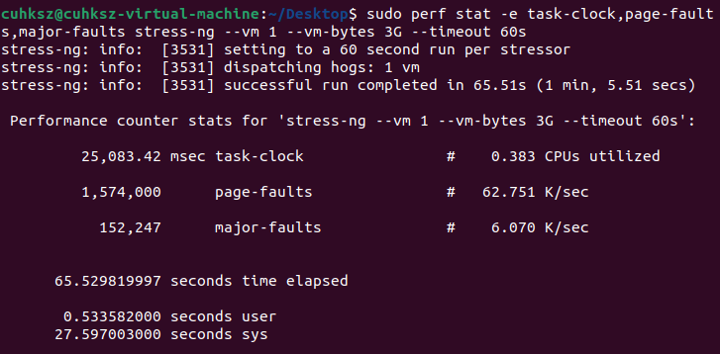
Experiment
Use perf to monitor faults
Notes:
As required by the project, we used the `pref` command to monitor several key metrics, including:
Task-clock and CPUs utilized;
The page-faults and major-faults.
As shown in the figure, after applying 3 GB of memory pressure, the system output displayed low CPU utilization and high major-faults values.

Slide 14
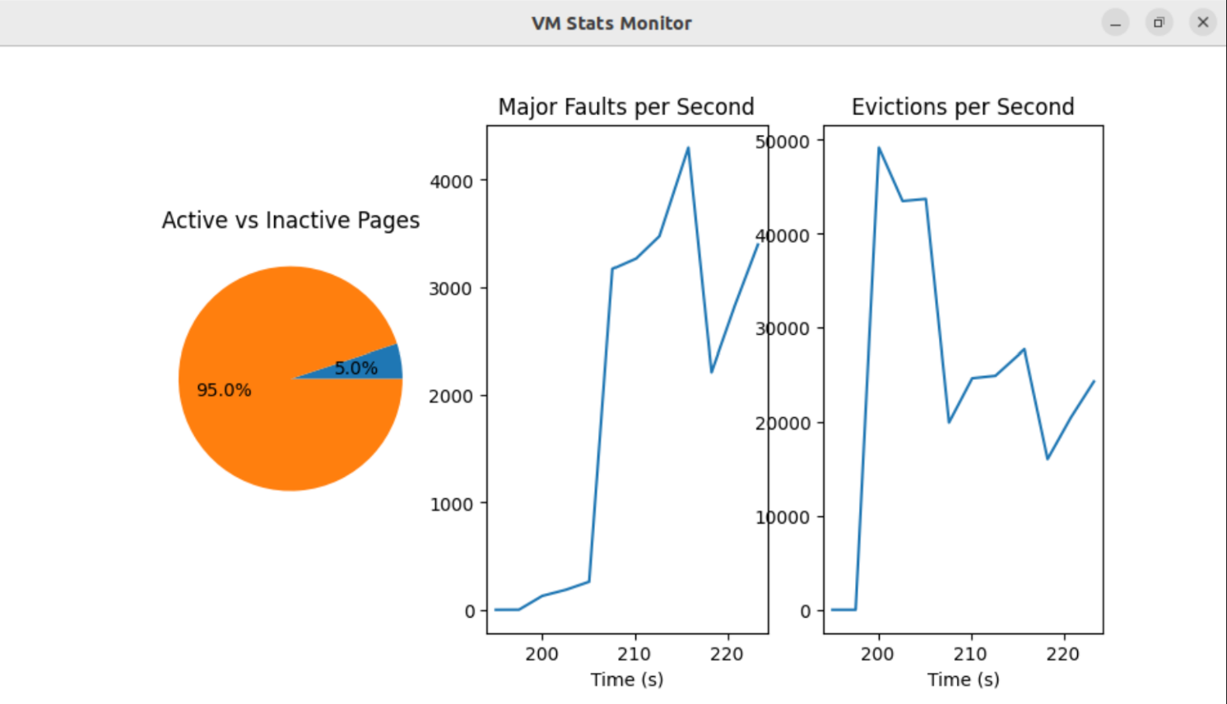
Experiment
GUI displaying real-time page status.
Data Sources for Visualization: /proc/vmstat
Active vs Inactive;
Major Faults in recent 30 seconds;
Evicitions in recent 30 seconds;
Notes:
To provide a visual display of the page's status, a GUI has been implemented.
The program reads data from the /proc/vmstat file every 2.5 seconds.
It plots the number of pages in the active and inactive lists as a pie chart, and plots major faults and evictions from the past 30 seconds as a line chart.

Slide 15
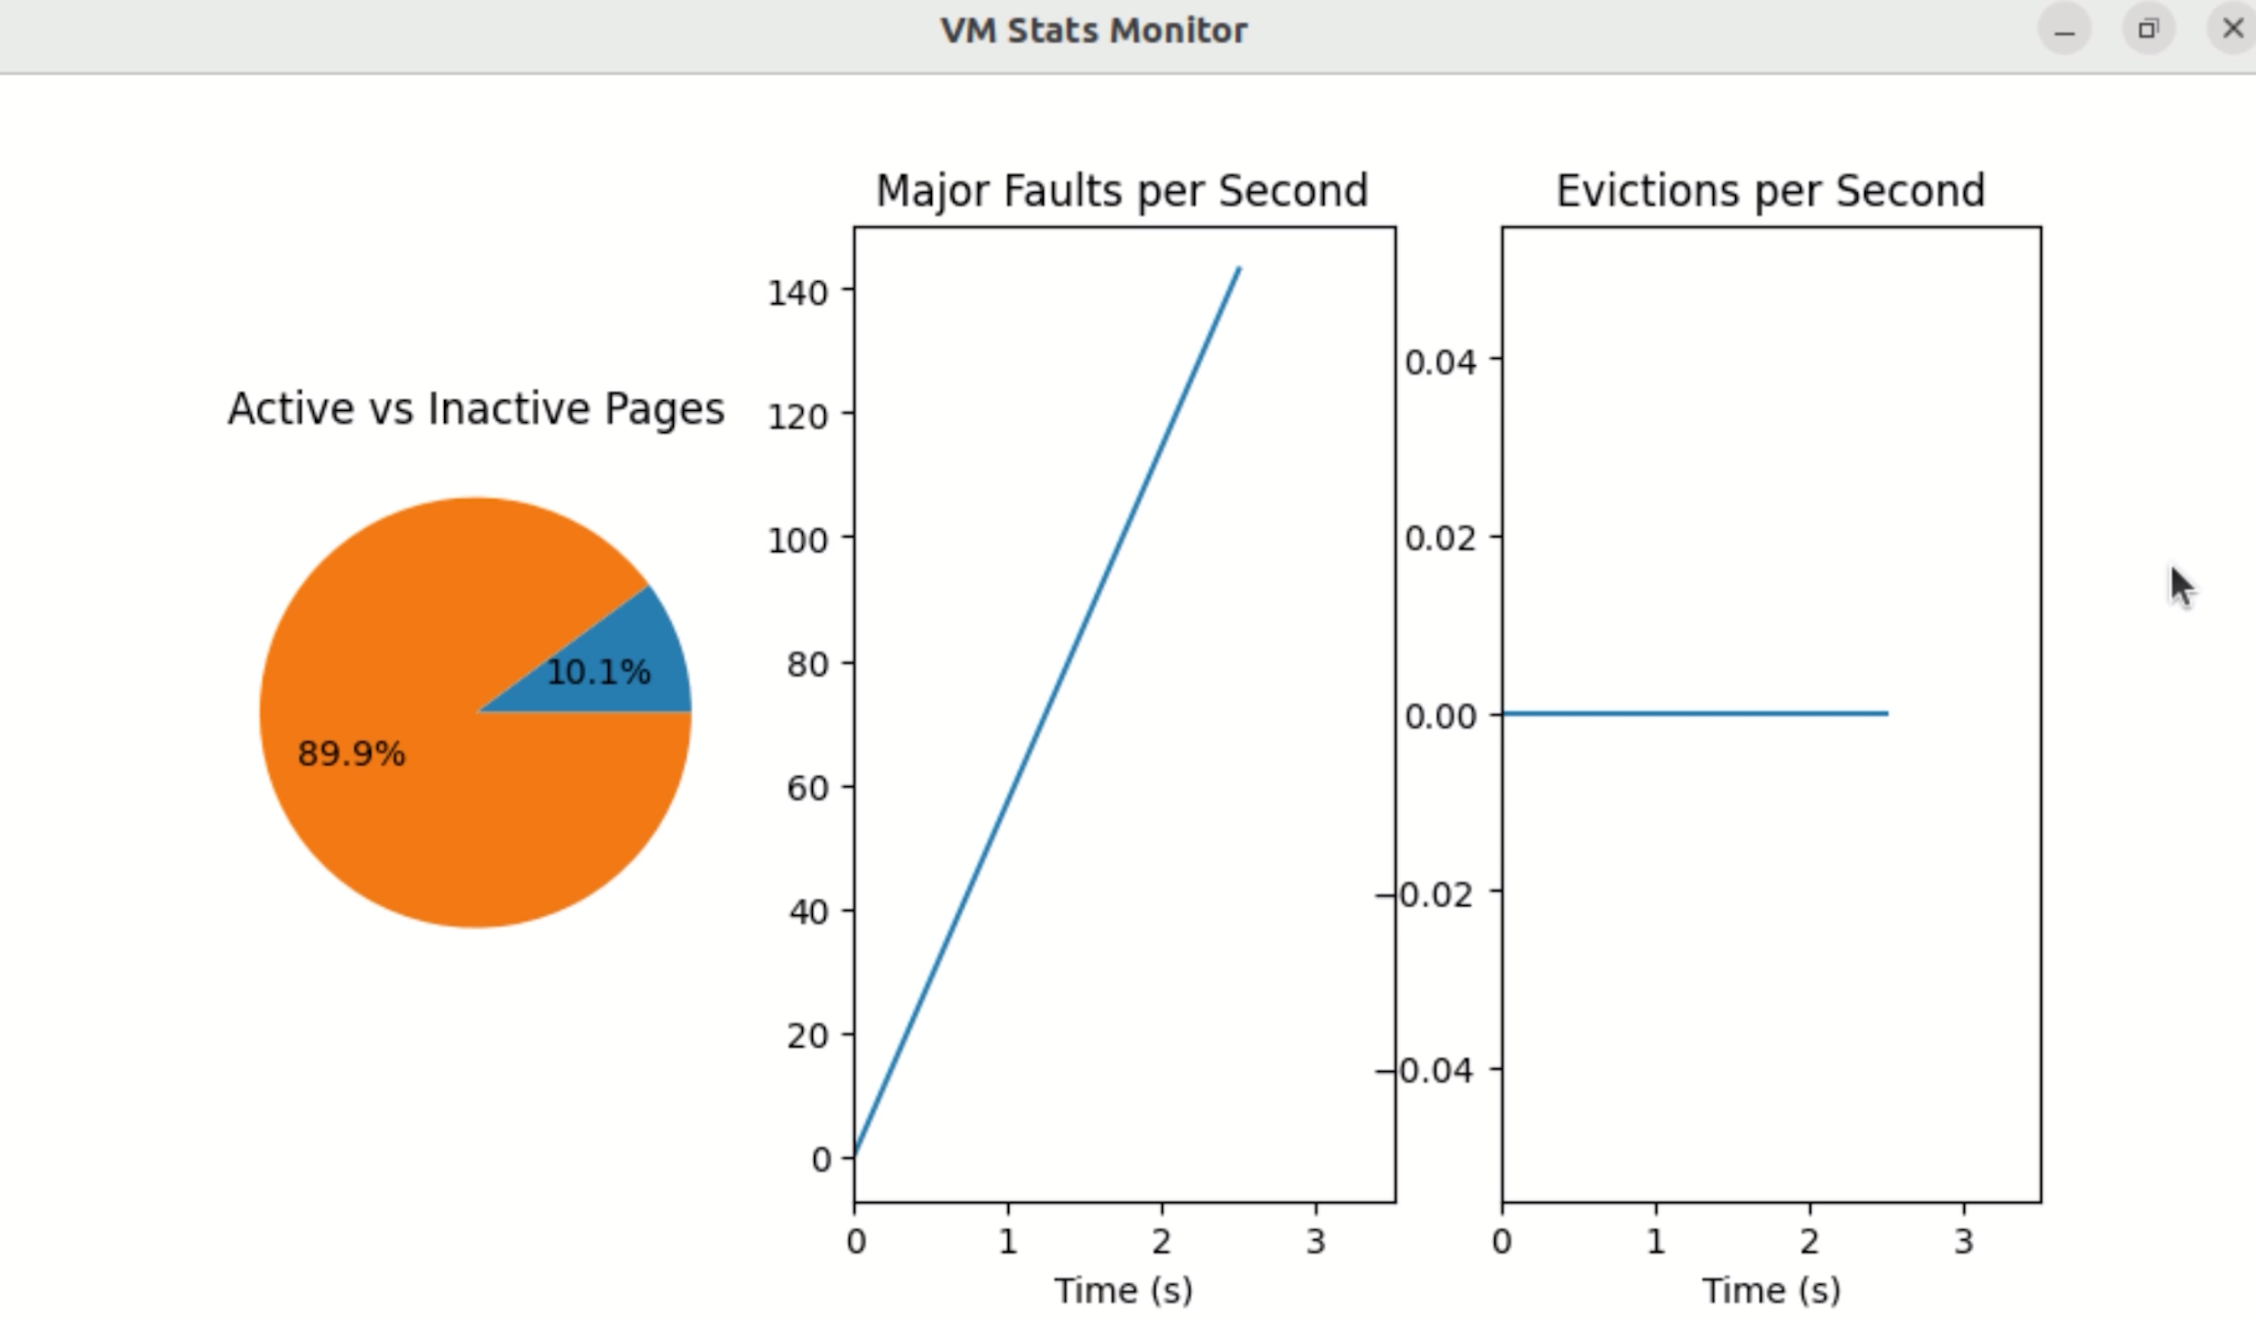
Experiment
GUI displaying real-time page status.
Notes:
The following video show how it works. It plays at double speed.
Initially, the system is in an idle state with no user programs loaded.
After applying a 3GB memory load, several metrics began to show significant changes.
When it was over, the images returned to calm.

Slide 16
Experiment
Testing page faults and thrashing points
Notes:
In addition, I tested how the major faults per second and CPU utilization changed under varying memory pressure.
As shown in the graph, when memory pressure reaches 2.9 GB, major faults increase significantly, while CPU utilization drops noticeably. So we can find where the thrashing start.
Then as the memory pressure increased, the major faults increase.
After the memory pressure increased to 3.5GB, CPU utilization increases, because the system spends more time handling page faults and memory reclaim, rather than executing useful application logic.

Slide 17
Future Work
Improvements: Resolve stale hot pages;
Parameter optimization: window size and threshold are currently set to fixed default values;
Further reduction of overhead;
Notes:
Finally, there is still some work to be done.
Pages that were once “hot” may remain in the active state for a long time, which called stale hot pages.
The window size and threshold are currently set to fixed default values.
It may be necessary to determine the appropriate values through experimentation or to design a dynamic adjustment mechanism.
and costs need to be further reduced.

Slide 18
THANKS
Notes:
Thank you for listening. Questions are welcome.

