Slide 1


Investigating and Tuning
the Linux Buddy Allocator
CSC5031 Operating Systems — Topic 6 Project
Tangjun Su 225040133
Yingyun Zhang 225040127

Slide 2
OUTLINE
Motivation & Background
Project Objectives
Implementation & Evaluation
Conclusion
Q&A

Slide 3
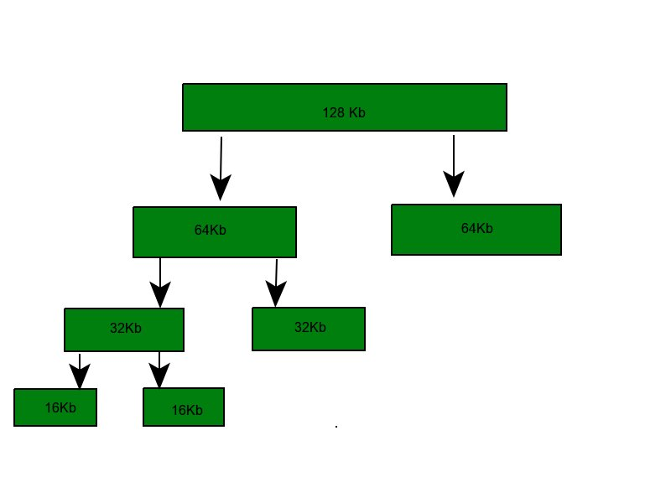
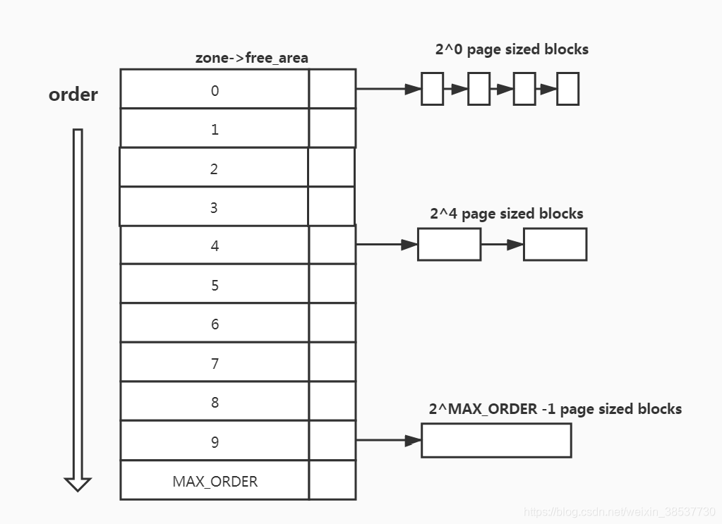
Motivation & Background
The Linux Buddy Allocator
Core Mechanism:
Grouping pages into blocks of powers of two.
The Fast Path:
Incredibly fast allocation and freeing by splitting or merging paired "buddy" blocks.
The Limitation:
Does not inherently prevent the scattering of in-use pages over time.

Slide 4
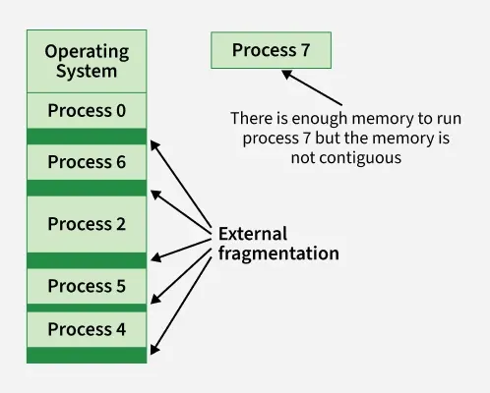
Motivation & Background
The External Fragmentation Crisis
The "Swiss Cheese" Effect:
Their buddies are still in use, so the blocks cannot merge.
The Consequence:
Fail to allocate even a single contiguous block.

Slide 5
Motivation & Background
Why High-Order Allocations Matter
Modern workload Demands
Transparent Huge Pages (THP)
I/O and Networking
Impact of Failure

Slide 6
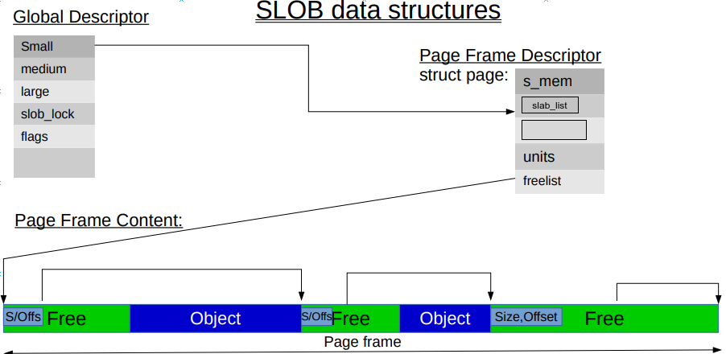
Motivation & Background
The SLOB Allocator
Architecture: SLOB avoids complex cache management. Instead, it tracks partially free pages based on object size:
free_slob_small: Objects under 256 Bytes.
free_slob_medium: Objects under 1024 Bytes.
free_slob_large: Objects up to PAGE_SIZE.
The Trade-off: Simplest, but using SLOB can end up in a state of heavy memory fragmentation over time.

Slide 7
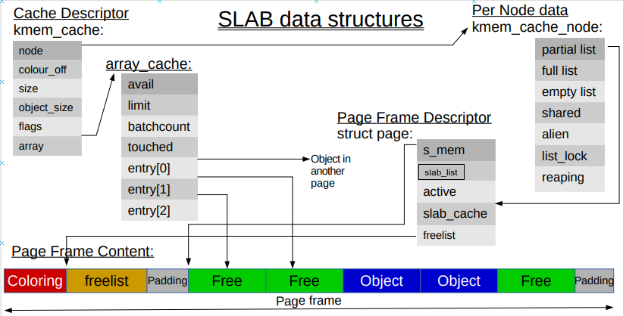
Motivation & Background
The SLAB Allocator
Evolution: SLAB creates "Dedicated" caches for frequently used kernel structures
CPU Cache Optimization: It utilizes a per-CPU array cache with LIFO.

Slide 8
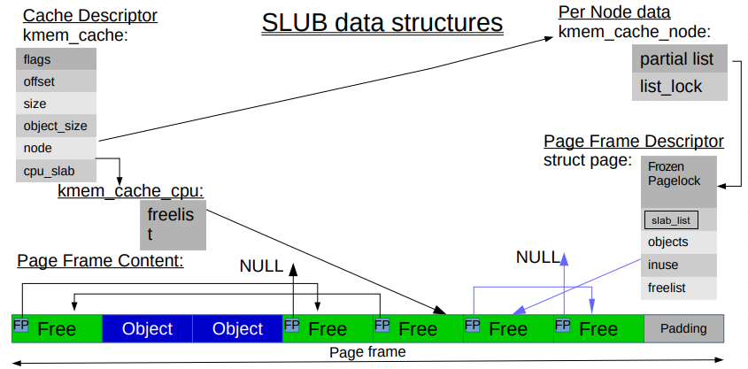
Motivation & Background
The SLUB Allocator
The Standard: SLUB is the default slab allocator using in Linux.
Using TLB and Dual-Freelist System as Optimization.

Slide 9
OUTLINE
Motivation & Background
Project Objectives
Implementation & Evaluation
Conclusion
Q&A

Slide 10
Project Objectives
Project Goals
Analyze the internal mechanics of the Slab, Slub, and Buddy allocators
Rewrite core allocation logic to optimize for high-concurrency workloads

Slide 11
Project Objectives
Requirements
Mandatory
Monitor Buddy System allocation patterns
Design and inject an adaptive algorithm into the kernel
Advanced
Dynamically adjust behavior by a Fragmentation Threshold
Compare performance of SLAB vs. SLUB vs. SLOB

Slide 12
OUTLINE
Motivation & Background
Project Objectives
Implementation & Evaluation
Conclusion
Q&A

Slide 13
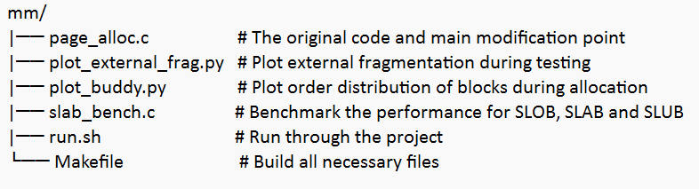
Implementation & Evaluation
System Architecture
File Structure

Slide 14
Implementation & Evaluation
Breakthrough Point:
mm/page_alloc.c
It implements the Buddy System algorithm.
Key Components:
__alloc_pages_nodemask():
“the ‘heart’ of the zoned buddy allocator”
get_page_from_freelist():
Fast path, based on the symbol set and allocation order
__alloc_pages_slowpath():
Slow path, wakes up kswapd to use direct compaction

Slide 15
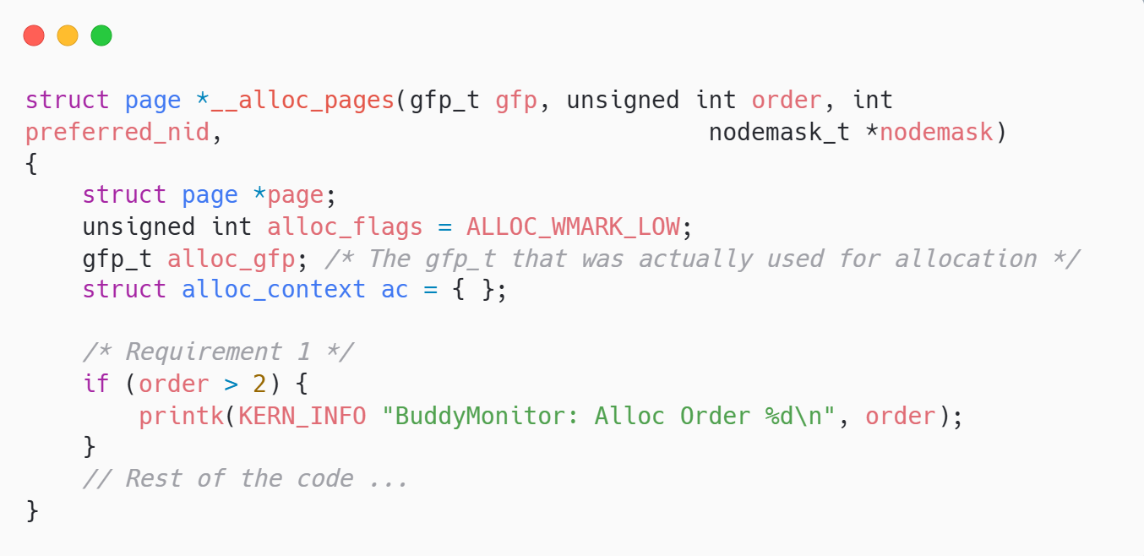
Implementation & Evaluation
Requirement 1 - The Monitor
Goal:
Track allocation patterns to understand system noise.
Action:
Inserted kernel probes to capture order requests.

Slide 16
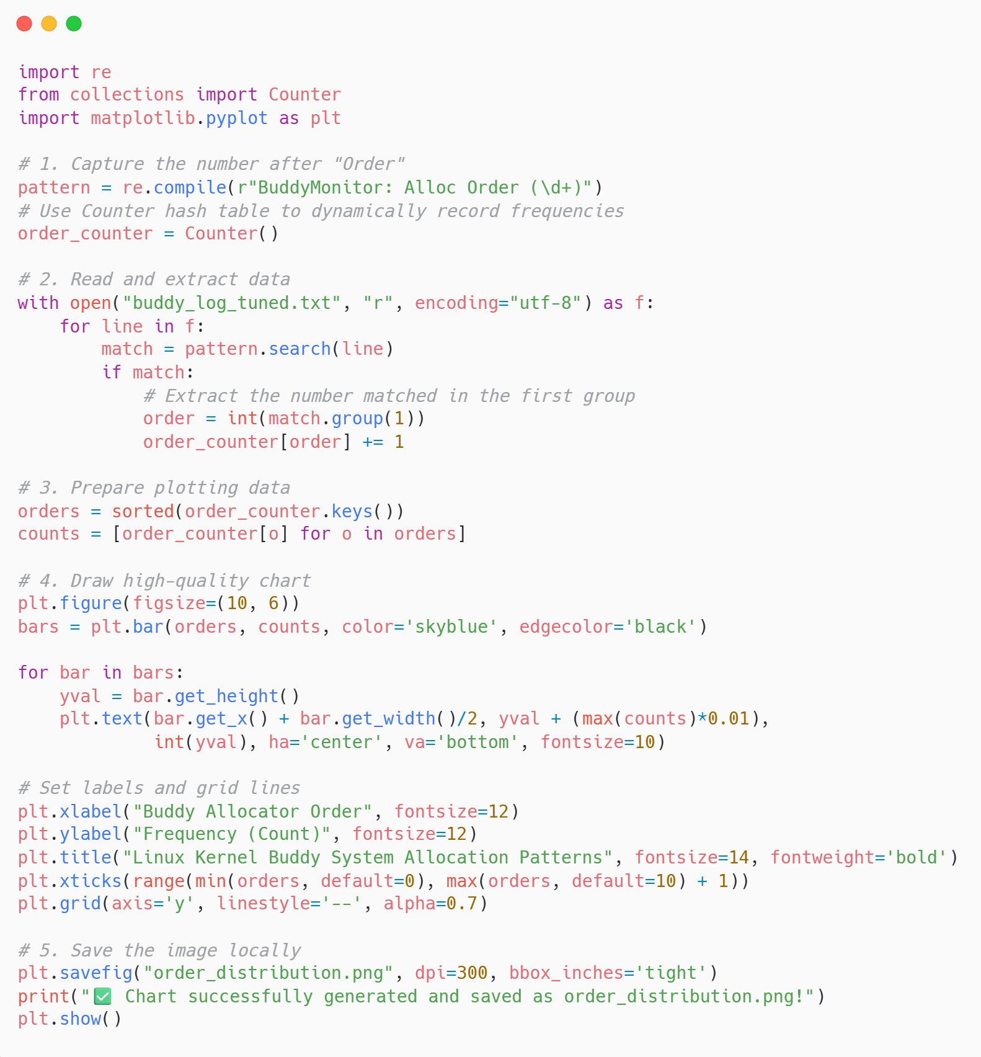
Implementation & Evaluation
Requirement 1 - The Monitor
We wrote a Python script using re and matplotlib to:
extract dmesg logs
parse the BuddyMonitor outputs dynamically.

Slide 17
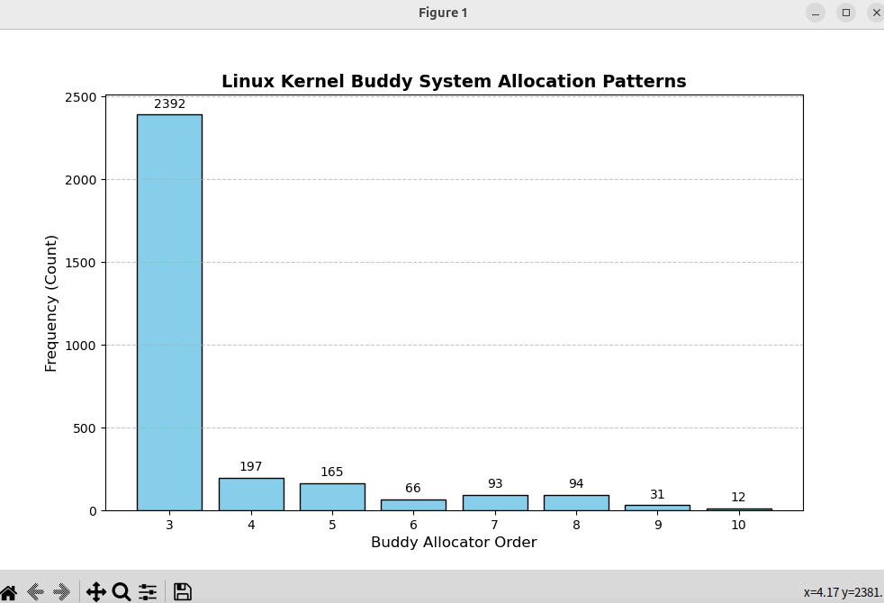
Implementation & Evaluation
Monitor Result
Classic long-tail distribution.
High volume of Order-3 (2,392 requests).
Sparse but critical Order-10 (12 requests).

Slide 18
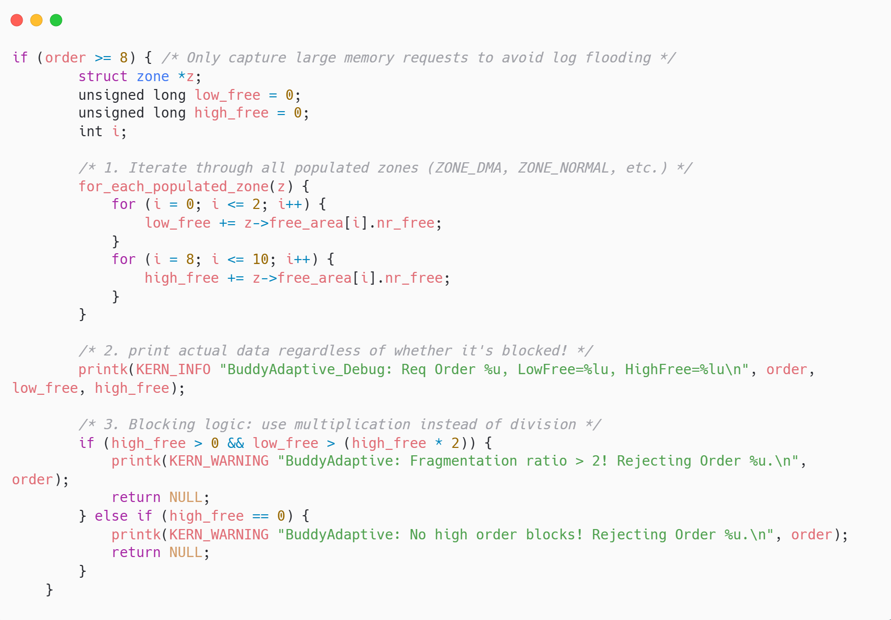
Implementation & Evaluation
Requirement 2 - Fallback Logic
Goal: Reject if Fragmented
(Low memory is > 200% of High memory)
Action: Iterates through ZONE_DMA, ZONE_NORMAL, etc.

Slide 19
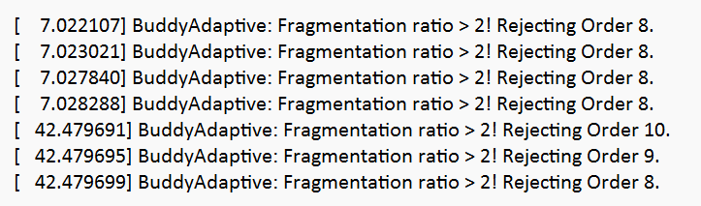
Implementation & Evaluation
Requirement 2 - Fallback Logic Result
Analysis:
When fragmentation ratio is too high, we reject the allocation of high order continuous memory.

Slide 20
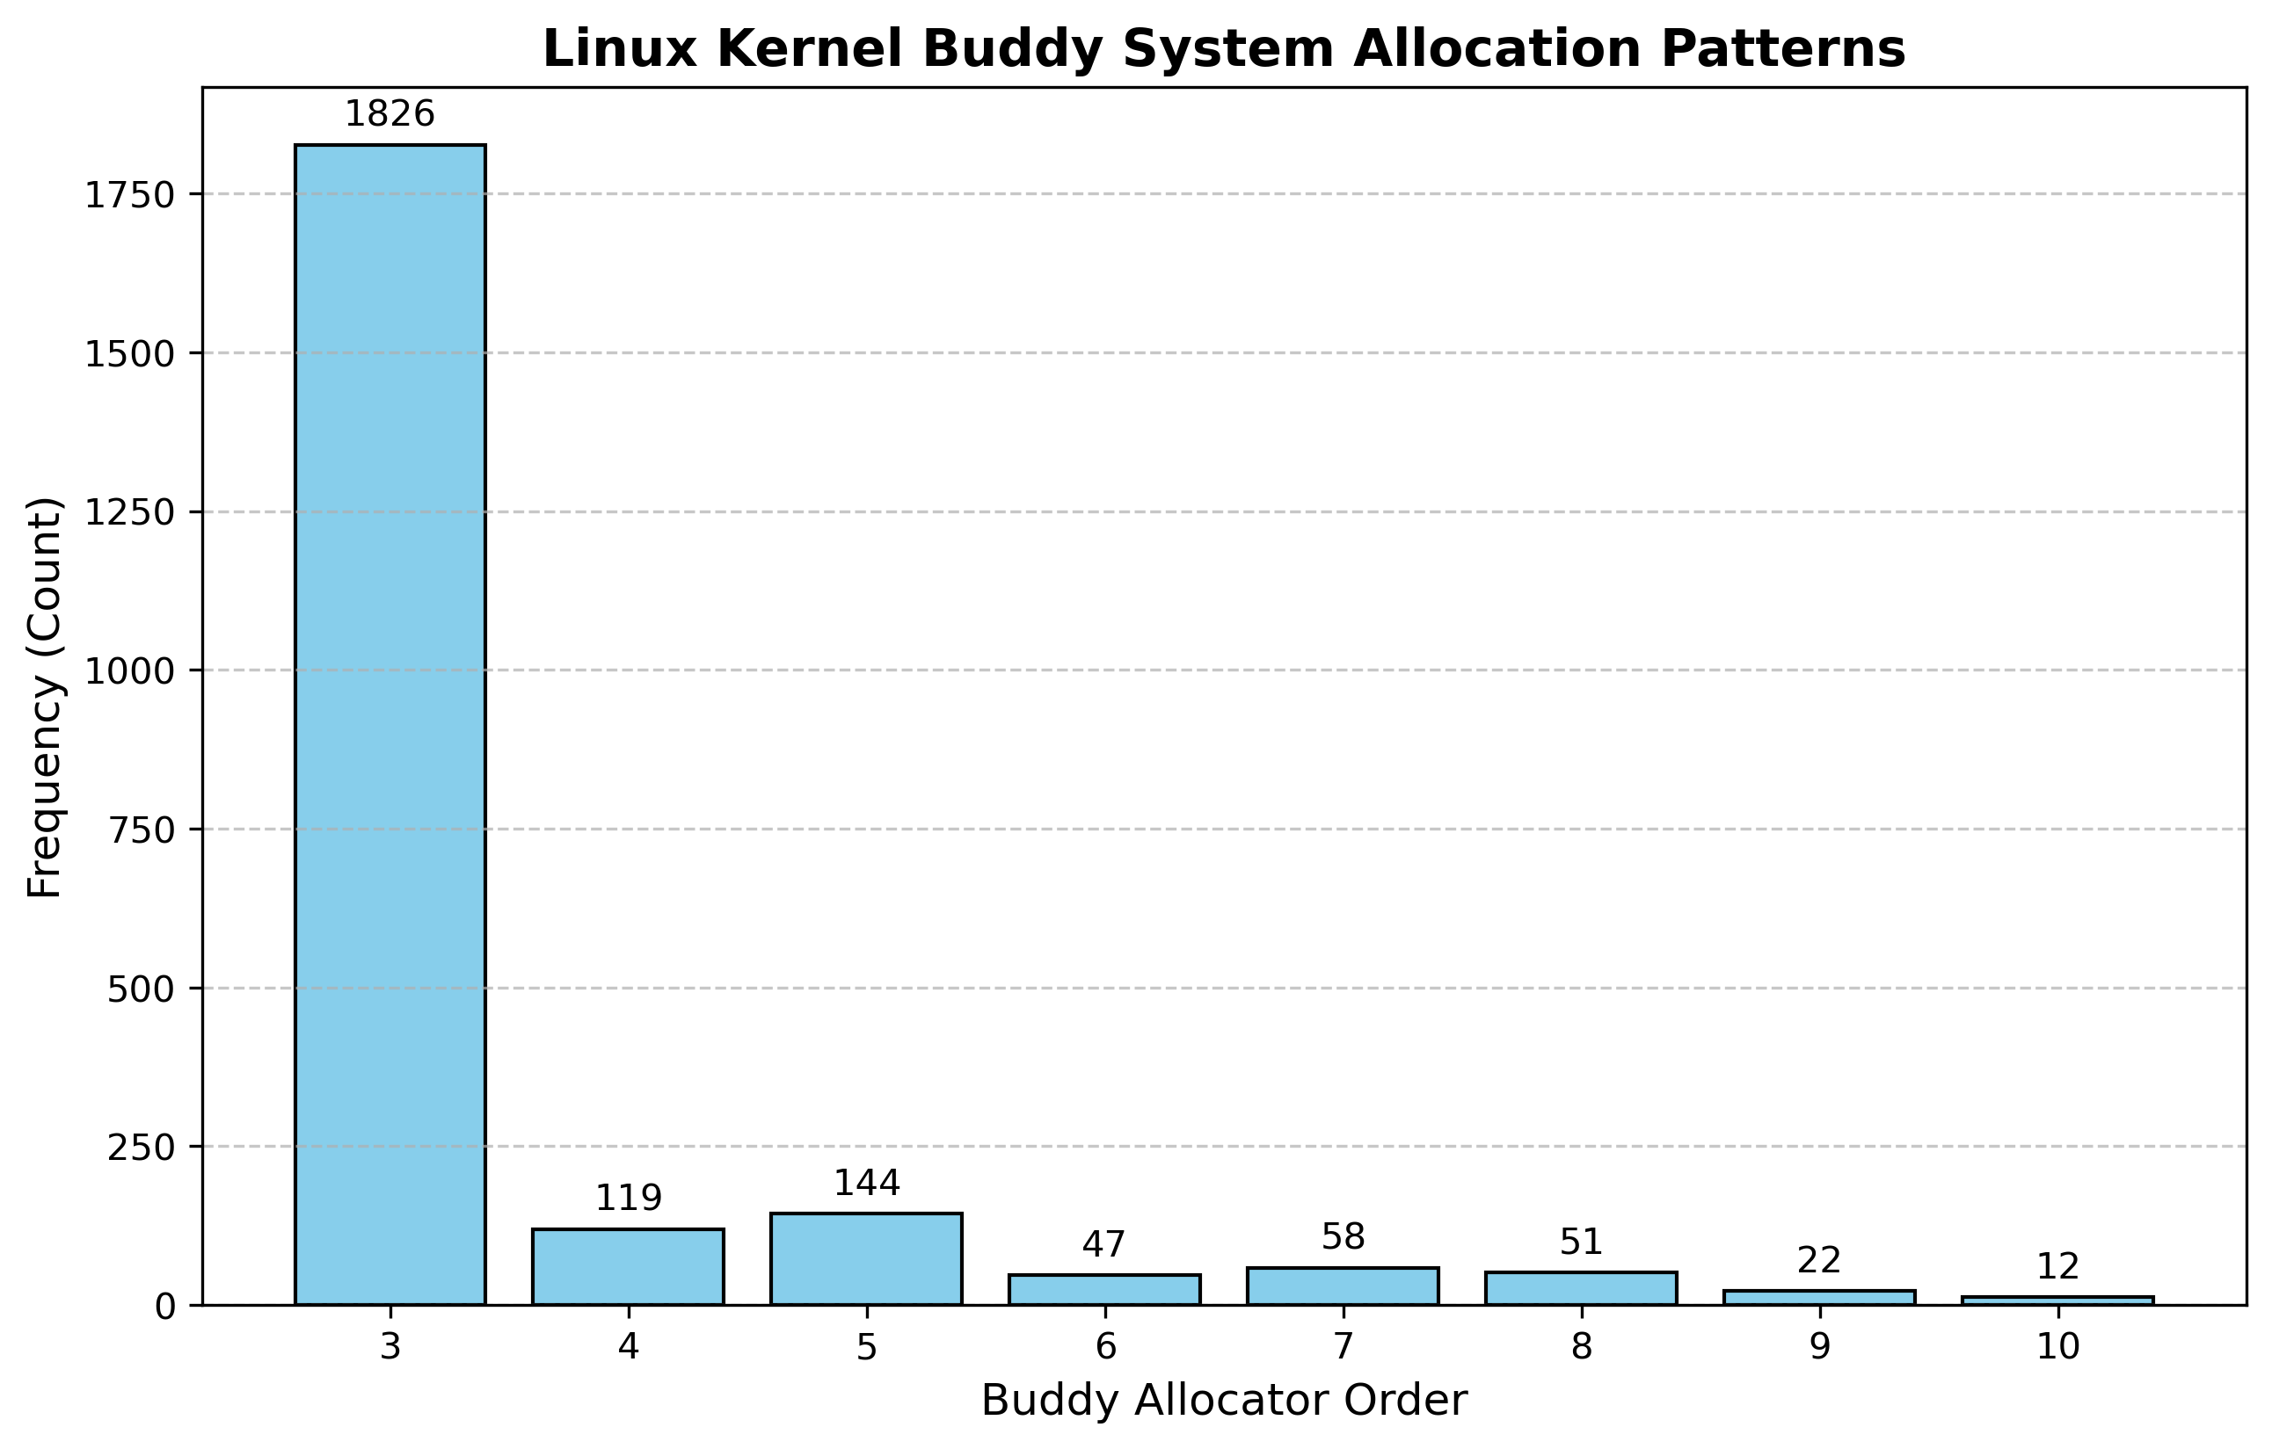
Implementation & Evaluation
Monitor Result after Modification
Order-3 volume reduced (1,826 vs 2,392)
The system successfully survived without allocating blocks that would shatter the heap.
The overall allocate time for large blocks reduced.

Slide 21
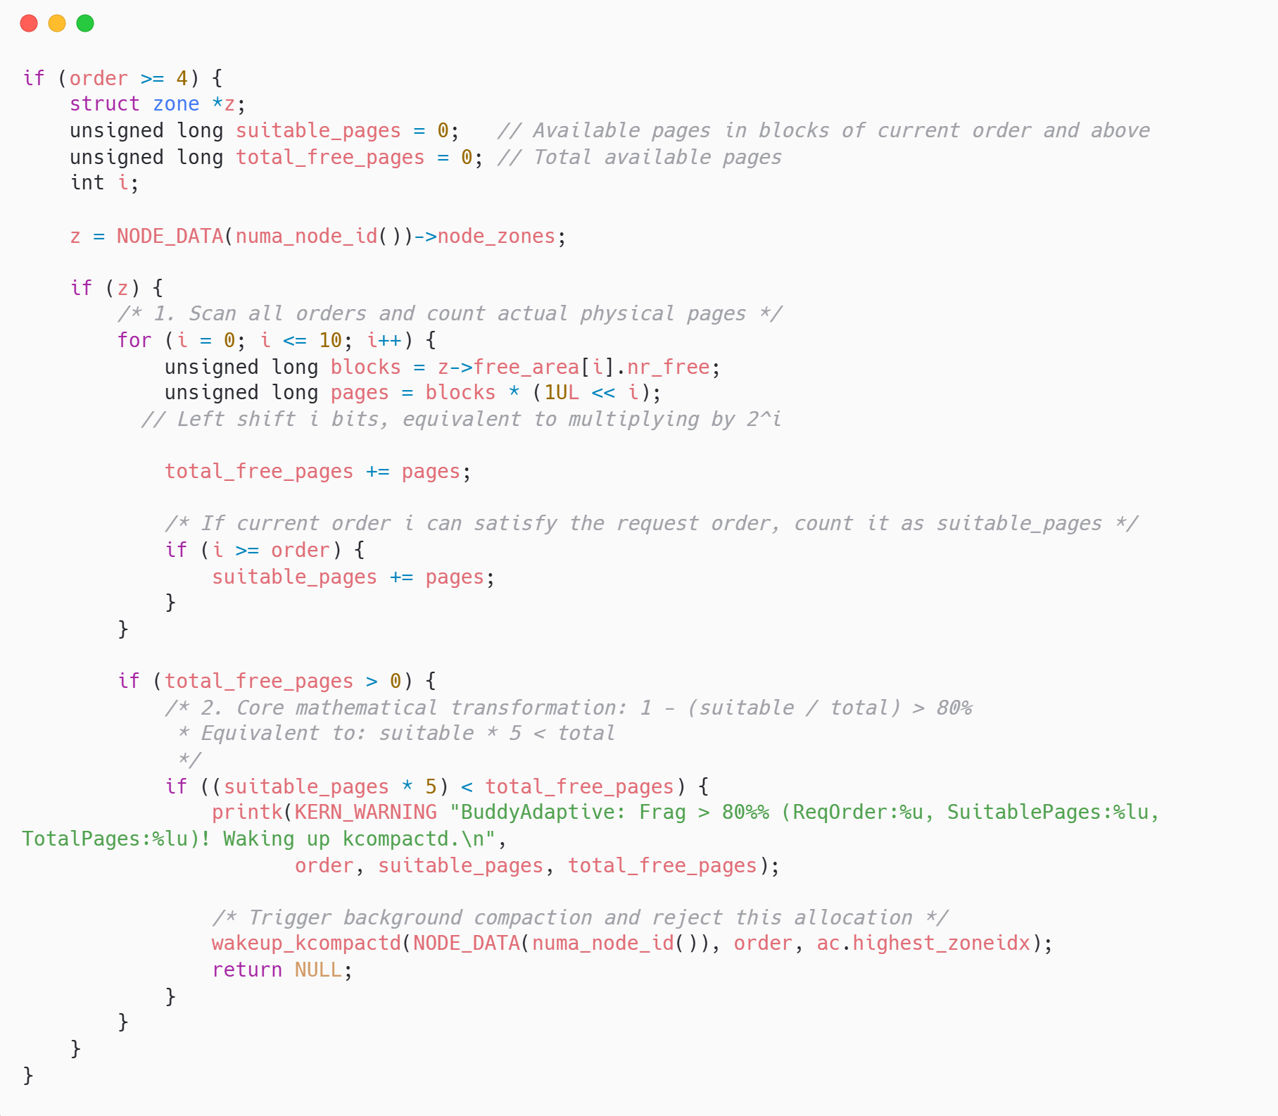
Implementation & Evaluation
Option A - Fine-Grained Fragmentation Control
Goal: Protect the large and contiguous memory blocks from being depleted.
Action: Intercept allocations of order 4 or higher to dynamically calculate the fragmentation ratio and trigger background compaction (kcompactd) if the ratio exceeds 80%.

Slide 22
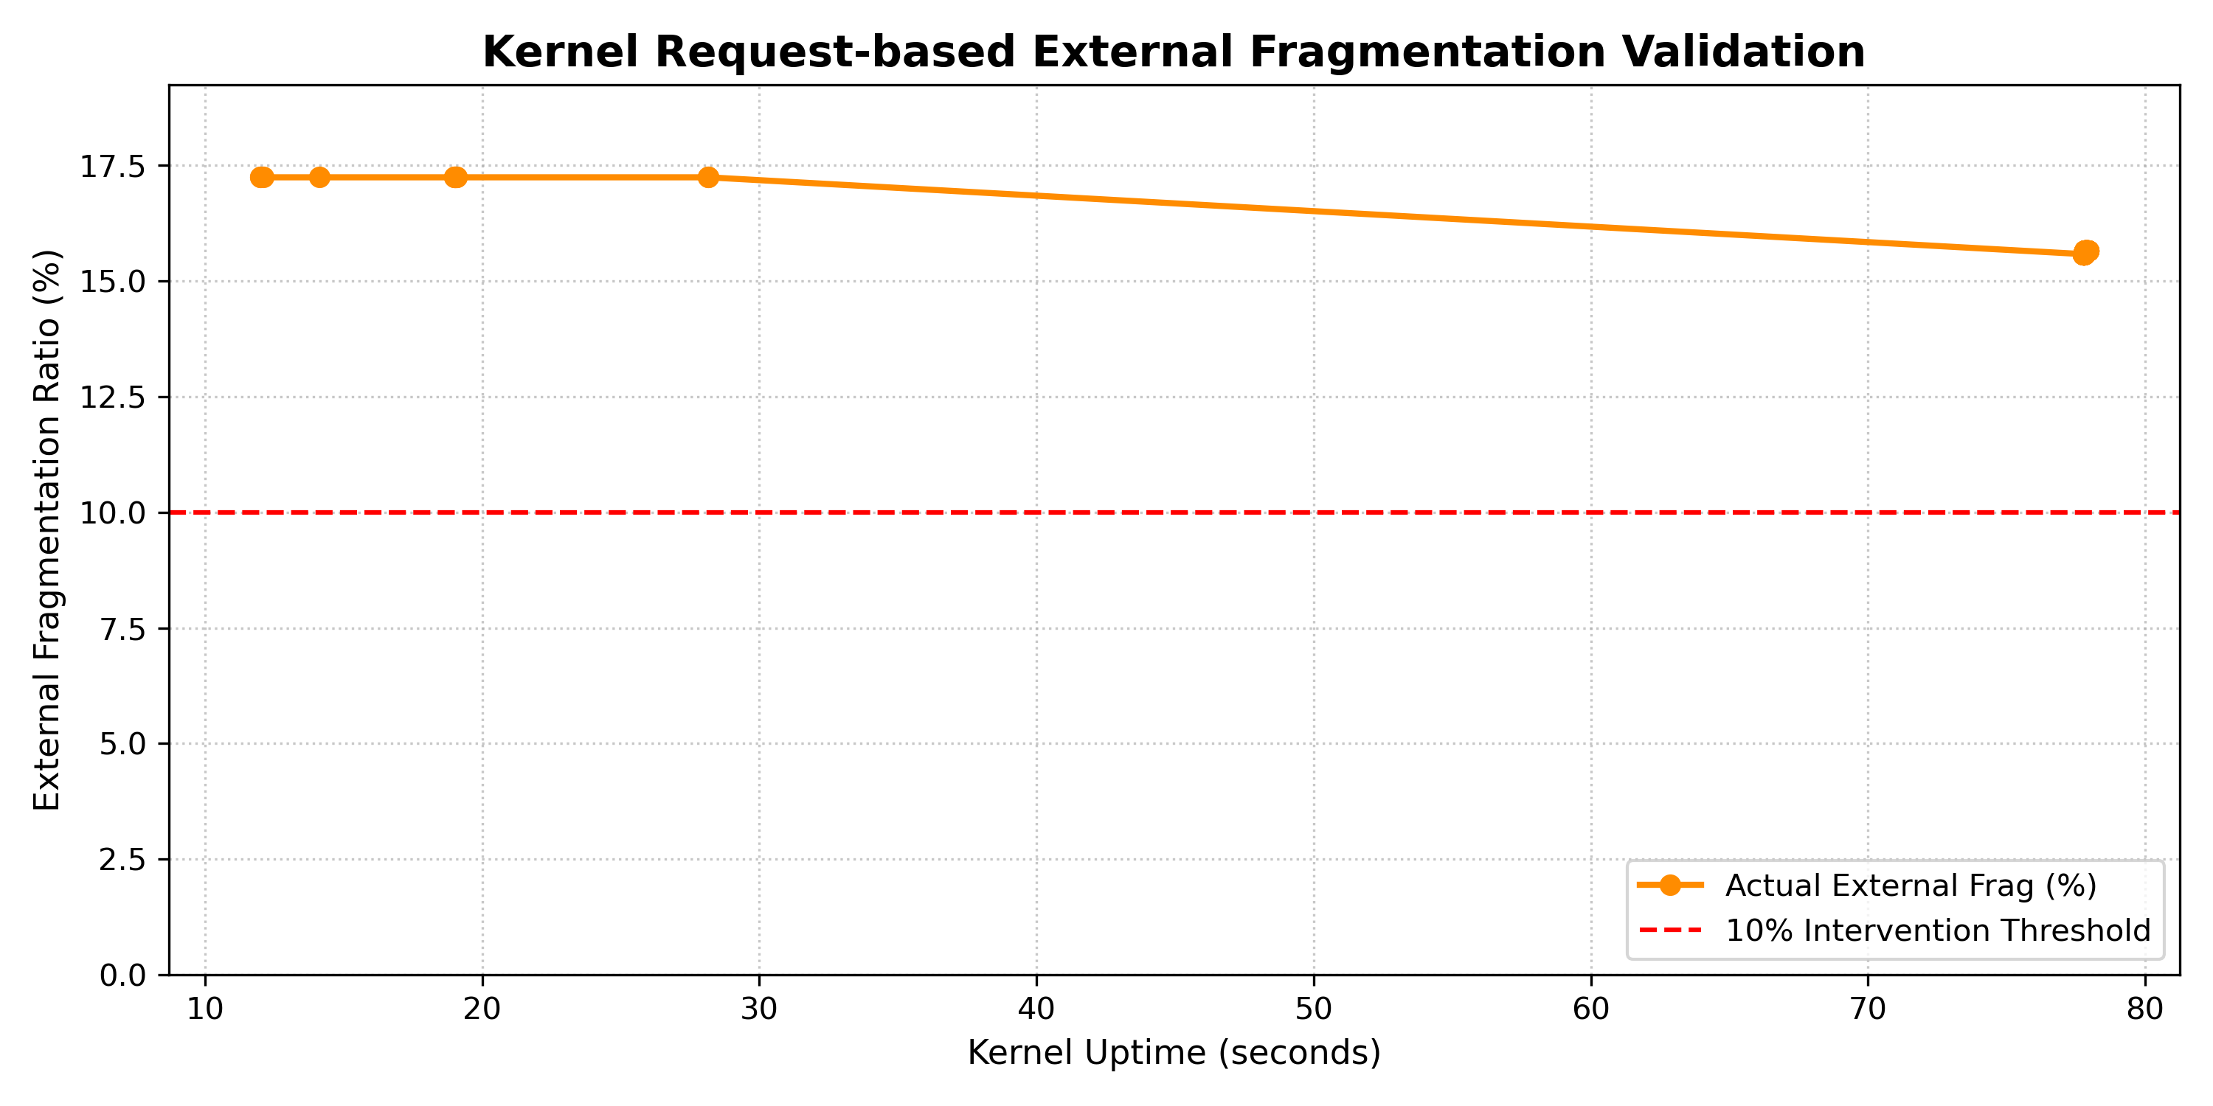
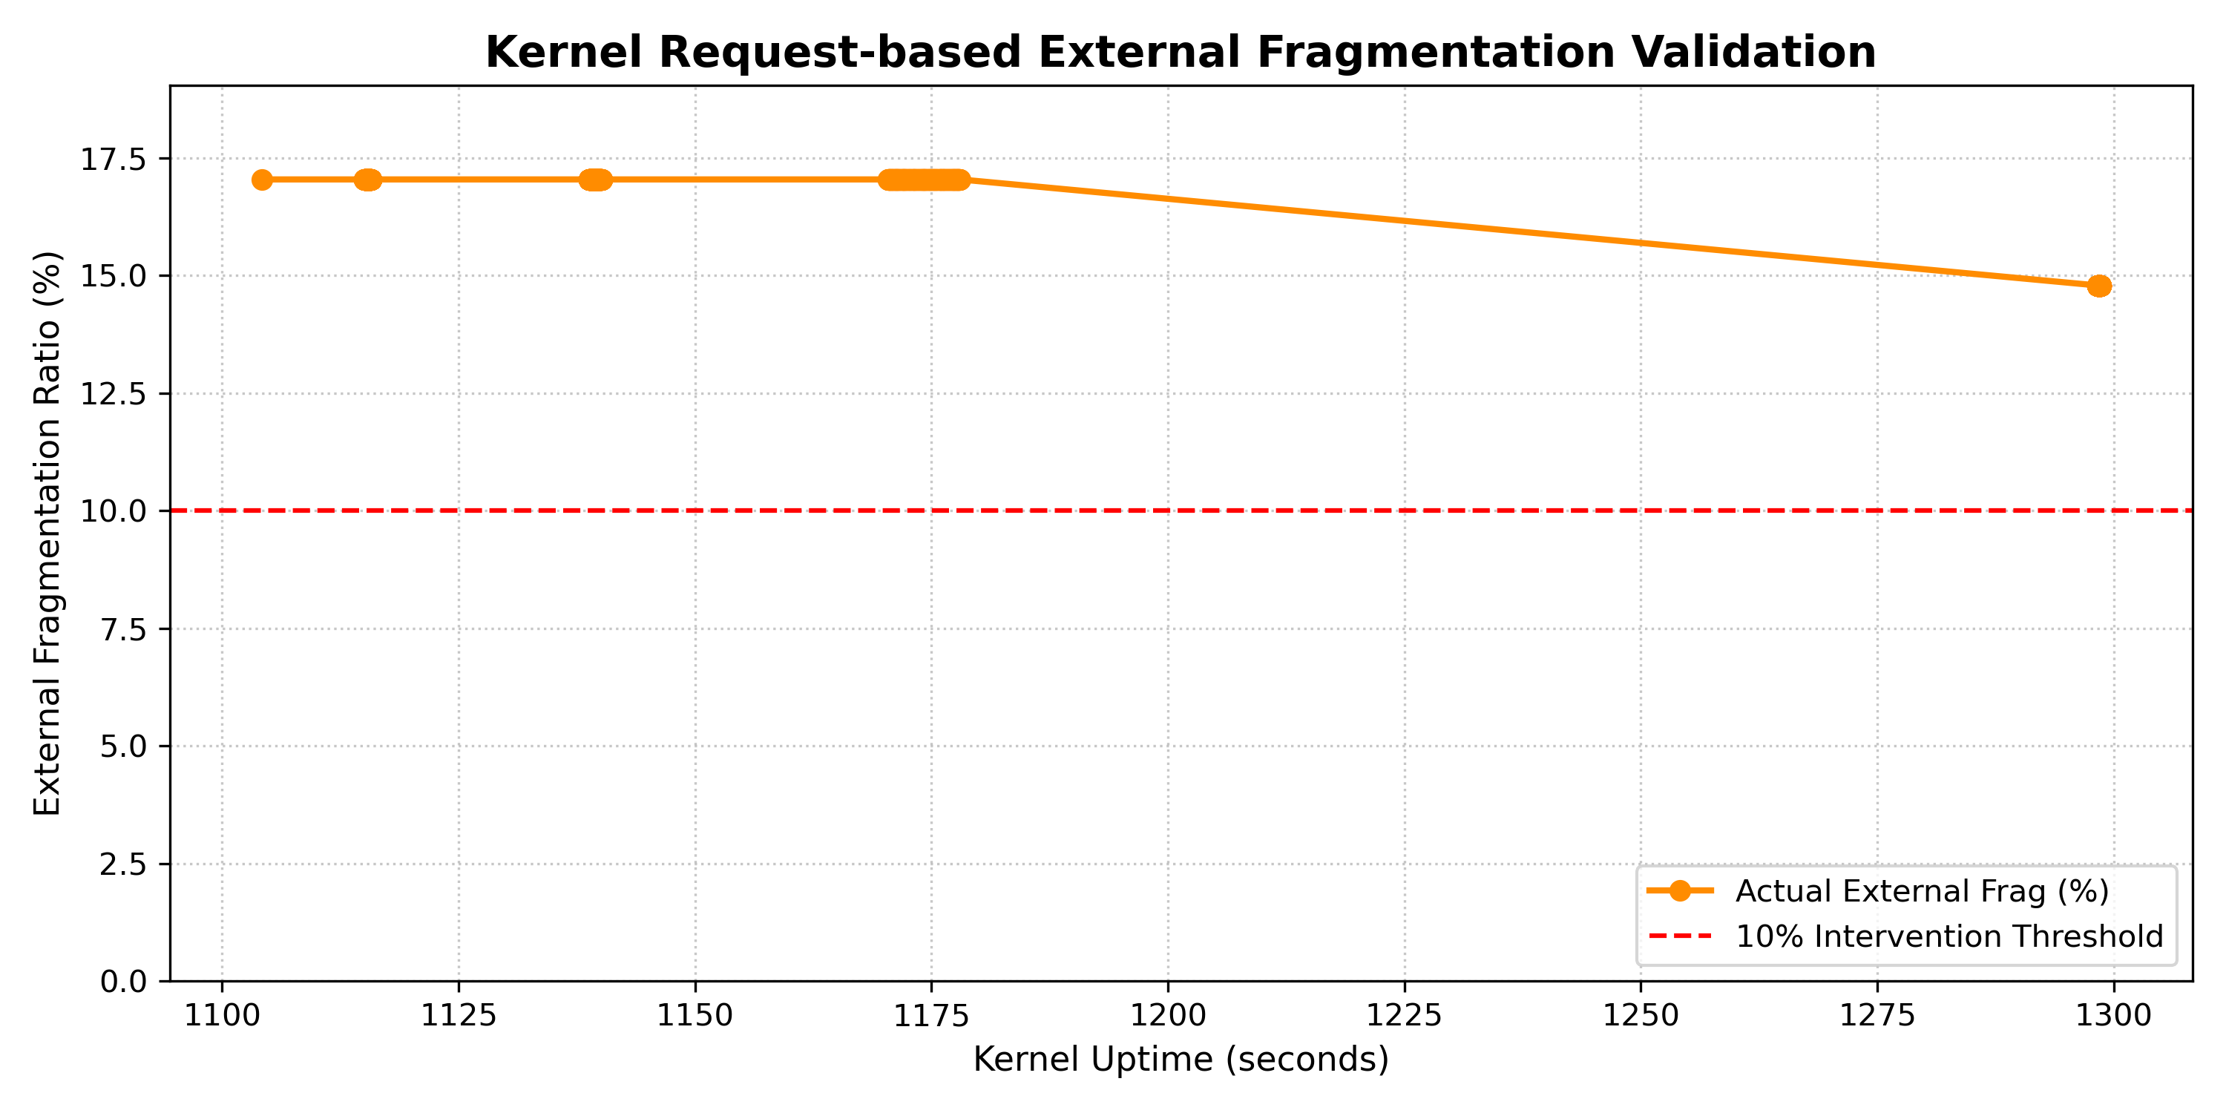
Implementation & Evaluation
Option A - Result
30s 120s
Command: stress-ng --vm 4 --vm-bytes 85% --mmap 4 --mmap-bytes 85% --matrix 2 -t 120s

Slide 23
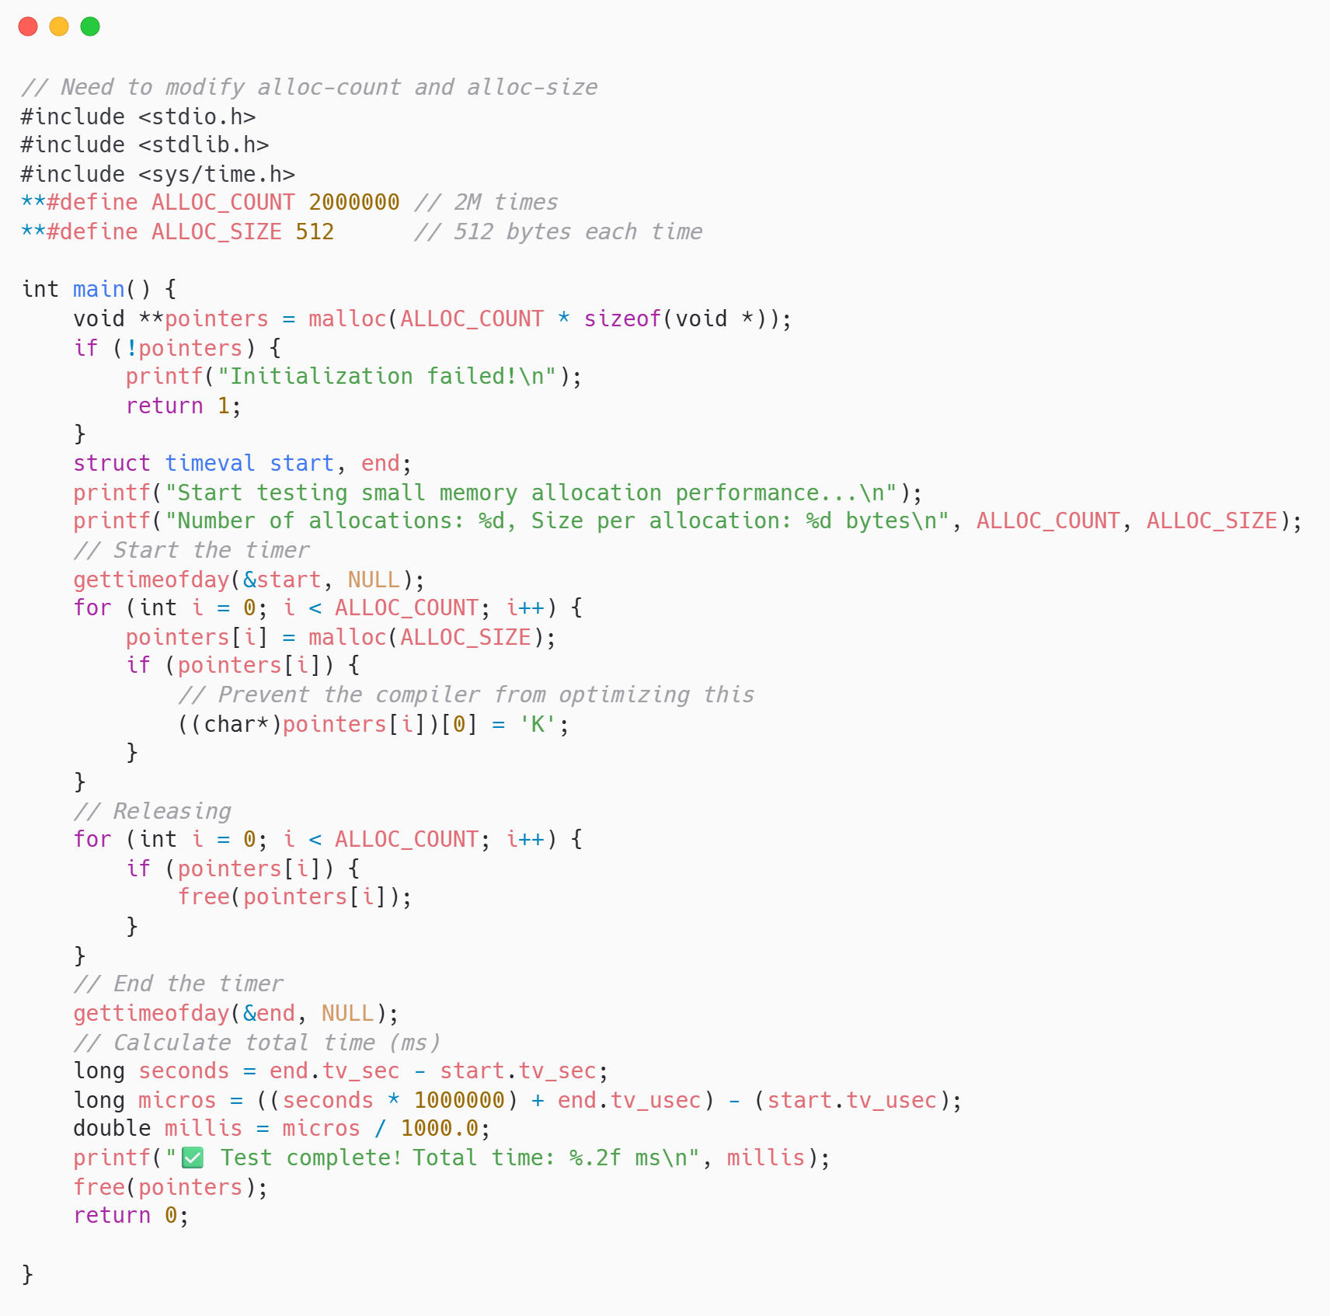
Implementation & Evaluation
Option B - Performance Comparison
Goal: Evaluate the speed and overhead of the memory allocation subsystem when handling high-frequency, small-sized memory requests.
Action: Execute a high-volume benchmark that accurately times the allocation, initialization, and release of two million 512-byte memory blocks.

Slide 24
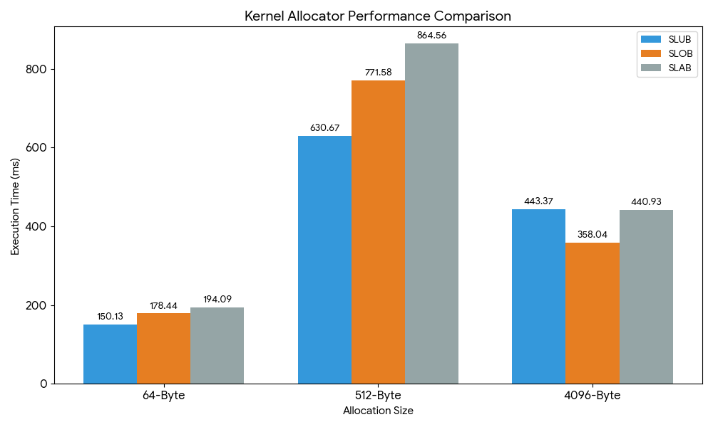
Implementation & Evaluation
Option B - Result
Analysis:
SLUB won decisively in micro-object test
but SLOB achieves the fastest time for page-sized allocations (4096B)
Why?

Slide 25
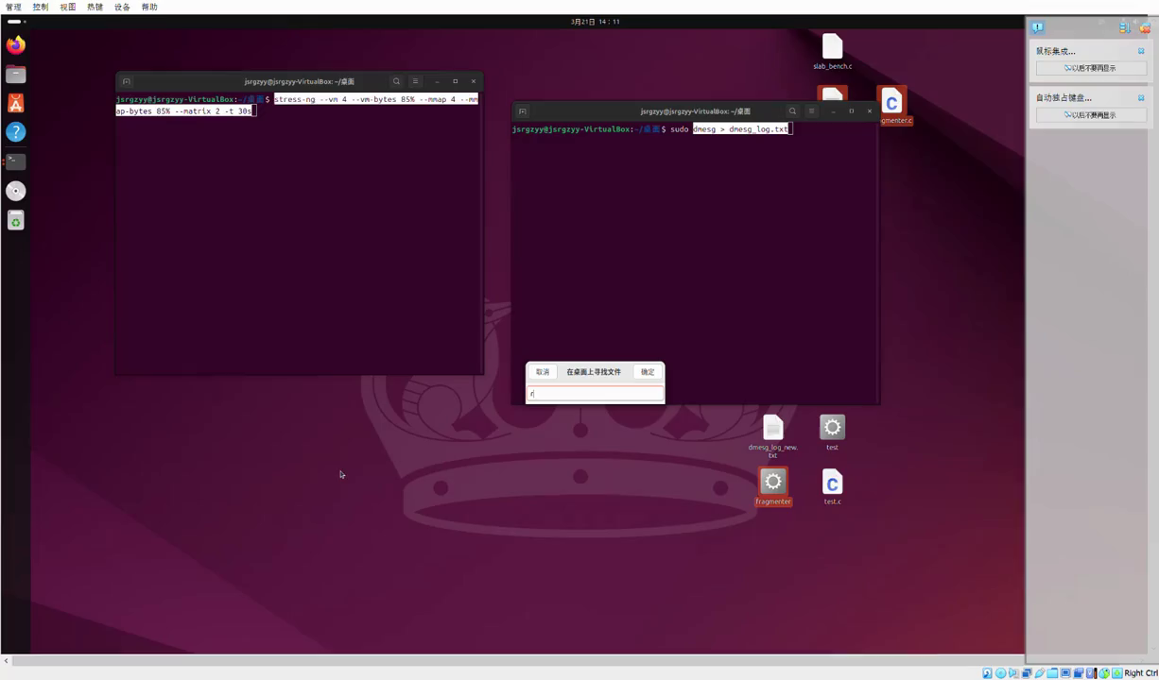
Implementation & Evaluation
Option A & B - Demo

Slide 26
OUTLINE
Motivation & Background
Project Objectives
Implementation & Evaluation
Conclusion
Q&A

Slide 27
6- Conclusion
6.1 Challenges & Solutions
The Kernel Panic Loop: A typo in kernel C code doesn't give a stack trace; it freezes the entire machine.
Compilation Time: Testing the kernel code required compiling the entire Linux kernel for separate times.
Data Extraction: Getting data out of dmesg safely without overflowing ring buffers.

Slide 28
6- Conclusion
6.2 Requirements Coverage
What We Built ？
Analyzed the Buddy, SLAB, SLOB, and SLUB allocators.
Modified the kernel's allocation of high-order requests (Option A)
Designed and executed a high-volume test of allocators (Option B)
Successfully demonstrated through testing that our kernel modifications reduce external fragmentation

Slide 29
OUTLINE
Motivation & Background
Project Objectives
Design & Implementation
Evaluation
Q&A

Slide 30
Contribution
Tangjun Su（50%）
Code: page_alloc.c, plot_buddy.py, Makefile, PPT preparation
Presents: Background & Requirement 1 and 2 & Results
Yingyun Zhang （50%）
Code: page_alloc.c, plot_external_frag.py, slab_bench.c, run.sh
Presents: Option A and B & Results & Conclusion
Notes:
So the workload was divided quite evenly. One person focused on the core runtime and verification, and the other focused on the advanced features and the final summary.

Slide 31
7- Q&A
Thank you！
Any Questions？

