Slide 1
Observation and Adaptive
Improvement of the Linux
Buddy Allocator
Runtime Observation and Adaptive Compaction
Team: 姚舜天, 刘芮辰
Platform: Ubuntu 20.04 | Linux 5.15.180

Slide 2
Contents
01
Project Overview
04
Experiments & Results
Background, objectives and scope
Workloads, testing and key findings
02
Research Methodology
05
Conclusion
Environment setup and observation design
Summary and future work
03
Implementation
06
Team
Compaction design and policy logic
Project team and acknowledgments
All major tasks in this project were completed collaboratively by both team members.
Yao Shuntian (50%)
Liu Ruichen (50%)
Focused more on environment preparation, kernel compilation and boot debugging, observation framework integration, and monitoring interface validation
Focused more on adaptive compaction design, workload construction, high-order allocation testing, and interpretation of experimental results
2
14

Slide 3
Project Background
Linux uses the buddy system for physical page allocation
High-order allocations are sensitive to fragmentation
Under memory pressure, fragmentation may force allocations into slowpath or compaction
Our goal is to observe this behavior and introduce an adaptive improvement.
3

Slide 4
Project Objectives
Implement runtime observation of buddy allocation behavior
Add a /proc interface for monitoring allocator statistics
Design and implement an adaptive compaction policy
Evaluate behavior under different workloads
4

Slide 5

Environment and Setup
OS: Ubuntu 20.04.3 LTS
Terminal
Kernel source: Linux 5.15.180
Tested in VirtualBox
Built and booted a custom kernel successfully
5

Slide 6
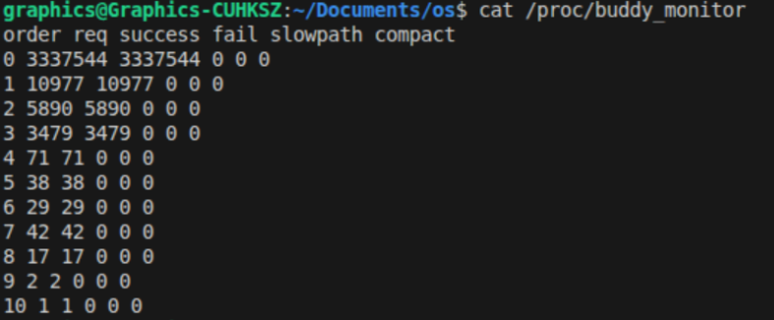
Observation Design
Added monitoring fields in mm/page_alloc.c
/proc/buddy_monitor
Exported statistics through /proc/buddy_monitor
Statistics Tracked:
req
success
fail
slowpath
compact
6

Slide 7
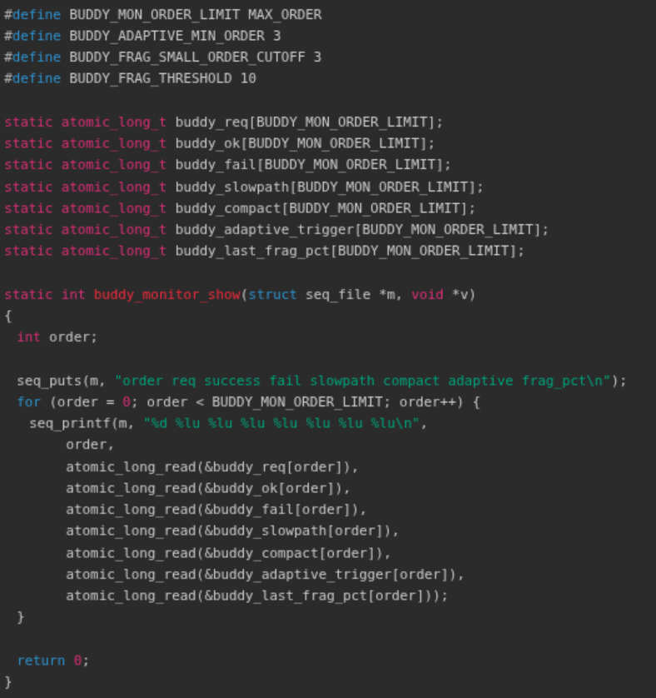
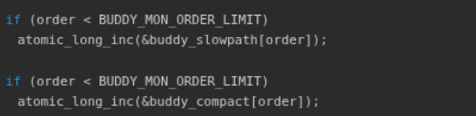
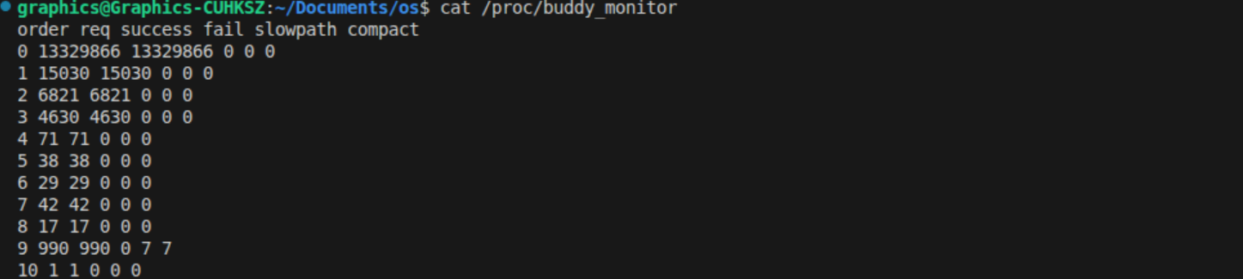
Observation Implementation Details
page_alloc.c
Hooked allocation accounting into key allocator paths
Fixed counter consistency so req = success + fail
Replaced normal counters with atomic_long_t to avoid
concurrency loss
Example output:
7

Slide 8
Adaptive Compaction Design
New Fields Added:
Policy Logic:
1
Only apply to higher-order requests (order >= 3)
adaptive
Track adaptive compaction triggers
Estimate fragmentation severity using internal free-area distribution
2
frag_pct
If frag_pct > threshold, use more aggressive compaction
3
Fragmentation percentage (0-100)
8

Slide 9
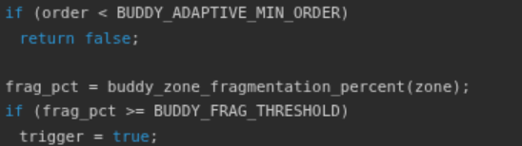
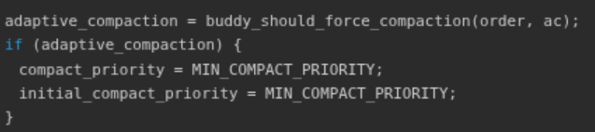
Adaptive Compaction Logic in mm/page_alloc.c
Trigger Conditions:
mm/page_alloc.c
1
High-order allocation requested
2
System entered slowpath allocation
3
Fragmentation > threshold
Action:
Raise compaction priority to
MIN_COMPACT_PRIORITY
9

Slide 10
Workloads and Testing Methods
$
fx
kt
stress-ng --vm
fragment_stress
high_order_test
General memory pressure tool with virtual memory stress testing capabilities
User-space fragmentation tool to create fragmented memory layout
Kernel module for repeated high-order page allocation testing
Why Multiple Workloads?
Not all workloads trigger high-order fragmentation equally.
We need diverse test scenarios to observe different allocator behaviors and verify adaptive compaction effectiveness.
10

Slide 11
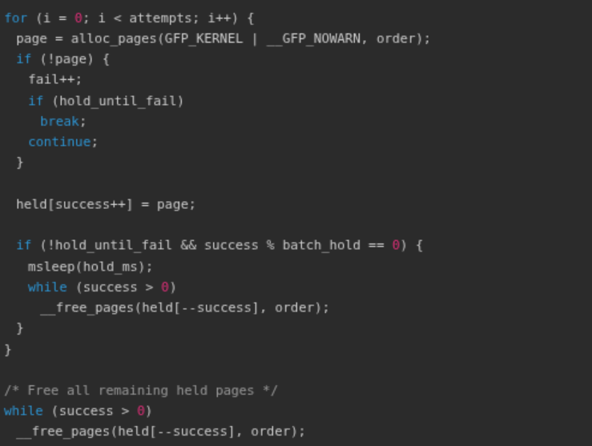
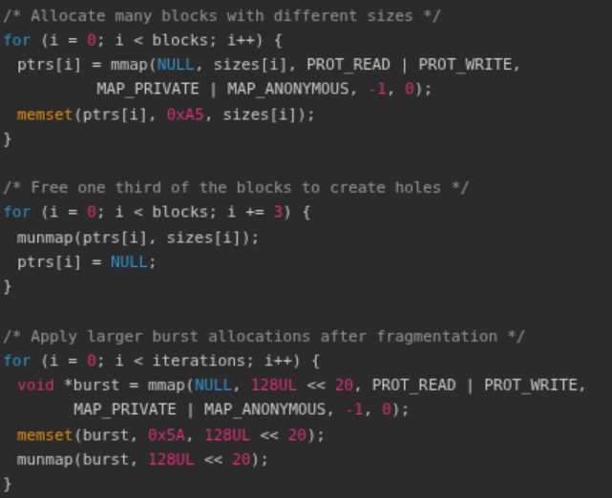
Custom Workload Implementation
fragment_stress.c high_order_test.c
These custom tools were designed to create fragmentation-like memory pressure and sustained high-order allocation pressure, which could not be reliably reproduced by general-purpose stress tools alone.
10.5

Slide 12
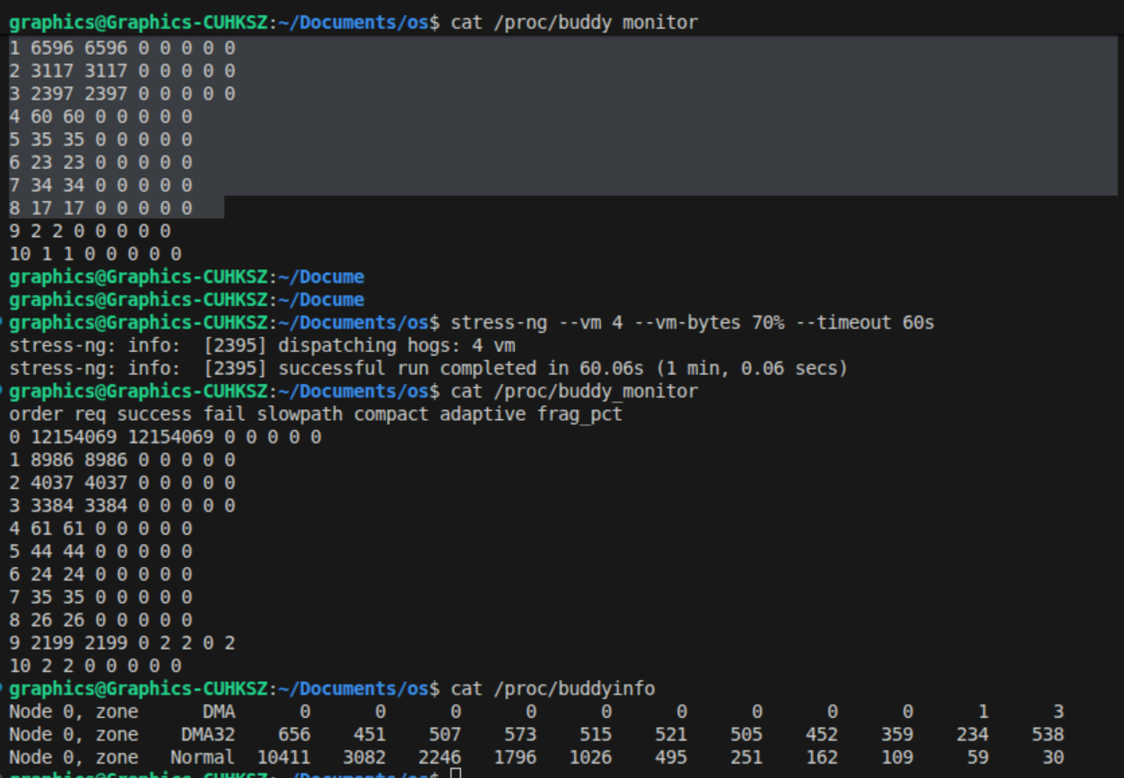
Baseline Results
Under Normal Pressure:
Monitoring system works correctly
Some workloads changed buddyinfo
Adaptive policy not always triggered
Key Insight
Ordinary VM stress is not enough to consistently create the target scenario
General memory pressure changes allocator state, but may not reliably trigger adaptive behavior.
11

Slide 13
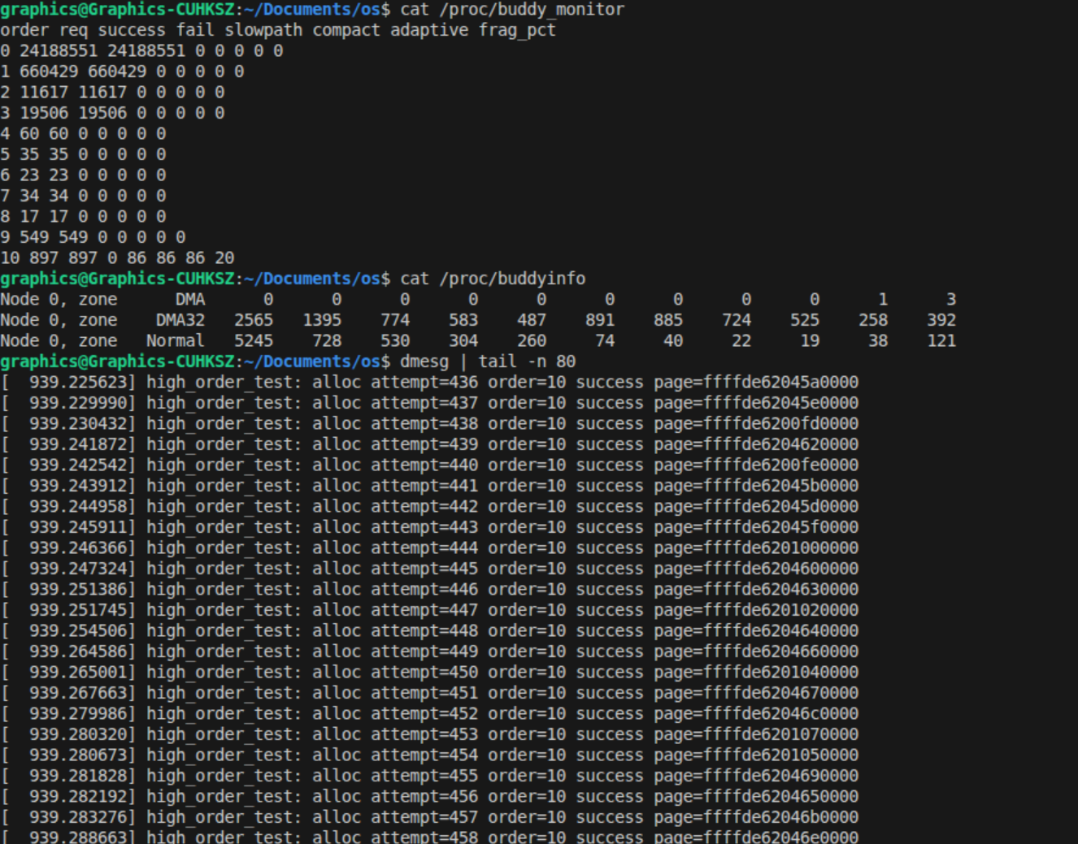
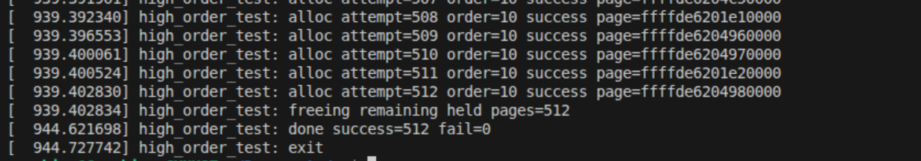
Final Triggering Experiment
Experiment Setup:
1
Used aggressive kernel module (high_order_test)
2
Module allocates and holds high-order pages
3
Forced order-10 allocations into slowpath
Adaptive Compaction Triggered!
12

Slide 14
Final Key Results
Order-10 Allocation Metrics:
Interpretation:
Fast path was insufficient
Requests
Success
897
897
System entered slowpath
Compaction was invoked
Fail
Fragmentation
Adaptive policy was activated
0
20%
All allocations succeeded (0 failures)
Observed in the final aggressive order-10 kernel module experiment.
Slowpath
Compact
Adaptive
86
86
86
13

Slide 15
Conclusion
1
Successfully observed buddy allocator behavior at runtime
2
Implemented an adaptive compaction strategy
3
Verified the strategy under dedicated high-order stress
4
Demonstrates both kernel modification and experimental evaluation
All major tasks in this project were completed collaboratively by both team members.
Yao Shuntian (50%)
Liu Ruichen (50%)
Focused more on environment preparation, kernel compilation and boot debugging, observation framework integration, and monitoring interface validation
Focused more on adaptive compaction design, workload construction, high-order allocation testing, and interpretation of experimental results
14

