Slide 1
Copy-on-Write (COW) Optimization Study
CSC5031 Operating Systems Project — Topic 7
Longjie Su (225040158) | Yutong Liu (225040151)
March 2026

Slide 2
Team & Work Distribution
Yutong Liu (225040151)
Longjie Su (225040158)
Requirement 1: Latency Measurement
● Instrumented wp_page_copy() with ktime_get()
● Designed sampling mechanism & log throttling
● Atomic counters (fault count, total/max ns)
● Latency percentile distribution analysis
Benchmarking & Evaluation
● Developed cow_test.c (correctness verification)
● Developed cow_bench.c (performance benchmark)
● Conducted all experiments & statistical analysis
● Report writing
Requirement 2: Pre-Copy Implementation
● Designed pre-copy trigger logic in cow_try_precopy()
● Implemented speculative page copy algorithm
● Safety guards: VMA/PMD boundary, race handling
● Added sysctl toggle (vm.cow_precopy)
System & Infrastructure
● Custom kernel build & configuration
● WiFi driver porting (AIC8800 for remote access)
● /proc/cow_stats interface design
● GRUB configuration & deployment

Slide 3
Outline
Yutong Liu
Longjie Su
1
Background: Virtual Memory, Fork & COW
6
Impl: Req 2 — Pre-Copy Optimization
2
Project Requirements
7
Results: Req 2 — Pre-Copy Evaluation
3
Impl: Req 1 — Latency Measurement
8
Experiment Design & Setup
4
Results: Req 1 — COW Latency Analysis
9
Analysis, Trade-offs & Limitations
5
Kernel Build & Deployment
10
Conclusion

Slide 4
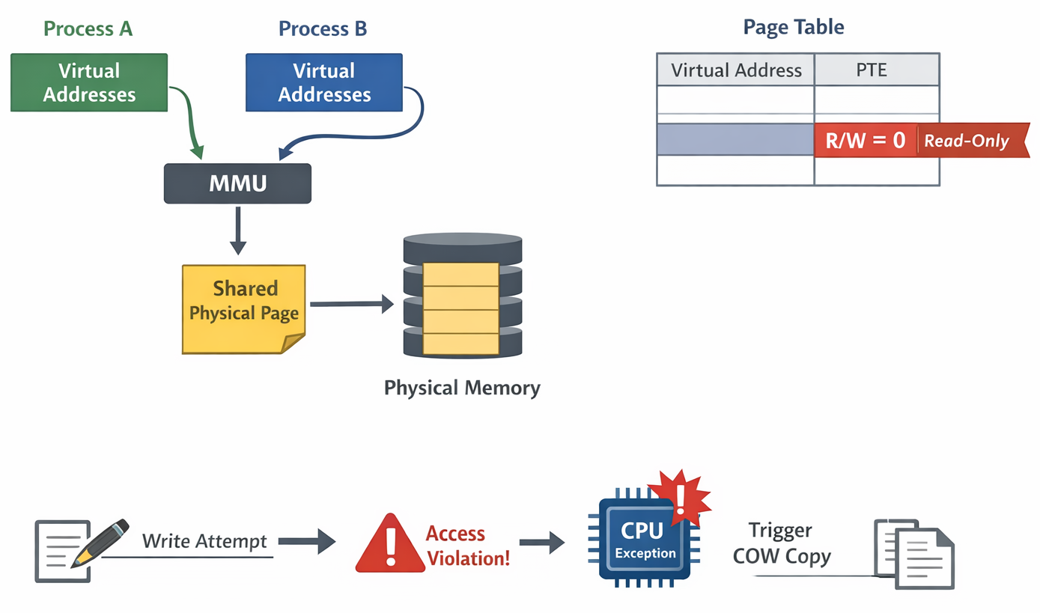
Background: Virtual Memory & Page Tables

Slide 5
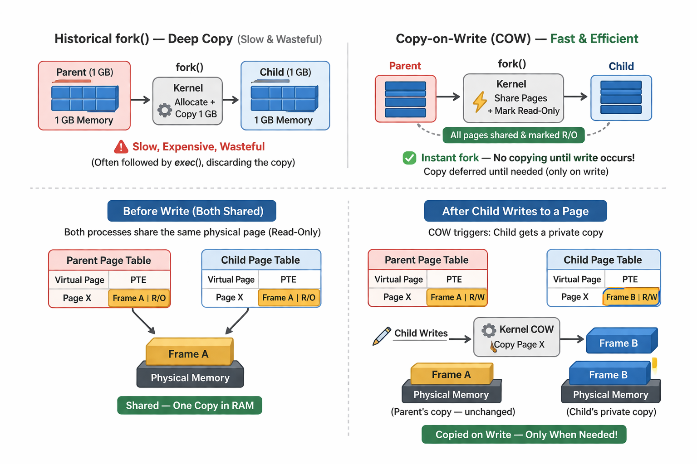
Background: The Fork Problem & COW Solution

Slide 6
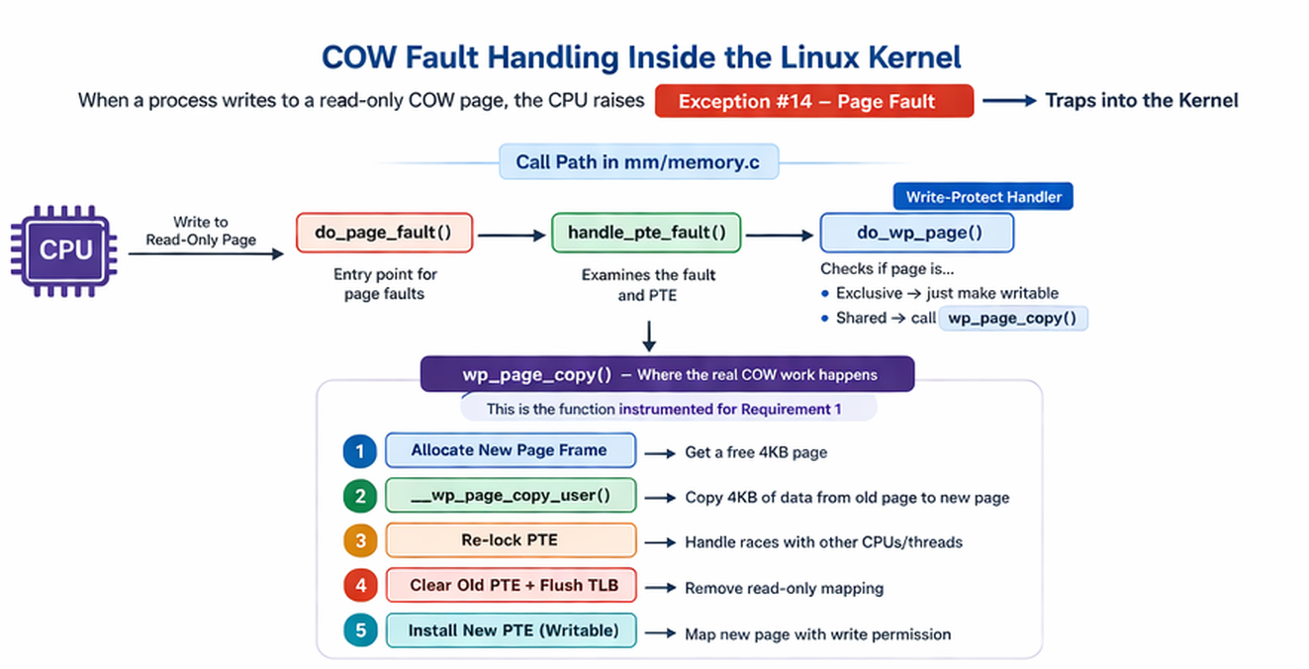
Background: COW Fault Handling in the Kernel

Slide 7
Implementation: Req 1 — Measurement Design
What We Measure
Design Decisions
Kernel copy latency (ktime instrumentation)
Full fault latency (user-space clock)
● ktime_get()
● Atomic counters
● Sampled printk
● Aggregate stats via /proc/cow_stats
● Reset-on-write
Counters Tracked (all atomic64, lock-free)
cow_fault_count — total COW copy events
cow_copy_total_ns — cumulative copy time
cow_copy_max_ns — maximum single-copy latency
cow_precopy_attempts — pre-copy attempts (Req 2)
cow_precopy_success — successful pre-copies (Req 2)
cow_copy_avg_ns — derived: total_ns / count

Slide 8
Implementation: Req 1 — Code Walkthrough
Key Points
Timing precision:
ktime_get() uses TSC on x86 — ~20ns
overhead per call
Lock-free max:
Uses CAS loop instead of spinlock — zero
contention in hot path
Sampling:
Only prints every Nth event (default 100)
Avoids dmesg flood
Position:
Wraps only the copy,not the PTE update or TLB flush
// In wp_page_copy() — wrapping the actual copy operation: /* COW Topic7: measure copy latency */ { ktime_t __cow_start = ktime_get(); // <- start timer err = __wp_page_copy_user( // <- actual 4KB copy &new_folio->page, vmf->page, vmf); { s64 __cow_ns = ktime_to_ns( // <- elapsed nanoseconds ktime_sub(ktime_get(), __cow_start)); u64 __cow_cnt = atomic64_inc_return(&cow_fault_count); atomic64_add(__cow_ns, &cow_copy_total_ns); // Atomic max update (lock-free CAS loop) s64 __prev_max = atomic64_read(&cow_copy_max_ns); while (__cow_ns > __prev_max) { if (atomic64_try_cmpxchg(&cow_copy_max_ns, &__prev_max, __cow_ns)) break; } if (__cow_cnt % cow_sample_interval == 0) printk(KERN_INFO "COW: copy=%lld ns PFN=%lx cnt=%llu\n", __cow_ns, page_to_pfn(vmf->page), __cow_cnt); } }

Slide 9
Implementation: Req 1 — /proc Interface
$ cat /proc/cow_stats
$ sudo dmesg | grep COW
cow_fault_count: 90474 cow_copy_total_ns: 41081508 cow_copy_avg_ns: 454 cow_copy_max_ns: 64301 cow_precopy_enabled: 0 cow_precopy_attempts: 0 cow_precopy_success: 0 cow_precopy_hitrate: 0% cow_sample_interval: 100
[ 2.647] COW: copy=421 ns PFN=183ac5 cnt=100 [ 2.653] COW: copy=381 ns PFN=183f1b cnt=200 [ 2.761] COW: copy=561 ns PFN=3edff2 cnt=300 [ 2.764] COW: copy=651 ns PFN=3edff6 cnt=400 [176.828] COW: copy=331 ns PFN=1edf33 cnt=100 [176.828] COW: copy=220 ns PFN=1f0e81 cnt=200 [176.828] COW: copy=380 ns PFN=1f2e51 cnt=400
Sysctl Controls
/proc/sys/vm/cow_precopy — 0=off, 1=on — runtime toggle for pre-copy (Req 2)
/proc/sys/vm/cow_sample_interval — print every Nth COW event (default 100)
echo 1 > /proc/cow_stats — write anything to reset all counters to zero

Slide 10
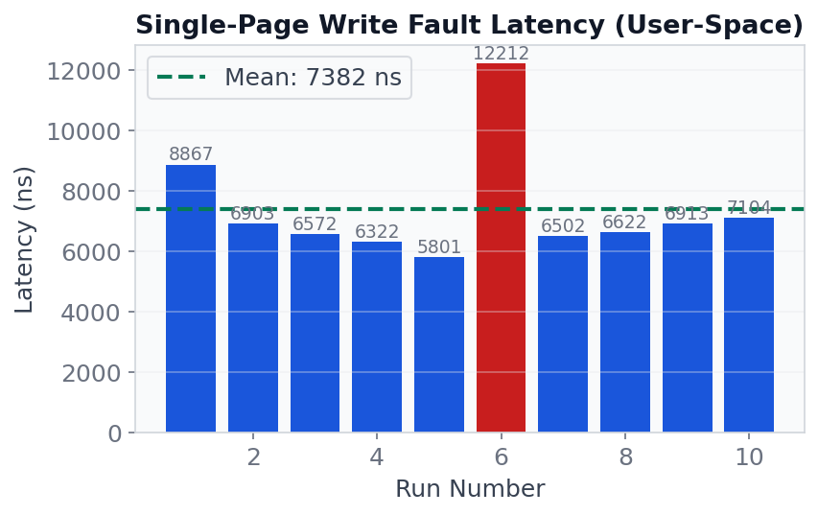
Results: Req 1 — Single-Page COW Latency
Analysis
Mean: 6,782 ns (~6.8 μs)
Min: 5,801 ns
Max: 12,212 ns (outlier — Run 6)
This measures FULL fault latency:
CPU trap entry/exit
Page table walk
VMA lookup
Page allocation
4KB memcpy (~350 ns)
PTE update + TLB flush
Return to user-space
The outlier (Run 6: 12,212 ns) is likely due to scheduling — the fault handler was preempted by another task or interrupted. This is normal variance in a non-real-time kernel.

Slide 11
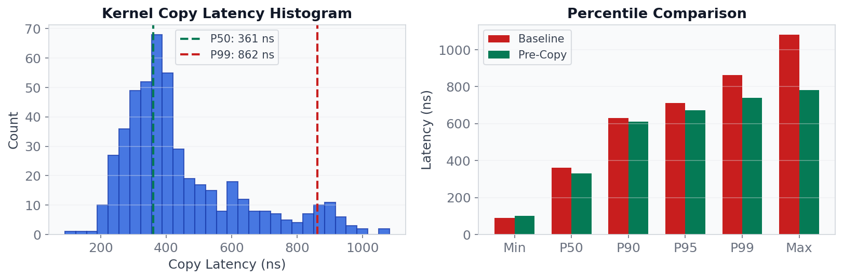
Results: Req 1 — Latency Distribution
Percentiles: Min=90 P50=361 P90=631 P95=711 P99=862 Max=1,082 ns (Mean=400 ns, N=493 samples)
Most copies complete in 200-500 ns. Tail latencies (>700 ns) are rare — caused by cache misses or preemption.
Pre-copy improves tails: P99 drops 14% (862→741 ns), Max drops 28% (1082→781 ns).

Slide 12
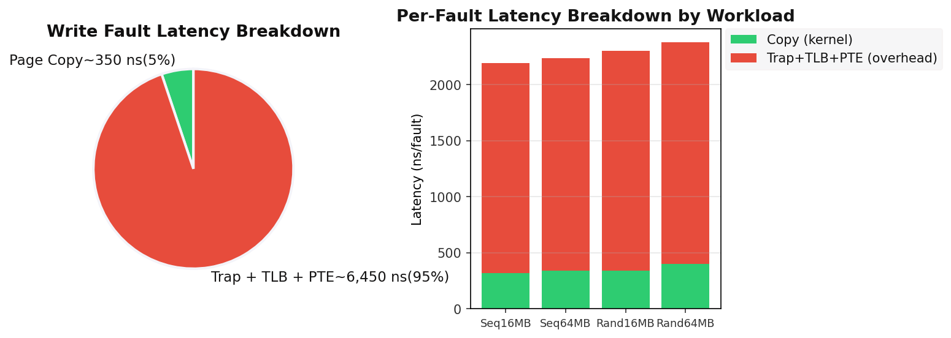
Results: Req 1 — Copy vs Trap Overhead
Key Insight
The 4KB page copy is only ~5% of total fault cost. The dominant cost is the page fault trap mechanism (~95%).
Implication: Reducing the NUMBER of faults matters far more than optimizing the copy itself.

Slide 13
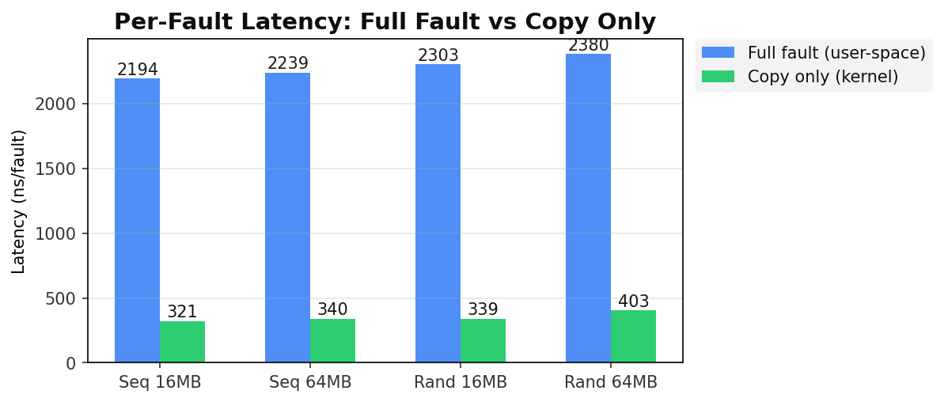
Results: Req 1 — Scaling with Workload
Observations
● Random access is ~8-10% slower than sequential — worse TLB and cache locality increases overhead
● Larger working set (64MB) shows slightly higher latency — more TLB misses as pages spread further
● Kernel copy time is remarkably stable (~320-400 ns) — the memcpy is cache-friendly regardless of pattern

Slide 14
Kernel Build & Deployment
1
Download kernel source
apt-get source linux-hwe-6.8 → full Ubuntu 6.8 source tree
2
Apply modifications
Patches mm/memory.c (measurement + pre-copy + /proc interface)
3
Configure kernel
cp /boot/config-$(uname -r) .config && make olddefconfig
4
Compile
make -j16 (~30 min on 16-core AMD) → bzImage + ~5000 modules
5
Install
make modules_install && make install → /boot/vmlinuz-6.8.12-cow-topic7
6
Generate initramfs
update-initramfs -c -k 6.8.12-cow-topic7 (all drivers included)
7
Port WiFi driver
Built AIC8800 USB WiFi driver from vendor source against custom kernel
8
Boot & verify
grub-reboot → SSH in → verify /proc/cow_stats and dmesg output

Slide 15
Implementation: Req 2 — Pre-Copy Design
Pre-Copy Algorithm
5 Safety Checks (all must pass)
When page N triggers COW fault:
Step 1: Complete normal COW for page N
(existing kernel behavior, unchanged)
Step 2: Look ahead at page N+1
Calculate next_addr = fault_addr + PAGE_SIZE
Step 3: Validate N+1 is a COW candidate
(5 safety checks — see right panel)
Step 4: If valid → allocate, copy, update PTE
Pre-copied page is immediately writable
Step 5: If any check fails → skip silently
No impact on current fault processing
1. next_addr < vma->vm_end (within VMA)
2. Same PMD range (no 2MB boundary cross)
3. PTE present AND read-only (COW candidate)
4. Page is anonymous (not file-backed)
5. Page is NOT exclusive (actually shared)
Race Condition Handling
Between check and copy, another CPU may:
● Modify the same PTE (concurrent fault)
● Free the page (process exit)
Solution: folio_get() before unlock,
re-lock + pte_same() verify after alloc
If PTE changed → discard new page, return

Slide 16
Implementation: Req 2 — Pre-Copy Code
static void cow_try_precopy(struct vm_area_struct *vma, struct mm_struct *mm, pmd_t *pmd, unsigned long fault_addr) { unsigned long next_addr = fault_addr + PAGE_SIZE; // Safety checks if (next_addr >= vma->vm_end) return; if ((next_addr & PMD_MASK) != (fault_addr & PMD_MASK)) return; if (!(vma->vm_flags & VM_WRITE)) return; if (vma->vm_flags & (VM_SHARED | VM_MAYSHARE)) return; // Lock PTE, verify COW candidate pte = pte_offset_map_lock(mm, pmd, next_addr, &ptl); if (!pte_present(pteval) || pte_write(pteval)) { unlock; return; } old_page = vm_normal_page(vma, next_addr, pteval); if (!folio_test_anon(old_folio) || PageAnonExclusive(old_page)) { unlock; return; } folio_get(old_folio); // ref before unlock pte_unmap_unlock(pte, ptl); // Allocate and copy new_folio = folio_prealloc(mm, vma, next_addr, false); copy_user_highpage(&new_folio->page, old_page, next_addr, vma); // Re-lock, verify PTE unchanged, install new page pte = pte_offset_map_lock(mm, pmd, next_addr, &ptl); if (!pte_same(ptep_get(pte), pteval)) { cleanup; return; } entry = maybe_mkwrite(pte_mkdirty(mk_pte(...)), vma); ptep_clear_flush(vma, next_addr, pte); set_pte_at(mm, next_addr, pte, entry); // now writable! }
Call Site
// In wp_page_copy(), // after successful COW: if (cow_precopy_enabled && page_copied) cow_try_precopy( vma, mm, vmf->pmd, vmf->address); delayacct_wpcopy_end(); return 0;
Placement:
After all cleanup of current fault.
PTL released, mmu_notifier done.
~80 lines added to mm/memory.c

Slide 17
Experiment Design & Setup
Environment
Methodology
Platform: AMD x86_64, 16 cores, 16GB RAM
OS: Ubuntu 22.04.5 LTS
Kernel: 6.8.12-cow-topic7 (modified)
Compiler: GCC 11.4.0
Page size: 4 KB (base pages)
1. Boot modified kernel
2. Reset /proc/cow_stats + clear dmesg
3. Run benchmark (pre-copy OFF) → baseline
4. Enable pre-copy → run same benchmarks
5. Compare: runtime, faults, latency, hit rate
Workload Design
Correctness Test (cow_test.c):
● mmap 256 pages, fill with known pattern
● fork(), child modifies every other page
● Parent verifies data unchanged (isolation)
Sequential Write (cow_bench seq):
● fork() then write pages 0, 1, 2, ..., N
● Best case for pre-copy (perfect locality)
Random Write (cow_bench rand):
● fork() then write pages in random order
● Fixed seed (12345) for reproducibility
● Worst case for pre-copy (no locality)
Single Page (cow_bench single):
● fork() then write only 1 page
● Measures per-fault overhead of pre-copy

Slide 18
Correctness Verification
$ ./cow_test
What This Verifies
● fork() produces shared pages (COW setup)
● Child writes trigger correct COW copies
● Parent data remains completely untouched
● No kernel panics, oops, or corruption
● Pre-copy does NOT break COW semantics
(tested with both pre-copy ON and OFF)
CHILD: All 256 pages verified OK PARENT: All 256 pages verified OK (data isolation confirmed) COW Correctness Test: PASSED
Robustness Guarantees
● Next page doesn't exist → cow_try_precopy returns silently (VMA boundary check)
● Next page not COW-shared → skipped (PageAnonExclusive check)
● Allocation fails → skipped, current fault unaffected (folio_prealloc returns NULL)
● Race condition (PTE changed during copy) → new page discarded (pte_same re-verify)

Slide 19
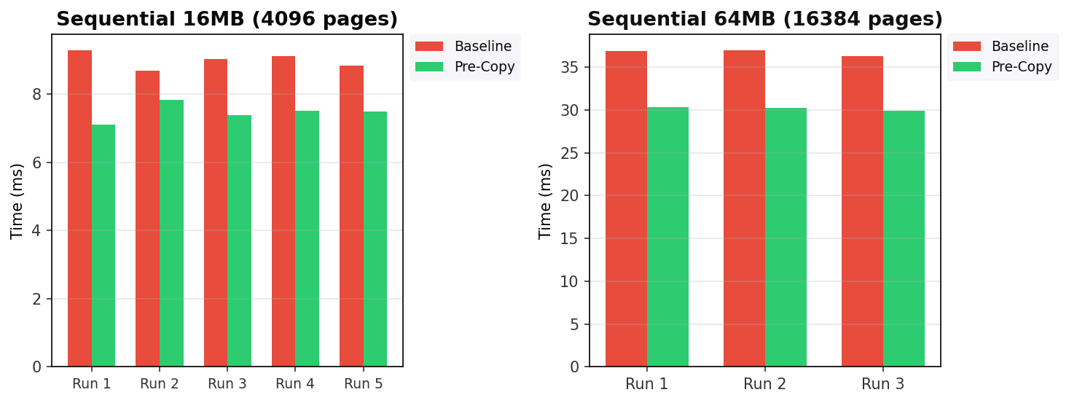
Results: Req 2 — Sequential Write Performance
16MB: 8.989 ms → 7.462 ms (-17.0%)
64MB: 36.692 ms → 30.169 ms (-17.8%)
COW faults: reduced by ~50%
Pre-copy hit rate: 99%
Why 99% hit rate?
Sequential access: page N → N+1 → N+2 → ...
Every pre-copied page IS the next fault target.
Each pre-copy saves one full fault trap (~6.5 μs).

Slide 20
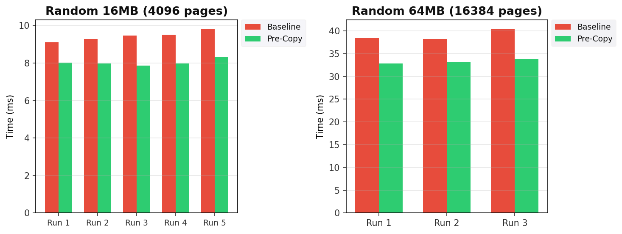
Results: Req 2 — Random Write Performance
16MB: 9.433 ms → 8.024 ms (-14.9%)
64MB: 39.003 ms → 33.291 ms (-14.6%)
COW faults: reduced by ~36%
Pre-copy hit rate: 57%
Why still 57% hit rate?
All pages will eventually be written (random order).
~half are already pre-copied from a neighbor's fault.
Even with 43% wasted copies, net gain is positive.

Slide 21
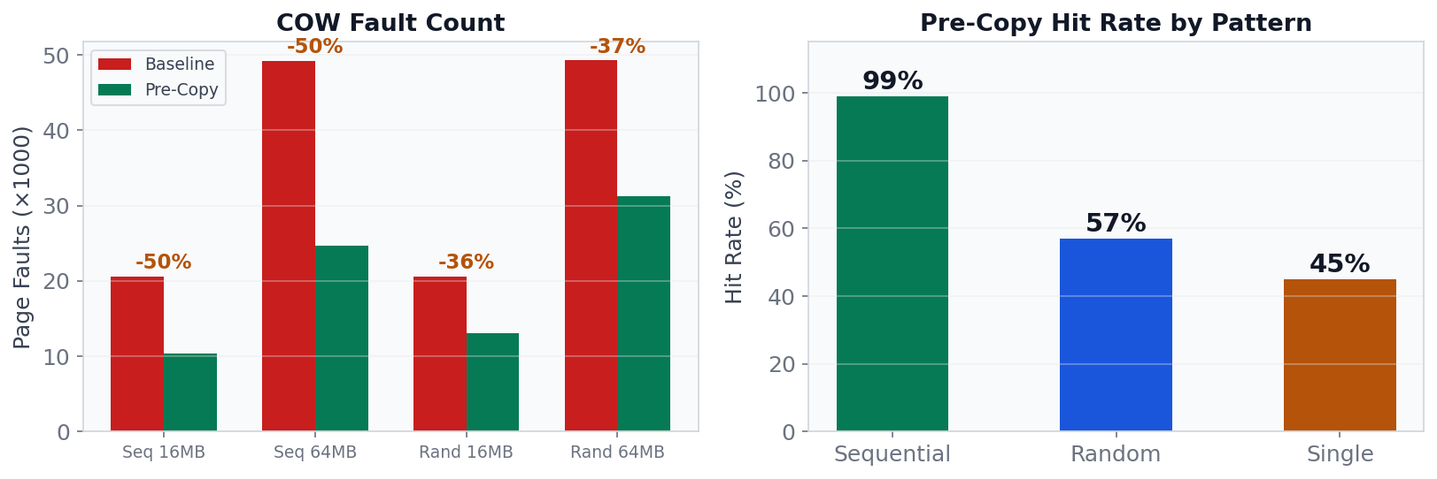
Results: Fault Reduction & Hit Rate Analysis
Sequential: 99% hit rate → 50% fault reduction. Almost every pre-copy is used (perfect spatial locality).
Random: 57% hit rate → 36% fault reduction. Lower locality but still positive — all pages eventually written.
Single: 45% hit rate → negligible benefit. Overhead of failed pre-copy attempt outweighs the rare hit.

Slide 22
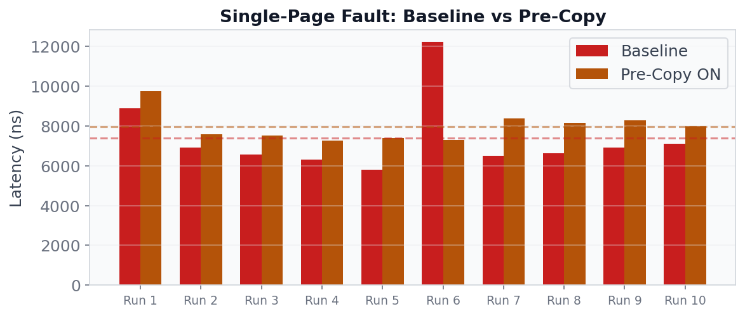
Results: Single-Fault Overhead of Pre-Copy
Baseline avg: 6,782 ns | Pre-Copy avg: 7,935 ns | Overhead: +17.0% (+1,153 ns)
Pre-copy adds ~1.15 μs per fault because it ALWAYS attempts to pre-copy the next page, even when only 1 page is written.
In bulk workloads (thousands of faults), this overhead is negligible compared to the faults eliminated.

Slide 23
Analysis: Why Pre-Copy Works
The Economics of Pre-Copy
Cost per pre-copy:
● PTE lookup: ~50 ns
● Page allocation: ~100 ns
● 4KB copy: ~350 ns
● PTE update: ~50 ns
● Total cost: ~550 ns
Savings per hit:
● Eliminated page fault trap: ~6,500 ns
Net savings per hit: ~5,950 ns
Break-even hit rate: 550/6500 = 8.5%
Our actual: 57-99% → massive net positive
Why It Works for Sequential
Why It Still Works for Random
Programs that process arrays, buffers, or
memory-mapped files access pages in order:
page 0 → page 1 → page 2 → ...
Pre-copy predicts with 99% accuracy.
Each hit saves a full trap cycle (~6.5 μs).
50% fewer faults → 17% faster runtime.
After fork(), ALL pages are COW-shared.
When page X faults, page X+1 is also shared.
Even in random order, X+1 will eventually
be written → the pre-copy is not wasted.
57% of pre-copies are used — page was going
to be copied anyway, just done it earlier.

Slide 24
Analysis: Trade-offs & Costs
Metric
Sequential
Random
Single Page
Runtime improvement
-17.0%
-14.9%
+17.0%
Fault reduction
-49.7%
-36.3%
~0%
Pre-copy hit rate
99%
57%
45%
Wasted copies
~1%
~43%
~55%
Extra memory per fault
1 page (4KB)
1 page (4KB)
1 page (4KB)
Per-fault overhead
+550 ns
+550 ns
+1,150 ns
Net benefit per fault
+5,950 ns
+2,700 ns
-1,150 ns

Slide 25
Limitations & Future Work
Limitations
Future Work
1. Page size: 4KB only
THP (2MB) not tested — would show very
different latency due to 512x larger copy
2. Pre-copy depth: 1 page ahead only
Deeper lookahead (N+2, N+3) not explored
3. Measurement perturbation
ktime_get() adds ~20-50 ns overhead per call
Sampled printk observes subset of events
4. Single child process only
Multi-child fork scenarios not tested
5. PMD boundary skipped
Affects at most 1 in 512 sequential pages
1. Adaptive pre-copy depth
Track hit rate per-VMA; if high, pre-copy
2-4 pages ahead for better prefetching
2. Huge Page support
Handle THP COW with sub-page granularity
(break 2MB into 4KB on partial write)
3. Workload detection
Auto-enable pre-copy for sequential VMAs,
auto-disable for random/sparse patterns
4. Delayed allocation
Alternative approach from assignment
5. Multi-process benchmarks
Test with multiple children sharing pages
25

Slide 26
Conclusion
Requirement 1: Measurement
Requirement 2: Pre-Copy
● 4KB COW page copy: ~350 ns
● Full write fault: ~6,800 ns
● Copy = only 5% of total cost
● Trap overhead dominates at 95%
● Random ~10% slower than sequential
● Latency stable across working set sizes
● P99 < 1 μs for the copy itself
● Sequential: -17% time, -50% faults
● Random: -15% time, -36% faults
● Hit rate: 99% (seq) / 57% (rand)
● Tail latency: P99 -14%, Max -28%
● Trade-off: +17% single-fault overhead
● Break-even at just 8.5% hit rate
● Net positive for all bulk workloads
Key Takeaway
Reducing the number of page fault traps matters far more than optimizing the copy itself. Pre-copy achieves this by exploiting spatial locality to speculatively eliminate future faults, delivering 15-18% runtime improvement with a simple, safe, and toggleable kernel modification.

Slide 27
Thank You!
Questions & Discussion

