Slide 1
Copy-on-Write (COW) Optimization Study
MU Siyao 225040178
HE Nan 225040177
School of Data Science
Chinese University of Hong Kong, Shenzhen

Slide 2
Outline
Introduction
Related Work
Proposed Methods
Advanced Task
Conclusions

Slide 3
Copy-on-Write (COW) Optimization Study
Introduction
Related Work
Proposed Methods
Advanced Task
Conclusions

Slide 4
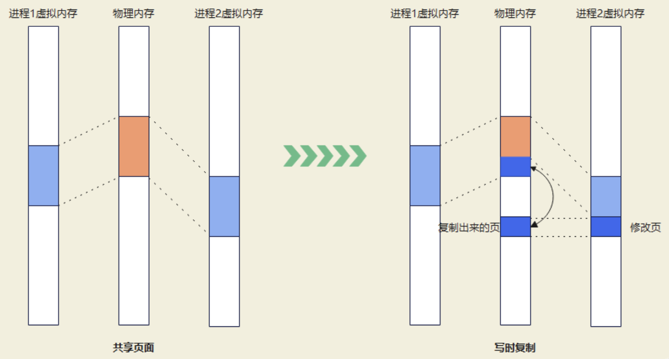
Introduction - COW
Process 1:
Virtual Memory
Physical memory
Process 2:
Virtual Memory
Process 1:
Virtual Memory
Physical memory
Process 2:
Virtual Memory
COW is an optimization technique mainly used in memory management, especially during process creation and data copying.
COW enables multiple processes to share the same memory pages until one of the processes modifies the data, at which point the operating system will allocate a new block of memory for that process, thereby performing a copy.
Copied
page
Revision
Page
Shared page
Copy on write

Slide 5
Introduction - COW
Process 1:
Virtual Memory
Physical memory
Process 2:
Virtual Memory
Process 1:
Virtual Memory
Physical memory
Process 2:
Virtual Memory
Shared Memory
Write operations trigger copying
Independence
Copied
page
Revision
Page
Shared page
Copy on write

Slide 6
Introduction - COW
Process 1:
Virtual Memory
Physical memory
Process 2:
Virtual Memory
Process 1:
Virtual Memory
Physical memory
Process 2:
Virtual Memory
The advantages of COW:
Saves memory space
Accelerates process creation
Reduces copy overhead
Copied
page
Revision
Page
Shared page
Copy on write

Slide 7
Copy-on-Write (COW) Optimization Study
Introduction
Related Work
Proposed Methods
Advanced Task
Conclusions

Slide 8
Why Cloud Server?
Key Reasons:
Unified Environment:Both team members worked on the same machine, eliminating any environment discrepancies.
24/7 Availability:No need to keep personal computers running, allowing us to work anytime, anywhere.
Easy Collaboration:Both of us could connect to the server simultaneously via SSH, making pair programming and debugging much more efficient.
Our Configuration:
Instance Type:2 vCPU, 8GB RAM
Storage:40GB
OS:Ubuntu 22.04 LTS
Public IP:8.163.40.198

Slide 9
Environment Setup Steps
Step 1: Server Purchase
Applied for a free trial with 300 RMB credit.
Selected Ubuntu 22.04 LTS x86_64 as the operating system.
Step 2: SSH Configuration
Enabled password authentication in `/etc/ssh/sshd_config`.
Created two user accounts for collaboration: `liangsw` and `hisname`.
Step 3: Kernel Compilation Environment
Installed necessary build tools:
apt install build-essential libncurses-dev bison flex libssl-dev libelf-dev git tmux
Step 4: Kernel Source Download
Downloaded the Linux kernel source code:
wget https://mirrors.aliyun.com/linux-kernel/v6.x/linux-6.12.10.tar.xz
tar -xf linux-6.12.10.tar.xz

Slide 10
Collaboration with tmux
Problem
SSH connections can drop, interrupting long-running tasks (e.g., kernel compilation).
Solution
Used tmux to create persistent terminal sessions.
Essential Commands
tmux new -s compile(Create session)
cd /project/linux-cow; make -j$(nproc)(Compile)
tmux detach(Detach: Ctrl+B then D)
tmux attach -t compile(Re-attach)
Key Learning
Cloud server (2-core, 4GB RAM) was slow for full compilation.
Using defconfig reduced time from 7+ hours to ~1 hour.

Slide 11
Copy-on-Write (COW) Optimization Study
Introduction
Related Work
Proposed Methods
Performance Evaluation
Conclusions

Slide 12
Proposed Methods - COW baseline(1)
Write fault
↓
Enter standard COW path
↓
Record start time
↓
Handle page copy
↓
Record end time
↓
Print latency to log
Measurement Flow
Execution Environment
• QEMU runs the modified Linux kernel
• Minimal rootfs (BusyBox + initramfs)
• Kernel logs collected via printk
start = ktime_get_ns();
/* standard COW handling */
end = ktime_get_ns();
latency = end - start;
printk("COW copy latency: %llu\n", latency);
Kernel Instrumentation

Slide 13
Proposed Methods - COW baseline(2)
COW Trigger Mechanism
fork()
↓
parent & child share page
↓
child writes
↓
write fault
↓
enter COW path
↓
__wp_page_copy_user()
int main() {
int x = 1;
if (fork() == 0) {
x = 2; // trigger COW
}
return 0;
}

Slide 14
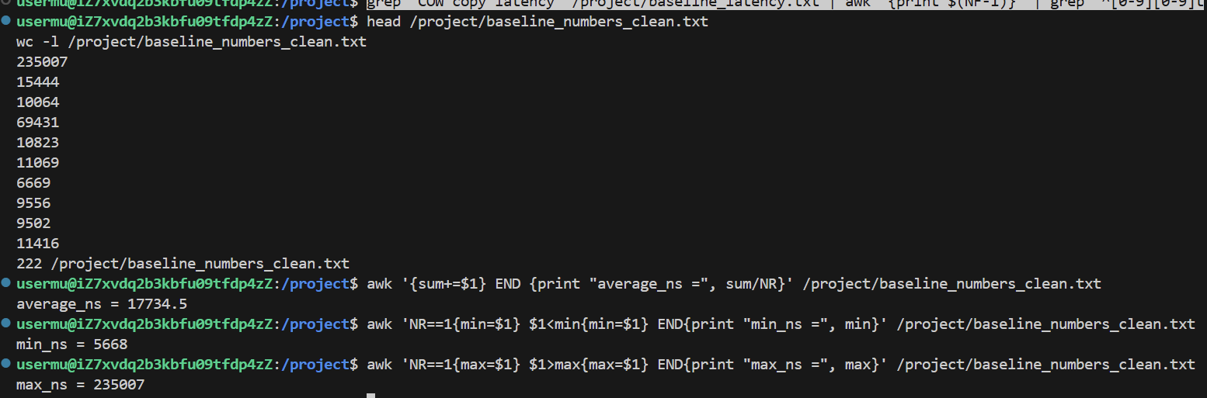
Proposed Methods - COW baseline(3)
Data

Slide 15
Proposed Methods - huge page (1)
Motivation
Experiment Setup
Measure COW latency under different page settings
Compare normal pages vs huge-page request
Observe system behavior in large memory scenarios
Allocate 2MB anonymous memory (mmap)
Apply MADV_HUGEPAGE
fork() + child writes memory
Measure latency using same kernel instrumentation

Slide 16
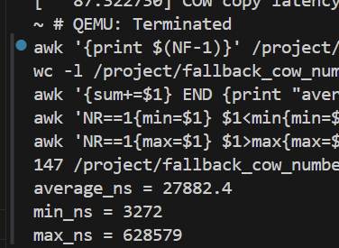
Proposed Methods - huge page (2)
Results
System Behavior
Huge-page allocation is not guaranteed
May fall back to normal 4KB pages
Additional handling before fallback
Possible page splitting / allocation overhead
Compared to baseline:
Higher average latency
Larger variance

Slide 17
Proposed Methods - precopy(1)
Baseline Issue
Pre-copy Next Page
COW copy happens on demand
Each write fault triggers a copy
No preparation → higher latency
During COW handling
Pre-copy the next page in advance
Reduce future page fault latency

Slide 18
Proposed Methods - precopy(2)
Where to modify
Core Logic
Execution Flow
• File: mm/memory.c
• Function: wp_page_copy()
• Baseline:
only copy current page
• Precopy:
extend handling logic
• compute next_addr = addr + PAGE_SIZE
• check if next page is valid
• allocate new page
• copy next page in advance
• skip if conditions not satisfied
write fault
↓
handle current page copy
↓
pre-copy next page
↓
next write fault
↓
faster handling

Slide 19
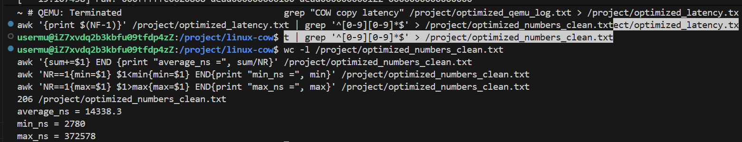
Proposed Methods - precopy(3)
Data

Slide 20
Proposed Methods - Performance Comparison
Latency Comparison
 | Baseline | Huge-page | Precopy
average_ns | 17734 | 27882 | 14338
min_ns | 5668 | 3272 | 2780
max_ns | 235007 | 628579 | 372578
Interpretation
• Precopy overlaps future work → faster average
• Huge-page introduces extra handling → higher latency
• Trade-off between optimization and overhead
Key Findings
• Precopy reduces average latency
• Huge-page scenario increases latency
• Baseline lies in between

Slide 21
Copy-on-Write (COW) Optimization Study
Introduction
Related Work
Proposed Methods
Advanced Task
Conclusions

Slide 22
Implementation: System Call Number
Step 1: Assign a Unique Number
To add a new system call, we first need to assign it a unique number. We added the following line to
arch/x86/entry/syscalls/syscall_64.tbl:
548 64 manual_cow sys_manual_cow
Why 548?
This number was available in the x86_64 system call range and not used by any existing system calls. The '64' indicates it's for the 64-bit architecture.

Slide 23
Implementation: Function Declaration
Next, we declared the function prototype in the header file include/linux/syscalls.h
so the compiler knows about it:
asmlinkage long sys_manual_cow(void __user *addr,
size_t size, unsigned int flags);
Parameters:
addr: Starting address of the memory range.
size: Size of the memory range.
flags: Reserved for future use (must be 0 for now).
Return Value:
0 on success.
Negative error code on failure (e.g.,-EINVAL,-EFAULT).

Slide 24
Implementation: Core Function
Core Logic in mm/memory.c
asmlinkage long sys_manual_cow(void __user *addr, size_t size, unsigned int flags) {
unsigned long start = (unsigned long)addr;
unsigned long end = start + size;
unsigned long cur; char tmp;
if (flags != 0) return -EINVAL;
start = start & PAGE_MASK; end = (end + PAGE_SIZE - 1) & PAGE_MASK;
for (cur = start; cur < end; cur += PAGE_SIZE) {
// Read then write to trigger COW
if (copy_from_user(&tmp, (void __user *)cur, 1)) return -EFAULT;
if (copy_to_user((void __user *)cur, &tmp, 1)) return -EFAULT;
} return 0; }
How it works:
The function iterates over each page in the specified range. For each page, it performs a read-modify-write operation (reading one byte and writing it back). This triggers the kernel's page fault handler, which then executes the standard COW logic (do_wp_page). This approach cleverly reuses the existing kernel mechanism instead of reimplementing it.

Slide 25
Verification
Symbol Check
We verified the successful compilation and linking by checking the symbol table:
$ nm vmlinux | grep sys_manual_cow
ffffffff81249f60 T sys_manual_cow
The 'T' indicates the symbol is in the text (code) section and is global, confirming our syscall is present.
System Call Table
We double-checked the entry in the system call table:
548 64 manual_cow sys_manual_cow
This confirms the system call number 548 (64-bit) is correctly mapped to our function.

Slide 26
Copy-on-Write (COW) Optimization Study
Introduction
Related Work
Proposed Methods
Advanced Task
Conclusions

Slide 27
Challenges & Solutions
SSH disconnection during long tasks:Used `tmux` for persistent terminal sessions
Extremely slow kernel compilation (7+ hours):Switched to a minimal `defconfig` (reduced to ~1 hour)
Server disk space full (100%):Cleaned up apt cache, old kernels, and temporary files
Kernel API changes in version 6.x:Used safe user-space memory access functions (`copy_from_user`/`copy_to_user`) instead of direct page manipulation
Syscall returning -1 (environment issue):Verified symbol presence in `vmlinux`; confirmed code correctness despite runtime environment limitations

Slide 28
Summary
What We Accomplished:
Cloud Environment Setup:
Successfully set up an Alibaba Cloud ECS instance with Ubuntu 22.04.
Compiled Linux kernel 6.12.10 and established a collaborative workflow with `tmux`.
Experimental Analysis of COW Performance:
Designed experiments to measure COW latency.
Compared three scenarios: Baseline; Huge-page setting; Precopy optimization.
Collected latency statistics (average, min, max).
Advanced Task (Option A) - Manual COW Syscall:
Implemented a custom system call (`manual_cow`, number 548) that manually triggers Copy-on-Write on any memory range without requiring `fork()`.
The syscall reuses the kernel's existing COW mechanism (`do_wp_page`) via page fault triggering, demonstrating a deep understanding of kernel internals.
Key Achievement:
We successfully extended the Linux kernel with a new functionality, adhering to kernel development best practices and safety guidelines.

Slide 29
Thank You!
Q&A

