Slide 1



VMMap Visualizer:
Kernel Virtual Memory Mapping & Process Lifecycle Tracker
Opening the "Black Box" of Linux Process Address Spaces
Presenters: Ren Pengxu, He Yunhui
Date: 2026.4.2
Course: Operating Systems (Topic-8)
Notes:
Good morning, everyone.
This project focuses on one important but often abstract topic in operating systems, which is the virtual memory layout of Linux processes.
Although process memory is continuously managed by the operating system, for most students and developers it still feels like a black box.
So the main purpose of our project is to make that black box visible and easier to understand.

Slide 2
Division of Work
Kernel Instrumentation & Backend Logic
Lifecycle Tracking & Visualization
He Yunhui 225040182
Ren Pengxu 225040184
Implementing BCC tracepoints to monitor memory-related syscalls (mmap, brk, etc.).
Developing the high-performance Ring Buffer event channel to relay data from kernel space.
Designing the system architecture and defining the theoretical memory distribution.
Addressing low-level instrumentation challenges and kernel-to-user data integrity.
Building the Lifecycle Tracking state machine for fork, exec, and exit events.
Developing the Reconciliation (Diff) Engine using /proc filesystem snapshots as the "Source of Truth".
Designing the Frontend Visualization using Vanilla JS and DOM-based rendering.
Implementing the real-time WebSocket stream and interactive timeline features.
Notes:
Left includes using BCC tracepoints to monitor memory-related syscalls such as `mmap` and `brk`, building the ring buffer event channel, designing the system architecture, and dealing with low-level instrumentation challenges.
Right includes the lifecycle tracking state machine, the reconciliation engine based on `/proc` snapshots, the frontend visualization, and the real-time WebSocket and timeline features.
Our presentation will be divided into two parts.
I will first introduce the motivation, requirements, architecture, theoretical foundation, and kernel instrumentation.
Then my teammate will continue with lifecycle tracking, reconciliation, visualization, demo results, and the final conclusion.

Slide 3
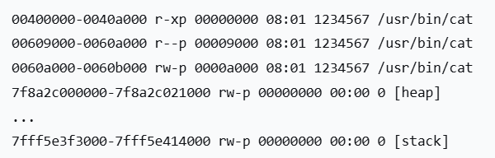
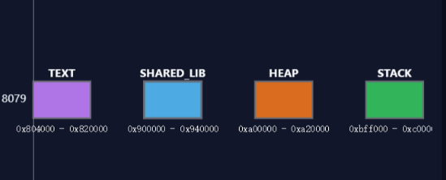


Project Motivation
The Problem
Our Goal
Virtual memory is an abstract concept.
/proc/pid/maps is static and hard to read.
Understanding fork()/exec() memory changes is difficult.
Create a "Live Map" of memory.
Zero kernel source modification (using eBPF).
Visualize transitions, not just states.
Notes:
Virtual memory is a fundamental concept, but it is difficult to observe directly.
In real Linux processes, the address space changes dynamically when a program allocates memory, loads libraries, creates child processes, or executes another binary.
Linux provides `/proc/<pid>/maps`, but that file is only a static snapshot. (Left Figure)
It tells us what the memory layout looks like at one moment, but not how it evolves.
So if we want to understand what really happens after `fork()` or `exec()`, the plain text output is not enough.
That is why we wanted to build a **live map** of process memory.
Instead of only showing states, we want to show transitions.

Slide 4




Project Objectives
Instrument Syscalls
Instrument mmap(), munmap(), and brk() to monitor memory operations.
Capture VMA Metadata
Record critical data including Start/End addresses, Permissions, and Backing File info.
High-Freq & Visualization
Support high-frequency updates and provide clear visualization of memory changes.
Tracking Process Lifecycle
Track Fork/Exec events and analyze Parent-Child memory divergence.
Focus: Comprehensive memory instrumentation with a focus on real-time data capture and lifecycle analysis.
Notes:
The first requirement is to instrument `mmap()`, `munmap()`, and `brk()`.
These syscalls are closely related to memory allocation, mapping removal, and heap adjustment.
The second requirement is to capture VMA metadata, including start and end addresses, permissions, and backing file information.
These fields help us understand what each memory region actually represents.
The third requirement is to support high-frequency updates and clear visualization, so that changes can be observed in real time.
In addition to these required goals, we also implemented an extended goal: **process lifecycle tracking**.
That means tracking `fork` and `exec`, and observing how parent and child processes diverge over time.

Slide 5
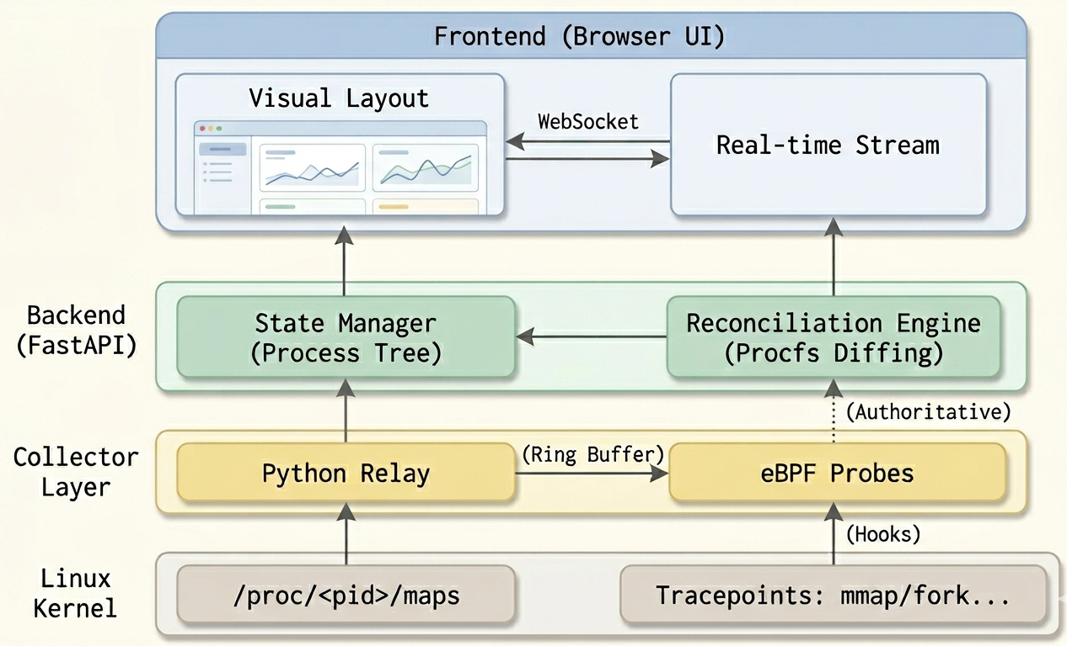
System Architecture Overview
Vanilla JS
+
WebSocket-based visualization
Python/FastAPI state manager
+
procfs parser
eBPF/BCC probes in the kernel
Notes:
Now let us look at the overall architecture.
Our system consists of three layers.
At the bottom is the **collector layer in kernel space**, where eBPF and BCC probes monitor kernel events.
Whenever important syscalls or lifecycle events occur, the collector captures lightweight event metadata.
In the middle is the **backend layer in user space**, implemented with Python and FastAPI.
It receives events, maintains tracked process states, reads `/proc/<pid>/maps`, computes differences between snapshots, and generates higher-level semantic labels.
At the top is the **frontend visualization layer**, built with Vanilla JavaScript and WebSocket-based updates.
This layer displays process memory layouts, timeline history, and comparison views.
So the overall pipeline is: kernel event capture, state reconstruction, diff and interpretation, and then live visualization.

Slide 6

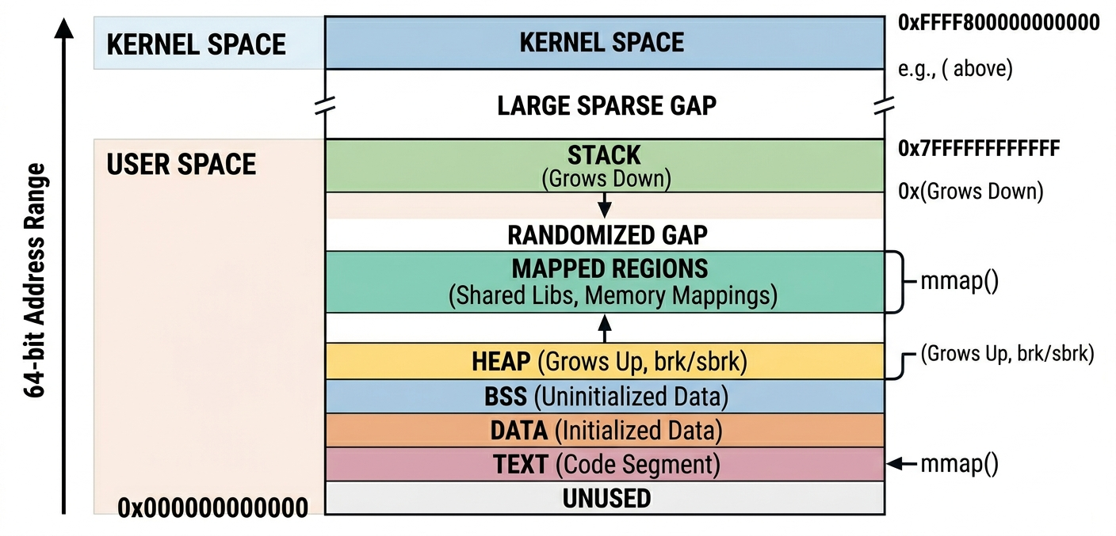

Theoretical Foundation: Virtual Address Space
Key Concepts
Virtual Memory Space Distribution
VMA (Virtual Memory Area) structures
The role of mm_struct in the task descriptor
Annotation
Showing high-address stack growing down and low-address heap growing up.
Operating System Internals / Memory Management
Notes:
A Linux process address space is composed of multiple **virtual memory areas**, or VMAs.
Each VMA is a contiguous region with its own address range, permissions, and role.
Examples include code segments, data segments, heap, stack, mapped files, and shared libraries.
The kernel uses structures such as `mm_struct` to organize this address space.
Although a process sees a continuous virtual memory view, internally the kernel manages many VMAs that may be created, resized, merged, or removed during execution.
One important structural pattern is the growth direction:
the heap usually grows upward, while the stack grows downward.
This is one of the core behaviors that our visualizer tries to make easier to observe.

Slide 7
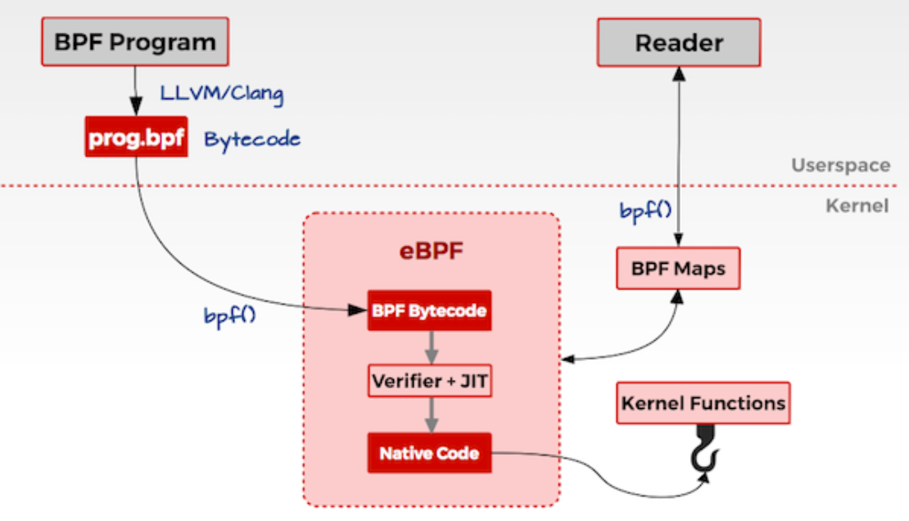
Theoretical Foundation ：eBPF
eBPF (Extended Berkeley Packet Filter)
a Linux kernel technology that allows running sandboxed programs in kernel space without modifying kernel source or loading kernel modules.
It provides a safe, efficient, and programmable way to observe and interact with kernel events.
Annotation
Notes:
eBPF, or Extended Berkeley Packet Filter, is a Linux kernel technology that allows small sandboxed programs to run inside kernel space.
It does not require modifying the kernel source code or loading a full kernel module.
in our design, eBPF mainly plays the role of lightweight event capture inside the kernel.

Slide 8


Kernel Instrumentation (Core Component)
Core Technology
Key Advantages
Hooked Syscalls
Leveraging eBPF (Extended Berkeley Packet Filter) for dynamic tracing.
Safe execution environment, high efficiency, and zero downtime deployment.
sys_mmap, sys_munmap, sys_brk, sys_clone, sys_execve.
Insight:By hooking these critical syscalls, we gain deep visibility into memory management and process lifecycle events without disrupting normal operation.
Notes:
The first core technical component of our project is **kernel instrumentation**.
We chose to use eBPF for dynamic tracing because it is non-invasive, efficient, and safer than directly modifying kernel behavior.
It allows us to observe important events without rebuilding the kernel.
The syscalls we mainly monitor are `mmap`, `munmap`, and `brk`, because they directly correspond to major changes in the process memory layout.
For the extended lifecycle part, we also monitor `fork` and `exec`.
One important design decision is that the kernel-side component does not try to reconstruct the complete memory state by itself.
Instead, it focuses on identifying when important events happen and collecting lightweight metadata that can later be used by the backend.

Slide 9


Implementation: Kernel Instrumentation Code
// Logic for intercepting memory syscalls in Kernel Space (pseudocode)
on syscall_event(mmap / munmap / brk):
if current process is tracked:
collect PID from bpf_get_current_pid_tgid()
identify syscall type (MMAP, MUNMAP, or BRK)
capture address, length, and permissions metadata
package event metadata into a structured record
send event to user space through ring buffer
Non-Invasive
Hooks into Linux kernel tracepoints without modifying source code.
Efficient Relay
Uses the BPF Ring Buffer to forward events to the backend with minimal latency.
Precision
Captures essential VMA (Virtual Memory Area) attributes directly at the point of allocation.
Notes:
This slide shows the simplified logic of the kernel-side implementation.
Whenever a memory-related syscall occurs, the eBPF program first checks whether the current process belongs to the tracked set.
This is necessary because tracing the entire system would generate too much irrelevant data.
If the process is tracked, the program collects key information such as the PID, syscall type, address, length, and permission-related metadata.
Then it packages the event into a structured record.
After that, the event is sent to user space through the **ring buffer**, which serves as an efficient communication mechanism between kernel space and the backend.
So, from the kernel side, the main job is to detect important events, extract the essential metadata, and pass them upward efficiently.

Slide 10

Challenges in Kernel Instrumentation
Handling brk() specifically
Filtering noise
Unlike mmap, brk only provides the new program break address. We must calculate how the heap actually changed.
System-wide tracing generates massive data; we implemented PID-based filtering inside the BPF program to save CPU cycles.
These optimizations ensure efficient and accurate kernel-level monitoring without overwhelming the system resources.
Notes:
There were two important challenges in this part.
The first challenge is handling `brk()`.
Unlike `mmap`, `brk` does not directly create a clearly identifiable new region.
Instead, it only changes the program break, so we later need snapshot comparison to determine how the heap actually changed.
The second challenge is filtering noise.
System-wide tracing can produce a large number of events, many of which are unrelated to the target process.
So we implemented PID-based filtering inside the BPF program to reduce overhead and improve efficiency.

Slide 11


Lifecycle Tracking (Advanced Feature)
Beyond VMA tracking: Monitoring the "birth" and "transformation" of processes.
Different Stages
Fork
Exec
Exit
Copy-on-Write (COW) initial state
Complete address space replacement
Immediate cleanup of all VMAs
A child process initially has a memory layout very similar to the parent.
The old address space is replaced with a new one
All VMAs are cleaned up
Notes:
A process address space changes not only because of `mmap` or `brk`, but also because processes are created, replaced, and terminated.
For example, after `fork`, a child process initially has a memory layout very similar to the parent.
After `exec`, the old address space is replaced with a new one.
After `exit`, all VMAs are cleaned up.
These lifecycle transitions are difficult to understand from raw events alone.
So our goal is to turn them into higher-level process semantics that can be tracked and visualized more clearly.

Slide 12
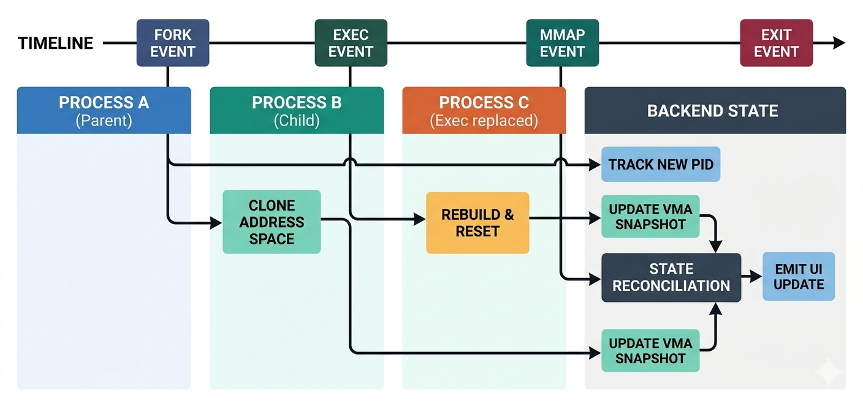
Lifecycle Tracking Architecture
Architecture Description
The diagram shows how the StateManager handles a FORK event by cloning the parent’s VMA list to establish a baseline for tracking memory divergence between parent and child processes.
Notes:
At the center of this design is the **StateManager**, which maintains the state of each tracked process.
This includes the current memory snapshot, parent-child relationships, and recent events.
When a `fork` event arrives, the backend creates a child process state.
If the child process’s own `/proc/<pid>/maps` is not ready yet, the system temporarily uses the parent snapshot as a seed.
This keeps the interface continuous until the child’s actual memory map becomes available.
As more events arrive, the backend keeps refreshing the child state, so the system can visualize how the child gradually diverges from the parent.

Slide 13
Implementation: Lifecycle Logic Code
// Logic for managing process transitions in User Space
on user-space event received:
identify process PID and event type from the event stream
if event is fork:
create child process state from parent baseline (seeding)
else if event is exec:
mark process memory as rebuilt (triggering full map refresh)
else if event is exit:
remove process from active tracking and cleanup metadata
read latest /proc/<pid>/maps to get the authoritative state
compare old snapshot with new snapshot to detect specific changes
generate high-level memory changes (e.g., BRK_GROW, MMAP_ADD)
update visualization via WebSocket to the frontend
Resilient State
Uses parent snapshots as a "seed" for new children to ensure UI continuity before /proc is ready.
Authoritative Sync
Uses the /proc filesystem as the final "source of truth" to reconcile kernel events.
Event Synthesis
Translates raw syscalls into semantic labels (e.g., "Heap Growth") for the user.
Notes:
This slide presents the core logic of lifecycle tracking in user space.
When the backend receives an event, it first identifies the process ID and the event type.
Then it updates the process state according to that event.
If the event is `fork`, the backend creates a new child state based on the parent baseline.
If the event is `exec`, the process is marked as rebuilt because the address space needs to be refreshed.
If the event is `exit`, the process is removed from active tracking.
After that, the backend reads the latest `/proc/<pid>/maps`, compares it with the previous snapshot, detects memory changes, and translates them into semantic labels such as heap growth or mapping addition.
Finally, the updated state is pushed to the frontend through WebSocket.

Slide 14
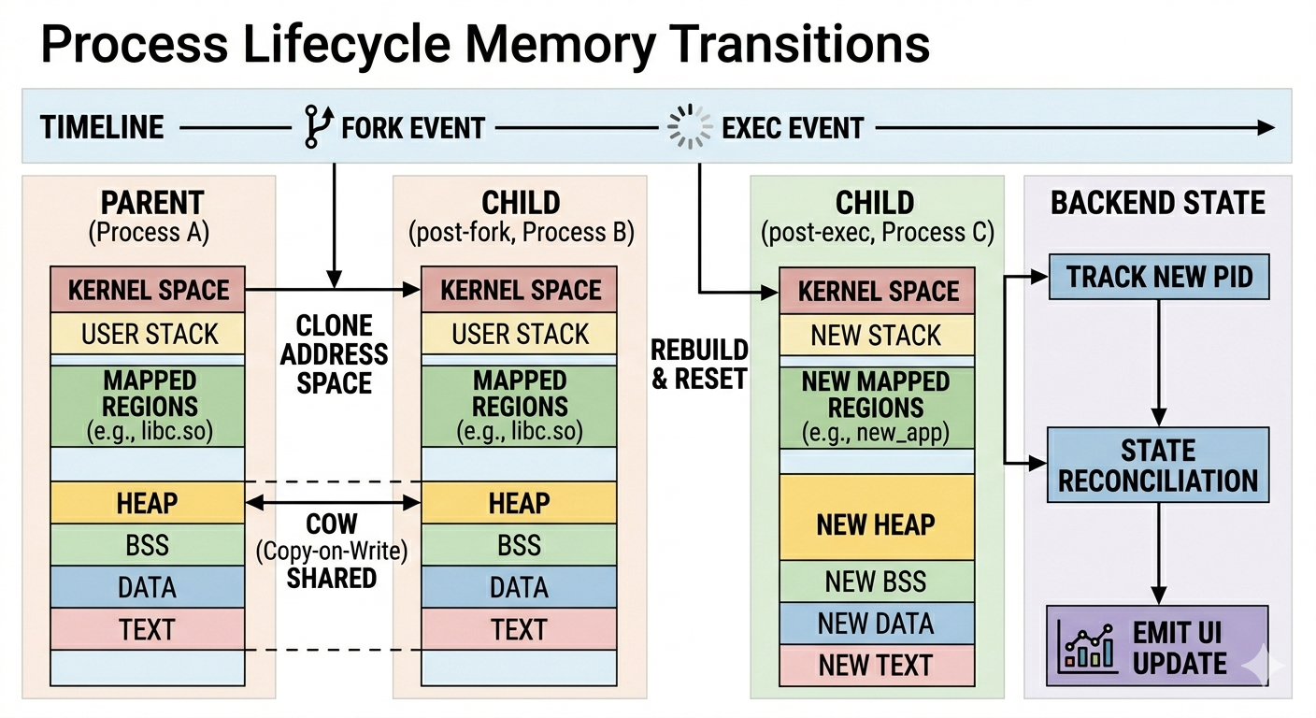




Process Lifecycle Memory Transitions
Clone
Diverged VMAs
Exec (Rebuild)
Exit
Initial Creation
Memory Layout Diff
Full Reconstruction
Termination
Walk through the transition from Clone to Diverged VMAs, then to Exec (Rebuild) where the memory layout is fully reconstructed, and finally to Exit.
Notes:
This slide summarizes the main lifecycle transitions that our system visualizes.
The first stage is **Clone**, which corresponds to the child process being created after `fork`.
At this point, the child initially looks very similar to the parent.
The second stage is **Diverged VMAs**.
As the parent and child continue running independently, they may allocate or release memory differently, so their layouts gradually diverge.
The third stage is **Exec Rebuild**.
This is a major transition because `exec` replaces the old program image with a new one, so the process memory layout changes substantially.
The final stage is **Exit**, where the process terminates and the tracked state is cleaned up.

Slide 15









The Reconciliation Engine (Diffing)
Authoritative Source:/proc/<pid>/maps(System of Record)
Event Triggers
eBPF mmap / Signal
Read Snapshot
Backend fetches new state
Diff Engine
Compare Old vs. New
Detect
Changes
Detected Memory Changes:
MMAP_ADD
MUNMAP_DEL
BRK_GROW
RESIZE
Notes:
This slide shows one of the most important ideas in our design: the **reconciliation engine**.
The key principle is that kernel events are treated as triggers, while `/proc/<pid>/maps` is treated as the source of truth.
In other words, eBPF tells us when something important happened, but `/proc` tells us what the actual memory layout is.
Whenever a relevant event occurs, the backend reads a new snapshot from `/proc/<pid>/maps`.
Then it compares that snapshot with the previous one.
Through this diff process, the backend can detect mapping addition, mapping removal, heap growth, or region resizing.
This approach is especially important because raw syscalls alone are not always enough to reconstruct the final memory layout precisely.

Slide 16



Visualization Strategy
Lane Renderer
Normalized Y-Axis
Each process is represented as a distinct vertical lane for clarity.
Scaled visualization, supporting full range memory mapping.
Visual Encoding System
Heap
Dynamic Memory
Stack
Function Calls
Shared Libraries
System Resources
Code / Data
Executable Segments
Memory Layout Analysis • Address Space Visualization • Process Mapping
Notes:
After reconstructing the process state, the next step is to visualize it clearly.
Our strategy is to represent each process as an independent lane.
This makes comparison easier, especially for parent-child processes after `fork`.
Within each process view, different memory regions are visually encoded by type, such as heap, stack, shared libraries, and executable regions.
This helps users understand the address space at a glance instead of reading raw address ranges.
Another important design goal is to visualize both structure and change.
The interface should show not only what the memory layout looks like now, but also which parts changed and how.

Slide 17


Live Visualization Implementation
Real-Time Rendering
Timeline History
Parent–Child Comparison
Receive backend updates through WebSocket and refresh process memory views dynamically.
Store recent snapshots and event markers for inspecting memory evolution step by step.
Show processes side by side to highlight divergence after fork and reconstruction after exec.
Real-Time Updates · Timeline Inspection · Process Comparison
Notes:
This slide explains how the frontend supports real-time interaction.
First, the frontend performs **real-time rendering**.
It receives updates through WebSocket and refreshes the process memory views dynamically.
Second, it maintains **timeline history**.
By storing recent snapshots and event markers, the system allows users to inspect how the memory state evolves step by step.
Third, it supports **parent-child comparison**.
By showing processes side by side, the system makes it easier to observe how the child initially resembles the parent after `fork`, and how the address space is rebuilt after `exec`.

Slide 18
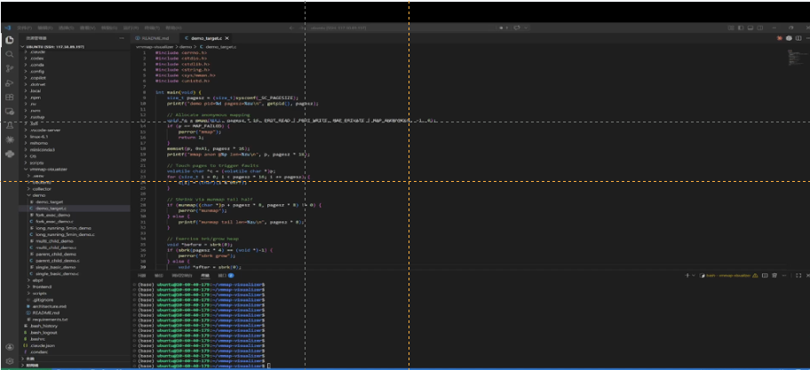
Demo Presentation
Notes:
Now I will introduce the demo part.
In the demo, there are several key things we want the audience to observe.
First, we show **process start**.
This demonstrates how a target process appears in the system and how its initial address space is displayed.
Second, we show **memory growth**.
When the process allocates memory, we can observe changes related to `brk` or `mmap`, especially in heap-related behavior.
Third, we show **fork**.
At that moment, a new child process appears, and its memory layout initially looks very similar to the parent.
Finally, we show **exec**.
This is where the child process memory layout is effectively cleared and rebuilt, which clearly shows why lifecycle-aware tracking is important.

Slide 19


Key Findings & Insights
Kernel vs. User
Performance
Precision
The kernel handles stack growth automatically via page faults; our visualizer captures the resulting VMA expansion.
Polling `/proc` is too slow for high-frequency apps; eBPF triggers are essential for responsiveness.
mmap doesn't always allocate memory immediately (Lazy Allocation); the RSS vs. Virtual Size distinction is crucial.
“Deep insights into memory management mechanisms, performance bottlenecks, and allocation precision.”
Notes:
hrough this project, we gained several important insights.
The first is about the relationship between kernel behavior and visible memory layout.
For example, stack growth is often handled automatically through page faults, but the resulting VMA expansion can still be captured by our visualizer.
The second is about performance.
If we rely only on polling `/proc`, the system is not responsive enough for high-frequency changes.
This shows why eBPF-triggered updates are important.
The third is about precision.
A successful `mmap` does not always mean that physical memory has already been allocated.
This is related to lazy allocation and the distinction between virtual size and RSS.

Slide 20
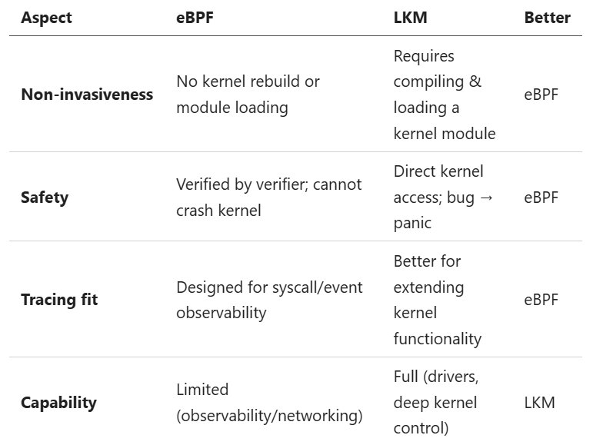
eBPF+BCC vs. LKM – Pros & Cons
Why eBPF is better suited for this project:
It is non‑invasive, safe (verifier‑protected), and purpose‑built for tracing syscalls and lifecycle events.
LKM offers full kernel control, but that capability is unnecessary for our monitoring goals.

Slide 21


Challenges & Future Work
Challenges Encountered
Future Development
UI Lag due to High-frequency Changes
Mitigated by limiting refresh frequency and using event-triggered updates.
Page Table Level: Visualizing PTE status
Visualize Valid, Invalid, and Dirty flags for deeper insights.
Tracking children of children
Addressed with a recursive tracking mechanism.
NUMA Support: Showing memory node
Extend mapping to show which NUMA node memory resides on.
Summary:Successfully addressed performance bottlenecks; future focus on deeper memory visualization and advanced architecture support.
Notes:
This slide discusses the remaining challenges and future directions.
One challenge is handling rapid memory-state changes while keeping the frontend responsive and readable.
To mitigate this, the system limits refresh frequency and uses event-triggered updates rather than redrawing everything on every change.
Another challenge is recursive tracking, such as following children of children.
This becomes important when lifecycle tracking goes beyond simple parent-child examples.
For future work, one possible direction is page-table-level visualization.
Currently, we mainly work at the VMA level, but going deeper into page tables could reveal more low-level details.
Another direction is NUMA-aware visualization, which would allow the system to show where memory is physically located in multi-node systems.

Slide 22

Conclusion
We successfully built a non-invasive, real-time memory visualizer that bridges the gap between kernel theory and observable behavior.
Goal
Our Implementation
mmap/munmap/brk
BCC tracepoints + syscall tracing
VMA Metadata
/proc/<pid>/maps reconstruction
Dynamic GUI
FastAPI + WebSockets + Browser UI
Advanced: fork/exec
Parent-Child tracking + Exec rebuild
Notes:
o conclude, we successfully built a **non-invasive, real-time memory visualizer** for Linux processes.
Our implementation covers the core Topic-8 requirements:
* syscall instrumentation for `mmap`, `munmap`, and `brk`
* VMA metadata reconstruction
* dynamic visualization
* and an advanced extension for `fork` and `exec`
More importantly, the project demonstrates a complete pipeline from kernel event capture to user-space reconstruction and live visualization.
Thank you very much for listening.
We are happy to take any questions.

Slide 23
Q&A
Questions?

