Slide 1


Topic 9
Implement and Evaluate a Custom Disk Scheduler
Team 17: Shengnan Chen 225040187
Yuxuan Fan 225040159
Date: 2026.4.7

Slide 2

CONTENTS
1. Background and Goals
2. Basic Method
3. Advanced Optimization
4. Evaluation Results

Slide 3
01
Background and Goals

Slide 4
1. Background and Goals
2. Basic Method
3. Advanced Optimization
4. Advanced options
1.1 Background
1. A massive speed disparity exists (RAM 100ns vs. HDD 10ms / NVMe 100µs), necessitating block-layer scheduling to hide this latency.
Latency Gap and Limitations
2. Default schedulers lack absolute priority differentiation, causing critical tasks to be interfered with by non-critical ones.
While multi-level queues guarantee low latency for high-priority tasks, continuous high-priority influx will cause low-priority tasks to starve indefinitely.
Starvation

Slide 5
1. Background and Goals
2. Basic Method
3. Advanced Optimization
4. Advanced options
1.2 Goals
Multi-Level Queue and Anti-Starvation
Implement a custom 3-tier strict priority scheduler (HIGH / NORMAL / LOW) within the Linux blk-mq framework and introduce an aging mechanism using arrival timestamps.
Evaluation
Prove effectiveness via metrics: ensure high-priority tasks achieve high IOPS and low latency, while low-priority tasks maintain non-zero throughput despite higher latency.

Slide 6
02
Basic Method

Slide 7
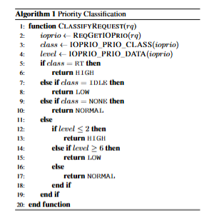
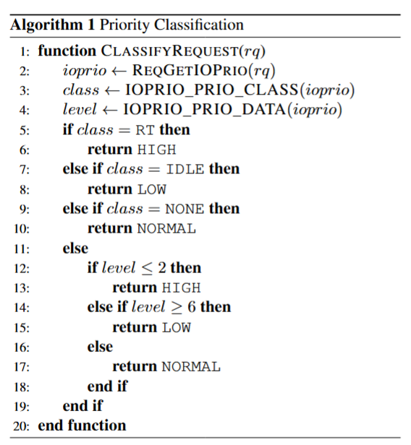
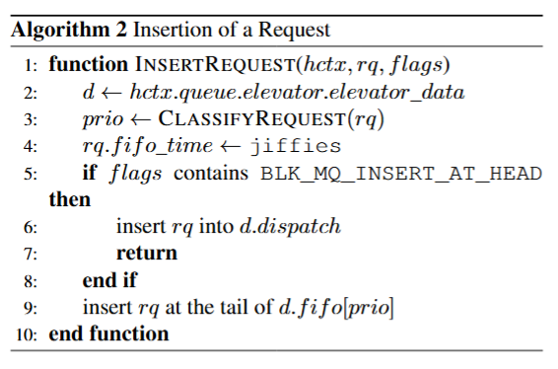
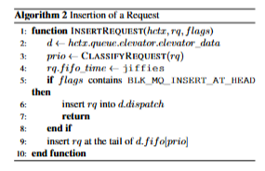
1. Background and Goals
2. Basic Method
3. Advanced Optimization
4. Advanced options
2.1 Three-Level Priority Queue
The first step for any scheduler is to accept requests from the upper-layer CPU software queues and place them in the correct positions, which brings us to the batch entry point
Next is the function that does the actual heavy lifting, It first calls a helper to extract the request’s I/O priority and maps it to one of three internal levels: HIGH, NORMAL, or LOW.

Slide 8
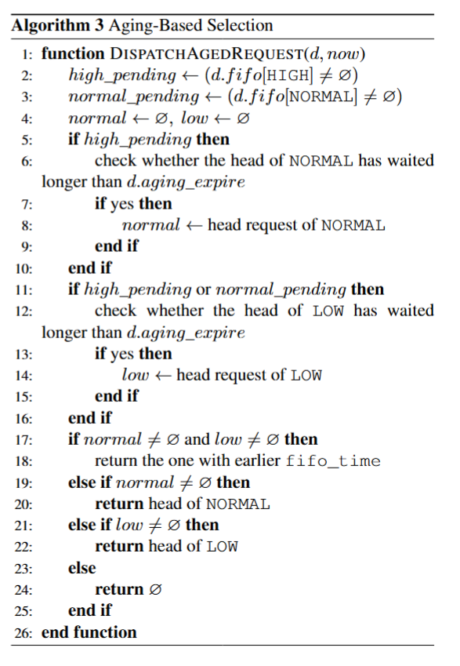
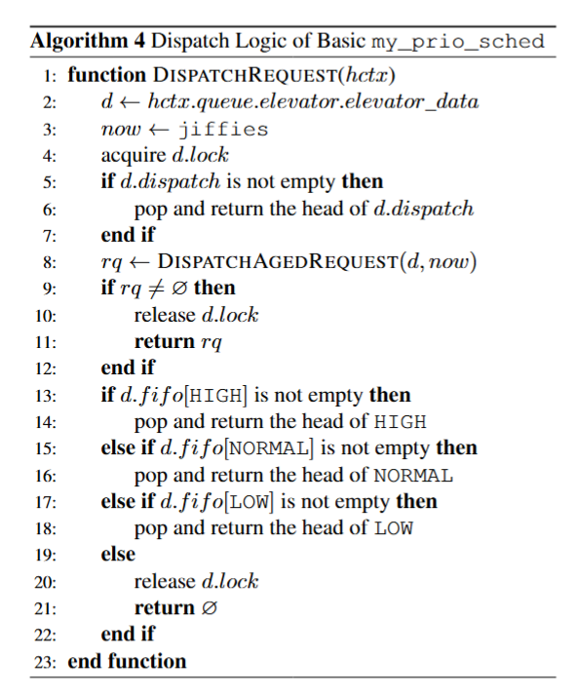
1. Background and Goals
2. Basic Method
3. Advanced Optimization
4. Advanced options
2.1 Aging and Starvation
Note that a pure three-level strict priority queue may cause starvation. Therefore, before normal priority dispatch, the scheduler first checks whether any lower-priority requests have waited too long and, if so, dispatches them earlier through aging.

Slide 9
03
Advanced Optimization

Slide 10
1. Background and Goals
2. Basic Method
3. Advanced Optimization
4. Advanced options
3.1 Analysis of Naive Method (1)
Priority Classification
Queue Insertion
Strict Priority Dispatch
Aging for Starvation Prevention
The scheduler first classifies each incoming request into one of three priority classes according to its ioprio value.
The request is inserted into the FIFO queue of its priority class. Requests with the special head-insertion flag are instead into a dispatch queue
The scheduler first checks the dispatch queue, and if it is empty, it selects requests in strict priority order.
To prevent starvation of lower-priority requests, the scheduler applies an aging mechanism before normal strict-priority dispatch.

Slide 11
1. Background and Goals
2. Basic Method
3. Advanced Optimization
4. Advanced options
3.1 Analysis of Naive Method (2)
Although the naive version correctly implements priority isolation and starvation prevention, its scheduling policy itself does not explicitly exploit sector locality or device characteristics.
Limitation
1.Adaptive Optimization to detect whether the current workload looks more sequential or more random.
2.The media-aware strategy to infer whether the current device should be treated as rotational or non-rotational.
Optimization

Slide 12
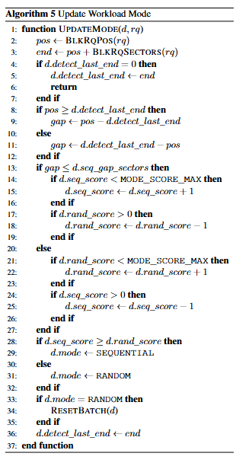
1. Background and Goals
2. Basic Method
3. Advanced Optimization
4. Advanced options
3.2 Adaptive Optimization (1)
States Update:
my_update_mode() tracks the sector gap between consecutive requests and maintains seq_score and rand_score
Merging Opeartions:
my_bio_merge() and my_request_merge() merge before insertion.
blk_mq_sched_try_insert_merge() merges during insertion.
Sequential
Random
Dispatch:
Dispatch immediately to prevent the consumption of merging operations.
Private Data Update:
Repairs private metadata structures and provide a lightweight short-burst mechanism in sequential mode.

Slide 13
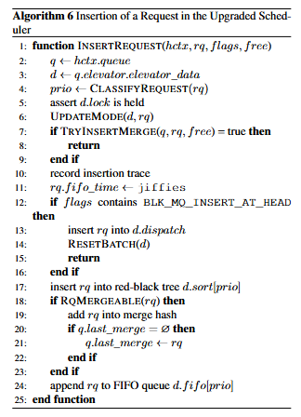
1. Background and Goals
2. Basic Method
3. Advanced Optimization
4. Advanced options
3.2 Adaptive Optimization (2)
States Update:
my_update_mode() tracks the sector gap between consecutive requests and maintains seq_score and rand_score
Merging Opeartions:
my_bio_merge() and my_request_merge() merge before insertion.
blk_mq_sched_try_insert_merge() merges during insertion.
Sequential
Random
Dispatch:
Dispatch immediately to prevent the consumption of merging operations.
Private Data Update:
Repairs private metadata structures and provide a lightweight short-burst mechanism in sequential mode.

Slide 14
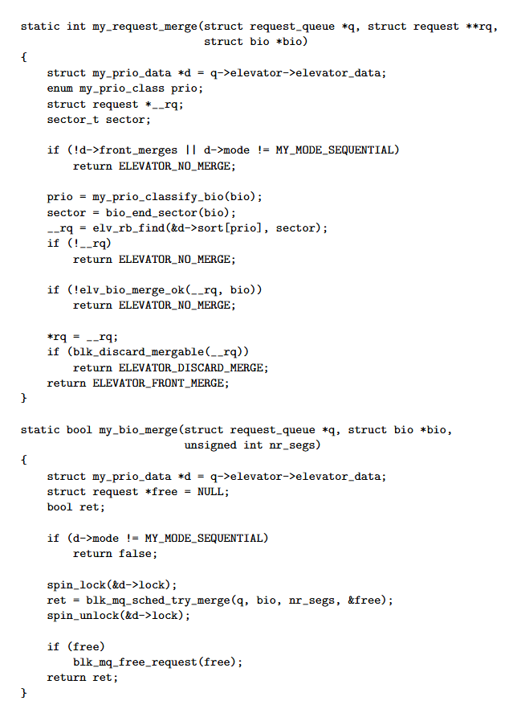
1. Background and Goals
2. Basic Method
3. Advanced Optimization
4. Advanced options
3.2 Adaptive Optimization (3)
States Update:
my_update_mode() tracks the sector gap between consecutive requests and maintains seq_score and rand_score
Merging Opeartions:
my_bio_merge() and my_request_merge() merge before insertion.
blk_mq_sched_try_insert_merge() merges during insertion.
Sequential
Random
Dispatch:
Dispatch immediately to prevent the consumption of merging operations.
Private Data Update:
Repairs private metadata structures and provide a lightweight short-burst mechanism in sequential mode.

Slide 15
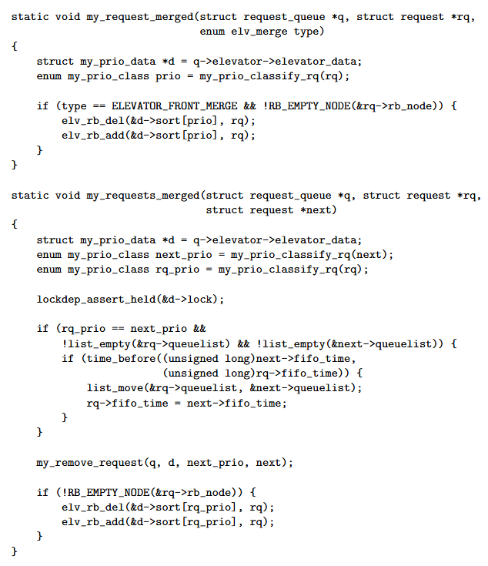
1. Background and Goals
2. Basic Method
3. Advanced Optimization
4. Advanced options
3.2 Adaptive Optimization (4)
States Update:
my_update_mode() tracks the sector gap between consecutive requests and maintains seq_score and rand_score
Merging Opeartions:
my_bio_merge() and my_request_merge() merge before insertion.
blk_mq_sched_try_insert_merge() merges during insertion.
Sequential
Random
Dispatch:
Dispatch immediately to prevent the consumption of merging operations.
Private Data Update:
Repairs private metadata structures and provide a lightweight short-burst mechanism in sequential mode.

Slide 16
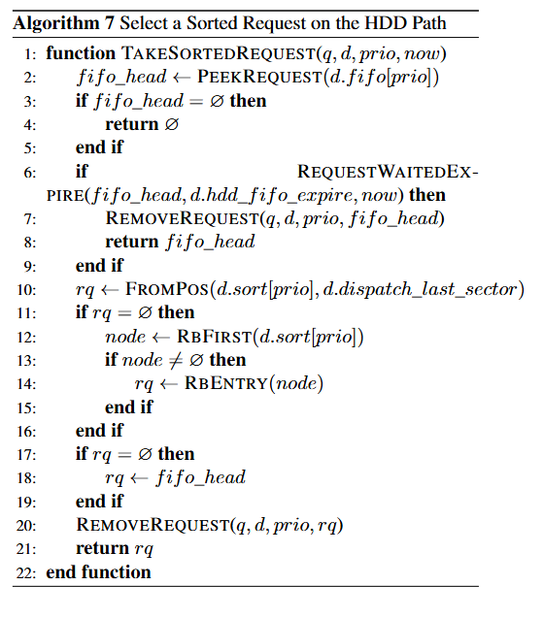
1. Background and Goals
2. Basic Method
3. Advanced Optimization
4. Advanced options
3.3 Media-Aware Optimization (1)
Branch HDD:
my_dispatch_from_prio() calls my_take_sorted_request() to check whether the FIFO head has expired; if so, it dispatches the FIFO head directly to avoid starvation. Otherwise, it selects a request from the sector-sorted RB-tree around dispatch_last_sector.
Branch SSD:
my_dispatch_from_prio() instead calls my_take_fifo_head(), directly popping the FIFO head without paying the extra cost of seek-oriented arbitration.

Slide 17
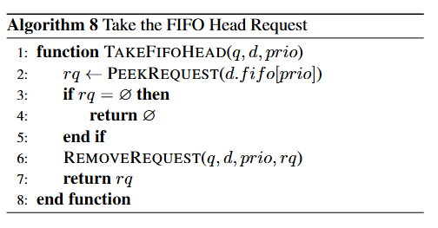
1. Background and Goals
2. Basic Method
3. Advanced Optimization
4. Advanced options
3.3 Media-Aware Optimization (2)
Branch HDD:
my_dispatch_from_prio() calls my_take_sorted_request() to check whether the FIFO head has expired; if so, it dispatches the FIFO head directly to avoid starvation. Otherwise, it selects a request from the sector-sorted RB-tree around dispatch_last_sector.
Branch SSD:
my_dispatch_from_prio() instead calls my_take_fifo_head(), directly popping the FIFO head without paying the extra cost of seek-oriented arbitration.

Slide 18
04.
Evaluation Results

Slide 19
1. Background and Goals
2. Basic Method
3. Advanced Optimization
4. Evaluation Results
4.1 Experiment Settings
Environment: Ubuntu Server 24.04.4 LTS on Oracle VirtualBox
Device under test: dedicated disk /dev/sdb
fio: fio-3.36, libaio, direct=1, time_based=1, runtime=30s, size=1G, norandommap=1, randrepeat=0, thread=1
database_sim: randread, 4k, iodepth=32, prioclass=2, prio=1
backup_sim: read, 128k, iodepth=8, prioclass=2, prio=7
Schedulers: none, mq-deadline, my_prio_sched (basic), my_prio_sched (optionab)
Evaluation: each setting repeated 5 times, results reported as mean ± std

Slide 20
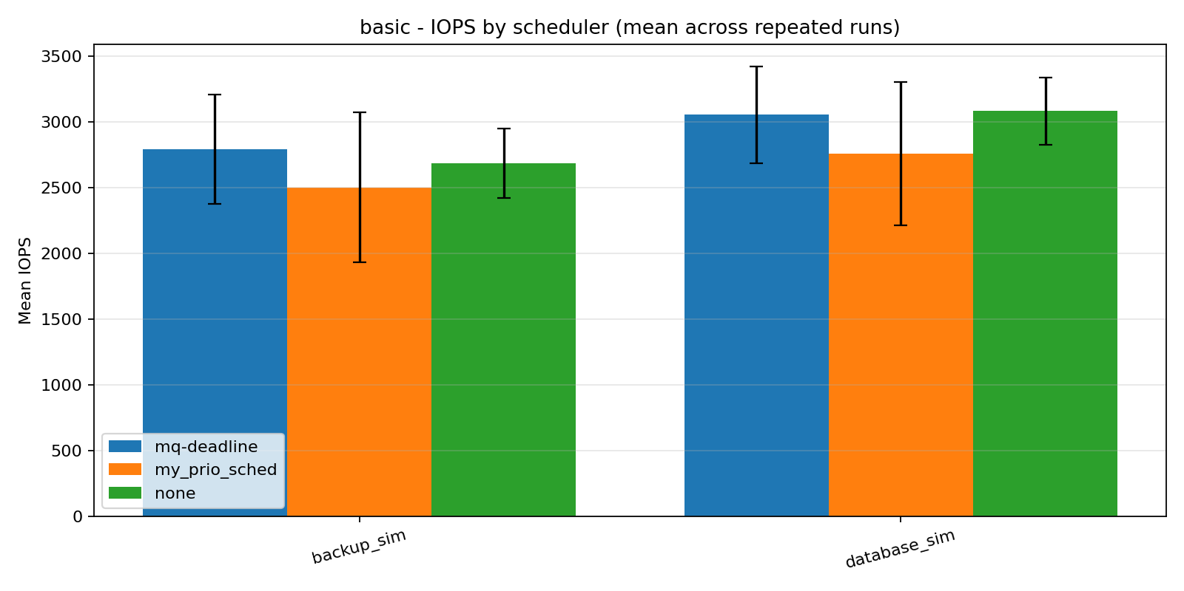
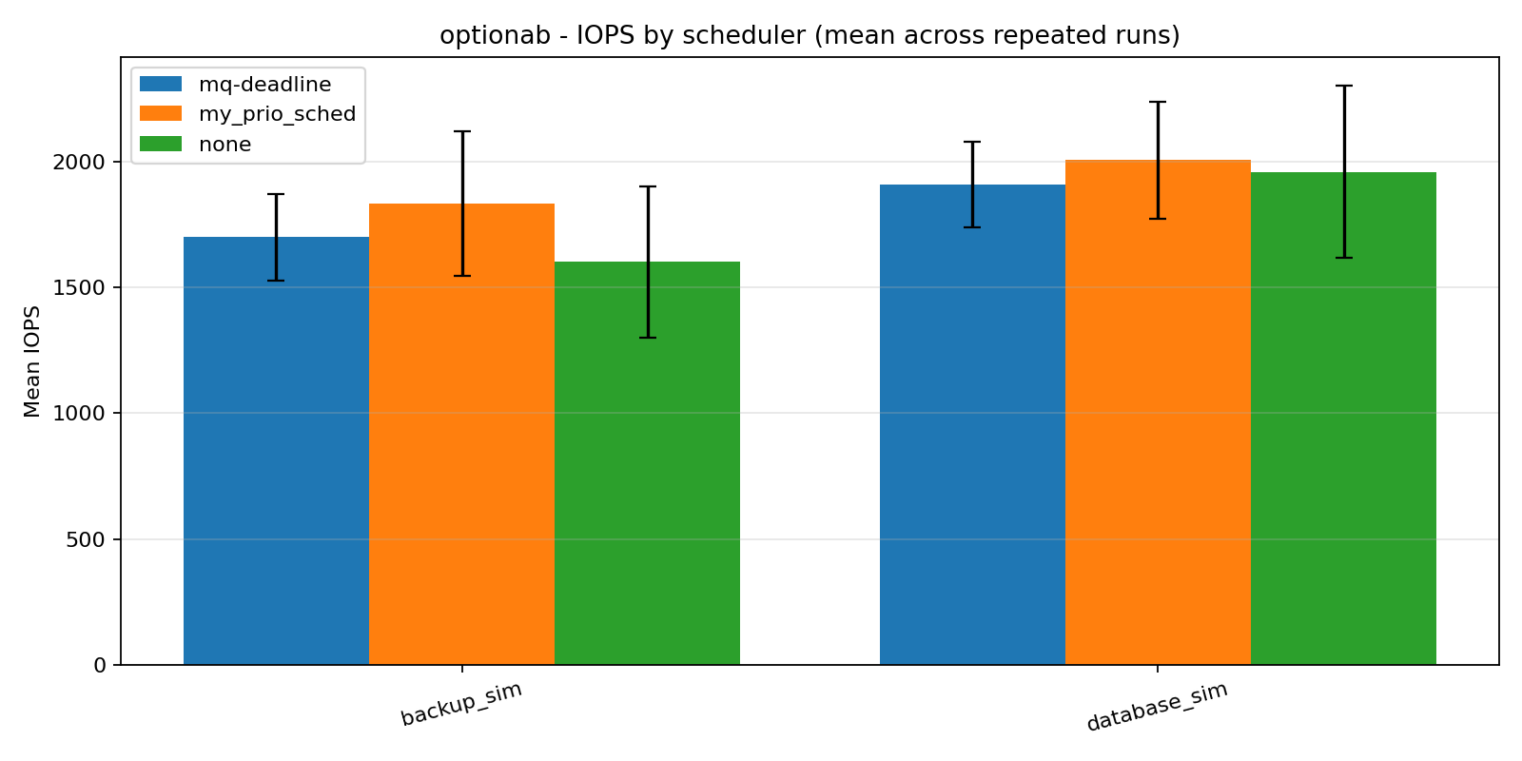
1. Background and Goals
2. Basic Method
3. Advanced Optimization
4. Evaluation Results
4.2 Compare with IOPS
1、Enter Text Enter Text Enter Text Enter Text Enter Text
Fig.1 IOPS results for the basic group
Fig.2 IOPS results for the advanced group

Slide 21
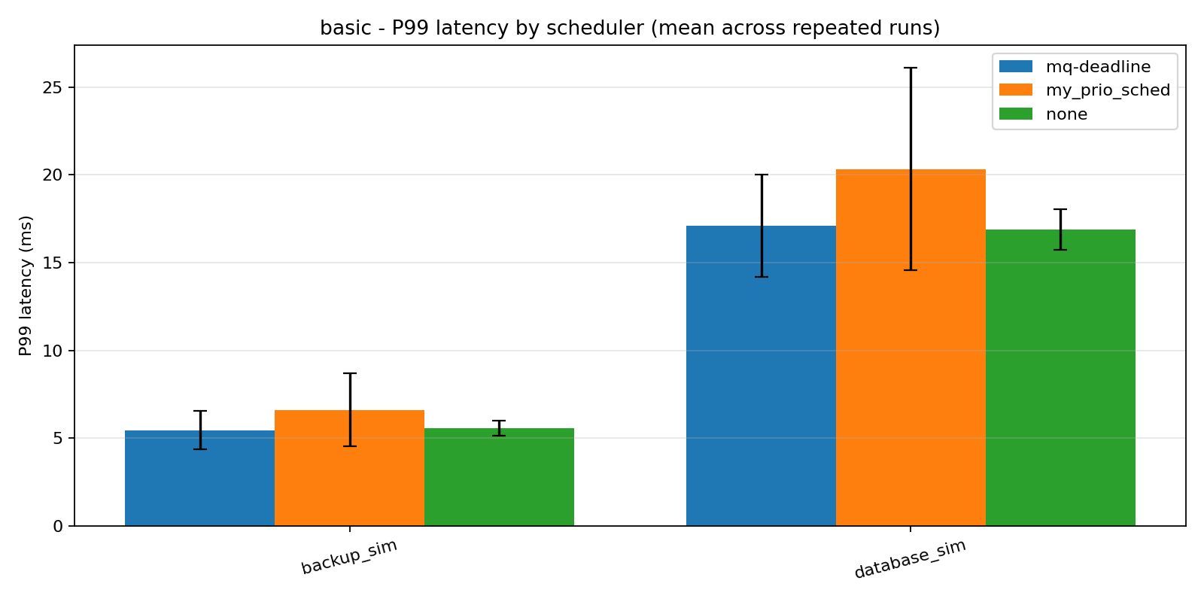
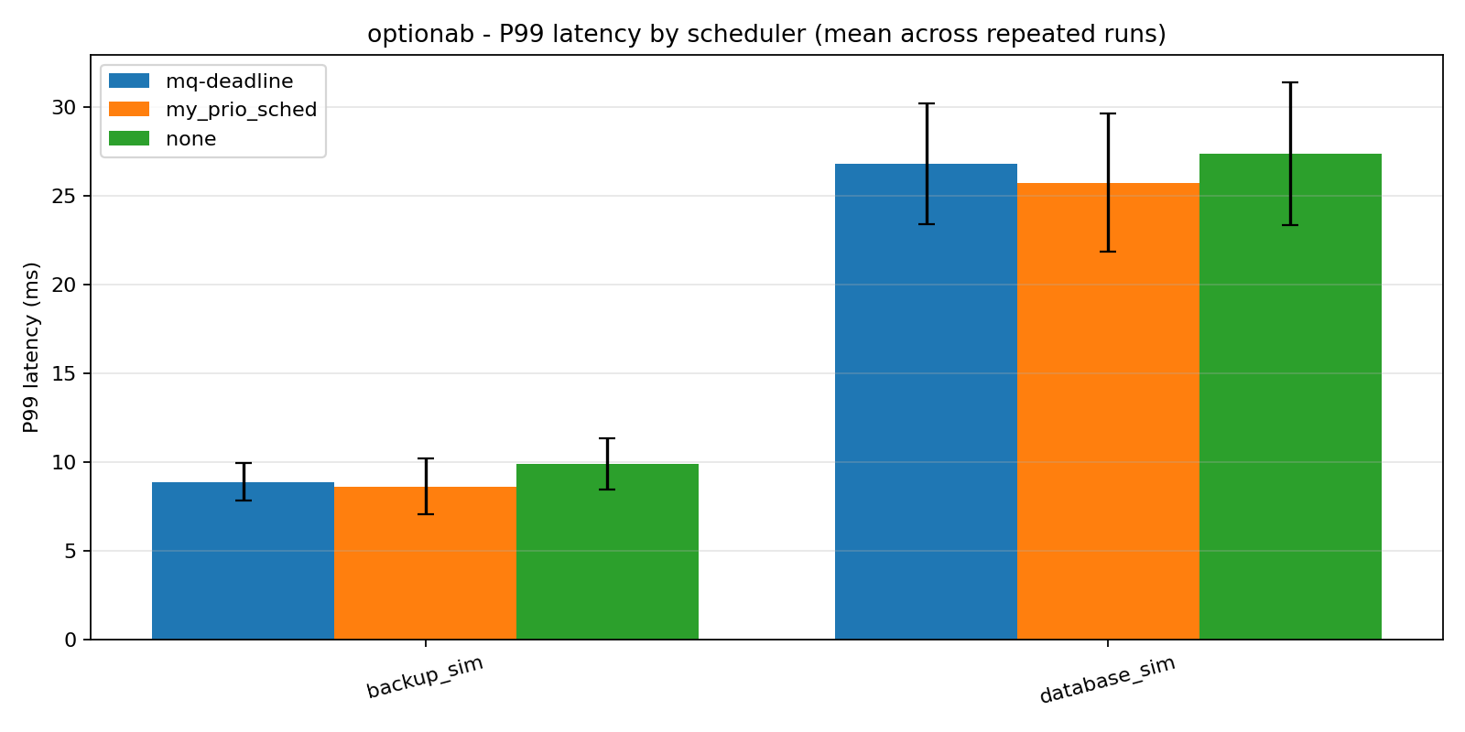
1. Background and goals
2. Basic Method
3. Advanced Optimization
4. Evaluation Results
4.3 Compare with Latency
Fig.3 P99 latency of basic group
Fig.4 P99 latency of advanced group

Slide 22
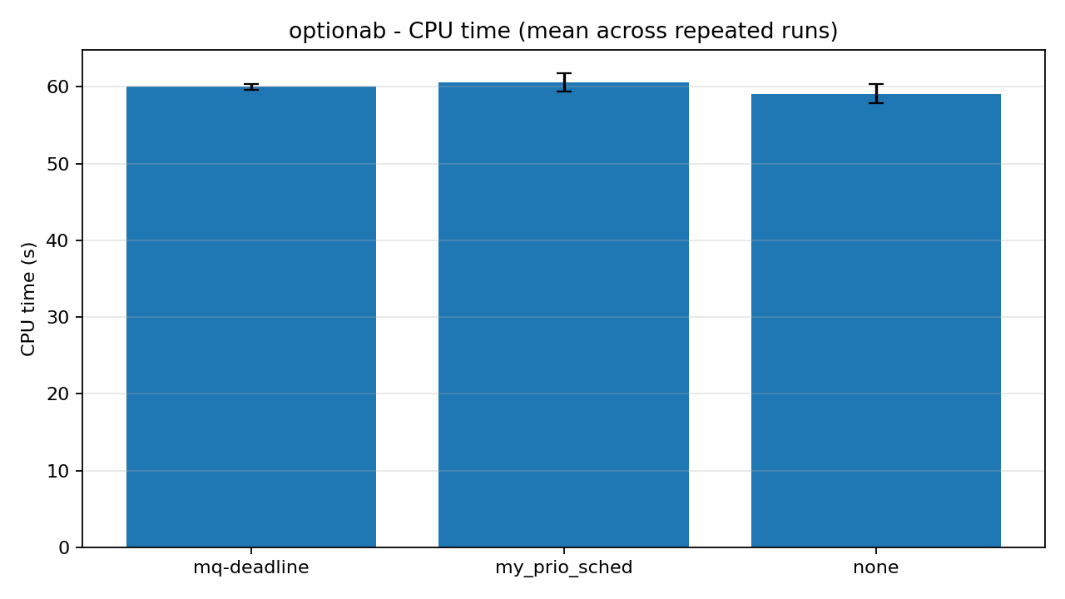
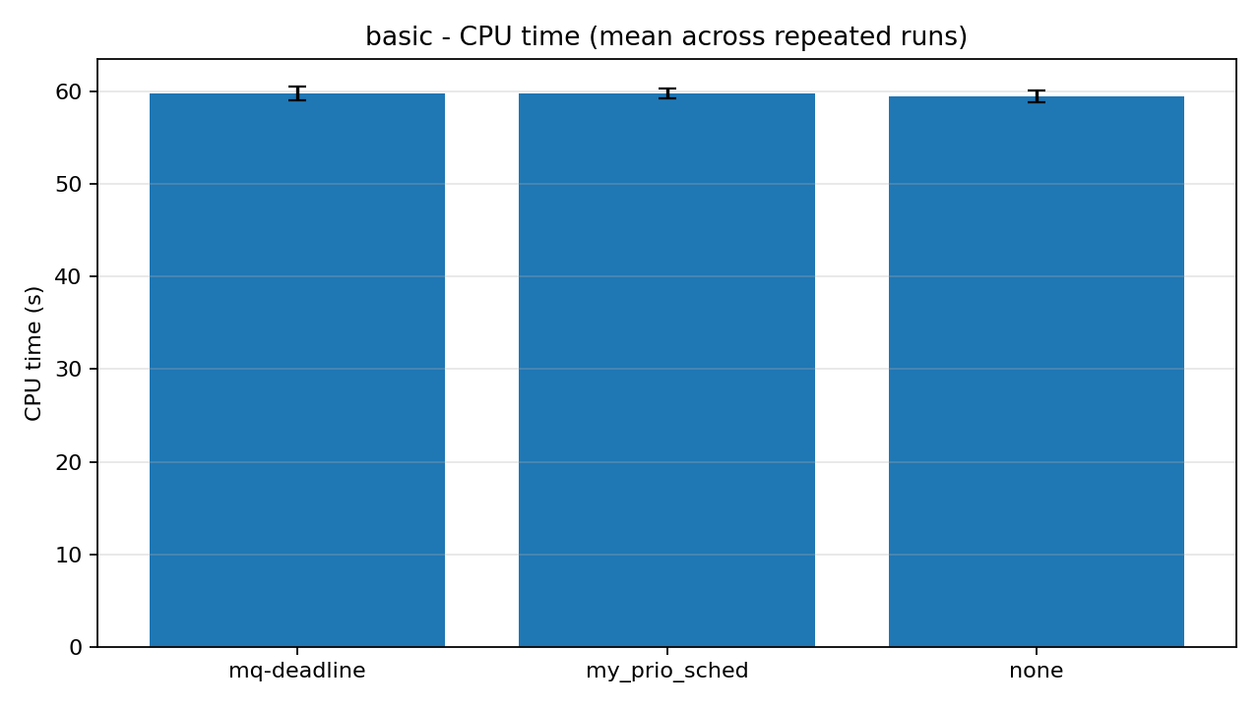
1. Background and Goals
2. Basic Method
3. Advanced Optimization
4. Evaluation Results
4.4 Compare with CPU Overhead (1)
Fig.5 CPU overhead results of basic group
Fig.6 P99 latency of advanced group

Slide 23
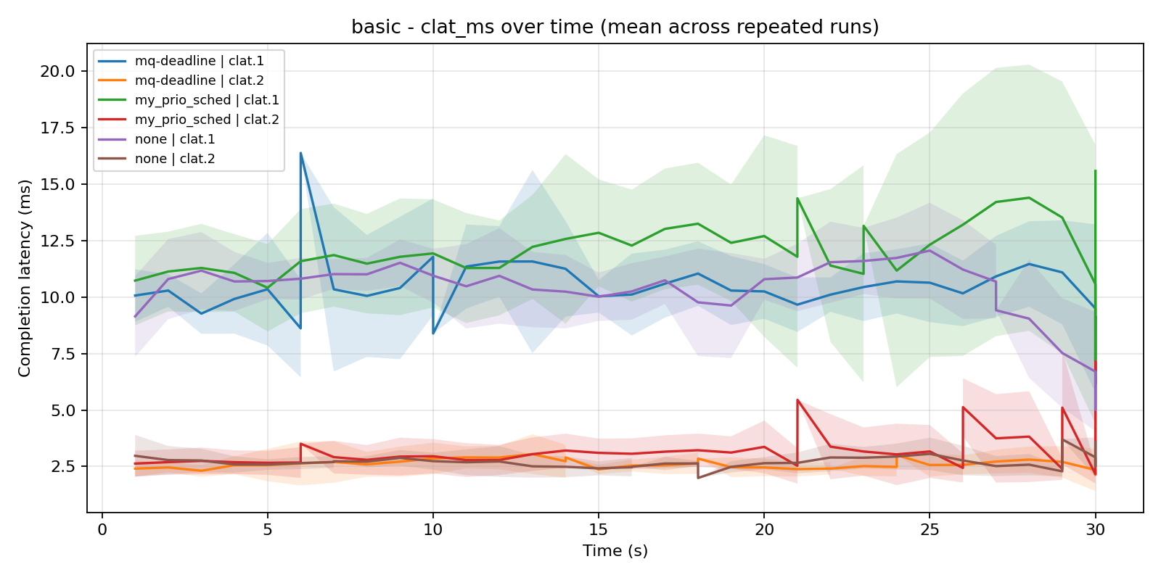
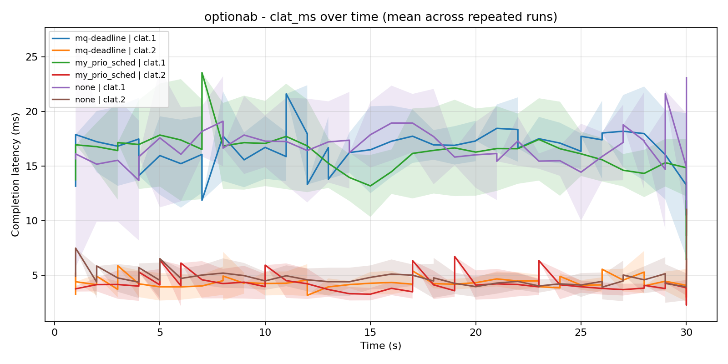
1. Background and Goals
2. Basic Method
3. Advanced Optimization
4. Evaluation Results
4.5 Compare with CPU Overhead (2)
Fig.7 latency timeseries of basic group
Fig.8 latency timeseries of advanced group

Slide 24
1. Background and Goals
2. Basic Method
3. Advanced Optimization
4. Evaluation Results
4.6 Summary
Conclusion
We implemented and evaluated a custom priority-aware scheduler inside Linux blk-mq. The experimental results show that our basic version validated the effectiveness of a three-level priority queue with aging, while the advanced version further demonstrated workload-aware and media-aware extensions.
Limitation
1.The current evaluation is conducted on VirtualBox virtual disks, so Option B should be interpreted as media-aware / HDD-like / SSD-like behavior, rather than strict physical HDD-versus-SSD validation.
2. Compared with the mature mq-deadline scheduler, our implementation is still lack of stability.

Slide 25
1. Background and Goals
2. Basic Method
3. Advanced Optimization
4. Evaluation Results
4.7 Contribution
Shengnan Chen
Yuxuan Fan
1. Implemented and debugged the core basic scheduler.
2. Took for the analysis and extension advanced options.
3. Organized repeated experiments and completed result aggregation, statistical analysis and figure interpretation.
4. Took for writing and integrating the experiment, conclusion, and presentation materials.
1. Implemented and debugged the core basic scheduler.
2. Contributed to background research and course-material review.
3. Assisted with VM and kernel experiment environment setup.
4.Took for writing and integrating the experiment, conclusion, and presentation materials.

Slide 26
Q&A
Team 17: Shengnan Chen 225040187
Yuxuan Fan 225040159
Date: 2026.4.7

