Slide 1
Implement and Evaluate
a Custom Disk Scheduler
Topic 9 - Linux blk-mq Priority-Aware Scheduler
Team18: JiangXinhang(225040179) and YangKefan(225040525)
April 2026
CSC5031 Operating Systems - Topic 9
1

Slide 2
Roadmap
Requirement -> code implementation -> evaluation -> conclusion
We focus on proving real kernel implementation quality, not only showing final charts.
Presentation Flow
1) Requirement alignment with Topic 9
2) Core blk-mq code implementation (with snippets)
3) Engineering challenge and stabilization
4) fio methodology and benchmark results
5) Interpretation, contribution statement, and conclusion
CSC5031 Operating Systems - Topic 9
2

Slide 3
Topic 9 Requirement Mapping
Our implementation is built directly around assignment checkpoints
Requirement 1: implementation correctness. Requirement 2: measurable fio evaluation.
Requirement 1
Requirement 2
Implement a custom scheduler in Linux blk-mq.
The policy must distinguish request priorities and favor high-priority traffic under contention.
Run mixed-priority fio workloads and report IOPS + Completion Latency + CPU Overhead.
Compare with mq-deadline and none to justify policy effect.
CSC5031 Operating Systems - Topic 9
3

Slide 4
System Boundary
Where our work is applied in Linux I/O stack
We modified scheduler policy in blk-mq only; filesystem and driver logic were not changed.
Applications
Filesystem
Block Layer
Our Scheduler (mq-prio)
blk-mq Hardware Queue
Storage Device
CSC5031 Operating Systems - Topic 9
4

Slide 5
Core Code A: Data Structures
Queue state and scheduler state used by mq-prio
Three class queues plus lock and aging threshold define the scheduler core state.
mp_per_prio and mq_prio_data
What It Does
struct mp_per_prio {
struct list_head fifo;
unsigned int count;
unsigned int dispatched;
};
struct mq_prio_data {
struct mp_per_prio per_prio[3];
spinlock_t lock;
int aging_expire;
};
Stores independent FIFO and stats for RT/BE/IDLE queues.
Why It Matters
Makes dispatch deterministic and thread-safe in kernel path.
Validation Link
Later result pages reflect this queue-level policy separation.
Source: disk-scheduler/mq_prio.c:80, disk-scheduler/mq_prio.c:90
CSC5031 Operating Systems - Topic 9
5

Slide 6
Core Code B: ioprio Mapping
Convert Linux ioprio classes into scheduler internal class
Priority semantics are explicit and aligned with kernel ioprio classes.
ioprio_class_to_mp_prio()
What It Does
static inline enum mp_prio
ioprio_class_to_mp_prio(unsigned short ioprio)
{
switch (IOPRIO_PRIO_CLASS(ioprio)) {
case IOPRIO_CLASS_RT: return MP_RT_PRIO;
case IOPRIO_CLASS_IDLE: return MP_IDLE_PRIO;
case IOPRIO_CLASS_NONE:
case IOPRIO_CLASS_BE:
default: return MP_BE_PRIO;
}
}
Maps RT/BE/IDLE classes before enqueue in insert path.
Why It Matters
Ensures behavior follows Linux ioprio semantics, not hard-coded app IDs.
Validation Link
fio prio=1 and prio=7 jobs trigger different queue paths.
Source: disk-scheduler/mq_prio.c:62
CSC5031 Operating Systems - Topic 9
6

Slide 7
Core Code C: Insert Path
Classify each request and record fairness timestamp
Insertion performs both priority classification and aging timestamp setup.
mp_insert_requests() excerpt
What It Does
while (!list_empty(list)) {
rq = list_first_entry(list, struct request, queuelist);
list_del_init(&rq->queuelist);
prio = ioprio_class_to_mp_prio(rq->ioprio);
pp = &d->per_prio[prio];
rq->fifo_time = jiffies;
rq->elv.priv[0] = (void *)1;
list_add_tail(&rq->queuelist, &pp->fifo);
pp->count++;
}
Routes request into RT/BE/IDLE FIFO by ioprio class.
Why It Matters
fifo_time is later used to detect starvation in dispatch.
Validation Link
Queue counts and timestamps support policy traceability in tests.
Source: disk-scheduler/mq_prio.c:161
CSC5031 Operating Systems - Topic 9
7

Slide 8
Core Code D: Dispatch Policy
Phase 1 aging check + Phase 2 strict RT/BE/IDLE order
This is the heart of policy behavior under mixed contention.
mp_dispatch_request() excerpt
What It Does
/* Phase 1: aging check */
for (prio = MP_BE_PRIO; prio <= MP_PRIO_MAX; prio++) {
rq = list_first_entry(&pp->fifo, struct request, queuelist);
if (time_after_eq(now, rq->fifo_time + d->aging_expire))
return dispatch_this_rq;
}
/* Phase 2: strict priority */
for (prio = 0; prio <= MP_PRIO_MAX; prio++) {
if (!list_empty(&pp->fifo))
return first_request_in_this_queue;
}
First protects fairness, then enforces strict service order.
Why It Matters
Prevents starvation without removing high-priority preference.
Validation Link
Low-priority progress in result slide comes from this design.
Source: disk-scheduler/mq_prio.c:204
CSC5031 Operating Systems - Topic 9
8

Slide 9
Core Code E: init_sched Lifecycle
Critical blk-mq initialization contracts
Correct scheduler initialization is mandatory for stability.
mp_init_sched() excerpt
What It Does
eq = elevator_alloc(q, e); if (!eq) return -ENOMEM; d = kzalloc_node(sizeof(*d), GFP_KERNEL, q->node); if (!d) { kobject_put(&eq->kobj); return -ENOMEM; } eq->elevator_data = d; blk_queue_flag_set(QUEUE_FLAG_SQ_SCHED, q); q->elevator = eq;
Allocates and binds elevator and scheduler private data.
Why It Matters
Fixes the early crash path caused by incomplete init flow.
Validation Link
Stability after this fix enabled consistent fio evaluation.
Source: disk-scheduler/mq_prio.c:272
CSC5031 Operating Systems - Topic 9
9

Slide 10
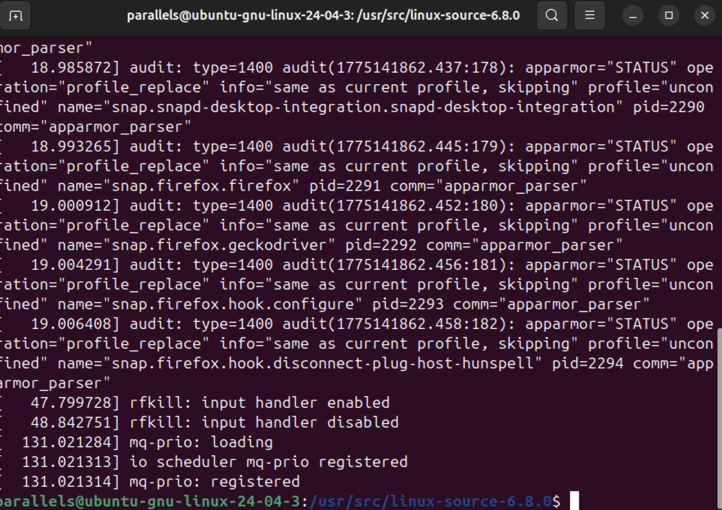
Core Code F: Scheduler Registration
Operation callbacks bound to elevator_type
Callback binding proves this is a full scheduler, not an isolated function patch.
Operation | Bound Function
insert_requests | mp_insert_requests
dispatch_request | mp_dispatch_request
prepare_request | mp_prepare_request
finish_request | mp_finish_request
init_sched / exit_sched | mp_init_sched / mp_exit_sched
module registration | elv_register(&mq_prio_sched)
CSC5031 Operating Systems - Topic 9
10

Slide 11
Engineering Challenge: Kernel Panic
From unstable prototype to reproducible module behavior
Root cause: incomplete init_sched contracts; fix: rebuild lifecycle using mq-deadline pattern.
Failure
Root Cause
Fix and Outcome
Early versions crashed when switching scheduler.
This blocked meaningful benchmark execution.
q->elevator initialization path was incomplete.
blk-mq expected mandatory elevator allocation and binding.
After init/ops lifecycle rebuild, module load/switch/test became stable.
Then fio evaluation could run reliably.
CSC5031 Operating Systems - Topic 9
11

Slide 12
fio Evaluation Methodology
Mixed-priority design for policy validation
We use fio to simulate contending processes, rather than isolated single-job throughput.
Workloads and Metrics
Environment and Baselines
database-sim: prio=1, rw=randread, bs=4k, numjobs=4
backup-sim: prio=7, rw=read, bs=128k, numjobs=2
Metrics: IOPS + Completion Latency + CPU Overhead.
Linux 6.5.0-18 VM, fio 3.28, 15-second runs.
Baselines: mq-deadline and none.
Goal: compare behavior and overhead.
CSC5031 Operating Systems - Topic 9
12
Notes:
The high-priority workload, called database-sim, uses priority level 1 with random reads, a 4 KB block size, and four jobs. This is intended to emulate latency-sensitive foreground database traffic.
The low-priority workload, backup-sim, uses priority level 7 with sequential reads, a 128 KB block size, and two jobs, representing background backup activity.
This mixed design is intended to emulate foreground database traffic vs background backup traffic, rather than isolate priority as the only variable.
We evaluate three metrics: throughput in IOPS, completion latency, and CPU overhead.
For comparison, we run the same mixed workload on three schedulers: our custom mq-prio scheduler, mq-deadline, and none.
The goal is

Slide 13
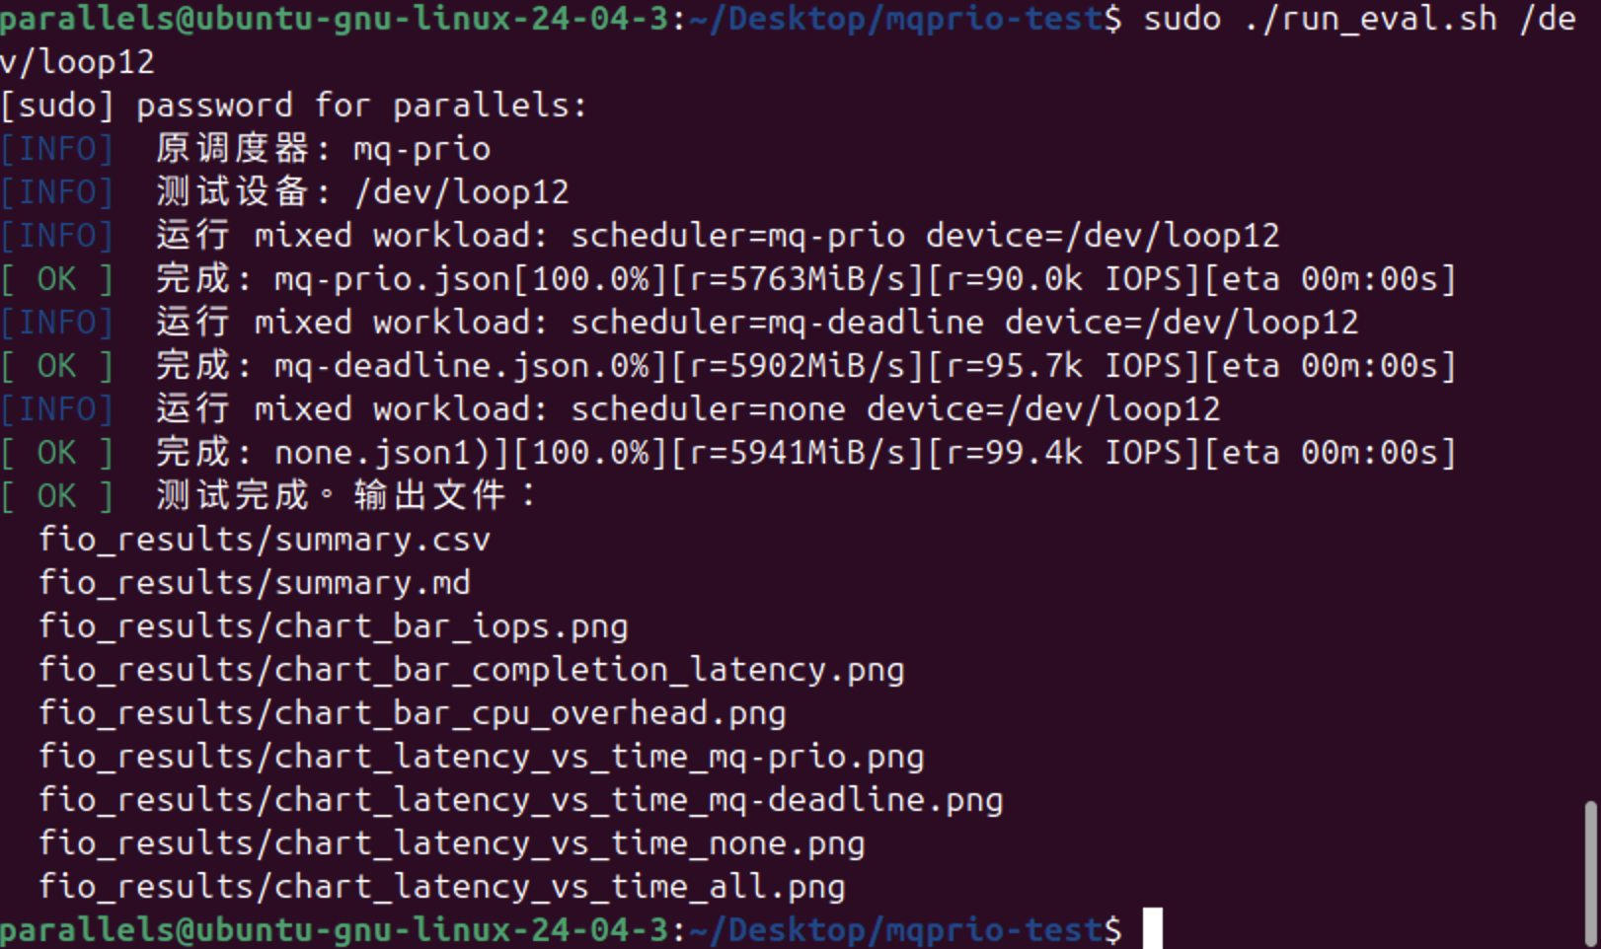
fio Evaluation Methodology
Mixed-priority design for policy validation
We use fio to simulate contending processes, not isolated single-job throughput.
CSC5031 Operating Systems - Topic 9
12

Slide 14
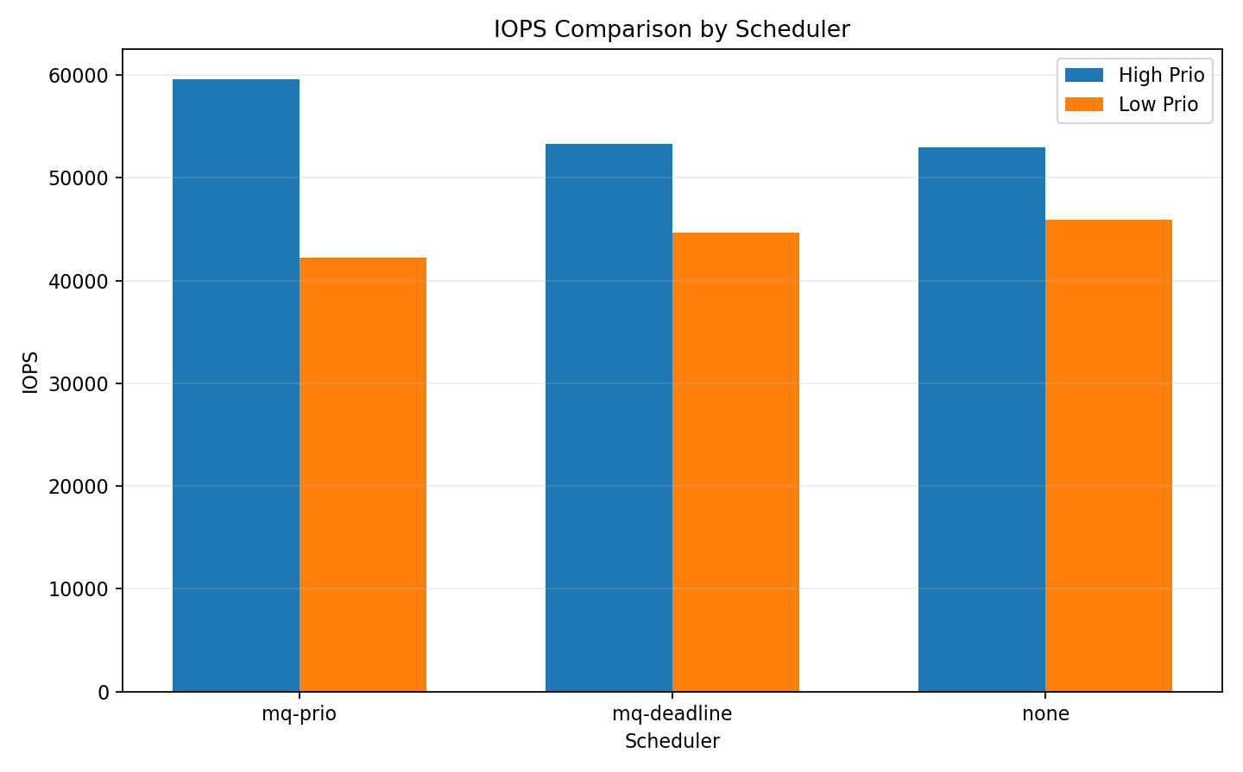
Result 1: IOPS
database-sim (prio=1, randread 4k) VS backup-sim (prio=7, sequential read 128k)
IOPS measures how many I/O operations a device completes per second.
Interpretation:
High-priority IOPS is higher under all schedulers.
mq-prio gives the highest high-priority IOPS.
mq-prio shows the strongest priority differentiation.
CSC5031 Operating Systems - Topic 9
13
Notes:
First, across all three schedulers, the high-priority workload consistently achieves higher IOPS than the corresponding low-priority workload.
Second, mq-prio delivers the highest IOPS for the high-priority workload among all tested cases, indicating that our scheduler can effectively enforce the design goal that high-priority tasks must preempt low-priority tasks.
In addition, mq-prio shows the largest IOPS gap between the high- and low-priority workloads, which suggests that it provides the strongest priority differentiation and most clearly reflects the intended scheduling policy in practice.
By contrast, mq-deadline and none show relatively similar performance between the two priority classes, indicating that they offer weaker priority awareness and treat the two workloads more uniformly under contention.

Slide 15
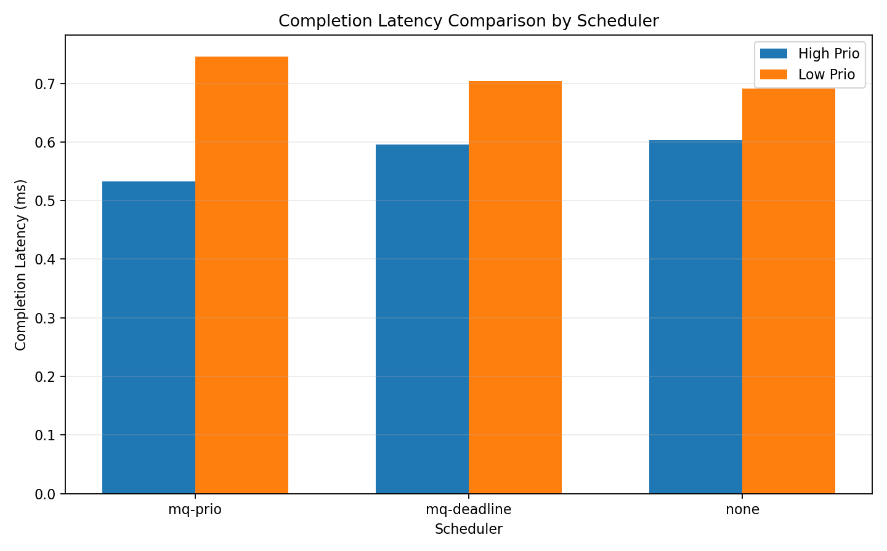
Result 2: Completion Latency
database-sim (prio=1, randread 4k) VS backup-sim (prio=7, sequential read 128k)
Completion latency is the time from when an I/O request is issued until it is fully completed.
Interpretation:
High-priority latency is lower than low-priority latency for all schedulers.
mq-prio gives the lowest high-priority latency.
mq-prio shows the strongest priority separation.
CSC5031 Operating Systems - Topic 9
13
Notes:
IOPS and completion latency generally show an inverse trend: higher IOPS usually comes with lower latency, although the relationship is not perfectly proportional.
mq-prio delivers the lowest latency for the high-priority workload and the largest high/low latency gap, showing the strongest priority differentiation among the three schedulers.

Slide 16
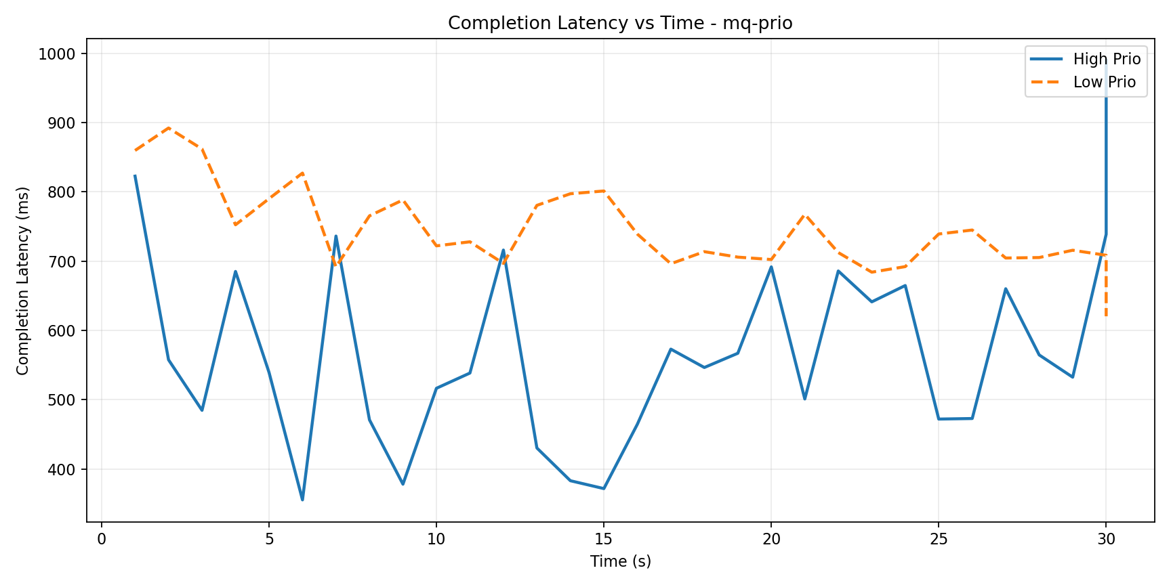
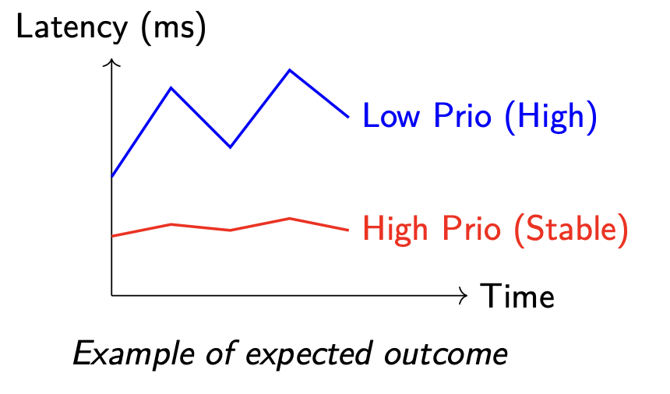
Result 2: Completion Latency
database-sim (prio=1, randread 4k) VS backup-sim (prio=7, sequential read 128k)
Completion latency is the time from when an I/O request is issued until it is fully completed.
CSC5031 Operating Systems - Topic 9
13
Notes:
This figure shows how the completion latency of the high-priority and low-priority workloads changes over time under mq-prio.
First, overall, the high-priority workload consistently shows much lower latency than the low-priority workload. This indicates that our scheduler does in fact favor high-priority tasks, which is consistent with the goal of a priority-aware scheduler.
Second, there is a clear and persistent gap between the two curves. This suggests that the priority differentiation provided by mq-prio is sustained over time, rather than appearing only at a few isolated time points.
Third, the pattern is somewhat different from the idealized example: the high-priority curve fluctuates more, while the low-priority curve is relatively smoother. We speculate that this is because mq-prio preferentially dispatches high-priority requests, so once a high-priority request gets service, it can often complete very quickly, producing some notably low points. However, the high-priority workload itself uses 4 KB random reads, which are more fragmented and more sensitive to transient queue conditions, so its latency naturally shows greater variation.
Finally, the last point in the figure shows a sudden jump. This is likely caused by an incomplete final log_avg_msec window and should be treated as boundary sampling noise rather than as a representative performance trend.

Slide 17
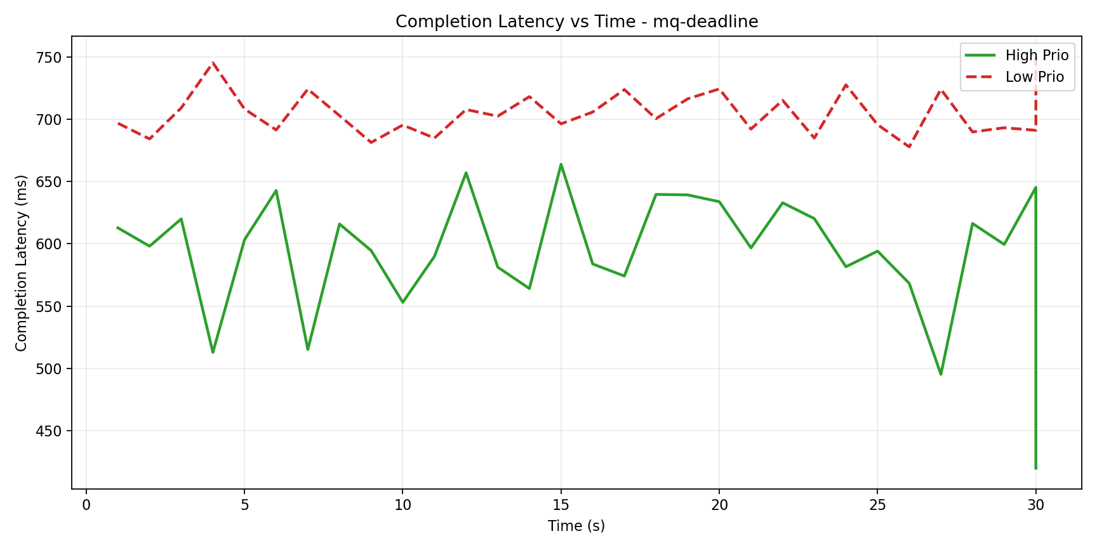
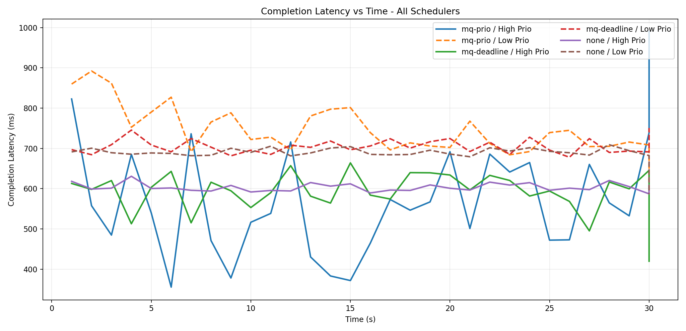
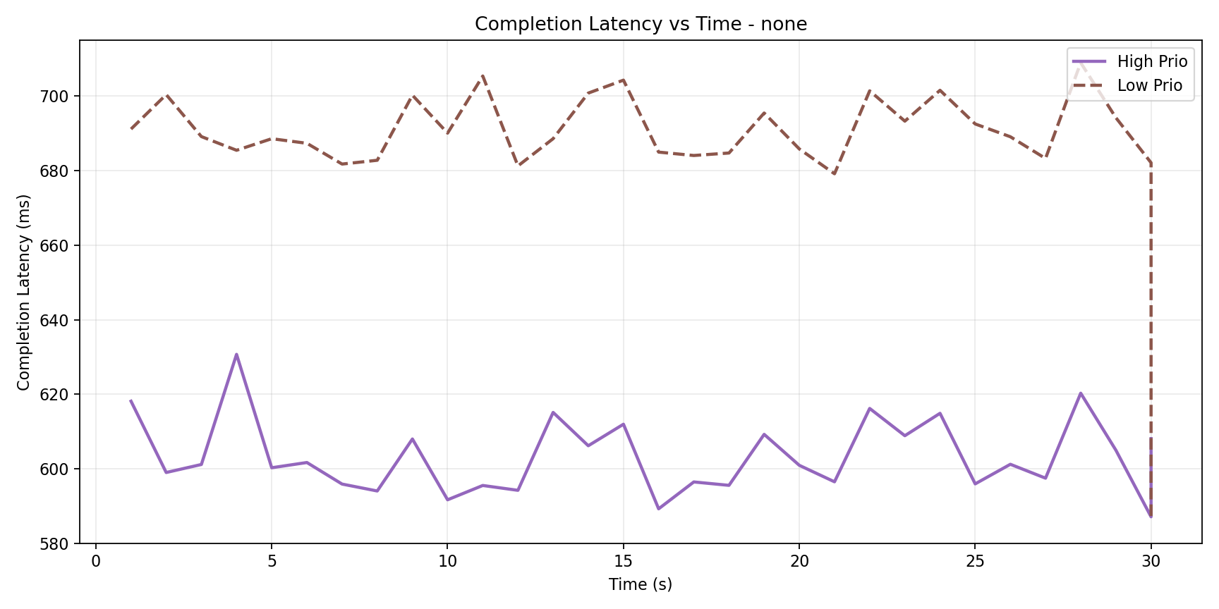
Result 2: Completion Latency
database-sim (prio=1, randread 4k) VS backup-sim (prio=7, sequential read 128k)
Completion latency is the time from when an I/O request is issued until it is fully completed.
Interpretation:
High-priority latency is lower than low-priority latency for all schedulers.
mq-prio gives the lowest high-priority latency.
mq-prio shows the strongest priority separation.
CSC5031 Operating Systems - Topic 9
13
Notes:
All three schedulers show the same overall pattern: the high-priority workload consistently has lower latency than the low-priority workload, meaning that high-priority requests complete faster.
mq-prio shows the strongest priority differentiation. This is because mq-prio explicitly schedules requests by priority: high-priority requests are more likely to be dispatched earlier, while low-priority requests are more likely to be delayed.
mq-deadline also shows a priority effect, but in a more conservative and balanced way.
By contrast, none shows the weakest separation between high- and low-priority workloads, because it introduces little to no additional I/O scheduling logic and relies more directly on the device itself and the default blk-mq path.

Slide 18
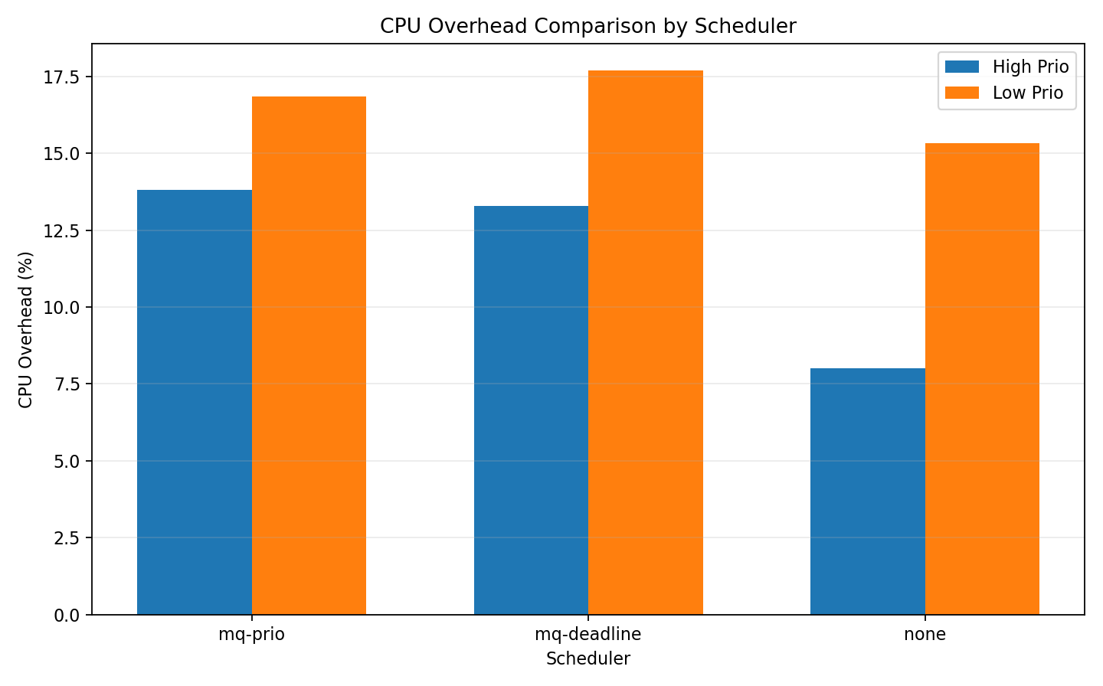
Result 3: CPU Overhead
database-sim (prio=1, randread 4k) VS backup-sim (prio=7, sequential read 128k)
mq-prio remains close to mq-deadline while keeping explicit priority policy semantics.
Interpretation:
mq-prio achieves clearer priority differentiation at the cost of a moderate and acceptable increase in CPU overhead.
CSC5031 Operating Systems - Topic 9
13
Notes:
The first types figures focus on effectiveness, while this figure highlights the cost. Across all three schedulers, the low-priority workload shows higher CPU overhead than the corresponding high-priority workload. This means that, under this mixed-workload setup, the low-priority task incurs greater CPU processing overhead. This does not imply that low-priority workloads are inherently more CPU-intensive; just under our particular experimental configuration, they result in higher kernel, scheduling, and processing costs.
Second, none has the lowest CPU overhead. Since none introduces almost no additional scheduling logic, its software-side CPU cost is naturally the smallest.
Third, the CPU overhead of mq-prio remains close to that of mq-deadline. This suggests that adding priority-aware scheduling logic does introduce some extra overhead, but the increase is moderate rather than excessive, and it stays in roughly the same range as the existing Linux scheduler mq-deadline.

Slide 19
Cross-Baseline Interpretation
Policy value beyond raw throughput
Topic 9 emphasizes controllable priority behavior, not only maximum IOPS.
mq-prio
mq-deadline
none
Explicit priority semantics + anti-starvation aging.
Balances urgency and fairness.
Strong baseline stability and maturity.
Priority separation is weaker for this scenario.
Can show high raw throughput.
Fairness and service guarantees are limited.
CSC5031 Operating Systems - Topic 9
15

Slide 20
Team Contributions (50/50)
Clear ownership and shared delivery
Both members contributed equally, with different technical leadership areas.
JiangXinhang (50%)
YangKefan (50%)
Led kernel scheduler implementation in mq_prio.c.
Built queue model, ioprio mapping, dispatch/aging logic, and lifecycle callbacks.
Led panic root-cause diagnosis and stabilization.
Led fio methodology, mixed-workload configuration, and baseline comparison workflow.
Collected and interpreted IOPS/latency/CPU head evidence.
Analyze the chart and results.
CSC5031 Operating Systems - Topic 9
17

Slide 21
Conclusion and Q&A
- We completed Topic 9 with full requirement mapping, core kernel implementation, debugging, and benchmark evidence.
- mq-prio provides explicit RT/BE/IDLE policy with 10-second anti-starvation aging.
- Results show stable behavior and practical overhead near kernel baselines.
- Physical SSD validation for stronger device-level differentiation.
Thank you. We welcome your questions.
CSC5031 Operating Systems - Topic 9
18

