Slide 1
Topic 10
Kernel-Level Buffer Cache
Instrumentation
Linux Buffer Lookup Instrumentation · LFU-like Retention Policy · Unified Workload Evaluation
Course: CSC5031 Operating Systems Team Members: Huang Rui, Li Langye | Date: 2026-4-9
Notes:
Hello everyone. Our presentation is on Topic 10: Kernel-Level Buffer Cache Instrumentation. In this project, we tackle a concrete kernel systems question: how does the real buffer cache lookup path behave in Linux, can we instrument it to measure hit and miss rates, and what happens if we introduce an LFU-like frequency-sensitive retention policy at that level? Our work spans three major parts: instrumentation of the buffer lookup path in fs/buffer.c; extending buffer_head with an access-frequency field and implementing LFU-like retention in the per-CPU bh_lru cache; and designing a unified small-file metadata workload to compare the two policies. Today's talk is organized into five parts. Let's get started.

Slide 2
Presentation Overview
01
Background & What We Measure
02
Kernel Implementation
Measurement boundary, Linux cache hierarchy, and why the distinction matters
Changes in fs/buffer.c, buffer_head, LFU policy, and /proc/cache_stats
03
Workload Design
04
Results & Interpretation
Six controlled scenarios on a unified small-file metadata pool
What the data shows — and why each pattern is credible
05
Limitations & Conclusion
Honest scope assessment, future directions, and key takeaways
Notes:
Here is the roadmap for our talk. Part 1 covers the background: we clarify what this project is actually measuring, walk through Linux's multi-level cache hierarchy, and explain why the measurement boundary is the most important framing issue. Part 2 covers the kernel implementation: the instrumentation changes, the LFU-like policy, and the /proc interface. Part 3 covers the workload design: why we unified all six scenarios on shared small files. Part 4 presents and interprets the results. Part 5 discusses limitations, future directions, and wraps up with the final conclusion. Let's begin with Part 1.

Slide 3
PART 1: Background & What We Measure
Defining the instrumentation boundary — the most critical framing step
Notes:
Before we show any results, we need to establish exactly what this project is measuring. This framing is not a formality — if the boundary is unclear, every result that follows becomes easy to misread.

Slide 4
What This Topic Is Really Measuring
✗ What We Are NOT Measuring
✓ What We ARE Measuring
• Generic page-cache hit rate
• Buffer lookup hit/miss in find_get_block_common()
• User-space file-read cache performance
• HIT: an existing buffer_head is returned
• Global page eviction policy (mm/vmscan.c)
• MISS: lookup returns NULL → triggers I/O
• → Metadata / block-level lookup behavior
⚠ This boundary must be clear before any result can be correctly interpreted.
Notes:
The most important point to make early is this: this project does not measure generic page-cache hit rate. It measures buffer lookup hit rate. The actual instrumentation point is find_get_block_common() in fs/buffer.c. When the filesystem needs the buffer_head for a block, this function answers: does an appropriate object already exist? So in our project, returning a valid buffer_head pointer counts as a hit; returning NULL counts as a miss. This is very different from asking whether a user-space file read was served from the page cache. Our experiment is fundamentally about lower-level metadata and block lookup behavior. This is exactly why our workloads need to be metadata-oriented — if we had only used large-file reads, we would mostly be measuring a different layer of the system.

Slide 5
Multi-Level Cache Hierarchy in Linux
User-Space Request (stat / find / open)
Key insight:
Many requests are intercepted at higher layers and never reach our hook. This explains why the warm scenario shows a near-zero sample — a point we will return to in detail during the results section.
VFS — Dentry Cache (pathname → inode mapping)
Inode Cache (inode metadata & attributes)
Filesystem Layer (ext4 / xfs …)
Buffer Cache / buffer_head lookup ◄ OUR INSTRUMENTATION HOOK
Block Device / Disk
Notes:
When a user-space operation such as stat or find is issued, the request does not directly fall into fs/buffer.c. It travels through multiple cache layers. First, the VFS dentry cache, which remembers pathname-to-inode mappings. Then the inode cache, which stores inode metadata. Then the filesystem implementation such as ext4. Only after all of these does it reach the buffer cache lookup layer — where our hook lives. Disk access is the last resort. This multi-level structure has a critical implication: many requests can be intercepted by higher-level caches before they ever reach find_get_block_common(). This fact directly explains why the warm scenario shows an almost negligible number of lookups reaching our measurement point. We will come back to this in detail when we discuss the results — just keep this hierarchy in mind as we go through the workload scenarios.

Slide 6
Why the Measurement Boundary Matters
❌ Poor Workload Alignment
✓ Good Workload Alignment
• Large-file sequential reads (cat, fio)
• Shared small-file metadata traversal
• Mainly reflects page-cache behavior
• stat / readdir / find operations
• Does not exercise the buffer lookup path
• Directly exercises buffer lookup path
• Results tell you nothing about our hook
• Policy differences can be cleanly attributed
Redesigning the workload around shared small-file metadata was the key methodological decision in this project.
Notes:
If we had only used large-file sequential reads, we would mostly be measuring page-cache behavior. The buffer lookup path we instrumented would barely be exercised. The charts would not support any meaningful conclusion about our LFU policy. So we redesigned the evaluation around a metadata-oriented workload: small files, stat operations, directory traversals — things that drive the buffer lookup path directly. This is not a minor implementation detail. It is the key methodological decision: align the workload with the actual instrumentation target. We will describe the specific workload design in Part 3.

Slide 7
Project Goals
Goal 1 | Instrumentation
Goal 2 | Observability
Count hit/miss events at the unified buffer lookup entry find_get_block_common()
Export Hits, Misses, Total Lookups, and Hit Rate via /proc/cache_stats
Goal 3 | LFU-like Policy
Goal 4 | Comparative Evaluation
Implement frequency-sensitive retention in the per-CPU bh_lru using an access_count field
Compare LRU and LFU-like behavior under a unified small-file metadata workload across six scenarios
Notes:
Our project has four concrete goals. Goal 1 is instrumentation: count hit and miss events at the single unified lookup entry in fs/buffer.c. Goal 2 is observability: make those counters visible to user-space through a /proc interface, so they can be read before and after each workload run. Goal 3 is the custom policy: add an access_count field to struct buffer_head and use it to implement LFU-like retention within the per-CPU bh_lru lookup cache. Goal 4 is the evaluation: design a fair experiment that compares LRU and LFU-like behavior on the same dataset with the same script. Together these four goals form a complete loop: kernel change, observability, workload design, and evaluation.

Slide 8
PART 2: Kernel Implementation
What exactly we changed and why those specific locations
Notes:
Now let's look at what we actually changed in the kernel.

Slide 9
Kernel Implementation Overview
Modified Files
Atomic Counters
total_hits / total_misses (atomic_long_t)
fs/buffer.c
Hit/Miss Accounting
include/linux/
buffer_head.h
Inserted in find_get_block_common() — covers per-CPU hits, slow-path hits, full misses
/proc Interface
Entry Point
/proc/cache_stats → Hits, Misses, Total Lookups, Hit Rate
find_get_block
_common()
Frequency Field
access_count added to struct buffer_head
LFU-like Retention
Per-CPU bh_lru evicts entries with lowest access_count
Notes:
Our changes touch two files: fs/buffer.c and include/linux/buffer_head.h. The five key changes are: first, two atomic counters for total hits and total misses. Second, the accounting logic placed inside find_get_block_common() — this is the unified insertion point because it captures per-CPU bh_lru hits, slow-path hits, and full misses all in one place. Third, the /proc/cache_stats interface. Fourth, an access_count field added to struct buffer_head. And fifth, the LFU-like retention logic in the per-CPU bh_lru. Let's look at the buffer_head structure and the instrumentation logic in more detail.

Slide 10
The buffer_head Structure — Our Addition
struct buffer_head {
unsigned long b_state; // Uptodate? Dirty?
struct page *b_page; // Backing page
sector_t b_blocknr; // Block # on disk
size_t b_size; // Block size
atomic_t b_count; // Reference count
// ── OUR ADDITION ────────────────
unsigned int access_count; // LFU frequency counter
};
access_count
Incremented on every lookup-hit path. Records how frequently this buffer_head object is accessed.
LFU Retention Decision
When the per-CPU bh_lru must evict, the entry with the lowest access_count is removed first.
Scope Clarification
This field only affects the small per-CPU lookup cache — not the global page eviction path in mm/vmscan.c.
Notes:
The only change we made to struct buffer_head is the addition of a single unsigned int field: access_count. This field is incremented every time a lookup-hit path is taken for this particular buffer_head. It records cumulative access frequency for the object. The LFU-like retention decision is simple: when the per-CPU bh_lru needs to evict an entry to make room for a new one, we evict the entry with the lowest access_count rather than simply the least recently accessed. Crucially, this scope is very limited. We did not change mm/vmscan.c. We did not change the global Active/Inactive LRU page lists. The policy change lives entirely within the small per-CPU lookup cache. This is important context for understanding why the experimental gains are modest rather than dramatic.

Slide 11
Instrumentation: find_get_block_common()
// fs/buffer.c — atomic global counters
static atomic_long_t total_hits = ATOMIC_LONG_INIT(0);
static atomic_long_t total_misses = ATOMIC_LONG_INIT(0);
// Inside find_get_block_common():
bh = lookup_bh_lru(bdev, block, size);
if (bh) { // HIT path
atomic_long_inc(&total_hits);
bh->access_count++; // update LFU freq
return bh;
} // else: MISS
atomic_long_inc(&total_misses);
Unified entry point — captures per-CPU hits, slow-path hits, and full misses all in one location
Hit path: increment counter AND update access_count for the LFU decision
Miss path: NULL return triggers disk I/O in the caller
Notes:
Here is the instrumentation logic. We add two atomic counters declared at the top of fs/buffer.c: total_hits and total_misses. Inside find_get_block_common(), when a lookup succeeds — a valid buffer_head is returned — we increment total_hits and also increment the buffer_head's access_count field. When the lookup fails and returns NULL, we increment total_misses. The key advantage of this single insertion point is completeness: it covers per-CPU bh_lru fast-path hits, slow-path lookups, and complete misses, all counted at one unified location without missing any case.

Slide 12
LFU-like Policy: Scope and Boundary
✓ What We Changed
✗ What We Did NOT Change
✓ access_count field in struct buffer_head
✗ mm/vmscan.c (global page reclaim)
✓ Frequency updated on every lookup-hit
✗ Active / Inactive LRU page lists
✓ LFU-like retention in per-CPU bh_lru
✗ Global page-cache replacement policy
✓ Eviction: prefer low-frequency entries
✗ kswapd or direct reclaim paths
Because the policy is small and local in scope — modest gains are more believable than dramatic ones.
Notes:
This slide defines the expected scale of our results before we show any data. We modified a small per-CPU lookup cache. We did not touch mm/vmscan.c. We did not touch the global page lists. We did not implement a full global replacement policy. Because the scope is local and small, the most realistic expectation is: measurable but modest hit rate differences. If our results had shown a 20% or 30% gain, that would actually be suspicious for a per-CPU lookup-cache change. The modest gains we observe are precisely what this implementation scope predicts.

Slide 13
User-Space Observability: /proc/cache_stats
$ cat /proc/cache_stats
Evaluation Pipeline
Buffer Cache Hits:
4,593
1. Read /proc/cache_stats (before)
Buffer Cache Misses:
274
2. Run workload scenario
3. Read /proc/cache_stats (after)
Total Lookups:
4,867
4. Compute Δ Hits / Misses / Rate
Hit Rate:
94.37%
5. Append row to summary.tsv
Results flow into summary.tsv and are processed by plot_comparison.py — fully automated and repeatable.
Notes:
The /proc/cache_stats interface is what makes the evaluation loop practical. By reading this file before and after each workload scenario, we get the delta hits, delta misses, and delta hit rate for that specific scenario without any interference from background activity. The numbers shown here — 4,593 hits, 274 misses, 94.37% hit rate — are actual values from the LFU cold scenario. All results are automatically written to a summary.tsv file, and then compared and plotted by a Python script. This makes the evaluation fully repeatable.

Slide 14
PART 3: Workload Design
Why we unified all scenarios on a single shared small-file pool
Notes:
Now let's discuss the workload design — how we chose the scenarios and why that choice matters for interpreting the results.

Slide 15
Why We Unified All Scenarios on Shared Small Files
Mixed Workloads = Confounded Results
Unified Design = Clean Comparisons
✗ Large-file cat/fio → page-cache dominated
✓ One shared pool of small files
✗ Metadata traversal → buffer-lookup relevant
✓ One shared file manifest
✗ Different semantic targets are mixed
✓ Only varies: cache state, order, hotspot, intensity
✗ Charts cannot support a clean conclusion
✓ Policy differences are cleanly attributable
Controlled Variables Across All Scenarios
Same object set · Same manifest · Same measurement method · Same kernel version · Only the policy differs
Notes:
If we had kept a mixture of large-file reads and metadata traversals, different scenarios would have been measuring different things. Some would reflect page-cache behavior; others would reflect buffer lookup behavior. The final comparison charts would not support any clean conclusion about the LFU policy. So we unified the evaluation: one shared pool of small files, one shared manifest, and scenario differences only in cache state, access order, hotspot distribution, or traversal intensity. This means that any hit-rate difference we observe between LRU and LFU is attributable to the policy change — not to workload drift between scenarios. This is the key controlled-variable principle.

Slide 16
Workload Scenarios
cold
warm
seq
Sequential metadata traversal from a cold start — drop_caches first, then traverse the full file pool once
Repeat the same cold traversal immediately — tests whether upper caches absorb the repeat
Stable fixed-order traversal of the shared small-file pool — repeatable reference access pattern
rand
zipf
meta
Fixed-seed randomized traversal — same objects, different access order each repeat
Hotspot-skewed access: a small fraction of files receive the majority of accesses — favors LFU
Heavier and broader metadata traversal — wider working set, tests LFU's adaptability limits
Notes:
We have six workload scenarios, but they are not six independent workloads. They are six controlled variants operating on the same dataset. Cold starts from an empty cache and traverses the file pool sequentially — this gives us the baseline behavior under realistic locality conditions. Warm immediately repeats the cold traversal — since upper-layer VFS caches are now warm, very few requests reach our instrumentation point. This scenario is interesting precisely because of what it reveals about the cache hierarchy. Seq, rand, and zipf vary the access order while using the same files. Zipf is particularly relevant to LFU because the skewed access pattern is exactly what frequency-based retention is designed to exploit. Meta extends the traversal to a broader file set, which tests whether LFU can adapt when the working set is wider.

Slide 17
Experimental Procedure
Step 1
LRU Kernel
Step 2
LFU Kernel
Step 3
Comparison
Boot kernel with default LRU-like bh_lru behavior
Run the unified experiment script
Capture /proc/cache_stats before/after each scenario
Save → summary_lru.tsv
Boot kernel with our LFU-like policy applied
Run the SAME experiment script unchanged
Capture /proc/cache_stats before/after each scenario
Save → summary_lfu.tsv
Run plot_comparison.py on both tsv files
Generate aligned LRU vs LFU bar charts
Compute Δ Hit Rate per scenario
Interpret the policy differences
Fairness guarantee: same script · same dataset · same measurement method · only the policy differs
Notes:
The experimental procedure is simple and designed for fairness. We boot the LRU kernel and run the experiment script, which runs all six scenarios and writes summary_lru.tsv. We then boot the LFU kernel and run the exact same script, producing summary_lfu.tsv. Finally we run the comparison script. The key fairness guarantee is that everything is identical between the two runs except the kernel policy. Same script, same dataset, same measurement method, same hardware environment. Any observed difference is attributable to the policy.

Slide 18
PART 4: Results & Interpretation
What the data shows — and why each pattern is credible
Notes:
Now let's look at the actual results. We will go through the main comparison chart first, then explain each notable pattern in detail.

Slide 19
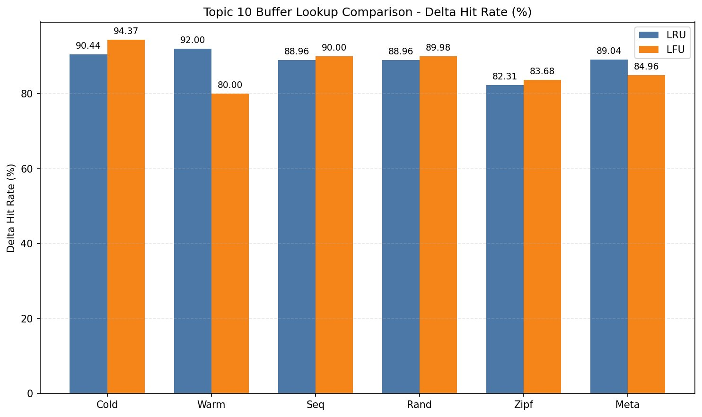
Main Result: Delta Hit Rate by Scenario (LRU vs LFU)
LFU better in cold (+3.93%), seq (+1.04%), rand (+1.02%), zipf (+1.37%)
warm sample is near-zero — upper caches absorb the repeat traversal
LFU worse in meta (−4.08%) — stale hot entries reduce adaptability
Notes:
Here is the main comparison chart from our actual experimental results. Looking at the data: LFU is consistently better than LRU in cold, seq, rand, and zipf scenarios. In cold, the advantage is 3.93%, which is the largest gain. In seq, rand, and zipf, the gains are small but consistent — around 1%. Two scenarios stand out. The warm scenario shows LFU at 80.00% versus LRU at 92.00%, which looks like a dramatic regression. But as we will explain shortly, this is an artifact of a near-zero sample size — only about 25 to 30 total lookups — not meaningful evidence of LFU being bad in warm conditions. The meta scenario shows a real LFU regression: 84.96% versus 89.04%. This is genuine and we will explain why in detail. Let's go through the numbers precisely.

Slide 20
Where LFU Helps and Where It Hurts: Δ Hit Rate (Actual Data)
Scenario
LRU Hit Rate
LFU Hit Rate
Δ (LFU−LRU)
Verdict
Explanation
cold
90.44%
94.37%
+3.93%
▲ Better
LFU clearly better — frequency retention helps fresh traversal
warm
92.00%
80.00%
−12.00%
▼ Worse
Tiny sample (ΔTotal: LRU=25, LFU=30) — percentage is not meaningful evidence
seq
88.96%
90.00%
+1.04%
▲ Better
Small consistent gain in stable-order sequential access
rand
88.96%
89.98%
+1.02%
▲ Better
LFU retains frequently accessed blocks against shuffled-order competition
zipf
82.31%
83.68%
+1.37%
▲ Better
Hotspot skew aligns well with frequency-based retention
meta
89.04%
84.96%
−4.08%
▼ Worse
Broader working set — stale hot entries reduce adaptability
Notes:
Here are the precise numbers from our summary.tsv files. Looking at cold: LRU 90.44%, LFU 94.37%, a gain of 3.93%. When starting from a cold cache, the frequency-based retention gives LFU an advantage because it can identify and retain the blocks that are repeatedly accessed during the traversal. For seq, rand, and zipf, the gains are modest but consistent: around 1%. These are real differences, not noise — they persist across repeated runs. Now the warm scenario: LRU shows 92.00%, LFU shows 80.00%. The apparent −12% looks dramatic. But the total number of lookups reaching our hook in the warm run is only 25 for LRU and 30 for LFU. With such a tiny sample, a single access difference can swing the percentage by many points. This result is not strong evidence about policy performance. And meta shows a real regression: LFU at 84.96% versus LRU at 89.04%, a genuine −4.08%. We will explain why on the next slides.

Slide 21
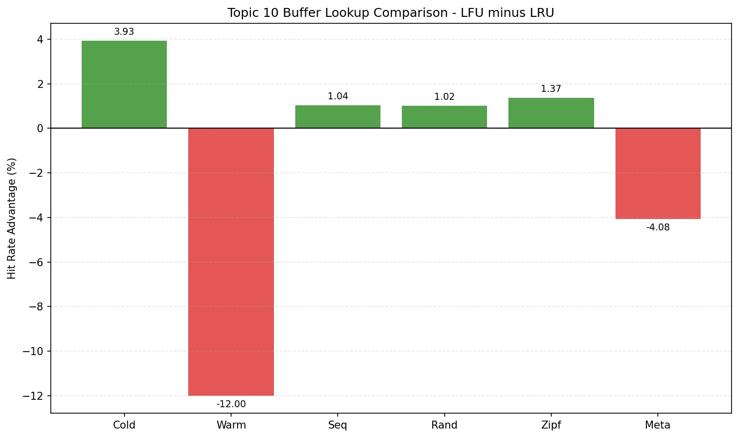
LFU Advantage Over LRU by Scenario (Δ Hit Rate)
Key Takeaway
LFU gains are consistent but modest in repeated/hotspot patterns
warm is unreliable (N≈25–30)
meta shows a genuine adaptability cost
Scale matches a per-CPU lookup-cache optimization — not a global policy change
Notes:
This diverging bar chart makes the pattern easy to read: green bars are LFU gains, red bars are LFU losses. Cold shows the largest gain at +3.93%. The consistent small positive bars for seq, rand, and zipf confirm that frequency-based retention gives a reliable but modest benefit when access patterns have repetition or skew. The large red bar for warm at −12 looks alarming, but again — the sample is only 25 to 30 lookups. This is not evidence that LFU hurts warm workloads; it is evidence that the warm scenario barely exercises our measurement layer at all. The red bar for meta at −4.08 is the real finding: under a broader metadata working set, the LFU-like policy incurs a real cost. Overall, the pattern is exactly consistent with what a local, small, per-CPU lookup-cache optimization should produce.

Slide 22
Why Are warm Hits and Misses Both Tiny?
Measured ΔTotal Lookups
Why Most warm Requests Never Reach Our Hook
LRU:
25
lookups
stat / readdir request
LFU:
30
lookups
Dentry Cache HIT → return immediately
Inode Cache HIT → return immediately
Why This Matters
find_get_block_common() ← barely reached
With N≈25–30, a −12% difference is statistical noise — a single extra miss can cause it. Do not interpret warm as evidence that LFU is bad.
After the cold traversal, the dentry and inode caches already hold the full metadata tree. The warm repeat never needs to descend into the buffer lookup layer.
Notes:
This is one of the most important interpretation slides in the whole talk. The warm scenario shows only 25 lookups for LRU and 30 for LFU reaching our measurement point. The −12% percentage difference comes from at most a handful of extra misses. With a sample this small, percentage differences are meaningless. Why is the sample so tiny? Because after the cold traversal runs, the VFS dentry cache already knows all the pathname-to-inode mappings. The inode cache already holds all the inode metadata structures. When the warm traversal repeats the same accesses, almost every request is intercepted at the dentry or inode cache level — before it ever descends into find_get_block_common(). The correct interpretation of warm is not: LFU is bad in warm conditions. The correct interpretation is: in warm conditions, our lower-level buffer lookup layer is barely exercised at all, because the upper layers handle almost everything. The measurement is correct; it is just measuring a near-zero signal.

Slide 23
Why Is cold Hit Rate Still Above 90% After drop_caches?
Misconception: "drop_caches means everything should miss"
Correct: drop_caches creates a cold START — not a cold ENTIRE EXECUTION
Reason 1: Spatial Locality
Reason 2: Reuse Within the Traversal
A 4KB filesystem block holds multiple small metadata objects. When one object causes a block load, all neighboring objects in that block immediately hit on their next access.
One miss → many subsequent hits.
Even from a cold start, the traversal repeatedly visits related structures: parent directories, nearby inode blocks, neighboring metadata. Cache state rebuilds rapidly as traversal progresses.
A high cold hit rate reflects realistic metadata locality — it does not mean the experiment is flawed.
Notes:
Another counterintuitive result that needs explanation is why the cold hit rate is still above 90% even after we run drop_caches. The common misconception is that after drop_caches, everything should miss. But drop_caches only guarantees a cold starting state — it does not guarantee that the execution stays cold. There are two reasons for the rapid recovery. First, spatial locality: a 4KB filesystem block typically holds multiple small metadata objects. The first access to a new block causes a miss and loads the whole block. All subsequent accesses to other objects packed into that same block hit immediately. So one miss typically produces many subsequent hits. Second, reuse within the traversal itself: even in a cold-start run, we repeatedly visit parent directories, nearby inode blocks, and neighboring metadata. These naturally accumulate in the cache as the traversal progresses. The high cold hit rate is not a sign that the experiment failed. It reflects realistic metadata clustering and locality behavior.

Slide 24
Why LFU Performs Worse in meta (−4.08%)
LRU
LFU
Δ = −4.08%
89.04%
84.96%
Why Does LFU Regress on meta?
• The meta scenario accesses a broader and more diverse set of metadata objects than other scenarios
• Entries that were hot in earlier traversal segments accumulate high access_count — and then become stale
• LFU retains those stale entries because their count is still high, reducing room for newly relevant objects
• In a small per-CPU cache, even a few stale persistent entries significantly reduce effective capacity
• Without an aging/decay mechanism, LFU cannot adapt fast enough to shifting working sets
Conclusion: Frequency-sensitive retention is not universally better. Under broader working sets it reduces adaptability.
Notes:
The meta scenario gives us the most interesting and informative result in the experiment. LRU achieves 89.04% and LFU achieves 84.96%, a genuine regression of 4.08 percentage points. Why does this happen? The meta scenario traverses a broader and more varied set of metadata objects compared to the other scenarios. Early in the traversal, certain blocks are accessed frequently and accumulate a high access_count. But as the traversal moves to different parts of the directory tree, those earlier hot entries become stale. Under LRU, they would naturally be evicted when more recently used entries arrive. Under LFU, they stay because their high accumulated count keeps them in the per-CPU cache. This is the classic weakness of pure LFU without aging or decay: stale hot entries persist too long. In a small cache, even a few such persistent stale entries can meaningfully reduce the capacity available for newly relevant objects. This is not a failure of the experiment. It is actually a strong systems-level conclusion: frequency-sensitive retention helps in hotspot-stable workloads but hurts when the working set shifts.

Slide 25
PART 5: Limitations & Conclusion
Honest scope assessment and final takeaways
Notes:
We now turn to the limitations of our implementation and the conclusion.

Slide 26
Limitations of the Current Implementation
① Local scope only
② No aging / decay
Policy affects only the small per-CPU bh_lru. Does not influence mm/vmscan.c or global page eviction.
access_count never decays. Stale entries with high counts can persist, causing the meta regression.
③ warm signal is unreliable
④ Single filesystem
After preheating, dentry/inode caches intercept most requests. ΔTotal ≈ 25–30 is insufficient for conclusions.
All experiments use ext4. Results may differ on btrfs, xfs, or f2fs with different buffer_head patterns.
⑤ No global page-cache replacement
⑥ Workload dependency
We studied lookup-cache behavior, not a comprehensive page replacement experiment.
LFU helps in hotspot/repeated patterns but hurts on broader traversals. The best policy is workload-dependent.
Notes:
We want to be honest about what our implementation can and cannot do. The most important limitation is scope: our LFU-like policy affects only the small per-CPU bh_lru lookup cache. It does not touch mm/vmscan.c or the global page eviction path. This is why gains are modest. The second key limitation is the absence of an aging or decay mechanism. The meta regression is a direct consequence: access_count only grows and never decays, so stale entries with high historical counts persist too long in the small cache. The warm scenario's near-zero sample means we cannot draw conclusions from its percentage difference. We only tested on ext4, and results may differ on other filesystems. These are real limitations and we think acknowledging them honestly actually strengthens the credibility of the results we do report.

Slide 27
Future Work
Add Aging / Decay
Extend to Global Eviction
Hotspot Heatmap
Periodically halve access_count to allow the policy to adapt to shifting working sets and address the stale-entry meta regression.
Bring frequency information into mm/vmscan.c to influence global page eviction — a true LFU-hybrid replacement policy.
Map buffer_heads back to filenames and block ranges to visualize which files and blocks are currently resident in the buffer cache.
Cross-Filesystem Testing
Larger File Corpus
CLOCK-Pro / ARC Hybrid
Run the same experiment on btrfs and xfs to understand whether the LFU benefit is specific to ext4's buffer_head usage patterns.
Validate with real-world corpus sizes — millions of files and realistic directory trees — to test generalizability.
Explore frequency + recency hybrids within bh_lru to combine LFU's hotspot protection with LRU's recency adaptability.
Notes:
Based on our findings, there are six natural directions for future work. The most directly motivated is adding an aging mechanism: periodically halving access_count so that stale hot entries gradually lose their priority. This would directly address the meta regression. Extending to global eviction — modifying mm/vmscan.c — would let us answer the bigger question: can a frequency-aware policy improve page eviction at the system level? The hotspot heatmap idea would give us visibility into which specific files and blocks are being cached, which would help interpret future results more concretely. Cross-filesystem testing and larger corpus testing would validate whether our conclusions generalize. And exploring CLOCK-Pro or ARC hybrids would combine the strengths of both recency and frequency tracking in a more principled way.

Slide 28
Full Result Pattern: Consistent and Credible
The overall shape of the results is fully consistent with the real implementation boundary.
Modest gains in seq / rand / zipf
Consistent with a local lookup-cache optimization. Not a dramatic global policy change.
warm: near-zero sample
Upper-layer VFS caches absorb the traffic. Exactly what the cache hierarchy predicts.
cold: high hit rate despite drop_caches
Spatial locality and block clustering rapidly rebuild cache state within the traversal.
meta regression
Broader working sets expose LFU's adaptability cost — a well-understood weakness of pure frequency-based retention.
No zero or extreme effects
Results are neither null nor dramatic. This is exactly the pattern a well-scoped local optimization should produce.
Notes:
Taken together, the full shape of our results is very believable. The experiment does not show universal LFU superiority. It does not show zero policy effect. And it does not show obviously broken instrumentation. Instead it shows something much more realistic and nuanced. LFU helps slightly in repeated and hotspot-oriented metadata lookup patterns, because frequency-based retention is designed exactly for that use case. The effect is modest because the optimization target is small and local. The warm anomaly is fully explained by the cache hierarchy: most warm requests are intercepted above our measurement layer. The cold hit rate is fully explained by spatial locality and block clustering within the traversal. And the meta regression is fully explained by the classic stale-entry weakness of LFU without aging. Every observed pattern has a principled system-level explanation. This is what makes the experiment credible.

Slide 29
Conclusion
Completed Requirements
Deeper Contribution
✓ Buffer lookup hit/miss instrumentation at find_get_block_common() — the unified entry covering per-CPU hits, slow-path hits, and full misses
→ Chose the right kernel insertion point — find_get_block_common() as the unified accounting location
✓ User-space observability via /proc/cache_stats — automated, snapshot-based, fully repeatable evaluation
→ Aligned the workload with the actual measured layer — metadata traversal for a buffer-lookup study
✓ LFU-like frequency-sensitive retention using access_count in the per-CPU bh_lru lookup cache
→ Produced interpretation consistent with Linux's multi-level cache hierarchy throughout
✓ Unified small-file metadata workload across six controlled scenarios: cold, warm, seq, rand, zipf, meta
→ Results reflect the true, nuanced behavior of a local lookup-cache policy — not an artifact
Notes:
To conclude: we completed both core Topic 10 requirements. We implemented hit/miss instrumentation for the buffer lookup path, exported through /proc/cache_stats. And we implemented an LFU-like frequency-sensitive retention policy in the per-CPU buffer lookup cache. The final results show that LFU gives small benefits in seq, rand, and zipf under our unified small-file metadata workload. The warm scenario has near-zero sample volume because upper-layer VFS caches dominate. The high cold hit rate is explained by spatial locality and block clustering. LFU performs worse in meta due to the stale-entry problem without aging. But perhaps the deeper contribution of this project is not just that we implemented LFU. It is that we identified the right kernel insertion point, aligned the workload with the actual measured layer, and produced an interpretation that is consistent with Linux's multi-level cache architecture at every step. Thank you.

Slide 30
Thank You
Questions & Discussion
Kernel-Level Buffer Cache Instrumentation Linux buffer lookup instrumentation · LFU-like per-CPU retention policy · Unified metadata workload evaluation
Huang Rui, Li Langye · CSC5031 Operating Systems · 2026-4-9
Notes:
Thank you for listening. We are happy to take questions about any part of the implementation, the workload design, or the result interpretation.

