Slide 1

Kernel-Level Buffer Cache Instrumentation & LFU Optimization
CSC5031 Operating Systems Project – Topic 10
Wang Peizhu (225040176) | He Haodong (225040162)
April 2026
1

Slide 2

OUTLINE
1
4
Introduction & Motivation
Experiment
2
5
Background
Results
3
6
Design & Implementation
Conclusion & Q&A
2

Slide 3

Division of Work
Designed extreme memory pressure tests using tmpfs memory hogging.
Automated fio workloads (Sequential, Random, Zipfian) via scripts.
Verified kernel stability under sustained 60-second heavy loads.
Visualized benchmark data and analyzed LRU vs. LFU performance.
Wang Peizhu
He Haodong
Extended buffer_head with atomic counters and lockless Per-CPU statistics.
Hooked fs/buffer.c core paths to track Cache Hit/Miss globally.
Implemented Bounded LFU cache replacement policy with Linear Decay.
Exposed real-time metrics to user-space via /proc/cache_stats.
3

Slide 4








Introduction — The Role of the Buffer Cache
The Performance Gap
Page Cache vs. Buffer Cache
Disk access is exponentially slower than RAM. The Linux kernel mitigates this massive bottleneck by aggressively caching data in memory.
Page Cache
Stores actual file data contents (typically managed in 4KB pages).
The Core Unit
Buffer Cache
Managed via struct buffer_head, which acts as a descriptor mapping a portion of a memory page to a specific physical disk block.
Stores critical filesystem metadata (Superblocks, Inodes, Bitmaps).
4

Slide 5







Motivation — Why Modify the Cache Policy?
The Default Policy: LRU
Our Objective: LFU
Heavy Reliance: Linux relies heavily on LRU (Least Recently Used) for cache management.
Instrumentation: Instrument the cache to expose real-time hit and miss metrics.
Scan Vulnerability: Fails under scan workloads. One-time background scans can completely flush out "hot" metadata.
VS
LFU Implementation: Deploy a Least Frequently Used policy specifically to protect frequently accessed metadata.
Result: Severe cache pollution and significantly higher disk I/O latency.
Anti-Zombie Strategy: Use bounded counters (cap = 50) and linear decay to prevent "ghost" items from permanently residing.
5

Slide 6
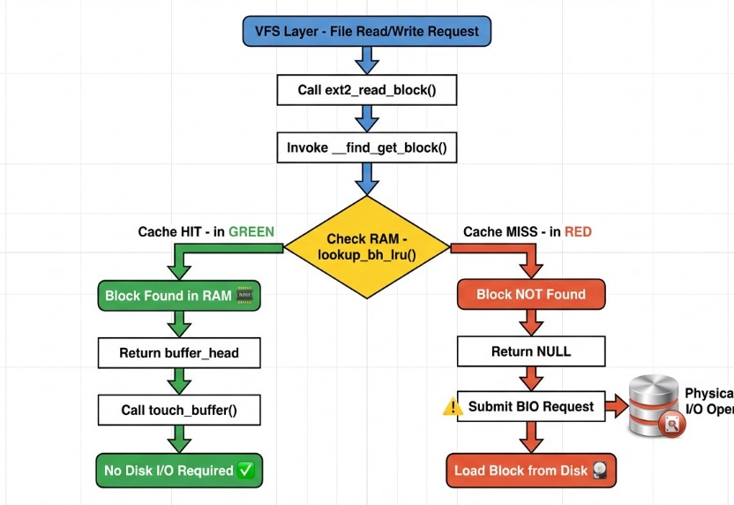





Background — Mechanics of the Buffer Cache
Trigger
Triggered by file access (Read/Write request) from the VFS layer.
Lookup Flow
When the filesystem calls ext2_read_block, it invokes __find_get_block.
Hit (Block Found)
Returns a valid buffer_head. No disk I/O required.
Miss (Not Found)
Returns NULL. The kernel must submit a BIO (Block I/O) request to the disk.
6

Slide 7





Background — LRU vs LFU Strategies
Weaknesses/Challenges
Notes
Strategy
Principle
Strengths
Simple to implement
Scan pollution vulnerability
LRU
"If you haven't been used lately, you probably won't be used soon."
Default standard policy in the Linux Kernel.
Good for standard temporal locality
Evicts "hot" but not recently used metadata
Default
Protects highly accessed hot metadata
Requires per-block frequency counters
LFU
Our Fix: Bounded counter + linear decay strategy.
"If you are rarely used, get out."
Our Goal
Robust against skewed DB workloads
"Ghost items" can accumulate counts forever
7

Slide 8





Project Objectives
1. Instrumentation
2. Observability
3. Custom Policy
Hook into fs/buffer.c to globally monitor and log Cache Hits and Misses across the operating system.
Expose real-time statistics via a custom /proc/cache_stats file using seq_file readers.
Implement a frequency-based (LFU) cache replacement strategy optimized specifically for filesystem metadata.
Platform: Ubuntu 22.04 LTS | Linux 5.15.202
8

Slide 9

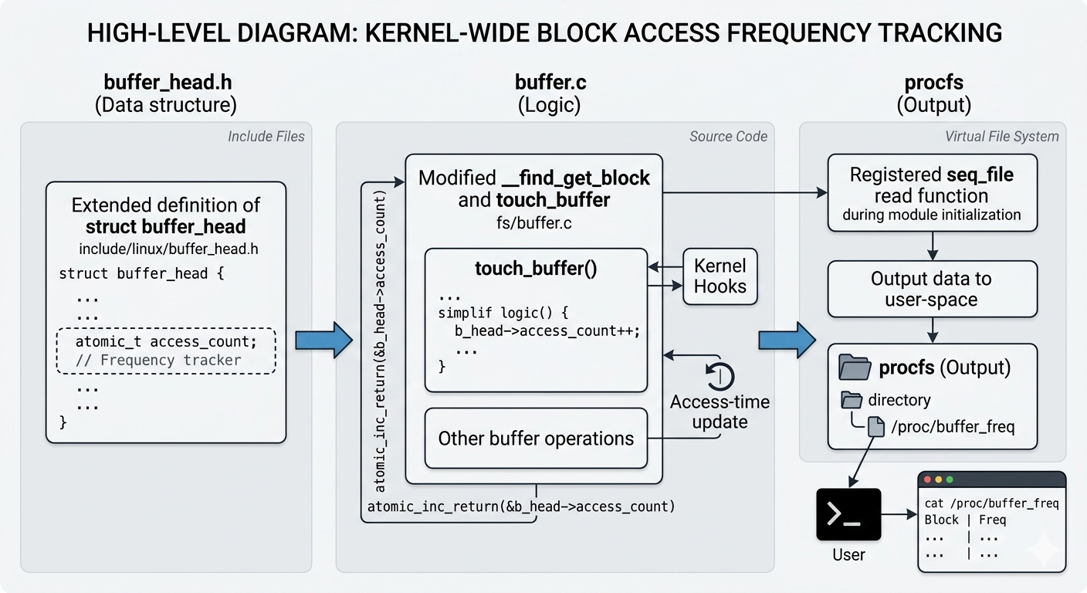



Design — Architecture
Data Structure
Extended struct buffer_head in include/linux/buffer_head.h to include a frequency tracker.
Kernel Hooks
Modified __find_get_block and touch_buffer in fs/buffer.c.
Insert Architecture Diagram Here
Procfs Integration
Registered a custom seq_file read function during module initialization to expose data to user-space.
9

Slide 10


Implementation 1 — buffer_head Modification
To support the LFU policy, we added a frequency tracker directly to the core cache mapping structure. We utilized atomic_t to maintain performance in multi-core environments.
include/linux/buffer_head.h
struct buffer_head
{
unsigned long b_state;
struct buffer_head *b_this_page;
struct page *b_page;
// ... (original fields) ...
spinlock_t b_uptodate_lock;
/* Topic 10: Custom field for LFU replacement strategy */
atomic_t access_count;
};
Why atomic_t?
The buffer cache is highly concurrent. Using standard variables would cause race conditions, while spinlock_t would create massive SMP bottlenecks. atomic_t provides lockless, hardware-level thread safety.
10

Slide 11
Implementation 2 — Hooking the Lookup Path
We instrumented __find_get_block. If lookup_bh_lru and __find_get_block_slow fail to find the block, we register a Miss. Otherwise, we register a Hit and call touch_buffer.
include/linux/buffer.c
if (bh == NULL)
{
bh = __find_get_block_slow(bdev, block);
if (bh) bh_lru_install(bh);
/* Topic 10: Cache Miss logic */
this_cpu_inc(cpu_cache_misses);
}
else
{
touch_buffer(bh);
/* Topic 10: Cache Hit logic */
this_cpu_inc(cpu_cache_hits);
}
11

Slide 12
Implementation 3 — Lockless Per-CPU Statistics
Problem: Using global counters with a spinlock on every cache check creates severe SMP (Symmetric
Multiprocessing) bottlenecks.
Solution: We implemented DEFINE_PER_CPU for completely lockless, zero-overhead incrementing.
include/linux/buffer_head.h
/* Removed global locks, using Per-CPU variables */
static DEFINE_PER_CPU(unsigned long, cpu_cache_hits); // Default set to 0
static DEFINE_PER_CPU(unsigned long, cpu_cache_misses); // Default set to 0
12

Slide 13
Implementation 4 — Exposing Data via /proc
We iterate through all CPU cores to aggregate the lockless counters safely and compute the total Hit Rate.
include/linux/buffer.c
static int my_stats_show(struct seq_file *m, void *v)
{
unsigned long hits = 0, misses = 0, hit_rate;
int cpu;
/* Safely aggregate per-cpu data without locks */
for_each_possible_cpu(cpu)
{
hits += per_cpu(cpu_cache_hits, cpu);
misses += per_cpu(cpu_cache_misses, cpu);
}
hit_rate = (hits * 100) / (hits + misses + 1);
seq_printf(m, "Hit Rate: %lu%%\n", hit_rate);
return 0;
}
13

Slide 14
Implementation 5 — Bounded LFU Increment
Anti-Zombie Block Strategy: To prevent "ghost" blocks from accumulating infinite counts and becoming permanently un-evictable, we hard-capped the frequency counter at 50.
include/linux/buffer_head.h
inline void touch_buffer(struct buffer_head *bh)
{
trace_block_touch_buffer(bh);
mark_page_accessed(bh->b_page);
/* Bounded LFU: Prevent counters from overflowing */
if (atomic_read(&bh->access_count) < 50)
{
atomic_inc(&bh->access_count);
}
}
14

Slide 15
Implementation 6 — Linear Decay Eviction
Instead of immediately dropping cold buffers, we introduced Linear Decay.
If a block has an access_count greater than 1, we decrement it by 1 and skip eviction. This ensures hot metadata survives sudden memory pressure waves, but gradually cools down if it stops being used.
include/linux/buffer.c
/* Inside drop_buffers() */
int current_count = atomic_read(&bh->access_count);
if (current_count > 1)
{
/* Linear Decay: cools down hot blocks gradually */
atomic_set(&bh->access_count, current_count - 1);
goto failed; // Skip eviction this time
}
15

Slide 16
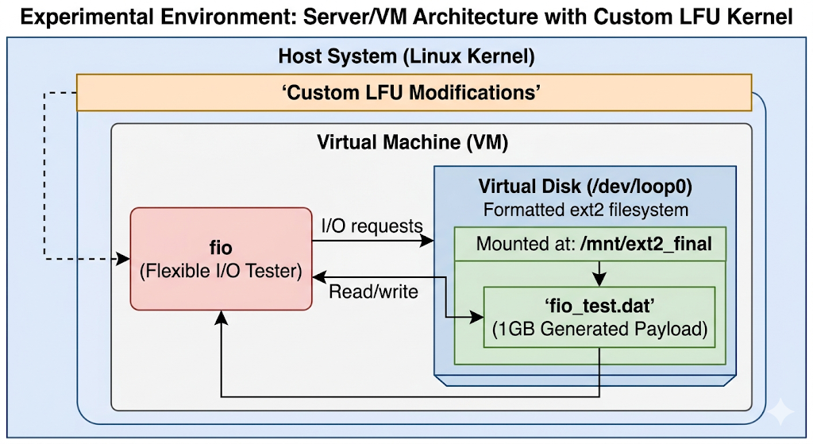
Experiment — Environment Setup
Host System
Custom-compiled Linux kernel with our LFU modifications.
Disk Setup
1.5GB ext2 loop device mounted at /mnt/ext2_final.
Insert Architecture Diagram Here
Data Size
1GB generated test payload (fio_test.dat).
16

Slide 17
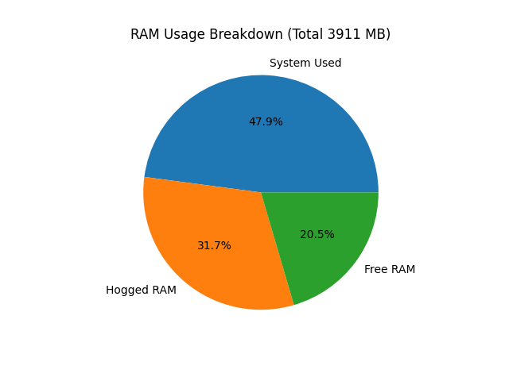
Experiment — Forcing Eviction
To accurately test eviction, we simulated extreme memory pressure.
Disabled System Swap (swapoff -a).
Mounted a tmpfs RAM disk and locked up memory, leaving exactly 800MB of free RAM.
Result: The kernel is forced to actively trigger drop_buffers, as the file is 1GB and RAM is 800MB.
Insert Architecture Diagram Here
17

Slide 18
Experiment — Workload (fio)
Sequential Read
Random Write
Zipfian Database Simulation (zipf:1.2)
A pure linear scan. Used to test if the cache gets "polluted" by one-off reads.
Used to test how dirty metadata pages (like block bitmaps) are handled and protected.
Simulates database index lookups. A highly skewed distribution where a tiny fraction of metadata blocks receives the vast majority of access traffic.
18

Slide 19
Result — Benchmark
Workload | Stage | LRU Hit Rate (%) | LFU Hit Rate (%) | Improvement (%)
Sequential Read | Warm | 83 | 84 | 1
 | Cold | 13 | 16 | 3
Random Write | Cold | 53 | 69 | 16
 | Warm | 97 | 96 | -1
DB Sim (Zipfian) | Cold | 52 | 67 | 15
 | Warm | 52 | 66 | 14
19

Slide 20
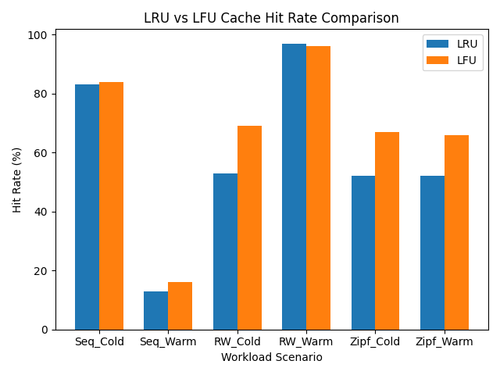
Result — Analysis of Hit Rate Comparison
The Zipfian Victory: Our LFU implementation drastically outperformed LRU in the Database Simulation (67% vs 52%).
Random Write Boost: LFU improved cold random writes (69% vs 53%) by protecting frequently modified ext2 bitmaps from premature eviction.
20

Slide 21
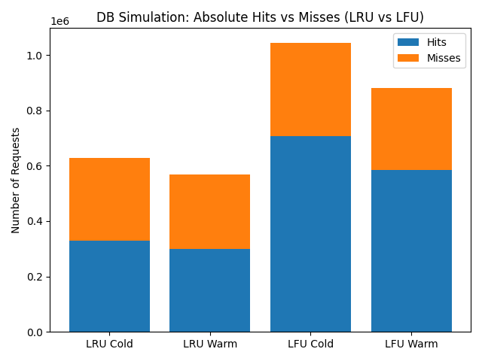
Result — Analysis of Hit v.s. Miss Volume
Looking at absolute numbers, LFU serves over 706,392 hits during the Cold DB Simulation, compared to only 329,378 hits with LRU.
This proves that LFU's Linear Decay algorithm is successfully keeping the "hot" data alive in RAM, significantly reducing disk I/O penalties.
21

Slide 22
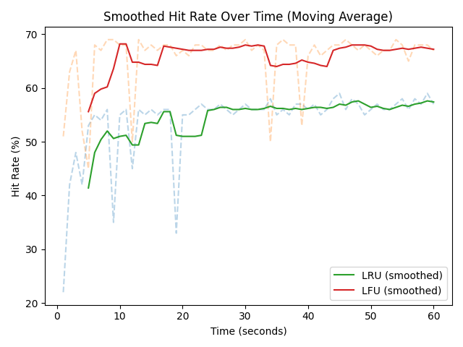
Result — Analysis of Zipfian Hit Rate Over Time
Behavior under Pressure: LRU shows clear instability under memory pressure, with early-phase hit rate drops and slow convergence. This indicates poor retention of high-frequency items when the cache is stressed.
LFU Stabilization: LFU rises quickly and maintains a stable plateau. Both time-series and aggregate results show that bounded LFU with decay consistently preserves hot data, reducing volatility and improving steady-state performance.
22

Slide 23
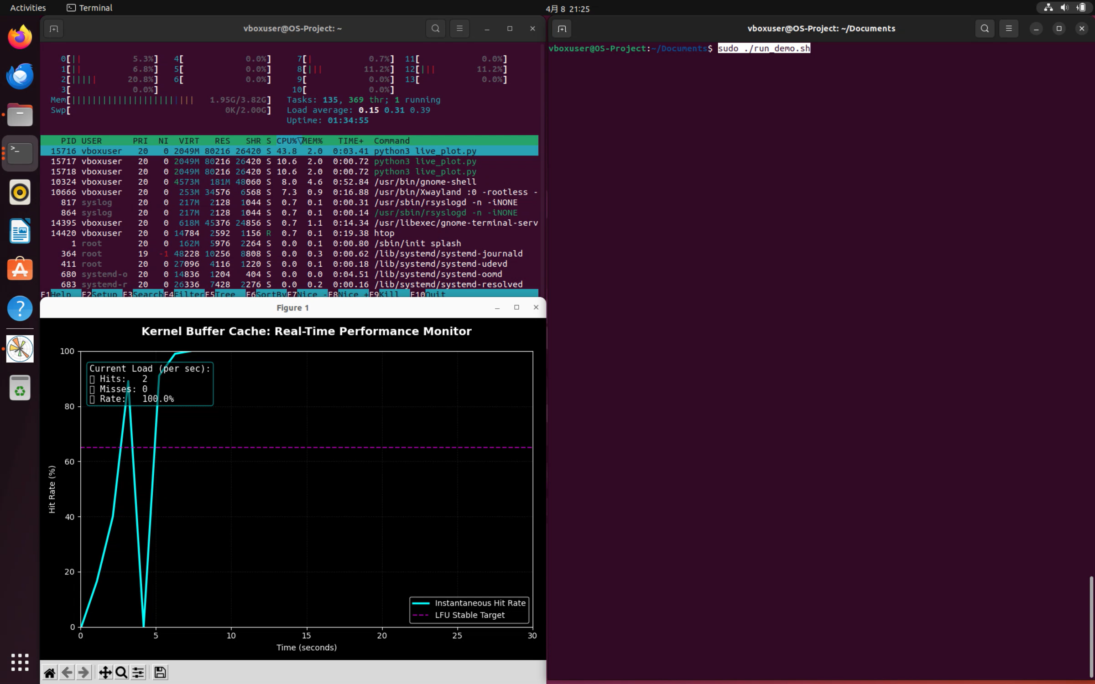
Live Demo
21

Slide 24
Conclusion
Summary: We successfully instrumented the kernel buffer cache using a lockless Per-CPU architecture, and deployed an anti-fragile LFU policy .
Key Insight: While LRU is sufficient for standard Page Cache data, the Buffer Cache (metadata) thrives under LFU, especially in skewed, database-like access patterns.
Future Work: Implement dynamic policy switching (e.g., Adaptive Replacement Cache) to detect workload patterns in real-time and toggle between LRU and LFU autonomously.
24

Slide 25
THANKS
Q & A
25

