Slide 1
Operating Systems Project Topic-11:
Asynchronous I/O Benchmark
and Enhancement (io_uring)
He Kaidi Han Zhiyang
225040185 225040137
Experiment Platform：Ubuntu 20.04 (VIrtualBox)

Slide 2
Contents
01
Requirements
05
Latency Test
06
Syscall Test
02
Theories
07
Kernel Enhencement
03
Designing the Evaluation
04
Throughout Test

Slide 3
Requirements
Benchmark
Kernel Enhancement
Compare the performance of
read/write (traditional)
io_uring (modern)
Metrics:
Latency
Throughput (IOPS)
Syscall Counts
Prove that io_uring is better
for high-concurrency workloads
Target file: fs/io_uring.c
Optimize queue contention
Problem: Multiple threads sharing one Ring Buffer fight for the SQ lock.
Task: Analyze lock contention using perf and propose optimizations.
1

Slide 4
Theories
The Cost of Synchronous I/O
Why not Legacy AIO?
The io_uring Architecture
2

Slide 5
Theory 1: The Cost of Synchronous I/O
Why is read() slow?
Context Switches
Spectre/Meltdown Mitigation
User Space
Kernel Space
Syscall+KPTI Overhead
read()
Block (wait for disk)
Context Switch
Return
CPU spends time switching modes, not moving data.
3

Slide 6
Theory 2: Why not Legacy AIO?
Linux already had libaio. Why create io_uring?
Legacy AIO Problems:
Direct I/O Only: Only worked with O_DIRECT (by passing cache). Buffered I/O would still block!
Complex API: Hard to use correctly.
Data Copy: Still required copying data structures for each submission.
io_uring Solutions:
Universal: Works for Buffered I/O, Network Sockets, etc.
Extensible: Designed to support any syscall asynchronously.
Zero Copy: Shared memory ring buffers.
4

Slide 7
Theory 3: The io_uring Architecture
Core Concept: Two circular ring buffers mapped into user space.
Shared Memory Region
User writes SQE.
Kernel writes CQE.
No copying!
Kernel
Consumes
Submission Queue Entries
(indice)
Completion Queue Entries
Indirect
SQ Entries Array
5

Slide 8
Designing the Evaluation
Build the Environment
Throughput
Test
Latency
Test
Syscall
Count
liburing + strace
4GB Test Files
4KB Random Reads
8 threads
sync: QD=1
io_uring: QD=128
1 thread, QD=1
uring-inturrupt
vs
uring-iopoll
Count the number of system calls.
Locate the source of the overhead.
6

Slide 9
Throughout Test (4KB Random Read, 8 threads)
configuration：sync(QD=1) vs io_uring(QD=128), ops=1,000,000
IOPS
mode | Runtime(s) | IOPS | Throughput(MB/s)
sync (qd=1) | 0.274810 | 3638880 | 14214.38
io_uring (qd=128) | 0.331905 | 3012907 | 11769.17
sync > io_uring?
Throughput
In-flight (Requests that have been sent out but have not been received):
sync: 8 threads × 1qd = 8
io_uring: 8 threads × 128qd = 1024
`
Cause the virtual machine's block layer to crash.
7

Slide 10
Latency Test (1 QD, 1 threads)
mode | Runtime(s) | Avg Lat(us)
io_uring interrupt | 0.170160 | 0.805
io_uring iopoll | 0.171706 | 0.823
Interrupt: After the hardware is completed, it will actively send an interrupt notification to the kernel.
IOPOLL: CPU performs active polling without interrupts.
8

Slide 11
Syscall Test
strace -f -c | 8 threads, 4KB, ops=200,000
Total Syscalls
metrics | sync | io_uring
Total syscalls | 200165 | 2741
Main I/O syscall | pread64=200008 | io_uring_enter=1568
Runtime(s) | 9.326144 | 0.196815
IOPS | 21445.09 | 1016181.65
Throughput(MB/s) | 83.77 | 3969.46
IOPS
Conclusion: The total number of syscalls decreased by 98.63%, and the IOPS in this scenario increased by approximately 47.4 times.
9

Slide 12
Kernel Enhancement
Mitigating SQ Lock Contention in io_uring
10
Notes:
Good morning, everyone. My name is [Your Name], and together with my partner [Partner's Name], we've been working on optimizing the Linux kernel's asynchronous I/O subsystem, io_uring. Today, I will present the second part of our project, focusing on Kernel Enhancement. Specifically, we'll dive into a critical performance issue we identified: the contention on the Submission Queue lock, and the strategies we developed to mitigate it. This work builds upon our previous benchmarking efforts and aims to provide a concrete solution to a known scalability bottleneck in high-concurrency environments.

Slide 13




Significant Reduction in Batching Efficiency: Contention on the Submission Queue (SQ) Lock
Shared Resource Dependency
All threads accessing a common `io_uring` instance must share the same Submission Queue (SQ), creating a natural access point.
Critical Section Contention
A mutex protects the SQ for thread safety, forcing concurrent threads to wait in a queue, drastically reducing parallelism.
Elimination of Batching Benefits
The lock serializes all submissions, preventing the kernel from efficiently batching multiple independent requests from different threads.
The Scalability Question
To what extent does this lock contention limit the overall system throughput and scalability as the number of threads increases?
11
Notes:
So, what is the core problem we're addressing? io_uring is designed for high performance, but it has a significant bottleneck when multiple threads share a single instance. The issue arises from the shared resource dependency: all threads must access the same Submission Queue, or SQ, to post their I/O requests. To ensure thread safety, this queue is protected by a mutex lock. Under high concurrency, threads spend a lot of time waiting for this lock, a phenomenon known as critical section contention. This waiting effectively ruins one of io_uring's biggest advantages: the ability to batch multiple requests together. This leads us to our central question: just how much does this lock contention hurt performance and scalability?

Slide 14
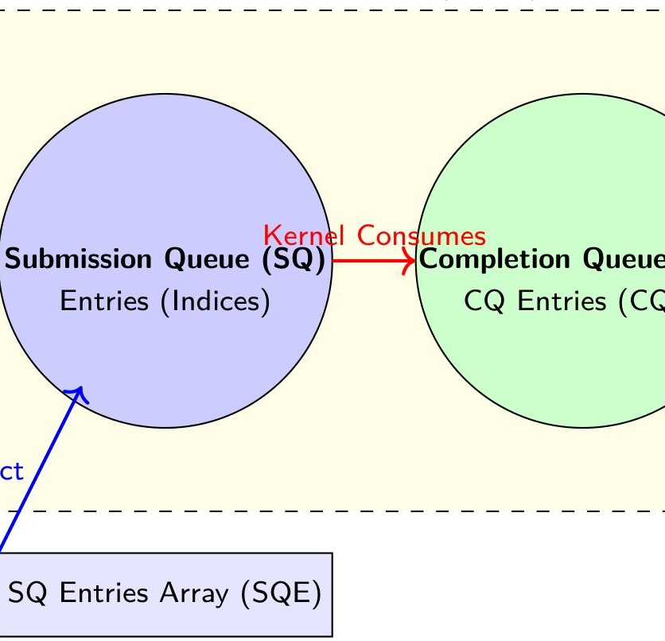
Root Cause: How Contention Breaks Batching
Synchronization Overhead
A coarse-grained mutex serializes all submissions, turning a parallel process into a strictly sequential one.
Diminishing Batch Size
Heavy contention forces small request sets per thread, leading to a continuous shrinkage of the average batch size.
Increased Submission Overhead
Lock acquisition/release overhead for tiny batches dominates total processing time, eroding performance.
io_uring Core Architecture (SQ/CQ)
RESULT: The fundamental advantage of io_uring—efficient request batching—is completely lost.
12
Notes:
To understand why this is happening, let's look at the root cause. The lock protecting the submission queue is a very blunt instrument. It forces all threads to take turns submitting their requests, creating a significant synchronization overhead. This means instead of one thread submitting a large, efficient batch of requests, we get many small, inefficient submissions, one after another. The average batch size diminishes rapidly. The overhead of acquiring and releasing the lock for each small batch becomes a major part of the workload, and the batching mechanism, which is crucial for io_uring's performance, simply breaks down. As you can see in the diagram, the shared ring buffer is the point of contention.

Slide 15
Identifying the Bottleneck with Performance Analysis
1. Kernel Instrumentation
2. Performance Profiling (perf)
We modified the Linux kernel (v5.15.198) by inserting custom instrumentation points within theio_submit_sqes()function to collect key metrics:
calls:Number of submission calls initiated by the application
reqs:Total I/O requests actually submitted to the kernel
big_batches:Count of batches with a size ≥ 32 requests
avg_batch:Average batch size (calculated as reqs / calls)
Aperfanalysis of the workload would reveal critical bottlenecks:
• Significant CPU time spent inmutex_lock()synchronization functions.
• Flame graphs highlight a hot path leading toio_uringsubmission logic, with time attributed to lock contention.
Analysis Focus
Measure and quantify how thebatching behavior(avg_batch, big_batches) degrades as the level of thread contention for the SQ lock increases.
13
Notes:
To quantify this problem and prove our hypothesis, we used two main methods. First, we performed kernel instrumentation. We modified the Linux kernel source code, specifically the io_submit_sqes() function, to collect detailed metrics about the submission process. We tracked the number of submission calls, total requests, and calculated the average batch size. Second, we used performance profiling tools like perf. While we don't have the exact flame graph here, we know it would show a huge amount of time spent waiting on locks within the io_uring submission path. Our primary goal with this analysis was to see how the batching efficiency drops as contention increases, and to identify the exact source of the overhead.

Slide 16
Findings: Batching Efficiency Collapses Under Contention
Kernel-Level Observations (8 Threads):
Scenario | avg_batch | big_batches | calls
Shared Ring | Plummets to~1 | Stops increasing | Increases rapidly
Per-Thread Ring | Stable at~2 | Maintained | Normal rate
Conclusion from Data
The data clearly shows that contention on the shared ring destroys the batching mechanism, reducing the submission process to a series of inefficient, single-request operations. This demonstrates that lock contention is the primary bottleneck limiting performance in the shared ring buffer scenario.
14
Notes:
And here are the findings from our kernel instrumentation. We compared the behavior of a shared ring versus per-thread rings under load from 8 threads. When eight threads share a single ring buffer, the average batch size plummets to almost 1. This means we're effectively making one system call per request, which is extremely inefficient. The number of large, efficient batches drops to zero. In contrast, when each thread has its own ring buffer, the average batch size remains stable and efficient. This data is the smoking gun: lock contention on the shared ring is directly responsible for the poor performance, as it destroys the batching mechanism.

Slide 17
The Solution: Per-Thread / Per-CPU `io_uring` Instances
Scaling io_uring: Avoiding Shared State Contention
❌ Problem: Shared Ring
• All threads fight for the same SQ lock.
• Request submission is forced to serialize.
• Efficient batching of requests is destroyed.
• Results in very poor multi-thread scalability.
✅ Solution: Private Rings
• Each thread gets its own dedicated `io_uring`.
• Submission is completely lock-free for the app.
• Batching is fully preserved and efficient.
• Achieves high scalability & true parallelism.
💡 CORE IDEA:Eliminate lock contention at its source by simply avoiding shared resources.
15
Notes:
So, what's the solution? It's actually quite simple: stop sharing. Instead of having all threads fight over a single ring buffer, we give each thread its own private instance. This way, there's no shared resource to protect, so there's no need for a lock. Each thread can submit its requests in large, efficient batches without any interference, which fully preserves the parallelism and scalability that io_uring promises.

Slide 18
Implementation: From Shared to Private Rings
Shared Ring Workflow
Private Rings Workflow
Implementation Method
Key Benefits & Outcome
1. Thread 1 acquires lock
2. Submits small batch
3. Thread 2 waits & locks
4. Submits small batch
1. Writes to its own SQ
2. Submits large batch
3. Thread 2 writesconcurrently
4. Submits batchconcurrently
The core modification is to create a separateio_uringcontext instance for each individual worker thread in the application.
• Eliminates lock contention bottleneck • Maximizes CPU utilization • Significantly higher I/O throughput via large batches • Full parallelism between threads
16
Notes:
Let's visualize the difference in workflow. With a shared ring, it's a slow, sequential process: one thread locks, submits a little, unlocks, then the next thread waits and repeats. It's a classic bottleneck. With private rings, the process is fully parallel. Thread 1 and Thread 2 can write to their own queues and submit large batches at the same time, with no locks involved from the application's perspective. Implementing this is straightforward: we simply modified the application to create a separate io_uring context for each worker thread.

Slide 19
Benchmark Design: Comparing `shared` vs. `perthread`
Experimental Setup
Test Modes & Concurrency
Kernel Environment
Linux 5.15.198 (with instrumentation)
`shared` Mode:All threads share a single io_uring instance.
`perthread` Mode:Each thread uses its own dedicated instance.
Concurrency Levels:1 Thread (Baseline) / 8 Threads (High Load)
IO Library
liburing (latest stable version)
Key Metrics:Runtime, Latency (Avg/P99), IOPS, Throughput.
Benchmark Goal:Quantify the performance impact of the per-thread optimization.
Workload Profile
4KB Random Reads (Queue Depth: 64)
17
Notes:
To prove our solution works, we designed a comprehensive benchmark. We tested both the shared and per-thread approaches under identical conditions: a 4KB random read workload with a queue depth of 64, using the liburing library on a Linux 5.15 kernel. We measured performance at both 1 and 8 threads, tracking key metrics like runtime, average latency, IOPS, and throughput. The goal was to see exactly how much performance we could gain by switching to the per-thread model and to validate our hypothesis.

Slide 20
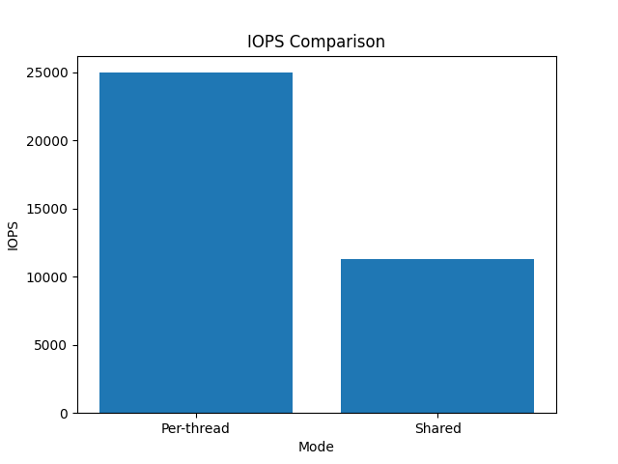

Performance Results: A Clear Win for Per-Thread Rings
Key Performance Metrics (8 Threads): Comparison of shared vs. per-thread rings
Metric | shared Ring (Before) | perthread Ring (After)
Throughput (MB/s) | 44.07 | 97.54
IOPS (ops/sec) | 11,281.54 | 24,970.39
Runtime (seconds) | 35.46 | 16.02 (-55%)
KEY IMPROVEMENT
+121%
Throughput & IOPS Increase
Conclusion: Dramatic Scalability Win
The perthread approach more than doubles the throughput and IOPS compared to the shared approach under 8-thread concurrency. This confirms that eliminating SQ lock contention is critical for achieving high scalability with io_uring.
18
Notes:
And here are the results, which speak for themselves. As you can see from the table, with 8 threads, switching to per-thread rings more than doubled both the throughput and IOPS, from about 44 MB/s to nearly 98 MB/s. The runtime was cut by more than half, from 35 seconds to just 16. The key improvement is a 121% increase in throughput and IOPS, and a 55% reduction in runtime. This dramatic improvement clearly demonstrates that eliminating the SQ lock contention is absolutely critical for achieving the high scalability that io_uring is capable of in multi-threaded applications.

Slide 21




Conclusion and Future Directions
Problem Verified
Shared `io_uring` instances create severe SQ lock contention, crippling scalability.
Solution Validated
Per-thread private instances are a highly effective strategy to mitigate lock contention.
Performance Gains
Benchmark results show this approach can more than double throughput for high-concurrency workloads.
Future Work
Explore lock-free shared ring designs or hybrid approaches for even better resource efficiency.
19
Notes:
To conclude, we've successfully identified and analyzed the SQ lock contention problem in shared io_uring instances. We've validated that using per-thread private instances is a highly effective solution, capable of more than doubling performance for high-concurrency workloads. This leads us to a clear design implication: for high-performance applications, it's strongly recommended to avoid sharing io_uring instances. For future work, we could explore more advanced solutions like lock-free shared rings or hybrid models to balance performance and resource usage, but for now, the per-thread approach offers a simple and powerful fix.

Slide 22
Thanks
Q & A

