Slide 1

CSC5031 Operating System Project
IO-uring Asynchronous I/O Performance Benchmarking and Kernel-Level Optimization
Breaking Through Synchronous I/O Performance Barriers:
From Multithreaded Benchmarking to Microsecond-Level Priority Scheduling Kernel Patches
Date: April 2026
Authors: Yuling Li (225040155) Xiaochen Bai (225040170)
Institution: Computer Science Department CSC5031
1

Slide 2
Agenda & Presentation Outline
Fundamental Shift
Traditional Sync I/O vs. io_uring Architecture
Experimental Setup
Environment Configuration & Methodology
Performance Benchmarking
Quantifying the Synchronous Barrier
Kernel-Level Innovation
Implementing IOSQE_URGENT Priority Scheduling
Future Roadmap
QoS Evolution and Conclusion
2

Slide 3
Part I - Architectural Paradigm Shift
Understanding the inherent limitations of the Linux synchronous I/O stack. This section explores how io_uring leverages shared-memory ring buffers to fundamentally eliminate context-switching and memory-copy overheads, moving from a (N×Syscall) model to a streamlined (1×Syscall) batch execution.
3

Slide 4
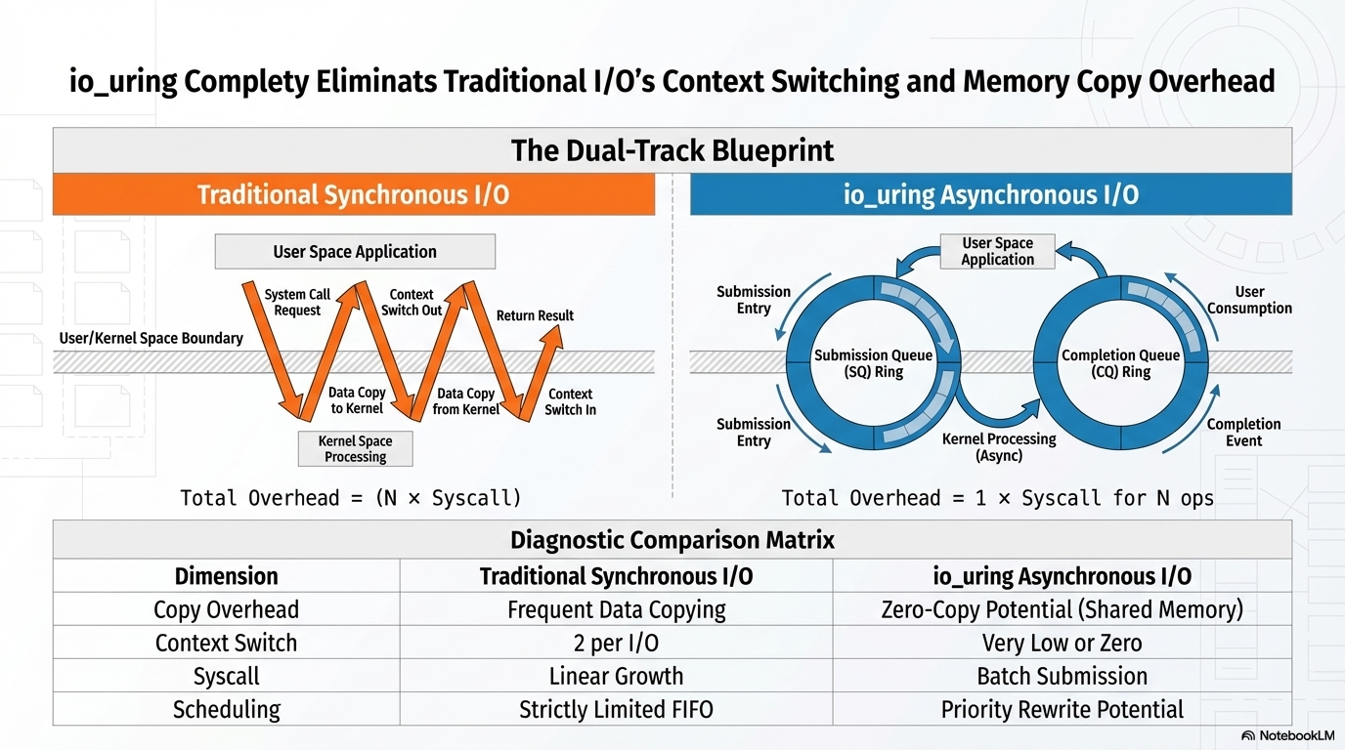
4

Slide 5
Part II - Methodology & Experimental Integrity
Systematic performance analysis requires a strictly controlled environment. We define our "Dual-Track Blueprint" across the Kernel Customization Layer (Custom 6.18 vs. Baseline 6.6) and the Basic Software Layer, ensuring that every microsecond of performance gain is traceable and reproducible under high-concurrency database workloads.
5

Slide 6
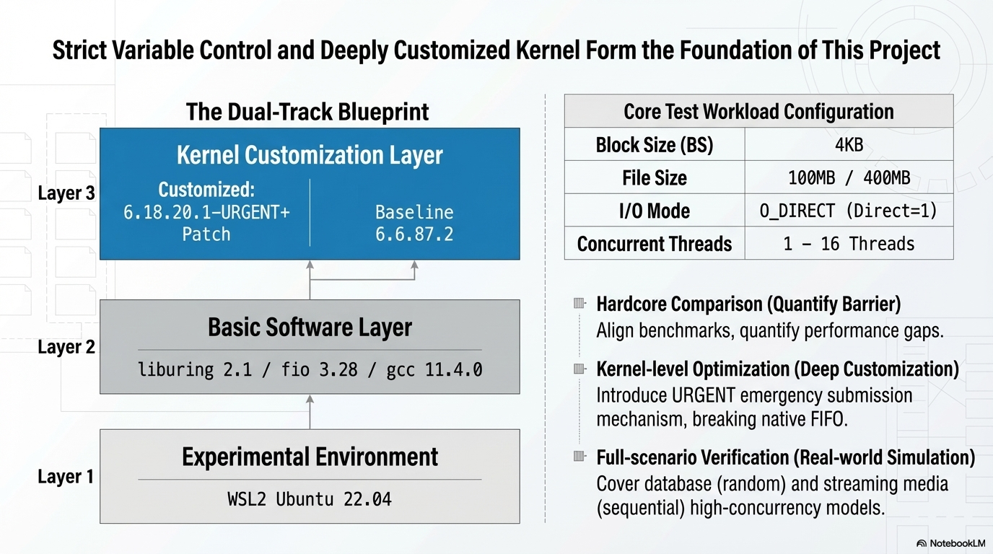
6

Slide 7
Part III - Performance Benchmarking:
Breaking the Barrier
From single-threaded IOPS jumps of 69% to a massive 50x leap in concurrent throughput. We present a multi-dimensional data analysis—covering latency, CPU saturation, and random read scenarios—to prove that io_uring doesn't just improve performance; it redefines the efficiency ceiling for modern I/O.
7

Slide 8
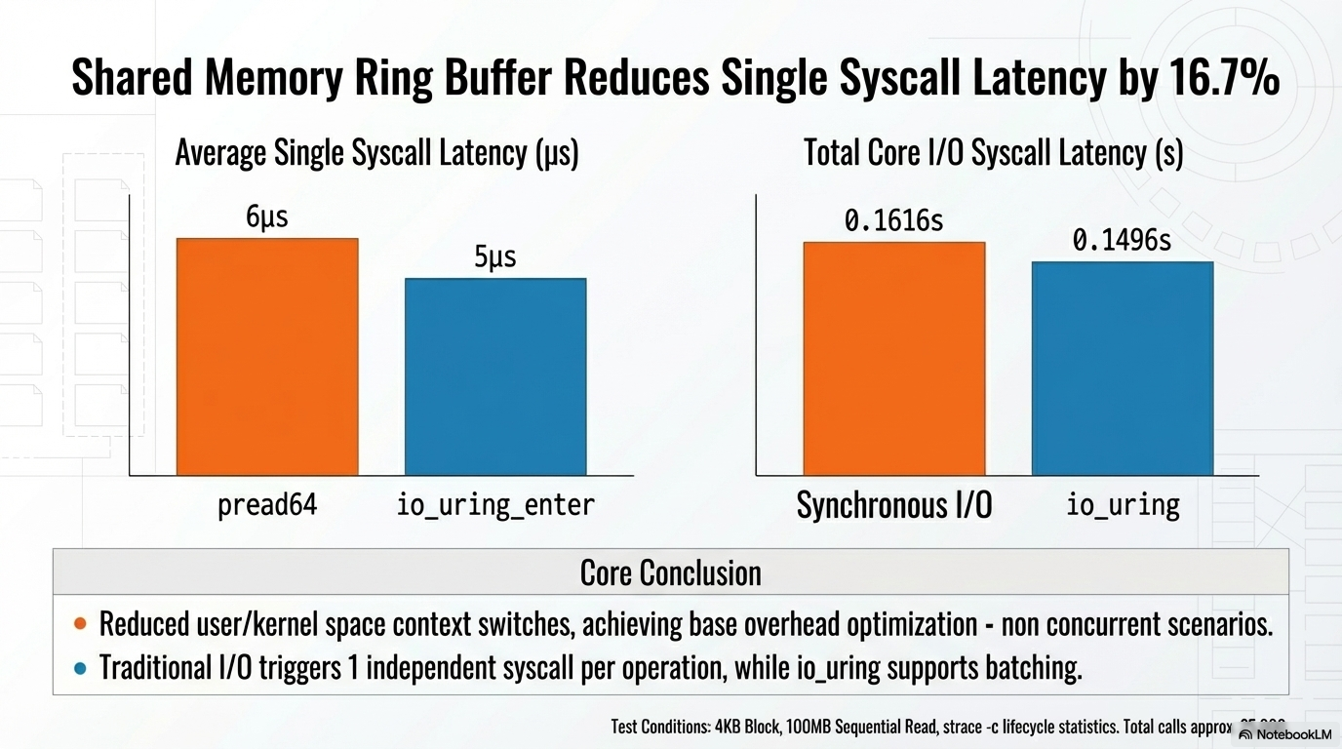
8

Slide 9
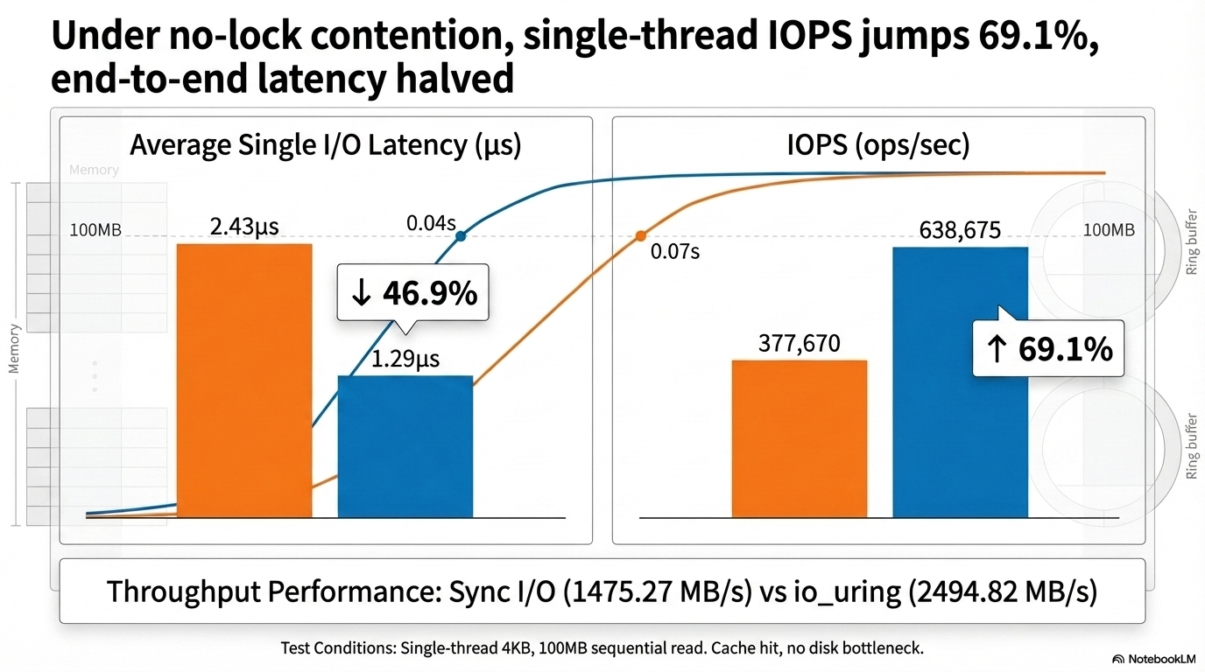
9

Slide 10
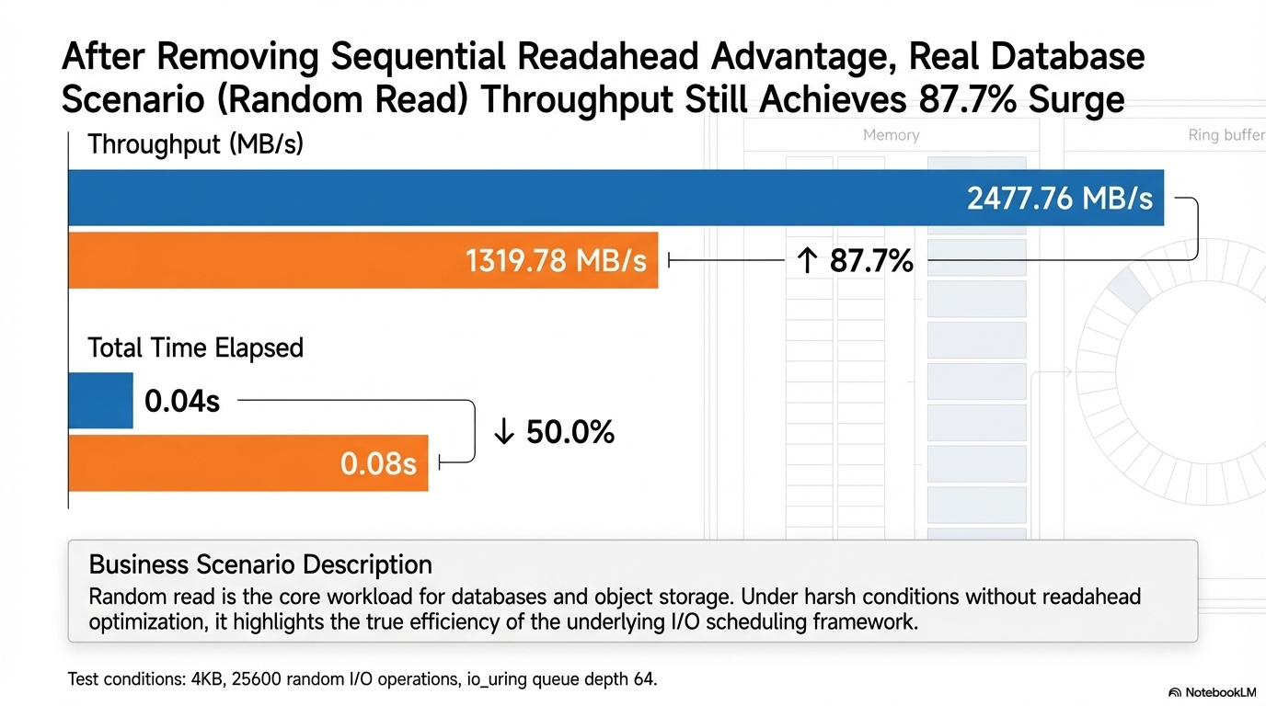
10

Slide 11
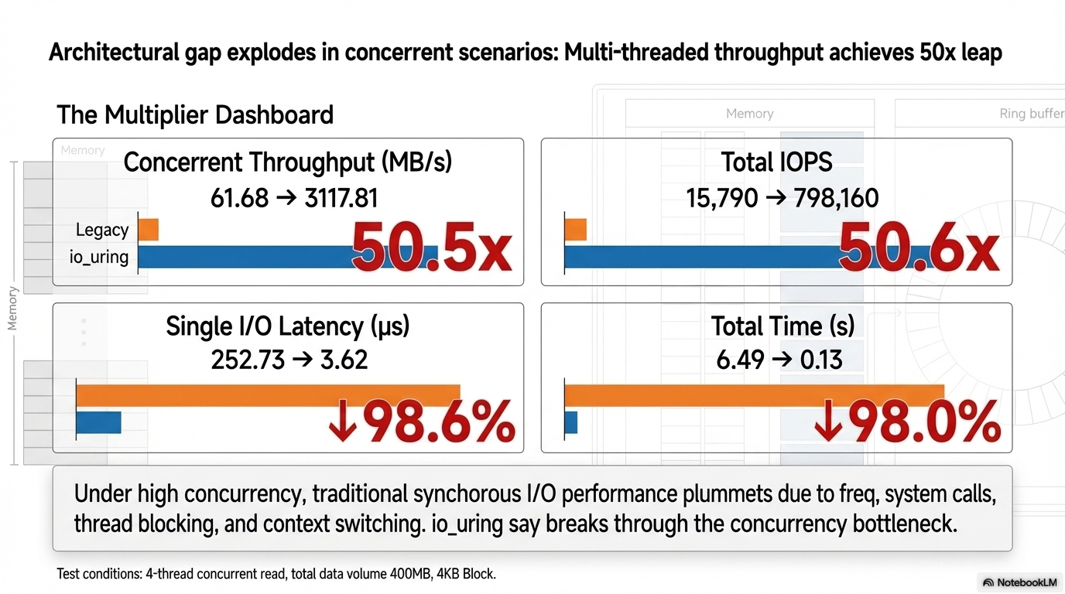
11

Slide 12
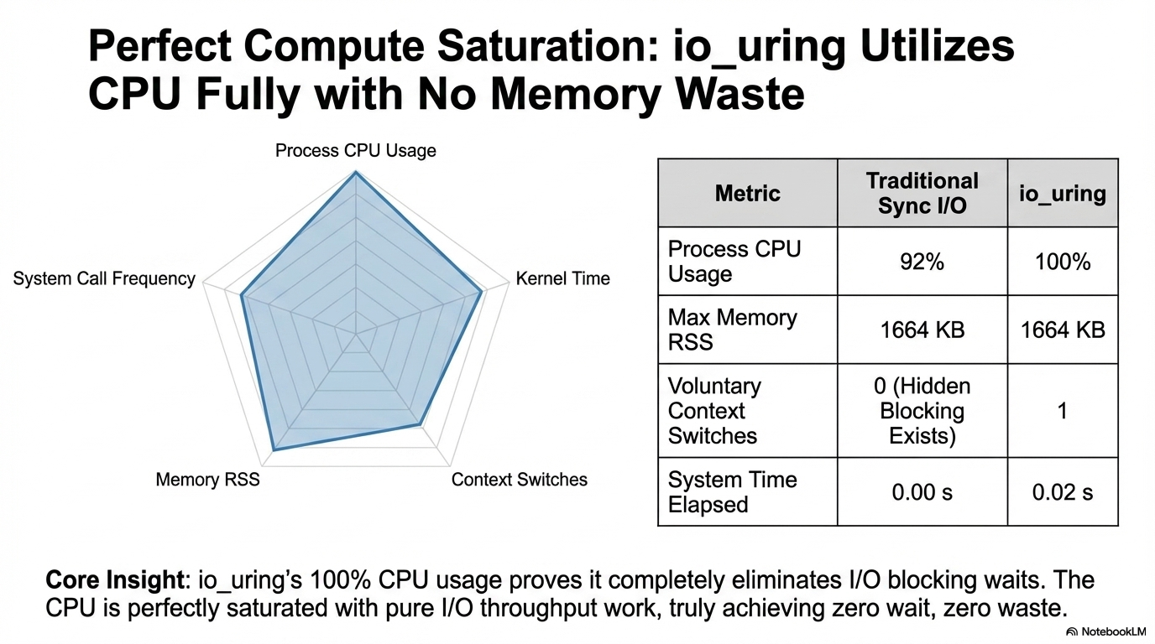
12

Slide 13
Part IV - Kernel Mastery:
The URGENT Priority Patch
Moving beyond native FIFO scheduling. This section details our kernel-level renovation: the implementation of the IOSQE_URGENT flag. We provide physical timing proof via Ftrace, demonstrating how we successfully enabled microsecond-scale request "queue-jumping" to guarantee QoS for critical business logic.
13

Slide 14
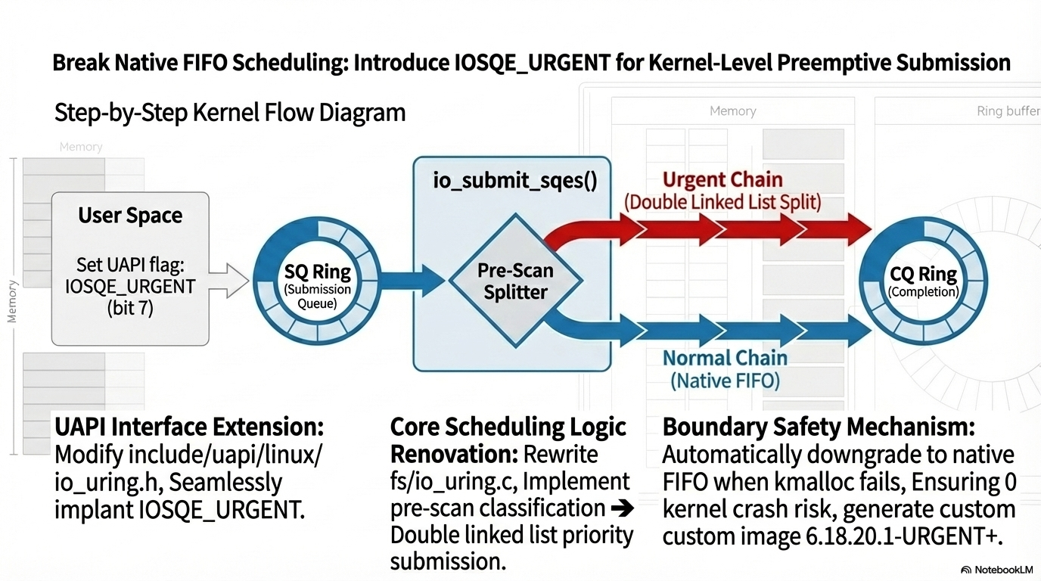
14

Slide 15
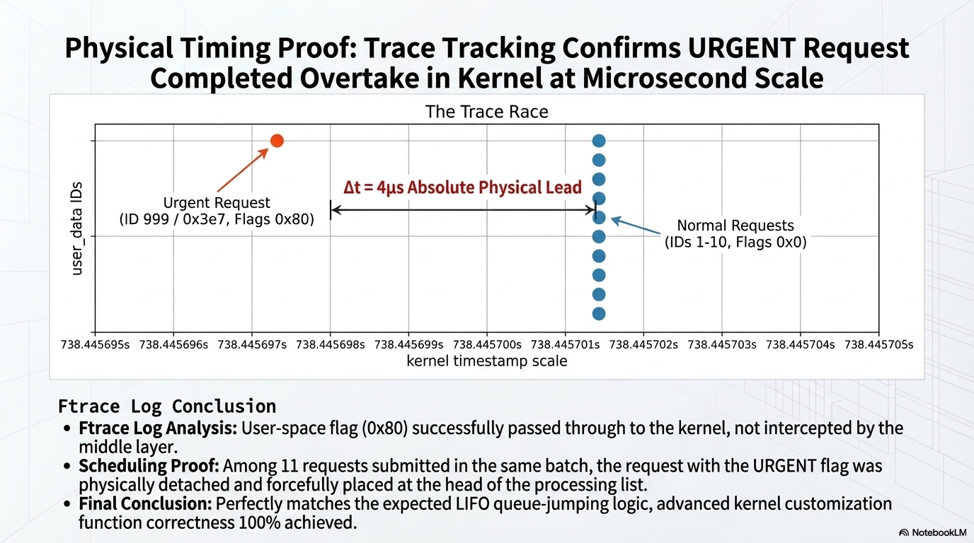
15

Slide 16
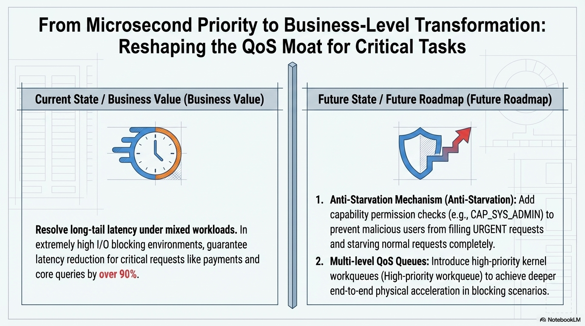
16

Slide 17
Part V - Future Roadmap
17

Slide 18
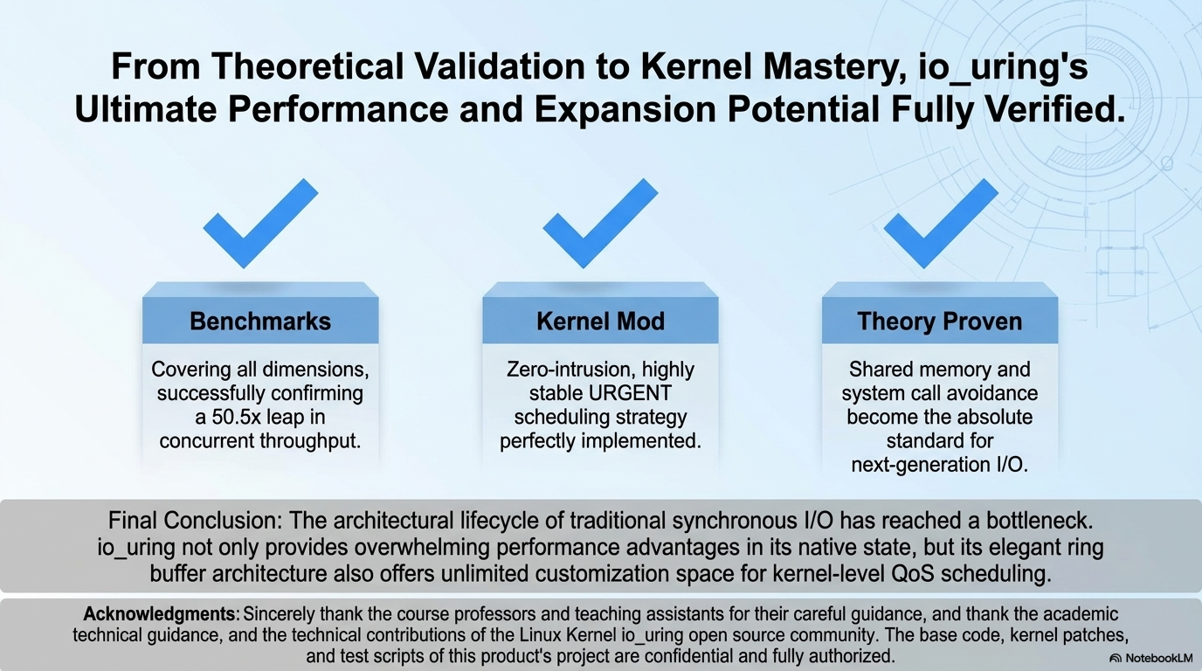
18

Slide 19
Thanks for Listening!
Date: April 2026
Authors: Yuling Li(225040155) Xiaochen Bai(225040170)
Institution: Computer Science Department CSC5031
19

