Slide 1
RamFS: A Pure-Python In-Memory File System
MA Guoqing 225040123
Yu Kuai 225040174
Operating Systems Project Topic 12
Design, Implementation, and Experimental Evaluation
Chinese University of Hong Kong, Shenzhen
1/17

Slide 2








Team Contribution
Division of work for implementation and defense preparation.
MA Guoqing
Yu Kuai
Core Developer & Technical Lead
Benchmark Engineer & Demonstrator
Led the first three sections of the presentation and prepared the main technical explanation for the project.
Took primary responsibility for testing, validation, and all experiment-related content.
Responsible for core RamFS implementation, including central FS logic, key data structures and operation workflow.
Handled CLI-related work, and prepared the demonstration workflow with all supporting assets.
Focused on the architecture-level design narrative.
Focused on evidence collection and usability evaluation.
2/17

Slide 3







Outline
01
04
07
Motivation and Goals
Experimental Setup
Live Demo and Q&A
02
05
Architecture and Design
Results and Evaluation
03
06
Operation Workflow
Discussion and Future Work
3/17

Slide 4


Motivation and Goals
Why Build RamFS?
Project Goals
•Expose VFS-style operations in a compact Python project.
•Support path resolution over a hierarchical directory tree.
•Turn inode, superblock, and page concepts into runnable code.
•Store payload with 4 KB page-like blocks inside each inode.
•Observe memory quota behavior directly during file operations.
•Track allocation under a global quota using the superblock.
•Keep the implementation small enough for defense-time walkthroughs.
•Persist and restore state by JSON snapshot export and reload.
Pure Python
4 KB Pages
JSON Snapshots
4/17

Slide 5


System Architecture Diagram
A layered view showcasing the complete call chain from user interaction to data persistence.
User Interaction
VirtualFS Core
Data & Storage
Key Components
High-Level API
SuperBlock & Cache
• Command Line Interface (CLI). • Automated Test Scripts. • Demo & Example Apps.
• API examples: mount, mkdir, write, read, stat, save_snapshot. • Provides a unified interface for all file ops.
• Tracks system quota.
• Stores actual file bytes in efficient 4 KB memory pages.
Layer Purpose
Resolution & Structure
RAM & Snapshot
• All user-visible actions and operations enter the system through this top-level layer.
• Resolve path names, walk children maps, validate inode types, and maintain directory structure.
• Maintains full runtime state in RAM for speed.
• Exports/imports JSON snapshots for persistence.
5/17

Slide 6



Core Structure: UML Class Diagram
A class-style view makes object ownership, quota state, and inode references easier to explain.
VirtualFS Class
SuperBlock Class
Inode Class
Methods
Methods
Methods
mount()
unmount()
read()
save_snapshot()
allocate_inode()
allocate_blocks()
free_blocks()
is_dir()
is_file()
add_chile()
Attributes
Attributes
Attributes
block_size: int = 4096
max_block: int
superblock: SuperBlock
patch_cache: Dict[str, Inode]
inode_counter: int
root_inode: Inode
mounted: bool
ino: int
file_type: FileType
pages: Dict[int, bytes]
children: Dict[str, Inode]
6/17

Slide 7






Operation Workflow
01. Path Input
Complexity Intuition
Target path parsing: `/home/user/note.txt`.
Lookup Cost Dominance
02. Path Walk
Overall overhead is determined by the depth of the path in the file tree.
Recursive lookup: Split path & Walk children map.
I/O Cost Dominance
03. File Access
Read/write performance is proportional to the number of data pages accessed.
Inode retrieval: Execute touch / read / write ops.
Quota Management
04. Page Update
Disk quota is updated only when new blocks are allocated to a file.
Metadata sync: Allocate blocks, Update size & mtime.
7/17

Slide 8



Experimental Setup
Functional tests
• 7 comprehensive scenarios defined in `tests.py`.
• Covers basic ops, persistence, error handling & stress.
CLI Demonstration
• Core commands: `mkdir`, `touch`, `echo`, `cat`, `save`.
• Designed for live walkthroughs of system functionality.
Example Applications
• Real-world use cases: Cache, Logger, User Sessions.
• Illustrate practical and reusable storage patterns.
Microbenchmarks
• Measures create, read, write & snapshot timings.
• Provides a simple latency comparison baseline.
8/17

Slide 9
Experiment 1: Functional Validation
✓
7 / 7 Passed
📂
30 Files Load
⚠️
ENOSPC Quota
• All functional test scenarios completed successfully.
• Stress test scenario with heavy I/O operations.
• Correct rejection on storage limit exhaustion.
Basic Operations
Directory Operations
• Verified core I/O actions: mount, touch, write, read, append. • Ensuring fundamental filesystem stability.
• Validated recursive path handling with ls and stat commands. • Over deeply nested directory structures.
Data Persistence
Error Handling & Robustness
• Confirmed data integrity after save & load snapshot cycles. • Proving non-volatile storage reliability.
• Tested boundary conditions including missing paths. • Wrong type checks for graceful failure.
9/17

Slide 10
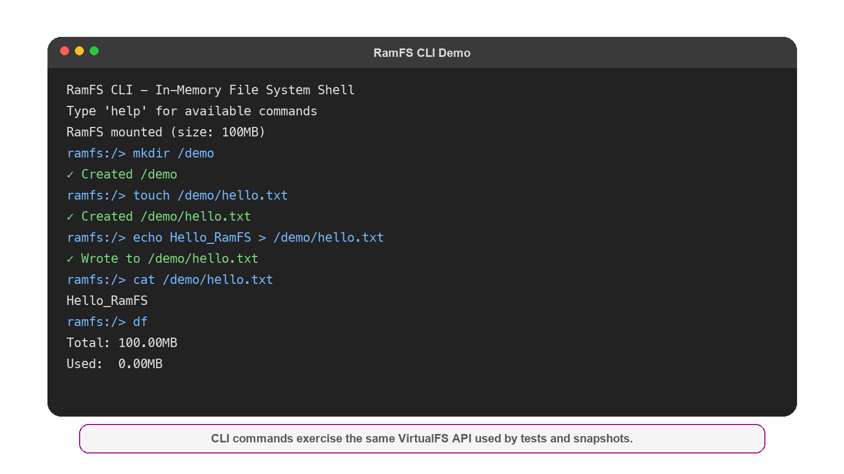



Experiment 2: CLI Demo and Snapshot
In-memory Tree & Snapshot Process
Directory nodes maintain direct pointers to file inodes, enabling O(1) fast lookup.
Core method `save_snapshot()` serializes all metadata & data pages into a portable JSON file (e.g.,backup.json).
Acts as a consistent, persistent checkpoint for system recovery.
💡 Key Takeaway
1. The CLI demo exposes the exact same API path used in our unit tests, ensuring interface consistency.
2. Demonstrates the CLI is a faithful, production-ready reflection of the underlying filesystem implementation.
10/17

Slide 11



Experiment 3: Application-Level Demos
Cache Demo
In-Memory Logger
User Sessions
• Object Count: 2
• Cache HIT: Alice (Target)
• Total Size: 117 Bytes
• Log Files: app1.log + app2.log
• File Sizes: 166 B / 121 B
• Levels: INFO / DEBUG / ERROR
• Created: 2 Sessions
• Removed: 1 (Expired)
• Activeness: 1 (Valid)
Demonstrates fast temporary object reuse with minimal overhead, ideal for high throughput caching.
Treats RamFS as an in-memory logging backend, enabling ultra-fast write operations for real-time monitoring.
Shows efficient transient state management entirely without disk I/O, perfect for web server session stores.
11/17

Slide 12


Experiment 4: Quota and Persistence
Quota Management Test
Data Persistence Validation
Storage Capacity Boundary
Snapshot Serialization & Restore
• Total Allocated Size: 1.0 MB. • Fixed filesystem volume limit for the experiment.
Step 1. Data Preparation Created test file with random data for verification.
• Write Operation (512 KB) → SUCCESS. • Current Usage: 0.50 / 1.00 MB (Within Quota)
Step 2. State Snapshot Executed API: save_snapshot()to serialize current state.
• Write Operation (600 KB) → ENOSPC Error (Quota Exceeded)
Step 3. Load & Verify Restored state from snapshot. Result: Data Fully Recovered.
12/17

Slide 13
Experiment 5: Microbenchmark Results
Relative latency (ms)
Fast write
0.178 ms
Write
0.178
Read cost
1.279 ms
Read
1.279
Snapshot
1.030
Snapshot
1.030 ms
13/17

Slide 14
Discussion: Strengths and Limitations
PROJECT STRENGTHS
KEY LIMITATIONS
Readable Layered Design
Clear architectural separation for easy understanding.
User-space Simulation Only
Lacks kernel-level integration for full system emulation.
Runnable Evidence
Verified with comprehensive tests and live demos.
Missing Advanced Features
No FUSE integration, journaling, or eviction policies.
Low Setup Overhead
Minimal dependencies for quick experiment setup.
Lightweight Benchmarking
Needs more comprehensive stress testing for validation.
14/17

Slide 15




Future Work
The next stage is to improve memory policy first, then correctness, then host integration.
LRU Eviction
Richer Metadata
Implement LRU caching strategy to optimize memory usage and significantly improve the cache hit ratio.
Expand metadata structures to fully support extended file attributes, enhancing data integrity and correctness.
Locks & Concurrency
FUSE Host Integration
Implement fine-grained locking mechanisms to ensure strict data consistency under heavy multi-threaded concurrent access.
Integrate with FUSE to enable direct OS mounting, providing standard file system access to userspace applications.
15/17

Slide 16
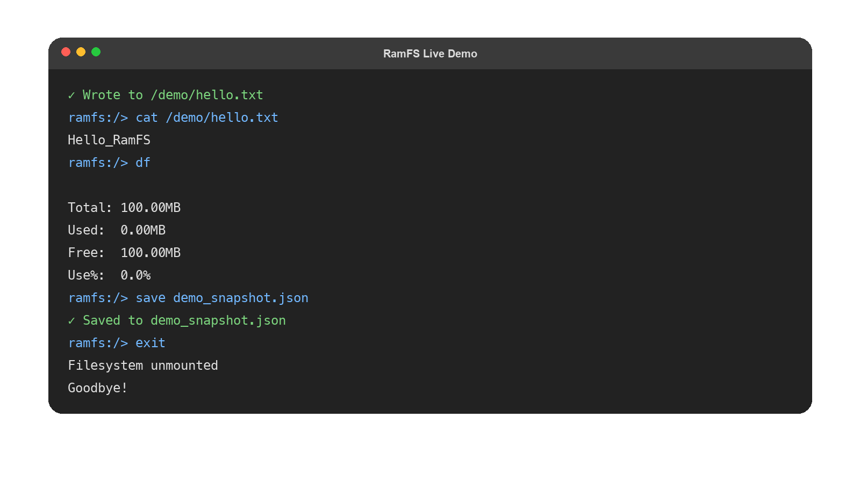

Live Demo
The presentation now embeds the actual video preview directly in this slide.
Step 1
Create and read a file
Step 2
Check quota and usage
Step 3
Export a snapshot
Embedded media - The mp4 is stored inside the deck and can be played directly during the presentation.
16/17

Slide 17



Thank you for listening
Presenters
Keywords
GitHub
MA Guoqing (225040123)
Yu Kuai (225040174)
RamFS | VFS API | Quota | Snapshots
Repo: YWh620/OS_Final
17/17

